Slide 1
JEAN FOR COUNCIL
Good
Morning!
Sedona Lodging Council
Will speak about myself and general platform briefly,
but focus on lodging industry issues.

Slide 2

MEET THE CANDIDATE
B&B Owner & General Manager
Jean-Christophe
24 YRS
A Sunset Chateau
Buillet
25-room boutique bed & breakfast in Sedona. Two decades of hospitality, operations, and workforce management in the heart of the community.
Candidate · Sedona City Council 2026
Real Estate Broker
20 YRS
Sage Realty
Designated Broker / Owner serving the Sedona & Verde Valley market. Deep knowledge of local land, zoning, and what it actually takes to house a family here.
Real Estate Investor & Developer
15 YRS
Buillet Real Estate LLC
Active investor in workforce housing — already provides housing for his own employees. Not a theory. Lived experience.
Accounting & Tax Professional
11 YRS
Sedona Taxes
❤ Married 10 years · 4 children, ages 2–9
Complex individual, trust, partnership, and corporate returns. Understands the city's finances, budgets, and the numbers behind every policy decision.
30 Year Sedona Resident · this is home.
Registered Investment Advisor
2 YRS
RRHS Class of '99
NAU · Electrical & Computer Engineering
Makarios Investments
State-registered RIA. Fiduciary duty to clients — the same standard he'll bring to every vote on the council.

Slide 3
JEAN FOR COUNCIL · FISCAL LEADERSHIP
Private-Sector Discipline. Public Accountability.
The budget process I’ve watched for two years isn’t good enough. I know how to fix it.
THE QUALIFICATION
THE PROBLEM
THE COMMITMENT
Why I Can Do This
What Two Years on the Citizens Budget Workgroup Revealed
What Will Change
Concurrently runs 5 businesses across hospitality, real estate, accounting, and investment advisory.
Built organizational systems and documented processes for each, accountability is not optional
11 years of complex financial analysis as an accountant: entities, trusts, partnerships, individuals
Registered Investment Advisor operating under fiduciary duty — legal obligation to act in clients’ best interest, not his own
Has personally audited, built financials, forecasts, projections, and performance dashboards for my businesses as well as hundreds of clients. I will bring the same discipline to city hall.
Budget packets are disorganized, incomplete, and not presentation-ready
Spending requests frequently lack clear objectives, measurable outcomes, or prior-year performance data
Reactive budgeting: action comes before analysis, not the other way around
No standard for what “budget ready” means — departments present inconsistently with no accountability framework
Council votes on spending without knowing whether last year’s spending worked
This is not how any responsible private-sector organization operates
Require every budget presentation to include: clear objectives, performance metrics, and expected measurable outcomes
Mandate prior-year performance reporting before any new spending in a department is approved
Establish a City-wide standard for what a budget packet must contain before it reaches council
Implement KPI-based department reviews — not just “did we spend the money” but “did it work”
Thoughtfulness before action. Every time. No figuring it out as we go along like the parking garage.

Slide 4
JEAN FOR COUNCIL · PLATFORM VISION
A Sedona That Works for Everyone Who Lives Here
Not a community planned in a vacuum. One built with residents, for residents.
♪
Arts as Identity, Not Afterthought
$
Fiscal Discipline.
Every Dollar Justified.
→
Traffic Mitigation &
Creative Roadways
Reinvigorate Sedona’s arts community as a central pillar of identity and economy. Stop treating arts programming as discretionary. Culture is infrastructure. Bring back forgotten festivals, arts events, and community dance events.
Metrics before money. Prior-year performance before new appropriations. A budget process that reflects the seriousness of the decisions being made. Improved processes for measuring performance and stronger planning for budget packages and budget increases.
Real solutions: roundabouts, signal optimization, timed access or trails, park-and-ride expansion. Stop patching and start planning. Traffic is the number one quality-of-life complaint.
⌂
Preserve our Small Town Feel
◎
Residents First
■
End Planning in a Vacuum
No more approvals that trade Sedona’s character for short-term revenue. Scale, density, and design standards that protect what makes this place worth living in. People enjoy the rural small-town feel, not high density living.
Decisions start with: how does this affect the people who live here? How does this affect residents businesses?
Community outreach that actually reaches people, not just the loudest voices at city hall. Surveys, town halls, neighborhood walks. Master plans that reflect real lives. Since we dropped below 10k residents, we no longer vote on the community plan but we should.

Slide 5
JEAN FOR COUNCIL
Workforce
Housing
Financial stability, making workers a fixture in our community

Slide 6
JEAN FOR COUNCIL · AFFORDABLE HOUSING DEVELOPMENT
$30,000.
Before a single nail is driven.
The cost in permits, sewer fees, and state inspections to site one manufactured home in Sedona. Then we wonder why no one is building.
WHERE THE $30,000 GOES
WHAT NEEDS TO CHANGE
Development Impact Fees
$12,018
Reduce & Waive Fees for Affordable Units
If the unit meets affordability criteria — income-restricted, workforce housing, or CLT — dramatically reduce or waive connection and permitting fees. The city waives far more for large developers. Do it for the little guy building one unit.
Sewer Connection Fees
~$12,160
State Manufactured Home Inspection
~$800
Streamline Manufactured Home & Preapproved Homes Pathway
Work with ADOH to create a Sedona-specific expedited inspection track for manufactured homes destined for permanent foundations. They’re HUD-certified. The process should reflect that. Preapproved plans should have the same pathway.
City Permits, Design Review, Utility & Fire Fees
~$5,000
TOTAL BEFORE CONSTRUCTION
~$30,000+
Sewer Fee Reform for Small Infill Units
Sewer connection fees are the single biggest barrier to ADU and manufactured home development. Cap them for sub-1,000 sq ft units. The infrastructure is already there.
Permit Bundling for Affordable Development
One permit, one timeline, one fee for qualifying affordable housing projects. Stop making developers run three parallel tracks. Bundle it, guarantee a timeline, and get out of the way.

Slide 7
JEAN FOR COUNCIL · THE CASE FOR OWNERSHIP
The Hidden Cost of Renting Forever
Every month a Sedona worker pays rent, they pay someone else's mortgage — and build nothing of their own.
Nothing to Show for It
$0
Rent Always Goes Up
↑
No Security, No Stability
⚠
After 10 years paying $875/mo at Villas at Shelby, a resident has spent $105,000 — and owns nothing. No equity. No asset. No return.
A fixed mortgage never changes. Rent increases every year — often faster than wages. What's affordable today may be out of reach next year.
A landlord can raise rent, sell the property, or decline to renew a lease with 30 days notice. Families are one letter away from having to leave.
No Roots, No Community
⌂
Priced Out of Your Own Town
→
No Legacy to Leave
∅
Renters move more often. Kids change schools. Neighbors stay strangers. Community bonds don't form when the ground can shift under your feet.
The teachers, nurses, cooks, and trail crews who make Sedona work are being pushed out. Long commutes. Fractured families. A hollowed-out workforce.
A homeowner passes down an asset. A renter passes down nothing. The next generation starts at zero — the cycle of displacement continues.
The question isn't whether Sedona workers deserve to own a home. The question is whether we have the will to make it possible.

Slide 8
JEAN FOR COUNCIL
What the City Can Offer
A tiered incentive structure that makes homeownership real for Sedona's workforce
Zero Down
Rent-to-Own
No Land Rent
Tiered Land Rent
GETTING IN THE DOOR
BUILDING TOWARD OWNERSHIP
BELOW 50% AMI
SCALED TO YOUR INCOME
No down payment required. Qualify with 2 consecutive years of Sedona employment — your paycheck is your commitment. Or incentivize certain professions, EG: teachers instantly eligible, responders eligible.
Monthly payments during the 2-year qualification period accumulate as equity credit toward your purchase — not lost rent.
Households earning below 60% of Area Median Income pay zero land lease cost. The land works for you, not against you.
Land lease fees graduate from 0% to a capped maximum as income rises, never more than what's affordable at your earnings level. Money can be used to maintain infrastructure and refill affordable housing fund.
Worker Priority
Locked Purchase Price
Job Loss Protection
Homeownership Prep
SEDONA ESSENTIAL WORKERS FIRST
CERTAINTY FROM DAY ONE
A SAFETY NET, NOT A TRAP
CREDIT & FINANCIAL COACHING
Teachers, first responders, healthcare, and hospitality workers move to the front of the queue — the people who make Sedona run.
Your purchase price is set at program entry. Rising property values don't price you out — appreciation is shared, not weaponized.
A 90-day grace period before any rent or payment adjustment if you lose your Sedona job. Stability for families, not a cliff.
City-sponsored counseling to build credit, manage finances, and navigate the purchase — so qualifiers actually reach closing day.
Incentive eligibility and thresholds subject to City Council adoption · AMI figures per Yavapai County HUD guidelines

Slide 9
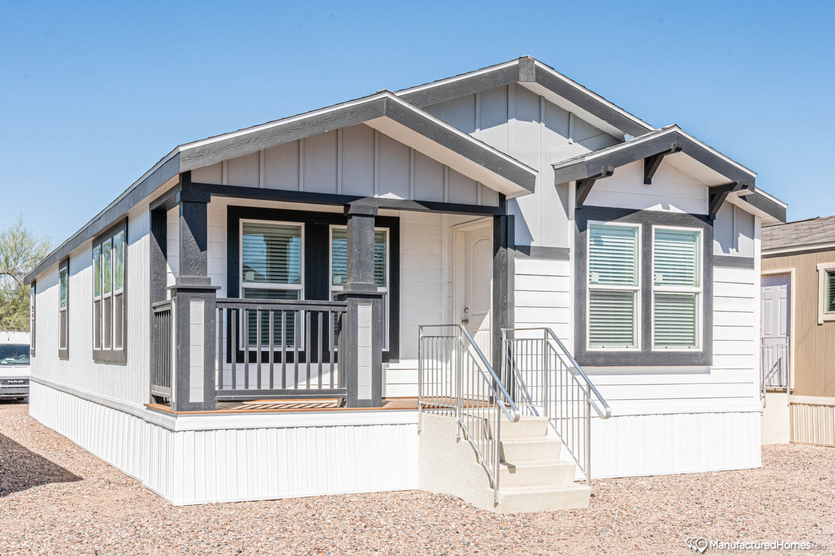
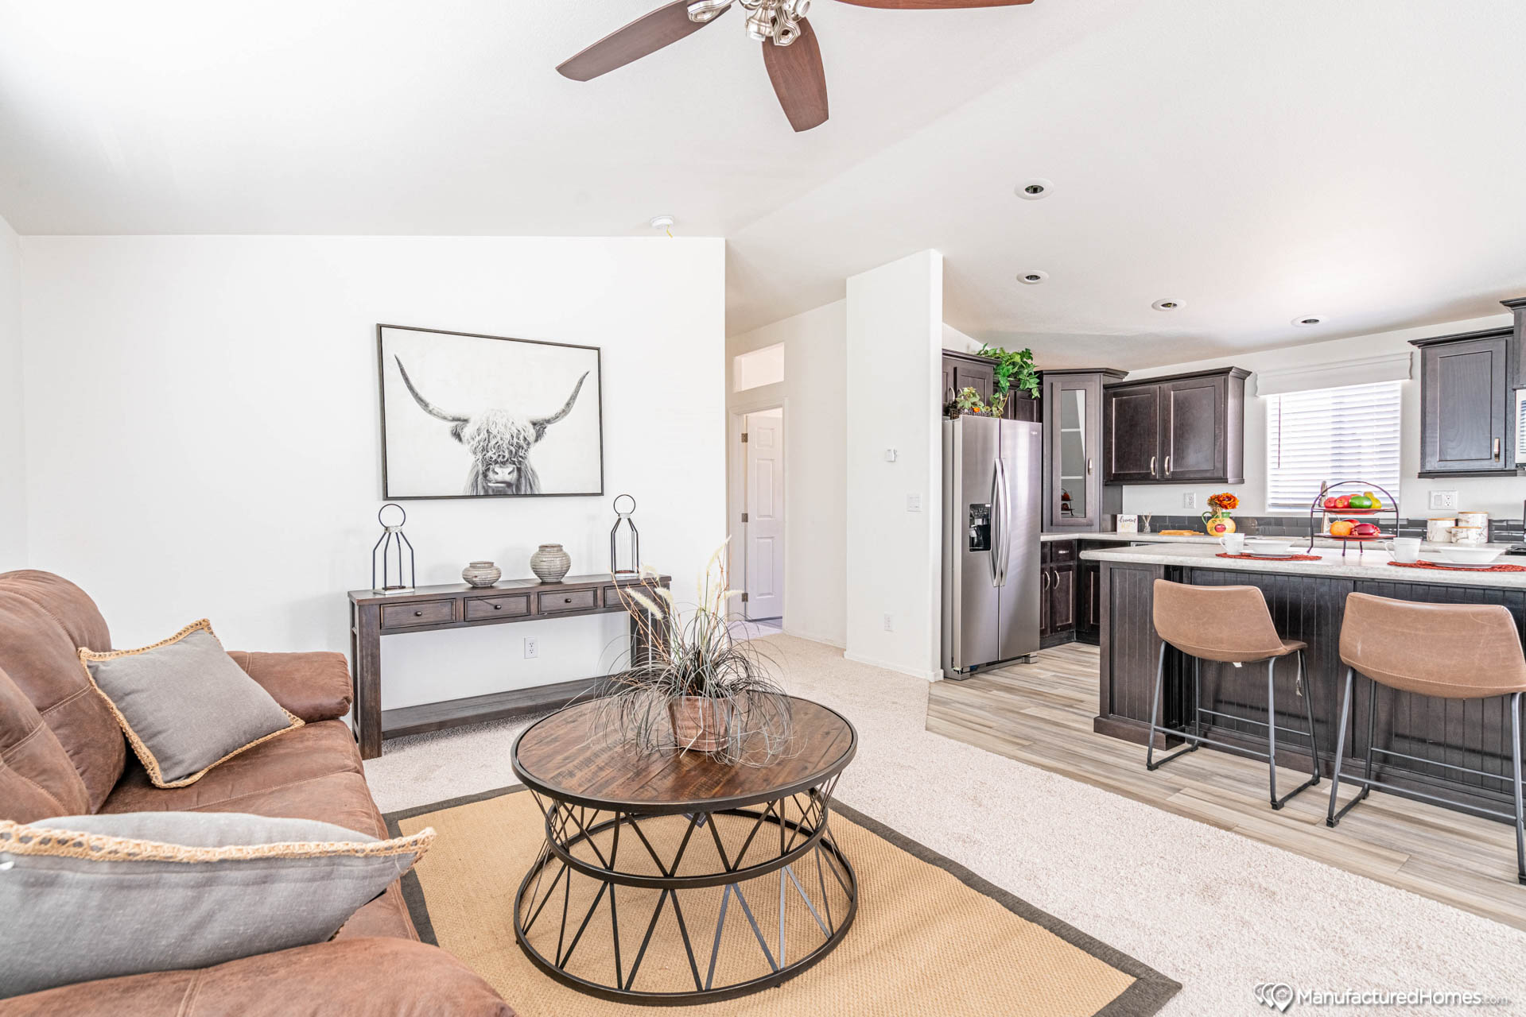
WORKFORCE HOUSING · ENTRY TIER
1 Bedroom
Cavco Westin Porch · Community Land Trust · ~$150,000 all-in
$30,000
$120,000
$858/mo
Down payment
(2-yr RTO)
Loan @ 6.5%
30 years
Ownership cost
incl. tax & ins.
MONTHLY COST COMPARISON
OWN
VILLAS ON SHELBY
EXTERIOR · CAVCO WESTIN PORCH
$858
$875
VS
/mo
/mo
8-YEAR EQUITY
$84,000
Own your home for $17/mo LESS than renting
...and build $84,000 in equity over 8 years
net advantage
over renting
Principal & Interest
$758/mo
$30,000 down
+ $54,000 appreciation
Tax & Insurance (est.)
$100/mo
Land lease (50% AMI)
$0/mo
LIVING ROOM
Villas at Shelby 1BR
$875/mo

Slide 10
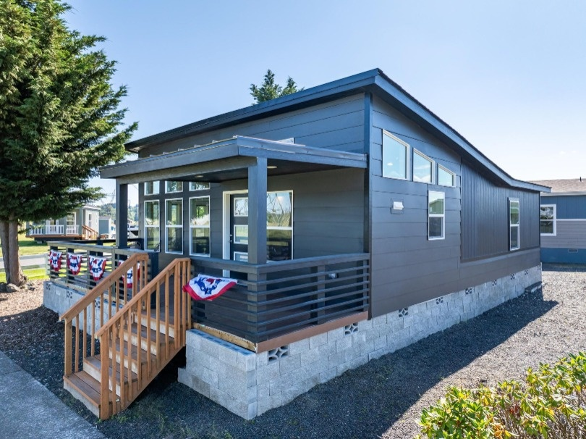
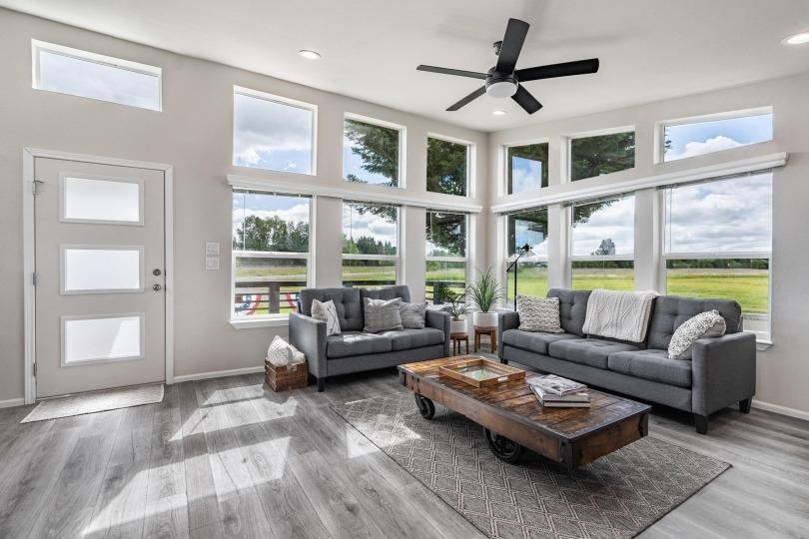
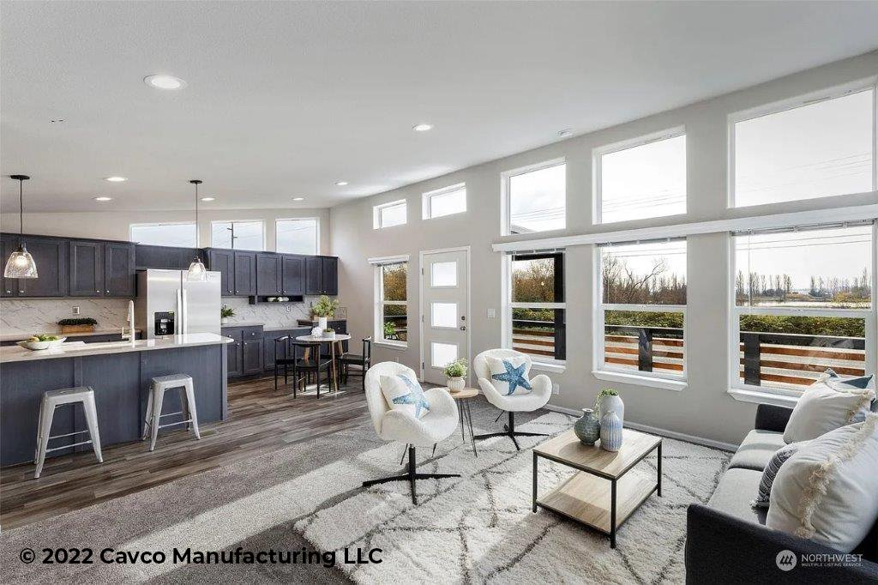
WORKFORCE HOUSING · WORKFORCE TIER
2 Bedroom
Cavco River's Edge · Community Land Trust · ~$200,000 all-in
$30,000
$170,000
$1,225/mo
Down payment
(2-yr RTO)
Loan @ 6.5%
30 years
Ownership cost
incl. tax & ins.
MONTHLY COST COMPARISON
OWN
VILLAS ON SHELBY (N/A)
EXTERIOR · CAVCO RIVER'S EDGE
$1,225
$1,050
VS
/mo
/mo
$175/mo more than renting — but you own something real
Build $103,000 equity · Net $86,000 ahead after 8 years
Principal & Interest
$1,075/mo
Tax & Insurance (est.)
$150/mo
Land lease (tiered)
$0–100/mo
LIVING ROOM
OPEN KITCHEN
Villas at Shelby 2BR
$1,050/mo

Slide 11
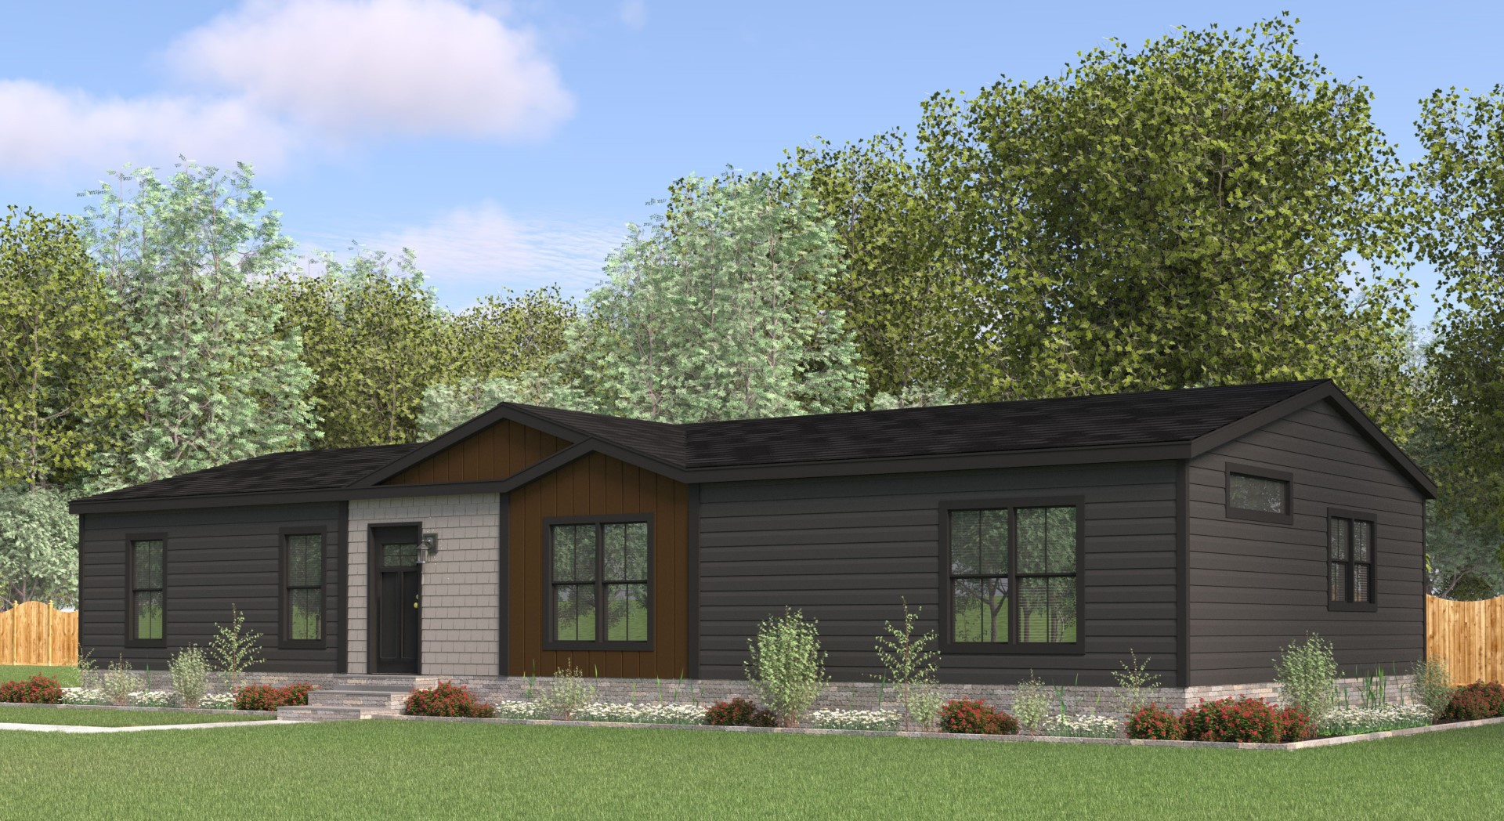
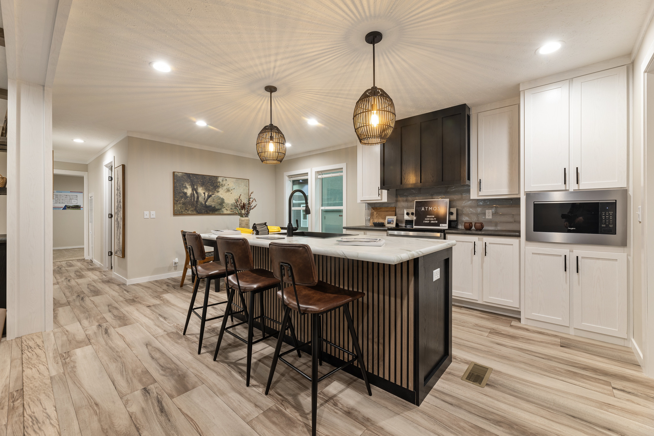
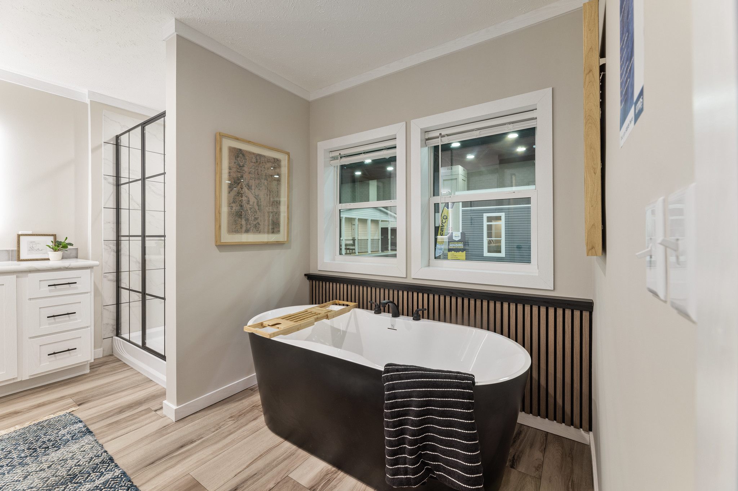
WORKFORCE HOUSING · FAMILY TIER
3 Bedroom
Cavco Atmos · Community Land Trust · ~$250,000 all-in
$30,000
$220,000
$1,591/mo
Down payment
(2-yr RTO)
Loan @ 6.5%
30 years
Ownership cost
incl. tax & ins.
MONTHLY COST COMPARISON
OWN
VILLAS ON SHELBY
EXTERIOR · CAVCO ATMOS
$1,591
$1,200
VS
/mo
/mo
$391/mo more than renting — but you own something real
Build $121,000 equity · Net $84,000 ahead after 8 years
Principal & Interest
$1,391/mo
Tax & Insurance (est.)
$200/mo
Land lease (tiered)
$0–150/mo
KITCHEN
MASTER BATH
Villas at Shelby 3BR
$1,200/mo

Slide 12
JEAN FOR COUNCIL
Fiscal
Responsibility
Forward looking budgeting, treating every dollar as our own.
Without a firm foundation, advertising dollars will be cut.

Slide 13
JEAN FOR COUNCIL · FISCAL ACCOUNTABILITY
Sedona Statement of Net Position · FY 2025
Fiscal Year Ending June 30, 2025 · All Activities (Governmental + Business-Type)
2025 Total Revenue
STATEMENT OF NET POSITION — ALL ACTIVITIES
$45,882,620
Line Item
Gov't Activities
Total
ASSETS
Cash & Investments
$66,500,134
$91,040,975
► Cash & Investments (Non-Restricted)
Restricted Assets
$23,923,011
$28,219,560
$91,040,975
Taxes & Receivables
$5,730,853
$6,793,204
Loans Receivable
$2,406,864
$2,406,864
Looks healthy — until you compare it to liabilities ↓
Capital Assets (Net)
$137,284,367
$241,926,518
► Total Liabilities
Total Assets
$238,132,622
$372,649,260
$91,559,125
DEFERRED OUTFLOWS
Total Deferred Outflows
$3,949,422
$4,270,455
Exceeds total cash — nearly 2x annual revenue
LIABILITIES
Accounts & Wages Payable
$2,699,394
$3,627,681
THE FISCAL REALITY
Construction & Contracts
$3,864,907
$4,853,461
Our budget far exceeds revenue. Total liabilities now equal our entire cash position — and we haven’t finished paying for current capital projects.
Debt & Interest Payable
$5,621,200
$6,903,593
Noncurrent Liabilities
$67,772,268
$69,693,559
Total Liabilities
$78,626,993
$91,559,125
If we continue to pursue large capital projects without aggressively managing debt, we risk crippling the city’s financial flexibility — and bankrupting our future.
NET POSITION
Net Invest. in Capital Assets
$100,315,521
$194,429,926
Restricted
$3,229,229
$3,283,339
Unrestricted
$58,898,333
$86,523,984
Total Net Position
$162,373,161
$284,167,327

Slide 14
JEAN FOR COUNCIL · FISCAL ACCOUNTABILITY
Three Projects.
$107,778,000. All Our Reserves — Gone.
THE MATH
$24,940,000
Sedona Intercept Lot
Total City Cash & Investments
A $25 million parking intercept facility. No demonstrated ridership model. No clear operational plan. No analysis of whether transit behavior in Sedona actually supports this investment at this scale.
$91,040,975
PARKING & TRANSIT INFRASTRUCTURE
Everything the city has
These 3 projects combined
$107,778,000
$49,170,000
Acquisition of the Brewer Road School
Exceeds all reserves by $18M+
83 years to break even with paying the lease rates and inflationary raises we are paying now.
Existing Total Liabilities
PROPERTY ACQUISITION
$91,559,125
Already owed before new projects
COMBINED EXPOSURE
$33,668,000
Bus Barn & Roadway Improvements
$200,000,000+
A $35M bus barn facility — including a gas station, while the city simultaneously pursues electrification. The planned amenities exceed what is available to our own citizens and other city employees. A facility this lavish raises serious questions about priorities.
FACILITIES & INFRASTRUCTURE
New projects + existing liabilities. Against $91M in cash.
This is not fiscal management — this is fiscal recklessness.
Any ONE of these projects requires serious justification. All three together, without a debt strategy, is a path to a broken city budget.

Slide 15
JEAN FOR COUNCIL
Business
Friendly
Less Regulations, Streamlined Processes
Compelling environment for support businesses to be flourish.
Diversity of economy and lower barriers to entry help us all.

Slide 16
JEAN FOR COUNCIL · BUSINESS DEVELOPMENT
Open for Business.
Streamlining Sedona’s Path to Entrepreneurship
THE BURDEN TODAY
THE REFORM
Redundant licensing requirements that duplicate state and county processes
Risk-Based Inspections
Scale inspection requirements to actual risk. A home-based candle maker is not a manufacturing facility. One-size fits all is costing us jobs.
Multiple rounds of inspections with weeks of wait time between each one
Single-Window Permitting
Layouts and documentation requirements that cost small operators thousands before they open
Consolidate licensing touchpoints into one streamlined process. One submission, one point of contact, clear timelines. No more chasing multiple departments.
Defined Approval Windows
No differentiation between a 300-seat restaurant and a one-person studio — same bureaucratic gauntlet
Guaranteed review timelines including instant approvals for certain business types and locations.
Nascent businesses can’t survive the friction. We lose them before they’ve started.
Small Business Fast Track
Dedicated pathway for businesses under a revenue or footprint threshold. Lower fees, fewer requirements, faster open dates. Diversity of economy starts here.
Existing Business Relief
Audit current license holders for redundant requirements. Remove them. We shouldn’t be making it harder to stay open than it was to open.

Slide 17
JEAN FOR COUNCIL
Hospitality &
Smart Tourism
Tourism
Quality visitors over volume
Sedona’s economy runs on hospitality. It’s time our council did too.
Hotelier Advocacy
Industry voice on council
Workforce Support
People who make it work
The industry that funds Sedona’s future deserves a voice at the table

Slide 18
JEAN FOR COUNCIL · TOURISM & HOSPITALITY STRATEGY
The Hotelier's Voice —
Finally at the Table
A FIRST FOR SEDONA CITY COUNCIL
THE STRATEGY SHIFT
Jean-Christophe Buillet would be the first council member who is also an active hotelier.
01
Guaranteed Ad Spend — No Contingencies
The industry that funds the city finally has someone who understands it from the inside.
Lock in the tourism bureau’s advertising budget as a fixed commitment, not a contingency line. Brand-building requires consistent investment. You can’t start and stop campaigns when it’s convenient — you lose ground every time.
HOTELS DRIVE THE CITY
02
Focus on the Drive Market
More tax revenue flows from hotel stays than any other single source in Sedona — yet hoteliers have had no seat at the council table. That ends now.
Phoenix, Tucson, Las Vegas, Los Angeles. These visitors drive themselves here, spend more per trip, and book longer stays. They don’t need an airport. Targeted drive-market campaigns yield higher ROI than broad national buys.
THE CONTINGENCY PROBLEM
A large portion of our tourism bureau’s ad spend sits in contingency.
03
Quality Over Quantity — Curated Visitors
Fewer visitors who spend more is better for everyone: less traffic, less trailhead damage, less strain on infrastructure. Market to the guest who books the nice room, eats at the good restaurant, and buys the local art.
The goal isn’t fewer tourists. It’s better ones.
Higher spending, lower volume, less wear on the city, and a hospitality industry that can provide consistent labor for workers and pay living wages without hurting properties.
04
Summer Premium Strategy – Not broad advertising
Sedona is hot in summer — but Phoenix is hotter. Drive the summer rate up, reduce volume, and improve the experience. Higher ADR in summer builds revenue without adding vehicles. Fewer guests, better margins, better trails.

Slide 19
JEAN FOR COUNCIL · TOURISM GOVERNANCE
The Tourism Advisory Board:
Time for a Seat at Our Table
THE PROBLEM
THE REFORM
“
I was told recently I don’t know what I’m talking about from a TAB member, because he knows the sales tax revenue.
Without hoteliers present, we’re not giving the TAB the full picture.
Require cross-section representation — by ordinance.
Hotel & Lodging
Residents / Neighborhoods
We need to be represented
Residents at large and HOA reps
Small Business (Non-Hotel)
Trail & Environment
Restaurants, retail, guides, arts
Stewardship has a stake in tourism
A board that only counts hotel dollars cannot represent a community.
Workforce & Labor
Arts & Cultural Orgs
Sales tax revenue is not the only measure of whether tourism is working.
The people who actually run Sedona
Sedona's identity beyond red rocks
Residents have no formal mechanism to shape the narrative — only to live with its consequences.
Partner with the Chamber of Commerce
The Chamber has the relationships and reach to recruit qualified community candidates across every sector. They can help us build a TAB that reflects all of Sedona — not just its hotel rooms.

Slide 20
JEAN FOR COUNCIL · SHORT-TERM RENTAL POLICY
AirBNBs: Good Neighbors or Nothing.
We already have the codes. It’s time to enforce them.
THE PROBLEM
THE ENFORCEMENT STANDARD
THE EFFICIENCY GAIN
Unenforced Rules & Escape Hatches
No Exceptions. No Waivers.
Streamlined Application = Less City Cost
Violations are issued but not followed through — operators know tickets get waived
Outstanding tickets do not currently block license renewals — operators run out the clock
No meaningful consequence = no meaningful behavior change
Neighbors absorb the noise, the parking, the parties — with no recourse
The current system protects the operator, not the community
Outstanding tickets = no license renewal. Full stop.
No ticket waiver process that lets serial violators reset the clock
Complaint-based inspection response within 48 hours
Publish the violation record publicly — transparency is enforcement
Digitize the entire STR application and renewal process end-to-end
Automated compliance checks tied to violation database — no manual review for clean records
Self-certification with random audit — reduces staff time by an estimated 60%+
Use the savings to fund the enforcement side — violations pay for oversight

Slide 21
JEAN FOR COUNCIL
Rethinking
Transit
Less Empty Busses, Less Traffic on the Roads, Less Impact on the Trails

Slide 22
JEAN FOR COUNCIL · TRANSPORTATION POLICY
Sedona In Motion: Rethinking the Route
We have the fleet, the infrastructure, and the ridership need. What's missing is a smarter strategy for when, where, and how shuttles run.
Dead Time
Shuttles sit largely idle during midday hours — capacity wasted while demand exists elsewhere
Coverage Gaps
Village of Oak Creek and canyon corridor residents have limited or no practical transit options
Trail Failure
Trailhead shuttles don't solve overcrowding — they just move the traffic jam from highway to trailhead
VOC
Village of Oak Creek Connection
OCC
Oak Creek Canyon Corridor
↺
Uptown → Tlaquepaque → Hillside Circulator
Extend service south to serve residents and workers in the VOC corridor — Sedona's largest underserved population. Shift commuters and residents out of cars during peak hours on SR-179.
A dedicated canyon run connecting West Sedona and Uptown to Oak Creek Canyon — reducing SR-89A congestion, serving hikers, and linking residents cut off during high-season gridlock.
A frequent loop connecting Uptown, Tlaquepaque, and Hillside galleries — the three highest-traffic tourist retail zones. Reduces parking demand and keeps dollars circulating locally.
⏱
Time-Use Trail Access · The Devil's Bridge Model
◎
Repurpose Dead-Time Capacity
Require shuttle access during designated hours at overcrowded trailheads. Stagger entry windows, guarantee parking-free access, and let the trail recover. Better experience. Preserved resource.
Redeploy underutilized midday fleet as workforce commuter service, school connections, or medical transport runs — turning idle assets into community infrastructure that serves residents, not just tourists.

Slide 23
JEAN FOR COUNCIL
Thank
You
Questions, please feel free to…
Email: jean@jeanforcouncil.com
Call: 928.301.3391

