Slide 1

CITY OF SEDONA TOURISM PROGRAM Lodging Council Meeting April 16, 2026

Slide 2
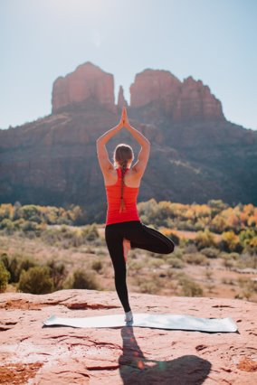

Agenda Items
Tourism Program Updates
Winter 2025/2026 Campaign Results
The Future of Tourism and the Sedona Experience Input Sessions
State of Sedona Tourism Research
TOURISM PROGRAM

Slide 3
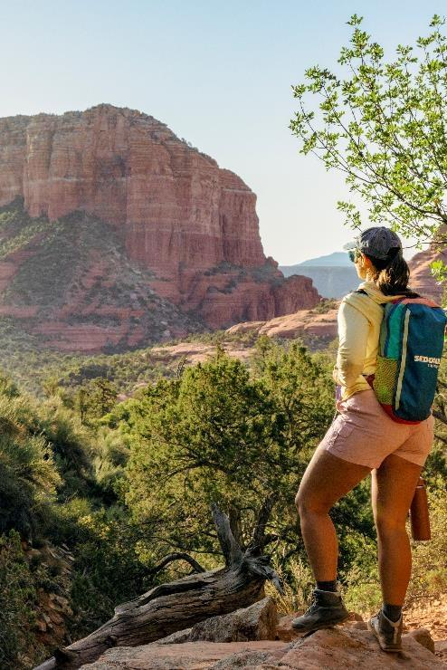
FY26 Trade Show Calendar
AAA Routz Conference – December 2025
IMM NYC – January 2026
IPEC – February 2026
AOT Sales & Media Mission – February 2026
Go West Summit – April 2026
HelmsBriscoe Annual Conference – April 2026
IPW – May 2026
TOURISM PROGRAM

Slide 4
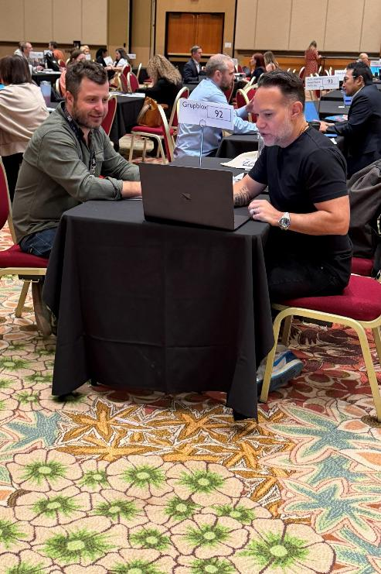
Go West Summit
I conducted 69 appointments over the two days
Key highlights included making strong progress with receptive tour operators like Rocky Mountain Holiday Tours, Bonotel, and New World Travel
A group tour lead was processed on the spot during one of my last meetings
TOURISM PROGRAM

Slide 5
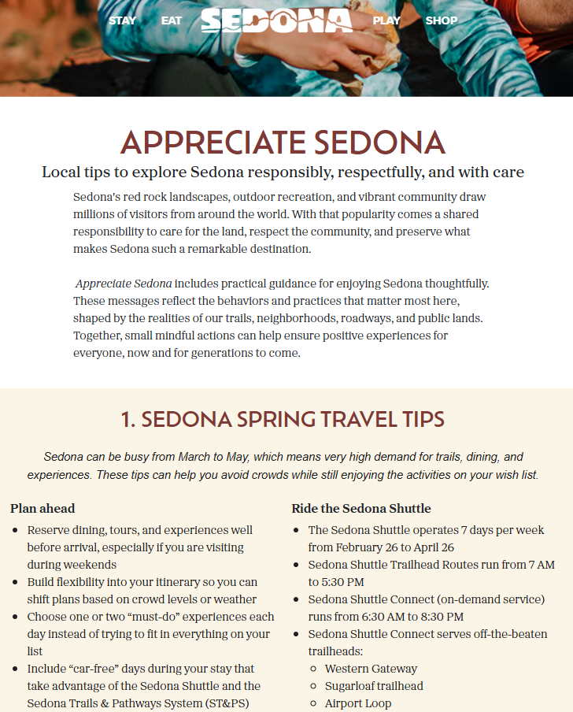
Appreciate Sedona Launch
Appreciate Sedona is part of the statewide Appreciate Arizona campaign
We worked with local leaders to define priority behaviors to address through strategic messaging
We’ll swap out seasonal messaging throughout the year, but keep evergreen messages year round
This spring, we’ve been running paid advertising in Arizona to known Spring Break visitors
TOURISM PROGRAM

Slide 6
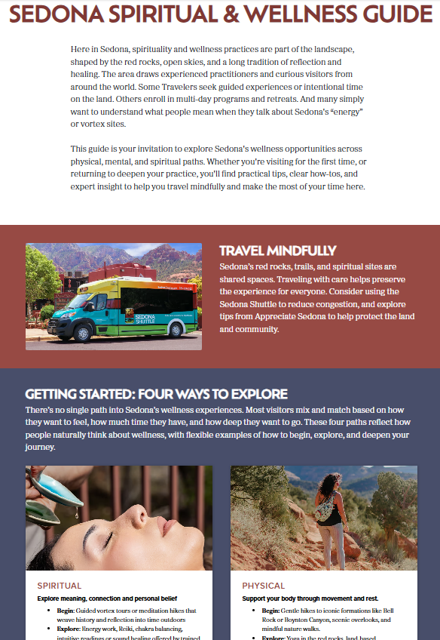
Sedona Spiritual & Wellness Guide
Our first of several experiential landing pages is now live on ScenicSedona.com
The Spiritual & Wellness Guide seeks to inspire and educate our visitors about the breadth of experiences we have to offer in Sedona
Future pages will include:
Verde Valley Wine Trail
Arts & Culture
Biking
Stargazing
TOURISM PROGRAM

Slide 7
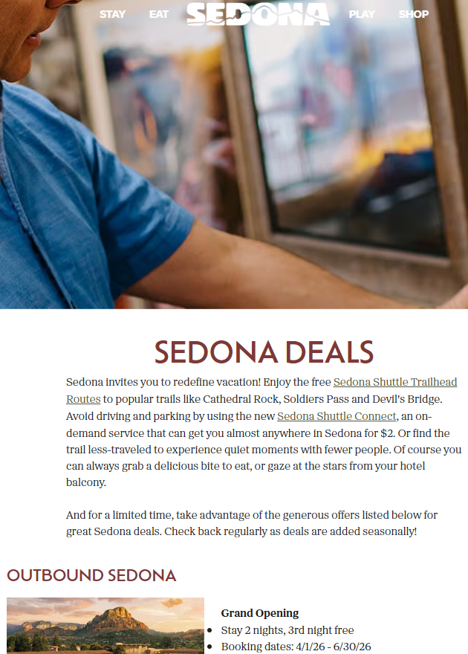
Submit Special Offers For Summer
We are now accepting special offers throughout the year that will be published on our deals page
Promotion of this primarily occurs during our winter and summer campaign executions
Email Rob MacMullan (RMacMullan@sedonaaz.gov) to submit your special offers
TOURISM PROGRAM

Slide 8
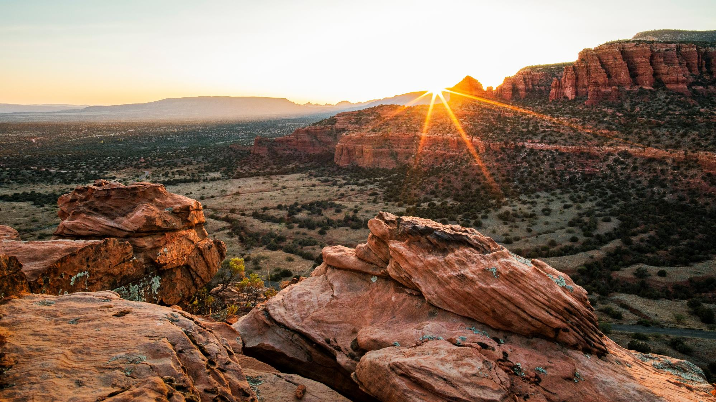
Winter 2025/2026
Campaign Results
TOURISM PROGRAM

Slide 9




TOURISM PROGRAM

Slide 10
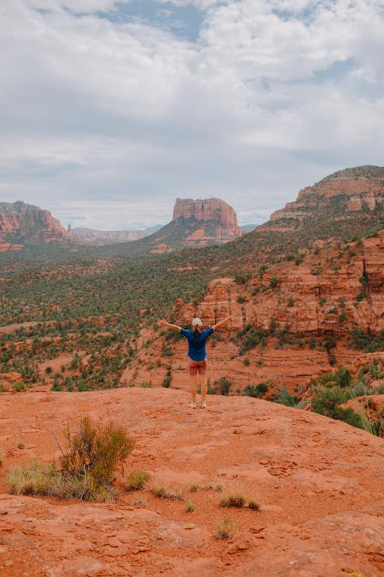
Winter Campaign Strategy
Winter campaign flight was Oct 17 to Feb 15
40 days earlier than Winter 2024/2025
Total paid advertising was $250,000, which was increased by $93,270 upon approval by City Council
Drive markets
Phoenix
Tucson
Los Angeles
San Diego
Las Vegas
Flight Markets
Chicago
Seattle
Denver
Minneapolis
New York
San Francisco
TOURISM PROGRAM

Slide 11
Attribution Results
Winter 2025/2026 Campaign Results
Economic Impact: $5,229,634
ROAS: $32:1
City Sales & Bed tax
$278,266 returned to the City
1.19:1 return on tax investment spend
*This is a blended ADR between Sedona+ and Village of Oak Creek+
TOURISM PROGRAM

Slide 12
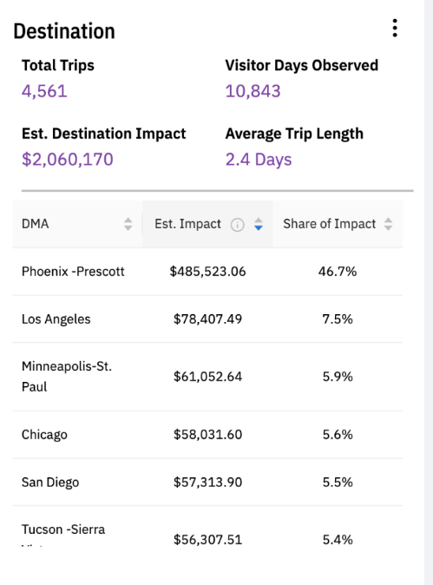
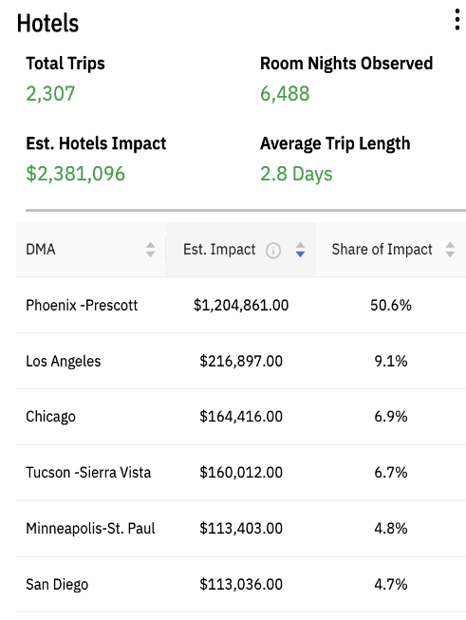
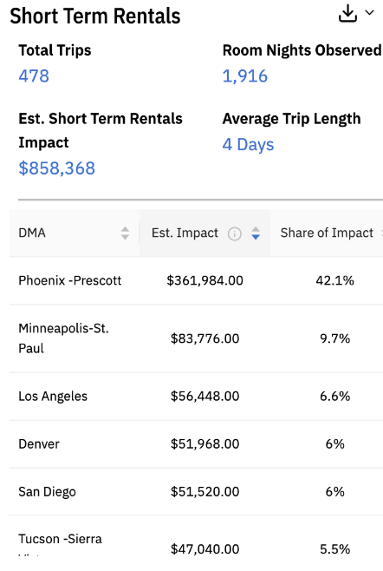
Attribution Results
$190/day spend
$367 ADR
$448 ADR*
TOURISM PROGRAM

Slide 13
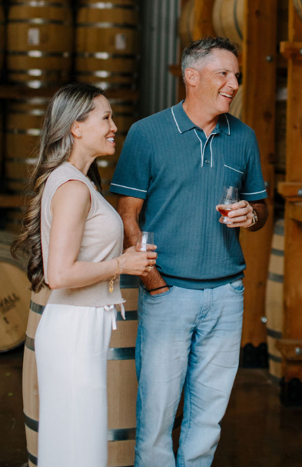
Greater Sedona Lodging Impact
Hotel Room Nights: 831
ADR: $291*
Economic Impact: $241,821
TOURISM PROGRAM

Slide 14
Market Analysis
Market | Spend | Visitor Days | Hotel Nights | STVR Nights | Length of Stay | Return By Market | ROI
Phoenix, AZ | $44,668.42 | 5769 | 3280 | 788 | 2.4 | $2,706,299 | $60.59
Tucson, AZ | $6,551.63 | 665 | 435 | 105 | 2.9 | $337,788 | $51.56
San Diego, CA | $13,520.97 | 572 | 308 | 116 | 2.8 | $269,887 | $19.96
Los Angeles, CA | $21,618.66 | 824 | 590 | 128 | 2.9 | $422,823 | $19.56
Las Vegas, NV | $11,416.23 | 369 | 244 | 43 | 2.2 | $173,779 | $15.22
Denver, CO | $11,476.24 | 419 | 236 | 117 | 2.4 | $214,285 | $18.67
Minneapolis, MN | $15,643.63 | 519 | 309 | 187 | 4.9 | $288,968 | $18.47
Chicago | $19,935.26 | 534 | 448 | 83 | 4.5 | $292,203 | $14.66
Seattle-Tacoma, WA | $10,108.25 | 271 | 146 | 85 | 4.2 | $137,651 | $13.62
San Francisco, CA | $8,799.95 | 203 | 127 | 58 | 2.4 | $105,814 | $12.02
TOURISM PROGRAM
Notes:
-ROI = (Hotel/STR Impact + Destination Impact) - Ad Spend) / Ad Spend
-Overall, the ROI ranking of the target markets between the Winter 2025/2026 campaign compared to the Winter 2024/2025 campaign ended up in a similar order, with the drive markets of Phoenix, Tucson, Los Angeles, San Diego, and Las Vegas still generating the highest ROI, and with Denver still generating the highest ROI within the flight markets.
-We are seeing great ROI from all flight markets, well above past performance. 24/25 saw an average ROI of $3.82 vs. $15.50 in 25/26.

Slide 15
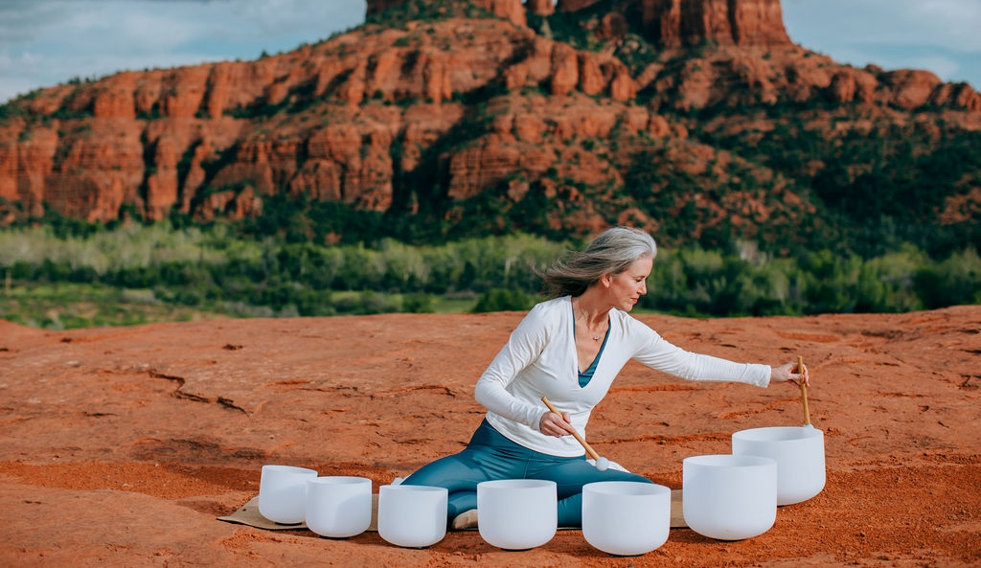
Summer 2026 Campaign Strategy
TOURISM PROGRAM

Slide 16
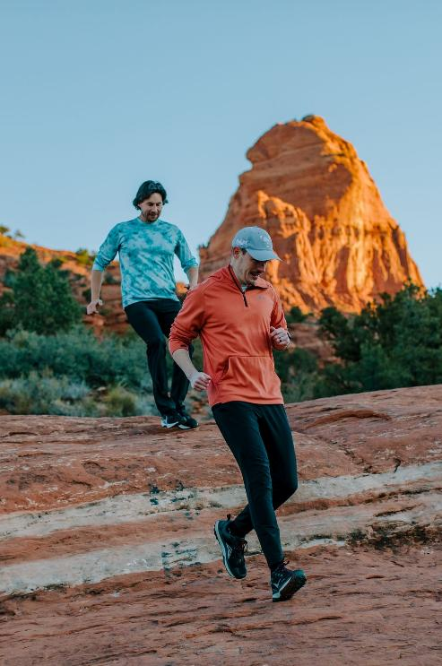
Summer 2026 Campaign Strategy
We will present our Summer 2026 campaign strategy to City Council this evening
Campaign timeline:
Flight markets: May 1, 2026 to August 15, 2026
Drive markets: May 15, 2026 to August 31, 2026
Campaign budget: $124,340
TOURISM PROGRAM

Slide 17
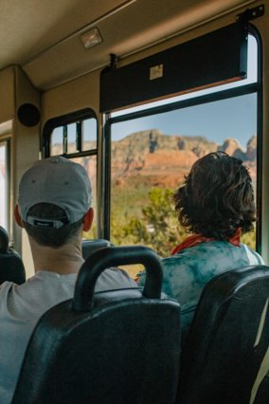
Summer 2026 Campaign Proposal
Drive Markets:
Phoenix
Tucson
Los Angeles
Flight Markets
Denver
Seattle*
San Francisco*
*Spend will be limited to past visitors and HNW
**This is a pilot with spend limited to HNW
San Diego
Las Vegas
Dallas*
Chicago*
Houston**
TOURISM PROGRAM

Slide 18

Sample Creative
TOURISM PROGRAM

Slide 19

Sample Creative
TOURISM PROGRAM

Slide 20

Sample Creative
TOURISM PROGRAM

Slide 21
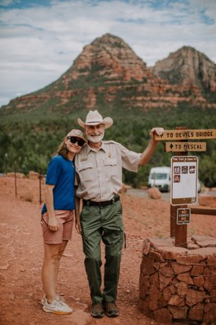
The Future Of Tourism Input Sessions
Two sessions have been scheduled at The HUB at Posse Grounds
Tuesday, April 21 from 6 p.m. to 8 p.m.
Wednesday, May 13 from 10 a.m. to noon
Attendees will be seated at round table of 5-6 people
Proposed agenda
Welcome, Opening Remarks, and Group Introductions
State of Sedona Tourism Update
Table Group Discussion #1: Defining the Sedona Experience
Table Group Discussion #2: Action Planning Enhancements
Closing Comments
TOURISM PROGRAM

Slide 22
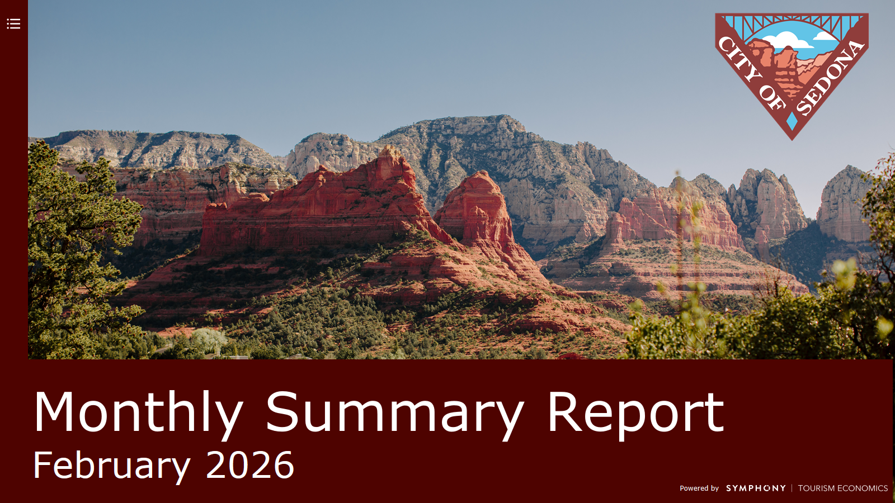

Slide 23
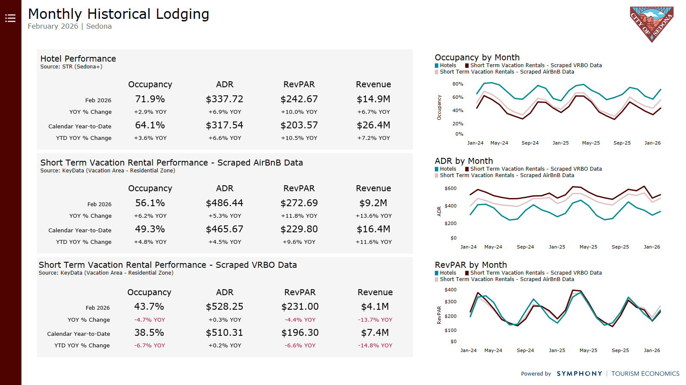

Slide 24
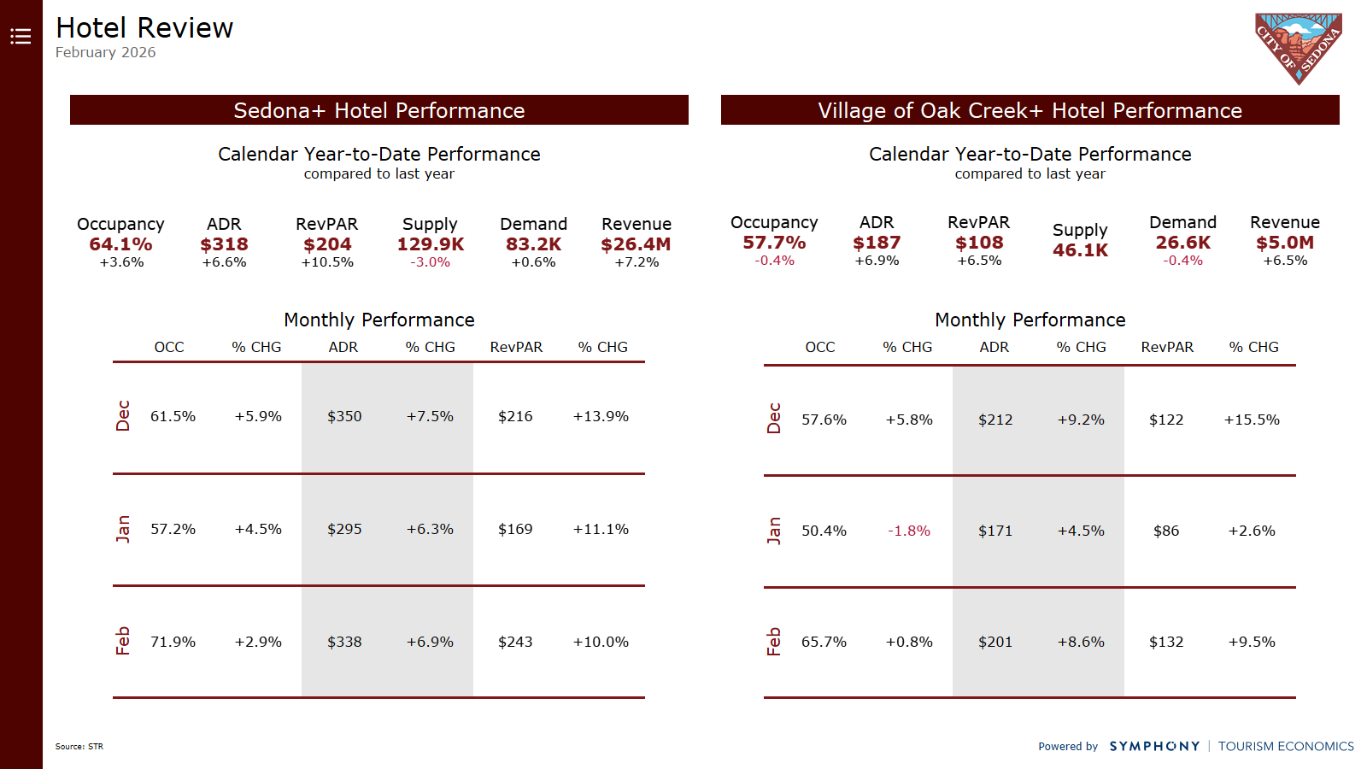

Slide 25
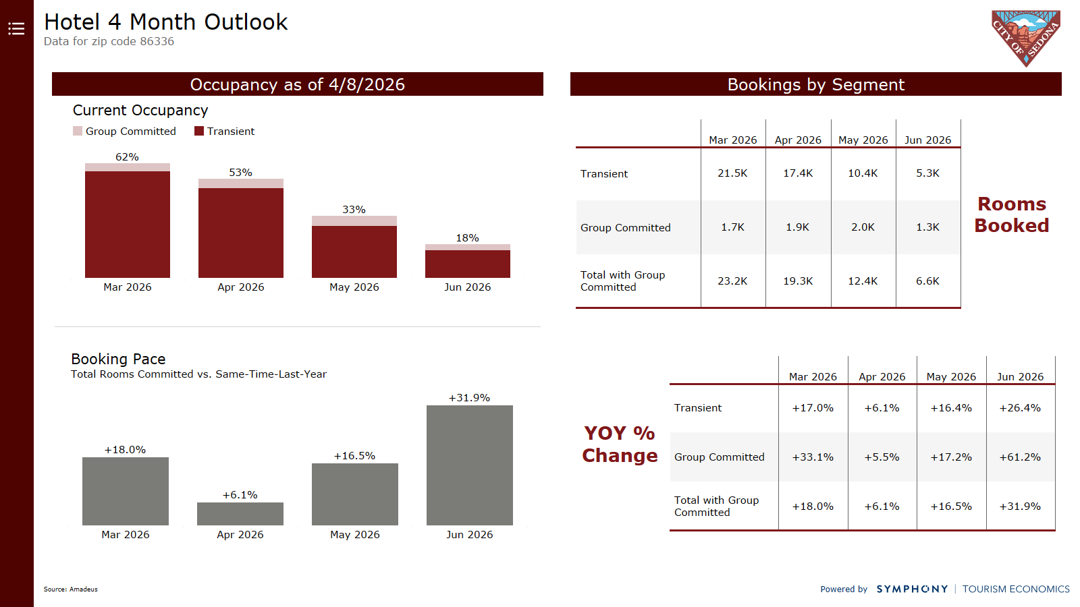

Slide 26
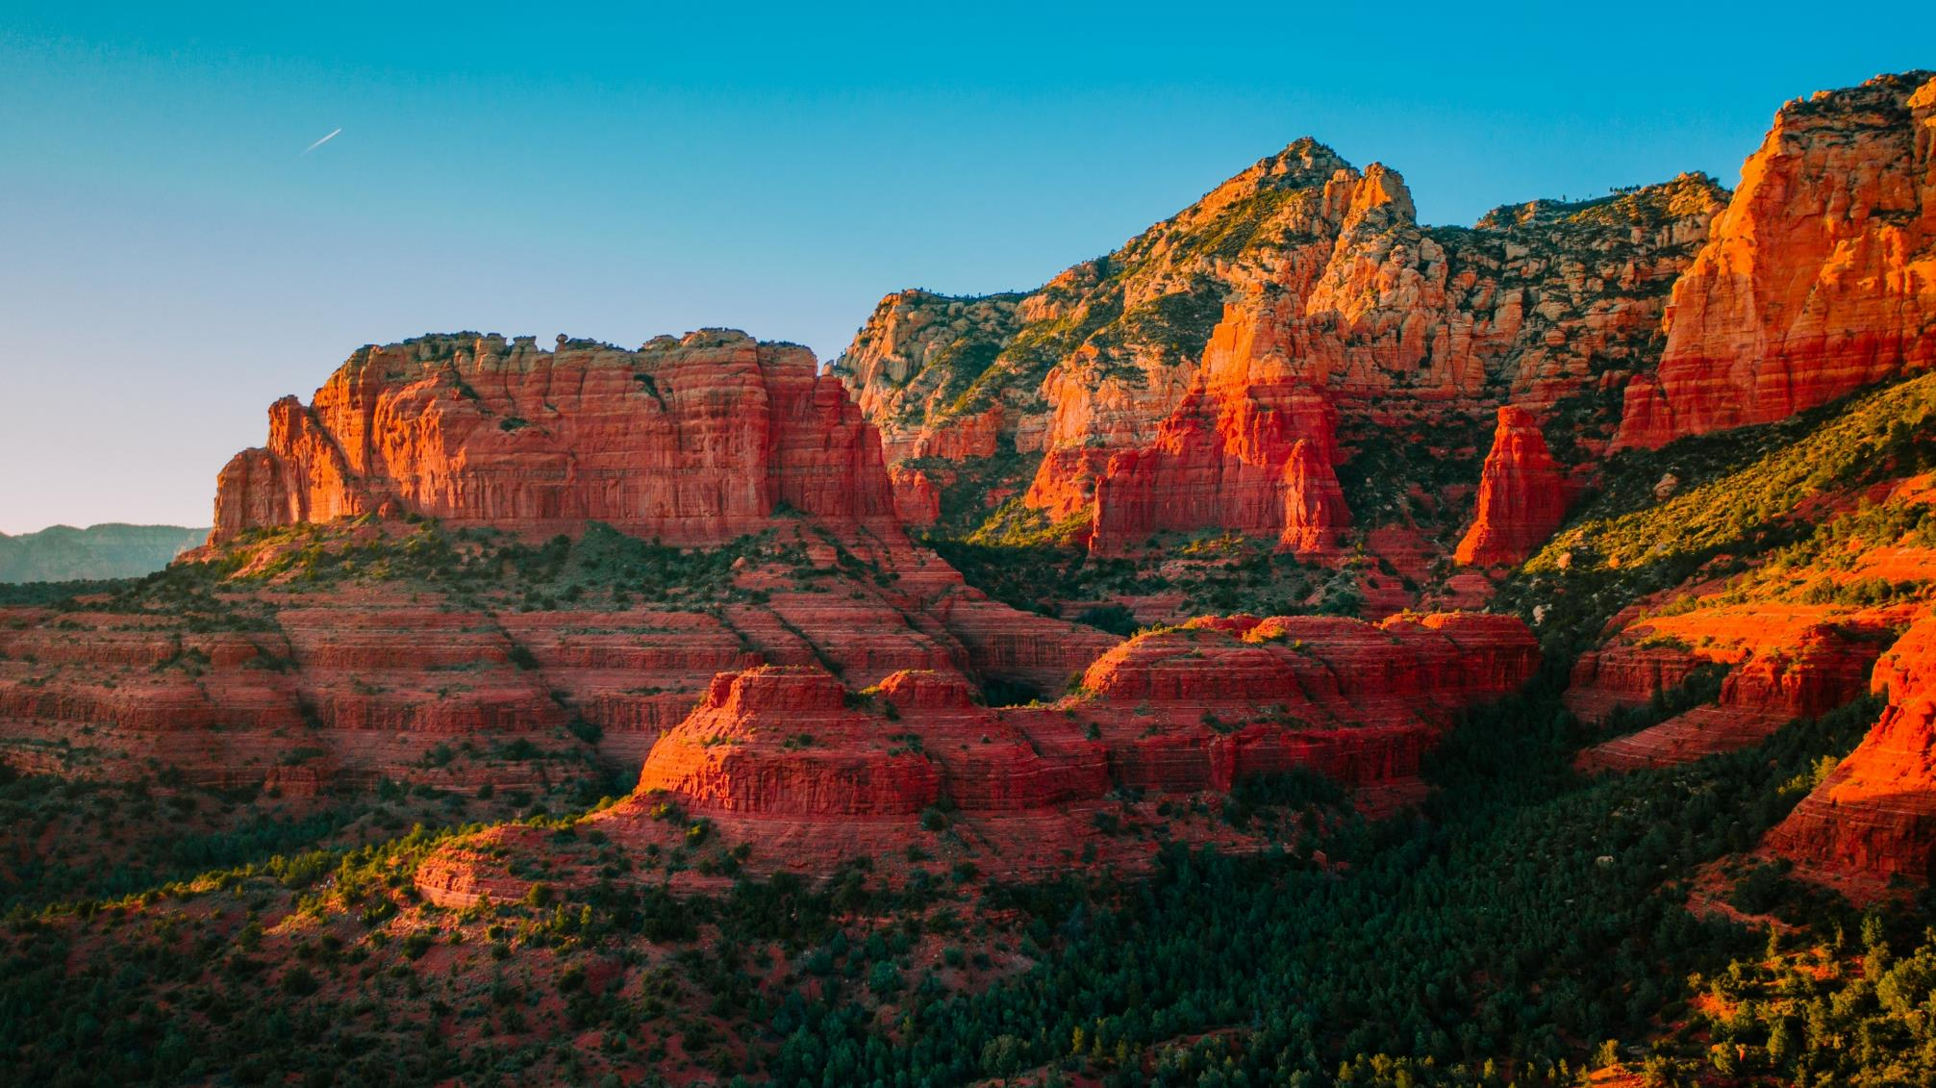
THANK YOU

