Slide 1

CITY OF SEDONA
TOURISM OFFICE
Lodging Council Meeting
June 9, 2026 Meeting

Slide 2
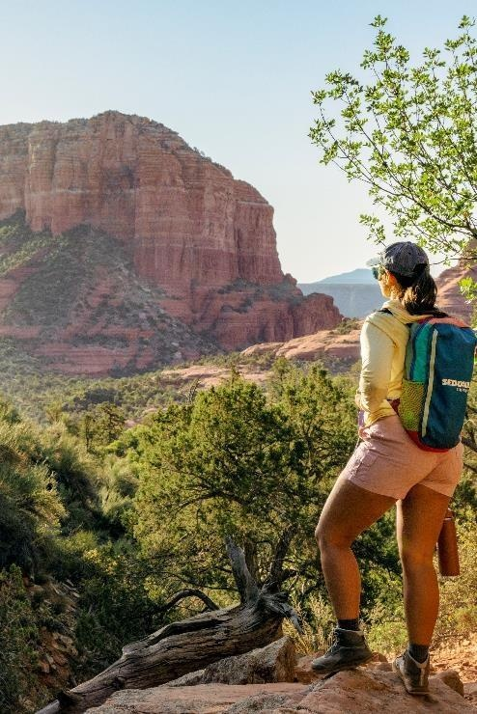

FY26 Trade Show Calendar
  AAA Routz Conference – December 2025
  IMM NYC – January 2026
  IPEC – February 2026
  AOT Sales & Media Mission – February 2026
  Go West Summit – April 2026
  HelmsBriscoe Annual Conference – April 2026
  IPW – May 2026
TOURISM OFFICE

Slide 3

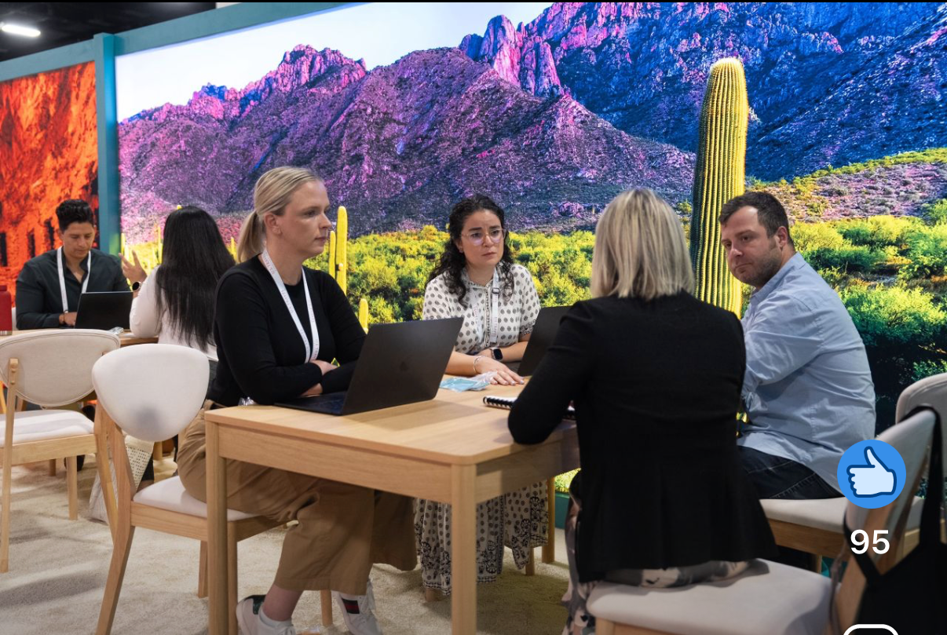
IPW 2026 Recap
  I attended the event with the Arizona Office of Tourism and conducted 42 appointments
  Key takeaways included:
    There has been pretty a significant drop in inbound demand for the U.S. in 2026 – “Flat is the new up”
    The U.S. is the only country that saw a decline in international travel in 2025
    The world is watching the World Cup and the Midterm elections
    We will move into the 2027 planning cycle this fall
TOURISM OFFICE

Slide 4

FY26 FAM & Press Trip Update
  We are on track to conduct 50 FAMs and Press Trips for 243 industry professionals in FY26
  Recent investments have been with Taiwan media in support of the new STARLUX flight and with French and German travel agents
TOURISM OFFICE

Slide 5
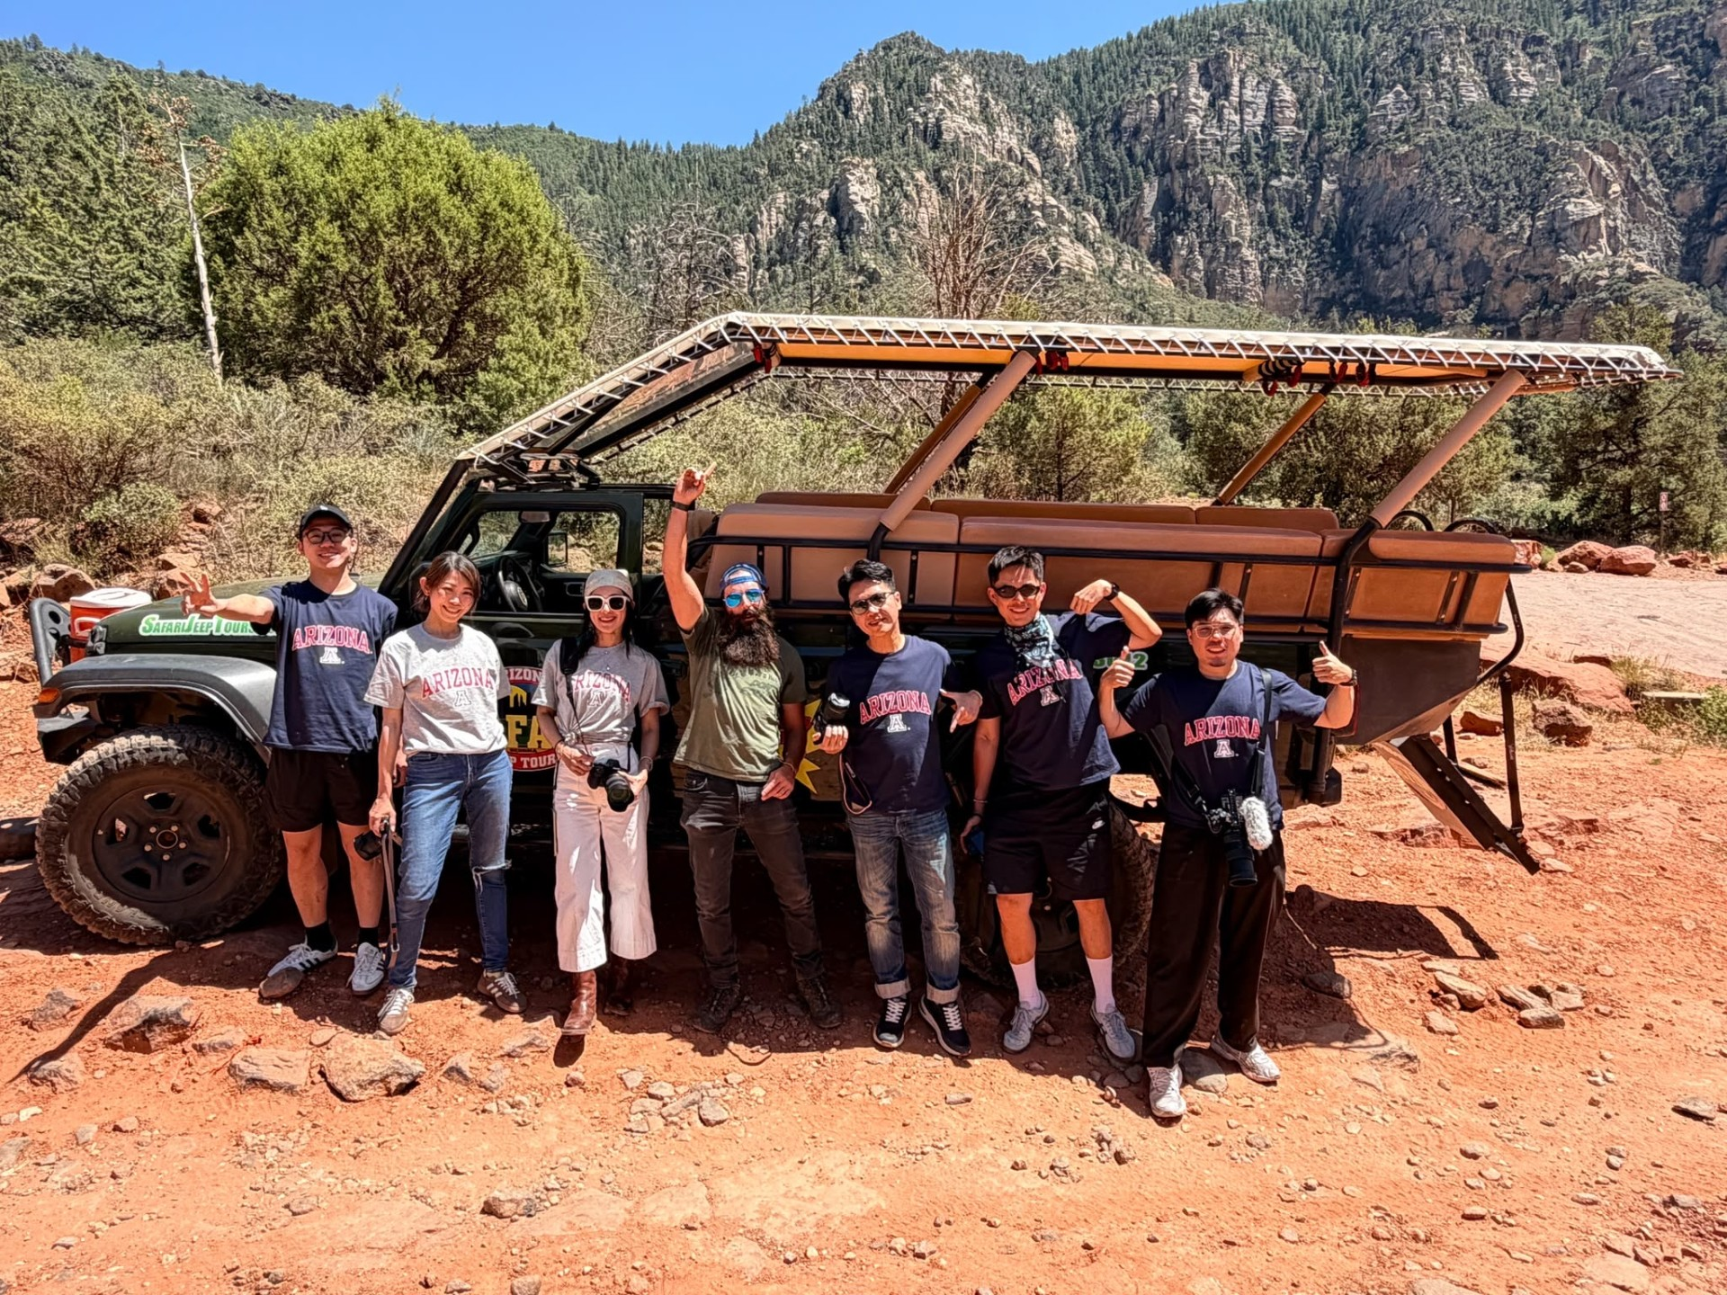
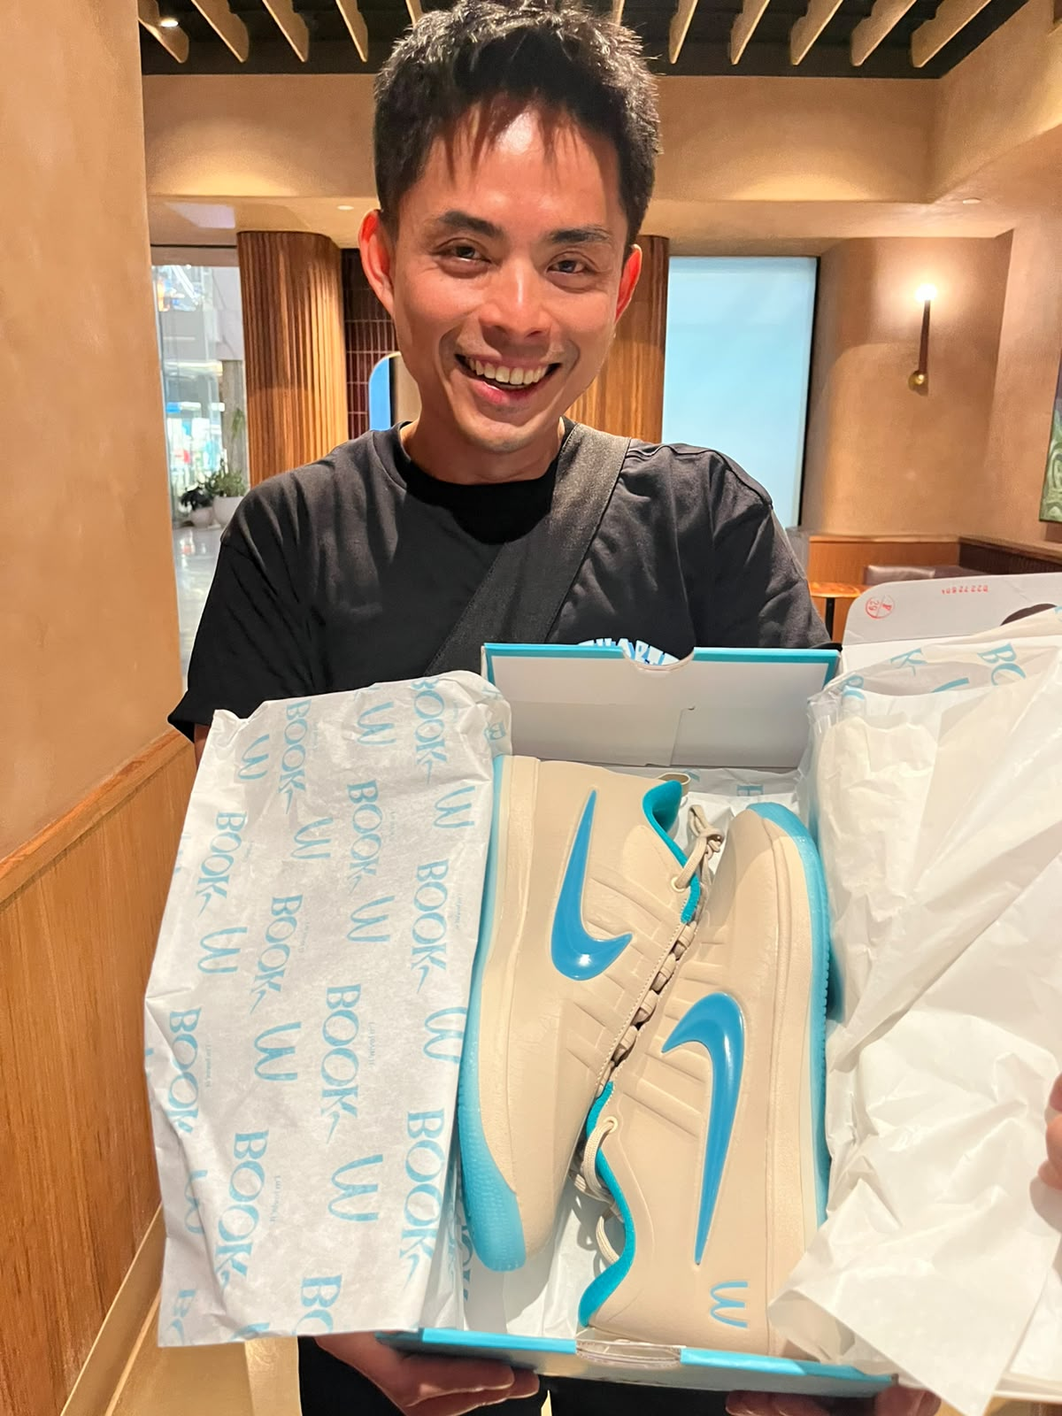
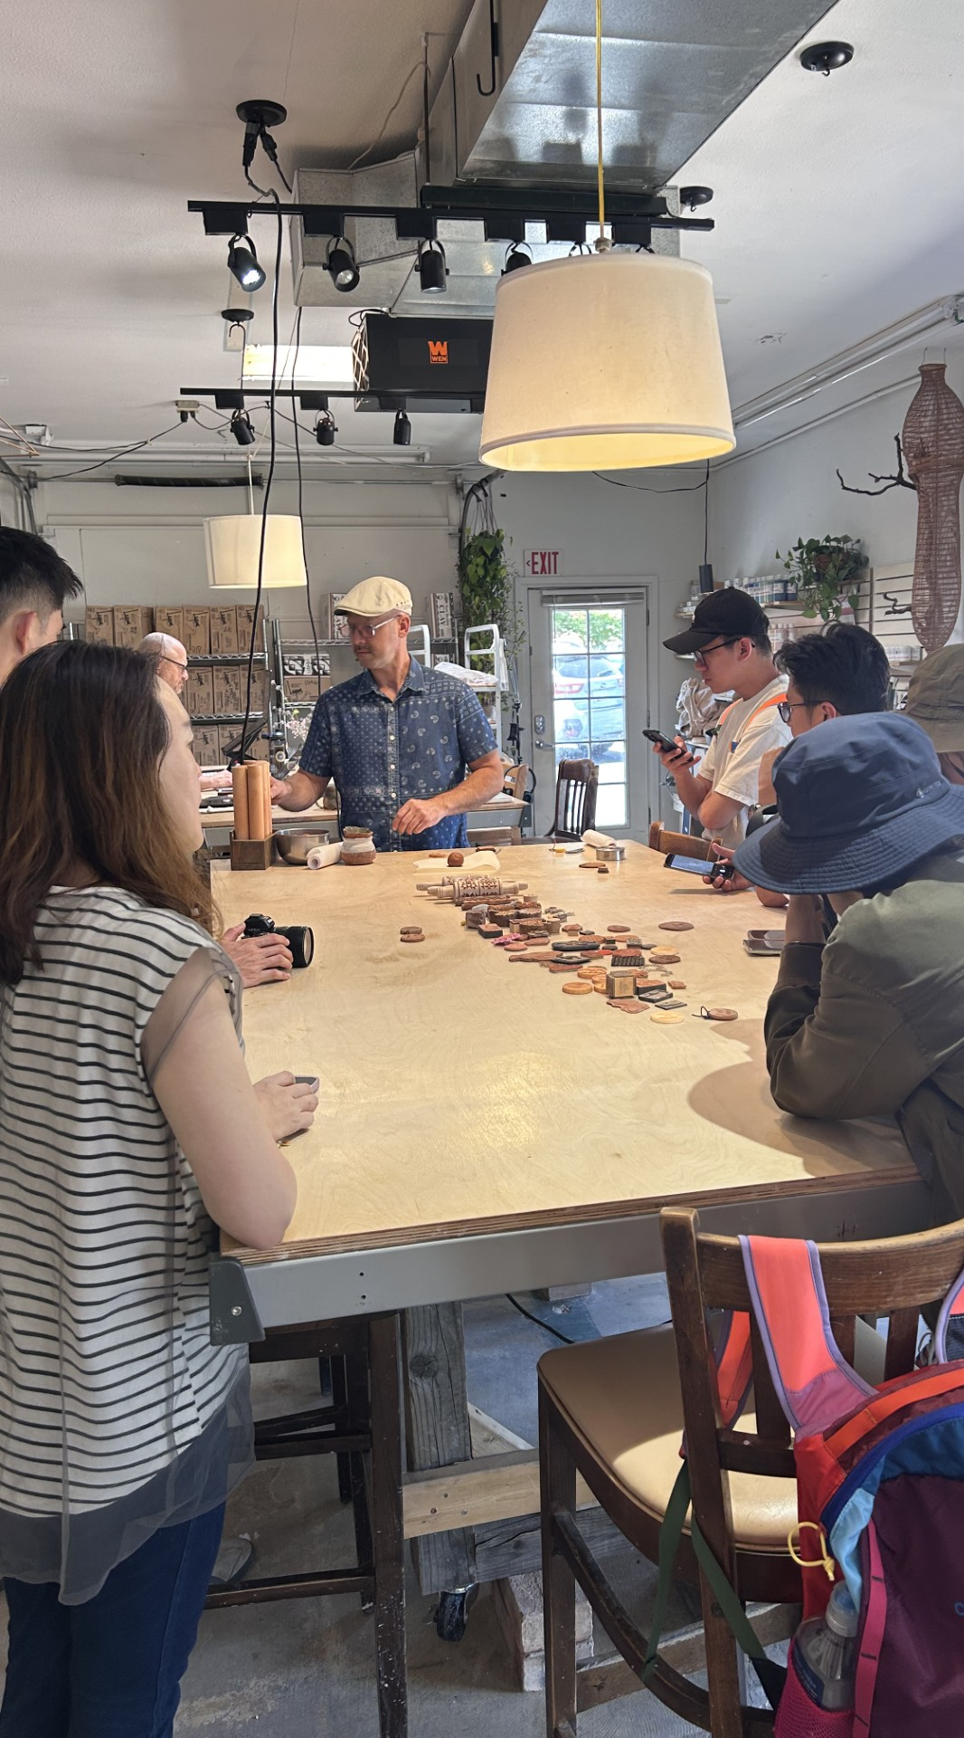
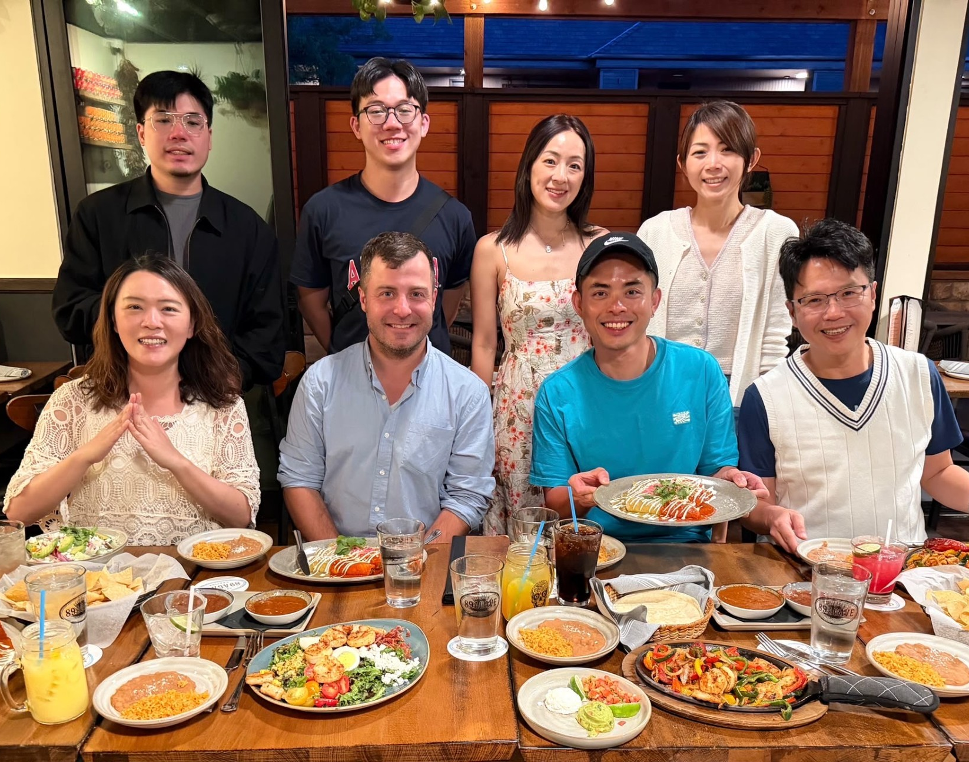
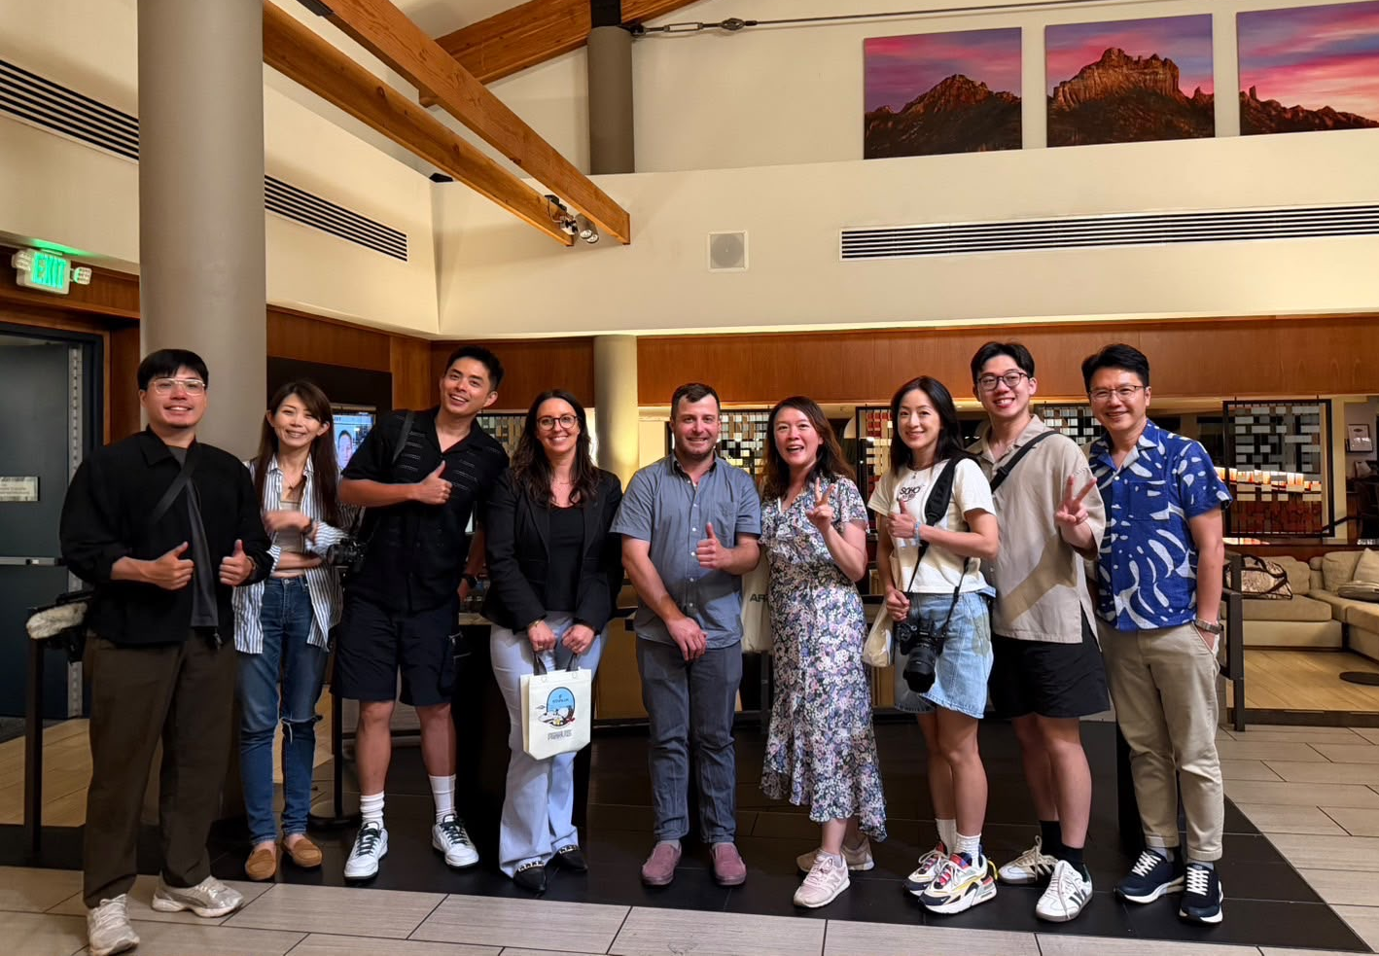
TOURISM PROGRAM

Slide 6
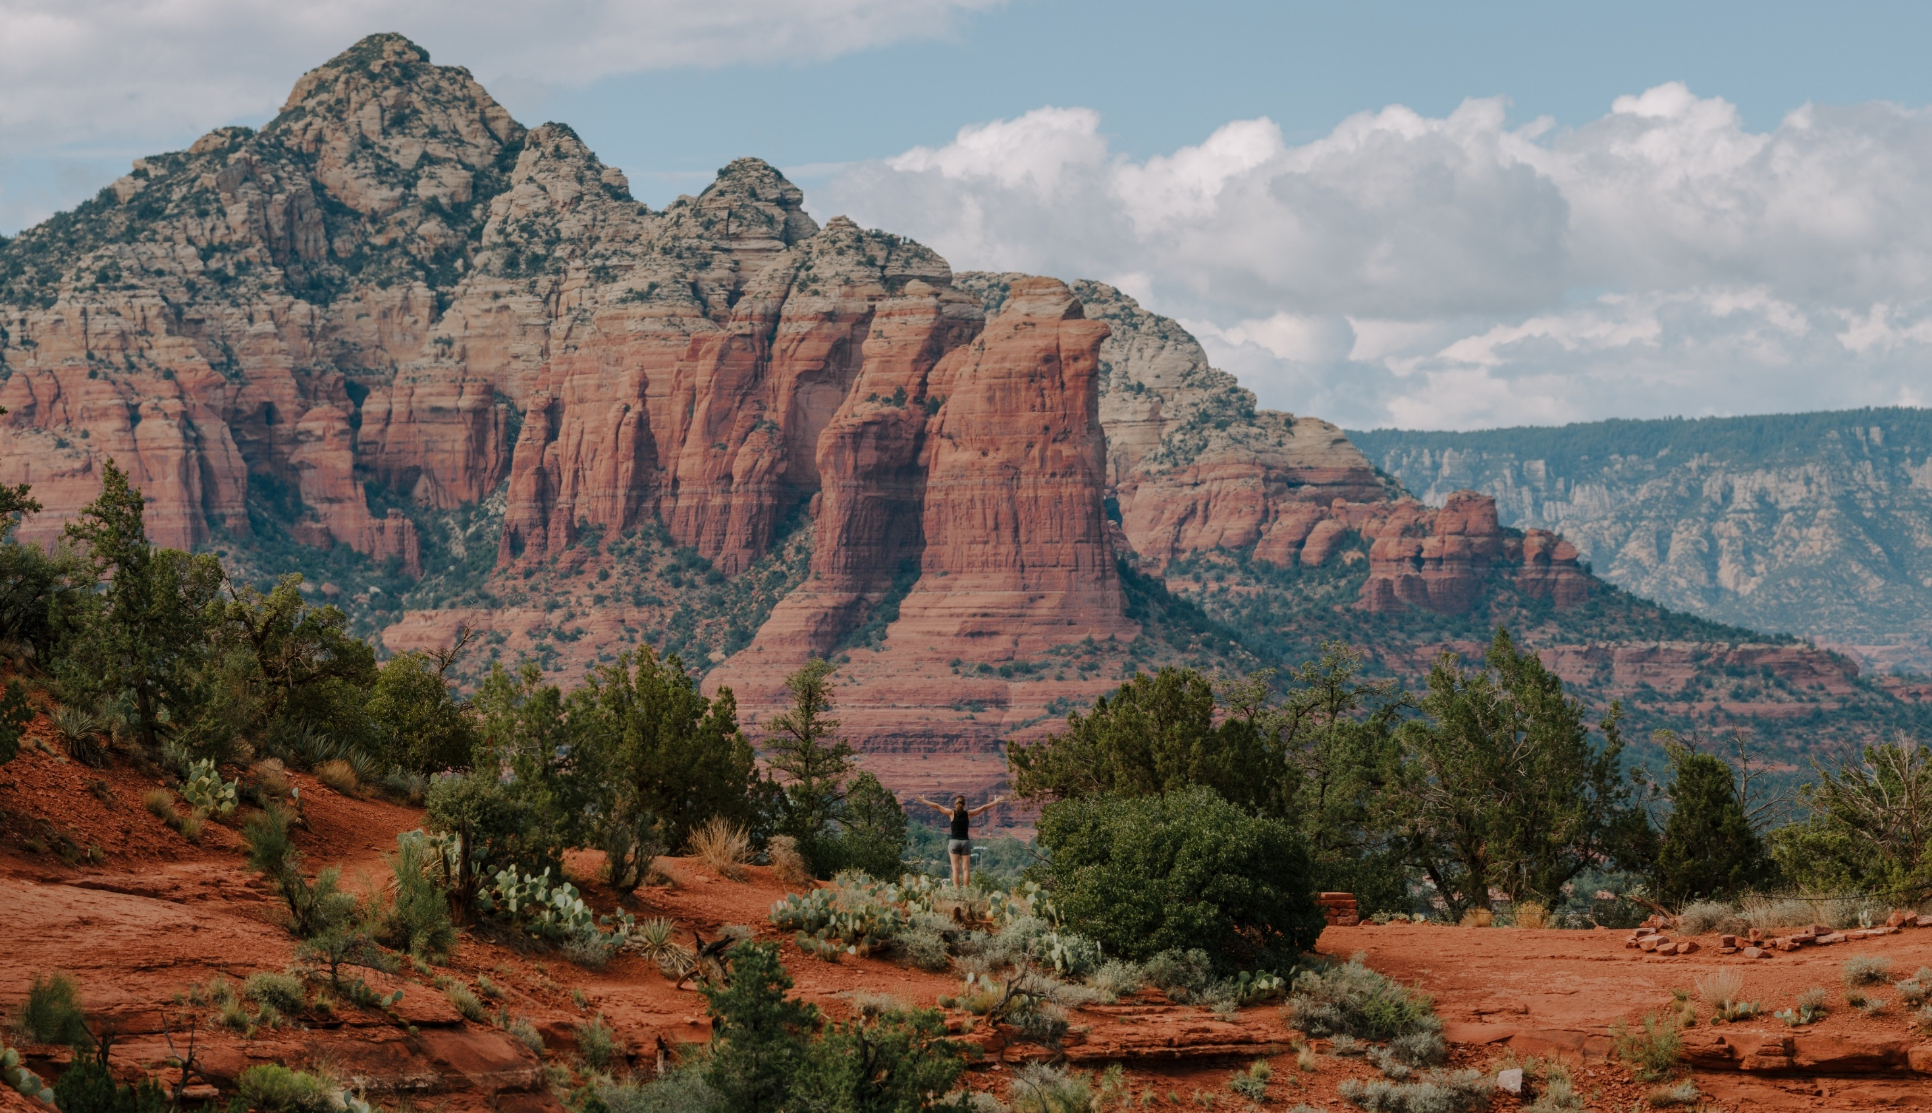
Future Of Tourism & Sedona Experience Input Sessions
TOURISM PROGRAM

Slide 7
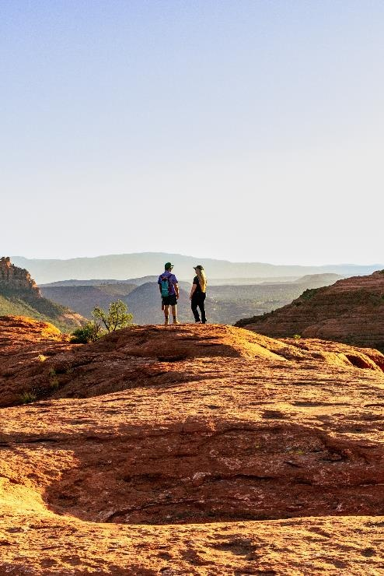
Update
  We hosted two Future of Tourism and the Sedona Experience Community Input Sessions in April and May
    We had more than 75 people attend both sessions
  Findings will be presented to City Council during a joint session this fall with the Tourism Advisory Board
  Feedback will also inform the 2026-2030 Sedona Tourism Plan
  Key themes included:
    Community
    Recreation
    Transportation/Mobility
    Arts & Culture
    Wellness
    Stewardship
TOURISM OFFICE

Slide 8
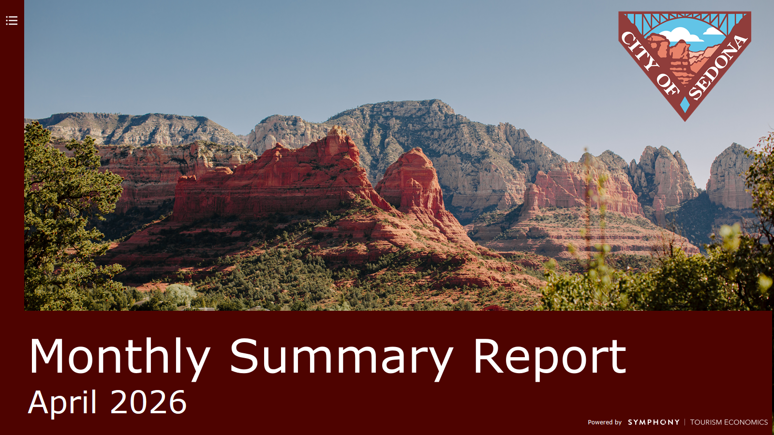

Slide 9
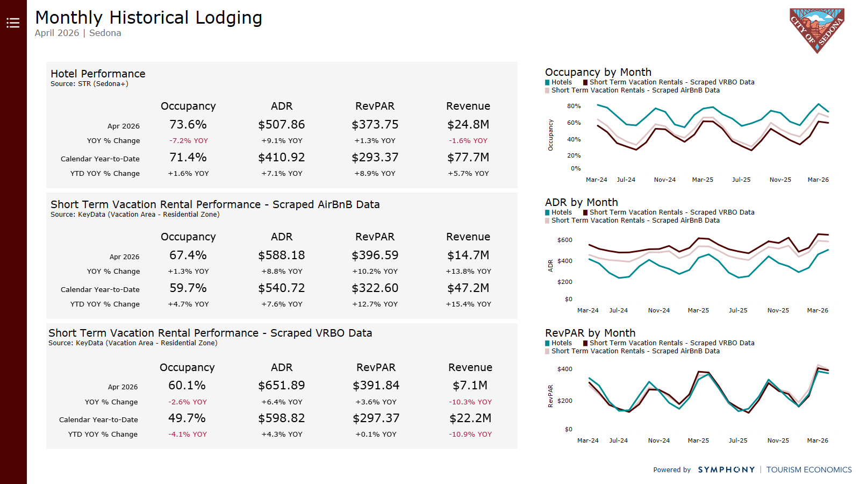

Slide 10
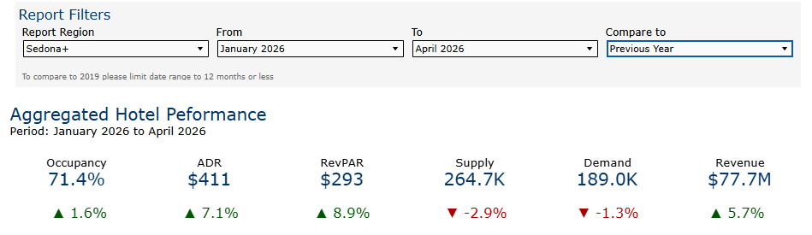
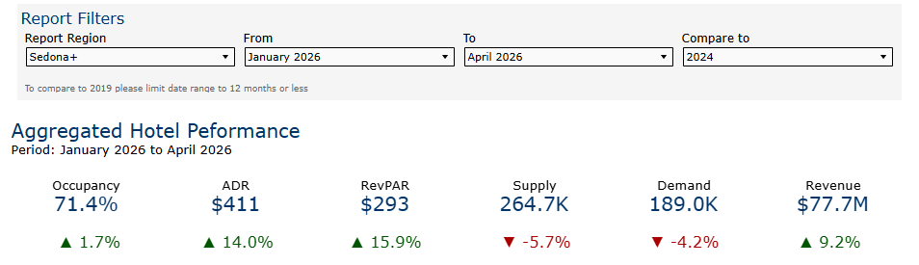
TOURISM OFFICE

Slide 11
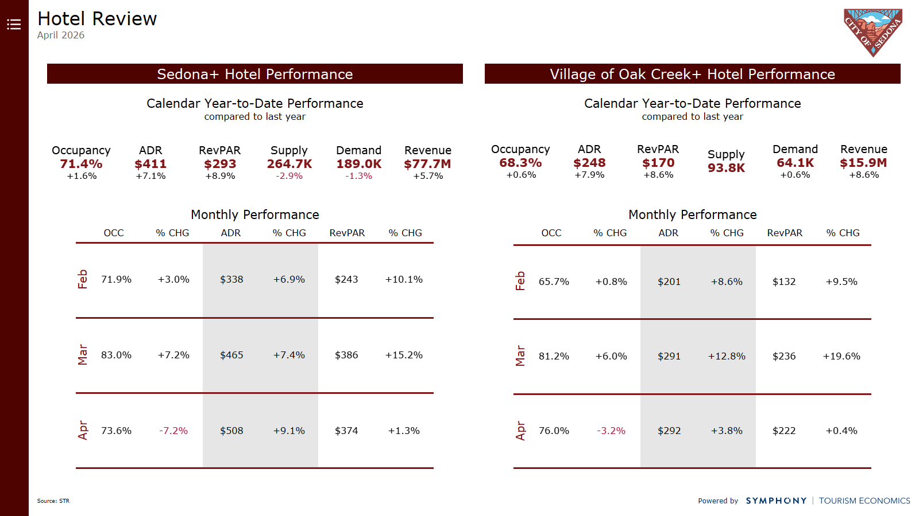

Slide 12
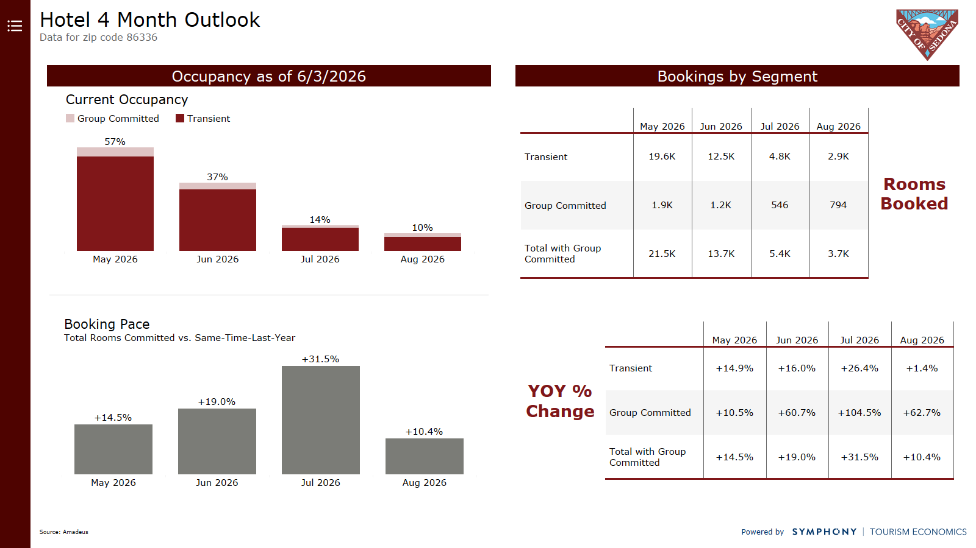

Slide 13

THANK YOU

