Slide 1
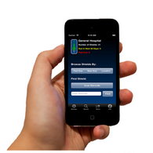
ShieldTracker XENOLITE Apron Tracking Application for iPhone, iPad, & iPod Touch From Beverly A. Simpson Inc
A Simple and inexpensive iPhone application that streamlines the shield testing process required by the Joint Commission (JACHO).
Key features include:
Built-in barcode scanner for easy shield identification
Log to track the last test date of the shield
Results of latest tracking
Database that allows for search of a particular shield
Notifications as to when the shield is due or past due for testing

Slide 2
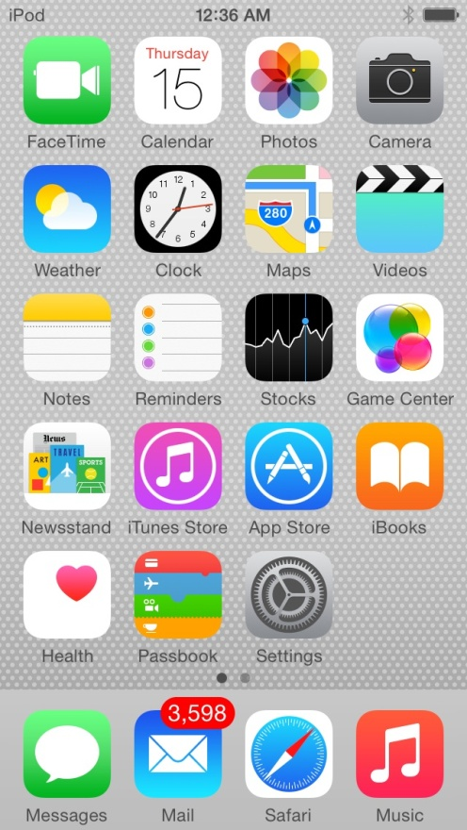
Works on Apple Operating Systems
Easy to use
Does not require a dedicated Internet connection to use
Application based
Found on Apple iTunes (under iPhones only)

Slide 3
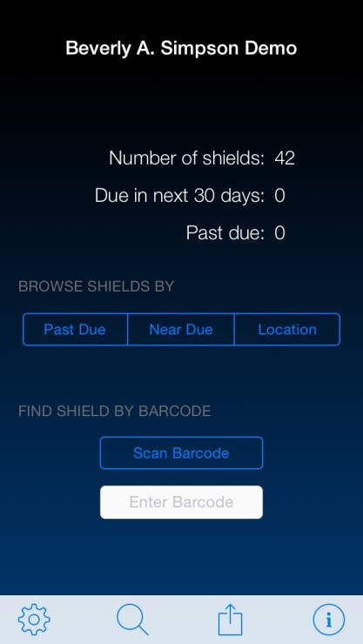
Simplified Home Screen
Shows total inventory
Active radiation protection shields
Shields that require testing
Shields that are past due testing
Search data base of inventory by
department
Scan from home screen

Slide 4
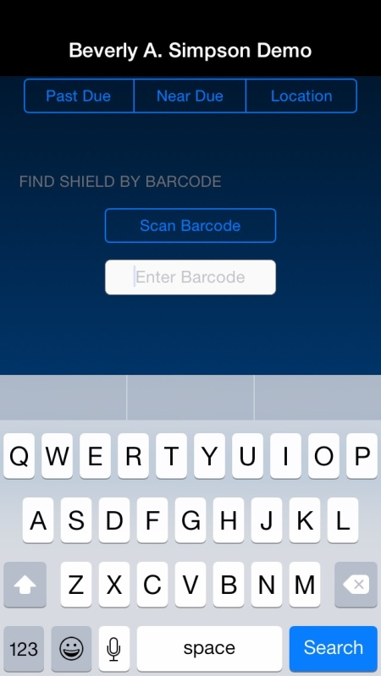
Searching for Shields
Search shields by name or use
scanner
Easy to use qwerty keyboard
Works with other keyboard applications
Scanner uses Apple product camera

Slide 5
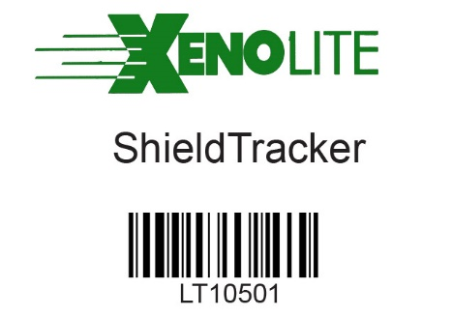
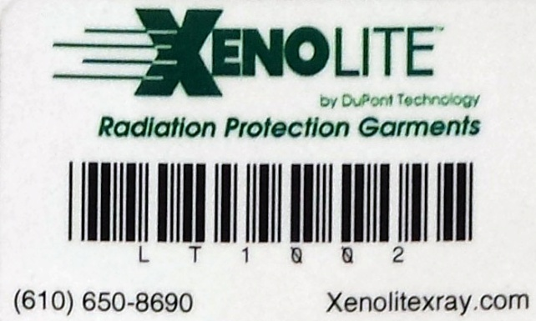
Scanning
Barcodes are sewn on new products
Non LiteTech and older products
can have the barcodes added
New Garments: Sew-on Labels
Retrofit Labels for Existing Garments
(Using 3M 300LSE Adhesive )

Slide 6
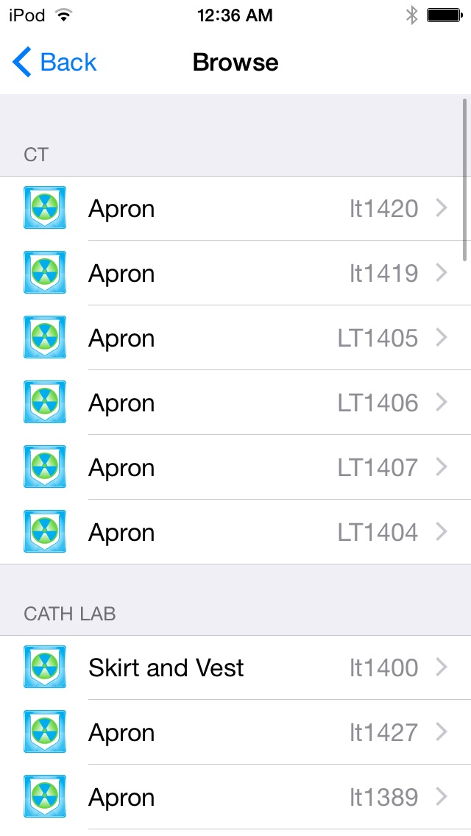
Database
Broken down by selected
Department
Color coded for detecting
shields

Slide 7
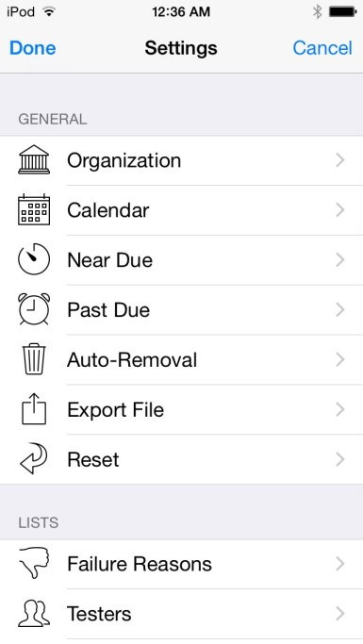
Settings
Easy customizable settings
Use default settings for simplified
operations

Slide 8
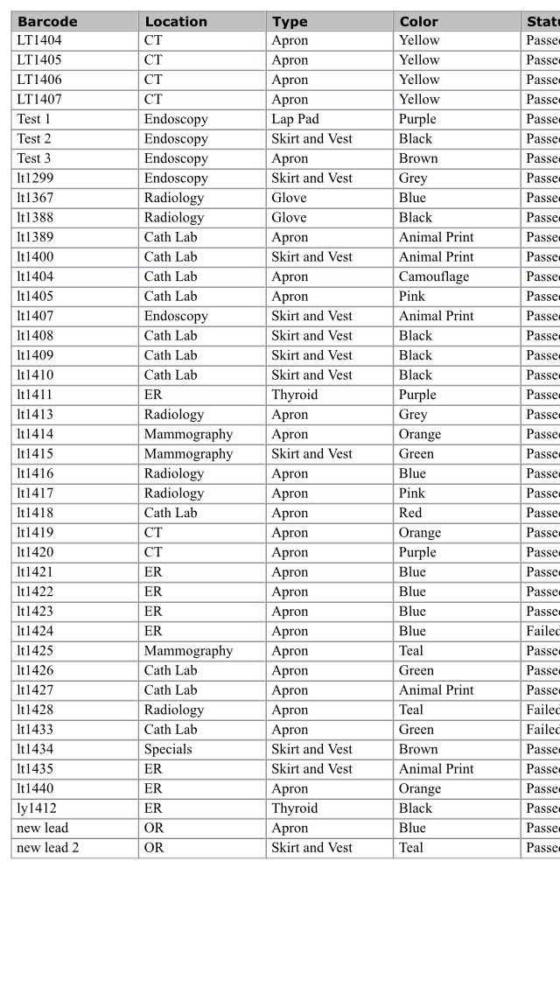
Downloaded Database
SheildTracker utilizes a spreadsheet
to track shields
Download or directly print a
spreadsheet
Upload a prior database

Slide 9
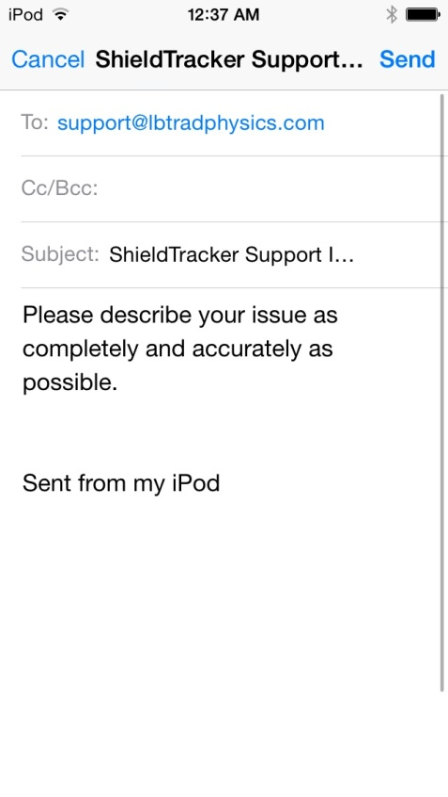
Customer Service
Email the creators directly
Receive an email or phone call
within 24 hours of contact

Slide 10
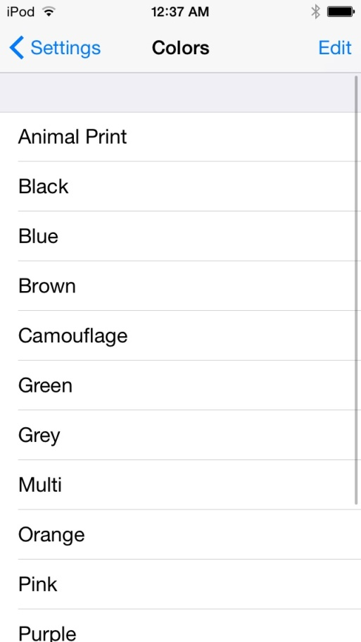
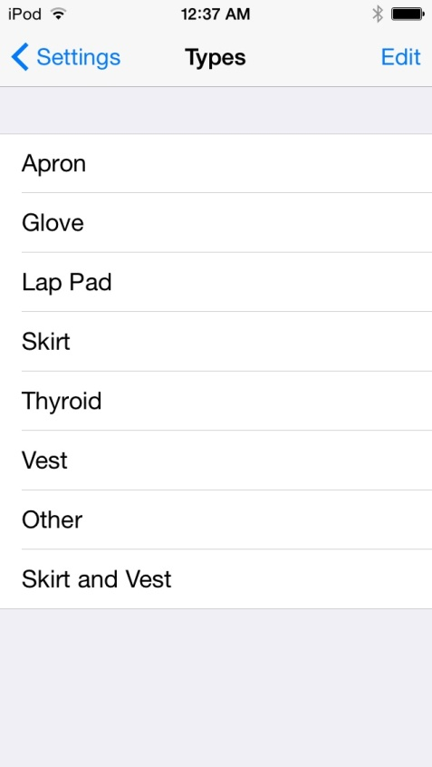
Customization
Use the default drop down
menu to create customizable
options
Changes made take affect
immediately

