Slide 1
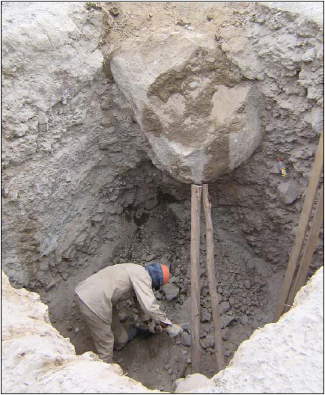
Recognize Any Hazard(s)?
Source: Southwest Safety Training Alliance

Slide 2
YES
No protective system in this excavation.
Potential crushing hazard from overhead boulder.

Slide 3
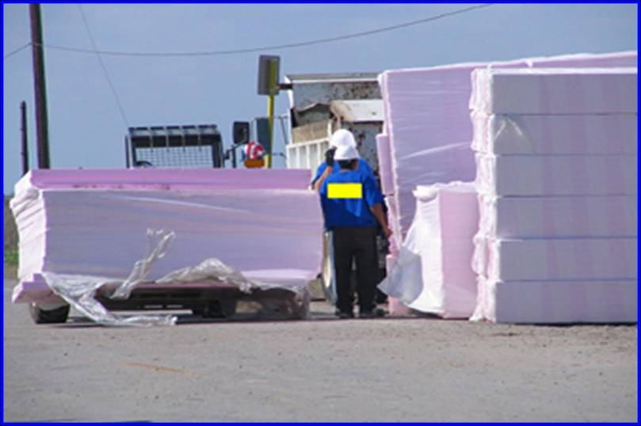
Recognize Any Hazard(s)?
Source: Compacion Foundation (HCAdetejas.org)

Slide 4
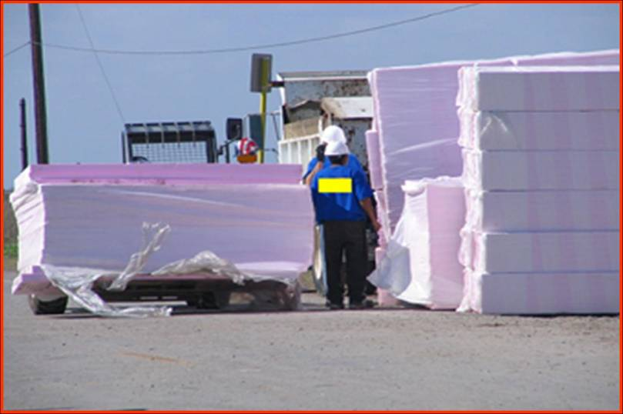
YES
Caught-in hazards occur when a worker could be caught inside of or in between different objects

Slide 5
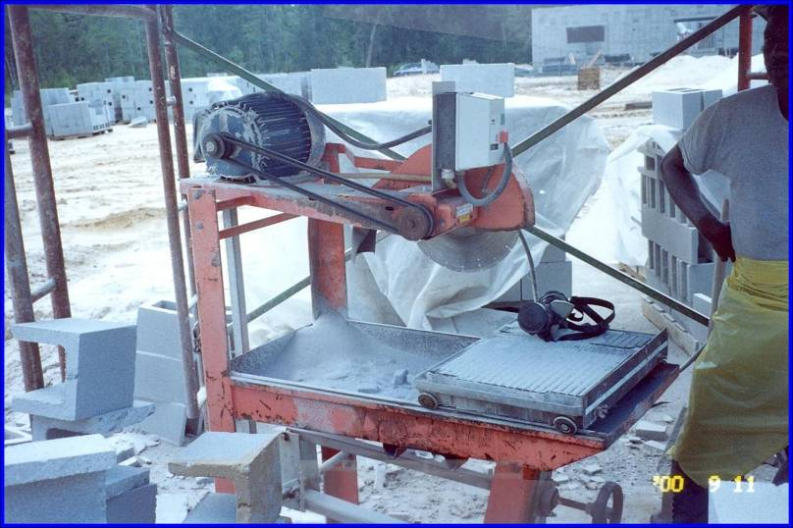
Recognize Any Hazard(s)?
Source: OSHA Region IV National Photo Archive

Slide 6
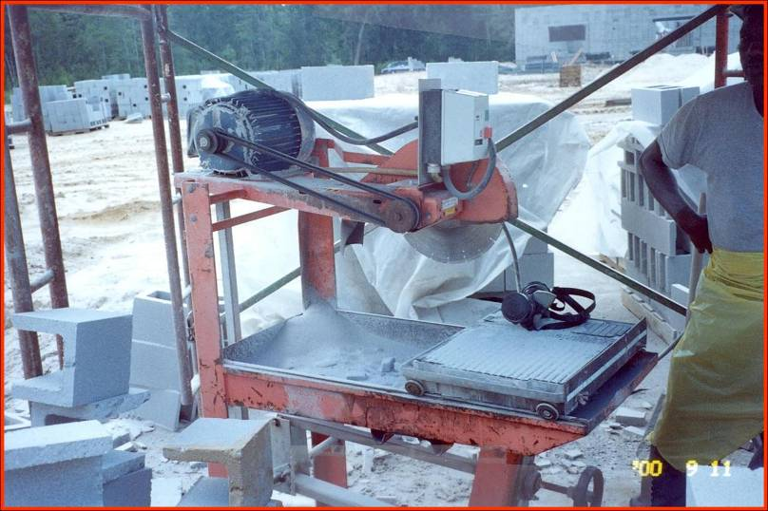
YES
Unguarded belt and pulley. Worker can get hand and/or clothing caught in running nip point

Slide 7
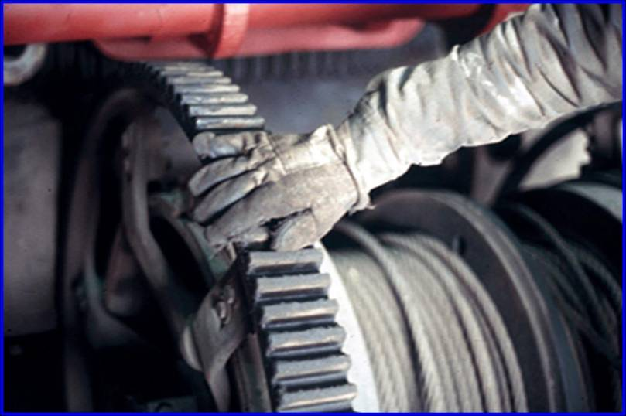
Recognize Any Hazard(s)?
Source: Compacion Foundation (HCAdetejas.org)

Slide 8
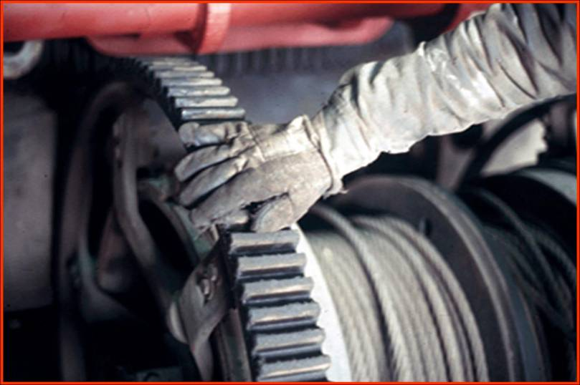
YES
Gloves, long sleeve shirts, jewelry, or loose fitting clothing can be hazardous if caught in moving parts.

Slide 9
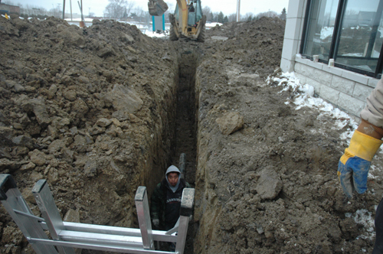
Recognize Any Hazard(s)?
Source: OSHA Directorate of Construction

Slide 10
YES
Next to a residential structure
Worker in an unprotected vertical wall trench [pipe work] is exposed to being totally engulfed by the trench if it collapses.
No protective systems in use
Ladder at the end of the trench

Slide 11
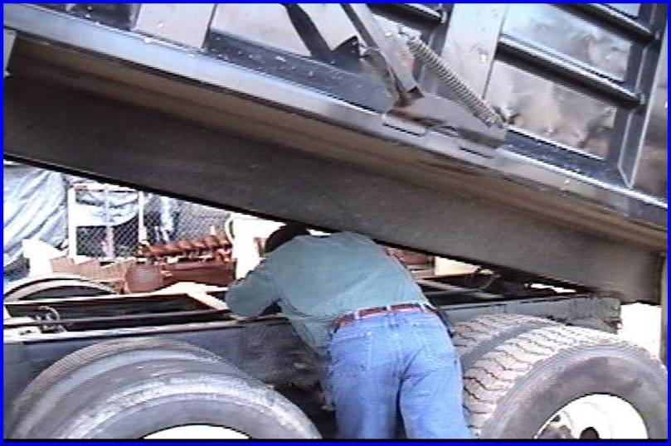
Recognize Any Hazard(s)?
Source: Indian River Community (now State) College
Notes:
Susan Harwood Training Grant Program (2006)
Focus Four Hazards in the Construction Industry
11

Slide 12
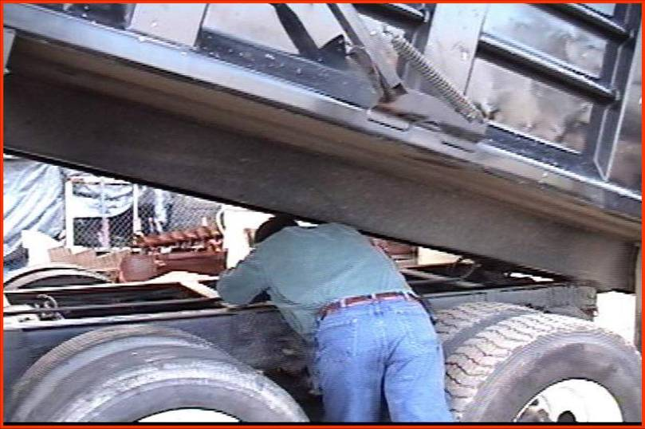
YES
Truck box not blocked
Do not work
between the frame
and dump box of
a dump truck
Source: Indian River Community (now State) College
Notes:
Susan Harwood Training Grant Program (2006)
Focus Four Hazards in the Construction Industry
12

Slide 13
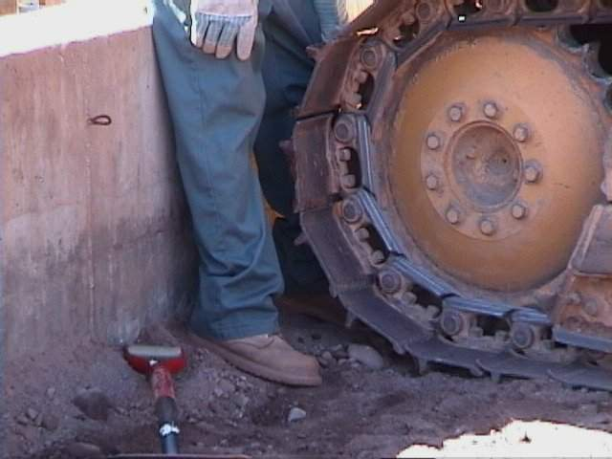
Recognize Any Hazard(s)?
Source: Indian River Community (now State) College
Notes:
Susan Harwood Training Grant Program (2006)
Focus Four Hazards in the Construction Industry
13

Slide 14
YES
Employee could be caught between track of dozer and wall
Notes:
Susan Harwood Training Grant Program (2006)
Focus Four Hazards in the Construction Industry
14

Slide 15
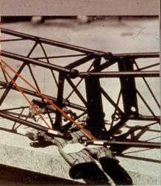
Recognize Any Hazard(s)?
Source: Indian River Community (now State) College
Notes:
Susan Harwood Training Grant Program (2006)
Focus Four Hazards in the Construction Industry
15

Slide 16
YES
Do not work
under the truss
boom during
dismantling
Crane booms that are not adequately supported when the pins are removed during dismantling
Notes:
Susan Harwood Training Grant Program (2006)
Focus Four Hazards in the Construction Industry
16

Slide 17
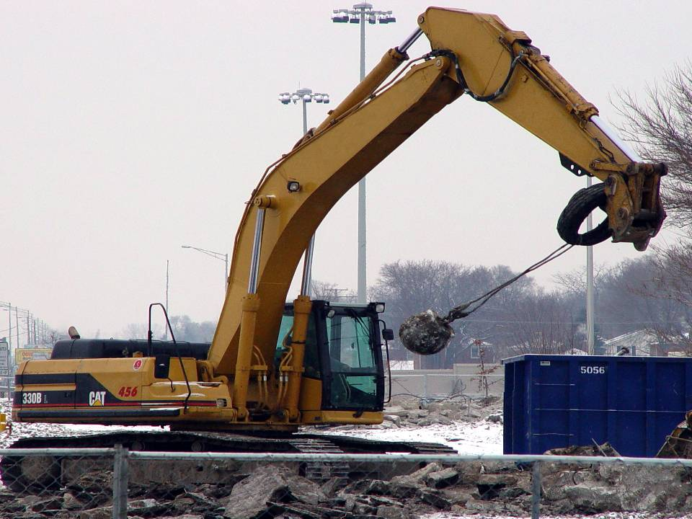
Recognize Any Hazard(s)?
Source: Construction Safety Council

Slide 18
YES
The wrecking ball is loosely attached to arm; could come loose and strike operator’s cab
A worker could be caught between the wrecking ball and the dumpster

Slide 19
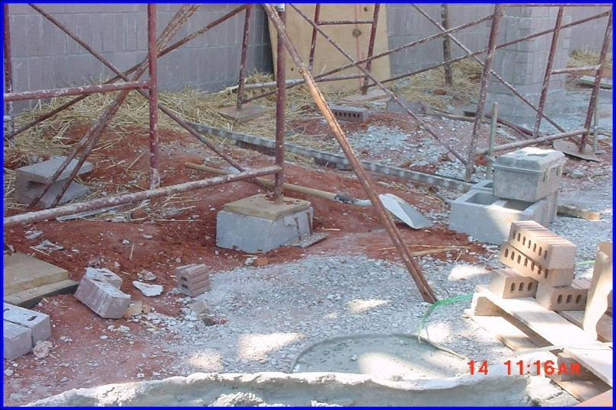
Recognize Any Hazard(s)?
Source: OSHA Region IV National Photo Archive

Slide 20
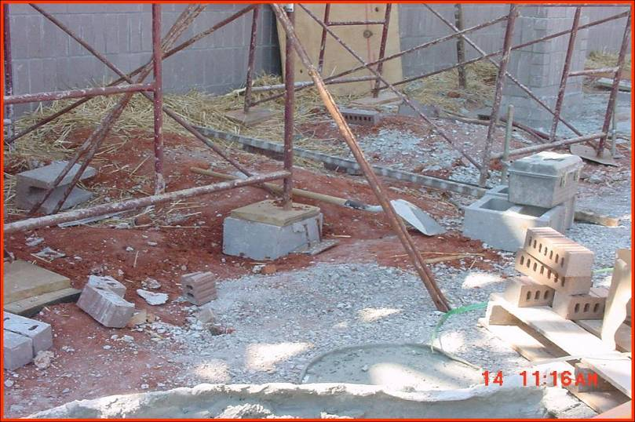
YES
Unstable footing on scaffold by using concrete block

Slide 21
Caught In or Between - Topics
Identify common caught-in or between hazards
Describe types of caught-in or between hazards
Protect themselves from caught-in or between hazards
Recognize employer requirements to protect workers from caught-in or -between hazards

Slide 22
Caught In or Between
The key factor in deciding between a Caught event and a Struck event is whether the impact of the object alone caused the injury. When the impact alone creates the injury, the event should be recorded as Struck. When the injury is created more as a result of crushing injuries between objects, the event should be recorded as Caught.

Slide 23
Caught In or Between Examples
Cave-ins (trenching)
Being pulled into or caught in machinery and equipment (this includes strangulation as the
result of clothing caught in running machinery and equipment)
Being compressed or crushed between rolling, sliding, or shifting objects such as semi-trailers and a dock wall, or between a truck frame and a hydraulic bed that is lowering

Slide 24
Cave-ins (trenching)
An employee and a co-worker were working in a 9-foot deep excavation installing water pipes, when the south side of the excavation caved in on the employee and buried him. The employee was killed.

Slide 25
Caught in Machinery
A worker was ripping a 6-inch piece of wood on an unguarded compound miter saw. His left thumb was caught in the saw and amputated.

Slide 26
Compressed or Crushed
A worker was operating a road grader when the engine died and the vehicle began to roll toward a small ravine. The employee jumped off the grader but was pulled under the grader as it overturned. He was killed when he was crushed underneath the tires.

Slide 27
What are the common types of caught-in or -between hazards in construction?
Machinery that has unguarded moving parts causing caught-in or -between incidents
Buried in or by
Pinned between

Slide 28
Machinery that has unguarded moving parts causing caught-in or -between incidents
Almost all sites use machinery that has moving or rotating parts or that requires maintenance or repair at some point during construction. If machinery is not properly guarded or de-energized during maintenance or repair, injuries from caught-in or –between hazards may result, ranging from amputations and fractures to death.

Slide 29
Buried In or By
The major hazard related to buried in or by is cave-ins of unprotected trenches and excavations. Cave-ins crush or suffocate workers. In addition, trenches may contain hazardous atmospheres; workers can drown in water, sewage, or chemicals in the trenches; and if working around underground utilities, workers may also face burns, electrocution or explosions from steam, hot water, gas, or electricity.

Slide 30
Pinned Between
You can be pinned between equipment and a solid object, such as a wall or another piece of equipment; between materials being stacked or stored and a solid object, such as a wall or another piece of equipment; or between shoring and construction materials in a trench. These types of hazards can result in multiple broken bones, asphyxiation, or death.

Slide 31
Use Machinery that is Properly Guarded
Never remove a safety guard when a tool is being used. Hazardous moving parts of power tools and equipment need to be safeguarded. For example, belts, gears, shafts, pulleys, sprockets, spindles, drums, fly wheels, chains, or other reciprocating, rotating, or moving parts of equipment must be guarded if such parts are exposed to contact by workers.
Be sure to avoid wearing loose clothing or jewelry that can be caught in moving parts.
Protect Yourself

Slide 32
Use Other Methods to Ensure that Machinery Is Sufficiently Supported, Secured or Otherwise Made Safe
Make sure that your equipment is de-energized and cannot be started accidentally.
Disconnect tools when not in use, before servicing, and when changing accessories such as blades, bits, and cutters.
Turn off vehicles before you do maintenance or repair work. If possible, lock out the power source to the equipment. The type of power source may be electric, pneumatic, liquid fuel, hydraulic, or powder-actuated.
Lower or block the blades of bulldozers, scrapers, and similar equipment before you make repairs or when the equipment is not in use.
Protect Yourself

Slide 33
Protect Yourself from Being Pinned Between Equipment, Materials, or Other Objects
BE AWARE at all times of the equipment around
you and stay a safe distance from it.
Never place yourself between moving materials and an immovable structure, vehicle, or stacked materials
Make sure that all loads carried by equipment are stable and secured
Stay out of the swing radius of cranes and other equipment.
Wear a seatbelt, if required, to avoid being thrown from a vehicle and then potentially being crushed by the vehicle if it tips over.
Protect Yourself

Slide 34
Protect Yourself on Excavation Sites
Do not work in an unprotected trench that is 5 feet deep or more. The type of protection may be one of the following:
  Sloping or benching. Sloping is cutting back the sides of the trench to a safe angle so it won’t collapse. Benching uses a series of steps that approximate the safe sloping angle. The angle depends on the soil type.
  Trench box or shield. These do not prevent cave-ins but protect the workers who are in them if a cave-in happens.
  Shoring. Shoring are wooden structures or mechanical or hydraulic systems that support the sides of an excavation.
Protect Yourself

Slide 35
Protect Yourself on Excavation Sites
Enter or exit a trench or excavation only by using a ladder, stairway or properly designed ramp that is placed within the protected area of the trench.
Do not work outside of the confines of the protection system!
Protect Yourself

Slide 36
Training
Make sure you have the proper training on the equipment and hazards of your job so that you can do your work safely.
Protect Yourself

Slide 37
What is my employer required to do to protect workers from caught-in or –between hazards?
Provide guards on power tools and other equipment with moving parts.
Support, secure or otherwise make safe equipment having parts that workers could be caught between.
Take measures to prevent workers from being crushed by heavy equipment that tips over.
Take measures to prevent workers from being pinned between equipment and a solid object.

Slide 38
What is my employer required to do to protect workers from caught-in or –between hazards?
Provide protection for workers during trenching and excavation work.
Provide means to avoid the collapse of structures scaffolds.
Provide means to avoid workers’ being crushed by collapsing walls during demolition or other construction activities.
Designate a competent person.
Provide training for workers.

