Slide 1
Health Hazards in Construction
10-Hour Construction Outreach
Notes:
Construction workers are exposed to a variety of health hazards, every day, that can result in injury, illness, disability, or even death.
OSHA images taken from https://www.osha.gov/dte/grant_materials/fy09/sh-19495-09.html

Slide 2
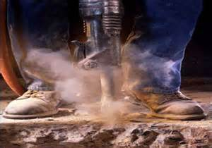
Health Hazards
Potential exposures to health hazards:
Worker on the job
Worker’s family
Source: OSHA
Notes:
Reference: Health Hazards in Construction (2009) – https://www.osha.gov/dte/grant_materials/fy09/sh-19495-09/health_hazards_workbook.pdf
Workers can be exposed to a variety of health hazards on a job site, including:
heavy metals, such as lead dust
concrete and silica dust
oils, greases, solvents
If not practicing good hygiene, these hazards can be brought home and expose family members as well.
Protect yourself and your family by knowing what health hazards may be present at your jobsite and take appropriate actions for exposure control.

Slide 3
Objectives
Identify common health hazards.
Describe types of common health hazards.
Apply health hazard protection methods.
Recognize employer requirements to protect workers from health hazards in construction, including hazards communication program.

Slide 4
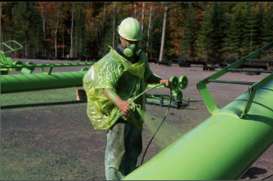
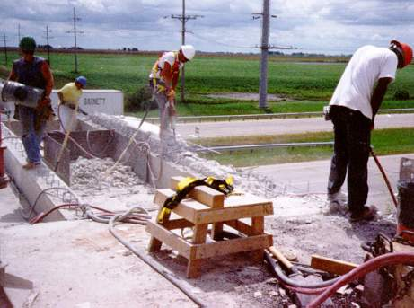
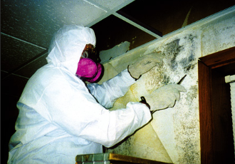
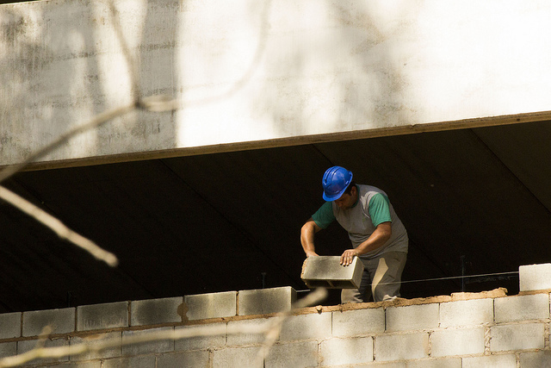
Common Health Hazards
Chemical
Physical
Source: OSHA
Source: OSHA
Biological
Ergonomic
Source: OSHA
Source: Arlosvaldo Gonzáfoles (Flickr.com)
Notes:
Types of health hazards include chemical, physical, biological, and ergonomic hazards. These hazards are broken down in subsequent slides.

Slide 5

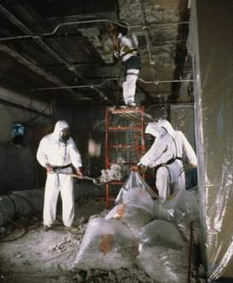

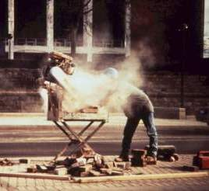

Common Ways Workers Encounter Chemical Hazards
Solids
Liquids
Gases and vapors
Aerosols
  Dust, Mist, Fumes
Welding Fumes
Asbestos
Source: U.S. Navy
Source: OSHA
Spraying Chemicals
Silica
Lead
Source: OSHA
Source: OSHA
Source: OSHA
Notes:
1.) Welding Fumes: Common metals include aluminum, antimony, arsenic, beryllium, cadmium, chromium, cobalt, copper, iron, lead, manganese, molybdenum, nickel, silver, tin, titanium, vanadium, and zinc.
2.) Asbestos: Removal/Repair/Demolition projects. Used in insulation for pipes, tiles, and various other building materials.
3.) Toxic Environments: "spray-finishing operation" as the "employment of methods wherein organic or inorganic materials are utilized in dispersed form for deposit on surfaces to be coated, treated, or cleaned." This may include such diverse activities as the application of flammable and combustible liquids, such as paint, in a spray booth or spray area, electrostatic coating operations, and automobile body lining operations.
4.) Crystalline Silica: Brick/mortar, concrete, slate, granite, sandstone, stone aggregate, tile, and sand
5.) Lead: Demolition/salvage/removal/encapsulation/clean-up/renovation activities. Also used in some paints, solder, electrical fittings/conduits, tank linings, plumbing fixtures, and many metal alloys.

Slide 6

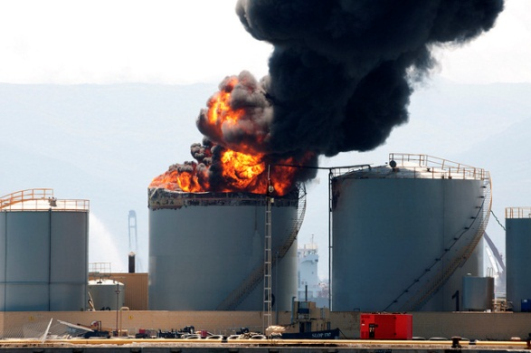
Effects of Chemical Exposure
May put workers at risk of developing health problems:
Health Problems
Heart Ailments | Lung Damage | Sterility
CNS Damage | Kidney Damage | Burns
Cancer | Liver Damage | Rashes
May pose risk of fire and explosion hazards:
Fire
Explosion
Source: Virginie Moerenhout (Flickr.com)
Source: Jonathan Perera (Flickr.com)
Notes:
[Taken from construction outreach lesson plan – Health Effects Section C]
1. May pose risk of fire and explosion hazards (physical hazards).
2. May put workers at risk of developing health problems such as heart ailments, central nervous system damage, kidney damage, lung damage, sterility, cancer, burns, or rashes (health hazards)

Slide 7

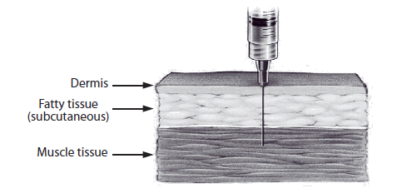
Routes of Entry
Inhalation: | Breathed in (Most common route)
Source: OSHA
Ingestion: | Swallowing via eating or drinking
Source: OSHA
Absorption: | Drawn through skin or eye surface
Source: OSHA
Injection: | Punctures through skin
Source: CDC
Notes:
Inhalation is the primary route of entry for hazardous chemicals in the work environment. Nearly all materials that are airborne can be inhaled.
Ingestion - toxic materials can be swallowed and enter the body through the gastrointestinal tract. In the workplace, people can unknowingly ingest harmful chemicals when you eat, drink, or smoke in a contaminated work areas.
Absorption through the skin is another route of entry. The skin is the largest organ of your body and a common exposure site for liquid and airborne chemicals. Absorption through the skin can occur quite rapidly if the skin is cut or abraded. Intact skin is an effective barrier to many hazardous materials.
Injection occurs when a sharp object punctures the skin, allowing a chemical or infectious agent to enter your body. For example, injection can occur when a contaminated object such as a rusty nail punctures the skin. High-pressure hydraulic oil is a common construction injection hazard. (OSHA)

Slide 8
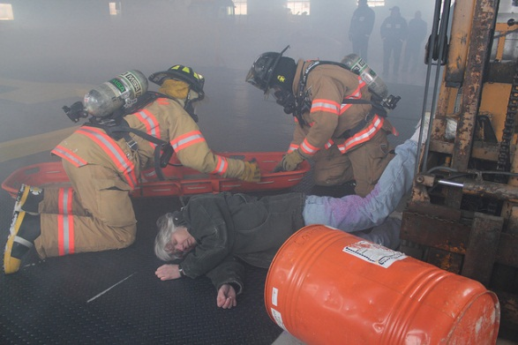
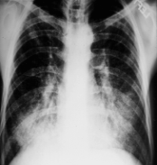
Health Effects
Exposure Condition |  | Exposure | Example
ACUTE | Immediate | Short-term, high concentration | H₂S exposure within a confined space
CHRONIC | Delayed; generally for years | Continuous; for long periods of time | Asbestosis
Acute
Chronic
Source: U.S. Army Corps of Engineers
Source: OSHA
Notes:
Acute Effect - Having an immediate response due to a short period of exposure to a relatively high concentration.
Chronic Effect - The heath effect exhibited by the body after long term exposure to relative low concentrations of a chemical. (OSHA)
Some chemical hazards can be acute or chronic – such as Carbon Monoxide
Acute Symptoms: headache, nausea, weakness, angina, dyspnea, loss of consciousness, seizures, and coma
Chronic Symptoms: lethargy, listlessness, lack of motivation, sleepiness → chronic fatigue syndrome, clinical depression, or an endocrine disorder
Sources:
[CO Acute] http://www.merckmanuals.com/professional/injuries-poisoning/poisoning/carbon-monoxide-poisoning
[CO Chronic] http://www.coheadquarters.com/table.cochronic1.htm

Slide 9
Chemical Hazard Protection
Eliminate
Substitution
Engineering
Administrative
PPE
Notes:
Newer hierarchy of hazard control. PPE is still listed as a last line of defense. (Broken down in next slide)
1.) Eliminate the hazard (if possible)
2.) Substitute hazard with safer alternative (if possible)
3.) Engineering controls: ventilation/wetting/guarding/etc.
4.) Administrative: Giving breaks/cycling work to minimize exposures/training
5.) PPE: Respirators/hearing protections/face shields/gloves/boots/etc.

Slide 10
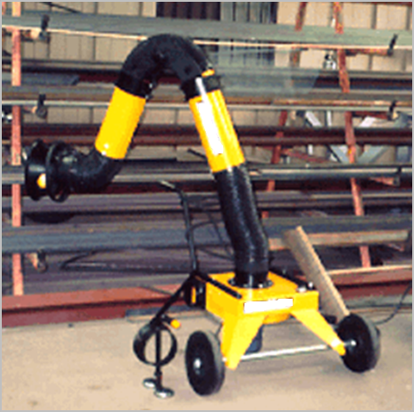
Chemical Hazard Protection
Engineering
  Ventilation (local/general)
  Process and equipment modification
  Isolation/automation
Administrative
  Monitor/measure exposure levels
  Inspections and maintenance
  Develop SOPs
PPE
  Respirators
  Gloves
  Safety glasses
  Protective clothing
Local Exhaust Ventilation
Source: OSHA
Notes:
1.) Eliminate the hazard (if possible)
2.) Substitute hazard with safer alternative (if possible)
3.) Engineering controls: ventilation/wetting/guarding/etc.
4.) Administrative: Giving breaks/cycling work to minimize exposures/training
5.) PPE: Respirators/hearing protections/face shields/gloves/boots/etc.

Slide 11


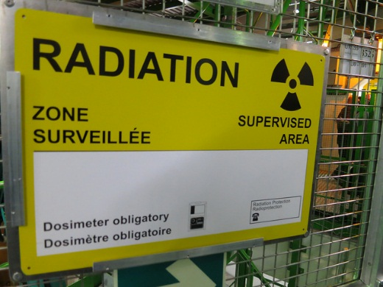
Physical Hazards in Construction
Noise
Temperature extremes
Vibration
Radiation
Noise and Vibration
Temperature
Radiation
Source: OSHA
Source: Alper Çuğun (Flickr.com)
Source: Nick Allen (Flickr.com)
Notes:
Explained in subsequent slides

Slide 12
Effects of Exposure to Physical Hazards
Temperature | Radiation | Vibration | Noise
Rash; Cramps | Burns | Fatigue | Interferences
Exhaustion | Sickness | Strains | Stress
Stroke | Aging | Carpal tunnel | Tinnitus
Hypothermia | Cancer | HAVS | Headaches
Frostbite | DNA mutations | Raynaud’s | Hearing loss
Notes:
1.) Temperature extremes: Exposure occurs both indoor and outdoor. Temperatures affected by humidity, wind speed, radiant heat, physical contact with hot or cold surfaces, and strenuous physical activities.
2.) Radiation: ELF produced by power lines and electrical wiring/equipment, RF and microwave radiation (cell phones and radio emitters), IR (IR lasers, furnaces, and heat lamps), UV (welding arcs, UV lasers, and sun) --- UV is the most common in construction!
3.) Vibrating/Impact: Hand-held and stationary tools that transmit vibration through work piece (i.e. chainsaws, mowers, drillers, air hammers, pile drivers, tractors, graders, excavators, earth-moving equipment, and other large machinery)
4.) Noise: Short and long-term exposure to loud noises (more on next slide)

Slide 13
Noise
Common Construction Noise Sources
Equipment | Noise (dB)
Backhoe | 85
Bulldozer | 87
Router | 90
Front end loader | 90
Chop saw | 92
Welding equipment | 92
Nail gun | 97
Jackhammer | 102
Grader/scraper | 107
Source: U.W. Dept. of Environmental & Occupational Health Services – Rick Neitzel July, 2005
Prolonged exposures to 85 dB can lead to hearing loss
Notes:
Action limit = 85 dBA
OSHA PEL = 90 dBA (8-hr TWA)
Hearing loss:
85 dBA = Prolonged
100 dBA = 15+ minutes
120 dBA = 9 seconds
140 dBA = Immediate

Slide 14
Protection Against Physical Hazards
Hazard | Engineering Controls | Administrative Controls | PPE
Temperature | Heaters; AC; windshields; ventilation | Water; Rest; Shade | Hoods; cooling vests; hard hat liners
Vibration | Vibration reduction equipment | Train not to grip too tightly; Job rotation | Anti-vibration gloves
Noise | Silencers; mufflers; enclosures; sound barriers | Increase distance between source and worker | Ear plugs; muffs
Eliminate or substitute hazard, whenever feasible
Notes:
[ https://www.osha.gov/SLTC/heatillness/index.html ]
1.) Eliminate the hazard (if possible)
2.) Substitute hazard with safer alternative (if possible)
3.) Engineering controls: ventilation/wetting/guarding/etc.
4.) Administrative: Giving breaks/cycling work to minimize exposures/training
5.) PPE: Respirators/hearing protections/face shields/gloves/boots/etc.

Slide 15



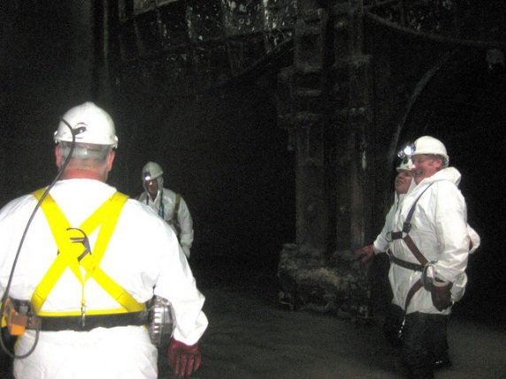

Biological Hazards in Construction
Insects
Animals
Mold
Source: James Jordan (Flickr.com)
Source: Jean-Jacques Boujot (Flickr.com)
Source: OSHA
Plants
Water/Sewage
Blood
Source: OSHA
Source: Matt Brown (Flickr.com)
Source: Monsleur Gordon (Flickr.com)
Notes:
Types of biological hazards
1. Contact with contaminated or disease-carrying soil, water, feces, animals (including insects, rodents, etc.), or plants
2. Contact with human blood or bodily fluids on a construction site, which may contain bloodborne pathogens such as HIV, Hepatitis B, Hepatitis C
3. Contact with biting or puncturing organisms
4. Exposure can occur during demolition, renovation, sewer work, or other activities that put workers in contact with biohazards
5. Pathogens causes diseases and illnesses, including, but not limited to:
a. Tetanus
b. H1N1 or Swine flu
c. Avian flu
d. West Nile virus
e. Lime disease
f. Bloodborne pathogens – HIV, Hepatitis B, Hepatitis C
6. Exposure to poisonous or harmful plants
a. Poison ivy, poison oak, poison sumac
b. Thorn-bearing plants
7. Exposure to animals
a. Mosquitoes and other biting insects, ticks, spiders, scorpions
b. Snakes
c. Stray or wild animals (OSHA)

Slide 16

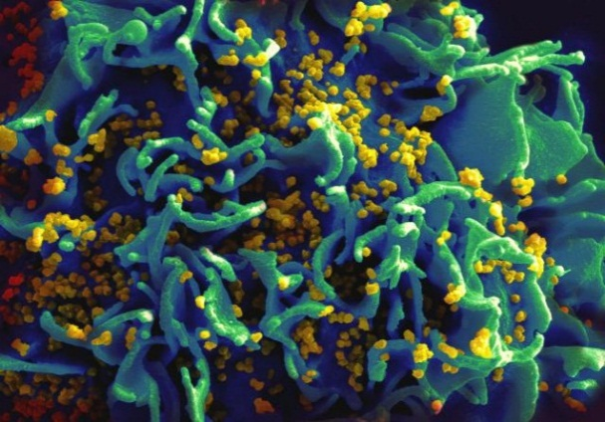
Effects of Exposure to Biological Hazards
Hepatitis C
Mild
  Allergic reaction
Serious
  Tetanus
  Swine Flu
  SARS
  Avian Flu
  West Nile
  Lyme Disease
Chronic/Terminal
  HIV
  Hepatitis B & C
Source: OSHA
HIV-infected H9 T cell
Source: NIAID
Notes:
1. Relatively mild, allergic reactions
2. Serious medical conditions, even death
3. Most virulent and prevalent biological agents – anthrax, avian flu, bloodborne pathogens, botulism, floodborne disease, hantavirus, Legionnaires disease, mold, plague, ricin, SARS, smallpox, tularemia, viral hemorrhagic fevers

Slide 17

Protection Against Biological Hazards
Practice precaution with:
  Blood
  Bodily fluids
  Animals
  Insects
Personal hygiene
Proper first aid
  Cuts/Scratches
Proper PPE
Vaccinations – schedule
Source: U.S. Army Corps of Engineers
Notes:
In order to limit your exposure to airborne mold, wear at a minimum an N-95 respirator; for higher level of protection use a 99 or 100 (H EPA) rated filter. If oil is present in the air then make sure to use either an R or a P designated filter
The NIOSH minimum recommendation for respiratory protection for workers remediating dusty areas contaminated with highly infectious Histoplasma capsulatum spores (from bird and bat manure) is a full-facepiece respirator (APF 50).
Get vaccinated for hepatitis B and follow the universal precautions towards bloodborne pathogens. Also, practice good hygiene; hands must be washed after using toilet facilities and before preparing food
There is no vaccine against HIV – prevention is the only defense against the virus! (OSHA)

Slide 18

Ergonomic Hazards in Construction
Lifting and pushing
  Heavy
  Awkward
  Repetitive
Awkward grips and postures
Reaching
Using wrong tool or using tool improperly
Using excessive force
  Overexertion
Source: OSHA
Notes:
Types of ergonomic hazards
1. Associated with a range of tasks, including, but not limited to, lifting, holding, pushing, walking, and reaching
2. Examples of ergonomic hazards:
a. Heavy, frequent, or awkward lifting
b. Awkward grips
c. Poorly designed tools or workstations
d. Repetitive and intensive work (OSHA)

Slide 19
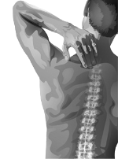
Effects of Exposure to Ergonomic Hazards
Musculoskeletal Disorders (MSDs)
Mild
  Joint pain
  Swelling
  Sciatica
  Acute lower back pain
Serious
  Epicondylitis (Tennis Elbow)
  Raynaud’s Phenomenon (White finger)
  Thoracic Outlet Syndrome
  Carpal Tunnel Syndrome
  Chronic lower back pain
  Tears (Rotator cuff is common)
Source: OSHA
Notes:
Effects of exposure to ergonomic hazards
1. Musculoskeletal Disorders (MSDs)
a. Early indications – persistent pain, restriction of joint movement, soft tissue swelling
b. MSD conditions – low back pain, sciatica, rotator cuff injuries, epicondylitis, carpal tunnel syndrome, tendinitis
c. One of the leading causes of workday injury and illnesses (OSHA)
- Epicondylitis = soreness or pain on the outside (lateral) side of the upper arm near the elbow
- Raynaud’s Phenomenon = a condition in which cold temperatures or strong emotions cause blood vessel spasms. This blocks blood flow to the fingers, toes, ears, and nose.
- Thoracic Outlet Syndrome = a rare condition that involves pain in the neck and shoulder, numbness and tingling of the fingers, and a weak grip. The thoracic outlet is the area between the rib cage and collar bone.
Sources:
[Epicondylitis] http://www.nlm.nih.gov/medlineplus/ency/article/000449.htm
[Raynaud’s Phenomenon] http://www.nlm.nih.gov/medlineplus/ency/article/000412.htm
[Thoracic Outlet Syndrome] http://www.nlm.nih.gov/medlineplus/ency/article/001434.htm

Slide 20
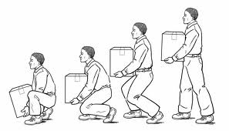
Protection Against Ergonomic Hazards
Use ergonomically designed tools
Use correct work practices
  Proper lifting techniques
  Work station setup
Ask for help when handling:
  Heavy loads
  Bulky/Awkward materials
Proper PPE
Source: Boston University (bu.edu/wellness/workplace/ergonomic)
Notes:
Methods of protecting workers against exposure to ergonomic hazards
1. Use correct work practices, such as lifting techniques
2. Ask for help when handling heavy, bulky materials
3. Use tools ergonomically designed for job
4. Worksite analysis and design of workstation
5. PPE

Slide 21

Employer Requirements
Abide by OSHA regulations
  Permissible Exposure Limits (PELs) for all chemicals
  Monitoring and protection programs
  Hazard Communication Program (HAZCOM)
    Worker right to know
    Hazardous chemical training
    Written plan (Who, What, Where)
    Proper chemical labeling
    SDS
Source: OSHA
Notes:
Taken from Section VI of Health Hazards Lesson Plan -- Employer Requirements:
OSHA sets enforceable permissible exposure limits (PEL) to protect workers against the health effects of exposure to hazardous substances. PELs are regulatory limits on the amount or concentration of a substance in the air. They may also contain a skin designation. OSHA PELs are based on an 8-hour time weighted average (TWA) exposure.
B. Employees potentially exposed to a substance with a specific standard (example lead, asbestos, etc.) must be monitored and protected in accordance with that specific standard.
C. Hazard Communication Program
1. Worker right to know
2. Training related to hazardous chemicals to which workers are exposed
3. Written plan
a. Chemical present at workplace
b. Indication of who is responsible for various aspects of the program at the worksite
c. Indication of where written materials will be available to employees
d. Labeling and Safety Data Sheets (SDS)
=============================================================
EMPLOYERS:
Must furnish employees a place of employment free from recognized hazards.
Must comply with the occupational safety and health standards issued under the OSH Act. (OSHA)

Slide 22
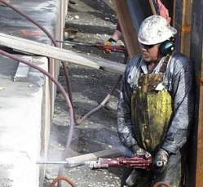
Multiple health hazards
In some cases, workers can be exposed to several health hazards at the same time or on the same worksite over time.
Source: OSHA
This worker is simultaneously exposed to noise, silica dust, vibration, and ergonomic hazards.

Slide 23
Knowledge Check
Which of the following is a common type of health hazard:
  Chemical hazards
  Economic hazards
  Electrical hazards
  Fall hazards
  a. Chemical hazards

Slide 24
Knowledge Check
Which of the following is an example of a physical health hazard:
  Asbestos
  Noise
  Silica
  Lead
  b. Noise

Slide 25
Knowledge Check
Which is an appropriate engineering control for protection against noise exposures:
  Audiograms
  Earplugs
  Increasing distance between source
  Constructing sound barriers
  d. Constructing sound barriers

Slide 26
Knowledge Check
Which is a requirement of the employer:
  Determine if workers’ exposures exceed OSHA PELs
  Perform medical evaluations on all employees
  Develop silica training programs for all employees
  Provide all workers with safety toe protective footwear
  a. Determine if workers exposures exceed OSHA PELs

Slide 27
Health Hazards in Construction
Questions?

