Slide 1
Personal Protective Equipment
10-Hour Construction Outreach

Slide 2
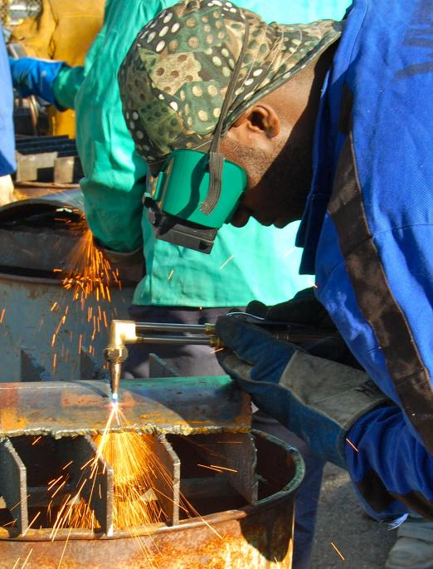
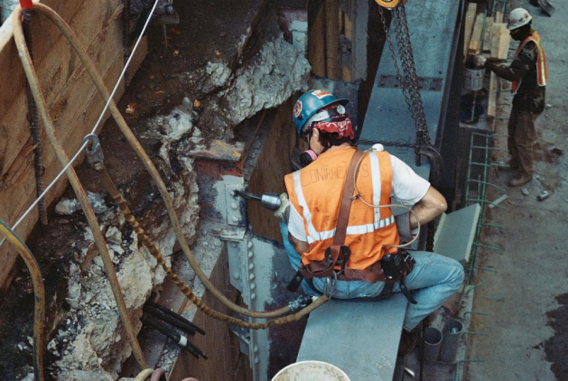
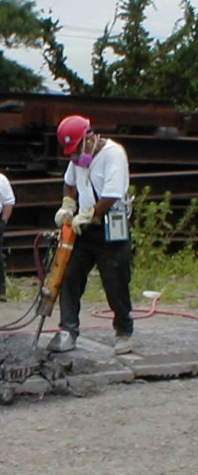
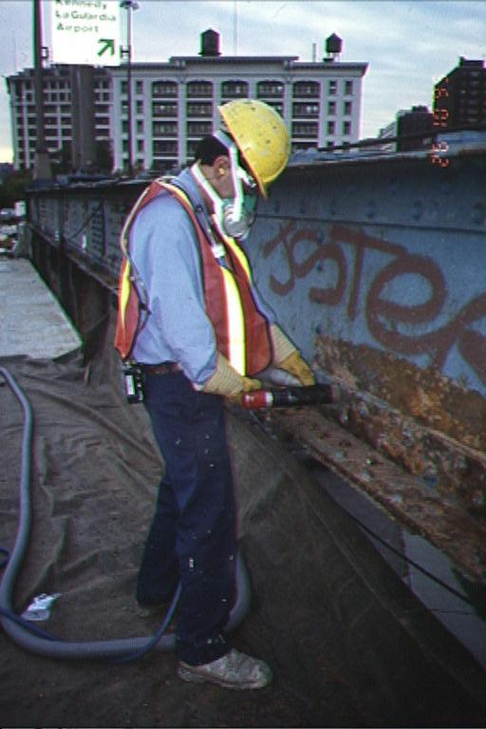
Personal Protective Equipment
Source of photos: Mount Sinai/CHEP/elcosh.org
Notes:
OSHA requires employees to protect their employees from workplace hazards through the use of engineering or work practice controls.
When these controls are not feasible or do not provide sufficient protection, the use of personal protective equipment (PPE) is required.

Slide 3
Personal Protective Equipment
Lesson Overview
Hierarchy of controls
Types of PPE
PPE Training Requirements
Employer and Employee Responsibilities
Hazard Recognition Activity
Notes:
Objectives:
Describe the hierarchy of controls as it relates to personal protective equipment.
Identify types of personal protective equipment utilized in construction.
Explain personal protective equipment training requirements.
Explain the responsibilities of employers and employees regarding personal protective equipment.

Slide 4
Protecting Employees
Employers must protect employees:
Assess workplace
Eliminate and reduce hazards using engineering and administrative controls
Then use appropriate personal protective equipment (PPE)
Remember, PPE is the last level of control!

Slide 5
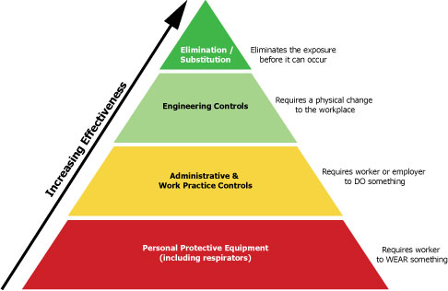
Protecting Employees
Source: OSHA
Notes:
The Hierarchy of Control Methods
Graphic illustrates the effectiveness of the systems used to prevent and control hazards.
Elimination/substitution
Provides the highest level of protection against hazards.
The hazard is eliminated from the workplace or a safer item/substance is substituted for the more hazardous item/substance.
Engineering controls are the second most effective means of protecting employees from hazards, followed by administrative and work practice controls.
PPE - last resort; it is least effective

Slide 6
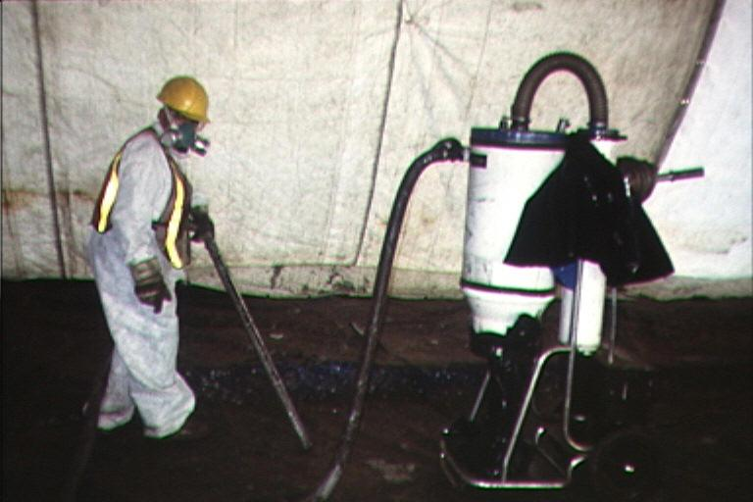
Engineering Controls
Physical changes to workplace
Isolation
Ventilation
Equipment modification
Others
Mount Sinai/CHEP/elcosh.org
Notes:
Engineering controls
Requires a physical change to the workplace
Based on the following principles: (OSHA 2001)
If feasible, design the facility, equipment, or process to remove the hazard.
If removal is not feasible, enclose the hazard to prevent exposure in normal operations.
Where complete enclosure is not feasible, establish barriers or local ventilation to reduce exposure to the hazard in normal operations.
Examples
Isolation – hazard is enclosed prohibiting exposure to worker
Ventilation – air exchanges to reduce atmospheric hazards
Equipment modifications – reduce the hazard through design of the equipment or attachments (Examples: reduced vibration, dust collection system, noise reduction, etc.)
https://www.osha.gov/SLTC/etools/safetyhealth/comp3.html

Slide 7
Administrative Controls
Requires worker to do something
Proper procedures
Inspection and maintenance
Housekeeping
Supervision
Regulated areas
Limit exposure by time or distance
Notes:
Administrative Controls
Includes work practices
Requires the worker or employer to do something
Examples
Proper procedures – workplace rules and other operation-specific rules
Inspection and maintenance – regularly inspect tools and equipment; keep them well maintained; remove from service any damaged or broken items
Housekeeping
Supervision
Regulated areas – designate areas for lunch and break times; no eating, drinking, smoking, chewing tobacco or gum, and applying cosmetics in workplace
Limit exposure by time and distance – shorten amount of time a worker is exposed to task involving the hazard; distance hazard from workers

Slide 8
Administrative Controls
Example: Noise Exposure
  Operate noisy machines during shifts when fewer people are exposed
  Limit the amount of time a person spends at a noise source
  Provide quiet areas where workers can gain relief from hazardous noise sources
  Control noise exposure through distance
Notes:
Examples of administrative controls that could be used to reduce noise exposure are listed here. (Note: noise protection will be further discussed later in this presentation)

Slide 9
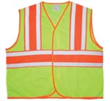

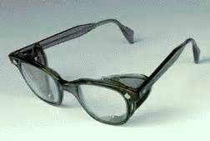
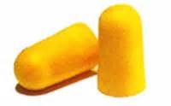
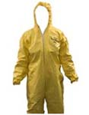
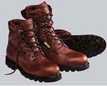
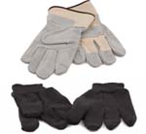
Types of PPE
Source of photos: OSHA
Notes:
“When exposure to hazards cannot be engineered completely out of normal operations or maintenance work, and when safe work practices and other forms of administrative controls cannot provide sufficient additional protection, a supplementary method of control is the use of protective clothing or equipment. This is collectively called personal protective equipment, or PPE. PPE may also be appropriate for controlling hazards while engineering and work practice controls are being installed” (OSHA 2001).
https://www.osha.gov/SLTC/etools/safetyhealth/comp3.html
The type of PPE needed by workers depends on the hazards to which they are exposed.

Slide 10

Head Protection
Frequent Causes of Head Injuries:
  Object striking head
  Head striking object
  Contact with exposed, energized electrical conductors
Source: OSHA
Notes:
https://www.osha.gov/Publications/osha3151.html
“Protecting employees from potential head injuries is a key element of any safety program. A head injury can impair an employee for life or it can be fatal. Wearing a safety helmet or hard hat is one of the easiest ways to protect an employee's head from injury. Hard hats can protect employees from impact and penetration hazards as well as from electrical shock and burn hazards.
Employers must ensure that their employees wear head protection if any of the following apply:
Objects might fall from above and strike them on the head;
They might bump their heads against fixed objects, such as exposed pipes or beams; or
There is a possibility of accidental head contact with electrical hazards.”
(OSHA Publication 3151-12R, 2003)

Slide 11
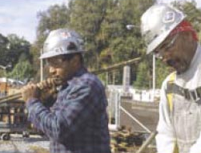
Classes of Hard Hats
Class G (General)
  General service (e.g., building construction, shipbuilding, lumbering, and manufacturing)
  Good impact protection
  Limited voltage protection
  (proof-tested at 2,200 volts)
Source: OSHA
Notes:
https://www.osha.gov/Publications/osha3151.html
“There are many types of hard hats available in the marketplace today. In addition to selecting protective headgear that meets ANSI standard requirements, employers should ensure that employees wear hard hats that provide appropriate protection against potential workplace hazards. It is important for employers to understand all potential hazards when making this selection, including electrical hazards. This can be done through a comprehensive hazard analysis and an awareness of the different types of protective headgear available.”
(OSHA Publication 3151-12R, 2003)
Class G hard hats are intended for general service use, such as building construction, shipbuilding, lumbering, and manufacturing. Class G hard hats provide good impact protection, but limited voltage protection (proof-tested at 2,200 volts).

Slide 12
Classes of Hard Hats
Class E (Electrical)
  Electrical work
  Protect against falling objects
  Protect against high-voltage shock/burns (proof-tested at 20,000 volts)
Notes:
Class E hard hats are designed for electrical/utility work. They protect against falling objects and provide protection against conductors with higher voltage levels (proof-tested at 20,000 volts).

Slide 13
Classes of Hard Hats
Class C (Conductive)
  Designed for comfort, offers limited protection
  Protects heads that may bump against fixed objects
  Does not protect against falling objects or electrical hazards
Notes:
Class C hard hats provide limited protection, mostly from bumps against fixed objects. Class C hard hats do not provide any protection against electrical hazards.

Slide 14
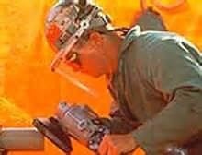
Eye and Face Protection
Common Causes of Eye Injuries
  Dust
  Flying particles
  Harmful chemicals
  Intense light
    Welding
    Lasers
Source: OSHA
Notes:
https://www.osha.gov/Publications/osha3151.html
“Employees can be exposed to a large number of hazards that pose danger to their eyes and face. OSHA requires employers to ensure that employees have appropriate eye or face protection if they are exposed to eye or face hazards from flying particles, molten metal, liquid chemicals, acids or caustic liquids, chemical gases or vapors, potentially infected material or potentially harmful light radiation.”
(OSHA Publication 3151-12R, 2003)
1926.102(a)(2)
Eye and face protection equipment required by this Part shall meet the requirements specified in American National Standards Institute, Z87.1-1968, Practice for Occupational and Educational Eye and Face Protection.

Slide 15
Safety Glasses
Selecting eye and face protection:
  Meet requirements of ANSI Z87
  Elements to consider
    Ability to protect
    Fit and comfort
    Vision and movement not restricted
    Durable and cleanable
    Other PPE not restricted
Notes:
1926.102(a)(2)
Eye and face protection equipment required by this Part shall meet the requirements specified in American National Standards Institute, Z87.1-1968, Practice for Occupational and Educational Eye and Face Protection.
https://www.osha.gov/Publications/osha3151.html
“Selecting the most suitable eye and face protection for employees should take into consideration the following elements:
Ability to protect against specific workplace hazards.
Should fit properly and be reasonably comfortable to wear.
Should provide unrestricted vision and movement.
Should be durable and cleanable.
Should allow unrestricted functioning of any other required PPE.”
(OSHA Publication 3151-12R, 2003)

Slide 16
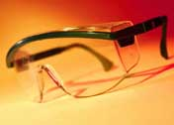
Safety Glasses
Protect against:
  Flying particles from wood, metal, cement, plastics, or other materials
  Airborne particulates such as ashes, dust, embers, sand blast, grit, paint,
  or other materials
Source: OSHA
Notes:
https://www.osha.gov/SLTC/etools/eyeandface/ppe/impact.html#spectacles
“Safety spectacles are intended to shield the wearer's eyes from impact hazards such as flying fragments, objects, large chips, and particles. Workers are required to use eye safety spectacles with side shields when there is a hazard from flying objects. Non-side shield spectacles are not acceptable eye protection for impact hazards.
The frames of safety spectacles are constructed of metal and/or plastic and can be fitted with either corrective or plano impact-resistant lenses. Side shields may be incorporated into the frames of safety spectacles when needed. Consider each component of safety spectacles when selecting the appropriate device for your workplace.”
(OSHA Eye and Face Protection eTool, 2002)

Slide 17
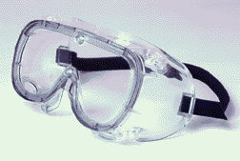
Goggles
Protect eyes, eye sockets and facial area around eyes from impact, dust, & splashes
Goggles or other eye protection
  may fit over corrective lenses
  may not interfere with the function of the glasses
Source: OSHA
Notes:
https://www.osha.gov/Publications/osha3151.html
Googles “are tight-fitting eye protection that completely cover the eyes, eye sockets and the facial area immediately surrounding the eyes and provide protection from impact, dust and splashes. Some goggles will fit over corrective lenses.”
(OSHA Publication 3151-12R, 2003)
https://www.osha.gov/SLTC/etools/eyeandface/ppe/impact.html#goggles
“Safety goggles are intended to shield the wearer's eyes from impact hazards such as flying fragments, objects, large chips, and particles. Goggles fit the face immediately surrounding the eyes and form a protective seal around the eyes. This prevents objects from entering under or around the goggles.
Safety goggles may incorporate prescription lenses mounted behind protective lenses for individuals requiring vision correction. Take time to consider specific lens, frame, and ventilation options when selecting safety goggles.”
(OSHA Eye and Face Protection eTool, 2002)

Slide 18
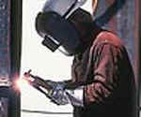
Welding Shields
Protect eyes from burns
  Infrared light
  intense radiant light
Protect face and eyes from
  flying sparks
  metal spatter slag
Source: OSHA
Notes:
https://www.osha.gov/Publications/osha3151.html
“Constructed of vulcanized fiber or fiberglass and fitted with a filtered lens, welding shields protect eyes from burns caused by infrared or intense radiant light; they also protect both the eyes and face from flying sparks, metal spatter and slag chips produced during welding, brazing, soldering and cutting operations. OSHA requires filter lenses to have a shade number appropriate to protect against the specific hazards of the work being performed in order to protect against harmful light radiation.”
(OSHA Publication 3151-12R, 2003)

Slide 19
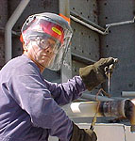
Face Shields
Protect face from nuisance
dusts and potential splashes
or sprays of hazardous liquids
Shields do not protect from
impact hazards unless so rated
Shields are for face protection, not eye protection. To protect the eyes, wear safety glasses with side shields under the face shield.
Source: OSHA
Notes:
https://www.osha.gov/SLTC/etools/eyeandface/ppe/impact.html#faceshields
“Face shields are intended to protect the entire face or portions of it from impact hazards such as flying fragments, objects, large chips, and particles. When worn alone, face shields do not protect employees from impact hazards. Use face shields in combination with safety spectacles or goggles, even in the absence of dust or potential splashes, for additional protection beyond that offered by spectacles or goggles alone.”
(OSHA Eye and Face Protection eTool, 2002)

Slide 20
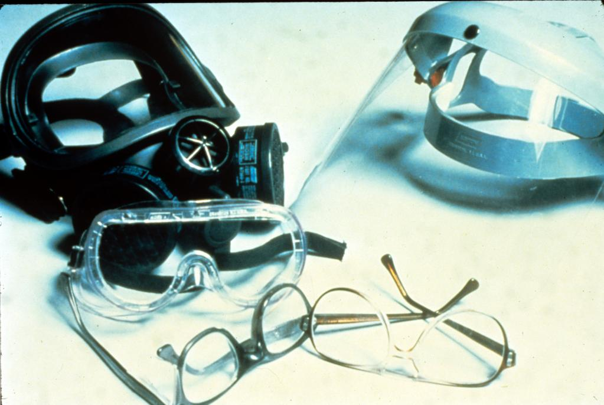
Warning: Employees Who Wear Corrective Lenses
Workers who wear prescription glasses must also wear required eye protection.
NIOSH/John Rekus/elcosh.org
Notes:
https://www.osha.gov/SLTC/etools/eyeandface/employer/requirements.html
“Employers must ensure that employees who wear prescription (Rx) lenses or contacts use personal protective equipment (PPE) that incorporates the prescription or use eye protection that can be worn over prescription lenses.
Workers who wear prescription glasses must also wear required eye protection.
Eye and face protection that fits comfortably over glasses is available.
Safety goggles and spectacles may incorporate prescription lenses.
Dust and chemicals present additional hazards to contacts wearers. OSHA recommends that workers have an extra pair of contacts or eyeglasses in case of contact failure or loss.”
(OSHA Eye and Face Protection eTool, 2002)

Slide 21
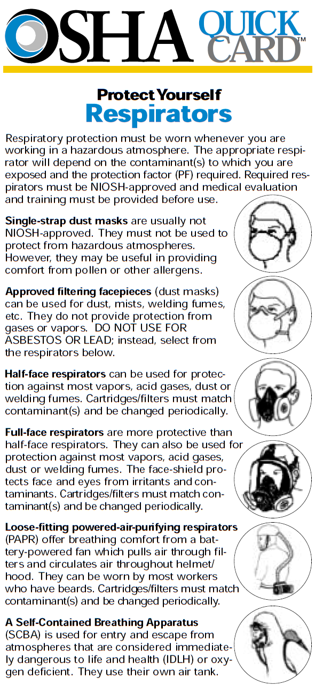

Respiratory Protection
Source: OSHA
Notes:
https://www.osha.gov/SLTC/etools/respiratory/respirator_selection.html
“In order to select an appropriate respirator you must:
Conduct an exposure assessment to determine the type and amount of hazardous exposure
Take into account the factors that can influence respirator selection such as job-site and worker characteristics
Understand the assigned protection factors
Know the various kinds of respirators and their relevant characteristics.”
(OSHA Respiratory Protection eTool 1998)

Slide 22
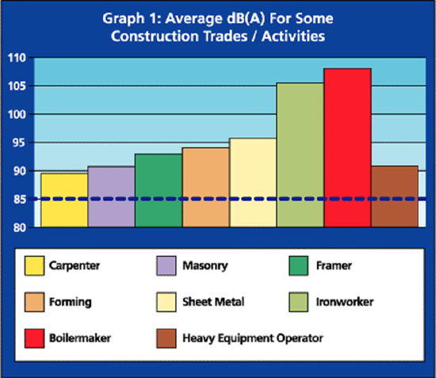
Hearing Protection
Exposure to over 85 dB can cause hearing loss
Hearing protection required at 90 dB
Effective Hearing Conservation Program
Source: Construction Safety Association of Ontario
Notes:
https://www.osha.gov/dts/osta/otm/noise/index.html
“Noise, or unwanted sound, is one of the most common health problems in American workplaces. The National Institute for Occupational Safety and Health (NIOSH) estimates that 30 million workers in the U.S. are exposed to hazardous noise. Exposure to high levels of noise may cause hearing loss, create physical and psychological stress, reduce productivity, interfere with communication, and contribute to accidents and injuries by making it difficult to hear warning signals.
OSHA requires employers to determine if workers are exposed to excessive noise in the workplace. If so, the employers must implement feasible engineering or administrative controls to eliminate or reduce hazardous levels of noise. Where controls are not sufficient, employers must implement an effective hearing conservation program.”
(OSHA Noise and Hearing Conservation eTool, 2005)

Slide 23
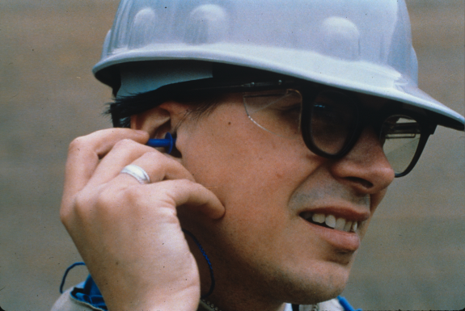
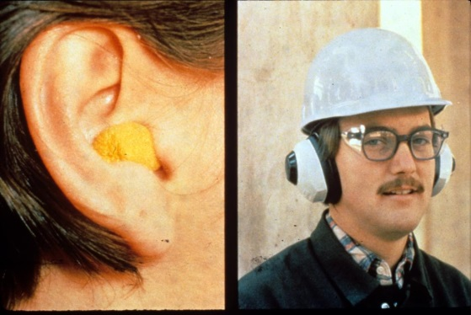
Hearing Protection
Examples
  Disposable foam plugs
  Molded ear plugs
  Noise cancelling ear plugs
  Ear muffs
Consider Noise Reduction Rating (NRR) of devices
NIOSH/John Rekus/elcosh.org
NIOSH/John Rekus/elcosh.org
Notes:
https://www.osha.gov/dts/osta/otm/noise/index.html
“Hearing protection devices (HPDs) are considered the last option to control exposures to noise. HPDs are generally used during the necessary time it takes to implement engineering or administrative controls, or when such controls are not feasible.”
(OSHA Noise and Hearing Conservation eTool, 2005)
This slide shows some examples of hearing protection devices.
https://www.osha.gov/dts/osta/otm/new_noise/appendixe.pdf
The Noise Reduction Rating of hearing protectors is required labeling on the hearing protector package; manufacturers must identify the noise reduction capability of the product through “laboratory-derived numerical estimate of the attenuation achieved by the protector” (OSHA n.d.).

Slide 24
Hand and Arm Protection
Employers must provide hand protection when employees are exposed to hazards
  Skin absorption of harmful substances
  Severe cuts or lacerations
  Severe abrasions
  Punctures
  Chemical and thermal burns
  Harmful temperature extremes
Notes:
https://www.osha.gov/Publications/osha3151.html
“If a workplace hazard assessment reveals that employees face potential injury to hands and arms that cannot be eliminated through engineering and work practice controls, employers must ensure that employees wear appropriate protection. Potential hazards include skin absorption of harmful substances, chemical or thermal burns, electrical dangers, bruises, abrasions, cuts, punctures, fractures and amputations. Protective equipment includes gloves, finger guards and arm coverings or elbow-length gloves.”
(OSHA Publication 3151-12R, 2003)

Slide 25
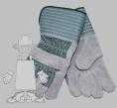
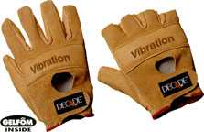
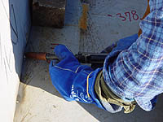

Types of Gloves
Anti-vibration
Leather Palm
Heat Resistant
Permeation Resistant
Cut Resistant
Source of photos: OSHA
Notes:
https://www.osha.gov/Publications/osha3151.html
“There are many types of gloves available today to protect against a wide variety of hazards. The nature of the hazard and the operation involved will affect the selection of gloves. The variety of potential occupational hand injuries makes selecting the right pair of gloves challenging. It is essential that employees use gloves specifically designed for the hazards and tasks found in their workplace because gloves designed for one function may not protect against a different function even though they may appear to be an appropriate protective device.
The following are examples of some factors that may influence the selection of protective gloves for a workplace. Type of chemicals handled.
Nature of contact (total immersion, splash, etc.).
Duration of contact.
Area requiring protection (hand only, forearm, arm).
Grip requirements (dry, wet, oily).
Thermal protection.
Size and comfort.
Abrasion/resistance requirements.
Gloves made from a wide variety of materials are designed for many types of workplace hazards. In general, gloves fall into four groups:
Gloves made of leather, canvas or metal mesh;
Fabric and coated fabric gloves;
Chemical- and liquid-resistant gloves;
Insulating rubber gloves (See 29 CFR 1910.137 and the following section on electrical protective equipment for detailed requirements on the selection, use and care of insulating rubber gloves).”
(OSHA Publication 3151-12R, 2003)

Slide 26
Foot and Leg Protection
Causes of Foot Injuries
  Heavy objects
  Sharp objects
  Molten metal
  Hot surfaces
  Slippery or wet surfaces
  Electrical hazards
Notes:
https://www.osha.gov/Publications/osha3151.html
“Employees who face possible foot or leg injuries from falling or rolling objects or from crushing or penetrating materials should wear protective footwear. Also, employees whose work involves exposure to hot substances or corrosive or poisonous materials must have protective gear to cover exposed body parts, including legs and feet….
Examples of situations in which an employee should wear foot and/or leg protection include:
When heavy objects such as barrels or tools might roll onto or fall on the employee's feet;
Working with sharp objects such as nails or spikes that could pierce the soles or uppers of ordinary shoes;
Exposure to molten metal that might splash on feet or legs;
Working on or around hot, wet, or slippery surfaces; and
Working when electrical hazards are present.”
(OSHA Publication 3151-12R, 2003)

Slide 27
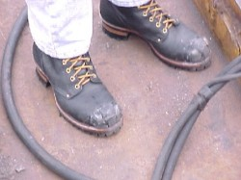
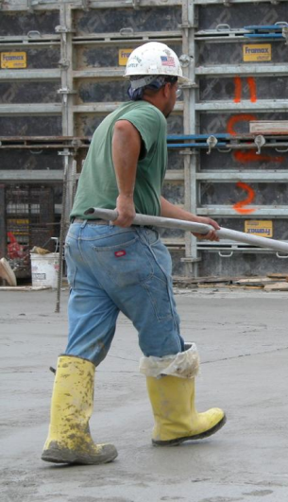
Foot and Leg Protection
Examples
  Impact-resistant toe and/or
  instep
    Steel
    Composite
  Heat-resistant soles
  Metal shanks
  Specialty footwear may be needed
    Metatarsal guards
    Liquid or chemical resistant
    Conductive or nonconductive
Source: OSHA
Steve Clark/Laborers/elcosh.org
Notes:
https://www.osha.gov/Publications/osha3151.html
“Safety shoes have impact-resistant toes and heat-resistant soles that protect the feet against hot work surfaces common in roofing, paving and hot metal industries. The metal insoles of some safety shoes protect against puncture wounds. Safety shoes may also be designed to be electrically conductive to prevent the buildup of static electricity in areas with the potential for explosive atmospheres or nonconductive to protect workers from workplace electrical hazards.”
“Metatarsal guards protect the instep area from impact and compression. Made of aluminum, steel, fiber or plastic, these guards may be strapped to the outside of shoes.”
“Electrically conductive shoes provide protection against the buildup of static electricity…. Employees exposed to electrical hazards must never wear conductive shoes.”
“Electrical hazard, safety-toe shoes are nonconductive and will prevent the wearers' feet from completing an electrical circuit to the ground. These shoes can protect against open circuits of up to 600 volts in dry conditions and should be used in conjunction with other insulating equipment and additional precautions to reduce the risk of a worker becoming a path for hazardous electrical energy. The insulating protection of electrical hazard, safety-toe shoes may be compromised if the shoes become wet, the soles are worn through, metal particles become embedded in the sole or heel, or workers touch conductive, grounded items. Note: Nonconductive footwear must not be used in explosive or hazardous locations.”
(OSHA Publication 3151-12R, 2003)

Slide 28
Body Protection
Causes of bodily injuries
  Intense heat
  Splashes of hot metals or hot liquids
  Impacts from tools, machinery, or materials
  Sharp objects
  Hazardous chemicals
  Contact with potentially infectious materials
  Radiation
Notes:
https://www.osha.gov/Publications/osha3151.html
“Employees who face possible bodily injury of any kind that cannot be eliminated through engineering, work practice or administrative controls, must wear appropriate body protection while performing their jobs. In addition to cuts and radiation, the following are examples of workplace hazards that could cause bodily injury:
Temperature extremes;
Hot splashes from molten metals and other hot liquids;
Potential impacts from tools, machinery and materials;
Hazardous chemicals. “
(OSHA Publication 3151-12R, 2003)

Slide 29
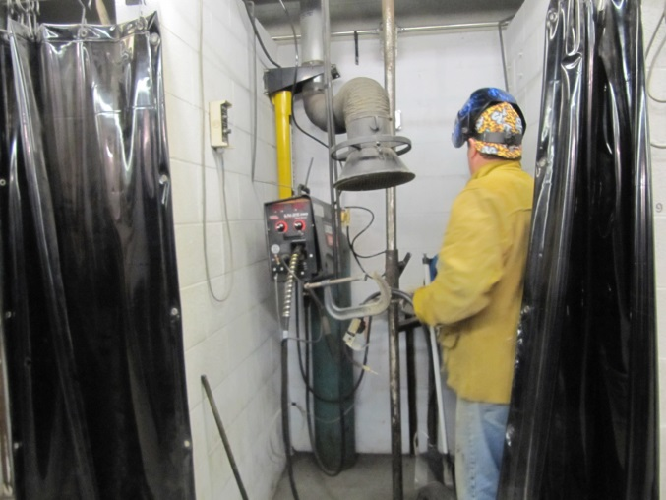
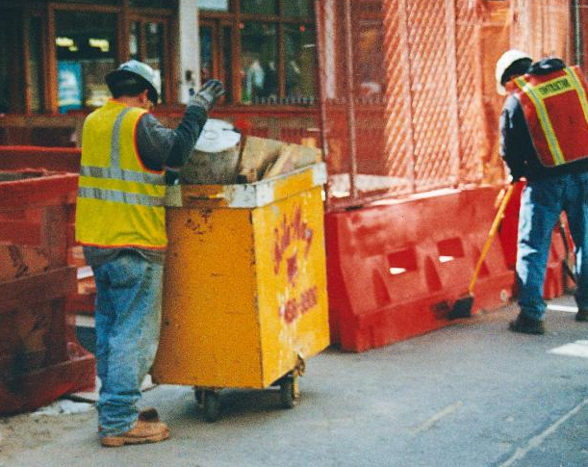
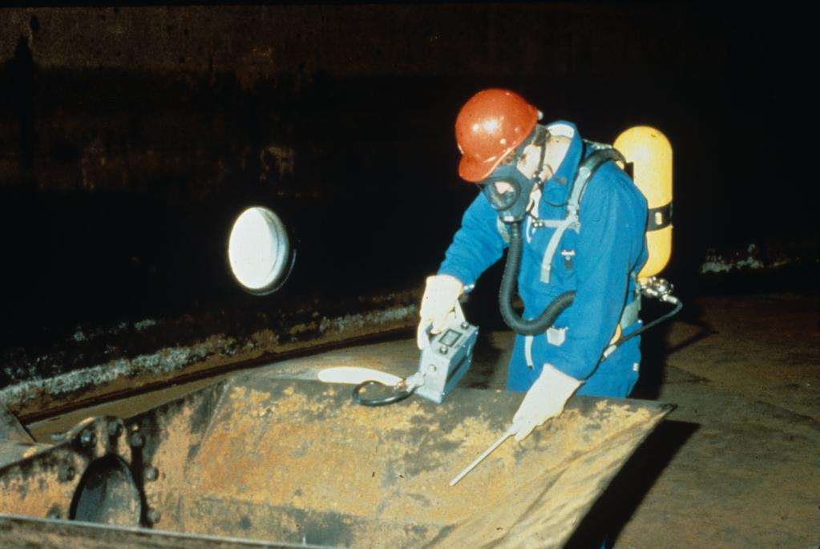
Body Protection
Mount Sinai/CHEP/elcosh.org
Mount Sinai/CHEP/elcosh.org
NIOSH/John Rekus/elcosh.org
Notes:
https://www.osha.gov/Publications/osha3151.html
“There are many varieties of protective clothing available for specific hazards. Employers are required to ensure that their employees wear personal protective equipment only for the parts of the body exposed to possible injury. Examples of body protection include laboratory coats, coveralls, vests, jackets, aprons, surgical gowns and full body suits.
If a hazard assessment indicates a need for full body protection against toxic substances or harmful physical agents, the clothing should be carefully inspected before each use, it must fit each worker properly and it must function properly and for the purpose for which it is intended.
Protective clothing comes in a variety of materials, each effective against particular hazards, such as:
Paper-like fiber used for disposable suits provide protection against dust and splashes.
Treated wool and cotton adapts well to changing temperatures, is comfortable, and fire-resistant and protects against dust, abrasions and rough and irritating surfaces.
Duck is a closely woven cotton fabric that protects against cuts and bruises when handling heavy, sharp or rough materials.
Leather is often used to protect against dry heat and flames.
Rubber, rubberized fabrics, neoprene and plastics protect against certain chemicals and physical hazards. When chemical or physical hazards are present, check with the clothing manufacturer to ensure that the material selected will provide protection against the specific hazard.”
(OSHA Publication 3151-12R, 2003)

Slide 30
Training
Why PPE is necessary
How PPE will protect the employee
What PPE can and cannot do
When and how to wear PPE
How to identify signs of wear and tear
How to clean and disinfect PPE
When PPE is worn out and how to properly dispose of PPE
Notes:
https://www.osha.gov/Publications/osha3151.html
“Employers are required to train each employee who must use PPE. Employees must be trained to know at least the following: When PPE is necessary.
What PPE is necessary.
How to properly put on, take off, adjust and wear the PPE.
The limitations of the PPE.
Proper care, maintenance, useful life and disposal of PPE.
Employers should make sure that each employee demonstrates an understanding of the PPE training as well as the ability to properly wear and use PPE before they are allowed to perform work requiring the use of the PPE. If an employer believes that a previously trained employee is not demonstrating the proper understanding and skill level in the use of PPE, that employee should receive retraining. Other situations that require additional or retraining of employees include the following circumstances: changes in the workplace or in the type of required PPE that make prior training obsolete.
The employer must document the training of each employee required to wear or use PPE by preparing a certification containing the name of each employee trained, the date of training and a clear identification of the subject of the certification.”
(OSHA Publication 3151-12R, 2003)

Slide 31
Responsibilities
Employers must:
  Assess hazards
  Select appropriate PPE and determine when to use
  Provide some PPE at no cost to employee
  Make sure that employee-owned PPE is adequate, properly maintained and sanitary
  Train employees and enforce use of PPE
Notes:
https://www.osha.gov/Publications/osha3151.html
“To ensure the greatest possible protection for employees in the workplace, the cooperative efforts of both employers and employees will help in establishing and maintaining a safe and healthful work environment.
In general, employers are responsible for:
Performing a "hazard assessment" of the workplace to identify and control physical and health hazards.
Identifying and providing appropriate PPE for employees.
Training employees in the use and care of the PPE.
Maintaining PPE, including replacing worn or damaged PPE.
Periodically reviewing, updating and evaluating the effectiveness of the PPE program.”
(OSHA Publication 3151-12R, 2003)
https://www.osha.gov/dte/outreach/intro_osha/7_employee_ppe.pdf
“On May 15, 2008, a new OSHA rule about employer payment for PPE went into effect. With few exceptions, OSHA now requires employers to pay for personal protective equipment used to comply with OSHA standards. The final rule does not create new requirements regarding what PPE employers must provide.
The standard makes clear that employers cannot require workers to provide their own PPE and the worker’s use of PPE they already own must be completely voluntary. Even when a worker provides his or her own PPE, the employer must ensure that the equipment is adequate to protect the worker from hazards at the workplace.
Examples of PPE that Employers Must Pay for Include:
Metatarsal foot protection
Rubber boots with steel toes
Non-prescription eye protection
Prescription eyewear inserts/lenses for full face respirators
Goggles and face shields
Fire fighting PPE (helmet, gloves, boots, proximity suits, full gear)
Hard hats
Hearing protection
Welding PPE
Payment Exceptions under the OSHA Rule
Employers are not required to pay for some PPE in certain circumstances:
Non-specialty safety-toe protective footwear (including steel-toe shoes or boots) and nonspecialty prescription safety eyewear provided that the employer permits such items to be worn off the job site. (OSHA based this decision on the fact that this type of equipment is very personal, is often used outside the workplace, and that it is taken by workers from jobsite to jobsite and employer to employer.)
Everyday clothing, such as long-sleeve shirts, long pants, street shoes, and normal work boots.
Ordinary clothing, skin creams, or other items, used solely for protection from weather, such as winter coats, jackets, gloves, parkas, rubber boots, hats, raincoats, ordinary sunglasses, and sunscreen
Items such as hair nets and gloves worn by food workers for consumer safety.
Lifting belts because their value in protecting the back is questionable.
When the employee has lost or intentionally damaged the PPE and it must be replaced.”
(OSHA Handout #7 from Introduction to OSHA materials, Employers Must Provide and Pay for PPE)

Slide 32
Responsibilities
Employees must:
  Actively participate in training
  Consistently use PPE as prescribed
  Properly maintain, inspect, clean, and store PPE
  Immediately replace damaged PPE
Notes:
https://www.osha.gov/Publications/osha3151.html
“In general, employees should:
Properly wear PPE,
Attend training sessions on PPE,
Care for, clean and maintain PPE, and
Inform a supervisor of the need to repair or replace PPE.”
(OSHA Publication 3151-12R, 2003)

Slide 33
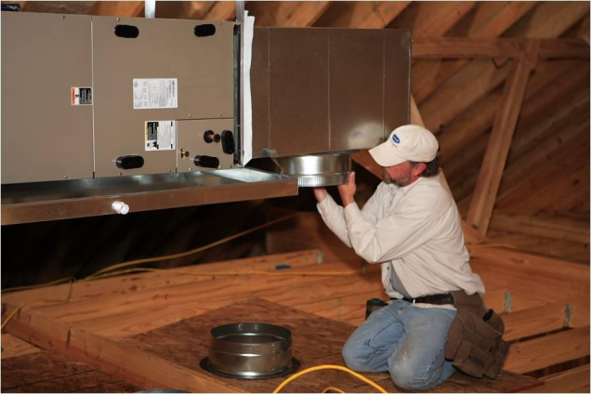
Hazard Recognition
Identify hazards and PPE needed
Southwest OSHA Training Institute Education Center/elcosh.org
Notes:
Hazard identification and PPE needed:
Floor opening with fall hazard; sharp edges on sheet metal; bump hazard overhead; potential confined space hazard
PPE needed: fall protection; gloves, goggles, hard hat,

Slide 34
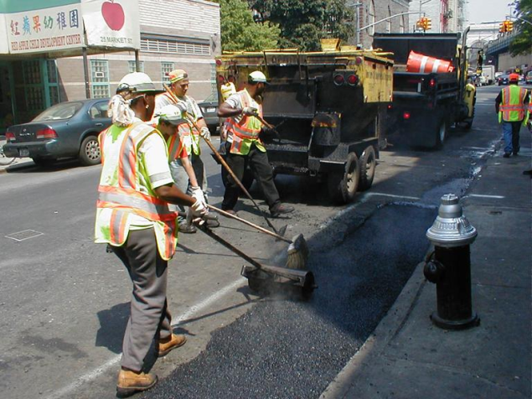
Hazard Recognition
Identify hazards and PPE needed
Mount Sinai/CHEP/elcosh.org
Notes:
Hazard identification and PPE needed:
Workers may be exposed traffic hazards, noise, weather conditions (heat);
Highly visible/reflective vests, hearing protection, heat-resistant soles on shoes, eye protection, gloves

Slide 35
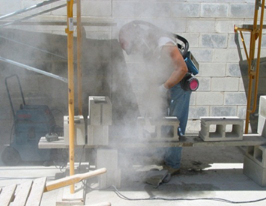
Hazard Recognition
Identify hazards and PPE needed
Source: OSHA
Notes:
Hazard identification and PPE needed:
Worker may be exposed to respirable crystalline silica, flying particles, and noise hazards;
Respiratory protection, eye protection, and hearing protection needed.
(Note: worker may also be exposed to ergonomic hazards)

Slide 36
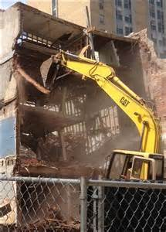
Hazard Recognition
Identify hazards and PPE needed
Source : OSHA
Notes:
Hazard identification and PPE needed:
Workers may be exposed to hazardous materials (including lead, asbestos, silica, and other chemicals or heavy metals), noise, struck-by hazards;
PPE needed may include eye, face, head, hand, and foot protection, respiratory protection, hearing protection, and other protective clothing (such as for cutting and welding operations).

Slide 37
Always Remember
Employers must:
  Assess the workplace for hazards
  Use engineering and work practice controls to eliminate or reduce hazards
  Select and provide appropriate PPE at no cost to employees to protect them

Slide 38
Knowledge Check
Who is responsible for providing PPE?
  The employer
  The employee
  OSHA
  Workers’ Compensation
a. The employer

Slide 39
Knowledge Check
Common causes of foot injuries include: crushing, penetration, molten metal, chemicals, slippery surfaces, and sharp objects.
  True
  False
  a. True

Slide 40
Knowledge Check
Safety controls must meet the following order of priority:
  Substitution, PPE, workaround, and administrative
  Workaround, stop work, PPE, and engineering
  Stop work, PPE, engineering, and substitution
  Substitution, engineering, administrative, and PPE
d. Substitution, engineering, administrative, and PPE

Slide 41
Knowledge Check
Which type of hard hat would provide the most protection from electrical hazards?
  Class A
  Class C
  Class E
  Class G
c. Class E

Slide 42
Knowledge Check
The need for hearing protection is triggered at which decibel level?
  When it exceeds 80 decibels
  When it exceeds 90 decibels
  When it exceeds 100 decibels
  When it exceeds 110 decibels
b. When it exceeds 90 decibels

Slide 43
Knowledge Check
Who is responsible for providing specialized work footwear?
  The employer
  The employee
  OSHA
  Insurance companies
a. The employer

Slide 44
Knowledge Check
Which of the following is considered approved eye protection?
  Sun glasses
  Prescription glasses
  Reading glasses
  Glasses meeting ANSI standard Z87
  d. Glasses meeting ANSI standard Z87

Slide 45
Knowledge Check
Which of the following is not considered PPE?
  Rubber gloves
  Glasses meeting ANSI Z87
  Sports shoes
  Hearing muffs
c. Sports shoes

