Slide 1
Scaffolds
10-Hour Construction Outreach

Slide 2
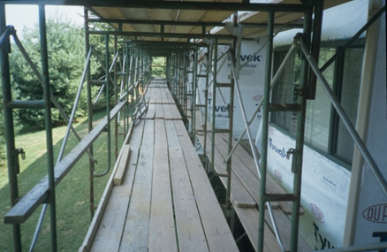
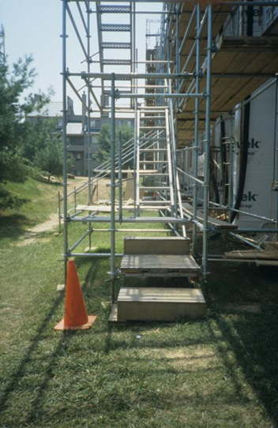
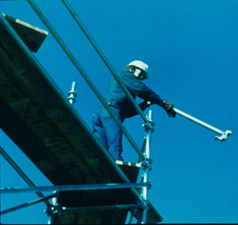
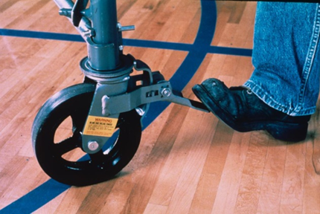
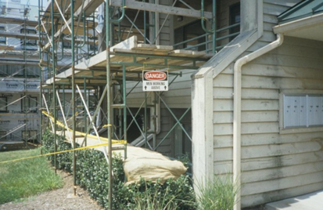
Scaffolds
source: www.elcosh.org/NIOSH/John Rekus
Notes:
Approximately 65% of construction workers frequently work on scaffolds. Scaffold-related accidents account for approximately 4,500 injuries and 50 fatalities every year.
“In a Bureau of Labor and Statistics (BLS) study, 72% of workers injured in scaffold accidents attributed the accident either to the planking or support giving way, or to the employee slipping or being struck by a falling object.” (OSHA SLTC)

Slide 3
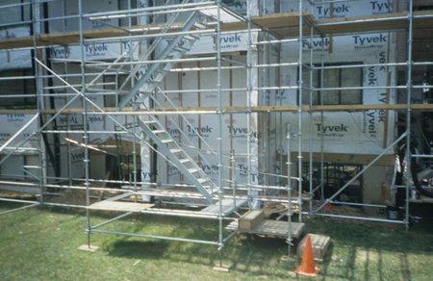
Scaffolds
Lesson Overview
  Competent person
  Basic types of scaffolds
  Scaffold hazards
  Methods of protecting against scaffold hazards
  Employer requirements
NIOSH/John Rekus/elcosh.org
Notes:
Enabling Objectives:
Describe the role of a competent person related to scaffolding.
Identify the types of scaffolds commonly used on construction sites.
Describe hazards associated with scaffolds.
Discuss methods to prevent hazards associated with scaffolds.
Recognize employer requirements to protect workers from scaffold hazards.

Slide 4
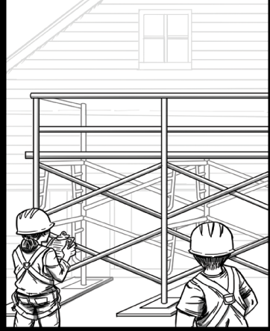
Competent Person
Oversees assembly, disassembly, inspection, and safe use of scaffolds
Trains all employees who erect, disassemble, move, operate, repair, maintain, inspect, or work on scaffolds
Source: OSHA
Notes:
CFR 1926.450(b) Definitions. Competent person means one who is capable of identifying existing and predictable hazards in the surroundings or working conditions which are unsanitary, hazardous, or dangerous to employees, and who has authorization to take prompt corrective measures to eliminate them.

Slide 5
Competent Person
Process for designating an employee as the competent person:
  Employer appointed
  Capability to identify hazards
  Executes qualified person design
  Authority to take prompt corrective action

Slide 6
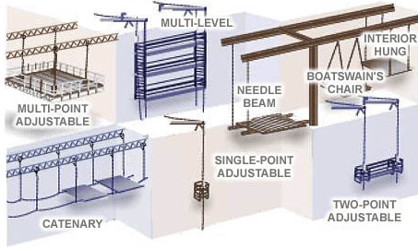
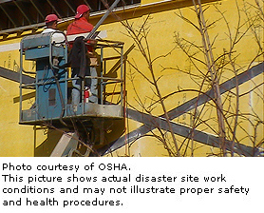
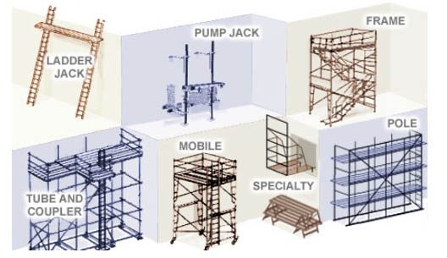
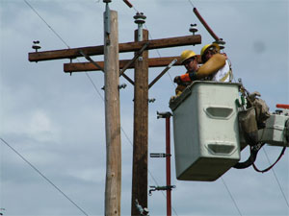
Basic Types of Scaffolds
Suspended
Supported
Aerial lifts
Source: OSHA
Notes:
CFR 1926.450(b) Definitions.
Supported scaffold means one or more platforms supported by outrigger beams, brackets, poles, legs, uprights, posts, frames, or similar rigid support.
Suspension scaffold means one or more platforms suspended by ropes or other non-rigid means from an overhead structure(s).
CFR 1926.453(a)(1)(i-v)
Aerial lifts include the following types of vehicle-mounted aerial devices used to elevate personnel to job-sites above ground:
Extensible boom platforms;
Aerial ladders;
Articulating boom platforms;
Vertical towers;
A combination of any such devices.
Aerial equipment may be made of metal, wood, fiberglass reinforced plastic (FRP), or other material; may be powered or manually operated; and are deemed to be aerial lifts whether or not they are capable of rotating about a substantially vertical axis.

Slide 7

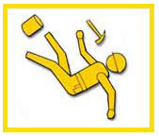
Hazards Associated with Scaffolds
Falls
Falling object(s)
Electrical hazards
Collapse hazards
Planking hazards
Weather conditions
Collisions or struck-by
Source: OSHA
Notes:
Falls – slips, unsafe access, lack of fall protection, or failure of scaffold platforms or planks are factors that lead to fall incidents.
Falling object(s) – materials, debris, or tools may fall from a scaffold at any time and hit workers below.
Electrical hazards – work on scaffolds near power lines exposes workers to electric shock or electrocution.
Collapse hazards – scaffolds can collapse if not secured, level, or stable or if they are overloaded.
Planking hazards – planks that are in poor condition (cracked, dry-rot, or otherwise weakened) or planks that are not placed properly are hazardous due to potential for failure or for people/objects to fall through them.
Weather conditions – rain, snow, wind, lightning
Collisions or struck by a construction vehicle or MV which could lead to tip-over

Slide 8
Reducing and Eliminating Hazards
Proper access
Guardrails
Personal Fall Arrest System (PFAS)
Protection from falling objects
Protection from electrical hazards
Precautions for moving scaffolds
Safe scaffold construction and disassembly

Slide 9
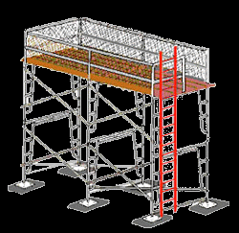
Proper Access
Required when platforms are more than two feet above or below a point of access
Examples of permitted access - ladders, stair towers, ramps, walkways
Do not use crossbraces or
unapproved ladder-like
ends for access
Source: OSHA
Notes:
1926.451(e) "Access." This paragraph applies to scaffold access for all employees. Access requirements for employees erecting or dismantling supported scaffolds are specifically addressed in paragraph (e)(9) of this section.
1926.451(e)(1) When scaffold platforms are more than 2 feet (0.6 m) above or below a point of access, portable ladders, hook-on ladders, attachable ladders, stair towers (scaffold stairways/towers), stairway-type ladders (such as ladder stands), ramps, walkways, integral prefabricated scaffold access, or direct access from another scaffold, structure, personnel hoist, or similar surface shall be used. Crossbraces shall not be used as a means of access.
1926.451(e)(9)(i) The employer shall provide safe means of access for each employee erecting or dismantling a scaffold where the provision of safe access is feasible and does not create a greater hazard. The employer shall have a competent person determine whether it is feasible or would pose a greater hazard to provide, and have employees use a safe means of access. This determination shall be based on site conditions and the type of scaffold being erected or dismantled.

Slide 10
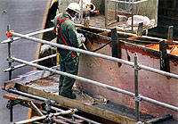
Guardrails
Must be installed on open sides and ends of scaffolds
If front edge (working edge) is more than 14 inches from work, guardrail and/or PFAS system must be used
Source: OSHA
Notes:
1926.451(b)(3) Except as provided in paragraphs (b)(3)(i) and (ii) of this section, the front edge of all platforms shall not be more than 14 inches (36 cm) from the face of the work, unless guardrail systems are erected along the front edge and/or personal fall arrest systems are used in accordance with paragraph (g) of this section to protect employees from falling.

Slide 11
Guardrails
Toprails
  Supported scaffolds manufactured or placed in service after 1/1/2000 must be 38-45” above platform
Midrails
  When used
  Halfway between toprail and scaffold platform
  Crossbracing, when used as a toprail or midrail, must meet certain height requirements
Notes:
When Used – All guardrail systems must include a midrail
1926.450.b Definitions. Guardrail system means a vertical barrier, consisting of, but not limited to, toprails, midrails, and posts, erected to prevent employees from falling off a scaffold platform or walkway to lower levels.
1926.451(g)(4)(iv) When midrails are used, they shall be installed at a height approximately midway between the top edge of the guardrail system and the platform surface.
1926.451(g)(4)(xv) Crossbracing is acceptable in place of a midrail when the crossing point of two braces is between 20 inches (0.5 m) and 30 inches (0.8 m) above the work platform or as a toprail when the crossing point of two braces is between 38 inches (0.97 m) and 48 inches (1.3 m) above the work platform. The end points at each upright shall be no more than 48 inches (1.3 m) apart.

Slide 12
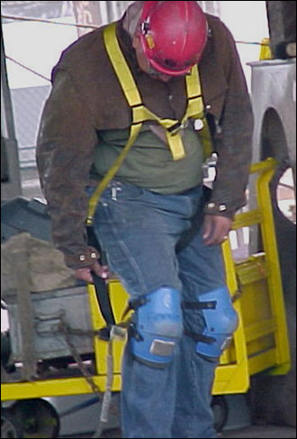
Personal Fall Arrest System (PFAS)
Components
Selection of fall protection
Engineering or qualified
person design
When to inspect
Free-fall limit
Source: OSHA
Notes:
1926.451(g)(3)
In addition to meeting the requirements of 1926.502(d), personal fall arrest systems used on scaffolds shall be attached by lanyard to a vertical lifeline, horizontal lifeline, or scaffold structural member. Vertical lifelines shall not be used when overhead components, such as overhead protection or additional platform levels, are part of a single-point or two-point adjustable suspension scaffold.
1. PFAS – consists of anchorage, connectors, and body harness; may include a lanyard, deceleration device, lifeline, or combination of these
2. Type of fall protection depends on kind of scaffold being used: (1926.451(g)(1) Paragraphs (g)(1)(i) through (vii) of this section establish the types of fall protection to be provided to the employees on each type of scaffold. Paragraph (g)(2) of this section addresses fall protection for scaffold erectors and dismantlers.
3. Inspect prior to each use
4. Should not allow a free-fall of more than 6 feet; there should be prompt rescue after a fall
5. Crossbracing 1926.451(g)(4)(xv) Crossbracing is acceptable in place of a midrail when the crossing point of two braces is between 20 inches (0.5 m) and 30 inches (0.8 m) above the work platform or as a toprail when the crossing point of two braces is between 38 inches (0.97 m) and 48 inches (1.3 m) above the work platform. The end points at each upright shall be no more than 48 inches (1.3 m) apart.

Slide 13
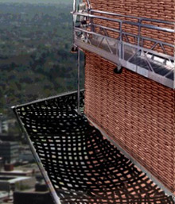
Protection From Falling Objects
Protection must be provided
when there is potential of
being struck by falling objects
Methods of protection
  Barricades, toeboards, screens
  or paneling, canopy or mesh nets,
  placement of large, heavy objects
Wear a hardhat when working
around or below scaffolds
Source: OSHA
Notes:
1926.451(h)(1)
In addition to wearing hardhats each employee on a scaffold shall be provided with additional protection from falling hand tools, debris, and other small objects through the installation of toeboards, screens, or guardrail systems, or through the erection of debris nets, catch platforms, or canopy structures that contain or deflect the falling objects. When the falling objects are too large, heavy or massive to be contained or deflected by any of the above-listed measures, the employer shall place such potential falling objects away from the edge of the surface from which they could fall and shall secure those materials as necessary to prevent their falling.

Slide 14
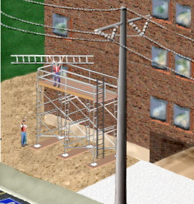
Protection From Electrical Hazards
Minimum distance based on voltage
  Insulated lines
  Uninsulated lines
When exceeding minimum
distance as necessary to
perform work, utility company
must be notified to
  De-energize or relocate line
  OR
  Install protective coverings to
  prevent contact
Source: OSHA
Notes:
1926.451(f)(6)
The clearance between scaffolds and power lines shall be as follows: Scaffolds shall not be erected, used, dismantled, altered, or moved such that they or any conductive material handled on them might come closer to exposed and energized power lines than as follows:
Insulated lines
i. Less than 300 volts – 3 feet
ii. 300 volts to 50 kilovolts – 10 feet
iii. More than 50 kilovolts – 10 feet plus 0.4 inches for each 1 kV over 50 kV
b. Uninsulated lines
i. Less than 50 kV – 10 feet
ii. More than 50 kV – 10 feet plus 0.4 inches for each 1 kV over 50 kV

Slide 15
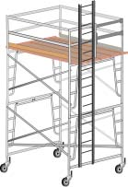
Moving Scaffolds
Workers may only be on moving scaffold when
  Level ground surface
  Height to width ratio
  Outriggers installed on both sides
  Standing inside the wheel base
  Competent person onsite
Source: OSHA
Notes:
Height to width ratio means height of scaffold cannot be more than twice the width.

Slide 16
Safe Scaffold Construction and Disassembly
Appropriate scaffold construction methods
Provide proper scaffold access
Use a competent person
Manufacturers’ instructions
Source: OSHA
Notes:
Appropriate scaffold construction methods include
a. Meet platform requirements
b. Component pieces must match
c. Erect on stable and level ground
d. Lock wheels and braces
e. Meet requirements for height of scaffold to base ratio
f. Base plates/mudsills
g. Requirements for a professional engineer (PE)
Proper Access – 1926.451(e)(9)(i) The employer shall provide safe means of access for each employee erecting or dismantling a scaffold where the provision of safe access is feasible and does not create a greater hazard. The employer shall have a competent person determine whether it is feasible or would pose a greater hazard to provide, and have employees use a safe means of access. This determination shall be based on site conditions and the type of scaffold being erected or dismantled.
Competent Person – 1926.451(f)(7) Scaffolds shall be erected, moved, dismantled, or altered only under the supervision and direction of a competent person qualified in scaffold erection, moving, dismantling or alteration. Such activities shall be performed only by experienced and trained employees selected for such work by the competent person.
1926.451(g)(2) Effective September 2, 1997, the employer shall have a competent person determine the feasibility and safety of providing fall protection for employees erecting or dismantling supported scaffolds. Employers are required to provide fall protection for employees erecting or dismantling supported scaffolds where the installation and use of such protection is feasible and does not create a greater hazard.

Slide 17
Employer Requirements
Comply with OSHA standards related to scaffolds
  Training
  Inspection
  Designating competent person
Comply with manufacturers’ requirements and recommendations
Follow plans designed by qualified person
Notes:
Training:
1926.454(a) The employer shall have each employee who performs work while on a scaffold trained by a person qualified in the subject matter to recognize the hazards associated with the type of scaffold being used and to understand the procedures to control or minimize those hazards.
Inspection:
1926.451(f)(3) Scaffolds and scaffold components shall be inspected for visible defects by a competent person before each work shift, and after any occurrence which could affect a scaffold's structural integrity.
1926.451(d)(10) Ropes shall be inspected for defects by a competent person prior to each workshift and after every occurrence which could affect a rope's integrity.

Slide 18
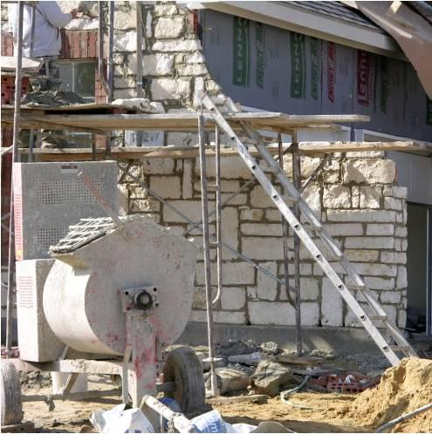
Scaffold Hazard Recognition
Identify hazards and solutions
Source: www.elcosh/org/OTI/Southwest Education Center
Notes:
Hazards and solutions:
Fall hazards – ladder not secured at top; no guardrails, planks extend too far
Secure ladder at proper angle, use guardrails, use planks of proper length.

Slide 19
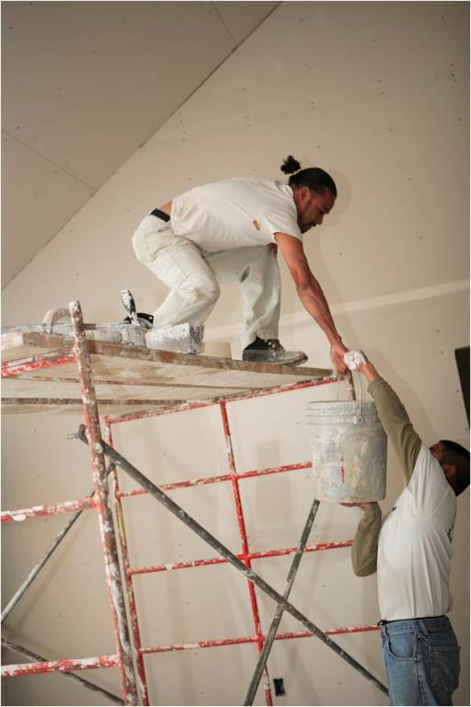
Scaffold Hazard Recognition
Identify hazards and solutions
Source: www.elcosh/org/OTI/Southwest Education Center
Notes:
Hazards and solutions:
Fall hazard – no guardrails
Use guardrails

Slide 20
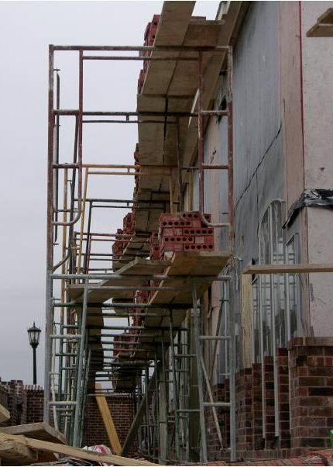
Scaffold Hazard Recognition
Identify hazards and solutions
Source: www.elcosh/org/OTI/Southwest Education Center
Notes:
Hazards and solutions:
Fall hazards – ladder not fully planked; planks extend too far.
Platform needs to be fully planked; planks should not extend more than 12” beyond the scaffold support.
1926.451(b)(4)
Each end of a platform, unless cleated or otherwise restrained by hooks or equivalent means, shall extend over the centerline of its support at least 6 inches (15 cm).
1926.451(b)(5)
1926.451(b)(5)(i)
Each end of a platform 10 feet or less in length shall not extend over its support more than 12 inches (30 cm) unless the platform is designed and installed so that the cantilevered portion of the platform is able to support employees and/or materials without tipping, or has guardrails which block employee access to the cantilevered end.

Slide 21
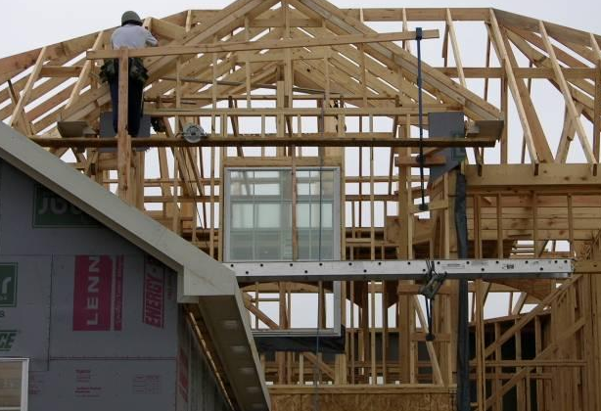
Scaffold Hazard Recognition
Identify hazards and solutions
Source: www.elcosh/org/OTI/Southwest Education Center
Notes:
Hazards and solutions:
Items may fall from scaffolding (no toeboard); no fall protection or guardrail.
Use toeboard; secure items to prevent from falling; use fall protection/guardrail.

Slide 22
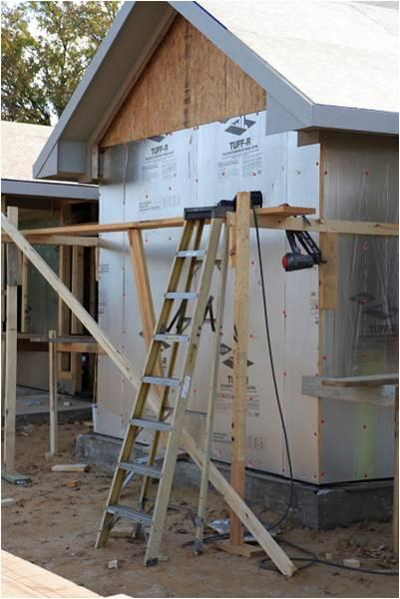
Scaffold Hazard Recognition
Identify hazards and solutions
Source: www.elcosh/org/OTI/Southwest Education Center
Notes:
Hazards and solutions:
Ladder is not used for intended purpose (A-Frame ladder); improper planking; questionable scaffold assembly.
Use ladder properly and for its intended purpose; use properly assembled scaffold with proper planking.

Slide 23
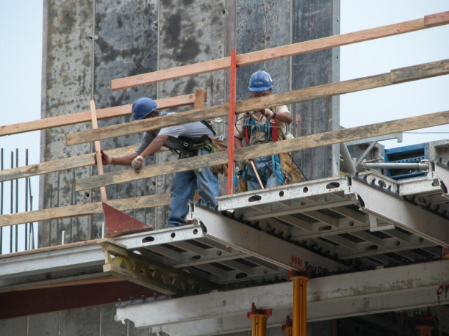
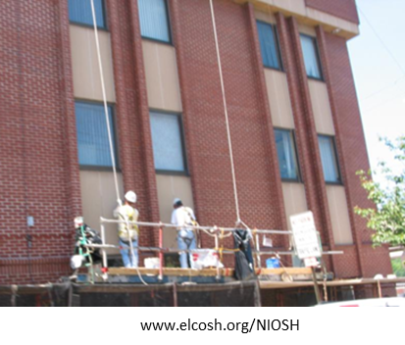
Always Remember
Employers must
  Designate a competent person for scaffold
  Ensure that employees are trained in proper assembly, disassembly, and use of scaffolds
  Utilize strategies to prevent and reduce scaffold hazards
www.elcosh.org/Steve Clark/Laborers

Slide 24
Knowledge Check
Who trains employees that work on scaffolds?
  Employees do not need training
  Employees are responsible for their own training
  Fellow employees who have experience
  Employer-designated competent person
  d. Employer-designated competent person

Slide 25
Knowledge Check
Scaffolds must be designed by a ___.
  Competent person
  Construction site manager
  Qualified person
  Experienced scaffold worker
  Qualified person

Slide 26
Knowledge Check
Which of the following is NOT an example of proper access?
  Ladders
  Crossbraces
  Stair towers
  Walkways
  Crossbraces

