Slide 1
Electrical Safety - Construction
Notes:
1926 Subpart K ‑ Electrical
This presentation is designed to assist trainers conducting OSHA 10-hour Construction Industry outreach training for workers. Since workers are the target audience, this presentation emphasizes hazard identification, avoidance, and control – not standards. No attempt has been made to treat the topic exhaustively. It is essential that trainers tailor their presentations to the needs and understanding of their audience.
This presentation is not a substitute for any of the provisions of the Occupational Safety and Health Act of 1970 or for any standards issued by the U.S. Department of Labor. Mention of trade names, commercial products, or organizations does not imply endorsement by the U.S. Department of Labor.
This presentation addresses electrical safety requirements that are necessary for the safety of construction employees and is divided into major divisions as follows:
Overview. Includes why electricity is dangerous and how it works.
Hazard / Controls. Covers the main hazards and explains the best ways to prevent these hazards from occurring.
General Planning and Controls.

Slide 2
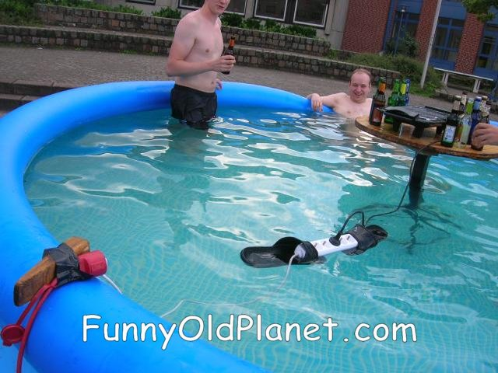

Slide 3
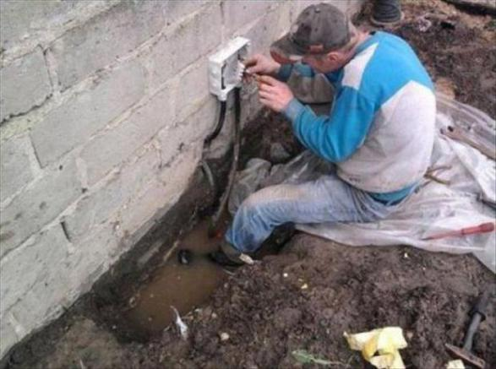

Slide 4
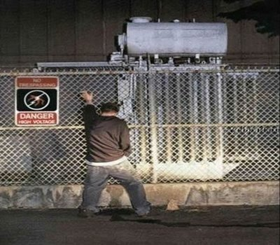

Slide 5
Electrocution Hazards - Topics
Identify major electrocution hazards
Describe types of electrocution hazards
Protect him/herself from electrocution hazards
Recognize employer requirements to protect workers from electrocution hazards

Slide 6
Electrocution Hazards
An electrical hazard can be defined as a serious workplace hazard that exposes workers to the following:
Burns
Electrocution
Shock
Arc Flash/Arc Blast
Fire
Explosions
Notes:
B = Burns:
A burn is the most common shock-related injury.
Burns from electricity are one of three types:
Electrical, Arc/Flash or Thermal Contact.
E = Electrocution:
Electrocution is fatal; it means to kill with electricity.
Electrocution results when a human is exposed to a
lethal amount of electrical energy.
S = Shock:
Shock results when the body becomes part of the
electrical circuit; current enters the body at one point
and leaves at another. Electrical shock is defined as a
reflex response to the passage of electric current
through the body.
A = Arc Flash/Blast:
An arc flash is the sudden release of electrical energy
through the air when a high-voltage gap exists and
there is a breakdown between conductors. An arc
flash gives off thermal radiation (heat) and bright,
intense light that can cause burns. Temperatures have
been recorded as high as 35,000 °F. High-voltage
arcs can also produce considerable pressure waves
by rapidly heating the air and creating a blast.
F = Fire:
Most electrical distribution fires result from problems
with "fixed wiring" such as faulty electrical outlets and
old wiring. Problems with cords (such as extension
and appliance cords), plugs, receptacles, and
switches also cause electrical fires.
E = Explosions:
An explosion can occur when electricity ignites an
explosive mixture of material in the air.
Note that although a) electricity is the source of these
hazards, and b) all of these hazards are of equal
importance, for this focus four module, this lesson
focuses on electrocution hazards.

Slide 7
What are the major types of electrocution hazards in construction?
Contact with overhead power lines
Contact with energized sources (e.g., live parts, damaged or bare wires, defective equipment or tools)
Improper use of extension and flexible cords

Slide 8
What is my employer required to do to protect workers from electrocutions?
Ensure overhead power line safety
Isolate electrical parts
Supply ground-fault circuit Interrupters (GFCI)
Ensure proper grounding
Ensure power tools are maintained in a safe condition
Ensure proper guarding
Provide training
Enforce a LOTO safety-related work practices
Ensure Proper Use of Flexible Cords

Slide 9
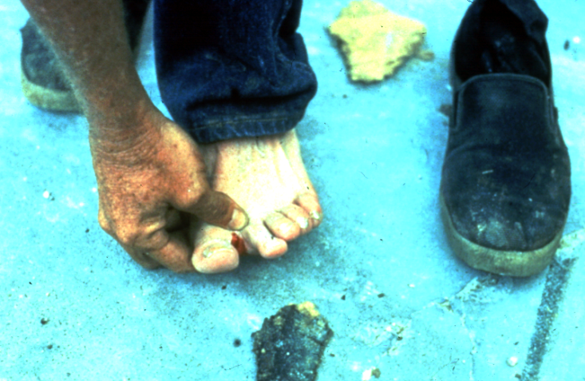
Electricity - The Dangers
About 5 workers are electrocuted every week
Causes 12% of young worker workplace deaths
Takes very little electricity to cause harm
Significant risk of causing fires
Notes:
Whenever you work with power tools or electrical circuits there is a risk of electrical hazards, especially electrical shock. Risks are increased at construction sites because many jobs involve electric power tools.
Electrical trades workers must pay special attention to electrical hazards because they work on electrical circuits. Coming in contact with an electrical voltage can cause current to flow through the body, resulting in electrical shock and burns. Serious injury or even death may occur.
Electricity has long been recognized as a serious workplace hazard, exposing employees to electric shock, electrocution, burns, fires, and explosions. In 1999, for example, 278 workers died from electrocutions at work, accounting for almost 5 percent of all on-the-job fatalities that year, according to the Bureau of Labor Statistics. What makes these statistics more tragic is that most of these fatalities could have been easily avoided.

Slide 10
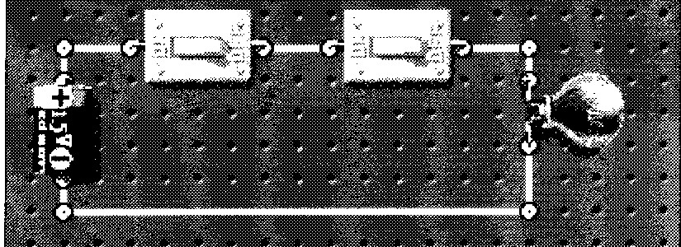
Electricity – How it Works
Electricity is the flow of energy from one place to another
Requires a source of power: usually a generating station
A flow of electrons (current) travels through a conductor
Travels in a closed circuit
Notes:
Operating an electric switch is like turning on a water faucet.
Behind the faucet (or switch) there is a source of water (or electricity) with a way to transport it, and pressure to make it flow. The faucet’s water source is a reservoir or pumping station. A pump provides enough pressure for the water to travel through the pipes. For electricity the source is the power generating station. A generator provides the pressure (voltage) for the electrical current to travel through electric conductors (wires).
Volts – the electrical pressure (measure of electrical force)
Amps – the volume or intensity of the electrical flow
Watts – the power consumed

Slide 11
Electrical Terms
Current -- electrical movement (measured in amps)
Circuit -- complete path of the current. Includes electricity source, a conductor, and the output device or load (such as a lamp, tool, or heater)
Resistance -- restriction to electrical flow
Conductors – substances, like metals, with little resistance to electricity that allow electricity to flow
Grounding – a conductive connection to the earth which acts as a protective measure
Insulators -- substances with high resistance to electricity like glass, porcelain, plastic, and dry wood that prevent electricity from getting to unwanted areas
Notes:
Resistance – Measured in ohms.
Four factors determine the resistance of a material to the flow of electricity.
What it is made of (silver is best, copper is most common)
Its diameter (smaller diameter = more resistance)
Its temperature (higher temperature = higher resistance)
Its length (longer = higher resistance)

Slide 12
Electrical Injuries
There are four main types of electrical injuries:
Direct:
    Electrocution or death due to electrical shock
    Electrical shock
    Burns
Indirect - Falls
Notes:
When an electrical shock enters the body it may produce different types of injuries. Electrocution results in internal and external injury to body parts or the entire body – often resulting in death. After receiving a “jolt” of electricity all or part of the body may be temporarily paralyzed and this may cause loss of grip or stability. A person may also involuntarily move as a result of receiving an electrical shock, resulting in a fall. Internal or external burns may result from contact with electricity.

Slide 13
Electrical Shock
An electrical shock is received when electrical
current passes through the body.
You will get an electrical shock if a part of your
body completes an electrical circuit by…
Touching a live wire and an electrical ground, or
Touching a live wire and another wire at a different voltage.
Notes:
Electricity travels in closed circuits, and its normal route is through a conductor. Electric shock occurs when the body becomes a part of the circuit.
Grounding is a physical connection to the earth, which is at zero volts.
The metal parts of electric tools and machines may become energized if there is a break in the insulation of the tool or machine wiring. A worker using these tools and machines is made less vulnerable to electric shock when there is a low-resistance path from the metallic case of the tool or machine to the ground. This is done through the use of an equipment grounding conductor—a low-resistance wire that causes the unwanted current to pass directly to the ground, thereby greatly reducing the amount of current passing through the body of the person in contact with the tool or machine.

Slide 14
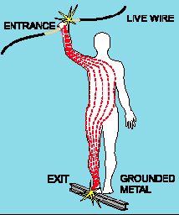
Shock Severity
Severity of the shock depends on:
  Path of current through the body
  Amount of current flowing through the body (amps)
  Duration of the shocking current through the body,
LOW VOLTAGE DOES NOT MEAN LOW HAZARD
Notes:
Other factors that may affect the severity of the shock are:
- The voltage of the current.
- The presence of moisture
- The general health of the person prior to the shock.
Low voltages can be extremely dangerous because, all other factors being equal, the degree of injury increases the longer the body is in contact with the circuit.
The resistance of the body varies based on:
The amount of moisture on the skin (less moisture = more resistance)
The size of the area of contact (smaller area = more resistance)
The pressure applied to the contact point (less pressure = more resistance)
Muscular structure (less muscle = less resistance)

Slide 15
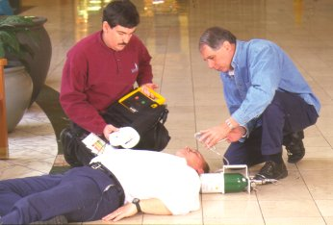
Dangers of Electrical Shock
Currents above 10 mA* can paralyze or “freeze” muscles.
Currents more than 75 mA can cause a rapid, ineffective heartbeat -- death will occur in a few minutes unless a defibrillator is used
75 mA is not much current – a small power drill uses 30 times as much
Defibrillator in use
* mA = milliampere = 1/1,000 of an ampere
Notes:
For example, 1/10 of an ampere (amp) of electricity going through the body for just 2 seconds is enough to cause death.
Currents above 10 mA can paralyze or “freeze” muscles. When this “freezing” happens, a person is no longer able to release a tool, wire, or other object. In fact, the electrified object may be held even more tightly, resulting in longer exposure to the shocking current. For this reason, hand-held tools that give a shock can be very dangerous. If you can’t let go of the tool, current continues through your body for a longer time, which can lead to respiratory paralysis (the muscles that control breathing cannot move). You stop breathing for a period of time. People have stopped breathing when shocked with currents from voltages as low as 49 volts. Usually, it takes about 30 mA of current to cause respiratory paralysis.

Slide 16
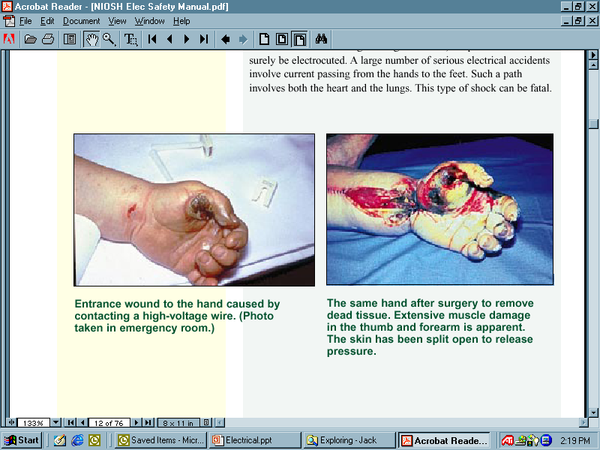
Burns
Most common shock-related injury
Occurs when you touch electrical wiring or equipment that is improperly used or maintained
Typically occurs on hands
Very serious injury that needs immediate attention
Notes:
Shock-related injuries include burns, internal injuries, and injuries due to
involuntary muscle contractions.
The most common shock-related injury is a burn. Burns suffered in electrical incidents may be one or more of the following three types.
Electrical burns cause tissue damage, and are the result of heat generated by the flow of electrical current through the body. These are one of the most serious injuries you can receive and require immediate attention.
Arc or Flash burns are caused by high temperatures near the body produced by an electrical arc or explosion. Attend to them immediately.
Thermal contact burns occur when skin comes in contact with overheated electric equipment, or when clothing is ignited by an electrical incident.

Slide 17
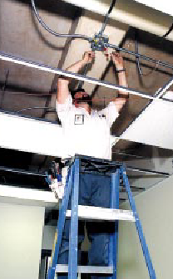
Falls
Electric shock can also cause indirect injuries
Workers in elevated locations who experience a shock may fall, resulting in serious injury or death

Slide 18
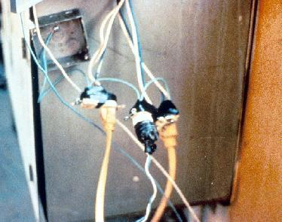
Electrical Hazards and How to
Control Them
Electrical accidents are caused by a combination of three factors:
  Unsafe equipment and/or installation,
  Workplaces made unsafe by the environment, and
  Unsafe work practices.
Notes:
Electrical shocks, fires, or falls result from these hazards:
Exposed electrical parts
Overhead power lines
Inadequate wiring
Defective insulation
Improper grounding
Overloaded circuits
Wet conditions
Damaged tools and equipment
Improper PPE

Slide 19
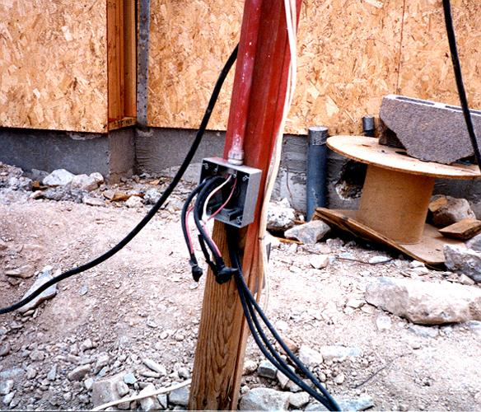
Hazard – Exposed Electrical Parts
Cover removed from wiring or breaker box

Slide 20
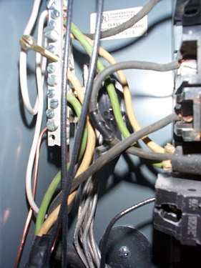
Control – Isolate Electrical Parts
Use guards or barriers
Replace covers
Guard live parts of electric equipment operating at 50 volts or more against accidental contact
Notes:
Reference 1926.403(i)(2)
Except as required or permitted elsewhere in the subpart, live parts of electric equipment operating at 50 volts or more shall be guarded against accidental contact by cabinets or other forms of enclosures, or by any of the following means:
* By location in a room, vault, or similar enclosure that is accessible only to qualified persons.
* By partitions or screens so arranged that only qualified persons will have access to the space within reach of the live parts. Any openings in such partitions or screens shall be so sized and located that persons are not likely to come into accidental contact with the live parts or to bring conducting objects into contact with them.
* By location on a balcony, gallery, or platform so elevated and arranged as to exclude unqualified persons.
* By elevation of 8 feet or more above the floor or other working surface and so installed as to exclude unqualified persons.

Slide 21
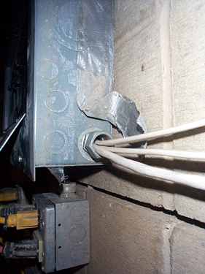
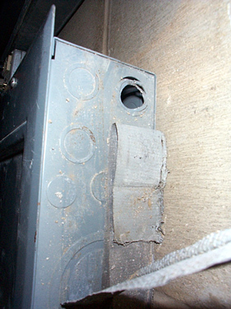
Control – Isolate Electrical Parts - Cabinets, Boxes & Fittings
Conductors going into them must be protected, and unused openings must be closed
Notes:
Reference 1926.405(b)(1)
Conductors entering boxes, cabinets, or fittings. Conductors entering boxes, cabinets, or fittings shall be protected from abrasion, and openings through which conductors enter shall be effectively closed. Unused openings in cabinets, boxes, and fittings shall also be effectively closed.
Covers and canopies. All pull boxes, junction boxes, and fittings shall be provided with covers. If metal covers are used, they shall be grounded. In energized installations each outlet box shall have a cover, faceplate, or fixture canopy. Covers of outlet boxes having holes through which flexible cord pendants pass shall be provided with bushings designed for the purpose or shall have smooth, well‑rounded surfaces on which the cords may bear.

Slide 22
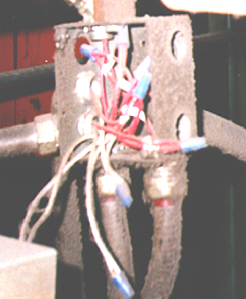
Control – Close Openings
Junction boxes, pull boxes and fittings must have approved covers
Unused openings in cabinets, boxes and fittings must be closed (no missing knockouts)
Photo shows violations
of these two requirements

Slide 23
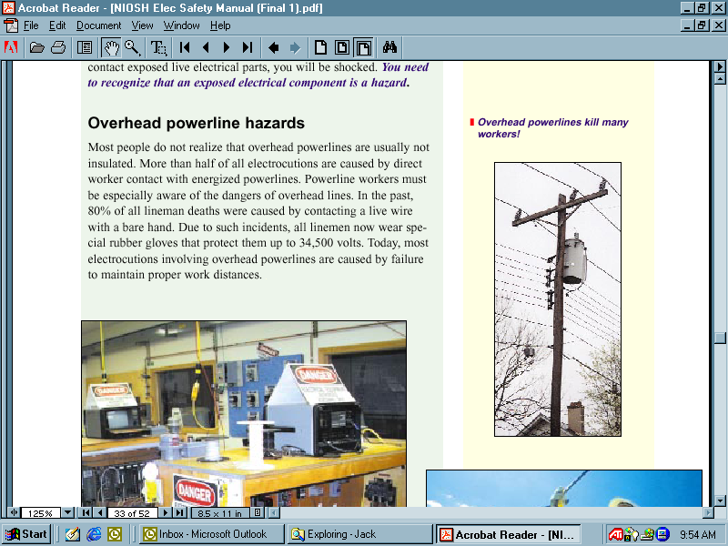
Hazard - Overhead Power Lines
Usually not insulated
Examples of equipment that can contact power lines:
  Crane
  Ladder
  Scaffold
  Backhoe
  Scissors lift
  Raised dump truck bed
  Aluminum paint roller
Notes:
Overhead and buried power lines are especially hazardous because they carry extremely high voltage. Fatal electrocution is the main risk, but burns and falls from elevation are also hazards. Using tools and equipment that can contact power lines increases the risk.
More than half of all electrocutions are caused by direct worker contact with energized powerlines. Powerline workers must be especially aware of the dangers of overhead lines. In the past, 80% of all lineman deaths were caused by contacting a live wire with a bare hand. Due to such incidents, all linemen now wear special rubber gloves that protect them up to 34,500 volts. Today, most electrocutions involving overhead powerlines are caused by failure to maintain proper work distances.
Overhead power lines must be deenergized and grounded by the owner or operator of the lines, or other protective measures must be provided before work is started. Protective measures (such as guarding or insulating the lines) must be designed to prevent contact with the lines.
PPE may consist of rubber insulating gloves, hoods, sleeves, matting, blankets, line hose, and industrial protective helmets.

Slide 24
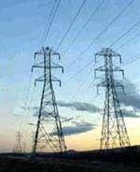
Control - Overhead Power Lines
Stay at least 10 feet away
Post warning signs
Assume that lines are energized
Use wood or fiberglass ladders, not metal
Power line workers need special training & PPE
Notes:
1926.416(a)
How Do I Avoid Hazards?
-- Look for overhead power lines and buried power line indicators. Post warning signs.
-- Contact utilities for buried power line locations.
-- Stay at least 10 feet away from overhead power lines.
-- Unless you know otherwise, assume that overhead lines are energized.
-- Get the owner or operator of the lines to de-energize and ground lines when working near them.
-- Other protective measures include guarding or insulating the lines.
-- Use non-conductive wood or fiberglass ladders when working near power lines.

Slide 25
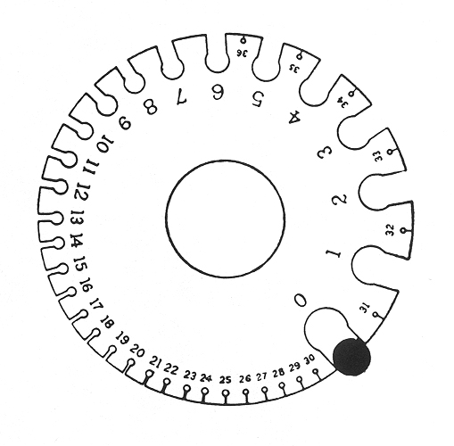
Hazard - Inadequate Wiring
Hazard - wire too small for the current
Example - portable tool with an extension cord that has a wire too small for the tool
  The tool will draw more current than the cord can handle, causing overheating and a possible fire without tripping the circuit breaker
  The circuit breaker could be the right size for the circuit but not for the smaller-wire extension cord
Wire Gauge
WIRE
Wire gauge measures wires ranging in size from number 36 to 0 American wire gauge (AWG)
Notes:
An electrical hazard exists when the wire is too small a gauge for the
current it will carry. Normally, the circuit breaker in a circuit is
matched to the wire size. However, in older wiring, branch lines to
permanent ceiling light fixtures could be wired with a smaller gauge
than the supply cable.
Note that wire-gauge size is inversely related to the diameter of the wire. For example, a No. 12 flexible cord has a larger diameter wire than a No. 14 flexible cord.
Choose a wire size that can handle the total current. Remember: The larger the gauge number, the smaller the wire!
American Wire Gauge (AWG)
Wire size Handles up to
#10 AWG 30 amps
#12 AWG 25 amps
#14 AWG 18 amps
#16 AWG 13 amps

Slide 26
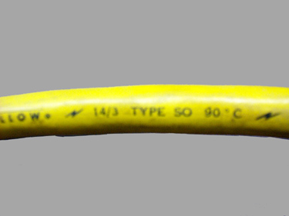
Control – Use the Correct Wire
Wire used depends on operation, building materials, electrical load, and environmental factors
Use fixed cords rather than flexible cords
Use the correct extension cord
Must be 3-wire type and designed for hard or extra-hard use
Notes:
1926.405(a)(2)(ii)(J)
The OSHA standard requires flexible cords to be rated for hard or extra-hard usage. These ratings are to be indelibly marked approximately every foot of the cord. Since deterioration occurs more rapidly in cords which are not rugged enough for construction conditions, the National Electric Code and OSHA have specified the types of cords to use in a construction environment. This rule designates the types of cords that must be used for various applications including portable tools, appliances, temporary and portable lights. The cords are designated HARD and EXTRA HARD SERVICE.
Examples of HARD SERVICE designation types include S, ST, SO, STO, SJ, SJO, SJT, & SJTO. Extension cords must be durably marked as per 1926.405(g)(2)(ii) with one of the HARD or EXTRA HARD SERVICE designation letters, size and number of conductors.

Slide 27
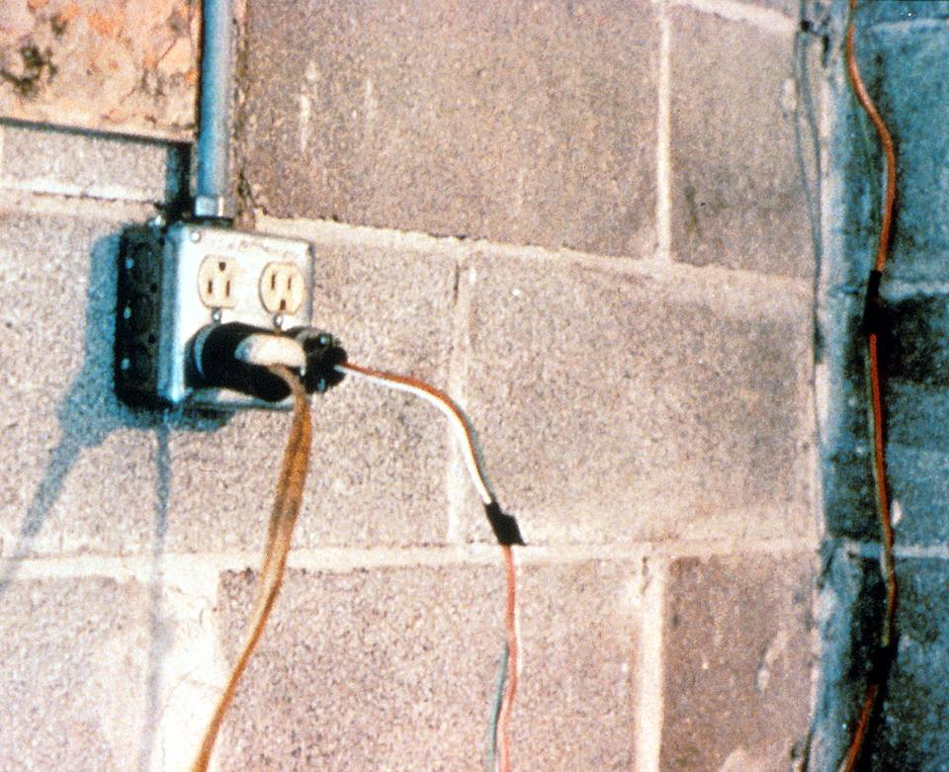
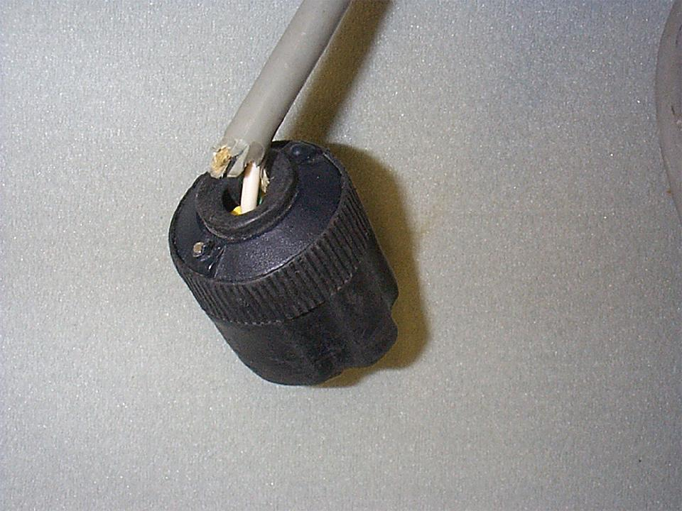
Hazard – Defective Cords & Wires
Plastic or rubber covering is missing
Damaged extension cords & tools
Notes:
Extension cords may have damaged insulation. Sometimes the insulation inside an electrical tool or appliance is damaged. When insulation is damaged, exposed metal parts may become energized if a live wire inside touches them. Electric hand tools that are old, damaged, or misused may have damaged insulation inside. If you touch damaged power tools or other equipment, you will receive a shock. You are more likely to receive a shock if the tool is not grounded or double-insulated.

Slide 28
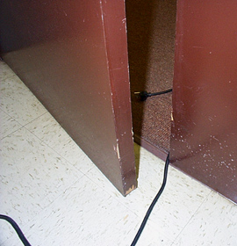
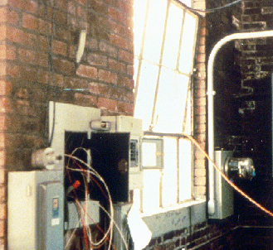
Hazard – Damaged Cords
Cords can be damaged by:
  Aging
  Door or window edges
  Staples or fastenings
  Abrasion from adjacent materials
  Activity in the area
Improper use can cause shocks, burns or fire
Notes:
Reference 1926.405(a)(2)(ii)(I)
The normal wear and tear on extension and flexible cords at your site can loosen or expose wires, creating hazardous conditions. Cords that are not 3-wire type, not designed for hard-usage, or that have been modified, increase your risk of contacting electrical current.

Slide 29
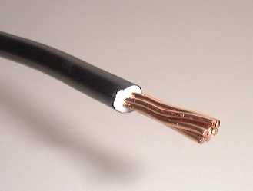
Control – Cords & Wires
Insulate live wires
Check before use
Use only cords that are 3-wire type
Use only cords marked for hard or extra-hard usage
Use only cords, connection devices, and fittings equipped with strain relief
Remove cords by pulling on the plugs, not the cords
Cords not marked for hard or extra-hard use, or which have been modified, must be taken out of service immediately
Notes:
Insulation is the most common manner of guarding electrical energy.
Extension cords must be 3-wire type so they may be grounded, and to permit grounding of any tools or equipment connected to them.
Extension cords when exposed to "normal" construction use can experience rapid deterioration. When this happens, conductors with energized bare wires can be exposed. Conductors can break or come loose from their terminal screws, specifically the equipment grounding conductor. If that occurs, the equipment grounding for the tool in use is lost.

Slide 30
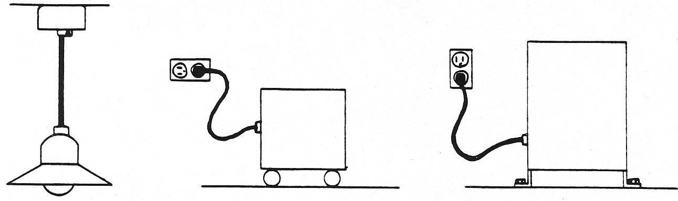
Permissible Use of Flexible Cords
DO NOT use flexible wiring where frequent inspection would be difficult or where damage would be likely.
Flexible cords must not be . . .
run through holes in walls, ceilings, or floors;
run through doorways, windows, or similar openings (unless physically protected);
hidden in walls, ceilings, floors, conduit or other raceways.
Stationary equipment-to facilitate interchange
Notes:
Other use examples:
Elevator cables
Wiring of cranes and hoists
Prevention of the transmission of noise or vibration
Appliances where the fastening means and mechanical connections are designed to permit removal for maintenance and repair
DO NOT use flexible wiring in situations where frequent inspection would be difficult, where damage would be likely, or where long-term electrical supply is needed. Flexible cords cannot be used as a substitute for the fixed wiring of a structure.
Flexible cords must not be . . .
run through holes in walls, ceilings, or floors;
run through doorways, windows, or similar openings (unless physically protected);
attached to building surfaces (except with a tension take-up device within 6 feet of the supply end);
hidden in walls, ceilings, or floors; or
hidden in conduit or other raceways.

Slide 31
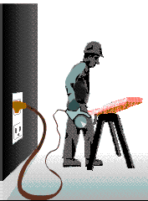
Grounding
Grounding creates a low-resistance path from a tool to the earth to disperse unwanted current.
When a short or lightning occurs, energy flows to the ground, protecting you from electrical shock, injury and death.
Notes:
Grounding is a secondary method of preventing electrical shock.
Grounded electrical systems are usually connected to a grounding rod that is placed 6-8 feet deep into the earth.
Grounded - connected to earth or to some conducting body that serves in place of the earth.
Grounded, effectively (Over 600 volts, nominal.) Permanently connected to earth through a ground connection of sufficiently low impedance and having sufficient ampacity that ground fault current which may occur cannot build up to voltages dangerous to personnel.
Grounded conductor. A system or circuit conductor that is intentionally grounded.
Grounding conductor. A conductor used to connect equipment or the grounded circuit of a wiring system to a grounding electrode or electrodes.

Slide 32
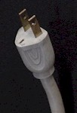
Hazard – Improper Grounding
Tools plugged into improperly grounded circuits may become energized
Broken wire or plug on extension cord
Some of the most frequently violated OSHA standards
Notes:
The most frequently violated OSHA electrical regulation is improper grounding of equipment and circuitry. The metal parts of an electrical wiring system that we touch (switch plates, ceiling light fixtures, conduit, etc.) should be grounded and at 0 volts. If the system is not grounded properly, these parts may become energized. Metal parts of motors, appliances, or electronics that are plugged into improperly grounded circuits may be energized. When a circuit is not grounded properly, a hazard exists because unwanted voltage cannot be safely eliminated. If there is no safe path to ground for fault currents, exposed metal parts in damaged appliances can become energized.
Extension cords may not provide a continuous path to ground because of a broken ground wire or plug.
Electrical systems are often grounded to metal water pipes that serve as a continuous path to ground. If plumbing is used as a path to ground for fault current, all pipes must be made of conductive material (a type of metal). Many electrocutions and fires occur because (during renovation or repair) parts of metal plumbing are replaced with plastic pipe, which does not conduct electricity.

Slide 33
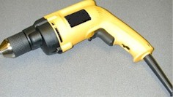
Control – Ground Tools & Equipment
Ground power supply systems, electrical circuits, and electrical equipment
Frequently inspect electrical systems to insure path to ground is continuous
Inspect electrical equipment before use
Don’t remove ground prongs from tools or extension cords
Ground exposed metal parts of equipment
Notes:
A typical extension cord grounding system has four components:
a third wire in the cord, called a ground wire;
a three-prong plug with a grounding prong on one end of the cord;
a three-wire, grounding-type receptacle at the other end of the cord; and
a properly grounded outlet.
Two kinds of grounds are required by the standard:
1. Service or system ground. In this instance, one wire, called the neutral conductor or grounded conductor, is grounded. In an ordinary low-voltage circuit, the white (or gray) wire is grounded at the generator or transformer and again at the service entrance of the building. This type of ground is primarily designed to protect machines, tools, and insulation against damage.
2. For enhanced worker protection, an additional ground, called the equipment ground, must be furnished by providing another path from the tool or machine through which the current can flow to the ground. This additional ground safeguards the electric equipment operator if a malfunction causes the metal frame of the tool to become energized.

Slide 34
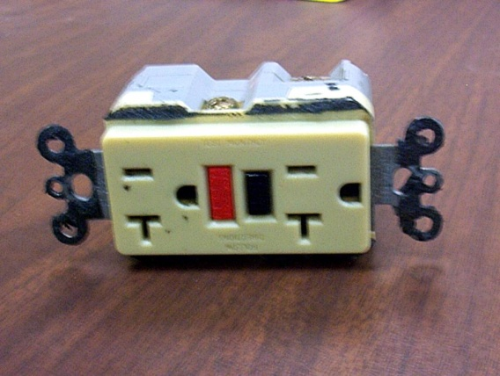
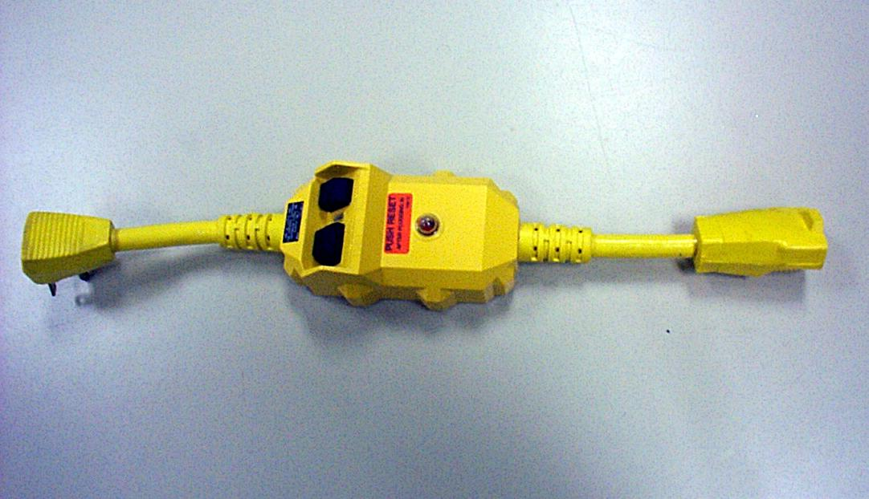
Control – Use GFCI (ground-fault circuit interrupter)
Protects you from shock
Detects difference in current between the black and white wires
If ground fault detected, GFCI shuts off electricity in 1/40th of a second
Use GFCI’s on all 120-volt, single-phase, 15- and 20-ampere receptacles, or have an assured equipment grounding conductor program.
Notes:
Reference 1926.404(b)(1)(i)
GFCI:
Matches the amount of current going to an electrical device against the amount of current returning from the device.
Interrupts the electric power within as little as 1/40 of a second when the amount of current going differs from the amount returning by about 5 mA
Must be tested to ensure it is working correctly.
NEC requires GFCI’s be used in these high-risk situations:
Electricity is used near water.
The user of electrical equipment is grounded (by touching grounded material).
Circuits are providing power to portable tools or outdoor receptacles.
Temporary wiring or extension cords are used.
There is one disadvantage to grounding: a break in the grounding system may occur without the user's knowledge. Using a ground-fault circuit interrupter (GFCI) is one way of overcoming grounding deficiencies.

Slide 35
Control - Assured Equipment Grounding Conductor Program
Program must cover:
  All cord sets
  Receptacles not part of a building or structure
  Equipment connected by plug and cord
Program requirements include:
  Specific procedures adopted by the employer
  Competent person to implement the program
  Visual inspection for damage of equipment connected by cord and plug
Notes:
Reference 1926.404(b)(1)(iii)
Assured Equipment Grounding Conductor Program (AEGCP).
The employer shall establish and implement AEGCP on construction sites covering all listed above which are available for use or used by employees. This program has the following minimum requirements:
- Daily visual inspections,
- Periodic test inspections (3 months at most for temporary cords and cords exposed to damage, 6 months for fixed cords not exposed)
- Written description,
- A competent person to implement the program, and
- Record of the periodic tests.
When portions of the building(s) or structures(s) which have been completed and no longer expose employees to weather or damp and wet locations, or to other grounding hazards, GFCIs or an assured equipment grounding program may not be required when approved extension cords are plugged into the permanent wiring at construction sites.

Slide 36
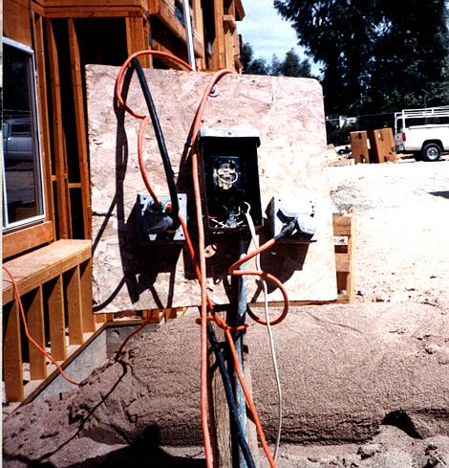
Hazard – Overloaded Circuits
Hazards may result from:
Too many devices plugged into a circuit, causing heated wires and possibly a fire
Damaged tools overheating
Lack of overcurrent protection
Wire insulation melting, which may cause arcing and a fire in the area where the overload exists, even inside a wall
Notes:
If the circuit breakers or fuses are too big (high current rating) for the wires they are supposed to protect, an overload in the circuit will not be detected and the current will not be shut off. A circuit with improper overcurrent protection devices – or one with no overcurrent protection devices at all – is a hazard.

Slide 37
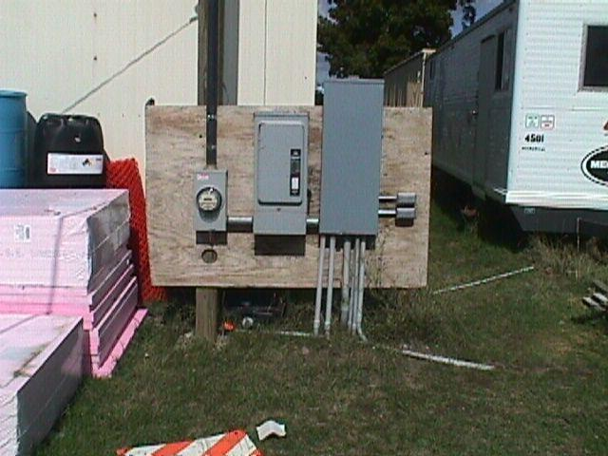
Control - Electrical Protective Devices
Automatically opens circuit if excess current from overload or ground-fault is detected – shutting off electricity
Includes GFCI’s, fuses, and circuit breakers
Fuses and circuit breakers are overcurrent devices. When too much current:
    Fuses melt
    Circuit breakers trip open
Notes:
To prevent too much current in a circuit, a circuit breaker or fuse is placed in the circuit. If there is too much current in the circuit, the breaker “trips” and opens like a switch. If an overloaded circuit is equipped with a fuse, an internal part of the fuse melts, opening the circuit. Both breakers and fuses do the same thing: open the circuit to shut off the electrical current
The basic idea of an overcurrent device is to make a weak link in the circuit. In the case of a fuse, the fuse is destroyed before another part of the system is destroyed. In the case of a circuit breaker, a set of contacts opens the circuit. Unlike a fuse, a circuit breaker can be re-used by re-closing the contacts. Fuses and circuit breakers are designed to protect equipment and facilities, and in so doing, they also provide considerable protection against shock in most situations. However, the only electrical protective device whose sole purpose is to protect people is the ground-fault circuit-interrupter.

Slide 38
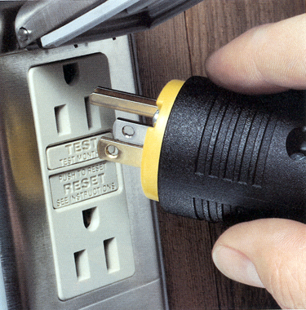
Power Tool Requirements
  Have a three-wire cord with ground plugged into a grounded receptacle, or
  Be double insulated, or
  Be powered by a low-voltage isolation transformer
Notes:
Common Examples of Misused Equipment = OSHA Violations
* Using multi-receptacle boxes designed to be mounted by fitting them with a power cord and placing them on the floor.
* Fabricating extension cords with ROMEX® wire.
* Using equipment outdoors that is labeled for use only in dry, indoor locations.
* Attaching ungrounded, two-prong adapter plugs to three-prong cords and tools.
* Using circuit breakers or fuses with the wrong rating for over-current protection, e.g. using a 30-amp breaker in a system with 15- or 20-amp receptacles. Protection is lost because it will not trip when the system's load has been exceeded.
* Using modified cords or tools, e.g., removing ground prongs, face plates, insulation, etc.
* Using cords or tools with worn insulation or exposed wires.

Slide 39
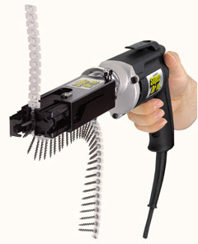
Tool Safety Tips
Use gloves and appropriate footwear
Store in dry place when not using
Don’t use in wet/damp conditions
Keep working areas well lit
Ensure not a tripping hazard
Don’t carry a tool by the cord
Don’t yank the cord to disconnect it
Keep cords away from heat, oil, & sharp edges
Disconnect when not in use and when changing accessories such as blades & bits
Remove damaged tools from use
Notes:
Avoid accidental starting. Don’t hold fingers on switch button while carrying a plugged-in tool.
Tag damaged tools: "Do Not Use."
Hazards of portable electric tools:
- Currents as small as 10 mA can paralyze, or “freeze” muscles: person cannot release tool.
- Tools are held tightly, resulting in longer shock exposure.
- Power drills use 30 times as much current as what will kill.

Slide 40
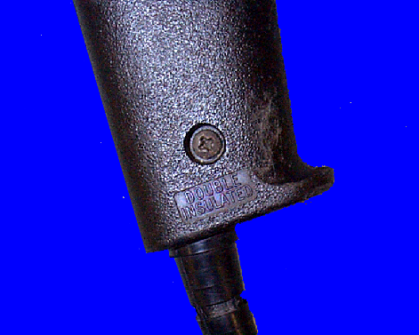
Preventing Electrical Hazards - Tools
Inspect tools before use
Use the right tool correctly
Protect your tools
Use double insulated tools
  Double Insulated marking
Notes:
* Use tools and equipment according to the instructions included in their listing, labeling or certification.
* Visually inspect all electrical equipment before use. Remove from service any equipment with frayed cords, missing ground prongs, cracked tool casings, etc. Apply a warning tag to any defective tool and do not use it until the problem has been corrected.

Slide 41
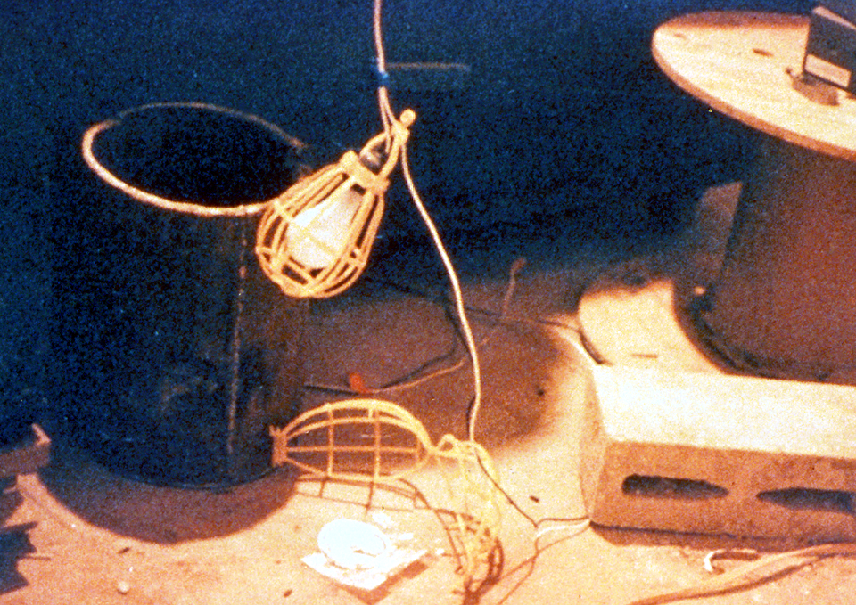
Temporary Lights
Protect from contact and damage, and don’t suspend by cords unless designed to do so.
Notes:
Reference 1926.405(a)(2)

Slide 42
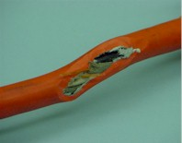
Clues that Electrical Hazards Exist
Tripped circuit breakers or blown fuses
Warm tools, wires, cords, connections, or junction boxes
GFCI that shuts off a circuit
Worn or frayed insulation around wire or connection
Notes:
There are “clues” that electrical hazards exist. For example, if a GFCI keeps tripping while you are using a power tool, there is a problem. Don’t keep resetting the GFCI and continue to work. You must evaluate the “clue” and decide what action should be taken to control the hazard.
There are a number of other conditions that indicate a hazard.
Tripped circuit breakers and blown fuses show that too much current is flowing in a circuit. This could be due to several factors, such as malfunctioning equipment or a short between conductors. You need to determine the cause in order to control the hazard.
An electrical tool, appliance, wire, or connection that feels warm may indicate too much current in the circuit or equipment. You need to evaluate the situation and determine your risk.
An extension cord that feels warm may indicate too much current for the wire size of the cord. You must decide when action needs to be taken.
A cable, fuse box, or junction box that feels warm may indicate too much current in the circuits.
A burning odor may indicate overheated insulation.
Worn, frayed, or damaged insulation around any wire or other conductor is an electrical hazard because the conductors could be exposed. Contact with an exposed wire could cause a shock. Damaged insulation could cause a short, leading to arcing or a fire. Inspect all insulation for scrapes and breaks. You need to evaluate the seriousness of any damage you find and decide how to deal with the hazard.
A GFCI that trips indicates there is current leakage from the circuit First, you must decide the probable cause of the leakage by recognizing any contributing hazards. Then, you must decide what action needs to be taken.

Slide 43
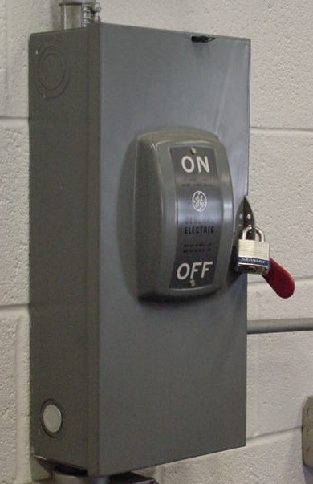
Lockout and Tagging of Circuits
Apply locks to power source after de-energizing
Tag deactivated controls
Tag de-energized equipment and circuits at all points where they can be energized
Tags must identify equipment or circuits being worked on
Notes:
Reference 1926.417:
(a) Controls. Controls that are to be deactivated during the course of work on energized or de-energized equipment or circuits shall be tagged.
(b) Equipment and circuits. Equipment or circuits that are deenergized shall be rendered inoperative and shall have tags attached at all points where such equipment or circuits can be energized.
(c) Tags. Tags shall be placed to identify plainly the equipment or circuits being worked on.
(d) Lockout and tagging. While any employee is exposed to contact with parts of fixed electric equipment or circuits which have been de-energized, the circuits energizing the parts shall be locked out or tagged or both.
Case study
An electrician was removing a metal fish tape from a hole at the base of a metal light pole.
(A fish tape is used to pull wire through a conduit run.) The fish tape became energized, electrocuting him. As a result of its inspection, OSHA issued a citation for three serious violations of the agency’s construction standards.
If the following OSHA requirements had been followed, this death could have been prevented.
• De-energize all circuits before beginning work.
• Always lock out and tag out de-energized equipment.
• Companies must train workers to recognize and avoid unsafe conditions

Slide 44
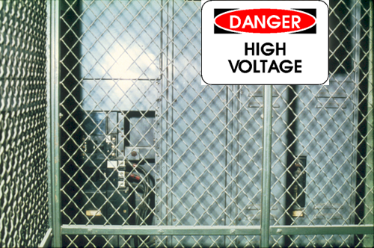
Safety-Related Work Practices
To protect workers from electrical shock:
  Use barriers and guards to prevent passage through areas of exposed energized equipment
  Pre-plan work, post hazard warnings and use protective measures
  Keep working spaces and walkways clear of cords
Notes:
1926.416, 1926.417
Employees must not work near any part of an electric power circuit that the employee could contact in the course of work, unless the employee is protected against electric shock by de-energizing the circuit and grounding it or by guarding it effectively by insulation or other means.
* In work areas where the exact location of underground electric power lines is unknown, employees using jack‑hammers, bars, or other hand tools which may contact a line shall be provided with insulated protective gloves.
* Before work is begun, inquire or observe by instruments whether any part of an energized electric power circuit is so located that the performance of the work may bring any person, tool, or machine into physical or electrical contact with the electric power circuit. Post and maintain proper warning signs where such a circuit exists. The employer shall advise employees of the location of such lines, the hazards involved, and the protective measures to be taken.

Slide 45
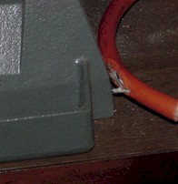
Safety-Related Work Practices
Use special insulated tools when working on fuses with energized terminals
Don’t use worn or frayed cords and cables
Don’t fasten extension cords with staples, hang from nails, or suspend by wire.
Notes:
1926.416, 1926.417
Only qualified persons may work on electric circuit parts or equipment that have not been deenergized. Such persons shall be capable of working safely on energized circuits and shall be familiar with the proper use of special precautionary techniques, PPE, insulating and shielding materials, and insulated tools.
Deenergize live parts that an employee may be exposed to before the employee works on or near them, unless the employer can demonstrate that deenergizing introduces additional or increased hazards or is infeasible due to equipment design or operational limitations. Live parts that operate at less than 50 volts to ground need not be deenergized if there will be no increased exposure to electrical burns or to explosion due to electric arcs.
If the exposed live parts are not deenergized other safety-related work practices shall be used to protect employees who may be exposed to the electrical hazards. Employees must be protected against contact with energized circuit parts with any part of their body or indirectly through some other conductive object.
Lock or tag out (or both) the circuits energizing the parts while any employee is exposed to contact with parts of fixed electric equipment or circuits which have been deenergized.
If working near overhead lines, the lines shall be deenergized and grounded, or other protective measures shall be provided before work is started.
Portable cord and plug connected equipment and extension cords shall be visually inspected before use on any shift for external defects (such as loose parts, deformed and missing pins, or damage to outer jacket or insulation) and for evidence of possible internal damage (such as pinched or crushed outer jacket).

Slide 46
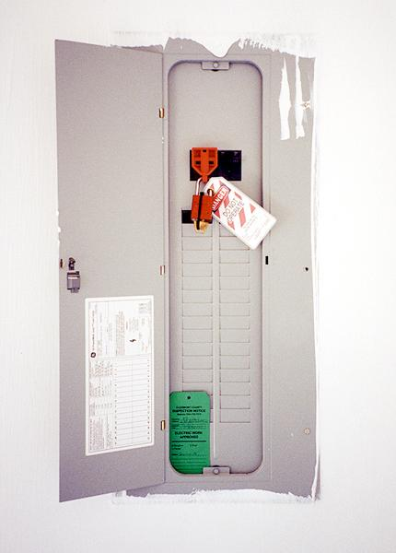
Preventing Electrical Hazards - Planning
Plan your work with others
Plan to avoid falls
Plan to lock-out and tag-out equipment
Remove jewelry
Avoid wet conditions and overhead power lines
Notes:
Make your environment safer by doing the following:
Lock and tag out circuits and machines.
Prevent overloaded wiring by using the right size and type of wire.
Prevent exposure to live electrical parts by isolating them.
Prevent exposure to live wires and parts by using insulation.
Prevent shocking currents from electrical systems and tools by grounding them.
Prevent shocking currents by using GFCI’s.
Prevent too much current in circuits by using overcurrent protection devices.

Slide 47
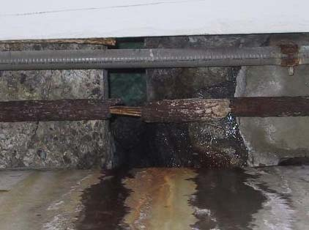
Avoid Wet Conditions
If you touch a live wire or other electrical component while standing in even a small puddle of water, you’ll get a shock.
Damaged insulation, equipment, or tools can expose you to live electrical parts.
Improperly grounded metal switch plates & ceiling lights are especially hazardous in wet conditions.
Wet clothing, high humidity, and perspiration increase your chances of being electrocuted.
Notes:
A damaged tool may not be grounded properly, so the housing of the tool may be energized, causing you to receive a shock.
Improperly grounded metal switch plates and ceiling lights are especially hazardous in wet conditions. If you touch a live electrical component with an uninsulated hand tool, you are more likely to receive a shock when standing in water. But remember: you don’t have to be standing in water to be electrocuted. Wet clothing, high humidity, and perspiration also increase your chances of being electrocuted.
Use extra caution when working with electricity when water is present in the environment or on the skin. Pure water is a poor conductor, but small amounts of impurities, like salt and acid (both are in perspiration), make it a ready conductor.

Slide 48
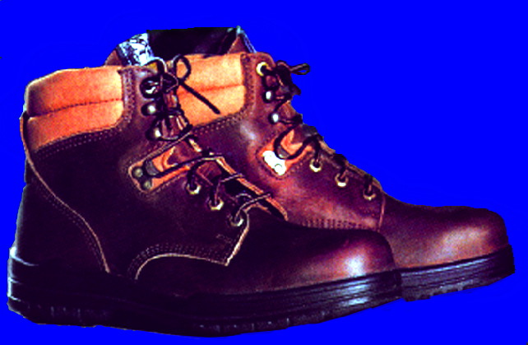
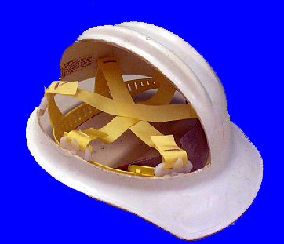
Preventing Electrical Hazards - PPE
    Proper foot protection (not tennis shoes)
    Rubber insulating gloves, hoods, sleeves, matting, and blankets
    Hard hat (insulated - nonconductive)
Notes:
Personal protective equipment (PPE) should always be the last line of defense against a hazard. If the hazard is unavoidable, and cannot be addressed in any other safe manner, then employees must be fitted with proper PPE.
Safety shoes should be nonconductive and protect your feet from completing an electrical circuit to ground. They can also protect against open circuits of up to 600 volts in dry conditions. These shoes should be used with other insulating equipment and in connection with active precautions to reduce or eliminate the potential for providing a path for hazardous electrical energy.
When it is necessary to handle or come close to wires with a potential live electrical charge, it is essential to use proper insulating PPE to protect employees from contact with the hazardous electrical energy.
Specific types of hard hats are needed when performing electrical work.
A “Class B” Electrical/Utility type hard hat protects against falling objects and high-voltage shock and burns.

Slide 49
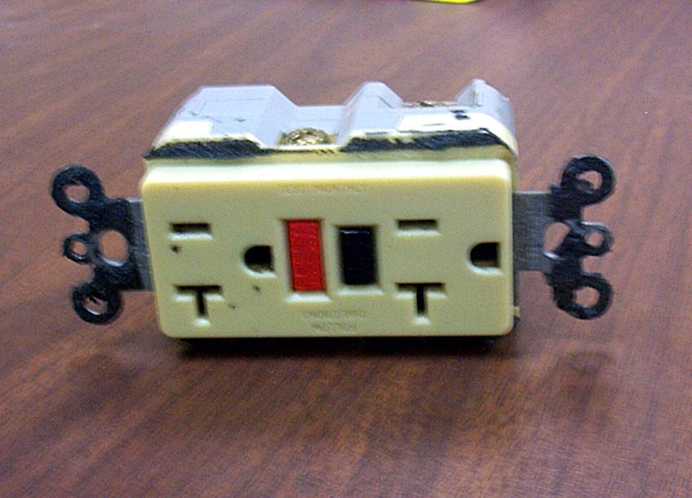
Preventing Electrical Hazards – Proper Wiring and Connectors
    Use and test GFCI’s
    Check switches and insulation
    Use three prong plugs
    Use extension cords only when necessary & assure in proper condition and right type for job
    Use correct connectors
Notes:
If the polarity is reversed on a GFCI, the lights will test good, but the press to test button will not trip the circuit.

Slide 50
Training
Train employees working with electric equipment in safe work practices, including:
Deenergize electric equipment before inspecting or repairing
Using cords, cables, and electric tools that are in good repair
Lockout / Tagout recognition and procedures
Use appropriate protective equipment
Notes:
1926.21(b)(2)
De-energizing Electrical Equipment.
Accidental or unexpected starting of electrical equipment can cause injury or death. Before ANY inspections or repairs are made, the current must be turned off at the switch box and the switch padlocked in the OFF position. At the same time, the switch or controls of the machine or other equipment being locked out of service must be securely tagged to show which equipment or circuits are being worked on.
Employees shall be trained in and familiar with the safety-related work practices that pertain to their respective job assignments.

Slide 51
Summary – Hazards & Protections
Hazards
Inadequate wiring
Exposed electrical parts
Wires with bad insulation
Ungrounded electrical systems and tools
Overloaded circuits
Damaged power tools and equipment
Using the wrong PPE and tools
Overhead powerlines
All hazards are made worse in wet conditions
Protective Measures
Proper grounding
Use GFCI’s
Use fuses and circuit breakers
Guard live parts
Lockout/Tagout
Proper use of flexible cords
Close electric panels
Training

Slide 52
Summary
Electrical equipment must be:
  Listed and labeled
  Free from hazards
  Used in the proper manner
If you use electrical tools you must be:
  Protected from electrical shock
  Provided necessary safety equipment

