Slide 1
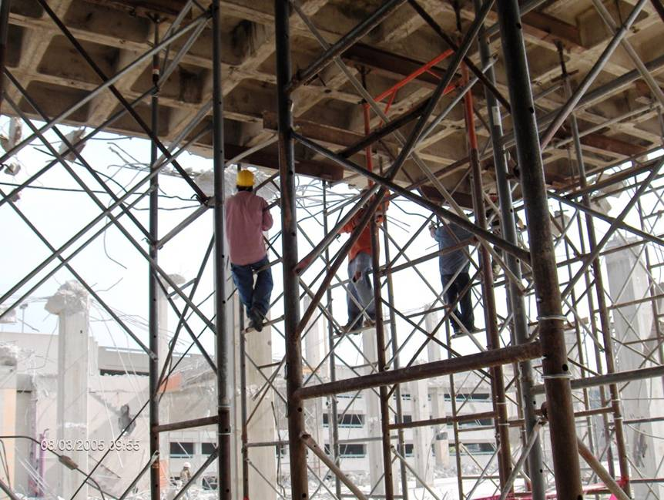
Is This a Fall Hazard?
Photos in this presentation are from the OSHA Region 4 National Photo Archive and OSHA Region 5.
1
Notes:
1
TRAINER NOTE: Your options are to use:
this presentation as developed to prompt hazard recognition classroom discussions; or
the presentation as developed along with the alternative activity approach to encourage student note taking regarding hazard recognition (see “Falls_HazRec_AltActivity” folder provided); or
your own photos to cover the hazard recognition component.
PHOTO: Workers are climbing on the shoring structure during set up and removal.

Slide 2
YES
Workers could fall while climbing on the shoring structure to set it up and remove it.
Ladders and lifts must be provided.
2
Notes:
2
Ladders/lifts are needed for safe access to the shoring structure.

Slide 3
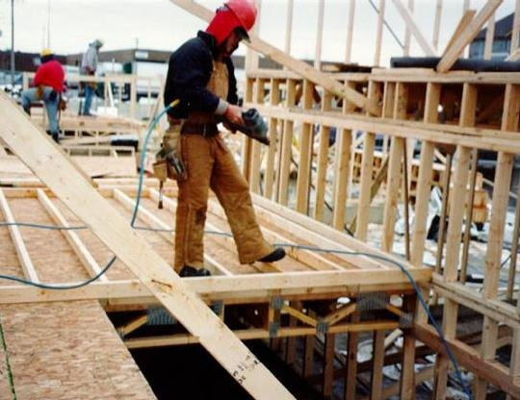
Any Fall Hazard Here?
3
Notes:
3
Worker working above ground level.

Slide 4
YES
Workers are exposed to a fall hazard greater than 6 feet, while working near stairwell opening.
Workers must be protected from falls over 6 feet.
4
Notes:
4
Workers are exposed to a fall hazard greater than 6 feet, while working near a stairwell opening.

Slide 5
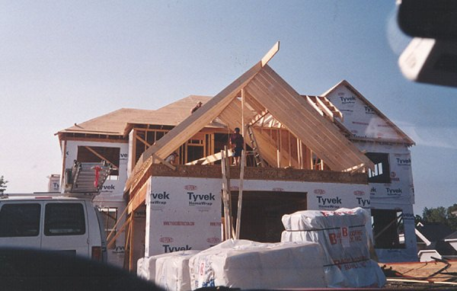
Is This a Fall Hazard?
5
Notes:
5

Slide 6
YES
Unprotected open-sided floors 6 feet or more above ground level.
Guardrail systems, safety net systems or personal fall arrest systems are required.
6
Notes:
6
Fall protection must be provided for workers on open-sided floors 6 feet or more above a lower level. Often material handling is the reason guardrails are not in place.

Slide 7
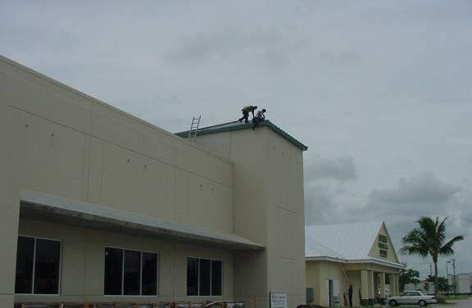
Any Fall Hazard Here?
7
Notes:
7
Workers are installing a new metal roof.

Slide 8
YES
Workers are installing a new metal roof without fall protection.
NOTE: Remember that ladders must extend 3 feet above the landing area.
8
Notes:
8

Slide 9
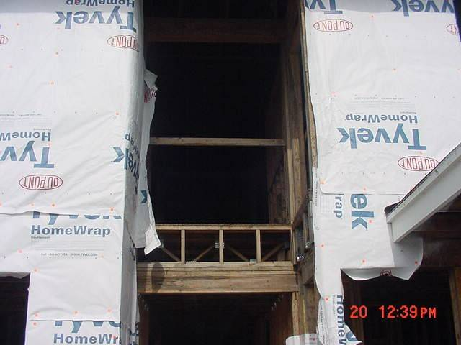
Is This a Fall Hazard?
9
Notes:
9
This is 12 feet above the lower level.

Slide 10
YES
The photo shows a mid-rail and toeboard are missing on an open-sided floor of a building.
This could expose workers to a 12 foot fall.
Toeboards are required to protect workers below from falling objects.
10
Notes:
10
There is a missing mid-rail and toeboard on an open-sided floor of a building, exposing workers to a 12 foot fall. When workers are exposed to falling objects from above, hard hats must be worn

Slide 11
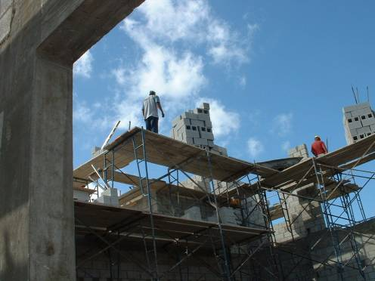
Can You Identify the Fall Hazard?
11
Notes:
11
Workers on fabricated frame scaffolds stacking blocks.

Slide 12
YES
Planks appear to be overloaded and there is no safe access for workers.
Lack of fall protection for workers on fabricated frame scaffolds.
The workers are exposed to a 35-foot fall hazard from a scaffold while stacking blocks prior to overhand bricklaying operations.
12
Notes:
12
Workers on fabricated frame scaffolds stacking blocks are exposed to a 35-foot fall hazard from a scaffold.
Lack of fall protection for workers on fabricated frame scaffolds. The workers are exposed to a 35-foot fall hazard from a scaffold while stacking blocks prior to overhand bricklaying operations. The planks appear to be overloaded and there is no safe access for the workers.

Slide 13
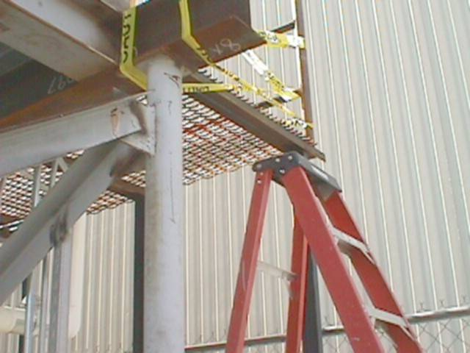
Can You Identify the Fall Hazard?
13
Notes:
13

Slide 14
YES
It must extend 3 feet above the working surface.
Ladder to work platform is not of sufficient length.
14
Notes:
14
Ladder to work platform is not of sufficient length.
The ladder must extend 3 feet above the working surface.

Slide 15
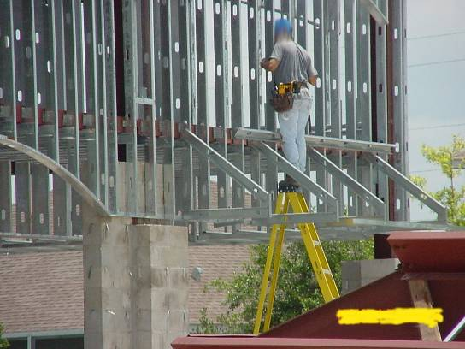
Is This a Fall Hazard?
15
Notes:
15
Worker is working off of the top of a step ladder.

Slide 16
YES
The top of a stepladder shall not be used as a step.
Worker is working off of the top of a step ladder.
16
Notes:
16
OSHA standards do not permit the top or top step of a stepladder to be used as a step. See 1926.1053(b)(13).

Slide 17
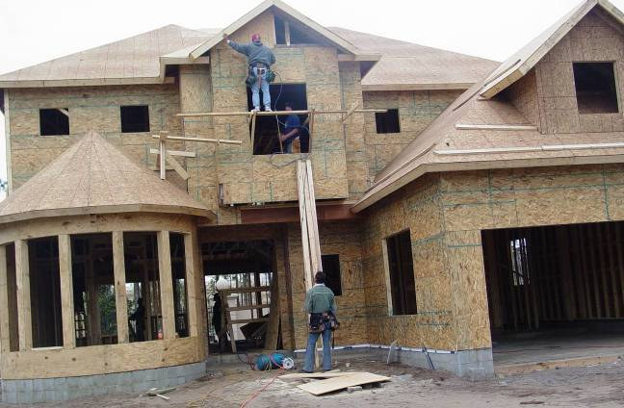
Can You Identify the Fall Hazards?
17
Notes:
17

Slide 18
YES
A worker is working from a carpenters' scaffold that has no guardrail, extends too far beyond either end, and is not wide enough.
The worker inside of the window is not provided with fall protection as there is no standard guardrail for the window.
The worker also does not have proper access to the scaffold.
The worker working below is exposed to the struck-by hazards of tools and equipment falling from the employees working above.
NOTE: A competent person must supervise as scaffolds are erected, moved and taken apart.
18
Notes:
18
There is no guardrail or other fall protection for the worker on the carpenters' scaffold. This scaffold extends too far beyond either end, and is not wide enough. It must be at least 18 inches. The scaffold must meet 1926.451(a)(1), four times the intended load. If installed, the top rails must have 200 lbs. capacity and the midrails must have 150 lbs. capacity. In addition, the worker did not have proper access to the scaffold. The worker inside of the window was not provided with fall protection because a standard guardrail was not provided for the window. The worker working below was exposed to the struck-by hazards of tools and equipment from the employees working above. When workers are exposed to falling objects, the employer shall have each employee wear a hard hat and implement protective measures, such as toeboards, screens, or barricades for the area underneath. In addition, scaffolds must be erected, moved, dismantled and altered only under the supervision of a competent person. See 1926.451(f)(7).

Slide 19
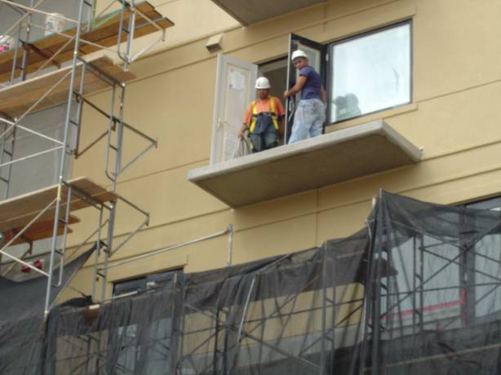
Any Fall Hazard Here?
19
Notes:
19
Workers working on balcony of structure.

Slide 20
YES
Workers working on balcony of structure exposed to fall hazard due to unprotected side/edge.
20
Notes:
20
Workers are exposed to a fall hazard due to the unprotected sides/edges of the balcony.

Slide 21
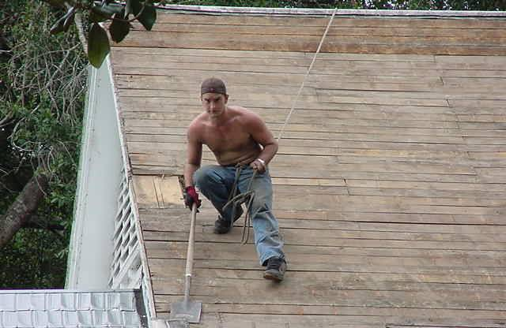
Is This a Fall Hazard?
21
Notes:
21
Worker working on an 8:12 pitch roof with the lifeline tied to his waist as fall protection.

Slide 22
YES
Worker working on an 8:12 pitch roof with only the lifeline tied to his waist as fall protection.
Employer must provide full body harnesses.
22
Notes:
22
Employer must provide full body harnesses.

Slide 23
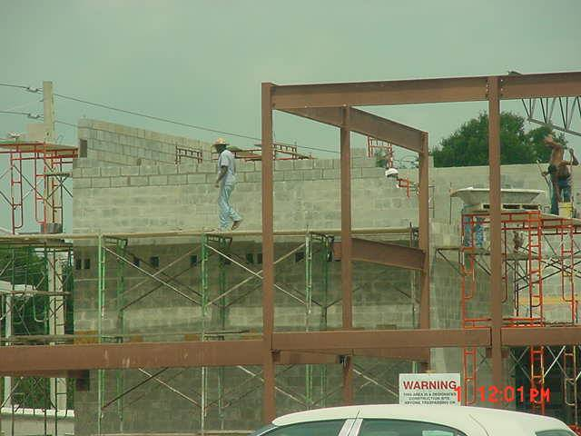
Is This a Fall Hazard?
23
Notes:
23
Workers were working at heights greater than 10 feet.

Slide 24
YES
Scaffold was not erected with guardrails in areas where workers were working at heights greater than 10 feet.
24
Notes:
24
The scaffold was not erected with guardrails in areas where workers were working at heights above 10 feet.

Slide 25
Fall Hazards - Topics
Identify major fall hazards
Describe types of fall hazards
Protect him/herself from fall hazards
Recognize employer requirements to protect workers from fall hazards

Slide 26
Fall Hazards
Falls are the leading cause of fatalities in the construction industry. An average of 362 fatal falls occurred each year from 1995 to 1999, with the trend on the increase.
Fall hazards are present at most worksites and many workers are exposed to these hazards daily. A fall hazard is anything at your worksite that could cause you to lose your balance or lose bodily support and result in a fall. Any walking or working surface can be a potential fall hazard.

Slide 27
Fall Hazards
Any time you are working at a height of four feet or more, you are at risk. OSHA generally requires that fall protection be provided at four feet in general industry, five feet in maritime and six feet in construction. However, regardless of the fall distance, fall protection must be provided when working over dangerous equipment and machinery. The importance of fall protection cannot be stressed enough.

Slide 28
Fall Hazards - Examples
Fall hazards in construction cause accidents such as the following:
A makeshift scaffold collapsed under the weight of four workers and their equipment, seriously injuring all four.
A worker carrying a sheet of plywood on a flat roof stepped into a skylight opening and fell to the level below.
A roofer, while attempting to remove a roof opening cover, fell approximately 21 feet to the concrete floor below and was killed.
A construction worker was working from a carpenters' wall bracket scaffold without fall protection. The worker fell 19 feet to the ground, sustained blunt trauma to the head and later died.

Slide 29
Major types of fall hazards in construction
Unprotected roof edges, roof and floor openings, structural steel and leading edges, etc.
Improper scaffold construction
Unsafe portable ladders

Slide 30
Examples - Unprotected roof edges, roof and floor openings, structural steel and leading edges, etc.
An ironworker was standing on a tilt-up concrete wall, throwing out bridging. He was wearing a harness and lanyard but was not tied-off. He fell 30 feet to the ground and sustained crushing injuries to his spine, resulting in permanent paralysis below the chest.
A worker was working on a second-story roof, which was stripped off of the original roofing clay tile, felt paper and existing skylights. He was preparing the roof for installation of new materials. While working, he stepped through the removed skylight opening, which was covered only with felt paper. He fell approximately 24 feet to a ceramic tile covered concrete floor and was hospitalized with a head fracture.
Notes:
The accident could have been
prevented if the ironworker was
properly tied off.
Holes, including skylights, must
have covers that are capable of
supporting, without failure, at least
twice the weight of employees,
equipment and materials that may
be imposed on the cover at any
one time.

Slide 31
How Do I Avoid Hazards?
Use at least one of the following whenever employees are exposed to a fall of 6 feet or more above a lower level:
  Guardrail Systems
  Safety Net Systems
  Personal Fall Arrest Systems
Cover or guard floor holes as soon as they are created during new construction.
For existing structures, survey the site before working and continually audit as work continues. Guard or cover any openings or holes immediately.
Construct all floor hole covers so they will effectively support two times the weight of employees, equipment, and materials that may be imposed on the cover at any one time.
In general, it is better to use fall prevention systems, such as guardrails, than fall protection systems, such as safety nets or fall arrest devices, because they provide more positive safety means.
Notes:
If your employer uses guardrails:
● Toprails must be at least ¼ inch thick to
prevent cuts and lacerations; and they must be
between 39 and 45 inches from the working
surface;
● If wire rope is used, it must be flagged at least
every six feet with highly visible materials;
● Midrails, screens or mesh must be installed
when there are no walls at least 21 inches high.
Screens and mesh must extend from the toprail to the working level.
● There can be no openings more than 19 inches;
● The toprail must withstand at least 200 lbs. of force; the midrail must
withstand 150 lbs. of force;
● The system must be smooth enough to protect workers from cuts and
getting their clothes snagged by the rail.
● If guardrails are used around holes at points of access, like a ladderway, a
gate must be used to prevent someone from falling through the hole, or be
offset so that a person cannot walk directly into the hole.

Slide 32
Examples - Improper scaffold construction
A construction worker was working from a carpenters' wall bracket scaffold without fall protection. The worker fell 19 feet to the ground, sustained blunt trauma to the head, and later died.
A worker preparing masonry fascia for removal from a building fell from the third level of a tubular welded-frame scaffold. No guarding system was provided for the scaffold. Further, the platform was coated with ice, creating a slippery condition.

Slide 33
How Do I Avoid Hazards?
Construct all scaffolds according to the manufacturer's instructions.
Install guardrail systems along all open sides and ends of platforms.
Use at least one of the following for scaffolds more than 10 feet above a lower level:
  Guardrail Systems
  Personal Fall Arrest Systems
Provide safe access to scaffold platforms
Do not climb cross-bracing as a means of access.
Notes:
Climbing the structural cross-braces of a scaffold is unsafe, and specifically forbidden by federal standards. However, OSHA permits direct access from another scaffold, structure, or personnel hoist.
If such access is not possible, portable ladders, hook-on ladders, attachable ladders, stair towers, stairway-type ladders, ramps, walkways, or built-in ladders must be used, under the following regulations:

Slide 34
Examples - Unsafe portable ladders
A worker was climbing a 10 foot ladder to access a landing, which was 9 feet above the adjacent floor. The ladder slid down, and the worker fell to the floor, sustaining fatal injuries. Although the ladder had slip-resistant feet, it was not secured and the railings did not extend 3 feet above the landing.
A worker fell approximately 11 feet from an unsecured 24-foot portable extension ladder, which he had leaned against the fascia board above the garage of a house under construction. The worker sustained left leg fracture injuries and was hospitalized.
Notes:
BLS data show that falls from ladders account for over
100 fatalities each year. Factors that contribute to falls
from ladders are ladder slip (top or bottom),
overreaching, slipping on rungs/steps, defective
equipment and improper ladder selection for a given
task. Frequently cited OSHA ladder violations include
not having a portable ladder extend 3 feet above the
landing, no worker training, and improper use of the
top of stepladders.

Slide 35
How Do I Avoid Hazards?
Position portable ladders so the side rails extend at least 3 feet above the landing.
Secure side rails at the top to a rigid support and use a grab device when 3 foot extension is not possible.
Make sure that the weight on the ladder will not cause it to slip off its support.
Before each use inspect ladders for cracked or broken parts such as rungs, steps, side rails, feet and locking components.
Do not apply more weight on the ladder than it is designed to support.
Use only ladders that comply with OSHA design
standards [29 CFR 1926.1053(a)(1)].
Notes:
Loads Self-supporting (foldout) and non-self-supporting (leaning) portable ladders must be able to support at least four times the maximum intended load, except extra-heavy-duty metal or plastic ladders, which must be able to sustain 3.3 times the maximum intended load.
Angle Non-self-supporting ladders, which must lean against a wall or other support, are to be positioned at such an angle that the horizontal distance from the top support to the foot of the ladder is about 1/4 the working length of the ladder. In the case of job-made wooden ladders, that angle should equal about 1/8 the working length. This minimizes the strain of the load on ladder joints that may not be as strong as on commercially manufactured ladders.
Rungs Ladder rungs, cleats, or steps must be parallel, level, and uniformly spaced when the ladder is in position for use. Rungs must be spaced between 10 and 14 inches apart. For extension trestle ladders, the spacing must be 8-18 inches for the base, and 6-12 inches on the extension section. Rungs must be so shaped that an employee's foot cannot slide off, and must be skid-resistant.
Slipping Ladders are to be kept free of oil, grease, wet paint, and other slipping hazards. Wood ladders must not be coated with any opaque covering, except identification or warning labels on one face only of a side rail.
Other Requirements Foldout or stepladders must have a metal spreader or locking device to hold the front and back sections in an open position when in use. When two or more ladders are used to reach a work area, they must be offset with a landing or platform between the ladders. The area around the top and bottom of ladder must be kept clear. Ladders must not be tied or fastened together to provide longer sections, unless they are specifically designed for such use. Never use a ladder for any purpose other than the one for which it was designed.

Slide 36
Employer Responsibilities
Provide fall protection
Ensure proper scaffold construction
Ensure safe ladder use and condition
Conduct worksite maintenance
Provide training

Slide 37
Employer Responsibilities
OSHA’s fall protection standards require employers to provide fall protection for you when you are exposed to a fall hazard.
The standards cover hazard assessment, fall protection and safety monitoring systems. Controlled access zones, safety nets, and guardrail, personal fall arrest, warning line and positioning device systems are also addressed.
Notes:
See 29 CFR, Subpart M, Fall
Protection, 1926.500, 1926.501,
1926.502, and 1926.503
Under 1926.502(d), OSHA
requires that employers provide for
“prompt rescue of employees in
the event of a fall or shall assure
that employees are able to rescue
themselves.” This should include
identifying rescue procedures that
address the potential for
suspension trauma or orthostatic
intolerance, which may be
experienced by workers using fall
arrest systems. See the
Suspension Trauma Safety and
Health Information Bulletin,
http://www.osha.gov/dts/shib/
shib032404.pdf
for additional information.

Slide 38
Employer Responsibilities
If personal fall protection systems are used, employers must pay particular attention to identifying attachment points and to ensuring that workers know how to properly don and inspect the equipment.
Notes:
The following are some things your employer should
do to prevent fall hazards at your worksite:
1. Develop a written fall protection plan.
2. Identify potential fall hazards prior to each project
and during daily walk-arounds. Pay attention to
hazards associated with routine and non-routine
tasks.
3. Eliminate the need for fall protection where
possible by rescheduling the task, isolating the
task, or changing the task.
4. Ensure that fall protection equipment is
appropriate to the task, in good condition and
used properly.
5. Conduct general fall prevention training on a
regular basis.
6. Train workers on the specific fall hazards identified
and on the required personal protective
equipment.
7. Conduct regular inspections of fall protection
equipment in accordance with the manufacturer’s
recommendations and OSHA’s requirements.
8. Emphasize fall hazards unique to the site, such as
open floor holes or shafts, riser penetrations and
skylights.

Slide 39
Employer Responsibilities
Proper scaffold construction
Employers must construct all scaffolds according to the manufacturer’s instructions. A “competent person” must supervise as scaffolds are erected, moved, taken apart or changed, and must inspect the scaffolding. A guardrail system or a personal fall arrest system is required for scaffolds more than 10 feet above a lower level. In addition, employers must provide safe access to scaffold platforms.
Notes:
OSHA defines a “competent
person’ as “one who is capable of
identifying existing and predictable
hazards in the surroundings or
working conditions which are
unsanitary, hazardous, or
dangerous to workers, and who
has authorization to take prompt
corrective measures to eliminate
them.”
See 29 CFR 1926.450 – 1926.454,
Scaffold requirements

Slide 40
Employer Responsibilities
Ladder use and condition
Employers are required to provide ladders where necessary and maintain the ladders in proper condition. Employers must also train workers to recognize ladder and stairway hazards.
Notes:
See 1926.1053, Ladders and
1926.1060, Training
Requirements. 1926.1060 (a)
states: The employer shall provide
a training program for each
employee using ladders and
stairways, as necessary. The
program shall enable each
employee to recognize hazards
related to ladders and stairways,
and shall train each employee in
the procedures to be followed to
minimize these hazards.

Slide 41
Employer Responsibilities
Worksite Maintenance
Poor worksite maintenance can lead to clutter and debris on a construction site, creating additional slip, trip and fall hazards. Poor maintenance of ladders, scaffolds and fall protection equipment can also lead to serious injuries. Employers are required to keep worksites free of form and scrap lumber with protruding nails and other waste and trash, including combustible debris.
Notes:
See 29 CFR 1926.25,
Housekeeping; 1926.28, Personal
Protective Equipment; 1926.95,
Criteria for Personal Protective
Equipment; 1926.451, Scaffolds;
1926 Subpart X, Ladders

Slide 42
Employer Responsibilities
Training
As discussed, your employer must provide you with training on fall hazards and the required personal protective equipment. OSHA also has specific standards that require your employer to train you when you work with scaffolds and ladders. If you see fall hazards or have any questions about fall prevention, contact your supervisor. Do not work until unsafe conditions have been corrected. If hazards are not corrected, you may contact OSHA and file a complaint.
Notes:
See 1926.503, Fall Protection
Training Requirements; 1926.454,
Scaffolds Training Requirements;
1926.1060, Ladders Training
Requirements. See also 29 CFR
1926.21(b)(2), OSHA’s general
training requirement: The employer
shall instruct each employee in the
recognition and avoidance of
unsafe conditions and the
regulations applicable to his work
environment to control or eliminate
any hazards or other exposure to
illness or injury.

