Slide 1




Slide 2
Lesson Overview
Purpose:
To provide workers with introductory information about OSHA…
Topics:
  OSHA’s Mission
  OSHA Standards
  Employer Responsibilities
  Workers Rights/Responsibilities
OSHA “We Can Help”

Slide 3
Lesson Overview
Topics: cont’d
  Enforcing Standards
  Reporting Safety Hazards
  Whistleblower Protection
  Worker Resources
OSHA “We Can Help”

Slide 4

Topic 1
History of OSHA
Until 1970, there were no national laws for safety and health hazards.
The U.S. Congress created OSHA under the Occupational Safety and Health Act of 1970 (the OSH Act).
Congress passed the law and established OSHA.

Slide 5

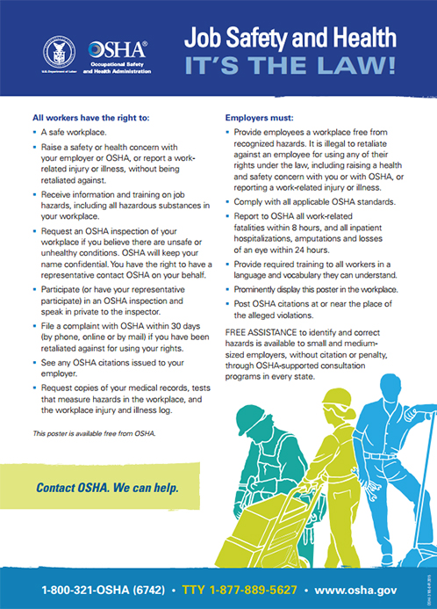
Worker Rights
Handout #1:
OSHA Poster
Have you seen this poster at your place of work?
Why was OSHA created?

Slide 6
OSHA’s Mission
The mission of OSHA is to save lives, prevent injuries and protect the health of America’s workers.
The OSH Act stated that workers have the right to a safe workplace and that it is the employer’s responsibility to provide safe and healthy workplaces.

Slide 7
OSHA’s Mission cont’d
OSH Act was passed to prevent workers from being killed or seriously harmed at work.
The law requires that employers provide their employees with working conditions that are free of known dangers.

Slide 8
OSHA’s Mission cont’d
The Act created the Occupational Safety and Health Administration (OSHA), which sets and enforces protective workplace safety and health standards.
OSHA also provides information, training and assistance to workers and employers..
OSHA “We Can Help”

Slide 9
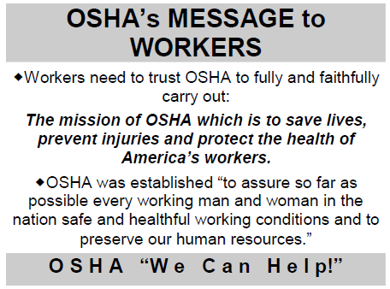

Slide 10
Topic 2
What are OSHA Standards?
Four Groups of OSHA Standards
General Industry*
Construction
Maritime
Agriculture
*General Industry is the set that applies to the largest number of workers and worksites
OSHA standards are:
Rules that describe the methods employers must use to protect employees from hazards.
Designed to protect workers from a wide range of hazards…

Slide 11
How Do OSHA Standards Protect Workers?
They are in the Code of Federal Regulations.
29 is the book assigned to the Department of Labor; therefore, the OSHA standards are:
1910 is assigned to General Industry
1926 is assigned to Construction
1915 is assigned to Maritime
Where there are no specific standards, employers must comply with the General Duty Clause of the OSH Act.

Slide 12
OSHA Standards cont’d
These standards:
Limit the amount of hazardous chemicals workers can be exposed to,
Require the use of certain safe work practices and equipment,
Require employers to monitor hazards and keep records of workplace injuries and illnesses.

Slide 13
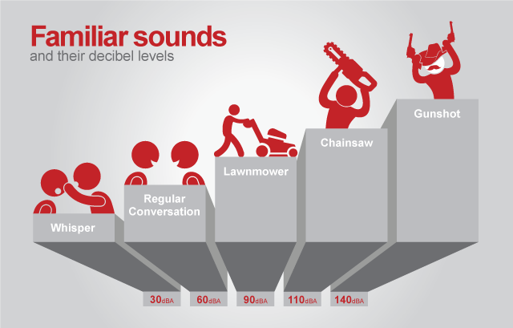
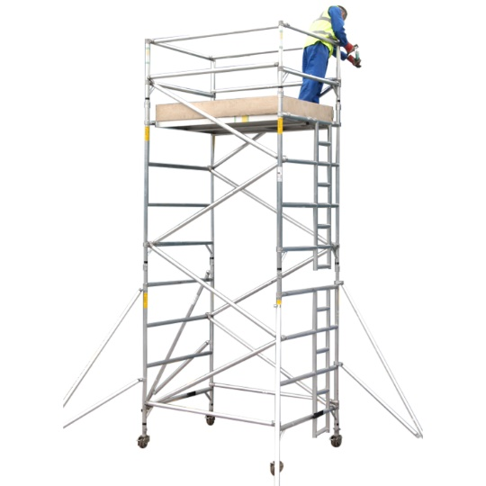
OSHA Standards cont’d
Noise
Chemicals
Protective equipment
Fall protection
Guarding of open sided platforms
Scaffolding
Right to know

Slide 14

Topic 3
What are the Employer’s Responsibilities?
Provide a workplace free from recognized hazards and comply with OSHA standards,
Provide training required by OSHA standards,

Slide 15
Employer’s Responsibilities
Keep records of injuries and illnesses:
  Set up a reporting system;
  Provide copies of logs (i.e., OSHA 300), upon request;
  Post the annual summary;
  Report within 8 hours any work-related fatalities and within 24 hours, all work-related:
    inpatient hospitalizations,
    amputations, and
    losses of an eye.

Slide 16
Employer’s Responsibilities?
Provide medical exams when required by OSHA standards and provide workers access to their exposure and medical records,
Not discriminate against workers who exercise their rights under the Act,
Post OSHA citations and hazard abatement verification notices,

Slide 17

Employer’s Responsibilities
Handout #2:
Provide and pay for most Personal Protective Equipment (PPE)

Slide 18
Topic 4
What are the Worker’s Rights & Responsibilities?
Worker’s Rights:
Section 5(a)(1) of the OSH Act states: “Each employer shall furnish to each of his employees employment and a place of employment which are free from recognized hazards that are causing or are likely to cause death or serious physical harm to his employees."

Slide 19
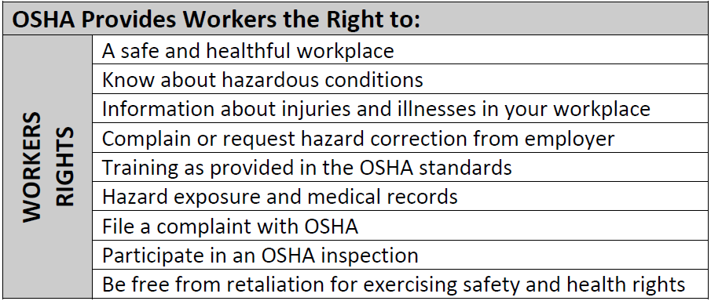
What are the Worker’s Rights

Slide 20
Worker’s Responsibilities
Workers should know that OSHA holds employers responsible for the safety and health conditions in the workplace and does not cite workers for violations.
However, Section 5(b) of the OSH Act states that each employee shall comply with occupational safety and health standards and all applicable rules, regulations and orders. Therefore, workers are encouraged to follow all appropriate safety and health rules and wear personal protective equipment while working.

Slide 21
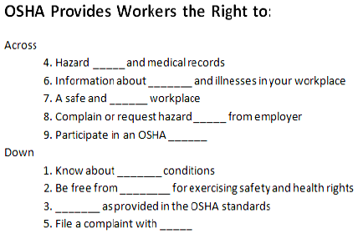
Worker’s Rights
Puzzle:

Slide 22
Topic 5
How Does OSHA Enforce Standards?
OSHA enforces standards through inspections.
Approximately 2,400 inspectors for over 7 million workplaces nationwide.
OSHA targets most dangerous workplaces.

Slide 23
Enforcing Standards
OSHA enforces standards through inspections.
Approximately 2,400 inspectors for over 7 million workplaces nationwide.
OSHA targets most dangerous workplaces.

Slide 24

Enforcing Standards
Questions for Review
Give an example of a reason why OSHA would conduct an inspection at your workplace.
What are the types of OSHA violations?

Slide 25
Enforcing Standards
OSHA inspection process:
  Opening conference,
  A walkthrough, and
  A closing conference with the employer.
Results can take up to 6 months
OSHA can issue citations which may include fines and dates by which the hazard must be abated.

Slide 26
Your Right to…
Participation in OSHA Inspections
Workers have right to have worker representative accompany OSHA inspector on inspection.
Workers can talk to the inspector privately.
Workers may point out hazards, describe injuries, illnesses or near misses that resulted from those hazards and describe any concern you have about a safety or health issue.

Slide 27
Your Right to…
Participation in OSHA Inspections cont’d
Workers can also find out about inspection results and abatement measures, and get involved in any meetings or hearings related to the inspection.
Workers may also object to date set for violation to be corrected and be notified if employer files a contest.

Slide 28
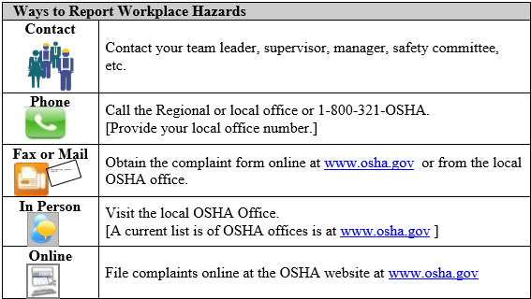
Topic 6
Reporting Safety Hazards

Slide 29
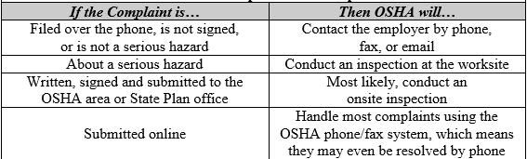

How OSHA Responds to a Complaint
Speed Rounds

Slide 30
Topic #7
What are Your Rights as a Whistleblower?
Handout #3:
If you have been punished or discriminated against for using your rights, you must file a complaint with OSHA within 30 days of the alleged reprisal for most complaints.
No form is required, but you must send a letter or call the OSHA Area Office nearest you to report the discrimination within 30 days of the alleged discrimination.

Slide 31

Topic #8
Worker Resources
Handout #4:

Slide 32
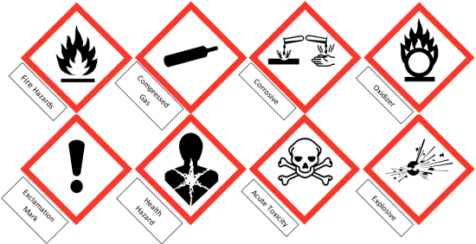
What Are Resources in the Workplace?
Employer or supervisor, co-workers and union representatives
Safety Data Sheet (SDS)
Labels and warning signs
Employee orientation manuals or other training materials

Slide 33
What Are Resources Outside the Workplace?
OSHA online at: http://www.osha.gov
Compliance Assistance Specialists in the area offices
National Institute for Occupational Safety and Health (NIOSH) – OSHA’s sister agency
  Health hazard Evaluations (HHEs)
OSHA Training Institute Education Centers
Health Care Providers

Slide 34
Questions & Answers

