Slide 1
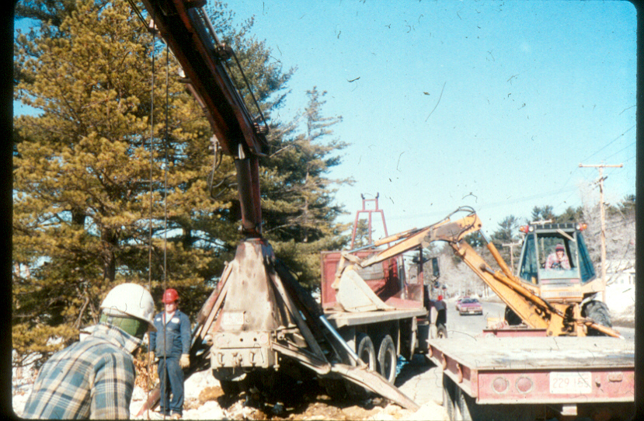
Recognize Any Hazard(s)?
Source: OTI Course #3030

Slide 2
YES
Avoid struck-by hazards by not working within the swing radius of heavy equipment
Source: OTI Course #3030

Slide 3
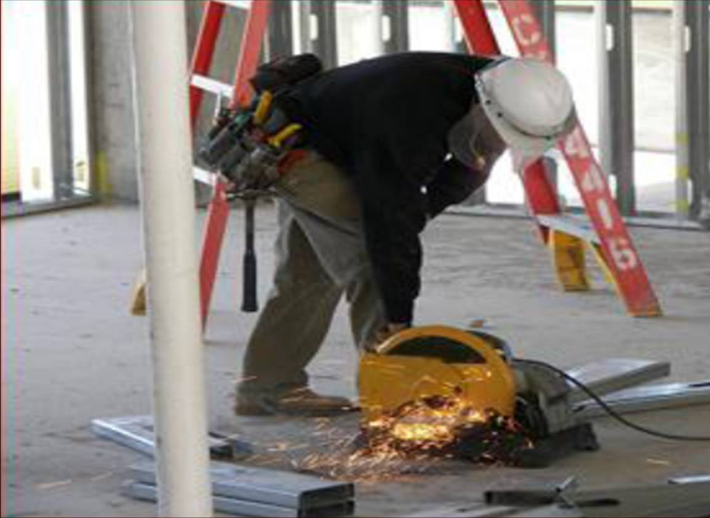
Recognize Any Hazard(s)?
Source: Susan Harwood Grant Number SH-17792-08-60-F-48 by Compacion Foundation

Slide 4
YES
Grinding or striking materials can create flying object hazards. This worker is protected by equipment guarding and faceshield, but should have safety glasses/goggles
Source: Susan Harwood Grant Number SH-17792-08-60-F-48 by Compacion Foundation

Slide 5
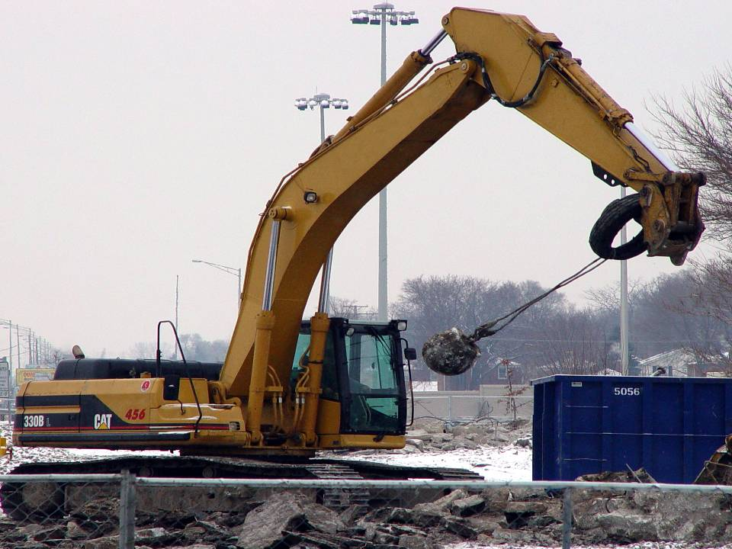
Recognize Any Hazard(s)?
Source: Construction Safety Council

Slide 6
YES
The wrecking ball is loosely attached to arm; could come loose and strike operator’s cab
A worker could be struck by the wrecking ball, hit, or run over by the excavator
Source: Construction Safety Council

Slide 7
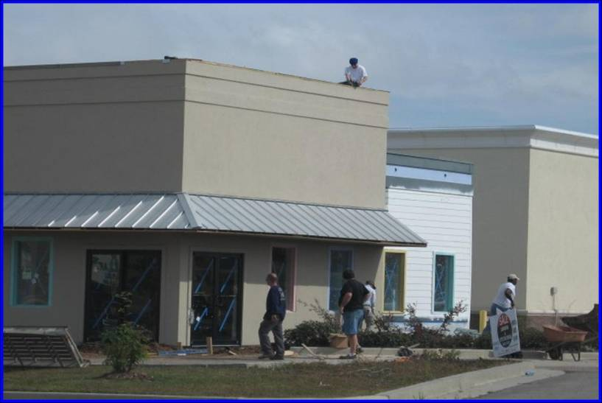
Recognize Any Hazard(s)?
Source: National Photo Archive ID #3295

Slide 8
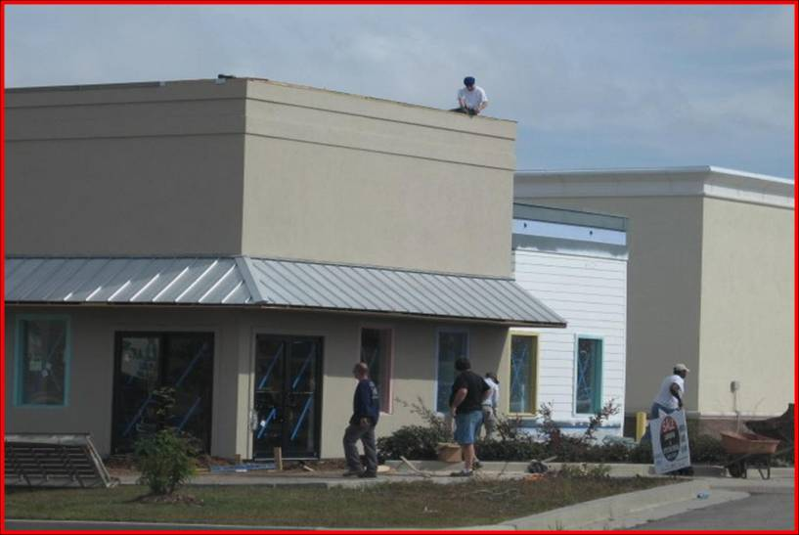
YES
No head protection - workers exposed to struck-by hazards from falling objects
Source: National Photo Archive ID #3295

Slide 9
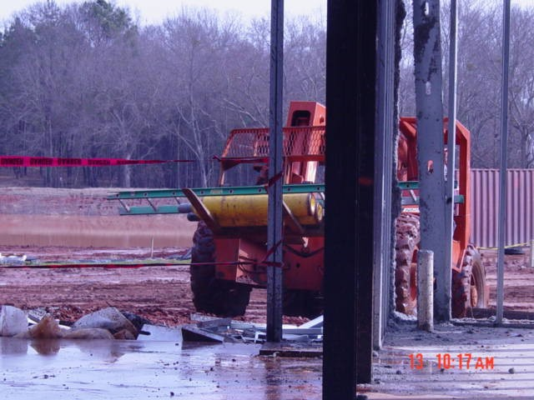
Recognize Any Hazard(s)?
Source: National Photo Archive ID #1470

Slide 10
YES
Unsecured gas cylinders are being transported, exposing workers to struck-by hazard from flying projectiles
Source: National Photo Archive ID #1470

Slide 11
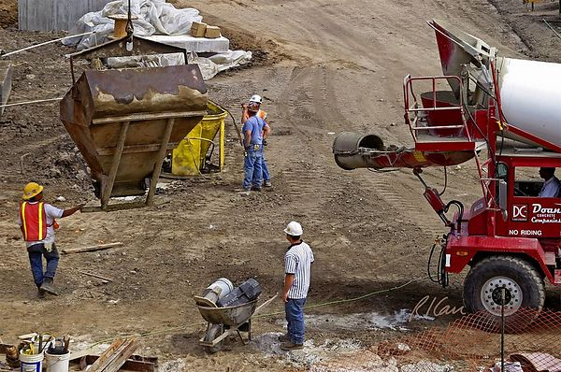
Recognize Any Hazard(s)?
Source: OTI Course #2000

Slide 12
YES
Avoid working below suspended overhead materials. Worker is exposed to falling and swinging struck-by hazards
Source: OTI Course #2000

Slide 13
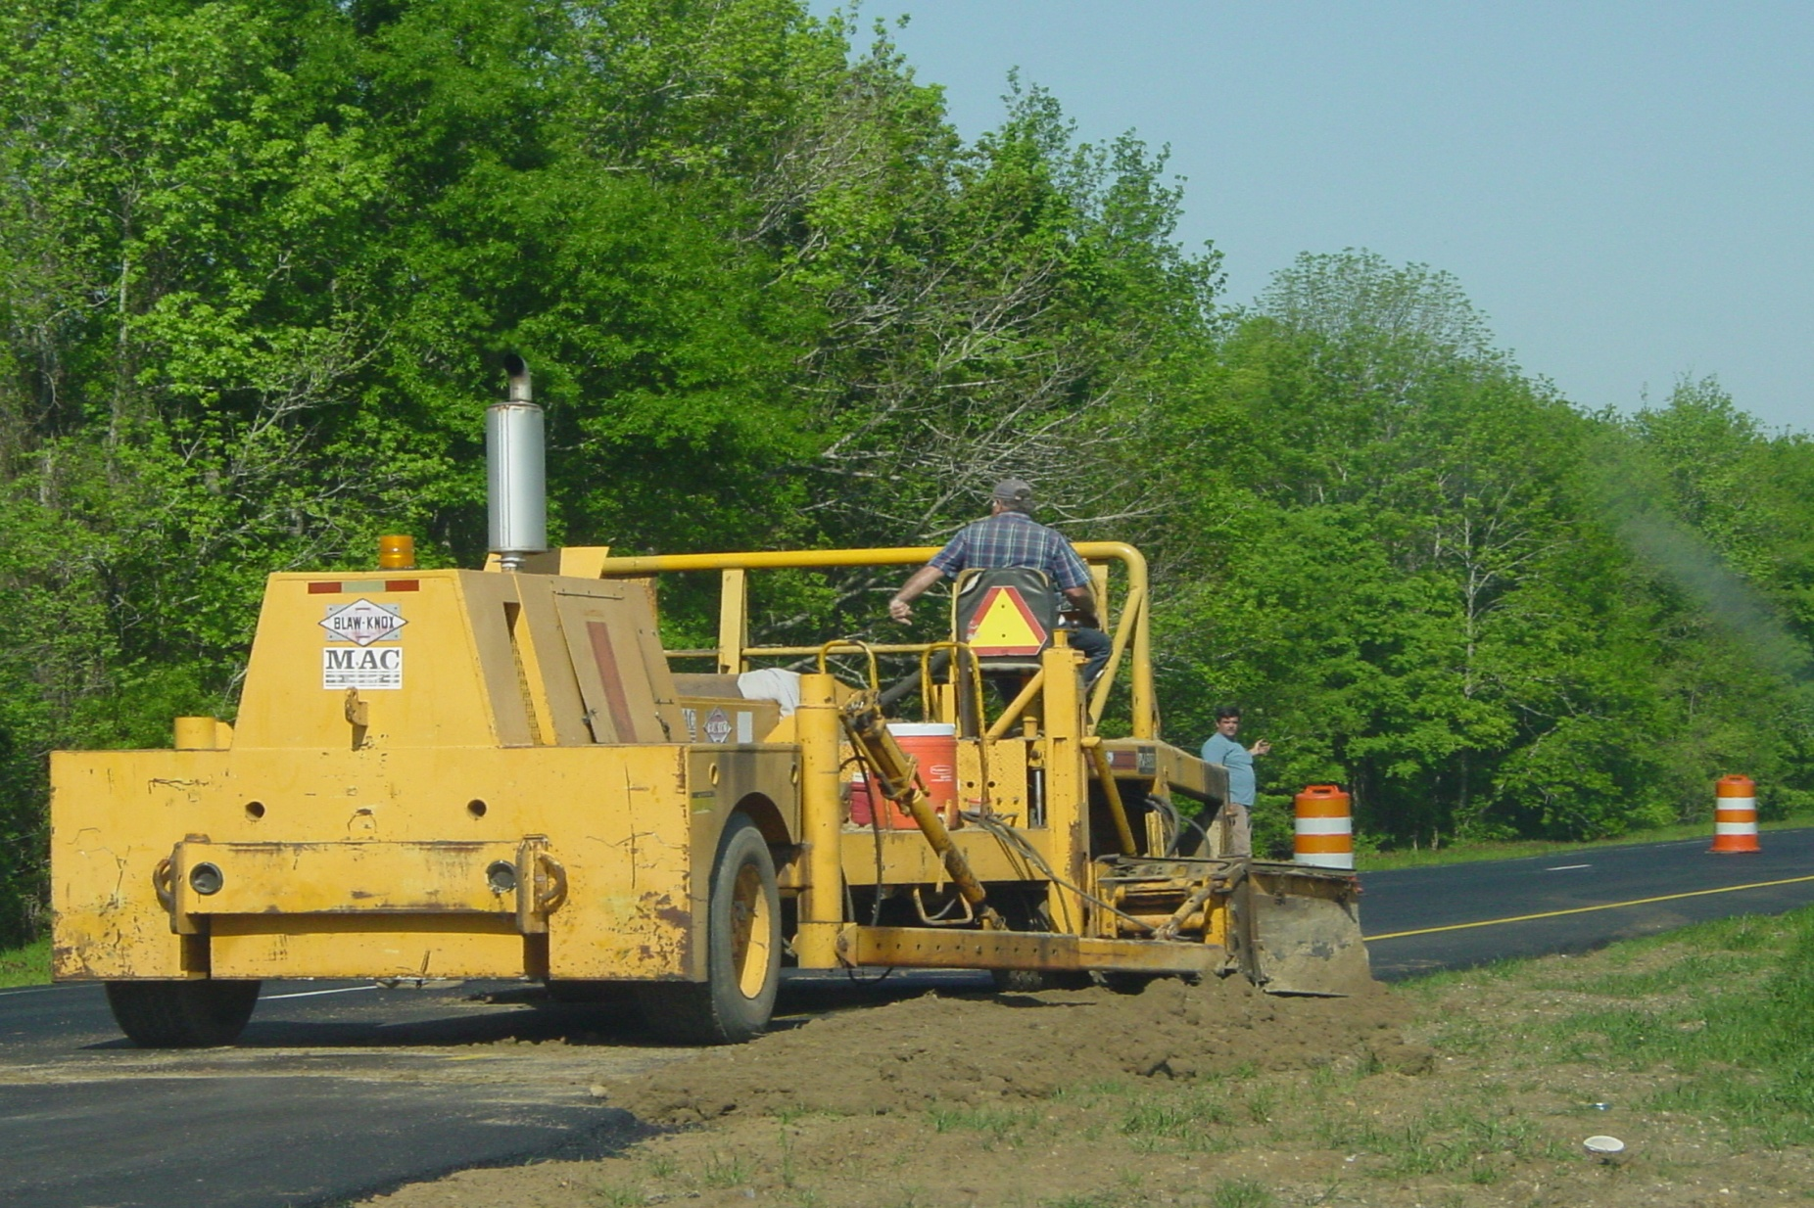
Recognize Any Hazard(s)?
Source: National Photo Archive ID #3466

Slide 14
YES
Highway construction worker needs to wear high visibility reflective clothing to help prevent struck-by hazard from moving heavy equipment
Source: National Photo Archive ID #3466

Slide 15
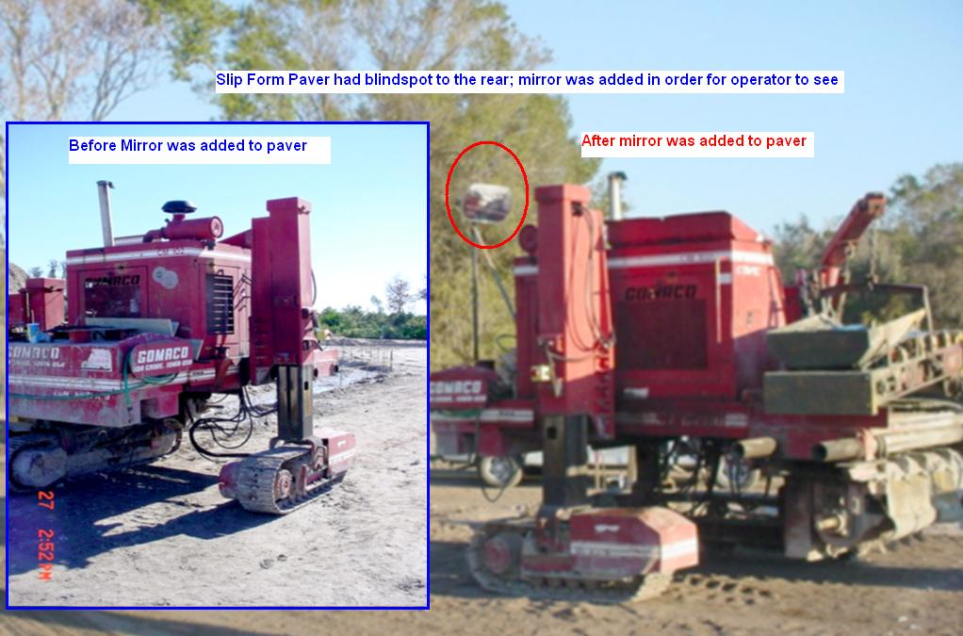
Recognize Any Hazard(s)?
Source: National Photo Archive ID #1860

Slide 16
YES
Slip form paver had blind spot to the rear exposing workers to a struck-by hazard from moving heavy equipment; mirror was added in order for operator to see
Source: National Photo Archive ID #1860

Slide 17
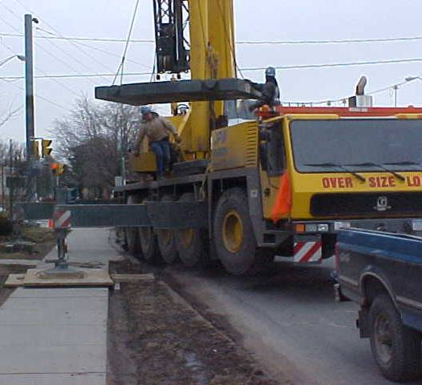
Recognize Any Hazard(s)?
Source: OTI Course #2080

Slide 18
YES
Stay clear of loads that are suspended or about to be suspended which create struck-by hazards from falling or swinging objects. If control of the load by a worker is necessary then a tag line should be used
Source: OTI Course #2080

Slide 19

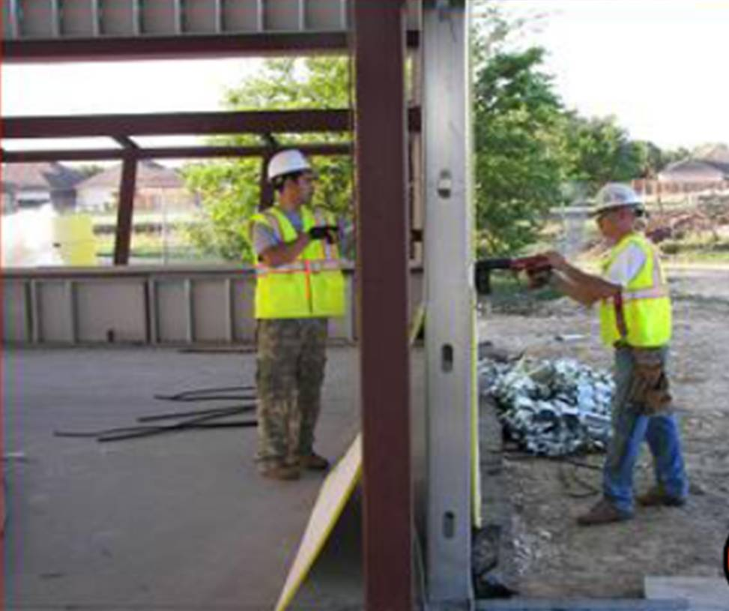
Recognize Any Hazard(s)?
Source: Susan Harwood Grant Number SH-17792-08-60-F-48 by Compacion Foundation

Slide 20

YES
Powder-actuated tools can create flying object struck-by hazards. Never drive into easily penetrated materials when workers are on the other side
Source: Susan Harwood Grant Number SH-17792-08-60-F-48 by Compacion Foundation

Slide 21
Struck By Hazards - Topics
Identify common struck-by hazards
Describe types of struck-by hazards
Protect themselves from struck-by hazards
Recognize employer requirements to protect workers from struck-by hazards

Slide 22
What is a struck-by hazard?
Struck-by injuries are produced by forcible contact or impact between the injured person and an object or piece of equipment. Having said that, it is important to point out that in construction, struck-by hazards can resemble caught–in or –between hazards.

Slide 23
What is a struck-by hazard?
There is a distinction which is best explained by looking at the key factor in making a determination between a Caught event and a Struck event, ask: Was it the impact of the object alone that caused the injury?
When the impact alone creates the injury, the event is considered as Struck. On the other hand, when the injury is created more as a result of crushing injuries between objects, the event is considered as Caught.
Notes:
According to OSHA, “Struck” is
defined as: injuries produced by
forcible contact or impact between
the injured person and an object or
piece of equipment.

Slide 24
Struck-by hazards are categorized as follows:
Struck-by flying object
Struck-by falling object
Struck-by swinging object
Stuck-by rolling object

Slide 25
Examples of accidents related to struck-by flying object hazards are:
Worker was freeing a pump component under pressure and was impaled by the pump component.
The victim was in the process of using an 8-foot step ladder to gain height to nail a strap onto a residential home single story construction project. The victim used a nail gun with a 16d nail to affix the strap to the exterior wall. Using his right hand for the gun, he leaned over to the left and tried to place a nail into the strap. The nail ricocheted and him on the left side of his head just above the left ear. He fell to the ground and eventually passed out. Fellow workers transported him to the hospital. He died approximately two days later.

Slide 26
Examples of accidents related to struck-by falling object:
Worker was tearing down a transmission structure using a digger-derrick when a pole broke and struck him on the head.
Worker was struck by a load of wall panels that fell off his truck.
Four workers rebuilding a bridge that had washed out by floods were injured when a crane boom cable broke, and the boom fell on them.

Slide 27
Examples of accidents related to struck-by swinging hazards:
Worker was working within the swing radius of a barge-mounted crane used in dredging operations. He was hit and killed.

Slide 28
Examples of accidents related to struck-by rolling hazards:
While walking along track, worker was struck by unmanned rail car at airport.
Worker (security guard) was struck by tractor trailer and dragged, resulting in fatal injuries.
Worker suffered fatal injuries after being struck by a moving semi truck while loading/unloading freight.

Slide 29
How Do I Avoid Hazards?
General
Wear hardhats and eye protection.
Stack materials to prevent sliding, falling, or collapse.
Use protective measures such as toeboards and debris nets.

Slide 30
How Do I Avoid Hazards?
Power Tools, Machines, etc.
Use safety glasses, goggles, face shields, etc., where machines or tools may cause flying particles.
Inspect tools, such as saws and lathes, to insure that protective guards are in good condition.
Make sure you are trained in the proper operation of powder actuated tools.

Slide 31
How Do I Avoid Hazards?
Cranes and Hoists
Avoid working underneath loads being moved.
Barricade hazard areas and post warning signs.
Inspect cranes and hoists to see that all components, such as wire rope, lifting hooks, chains, etc., are in good condition.
Do not exceed lifting capacity of cranes and hoists.

Slide 32
How Do I Avoid Hazards?
Overhead Work
Secure tools and materials to prevent them from falling on people below.
Barricade hazard areas and post warning signs.
Use toeboards, screens, or guardrails on scaffolds to prevent falling objects, or,
Use debris nets, catch platforms, or canopies to catch or deflect falling objects.

Slide 33
How Do I Avoid Hazards?
Compressed Air
Reduce compressed air used for cleaning to 30 psi, and only use with appropriate guarding and protective equipment.
Never clean clothing with compressed air.

Slide 34
What is my employer required to do to protect workers from struck-by hazards?
Heavy equipment [cranes, excavators, etc.]
Motor vehicles [trucks, cars, etc.]
General requirements for protecting workers
Provide personal protective equipment (PPE)
Training

Slide 35
Heavy equipment [cranes, excavators, etc.]
Employers must:
Determine whether the ground is sufficiently level and firm to support the anticipated weight of hoisting equipment and associated loads
Assess hazards within the work zone that would affect the safe operation of hoisting equipment such as, power lines and objects or personnel that would be within the swing radius of the hoisting equipment
Erect barriers to mark the area covered by the rotating superstructure to warn workers of the danger zone
Ensure that the equipment is in safe operating condition via required inspections
Comply with all manufacturer procedures regarding proper operational functions of equipment, including its use with attachments

Slide 36
Heavy equipment [cranes, excavators, etc.]
Ensure safe attachment of rigging devices such as, shackles, hooks, eyebolts, spreader beams and slings, wedge socket and wire rope clips
Provide seat belts when required
Ensure roadways and grades are maintained to accommodate the safe movement of equipment and vehicles
Ensure all earthmoving/compacting equipment with obstructed view does not operate in reverse gear unless the equipment has a reverse signal alarm or a worker has been designated to signal when it is safe

Slide 37
Motor vehicles [trucks, cars, etc.]
The employer is required to do the following:
Conduct a hazard assessment of the worksite using the job-site coordinator (supervisor or foreman) who should
  Make a thorough assessment of potential worksite safety hazards;
  Plan for work being conducted in close proximity of a public road or highway and for the safe handling of intermittent roadway traffic stoppages, such as a truck entering a roadway;
  Plan the entry and exit to and from the worksite to reduce exposure to traffic
Post construction areas with legible traffic signs at points of hazard
Erect barricades that conform to the MUTCD
Place necessary warning signs along the road
All workers on site should have a safety and operations orientation

Slide 38
General requirements for protecting workers
Employers must ensure:
All hand tools are maintained in good condition
The use of unsafe hand tools is not permitted (i.e., no sprung jaws on wrenches, no mushroomed heads, no splinters or cracks in wooden handles, no loose parts / heads of tools)
Saws are equipped with guards and have a constant pressure switch that will shut off the power when the pressure is released
Safety guards are on all abrasive wheel bench and stand grinders
Only trained workers are allowed to operate powder-actuated tools

Slide 39
General requirements for protecting workers
All powder-actuated tools are tested daily before use and all defects discovered before or during use are corrected
Powder-actuated tools are not loaded until immediately before use and loaded tools are not left unattended
Compressed air used for cleaning purposes is reduced to less than 30 pounds per square inch (psi) and provide effective chip guarding and PPE
All materials stored in tiers are secured to prevent sliding, falling, or collapsing
Toeboards are erected along the edge of overhead walking/working surfaces

Slide 40
Provide personal protective equipment (PPE)
Employers must:
Pay for PPE as required by OSHA
Provide and require the use of appropriate PPE in all operations where there is an exposure to hazardous conditions
Ensure adequacy of PPE including proper maintenance and sanitation
Provide head protection (e.g., hard hats, helmets) whenever there is possible danger of head injuries from impact, flying or falling objects
Provide eye and face protection when machines or operations present eye or face injury
Provide workers involved in welding operations with filter lenses or plates of proper shade number
Ensure eye, face and head protective equipment meets ANSI requirements

Slide 41
Training
Train workers in the work zone to recognize hazards associated with the use of the equipment and any related duties that they are assigned to perform
Ensure crane operators are qualified or certified according to OSHA standards
Ensure signal person meets qualification requirement according to OSHA standards
Instruct workers in the recognition and avoidance of unsafe conditions and the regulations applicable to his/her work environment to control or eliminate any hazards or other exposure to illness or injury
Ensure that qualified operators and riggers have been trained on rigging safety

