Slide 1
GENERALISED ANXIETY DISORDER
BY
DANIYA ZABEEN
EMOTIONOFLIFE

Slide 2
GENERALIZED ANXIETY DISORDER (GAD)
Generalized Anxiety Disorder is an anxiety disorder that is characterized by excessive uncontrollable and irrational worry about everyday things.
It is a common chronic disorder characterized by long-lasting anxiety that is not focused on any one object or situation.

Slide 3
It is a persistent anxiety brought about by continual day to day concern and worry. Can be linked to over thinking.

Slide 4
Those who suffer from GAD are at high risk of:
Suicidal Ideation or Suicide
Drug Use Disorders
Substance Abuse
Psychopathy

Slide 5
GAD Onset
It can occur from childhood to late adulthood, at any period of time.
There is no certain age of onset of GAD.
20% of adults suffer from GAD annually, in the general population.
Although it can be most commonly seen among women.
Women are more likely to suffer from GAD than men.
It is also common among elderly population.

Slide 6
There is no single cause of GAD present. However, it has been associated with: 1. Gender – females are twice as likely to be diagnosed with GAD then men. 2. Presence of any physical or emotional trauma.

Slide 7
OTHER FACTORS
Environmental Factors – Trauma or stressful events such as abuse or death of a loved one, divorce, changing jobs or schools, etc.
Bullying is associated with an increased risk.
Genetic is also a major factor for GAD.
Neurotransmitters - It is also associated with abnormal levels of certain neurotransmitters in the brain.

Slide 28
TREATMENT OF GAD

Slide 31
PSYCHOTHERAPY
Also known as talk therapy conducted in therapy sessions.
Psychotherapies helps in improving Emotional Health, Behavior and Brain and body function.
Cognitive Behavioral Therapy, Interpersonal Therapy, Dialectical behavior disorder therapy, support therapy are some of the different types of therapies used.

Slide 32
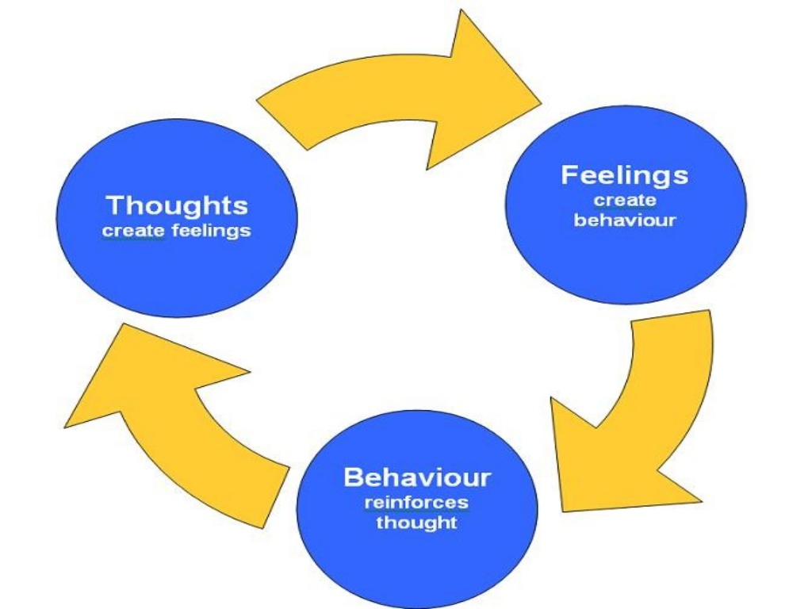
Cognitive Behavioral Therapy
It involves therapist working with the patients to understand how thoughts and feelings influences an individuals’ behavior.

Slide 35
Notes:
By talking about it more often

Slide 36
Notes:
Switch off from technology.

Slide 39
Cognitive Restructuring
When you change the way you look at things, the things you look at change.
Your words and thoughts creates your future.

Slide 40
Other Therapies
Progressive Relaxation Techniques
Mindful Meditation
Slow deep-breathing exercise
Listening of soothing music and relaxation tapes.
Helping the client building on coping methods that the client used to manage anxiety with.
Assisting the client in gaining control of overwhelming feelings and impulses through brief direct verbal interactions.

Slide 41
MEDICATIONS
Antipsychotic Drugs
Antidepressant Drugs
Mood stabilizers
Sleeping pills or tranquilizers

Slide 42
Things to prevent GAD
Stopping or reducing the consumption of products that contain caffeine such as coffee, tea, cola or chocolates.
Exercising daily and eating a healthy and balanced diet.
Practicing stress management techniques like Yoga or Meditation.

