Slide 1
Emotional Health “Key to Success”
Shyam Gupta
Clinical Psychologist & Therapist
Emotion Of Life www.emotionoflife.co.in
Email: info@emotionoflife..in
Phone: 7678694626

Slide 2
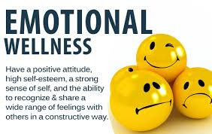
Emotional Health
Emotional Health is a state of mind.
in which an individual realizes/ identifies his or her own actual potential.
and also identified, acceptence his or her weakness, have willingness and able to work on those weakness.
can cope up with the normal life day to day stresses.
can work productively and fruitfully.
and is able to contribute to himself or herself and the community.

Slide 3
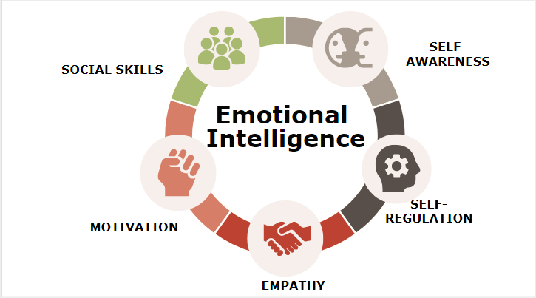
Emotional Intelligence
“One’s ability to manage emotions in self & others & use the emotions adaptively”
Theorized first by Peter Salovey & John Mayer in 1990 & then operationalised & popularized by Daneil Goleman in the late Nineties. The best selling books are
EMOTIONAL INTELLIGENCE : Why it can matter more than IQ (1995) & Working with Emotional Intelligence

Slide 4
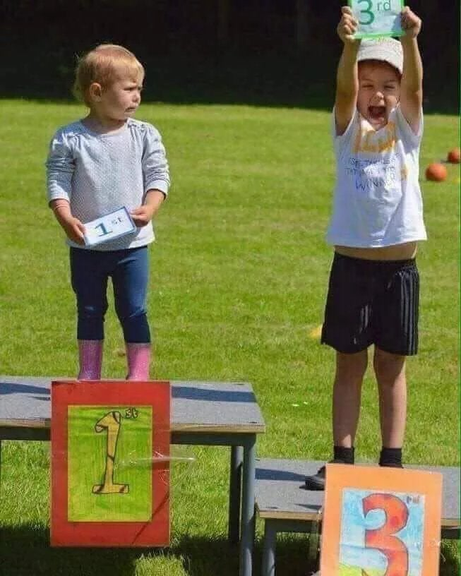
Positive Mind-set
All Major psychological properties & processes.
Thinking
Feeling
Willing
Doing (Behaving)

Slide 5
Emotional Health Issues
Major emotional health issues are Depression, Anxiety, Stress, Sadness, Negativity, Procrastination, Body Image, Grief, Loss.
Major changes in your life such as new college, new syllabus, new work set up, relationships, becoming a parent, can all affect your emotional health and day to day living.
Sometimes it is hard to know if what you are experiencing is depression, sadness, worry or anxiety.

Slide 6
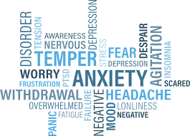

Slide 7
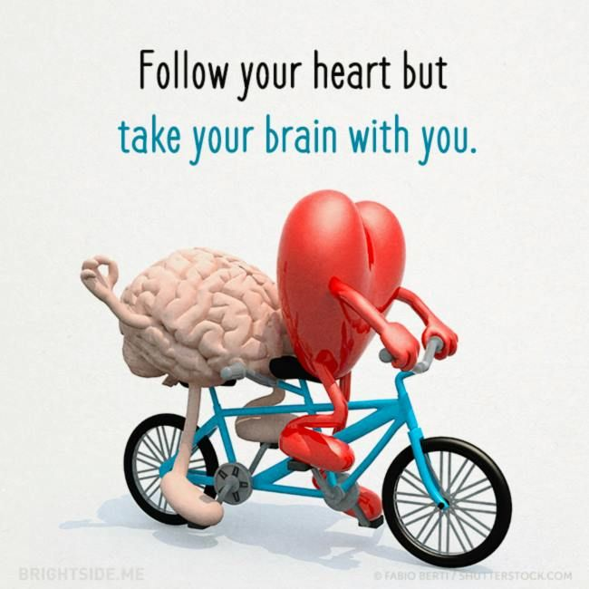

Slide 8
Factor that Influence Emotional Health
Personality type
Personality Dynamics
Level of Emotional Health
Parenting style
Education, Age, sex
Environmental situation
Ego structure
Coping strategy
Pattern of defense mechanism usage
Career Goal and purpose of life
High expectation by self and parents or spouse

Slide 9
Consequences of high EQ
High EQ generates feeling that builds positive attitudes
Motivation
Satisfaction/happiness
Desire
Self-esteem
Self-control
Friendship
Appreciation
Peace
Attributing setback or failure to immediate environment, temporal factors & external weakness (with optimism). Laughing on ones’ own setbacks by taking different perspectives.

Slide 10
Consequences of low EQ
Consequences of low EQ
Low EQ generates feeling that builds negative attitudes
Angers, resentment, frustration, disappointment
Loneliness, depression, stress, etc.
Fear, instability, etc.
Guilt, victimization, hurt ,etc.
Attributing setback or failure to larger environment,
permanent factor & internal weakness (with low optimism)

Slide 11
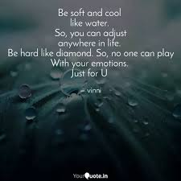

Slide 12
Types of Emotions
Negative Emotion
Positive Emotion
Neutral Emotion

Slide 13
Types of Emotions: Negative Emotion
Sorrow
Crying
Weeping
Anger
Embarrassment
Rage/ Revenge
Melancholy
Scared
Loneliness
Annoyance
Anxiety
Awkwardness
Confusion
Disgust
Envy
Fear
Sadness
Guilt
Frustration
Dissatisfaction

Slide 14
Types of Emotions: Positive Emotion
Triumph
Sympathy
Romance/ Intimate relation
Interest
Joy
Excitement
Satisfaction
Happiness
Calmness
Amusement
Hope
Pride
Gratitude
Awe
Serenity
Inspiration
Love
Forgiveness
Trust

Slide 15
Types of Emotions: Neutral Emotion
Boredom
Craving
Empathetic pain
Sexual Desire

Slide 16
Behavioural guidance for improving EQ & building positive attitudes
Creating self awareness
Respect yourself
Be positive
Be true to yourself

Slide 17
Strategies for better emotional health
Set a Career Goal and life purpose
Stay calm in difficult situations
Ask for help if in need from parents, spouse, friends, teacher, mentor, Psychologist.
Follow mindfulness, do meditation
Remove and settle life obstacle/hurdle/challenges.
Connect with people around you like family, friends, colleague, Invest time.
Be active, step outside.
Take care your physical & mental health
Appreciate yourself and others.
Follow your hobbies and dream.
Keep learning, there is no limit of learning in life.
Do volunteering, either at physical level or over virtual world. Try to help others
Be kind to each other.

Slide 18
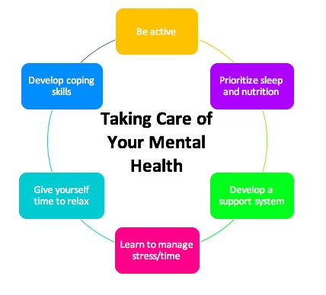
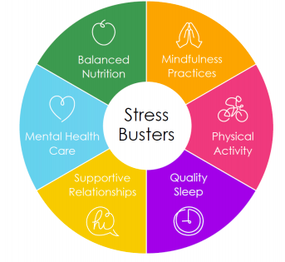

Slide 19
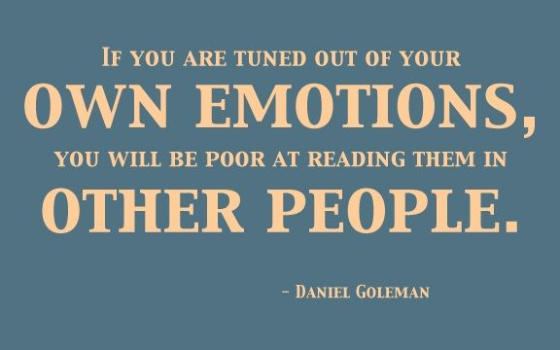
Thank you so much
Questions are welcome
www.emotionoflife.co.in

