Slide 1
PERSONALITY DISORDER Created by Ms. Nishu Under guidence: Mr. Shyam Gupta ClinicalPsychologist & Behaviour Therapist www.emotionoflife.in for Inquiry write to us info@emotionoflife.in

Slide 2
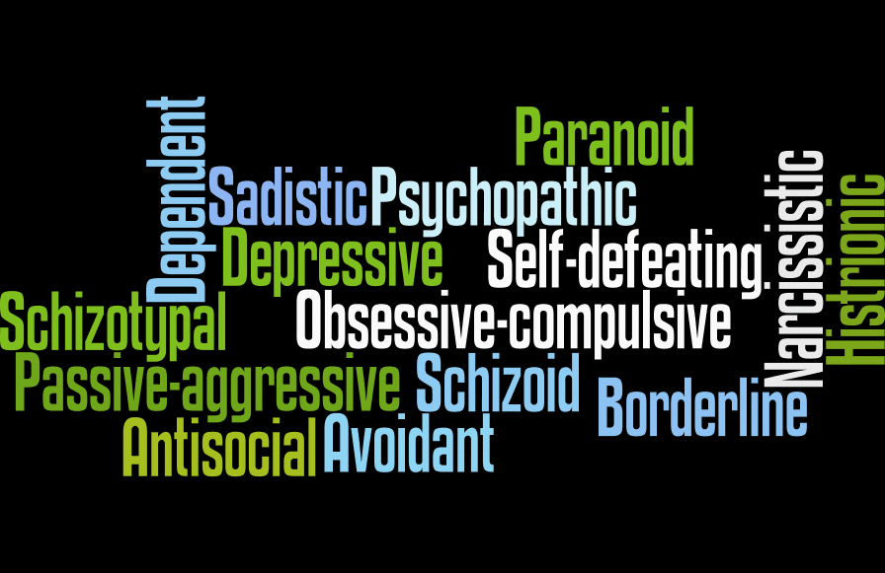
WHAT ARE PERSONALITY DISORDERS?
A personality disorder is a type of mental disorder in which you have a rigid and unhealthy pattern of thinking, functioning and behaving. A person with a personality disorder has trouble perceiving and relating to situations and people.

Slide 3
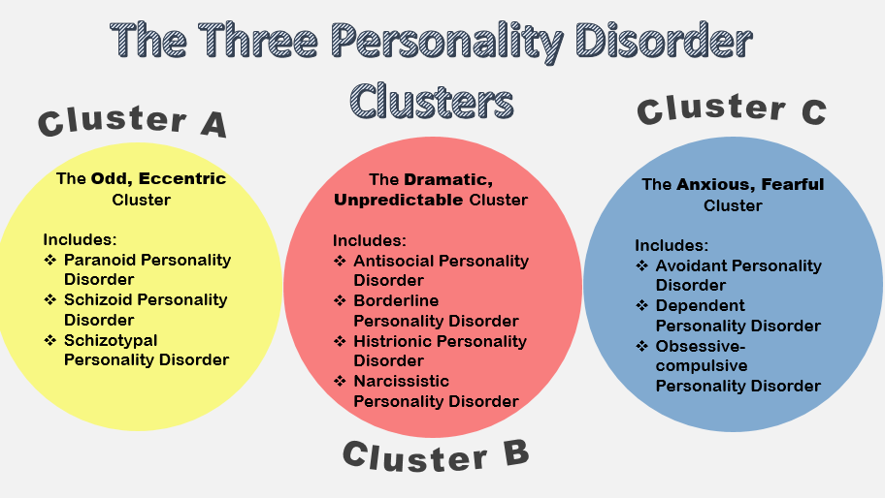
SYMPTOMS:
Types of personality disorders are grouped into three clusters, based on similar characteristics and symptoms.

Slide 4
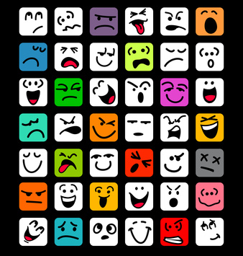
DIAGNOSIS:
In order for a diagnosis to be made, the behaviors and feelings must be consistent across many life circumstances. They should also cause significant distress and impairment in at least two of the following areas:
the way you perceive or interpret yourself and other people
the way you act when dealing with other people
the appropriateness of your emotional responses
how well you can control your impulses

Slide 5
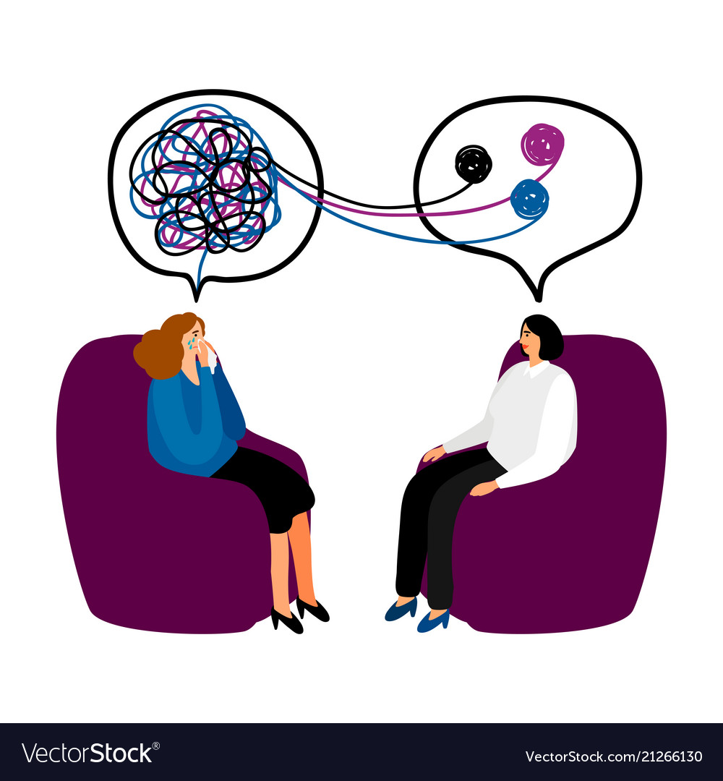
TREATMENT:
Certain types of psychotherapy are effective for treating personality disorders. During psychotherapy, an individual can gain insight and knowledge about the disorder and what is contributing to symptoms, and can talk about thoughts, feelings and behaviors. Psychotherapy can help a person understand the effects of their behavior on others and learn to manage or cope with symptoms and to reduce behaviors causing problems with functioning and relationships.

Slide 6
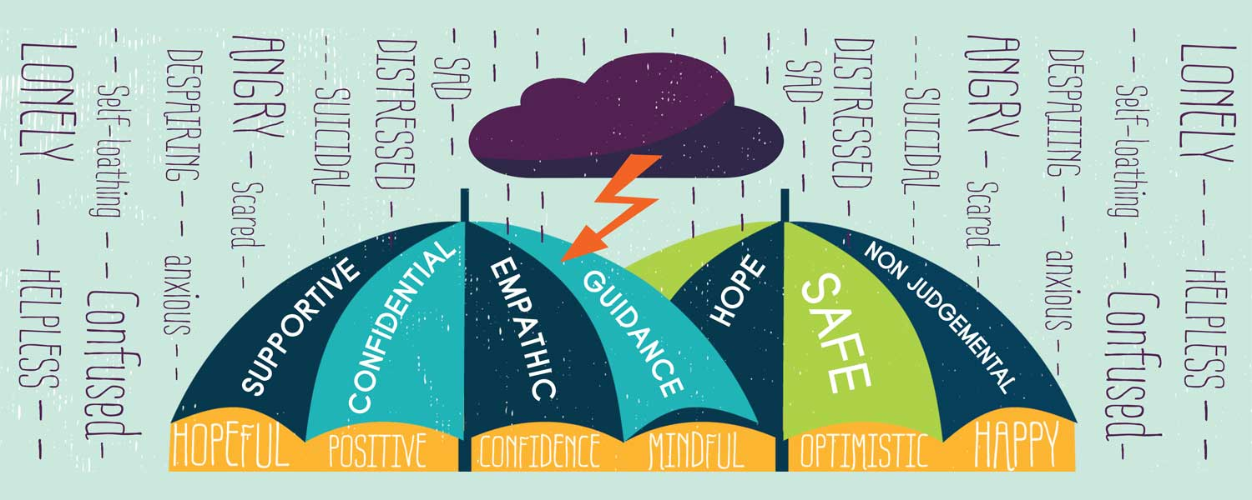
Commonly used types of psychotherapy include:
Psychoanalytic/psychodynamic therapy
Dialectical behavior therapy
Cognitive behavioral therapy
Group therapy
Psychoeducation

Slide 7
MEDICATION:
There aren’t any drugs approved for the treatment of personality disorders. However, certain types of prescription medications might be helpful in reducing various personality disorder symptoms:
antidepressants, which can help improve a depressed mood, anger, or impulsivity
mood stabilizers, which prevent mood swings and reduce irritability and aggression
antipsychotic medications, also known as neuroleptics, which may be beneficial for people who often lose touch with reality
anti-anxiety medications, which help relieve anxiety, agitation, and insomnia

