Slide 1
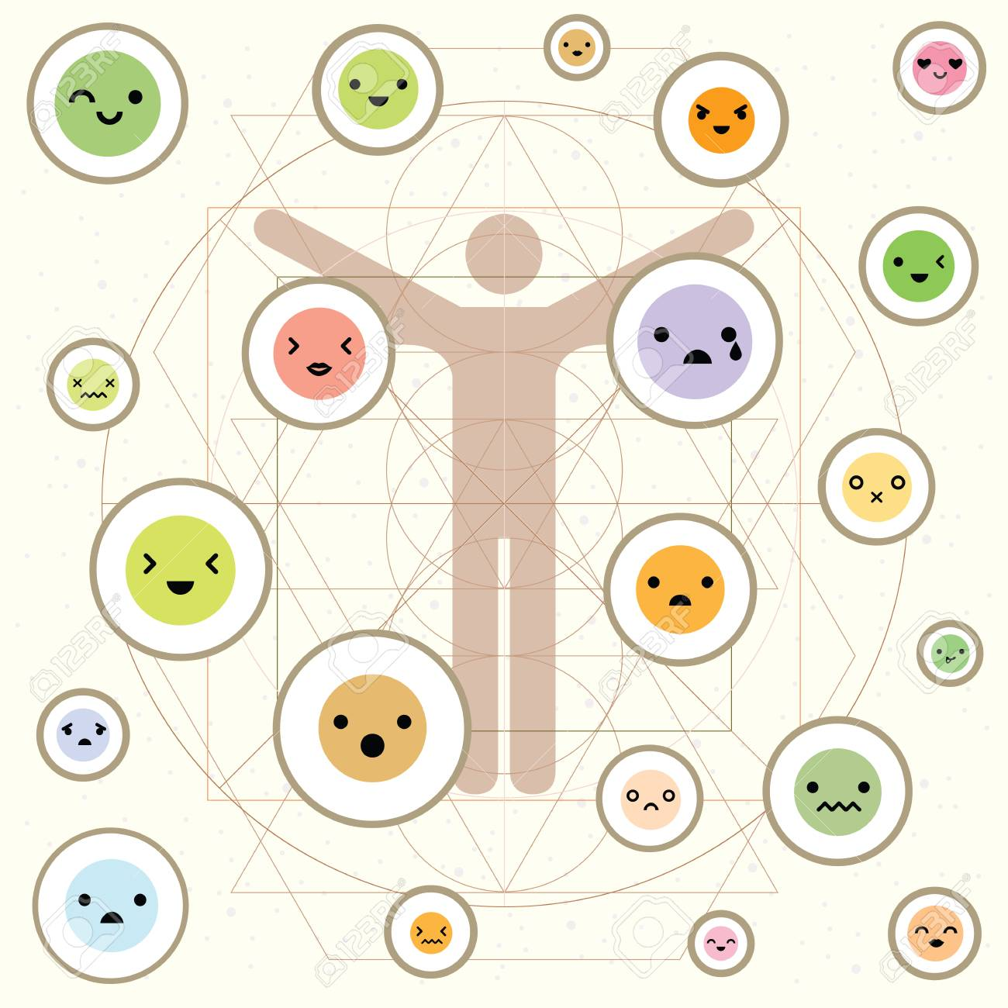
Psychosomatic Disorders
Yoshima Singh (Emotion of Life)

Slide 2
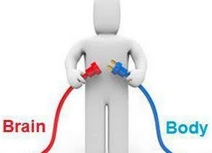
Introduction

Slide 3
A psychosomatic disorder is a disease which involves both mind and body. Some physical diseases are thought to be particularly prone to being made worse by mental factors such as stress and anxiety. Your mental state can affect how bad a physical disease is at any given time.

Slide 4
A psychosomatic illness originates from or is aggravated by emotional stress and manifests in the body as physical pain and other symptoms. Depression can also contribute to psychosomatic illness, especially when the body's immune system has been weakened by severe and/or chronic stress.

Slide 5
Cause

Slide 6
A psychosomatic disorder involves both the body and mind. These diseases have physical symptoms originating from mental or emotional causes. Most common causes are stress, anxiety, and depression. When these psychological entities are not perceived properly, it may result in somatic disease due to conversion hysteria.

Slide 7
Genetic and biological factors, such as an increased sensitivity to pain
Family influence, which may be genetic or environmental, or both
Personality trait of negativity, which can impact how you identify and perceive illness and bodily symptoms
Decreased awareness of or problems processing emotions, causing physical symptoms to become the focus rather than the emotional issues
Learned behavior — for example, the attention or other benefits gained from having an illness; or "pain behaviors" in response to symptoms, such as excessive avoidance of activity, which can increase your level of disability

Slide 8
Signs and Symptoms

Slide 9
Specific sensations, such as pain or shortness of breath, or more general symptoms, such as fatigue or weakness
Unrelated to any medical cause that can be identified, or related to a medical condition such as cancer or heart disease, but more significant than what's usually expected
A single symptom, multiple symptoms or varying symptoms
Mild, moderate or severe

Slide 10
Constant worry about potential illness
Viewing normal physical sensations as a sign of severe physical illness
Fearing that symptoms are serious, even when there is no evidence
Thinking that physical sensations are threatening or harmful
Feeling that medical evaluation and treatment have not been adequate
Fearing that physical activity may cause damage to your body
Repeatedly checking your body for abnormalities
Frequent health care visits that don't relieve your concerns or that make them worse
Being unresponsive to medical treatment or unusually sensitive to medication side effects

Slide 11
Treatment

Slide 12
Psychotherapy
Psychoanalysis
Cognitive behavior therapy
Group psychotherapy
Electroconvulsive therapy (ECT)
Hypnotherapy
Acupuncture therapy
Pharmacotherapy
Exercises
Yoga
Lifestyle changes

Slide 13
For more info visit: www.emotionoflife.in Contact us at: 7678694626 Email us on: info@emotionoflife.in
Thank you!! – Yoshima Singh (Emotion of Life)

