Slide 1
SHORT TEMPER
ASSIGnmEnT BY- VISHAL KOHLI
GUIDE- Shyam Gupta, CLINICAL PSYCHOLOGIST & THERAPIST

Slide 2
WHAT IS SHORT-TEMPER?
Short Temper Is Defined as a tendency Of a Person to become angry very quickly and easily.
In Other words, Quick to lose one's temper.

Slide 3
WHAT SHORT TEMPER LOOK LIKE

Slide 4
WHAT SHORT TEMPER LOOK LIKE
The person tend to have symptoms that are both physical and psychological, such as:
rage in the form of yelling and shouting
chronic irritability
heart palpitations
racing thoughts
loss of control

Slide 5
What Causes Short Temper?
A leading cause of anger is a person’s environment. Stress, financial issues, abuse, poor social or familial situations, and overwhelming requirements on your time and energy can all contribute to the formation of anger. As with disorders such as alcoholism, anger issues may be more prevalent in individuals who were raised by parents with the same disorder. Genetics and your body’s ability to deal with certain chemicals and hormones also play a role in how you deal with anger; if your brain doesn’t react normally to serotonin, you might find it more difficult to manage your emotions

Slide 6
Causes Of Short Temper
1 Stress
2 Anger
3 Financial Problems
4 Family Problems
5 Low Blood Sugar Level
6 Hormonal Change
7 Abuse
8 Poor Social Situations

Slide 7
Symptoms Of Short Temper
Anger causes physical and emotional symptoms. While it’s normal to experience these symptoms on occasion, a person with anger issues tends to experience them more often and to a more severe degree

Slide 8
The physical signs and symptoms of Short temper include:
Increased blood pressure
Increased heart rate
Tingling sensation
Muscle tension

Slide 9
The Emotional signs and symptoms of Short temper include:
Irritability
Frustration
Anxiety
Rage
Stress
Feeling overwhelmed
Guilt

Slide 10
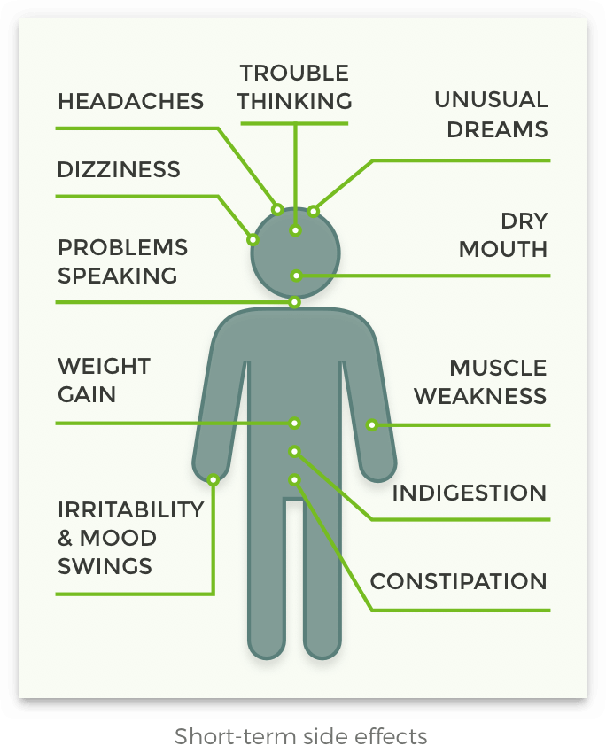
How It Affects Our Body?

Slide 11
How To Handle Short Temper :
1 Practice mindfulness
2 Refocus your energy
3 Get physical
4 Use a daily mood chart

Slide 12
How To Practice Mindfulness :
Incorporating mindfulness into your regular routine can help you better understand and control the reactivity that often drives a short temper.
The next time you feel your temper rising, try this exercise:
Find a quiet room and a comfortable place to sit.
Close your eyes and notice the physical sensation of anger travel through your body, whether it’s through your rapid heart rate or your clenched jaw.
Inhale deeply and allow all thoughts of anger to release as you exhale.
Repeat 2 to 3 times per day or whenever you start to feel anger arise

Slide 13
How To Refocus On Your Energy :
Come up with some concrete strategies for dealing with situations that you know will trigger your temper.
If you know your daily commute tends to set you off, for example, set aside some time to focus on alternative options. Waking up earlier to catch an emptier train or carpooling with a coworker might make all the difference.
Even if it doesn’t resolve the situation immediately, turning your attention to problem-solving can give you a greater sense of control and keep you from blowing up.

Slide 14
How To Get Physical :
When you start to feel your blood boil, work it off with an exercise session. Go out for a quick run, play a sport that gets your heart pumping, or swim a few laps in the neighborhood pool.
Regular physical activity is an effective way of increasing self-control and immediately calming your mind and body.

Slide 15
How To Use Daily Mood Chart :
Track episodes of anger and irritability by keeping a daily record of your moods. You can do this in a notebook or even download one of the countless mood-tracking apps available for your phone.
To get an extra clear picture of your moods, try to also take note of your intake of caffeine or other substances, quality of sleep, stressful situations or conversations, and any underlying emotions like fear or disappointment.

Slide 16
Effective Ways to Control Short Temper :
1 Take a timeout
2 Don’t carry your temper
3 Practice relaxation techniques
4 Take a walk
5 Take a class you enjoy
6 Change your mindset
7 Think of a funny memory
8 Discuss how you feel
9 Listen to music during stressful times
10 Identify a solution
11 Know your triggers
12 Smile
13 Look at your environment
14 Find a place you can be alone
15 Use calming scents

Slide 17
Conclusion:
In conclusion, managing anger and stress can seem very hard and overwhelming at times. Stress and anger are sometimes very hard to overcome and defeat, but there are ways and methods that I find are the most effective. "So keep calm and don't stress."

