Slide 1
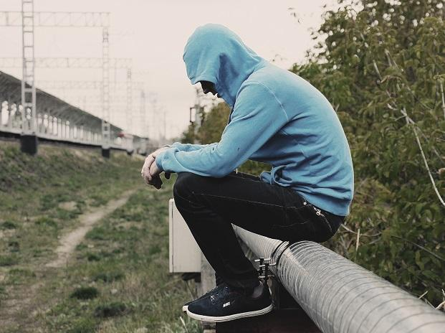
Managing Social Withdrawal
Made by : Trannum Gupta
Under the guidance of
Mr. Shyam Gupta (psychotherapist with TickTalkTo app)

Slide 2
What is social withdrawal or social isolation?
Social withdrawal is avoiding people and activities you would usually enjoy. For some people, this can progress to a point of social isolation, where you may even want to avoid contact with family and close friends and just be by yourself most of the time.
You may want to be alone because you feel it’s tiring or upsetting to be with other people.
Sometimes a vicious cycle can develop where the more time you spend alone, the less you feel like people understand you.
And the less you feel like people understand you, the more time you want to spend alone.

Slide 3
Social withdrawal can be both a symptom and a cause of anxiety. Social withdrawal can also characterize an anxiety disorder (social anxiety disorder) in and of itself.
Causes of Social Withdrawal

Slide 4
Symptoms of Social Isolation
Solitude can be chosen or forced, healthy or unhealthy. Social isolation describes an unwanted and often harmful experience. A person may be experiencing social isolation if they:
Avoid social interaction due to shame or depression.
Spend extended periods of time alone.
Experience social anxiety or fears of abandonment at the idea of social interaction.
Have only limited or superficial social contact.
Lack important social or professional relationships.
Develop severe distress and loneliness.

Slide 5
Causes of Social isolation
A 2017 study of young adults ages 19-32 years old found frequent social media users had higher levels of perceived social isolation. Social media may be a factor in loneliness when it replaces in-person connections or when fleeting online interactions substitute for more substantive conversation.
Anxiety attacks are a big reason why anxiety sufferers may want to seclude themselves. Reasons to avoid public panic attacks can range from pride and fear to a basic sense of self preservation.
Social phobia (now known as social anxiety disorder) is an exaggerated fear of social interactions. It involves making obsessive, negative assumptions about what people may think of you and what judgments they may be making (such as being unlikeable, useless, or that one is embarrassing to be around).

Slide 6
Causes of Social isolation
Speaking Problems : Some people also find that they have problems speaking normally when they have anxiety. For these people, having to talk to others, or even just trying to follow a conversation while worrying about what to say, may cause them to tense up to the extent that they can't say anything at all. In other cases, they may develop a stutter or obsess about aspects of speech such as sounding too loud or too quiet; or talking too fast or too slow.
Agoraphobia is a condition in which crowded or unfamiliar spaces cause anxiety. It commonly occurs as a result of anxiety attacks, where the person becomes afraid to leave their home because they tend to get attacks when they're out of their comfort zone.

Slide 7
Causes of Social isolation
Social withdrawal can often be triggered by negative thoughts. Too many negative thoughts, such as feeling inadequate or believing you are not fun to be around, may increase your likelihood of feeling more anxious; and people with poor a self-esteem are more likely to experience these sorts of negative thoughts.
I don't deserve to be happy
I just need to work harder.
Other people are more important than me.
I can handle it without help.
I have no power over my situation.

Slide 8
Solitude, isolation, and loneliness are similar terms, but they have distinct meanings: Solitude is the state of being alone. Solitude can be a healthy, rejuvenating experience. Isolation is a lack of social relationships or emotional support. Loneliness is a craving for social contact. It is often linked to feelings of sadness and emptiness.
SOLITUDE, ISOLATION, AND LONELINESS

Slide 9
WHAT IS EMOTIONAL ISOLATION?
Emotional isolation occurs when someone is unable or unwilling to share their emotions with others.
Someone may be reluctant to discuss anything but the most superficial matters.
Without emotional support, they may feel “shut down” or numb.
Emotional isolation can occur due to social isolation. Yet a person may feel emotionally isolated despite having a social network.
Even though relationships are necessary for our well-being, they can trigger negative feelings and thoughts.
Emotional isolation can act as a defense mechanism to protect a person from distress.

Slide 10
EFFECTS OF ISOLATION
On physical health
On Mental health
Increased risks of depression, dementia, social anxiety, and low self-esteem.
It may cause experiences of hallucinations, insomnia, posttraumatic stress (PTSD), and difficulty telling time.
Higher levels of stress hormones and inflammation.
Heart disease, including high blood pressure and coronary artery disease.
A heightened risk of developing a disability.
Increased vulnerability to chronic illnesses such as Type 2 diabetes.
Social isolation may even increase one’s risk of premature death by about 30%.

Slide 11
Why 5 Types of People May Withdraw From Social Life
1. People who are shy.
These are people who agree with statements such as, “Sometimes I turn down chances to hang out with other people, because I feel too shy.”
2. The avoiders.
They agree with statements such as, “I try to avoid spending time with other people.”
3. The unsocial.
They agree with statements such as, “I don’t have a strong preference for being alone or with others.”
“Loners come in different varieties, including healthy ones.”

Slide 12
Why 5 Types of People May Withdraw From Social Life
4.People rejected by their peers.
These people withdraw from social life because they are isolated by their peer group. They agree with statements such as, “Sometimes others don’t want me to hang out with them.” They are not choosing to be alone; they’ve been rejected.
5. People who enjoy spending time alone.
Another category of people embraces solitude. They savor the time they have to themselves. They have some very positive characteristics in their personality profiles. For example, they are very unlikely to be neurotic and very likely to be open-minded.

Slide 13
Negative behaviors or experiences linked to social withdrawal
Physical aggression. People who are physically aggressive agree with statements such as, “When someone makes me really angry, I push or shove the person.”
Relationship aggression. Relationship aggression isn’t physical. People who practice relationship aggression agree with statements such as “When I am not invited to do something with a group of people, I will exclude those people from future activities.”
Anxiety sensitivity. People with anxiety sensitivity are afraid of being afraid. They agree with statements such as, “It scares me when I have trouble getting my breath.”
Social anhedonia. This is an inability to get pleasure from experiences that are ordinarily pleasurable. They agree with statements such as, “Having close friends is not as important as many people say.”

Slide 14
What To Do When a Loved one Becomes Socially Withdrawn
Talk About It, and Talk About It Some More : It’s not easy to approach and talk to someone about their depression and limited social engagement. Simply be a good listener. Tell your friend or family member that you’re concerned and that you want to help and listen. Be compassionate, not judgmental. And then go back and check in again.
Get Them out of the House : Make plans to pick your friend up and go out for something easy and low-pressure like a cup of coffee nearby or even just a walk around the block. Don’t force your loved one to be around too many people or to do too much.
Help Them Connect With Others : Any kind of social connection you can help your friend or family make with other people will be beneficial. For instance, support groups for depression can be great for getting out of a period of withdrawal. Adding in a little more socialization here and there at a slow pace can help your friend start opening up again in a way that feels safe.
Discourage Drinking and Drug Use – Push for Healthy Habits

Slide 15
Thank you

