Slide 1
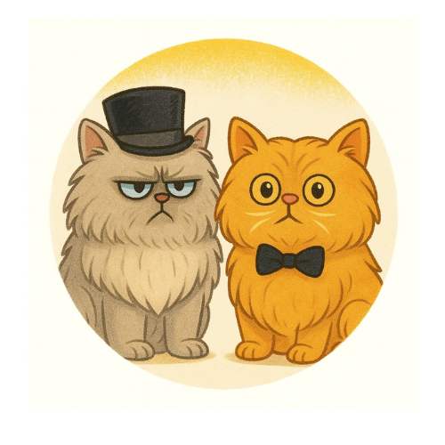
Mugsy & Bugsy: Perseverance, Creativity, and Big Dreams
Holly Barr
Author & Creator of Mugsy & Bugsy

Slide 2
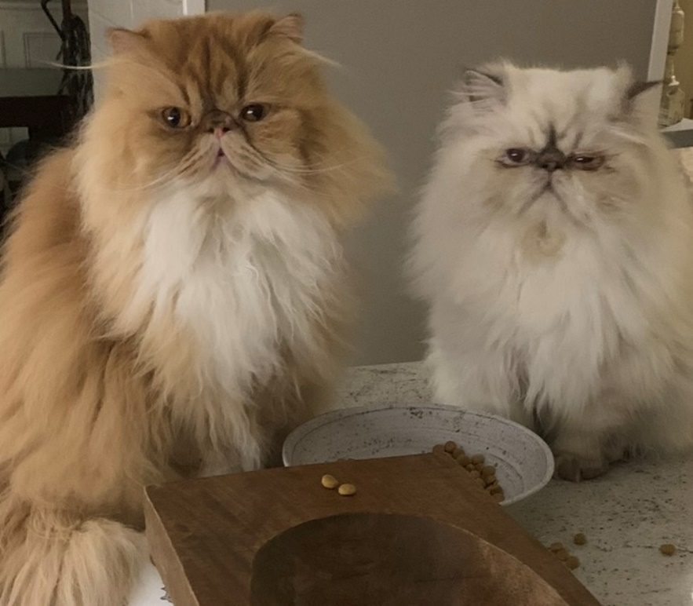
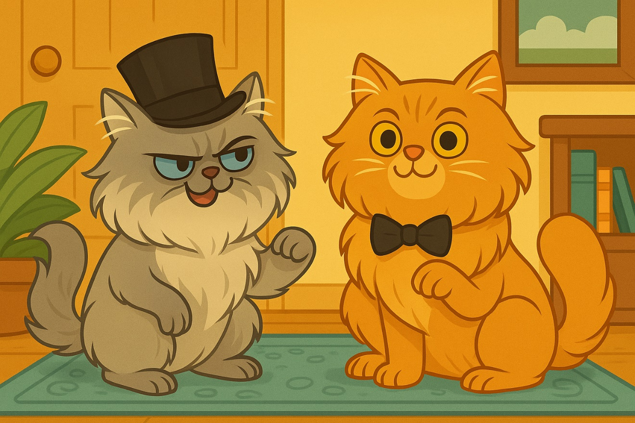
Meet Mugsy & Bugsy

Slide 3
How the Stories Began
I love my cats. I love stories. And one day I wondered….what if my cats came with me on my travel adventures and activities as Secret Cat Agents. So, I went to Hawaii and decided to bring them along in my mind and that’s where the first story took place…
And then the series grew and Mugsy and Bugsy went on many adventures…

Slide 4
How many of you have ever had an idea?
A story?
An invention?
A drawing?
A video game?
A business?
Every one of my books started as just one little idea.

Slide 5
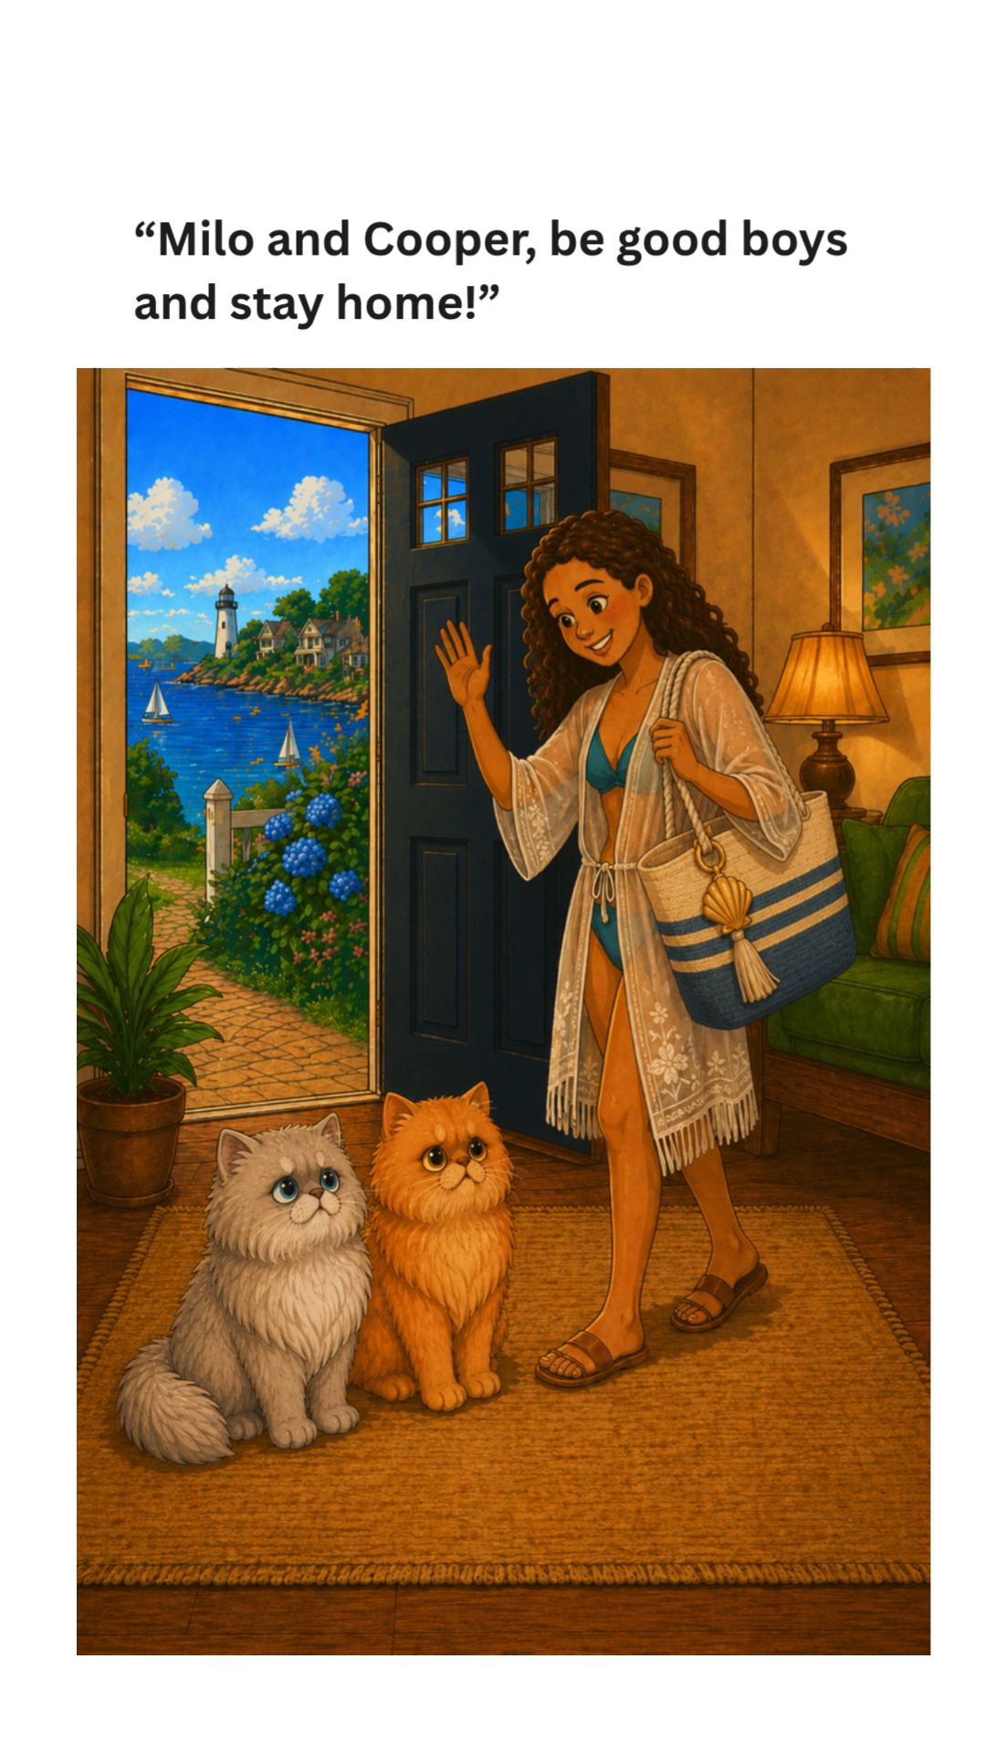

Slide 6
How many of you have animals?

Slide 7
How many of you love, love, love your animals?

Slide 8
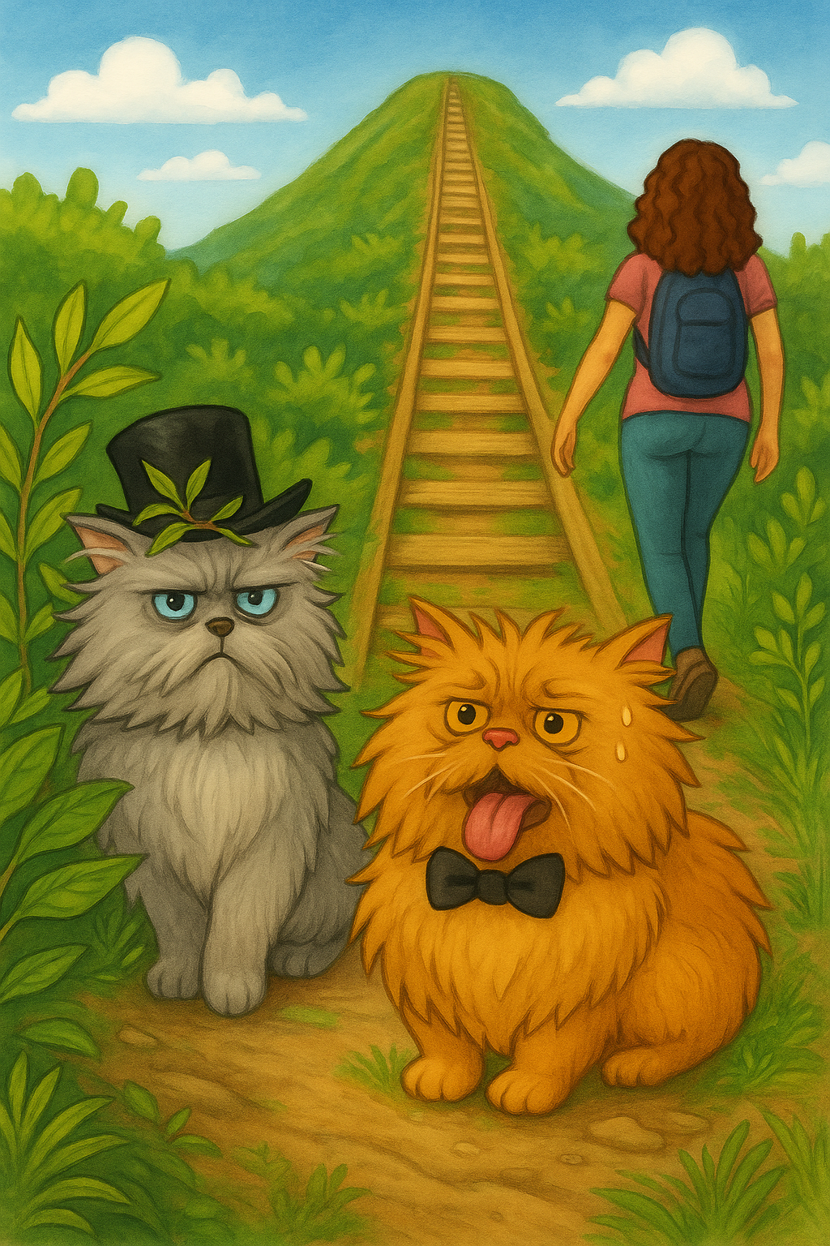
What does perseverance mean?
Not giving up when something is hard
Mugsy & Bugsy NEVER GIVE UP
They keep trying, even when it’s hard.

Slide 9

Mugsy & Bugsy Never Give Up! Can you guess what they did?

Slide 10
Who here has ever wanted to quit something?

Slide 11
Can I tell you my story?

Slide 12
I could not read when everyone else could.

Slide 13
Lessons Learned
Sometimes it just takes a little longer for something to click!
I did not give up and I persevered until I could learn to read.
Once I learned to read, I couldn't stop reading... and then I couldn't stop writing stories!

Slide 14

Big Dreams Start Small
Every big thing I’ve done started small. One page. One drawing. One idea.
I wrote this story when I was 12 years old.

Slide 15
What are YOUR Big Dreams?
Raise your hand if you like to write/draw/build/invent/help people
What hobby could become a book?
Have you ever had to keep trying after something was difficult?

Slide 16
My Dream Came True
A year ago I had never published a children's book.
Today there are 14 Mugsy & Bugsy books.
It all started with one idea...
...and I never gave up.
Whatever your dream is, don't give up on it either.

Slide 17
Q&A

