Slide 1
Wanna be PD?

Slide 2
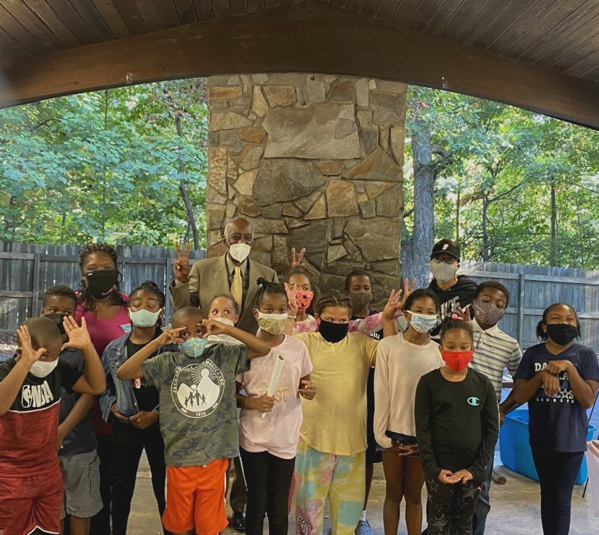
THE 💙 OF JACK AND JILL
Without focused and targeted programming, these are the world’s most expensive play dates!
What is programming really?

Slide 3
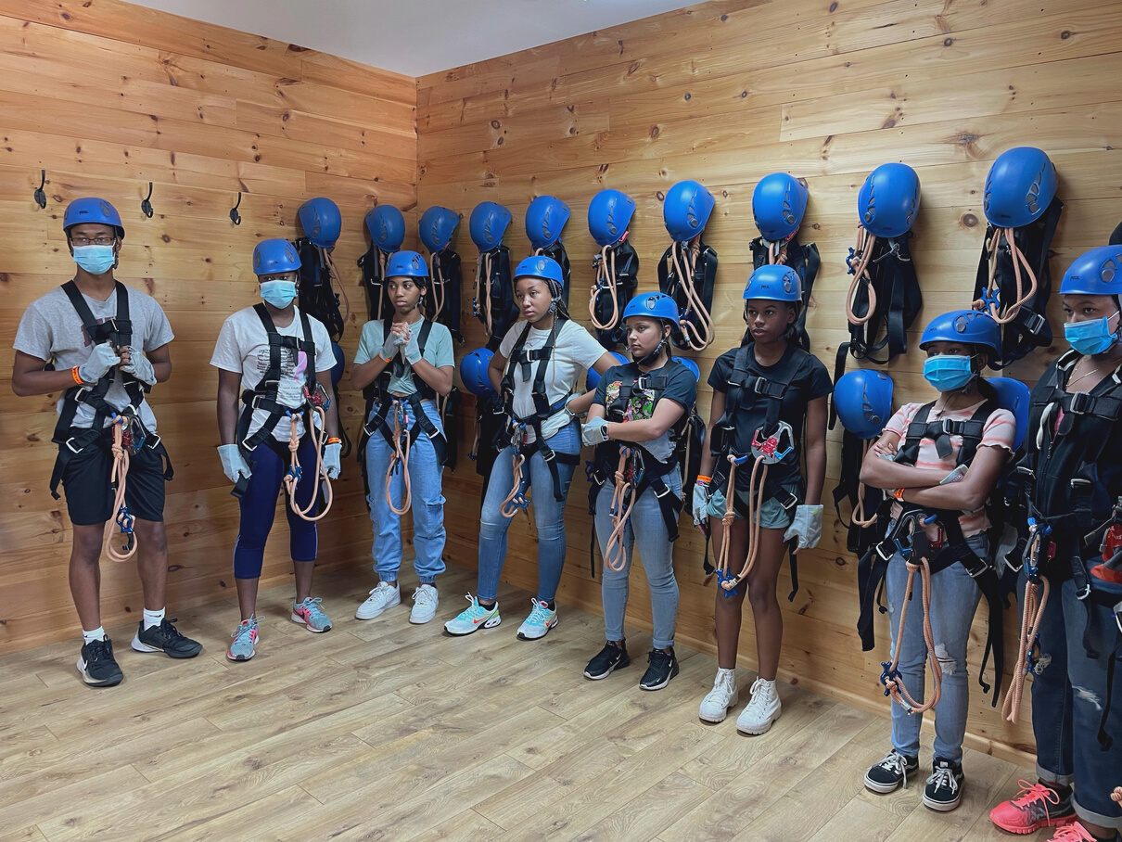
WHY IT MATTERS
Expose our children to unique and engaging opportunities for growth and personal development. Help create future leaders and contributing impactful citizens for the Black community
What do we want to see?

Slide 4
National Programming
Focus on our thrusts
Goal: Growth and development through leadership and engagement

Slide 5
TEAMWORK
TENACITY
Programming Excellence at a Glance
TIME
TALENT

Slide 6
Teamwork
WHO’S YOUR CREW?
DIVIDE AND CONQUER
Assemble a fantastic programming committee
This is not and should not be a one woman show. Solicit help and divvy up tasks.
COLLABORATE
CHAPTER PARTICIPATION
Willingness to work with other leadership in the chapter and beyond
Programming succeeds when all mothers have a vested interest in the outcomes

Slide 7
Tenacity
SET EXPECTATIONS
ACCOUNTABILITY
Do this early so chapter is cohesive
Accept responsibility for mistakes, apologize, move on. This is a helpful tool for any chapter position.
DEFINE GOALS
DON’T PROCRASTINATE
What is it that you want to achieve?
This is the devil’s playground. Resist!!! Set Internal deadlines and stick to them.

Slide 8
Time
ORGANIZE
DON’T RECREATE THE WHEEL
The role is labor intensive but an organized approach is EVERYTHING
If it ain’t broke…but do make the process your own. Continue to find ways to save time and effort.
DETAILS MATTER
SET BOUNDARIES
Set yourself up for success early on
Don’t let the role consume you. Walk away. It’s voluntary.

Slide 9
Talent
UNIQUE SKILLS
USE YOUR RESOURCES
What are yours? Bring those to the role.
Local, regional, and national resources abound.
DEEPEN YOUR BENCH
BUILD A STRONG PD NETWORK
Reach out to mothers with strengths you don’t have or want to learn
Your sister moms are amazing and supportive. Lean into those relationships.

Slide 10
What else is in the PD bag?
PATIENCE
FLEXIBILITY
APPROACHABILITY
Sometimes you will have “woosah” moments
Be amenable and try to work with any situation within reason
Moms have questions. Provide answers.

Slide 11
CHAPTER SUPPORT
How do you ensure that your PD succeeds?
PATIENCE
FLEXIBILITY
ACCOUNTABILITY
PDs are busy too. Give her grace and know that she’s working
Remember that this position is voluntary and that the PD and team are also doing ALL the things
Follow through amd stay informed.

Slide 12
Is that it?
Bonus: Getting to truly know all of
the dynamic moms and children of our chapter!
💙💗

Slide 13
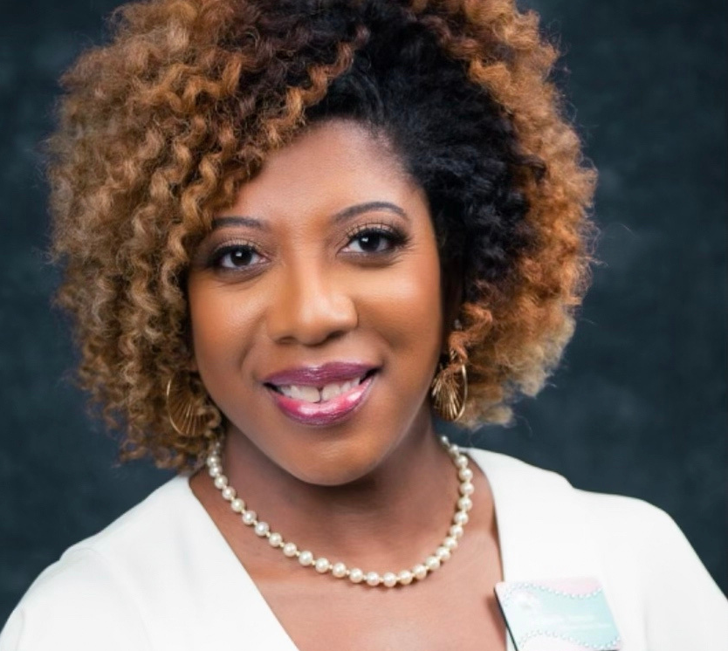
Camille French - Program Director
2019-2022
wsjjprogramdirector@gmail.com
💙 Long Live Jack and Jill!! 💗

