Slide 1

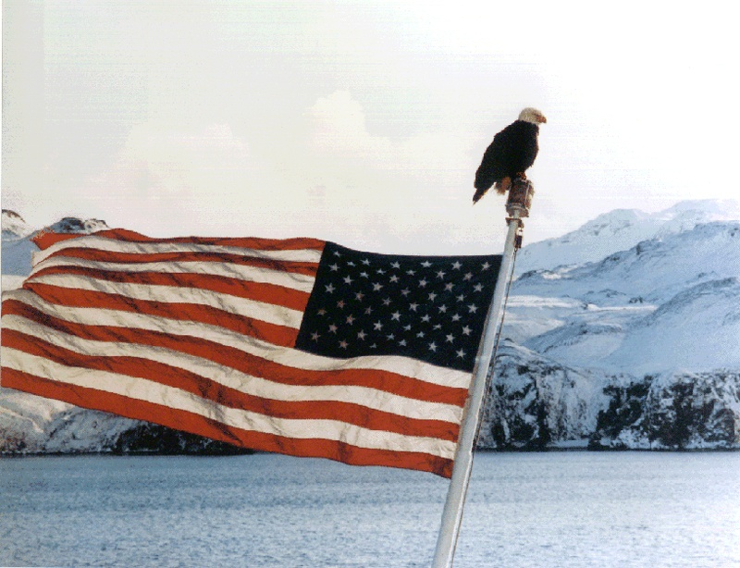

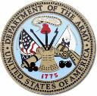

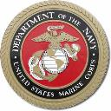
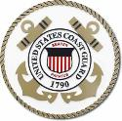
AMVETS
Veterans Helping Veterans
Farmington Post 332

Slide 2

A veteran - whether active duty, retired, or national guard or reserve - is someone who, at one point in their life, wrote a blank check made payable to "The United States of America," for an amount of "up to and including THEIR LIFE."
Notes:
Dick

Slide 3
Mission
To enhance and safeguard the entitlements for all American Veterans who have served honorably and to improve the quality of life for them, their families, and the communities where they live through leadership, advocacy and services.
Notes:
Dick

Slide 4
Information
Founded 1944
Chartered by Congress 1947
Over 250,000 members
Over 1,400 posts nationwide
Voice in DC
Members are active duty and honorably discharged veterans from all branches of services
Notes:
Ed

Slide 5
AMVETS Family
National Service Foundation
Ladies Auxiliary
Sons of AMVETS
AMVETS Riders
Junior AMVETS
Sad Sacks & Sackettes
Notes:
Dick
AMVETS National Service Foundation
The National Service Foundation (oftentimes referred to as simply “the Foundation”) is the fund-raising arm of AMVETS. A corporate subsidiary of the parent organization, it funds a variety of programs benefiting America’s veterans and their communities. Among them is the National Service Officer Program, the Memorial Carillon Program, the Americanism Program, AMVETS scholarships, youth programs and hospital projects.
Sad Sacks
A fun-making and honor organization comprised of AMVETS members, the Sad Sacks (who derive their name from the famous cartoon character of World War II) provide, as their chief community service project, scholarships for nurses.
Sackettes
The Ladies Auxiliary counterpart to the Sad Sacks, the Sackettes also raise funds for nurses’ scholarships.

Slide 6
National Programs
Value: $27,777,678 in 2015
Poster and essay Contest
Task Force DVD
ROTC and JROTC Medals
National Guard Family Program
National Coalition for Homeless Veterans
Military Funeral Honors
Notes:
Ed
Task Force DVD: Thank you to all who have donated your gently used DVDs; they will be used to provide entertainment for our service members abroad and Veterans currently in VA Medical Facilities. Due to your overwhelming kindness, we can no longer accept DVDs at this time.

Slide 7
National Programs
Freedoms Foundation
Citizen’s Flag Alliance
Ceremonial Rifles and Static Displays
Armed Services Blood Program
AMVETS White Clover
AMVETS & the Boy Scouts of America
AMVETS Against Drug & Alcohol Abuse
AMVETS Americanism Program
Notes:
Ed
Freedoms Foundation: Since 1987, AMVETS and the AMVETS National Service Foundation have offered this unique educational experience at the Freedoms Foundation in Valley Forge, Pennsylvania, to give young people a better appreciation of their freedoms granted by the United States Constitution.
White Clover: The White Clover, meaning, “remember me” is the official flower of AMVETS, it symbolizes the states from which the U.S. Armed Forces were drawn and the worldwide battlefields on which they fought. (It is a four-leaf clover.)

Slide 8
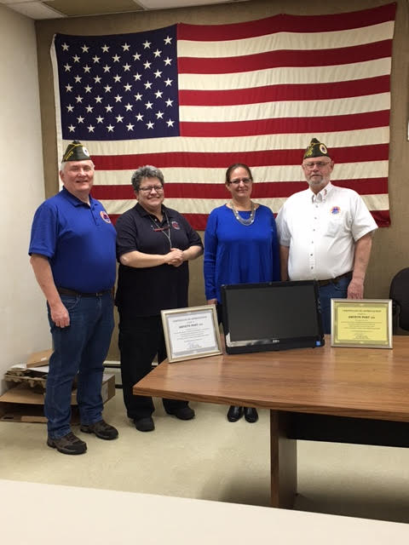
Post 332 Programs
Zion House
Notes:
Dick

Slide 9
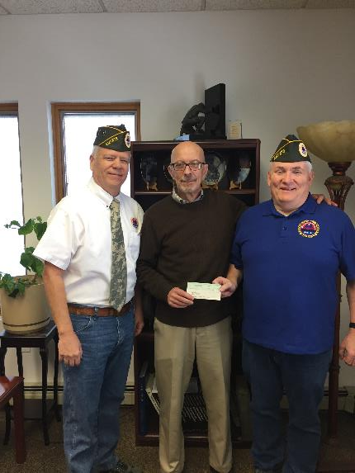
Post 332 Programs
Rochester
Vet
Center
Notes:
Dick

Slide 10
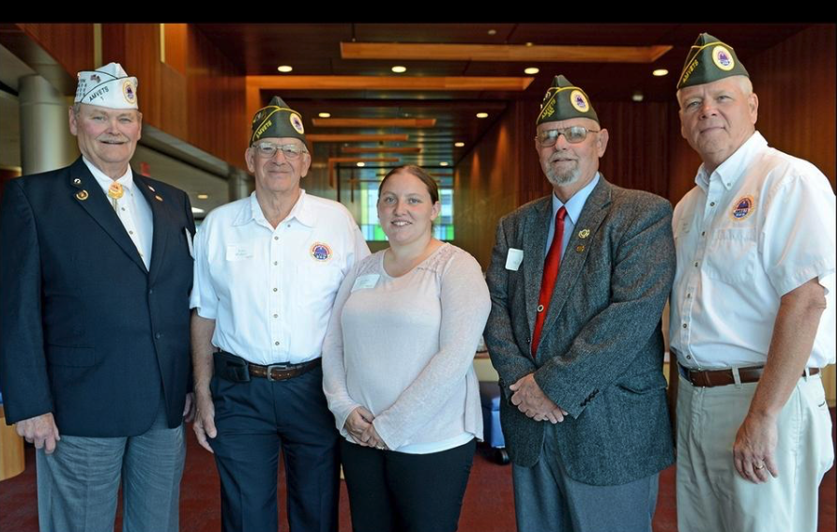
Post 332 Programs
2016 FLCC Scholarship Award
Notes:
Dick

Slide 11
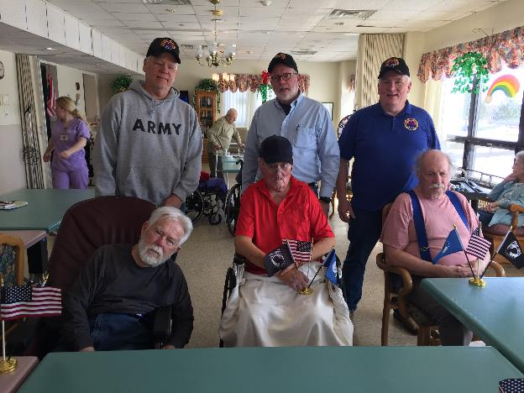
Post 332 Programs
Local Senior Vet Visits
Notes:
Dick

Slide 12
Post 332 Programs
Victor Farmington Food Cupboard
Canandaigua VA Support
Farmington Veterans Memorial
Honor Flight Rochester
Winter Clothing Program
Adopt a Family for Christmas (Blue Star Mothers)
Notes:
Dick

Slide 13
Post 332 Programs
Veterans Transportation
Ontario County Veterans Service Agency Support
Household Goods for Veterans
Personal care Kits for Female Veterans
Notes:
Dick

Slide 14
Contacts
Post 332 Farmington NY
Commander
Dick McDermott
(585) 362-2976
1st Vice Commander
Ed Hemminger
(585) 261-4502

