Slide 1



Slide 2
The Inspiration for CTRF
In November of 2024, Steve had to make sure I knew how to split wood for the water stove. He had to come down to the wood pile to supervise. His daughter Julie and our grandson Liam were visiting. After watching us for just a short time, Steve passed out and slowly fell to an awkward position on the ground. Chief Wayne Barneycastle was the first to respond followed by several other volunteers and then the EMS. One of the devices Steve wore around his neck was a dog tag with a QR code that, when scanned, held all of Steve’s emergency contacts, medications, information of his disease, physicians, and insurance cards. Wayne had never seen such a device. Shortly after that, the idea of the foundation was formed.

Slide 3

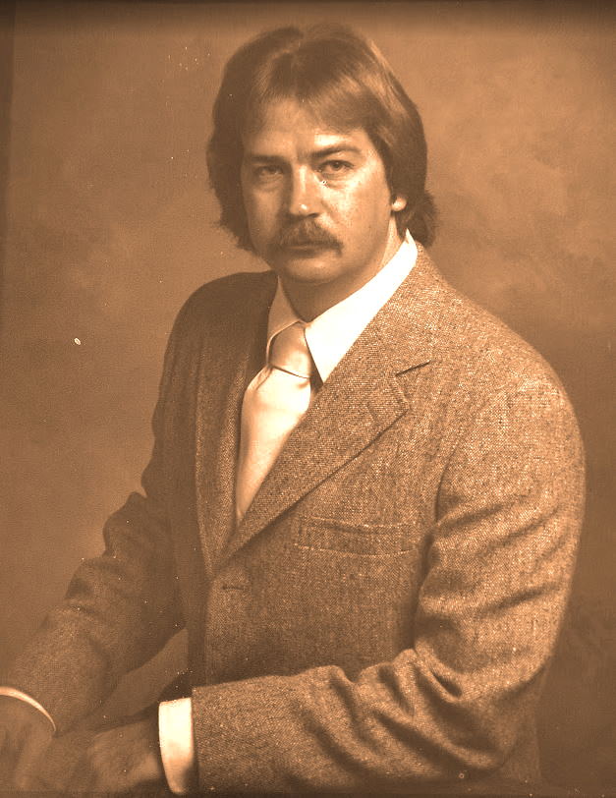
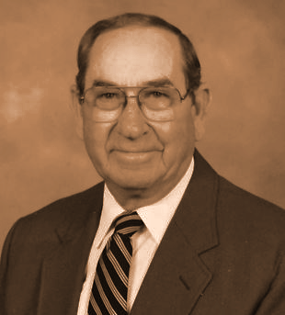
Chief Tedder & Chief Tedder
Steve W. Tedder
NC DENR - Division of Environmental Management,
Chief of the Water Quality Section
Ira W. Tedder
Chief of the Sauratown Fire & Rescue Department

Slide 4

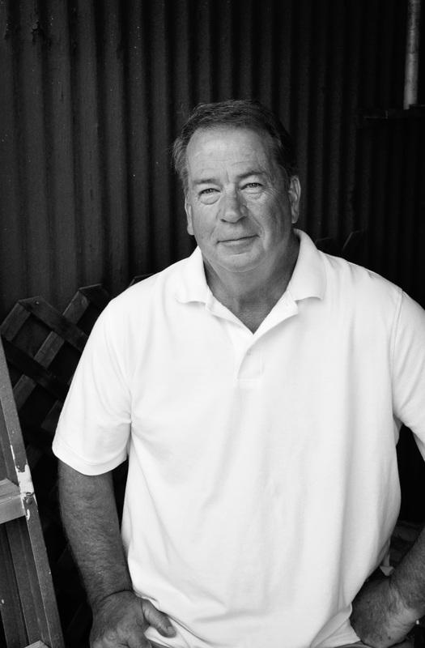
Our Mission
Our goal is to help provide life saving medical aid devices for the terminally ill, elderly, special needs population, children, veterans, and even pets. These devices will help these people and animals get the help and care
they need and deserve.

Slide 5
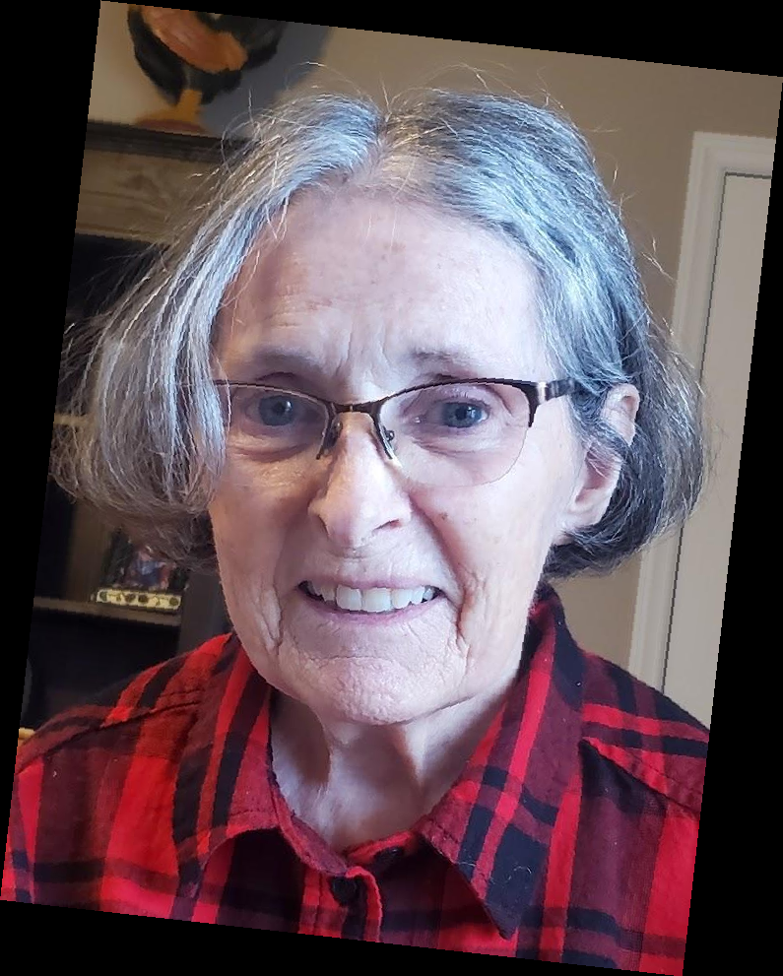
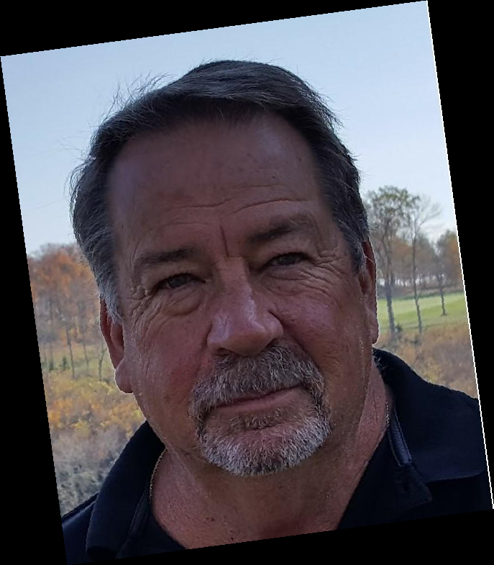
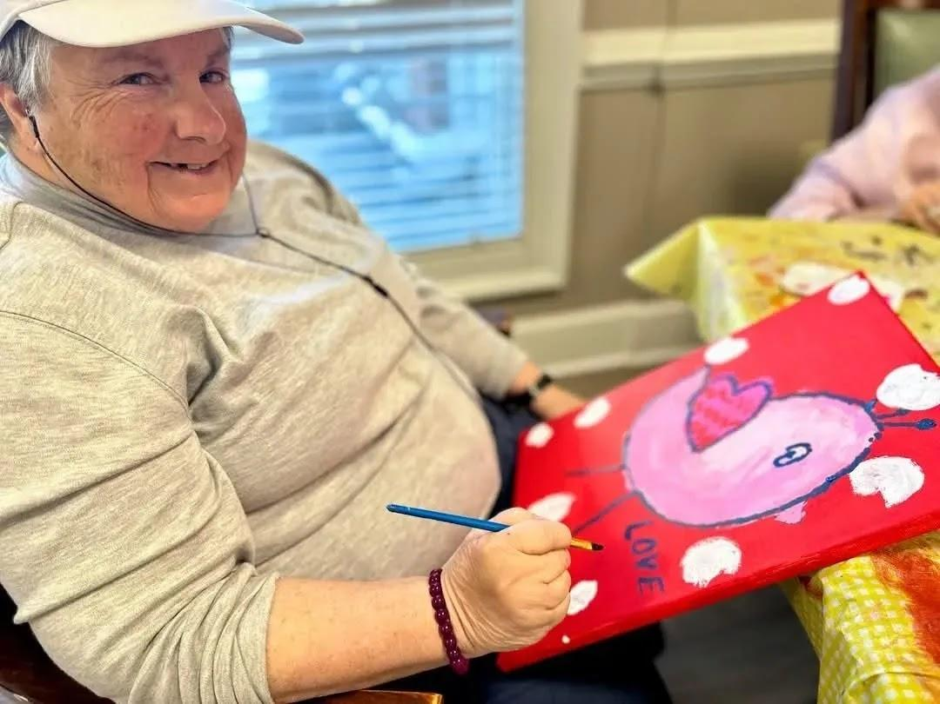
Our Focus
The Elderly
Special Needs
Terminal Diseases

Slide 6
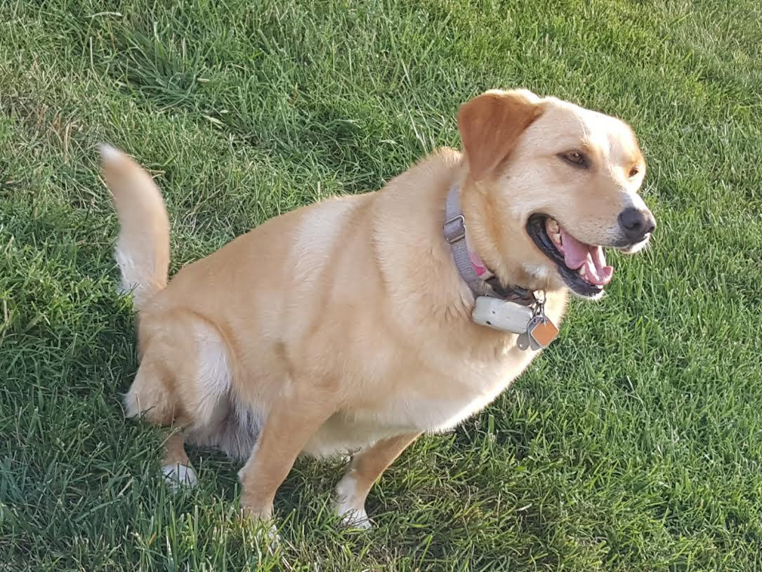
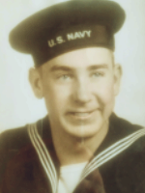
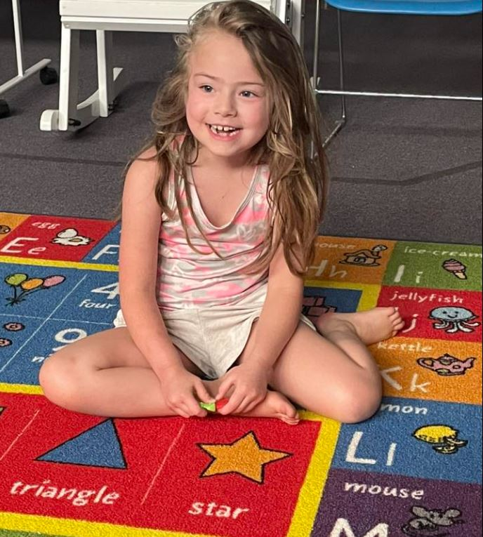
Our Focus
Pets
Autism Spectrum
Veterans

Slide 7
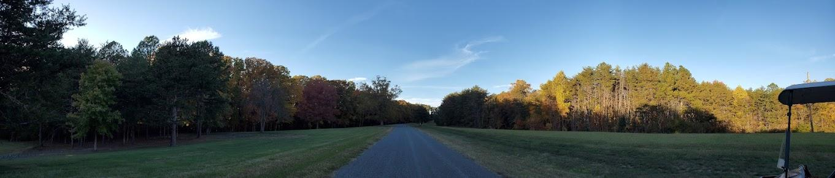
Our Journey

Slide 8
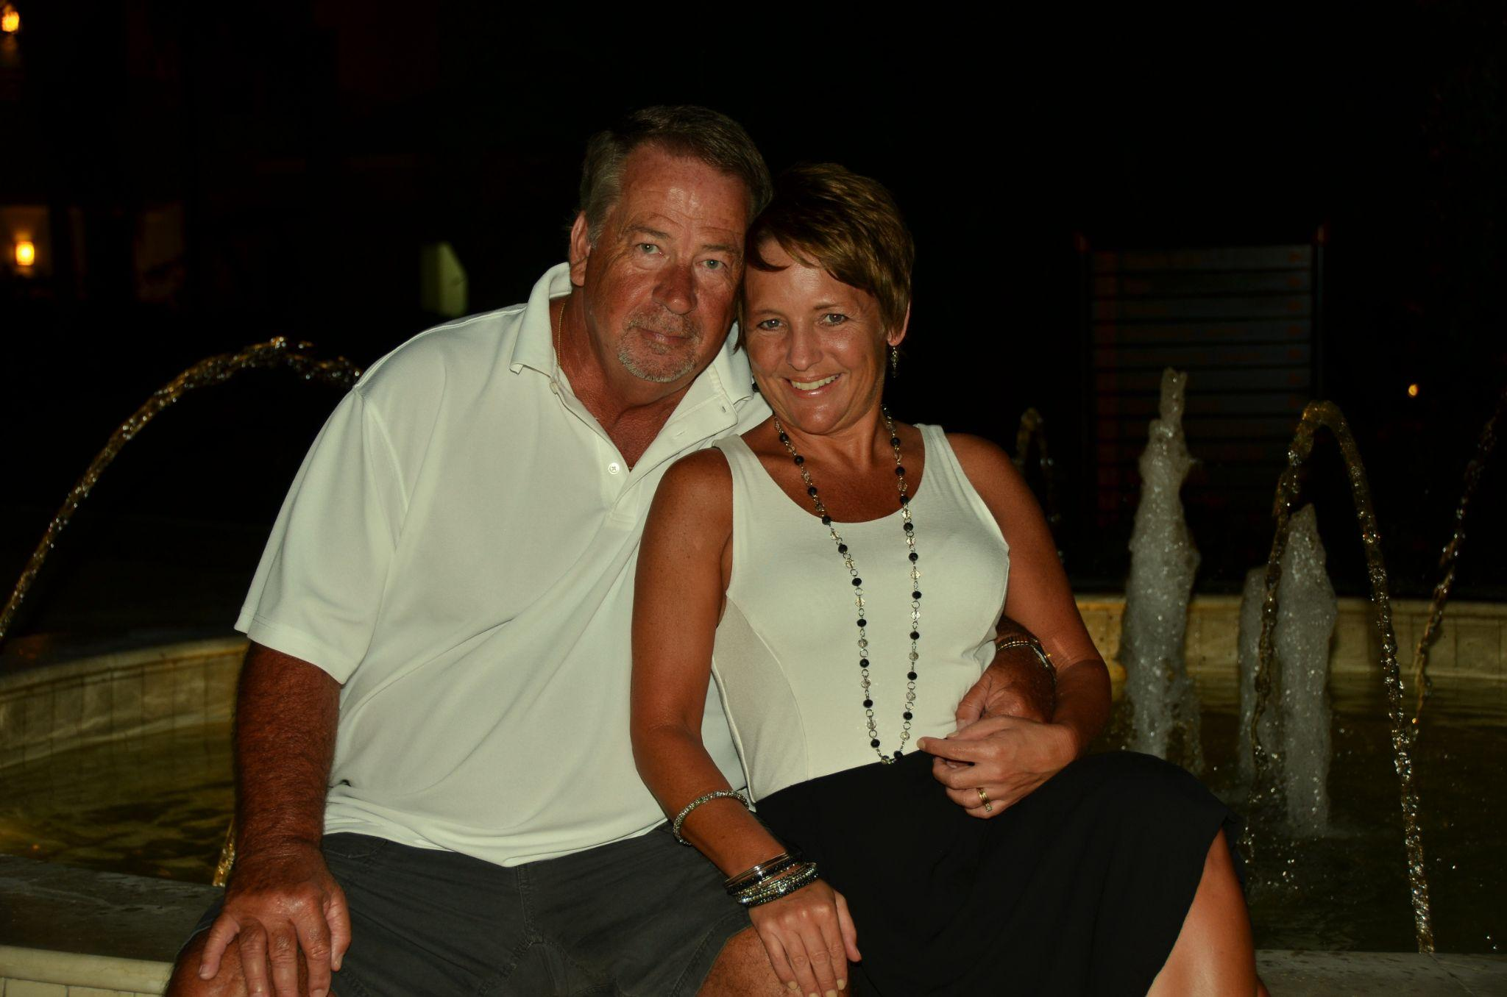
Our Timeline
Late 2022/Early 2023: Suffered trauma to the back of his head due to hard falls
March 2023: First doctor’s appointment to report symptoms
May 2023: Severe fall, suffered damage to the front of his head
Rest of 2023: Doctor visits continued
January 3, 2024: Diagnosis of probable PSP
Throughout 2024: Began a rapid decline in physical abilities, eventually lost over time
January 7, 2025: Entered Hospice Care
February 26, 2025 @ 5:45am, Steve succumbed to his illness

Slide 9
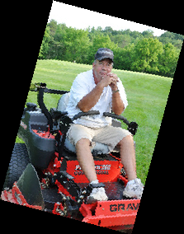
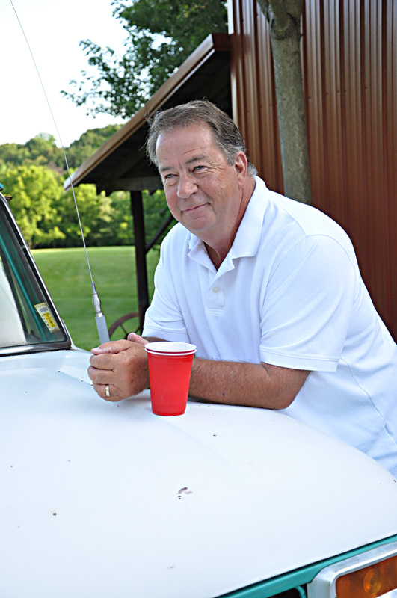
Symptoms
Noticeable difference in handwriting/typing
Dizziness
Suspected aphasia
Decline in vision, difficulty reading
Loss of balance
Speech decline (dysarthria)
Mobility difficulties (walker dependency)
Difficulty swallowing without choking
Unable to use right arm and hand
Loss of ability in right leg and foot
Could not be understood when attempting to speak
Inability to walk

Slide 10
Appointments, Tests, & Guesses
1st Neurologist
Spinal Surgeon
work stress and carpal tunnel syndrome
EMG testing
Degenerative disk & spinal decompression
Considered cervical decompression
Emergency department complete spine MRI
Psychological Testing
ENT
Inconclusive because instructions misunderstood
Right parotid cyst/benign
2nd Neurologist
B12 deficiency
Stated not Parkinson’s, but started Levodopa
Ordered MRI
Long COVID possibility
EMG testing
Multiple blood tests (All negative)

Slide 11
Appointments, Tests, & Guesses
Orthopedic Surgeon
3rd Neurologist
Torn rotator cuff
Bone spurs
Recommended DAT scan
Results Abnormal
1st Optometrist
4th Neurologist
Change in prescription
Deficient SACCADIC (eye movements)
Nothing new to recommend except for a movement specialist
Neuro Ophthalmologist
Diagnosed with Square Wave Jerks
Probable cerebellar ataxia

Slide 12
Appointments, Tests, & Guesses
Cardiologist
Pain Medicine Physician
Left atrium severely dilated
Otherwise unremarkable
Multiple appointments for epidural injections
5th Neurologist/Movement Specialist
Sleep Study Doctor
Probable PSP
Hypoxemia without obstructive sleep apnea
6th Neurologist/Movement Specialist UNC
2nd Cardiologist
Ordered skin biopsy
Confirmed PSP
Wore heart monitor, showed frequent PVCs

Slide 13
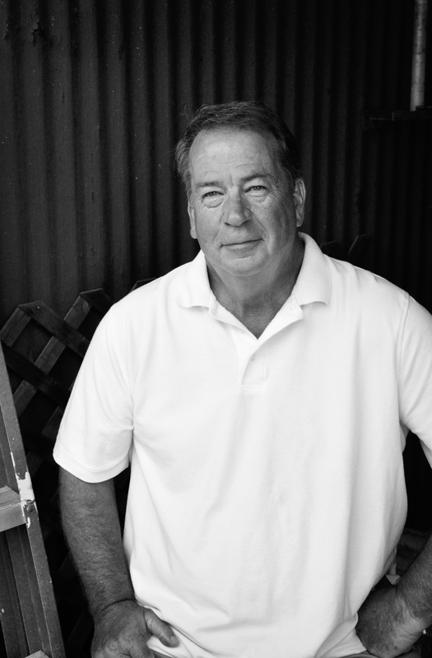
Appointments, Tests, & Guesses
Pain Anesthesiologist
Multiple visits resulting in spinal cord stimulator implant
PSP Clinical Trial
7th Neurologist
Failed screening process by one point
Additional confirmation of PSP

Slide 14

The Dreaded Truth
Progressive Supranuclear Palsy
Progressive supranuclear palsy (PSP), multiple system atrophy (MSA] and corticobasal degeneration (CBD) are brain diseases that can cause changes to speech, balance, walking, swallowing, vision, cognition and autonomic functioning. They can also involve symptoms similar to Parkinson’s disease including tremor, stiffness and slowness. Due to this, people may initially be diagnosed with Parkinson’s and you may hear PSP, CBD and MSA referred to as “atypical parkinsonism” syndromes. They are neurodegenerative, meaning that symptoms may change and worsen over time.
Caregivers often refer to this disease as “derived from the pits of Hell” and relate it more to ALS rather than Parkinson’s.

Slide 15

Treatments
Continue Carbidopa/Levodopa
Amantadine
Transition lenses
Prism covering for glasses
13 week vision therapy program
2 home health speech therapists
2 home health occupational therapists
Multiple outpatient speech therapy appointments
3 home health physical therapists
Home modifications
Numerous apparatuses for ADLs

Slide 16


Slide 17
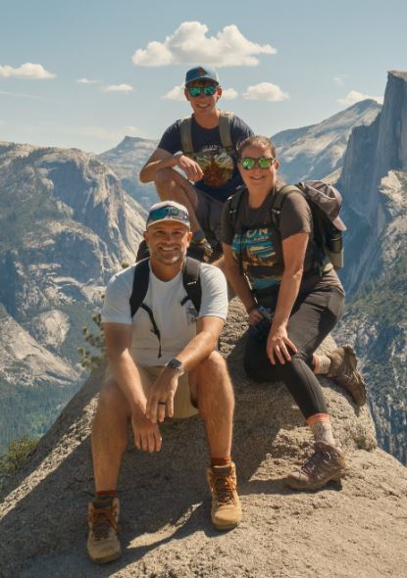
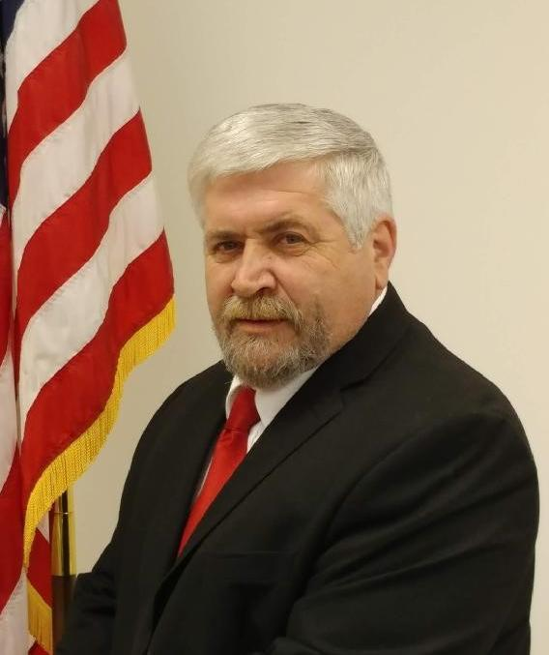
CTRF Board
The Queen Family
Steve’s daughter, Julie
Her husband, Chuck
Our grandson, Liam
Chief Wayne Barneycastle

Slide 18

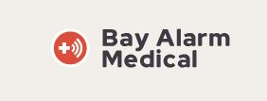

Our Partners
Click on the images for the link!

Slide 19
The CTRF Advisory Council
First Responders - EMS/Paramedics/Firefighters/Police
School Representatives - Guidance Counselors/Exceptional Children's Teachers/Social Workers/Hearing Impaired Teacher
Grant Writers/Technical Experts
Special Needs Community - Parents/former students/adults that overcame their disabilities and are now very successful community leaders
Resource Experts - Real Estate Agents, Investment Consultants, Insurance Specialists, Attorneys
Representative of assisted living facilities, adult living communities, home health agencies
Targeted experts - ESL, Deaf/Hard of Hearing, autism, birth defects, dementia/alzheimers, Veterans
Ministry/Grief Support/Therapists
Pet Advocates
Fellow Caregivers

Slide 20


Tedder Talk Tour
Stops Made
City of King
Board of County Commissioners
Town of Walnut Cove
Town of Danbury
Chestnut Grove Ruritans
Stokes County Militia and Dogwood Disaster Relief Inc.
Board of Education

Slide 21
Tedder Talk Tour
Next Stops
Rotary Club of King
Board of County Commissioners
Assisted Living and Nursing Homes
Numerous County Events

Slide 22



CTRF Community Commitment
Adopt a Highway Clean Up - Quarterly
CTRF - Scholarship for Stokes County Senior Entering First Responder Program
CTRF Walk/Run/Roll or Warriors

Slide 23

Call To Action
Share expertise/knowledge
Share ideas
Share the CTRF mission
Help vet recipients
Help fundraise when/if necessary
Volunteer at Community Programs

Slide 24


Slide 25
