Slide 1




Our Partners
Click on the images for the link!

Slide 2

OUR STAR PARTNER

Slide 3


Slide 4


Slide 5


Slide 6


Slide 7


Slide 8


Slide 9


Slide 10



Slide 11
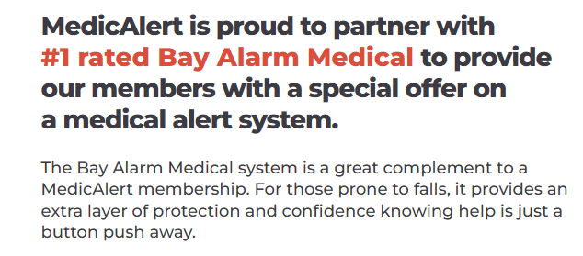


Slide 12



Slide 13



Slide 14


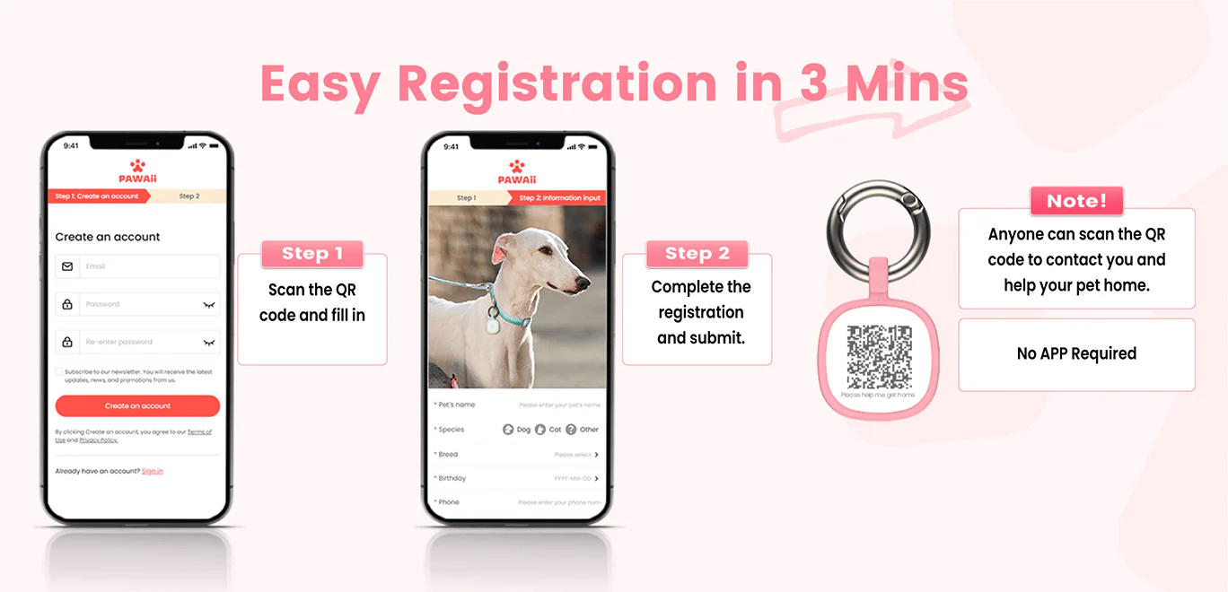

Slide 15


Slide 16
Questions/Comments?

