Slide 1
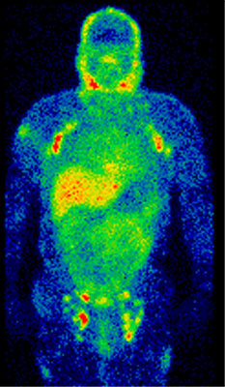
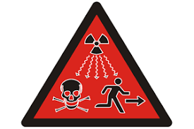
7 Radioactivity and Particles
www.physicstutoring.uk

Slide 2
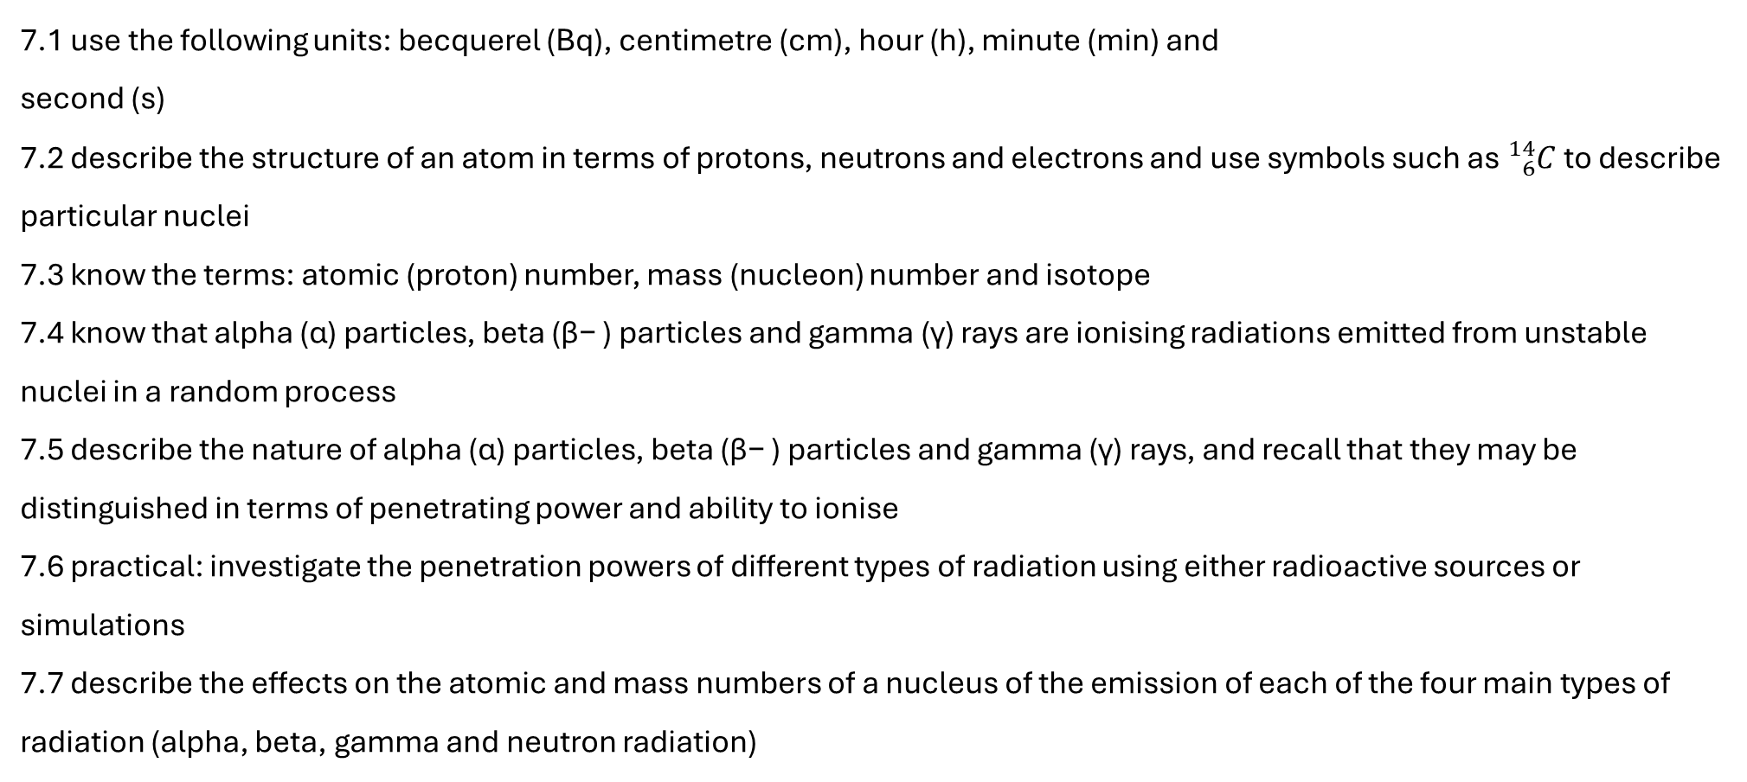
7 Radioactivity and Particles
7.1 use the following units: becquerel (Bq), centimetre (cm), hour (h), minute (min) and
second (s)
7.2 describe the structure of an atom in terms of protons, neutrons and electrons and use symbols such as ${}_{6}^{14}C$to describe particular nuclei
7.3 know the terms: atomic (proton) number, mass (nucleon) number and isotope
7.4 know that alpha (α) particles, beta (β− ) particles and gamma (γ) rays are ionising radiations emitted from unstable nuclei in a random process
7.5 describe the nature of alpha (α) particles, beta (β− ) particles and gamma (γ) rays, and recall that they may be distinguished in terms of penetrating power and ability to ionise
7.6 practical: investigate the penetration powers of different types of radiation using either radioactive sources or simulations
7.7 describe the effects on the atomic and mass numbers of a nucleus of the emission of each of the four main types of radiation (alpha, beta, gamma and neutron radiation)
www.physicstutoring.uk

Slide 3
7 Radioactivity and Particles
7.8 understand how to balance nuclear equations in terms of mass and charge
7.9 know that photographic film or a Geiger-Müller detector can detect ionising radiations
7.10 explain the sources of background (ionising) radiation from Earth and space
7.11 know that the activity of a radioactive source decreases over a period of time and is measured in becquerels
7.12 know the definition of the term ‘half-life’ and understand that it is different for differentradioactive isotopes
7.13 use the concept of the ‘half-life’ to carry out simple calculations on activity, including graphical methods
7.14 describe uses of radioactivity in industry and medicine
7.15 describe the difference between contamination and irradiation
7.16 describe the dangers of ionising radiations, including:
• that radiation can cause mutations in living organisms
• that radiation can damage cells and tissue
• the problems arising from the disposal of radioactive waste and how the associated risks can be reduced
www.physicstutoring.uk

Slide 4
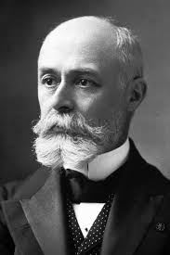
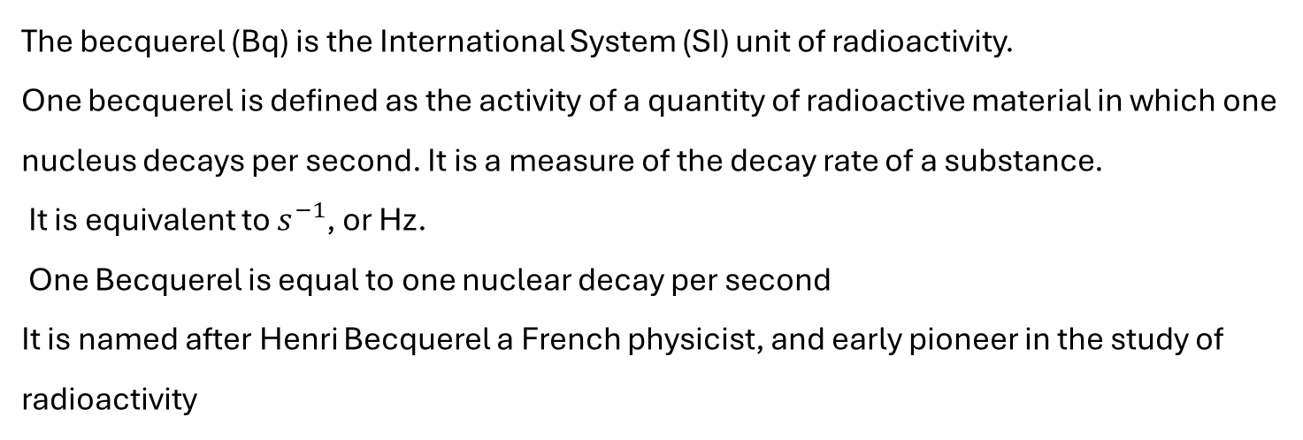
7.1 Radioactivity Units
7.1 use the following units: becquerel (Bq), centimetre (cm), hour (h), minute (min) and
second (s)
The becquerel (Bq) is the International System (SI) unit of radioactivity.
One becquerel is defined as the activity of a quantity of radioactive material in which one nucleus decays per second. It is a measure of the decay rate of a substance.
It is equivalent to $s^{−1}$, or Hz.
One Becquerel is equal to one nuclear decay per second
It is named after Henri Becquerel a French physicist, and early pioneer in the study of radioactivity
www.physicstutoring.uk

Slide 5
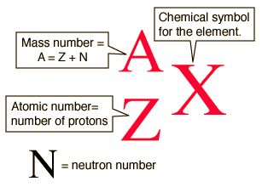

7.2 Nuclear Notation
7.2 describe the structure of an atom in terms of protons, neutrons and electrons and use symbols such as ${}_{6}^{14}C$to describe particular nuclei
Example: the isotopes of carbon. The element is determined by the atomic number 6.
Carbon-12 is the common isotope,
Carbon-13 as another stable isotope which makes up about 1%.
Carbon 14 is radioactive and the basis for carbon dating.
www.physicstutoring.uk

Slide 6
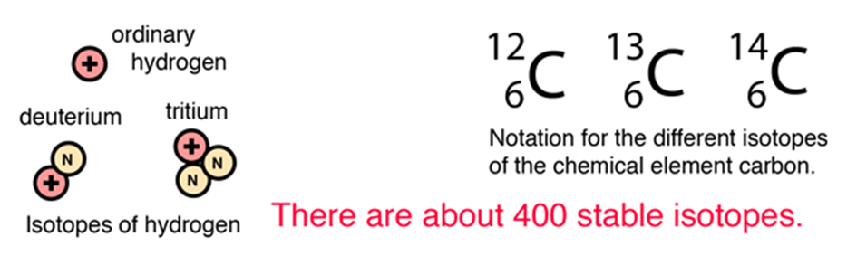
7.3 Nuclear Vocabulary
7.3 know the terms: atomic (proton) number, mass (nucleon) number and isotope
The three isotopes of hydrogen change in mass by a factor of three, but their chemical properties are identical.
www.physicstutoring.uk

Slide 7
7.3 Nuclear Vocabulary
7.3 know the terms: atomic (proton) number, mass (nucleon) number and isotope
Proton number or charge, Z = the number of protons in a nucleus
Nucleon number or Mass number, A = the number of protons and neutrons in a nucleus
Neutron number, N = the number of neutrons in a nucleus
Isotopes. Atoms of the same type, they have the same proton no, but different masses due to their having different numbers of neutrons.
www.physicstutoring.uk

Slide 8
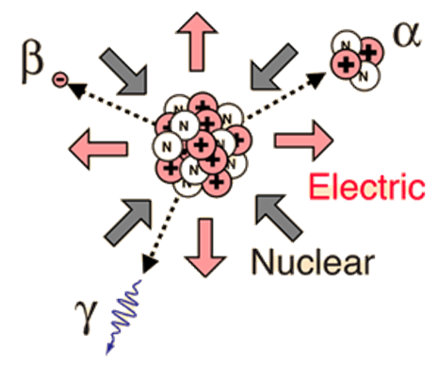
7.4 Types of Decay
7.4 know that alpha (α) particles, beta (β− ) particles and gamma (γ) rays are ionising radiations emitted from unstable nuclei in a random process
Nuclear decay arises from an imbalance between the two strongest forces in nature, the nuclear and electromagnetic.
In stable nuclei these forces are balanced;
the electrostatic repulsion that acts between protons is exactly balanced by the strong force of nuclear attraction that acts between all nucleons (protons and neutrons).
When these forces are unbalanced, the nucleus is said to be radioactive and can spontaneously and randomly decay.
There are four mechanisms of decay, alpha, beta, gamma, and neutron decay.
The first three are directly ionising, the fourth is electrically neutral and is not.
www.physicstutoring.uk

Slide 9
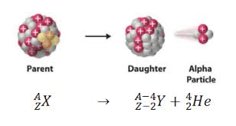
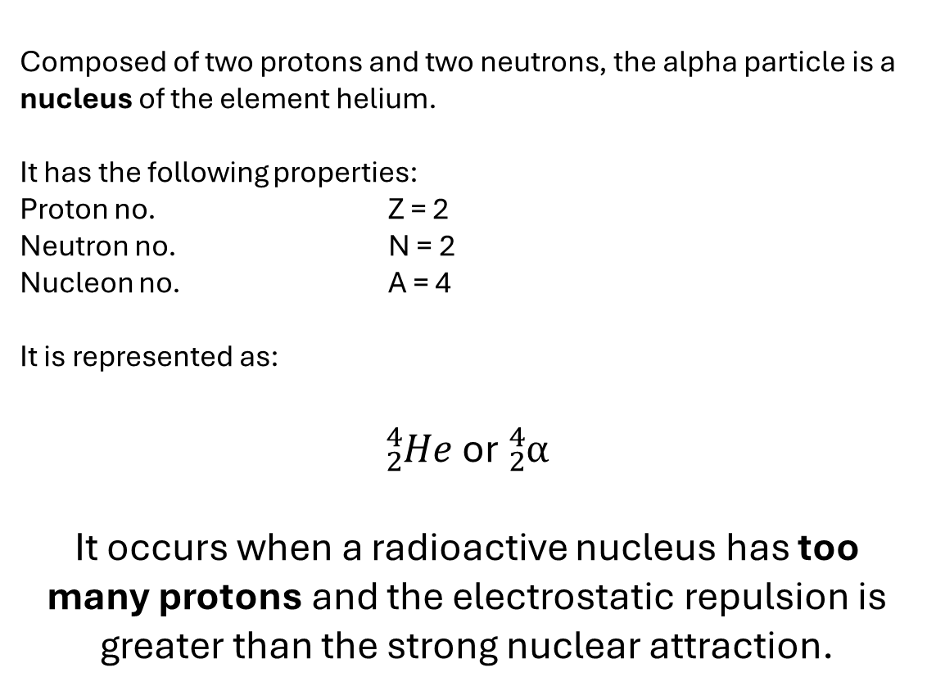
7.4 Alpha Decay - α
Composed of two protons and two neutrons, the alpha particle is a nucleus of the element helium.
It has the following properties:
Proton no. Z = 2
Neutron no. N = 2
Nucleon no. A = 4
It is represented as:
${}_{2}^{4}{He}$ or ${}_{2}^{4}α$
It occurs when a radioactive nucleus has too many protons and the electrostatic repulsion is greater than the strong nuclear attraction.
www.physicstutoring.uk

Slide 10
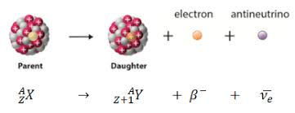
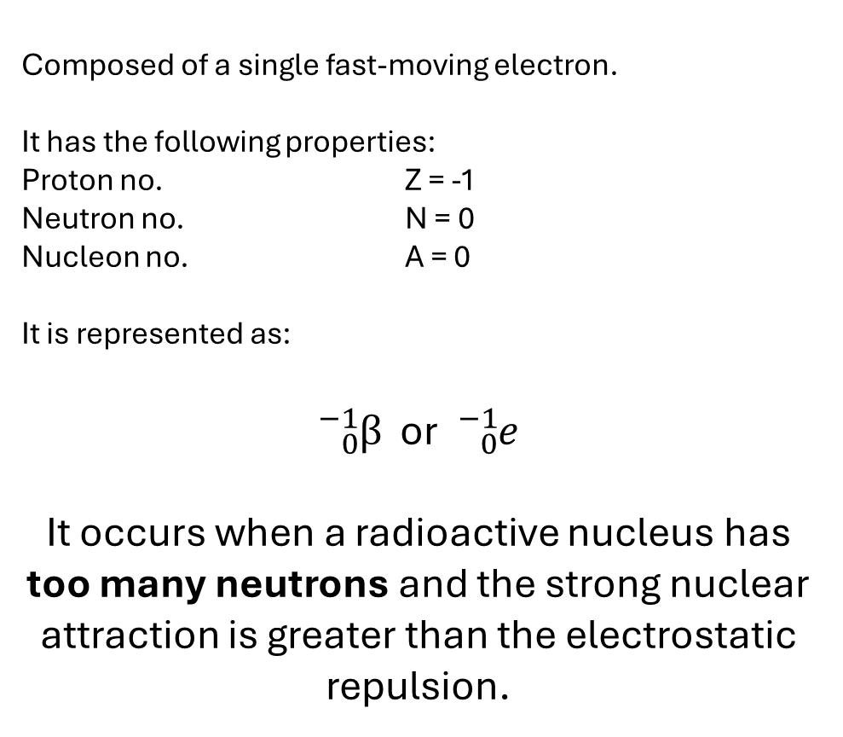
7.4 Beta Decay - β
Composed of a single fast-moving electron.
It has the following properties:
Proton no. Z = -1
Neutron no. N = 0
Nucleon no. A = 0
It is represented as:
${}_{0}^{−1}β$ or ${}_{0}^{−1}e$
It occurs when a radioactive nucleus has too many neutrons and the strong nuclear attraction is greater than the electrostatic repulsion.
N.B. You do not need to know about neutrinos for this course, but they are there!
www.physicstutoring.uk

Slide 11
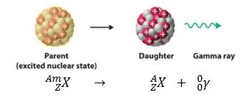
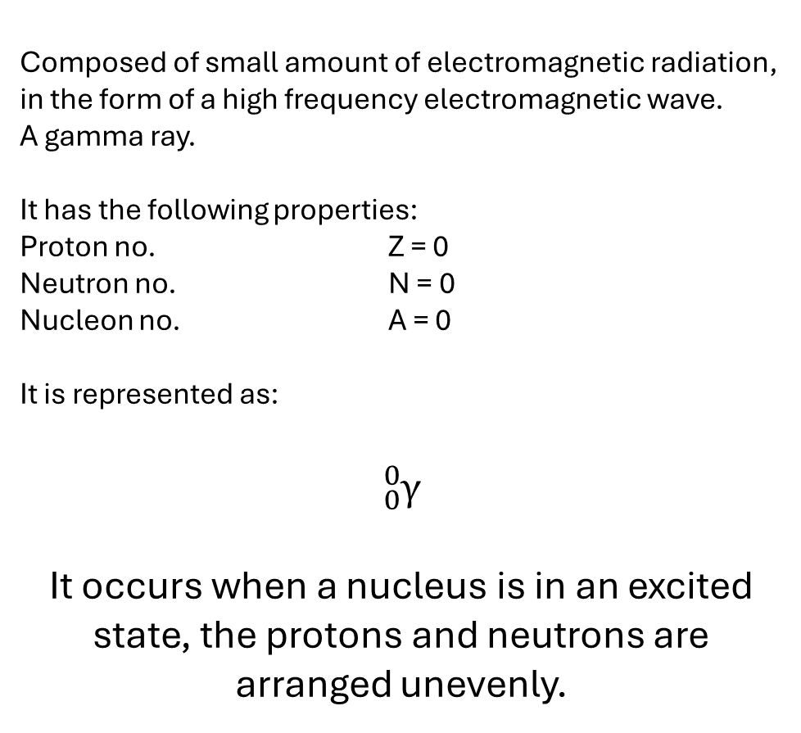
7.4 Gamma Decay - γ
Composed of small amount of electromagnetic radiation, in the form of a high frequency electromagnetic wave.
A gamma ray.
It has the following properties:
Proton no. Z = 0
Neutron no. N = 0
Nucleon no. A = 0
It is represented as:
${}_{0}^{0}γ$
It occurs when a nucleus is in an excited state, the protons and neutrons are arranged unevenly.
www.physicstutoring.uk

Slide 12
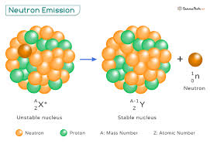
7.4 Neuton Decay - n
Neutron emission is a mode of radioactive decay in which one or more neutrons are ejected from a nucleus.
It occurs in the most neutron-rich/proton-deficient nuclides, and also from excited states of other nuclides.
As only a neutron is lost by this process
The number of protons remains unchanged,
The atom does not become an atom of a different element, but a different isotope of the same element.
www.physicstutoring.uk

Slide 13
7.5 Properties of Decay
7.5 describe the nature of alpha (α) particles, beta (β− ) particles and gamma (γ) rays, and recall that they may be distinguished in terms of penetrating power and ability to ionise
Type of decay | Penetrating ability | Ionising Ability
Alpha Decay | Weakly penetrating, absorbed by a few cm of air or a sheet of paper. | Most ionising, has a +2 charge
Beta Decay | Moderately penetrating, absorbed by a thin sheets of aluminium. | Moderately ionising, has a charge of -1.
Gamma Decay | Strongly Penetrating, absorbed by several centimetres of lead, or metres of concrete | Least ionising as has to ‘knock off’ an electron from an atom after colliding with it.
Neutron Decay | Extremely penetrating, only stopped by metres of concrete | Neutral, very unlikely to ionise, unless absorbed by a nucleus, and inducing a subsequent beta decay.
www.physicstutoring.uk

Slide 14
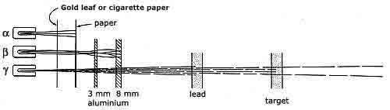
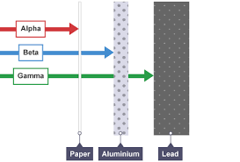
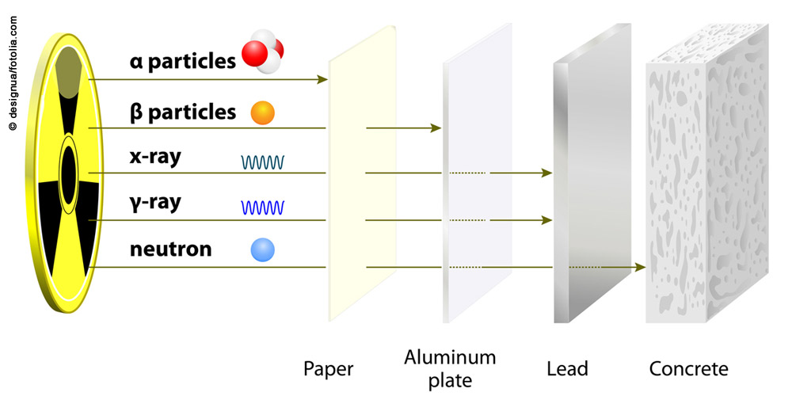
7.6 Radioactivity Properties - Practical
7.6 practical: investigate the penetration powers of different types of radiation using either radioactive sources or simulations
www.physicstutoring.uk

Slide 15
7.6 Radioactivity Properties - Practical
Practical Method: Investigating Absorption of Radiation
This experiment determines the type of radiation being emitted by checking which material stops it.
Equipment Needed:
Radioactive sources (Alpha, Beta, and Gamma)
Geiger-Müller (GM) tube and counter
Set of absorbers: Paper/Cardboard, Aluminum foil (approx. 3-5mm), Lead block (thick)
Tongs (for safety)
Method/Procedure:
Measure Background Count: Turn on the GM counter without any source present and record the count rate for 5 minutes. This must be repeated, averaged and then subtracted from all measurements.
Setup the Source: Using tongs, place the radioactive source (e.g., Americium-241 for Alpha, Strontium-90 for Beta, Cobalt-60 for Gamma) about 3-5 cm from the GM tube.
Test with Paper: Place a sheet of paper between the source and the tube. If the count rate drops to background levels, the source is alpha.
Test with Aluminum: If the count remains high, replace the paper with aluminum foil. If the count drops significantly, the source is beta.
Test with Lead: If the count still remains, place a thick lead block in front of the source. A significant decrease in the count suggests gamma radiation.
www.physicstutoring.uk

Slide 16




7.7 Decay Equations 1
7.7 describe the effects on the atomic and mass numbers of a nucleus of the emission of each of the four main types of radiation (alpha, beta, gamma and neutron radiation)
www.physicstutoring.uk

Slide 17
7.8 Decay Equations 2
There are some fundamental conservation laws that are never violated, these are:
Conservation of Mass/Energy
Conservation of Charge
Conservation of Momentum
The first two are maintained by balancing radioactive decay equations;
Nucleon No – conserves mass
Proton No – conserves charge
The relative direction and speed of the particles before and after the decay conserves momentum.
In practice the sum of each of these numbers on either side must be equal.
www.physicstutoring.uk

Slide 18
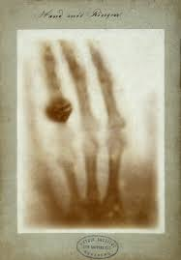
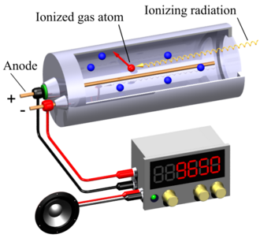
7.9 Detecting Radioactivity
7.9 know that photographic film or a Geiger-Müller detector can detect ionising radiations
www.physicstutoring.uk

Slide 19
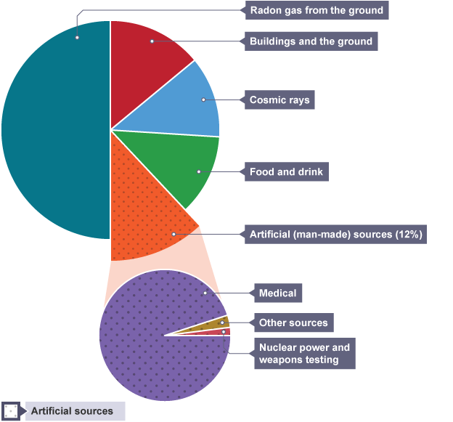
7.10 Background Radiation
7.10 explain the sources of background (ionising) radiation from Earth and space
Eating a banana that contains radioactive potassium | 0.000000098 Sv | 0.000098 mSv
Exposure for cabin crew on airliners (per year) | 0.0016 Sv | 1.6 mSv
6 months on the International Space station | 0.08 Sv | 80 mSv
Highest dose to a worker during Fukushima disaster | 0.67 Sv | 670 mSv
Typical fatal dose | 10 Sv | 10,000 mSv
https://remap.jrc.ec.europa.eu/Atlas.aspx
www.physicstutoring.uk

