Slide 1
Rock Springs 2026 Annual Meeting
Presiding: Dan Hofle - President/
Debra WALDRON, - secretary/
Mark Seltzer - Treasurer/with Michelle gleed/Kerry flenor, board members

Slide 2
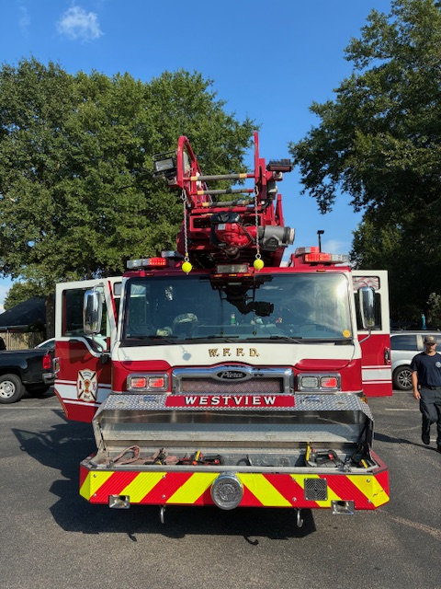

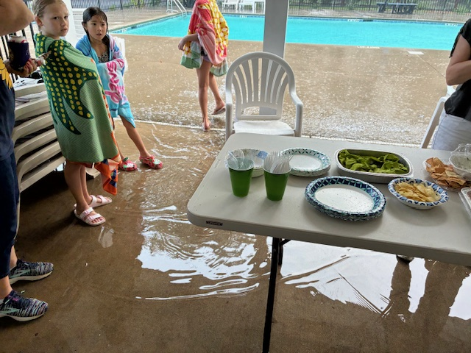
We had a great year!!
Ice cream social
All kids welcome!
Sometimes it rains on our parade…
Fire Department Visit
“When it rains it pours…”
HOA motto-

Slide 3
Overview of meeting
I. Committee Reports
II. Covenants review
III. Campaign and Vote for Board Members
Work Done
Pool Situation (good)
Finances (very good)
Questions?
-Please ask questions at the end of committee reports.
The board monitors the community for CCR compliance.
Enforcement is uniform and follows a structured approach.
When we moved to this neighborhood, we all agreed to abide by all the governing documents
Following the Covenants preserves the value of our real estate and provides a common expectation among neighbors.
At the end of the meeting:
>Current board members who are running again (2yr terms) will present their campaign.
>Other owners who wish to run for the board will present their campaign.
>Questions for any candidates?

Slide 4
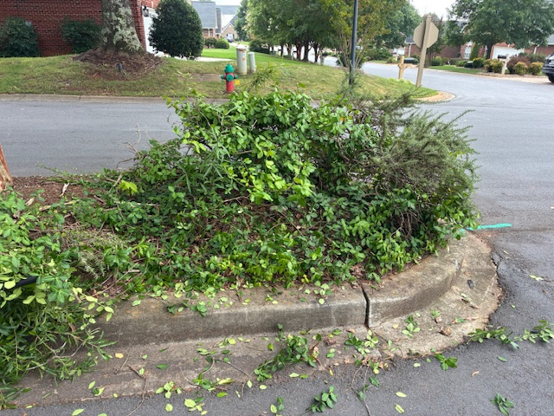
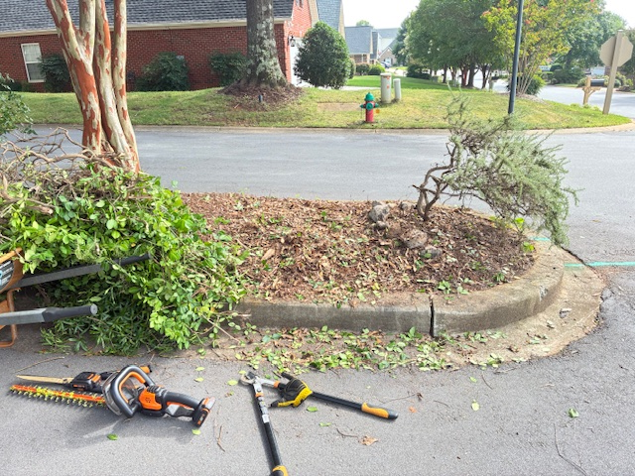
Work Done by volunteer committees
-Center Island trimming

Slide 5
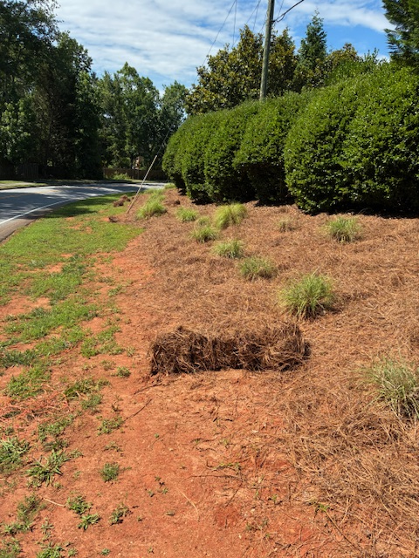
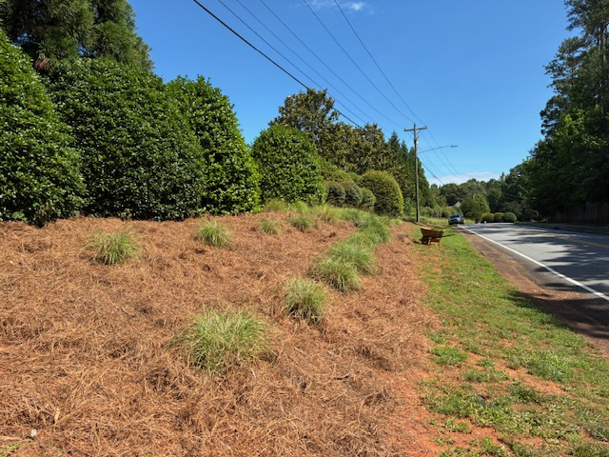
More work ($260 compared to over $1500 hired out).

Slide 6
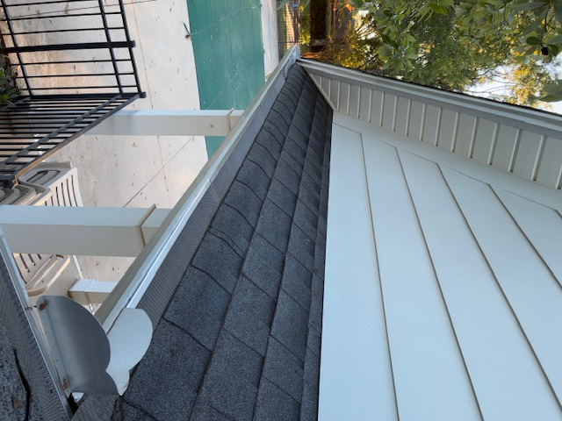
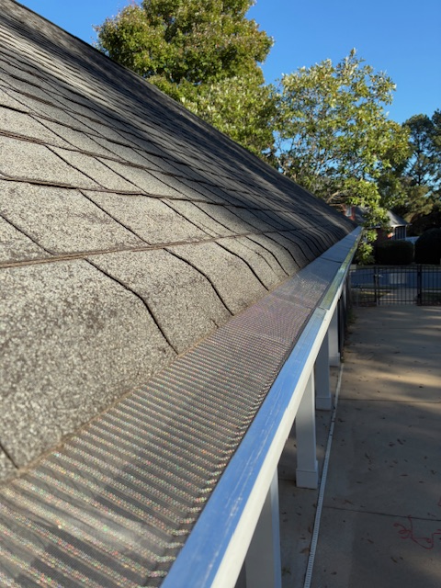
And…More work…
($160 cost) gutters cleaned, and stainless steel guards placed.

Slide 7
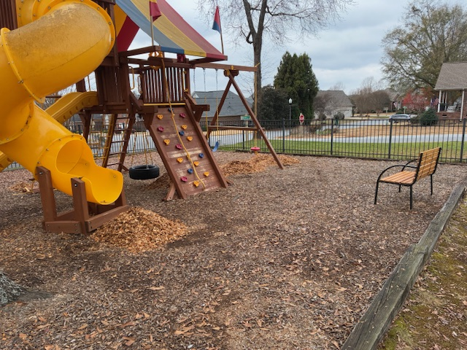
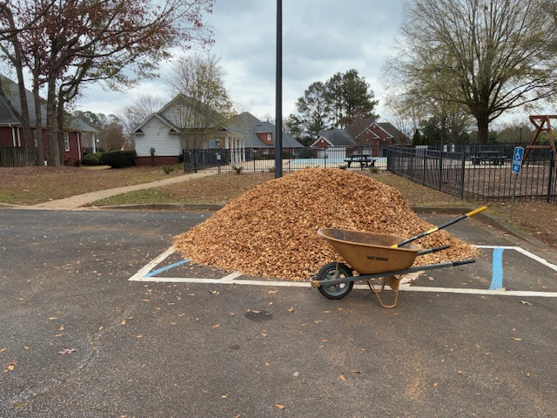
Volunteer-Work-work.
Mulch added to playground area

Slide 8
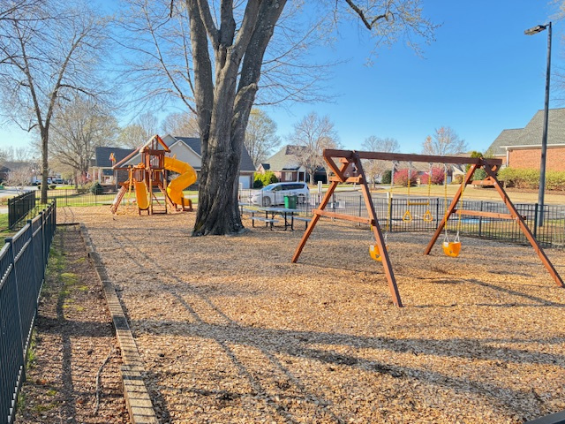
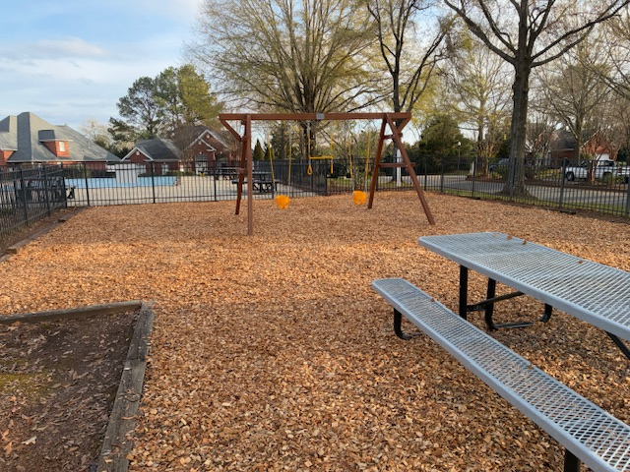
Playground new in April 2025

Slide 9
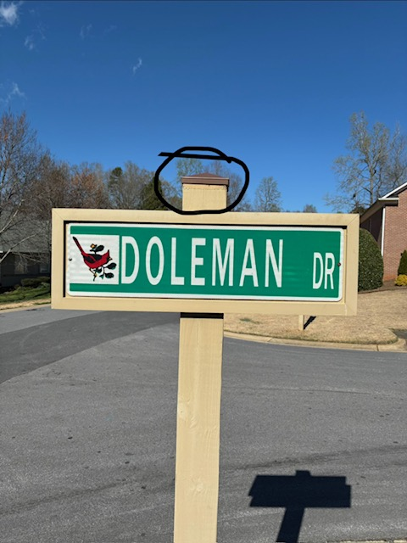
Street Signs
Overall the signs are in good repair.
Mark installed new sign tops from the back of his truck in 2025, which had rotted.
Remember to keep your bushes trimmed off of sidewalks and at intersections where line of sight is important for motorists.
Speed limit in RS-25mph is pretty fast. Please keep it slow for our walkers and kids.

Slide 10
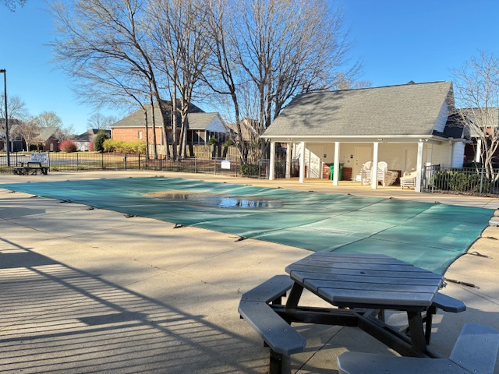
The Pool: the benefits and things to watch
Video and Fob system are working well. 2 weeks of video is stored for reference.
Gate hinges have been replaced, but show signs of aging.
Concrete slabs have shifted in some areas. Foam is very $$$ to stabilize. Okay for now with signs.
Bathrooms cleaned daily or as needed per reports.

Slide 11
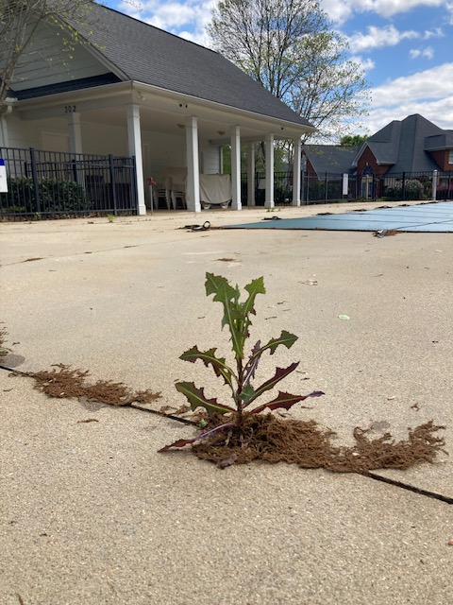
Pool cont.
We are very pleased with Splash Pools, and have saved about $6K in cost. Responsive owner.
We spray for weeds in the area when needed. The pool parking lot is showing signs of aging. Mark painted new lines in the lot in 2025.
The bulk of the reserve account should be designated for possible pool issues in the future.
New cover installed in 2025. Pool was not covered previously.

Slide 12
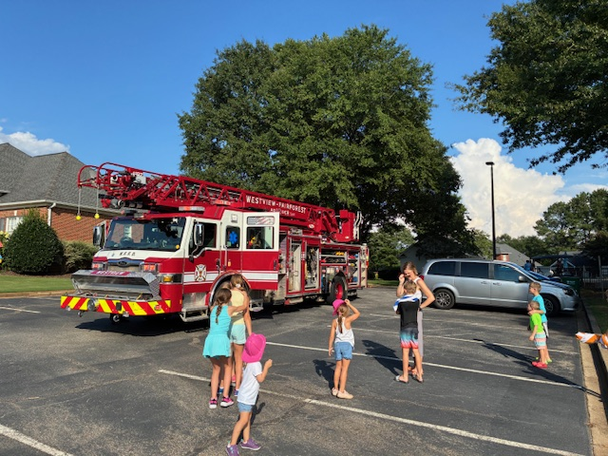
Pool cont.
Please lower umbrellas when you are done using them.
See a mess? Call Hinson.
See a crime? Call the Police!!!
Pool Fob is deactivated when owner is past dues or with outstanding fine.

Slide 13
$$$ Finance report $$$
2025 hoa income=$125,171
2025 expenses=$110,221
2025 cash Flow=$14,950
Includes $13,870 for new playground
Higher cost items: Landscape 26k
Pool 7k/ lighting 12k/management fee 11k
$40K moved to new reserve account 2/2025.
Target is $100k reserve funds; less than 5 years to that goal, likely 2 more yrs.
Fluid funds available if needed.
Current dues is satisfactory for foreseeable future. $525/yr

Slide 14
More finance info
Lumos caused some damage along our roadways and is repairing this at no cost to the hoa.
May budget money for a wiring diagram underground near the pool area this year.
We are considering a gazebo between the pool and playground. Comments?
>roughly $8-10k
Shelter during rain while at the playground/small gatherings. Difficulty keeping grass growing in that area anyway.

Slide 15
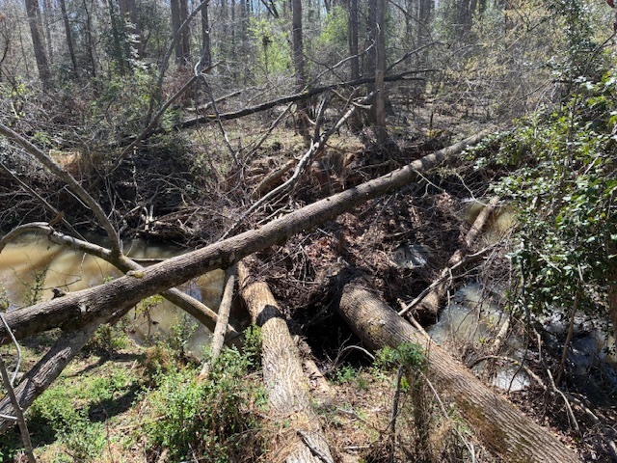
Landscape
There is a mess of wires near the entrance. Most items are working again, after a telecom company was around. They paid for the repairs after a delay.
Remaining 2 irrigation valves and the median lighting is currently not working. Median has solar lights for the meantime, and ample street lighting.
Wiring diagram desired in the near future so the community knows where all lines are near the entrance.
Currently working to get last remaining items fixed by telecom at no cot to RS.

Slide 16
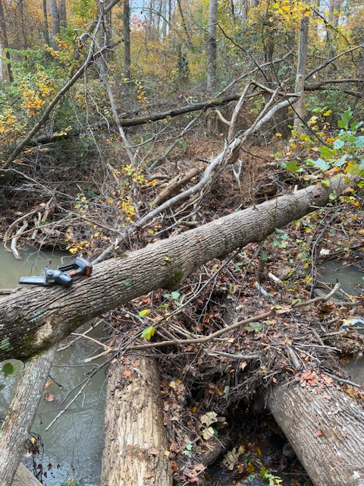
Total Landscape
Rock Springs has 12.5 acres of common properties.
Pool/Playground, Berm along Caldwell
Townes Entrance
8 acres behind RS and Merrivale, which is not maintained. Creek is presently dammed up at points.
Dangerous trees that fall in this area are assessed by the HOA, but aesthetic requests are not.

Slide 17
Covenants and such:
Violation letters are standard business practice, not harassment.
The form letter comes from Hinson, and we have modified the wording on some letters as feedback is given.
Hinson used to do violation monitoring, but ceased circa 2024.
We do weekly/daily inspection depending on situation, but also rely on owner complaints.
162+ owners agreed to the CCR’s we have before us today.
Procedure for a violation is:
>Violation letter (notice)
>Failure to comply letter
>Fine level(s)
*While we do not seek to be onerous, we also cannot ignore violations.
*We have to apply the CCR’s consistently and cannot grandfather in violations that exist.

Slide 18
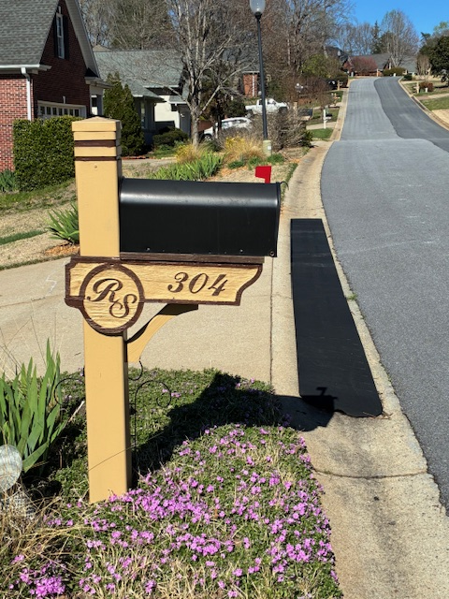
Covenants and such: mailboxes
Mailboxes: Spring 2025 campaign to clean up mailboxes in RS.
PDQ is the vendor, although you are free to touch up yourself.
Colors available from Hinson, our RS website, and we have a small amount in the pool house.
One of the first things people notice when they drive through.
The new mailboxes have a different top than previous.

Slide 19
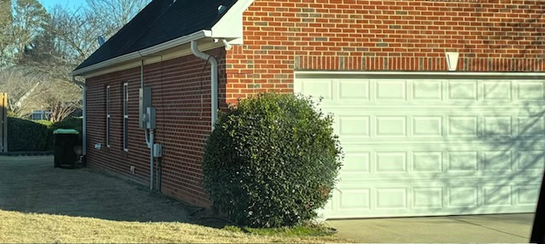
Covenants: Garbage Cans
Not everyone is blessed with a large bush!! Do your best.
Screened with a bush or a small fence.
Screens can be ordered from a home store etc. Prefer not white vinyl as this is not the community standard for fences.
Not screened from every angle, but 2/3 angles is reasonable (left, right, head-on), or an attempt to screen.

Slide 20
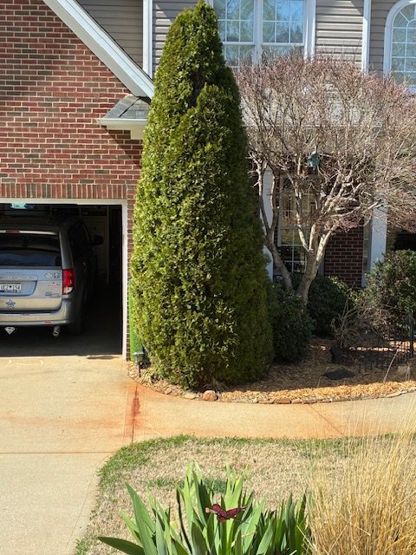
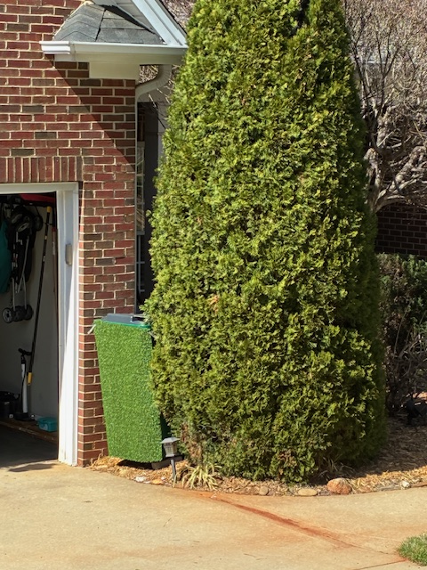
Garbage can excellence!!!

Slide 21
Covenants: parking
25. Vehicles and Parking. The term "vehicles," as used herein, shall include, without limitation, recreational or commercial vehicles, motorcycles, trucks, campers, vans, and automobiles.
a. All residential dwellings within the Property shall contain a garage. Detached carports are not permitted.
b. Vehicles shall not be parked in any front or side yard (for example, in the grass) daily except in areas designed as a paved driveway or paved parking area or as approved by the Board. Unlicensed, unregistered or inoperable vehicles shall not be stored upon any portion of a Lot unless the same are fully enclosed in a garage or in another area specifically designated by the Board. Visiting guests may only use paved streets for temporary parking of their vehicles (in addition, they are required to follow the same stipulations as stated herein for residents). All Owners, tenants and occupants must park their vehicles in designated paved parking areas or the garages on their Lot.
c. Temporary street side parking is allowed according to State and County law. For the safety and presentation of the community, the Board and the Owners do not allow extended street side parking. Extended street side parking is considered parking beyond twenty-four (24) hours.

Slide 22
Covenants: parking cont.
We need the road clear for- firetrucks and other emergency vehicles, USPS and Garbage trucks transiting roads, safety of persons walking or kids playing near areas constricted by vehicles in the road, and for aesthetic presentation of the community.
Trying to strike a balance from being onerous, to being selective. We have to learn vehicles to know which are guests or not. Persons with daily visitors who always park in the road are in violation.
Whenever there is space in your driveway, please use it. Not fair to the rest of the community to have to bob and weave around extra vehicles daily.
Pool lot can be used for temporary parking, but reaching out to Hinson is required past 48hrs.
Enforcing parking has not been enjoyable for the Board!!!

Slide 23
Comments/questions?
How does the community look and feel to you as an owner?
How many people have used our website or facebook page?
Official correspondence will always come in the mail, but publishing rule changes on the Hinson or RS website is also official notice to the community.
CCR’s expire in 2053.
Next garage sale 4/18/26
We plan on having 2 social events/yr, as well as community work days.
If you have a complaint, please fill out the complaint form on Hinson website. Facebook is not an official site for this.

Slide 24
Campaign/Board Election
2 yr terms
Current Board: 2yr term
New Nominees:
Dan Hofle (run)
Michelle Gleed (resigning)
Debra Waldron (run)
Mark Seltzer (run)
Kerry Flenor (1 yr left on term)
Austin Hinkle
Mr. McKinnon

Slide 25
New Board 2026-27
New Board after election
As of 4/7/26
Dan Hofle
Debra Waldron
Mark Seltzer
Kerry Flenor
Austin Hinkle

