Slide 1
HUMOR SECRETS
FIND FUNNY FASTER

Slide 2
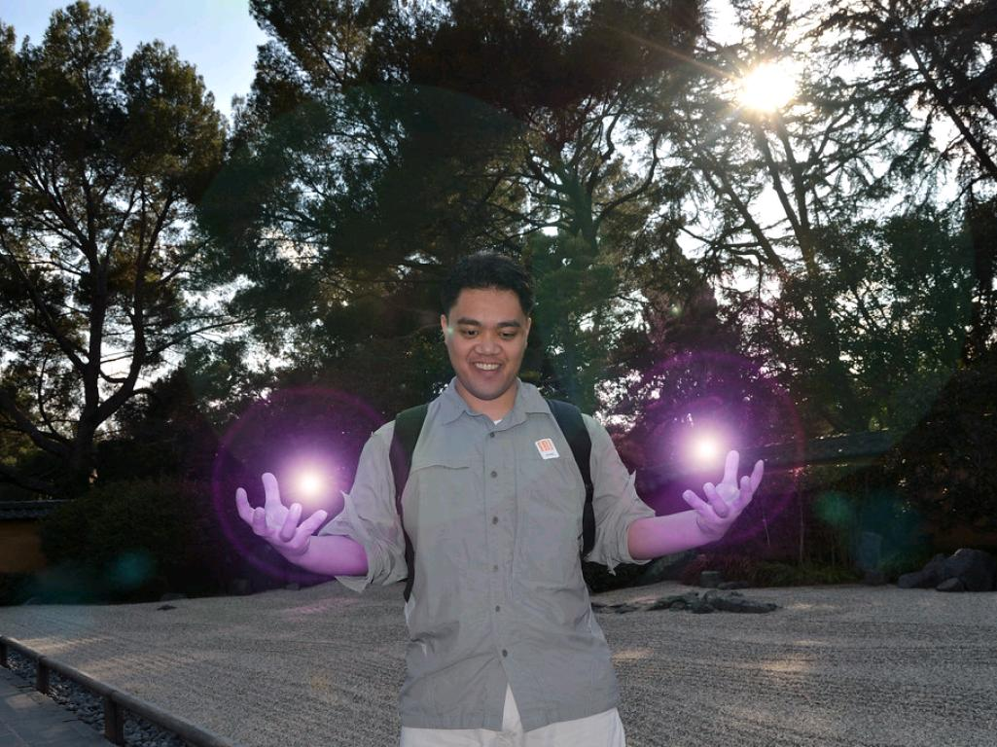
UNLOCK A SUPERPOWER
ABILITY TO CREATE LAUGHTER
cc: aj.lopez - https://www.flickr.com/photos/54235724@N07

Slide 3
HUMOR IS A SECRET WEAPON
cc: anna1395 - https://www.flickr.com/photos/53348227@N06
Notes:
Well when its funny I laugh... It like in a speech...the first thing you need is clarity on your message What is the process that makes someone laugh?

Slide 4
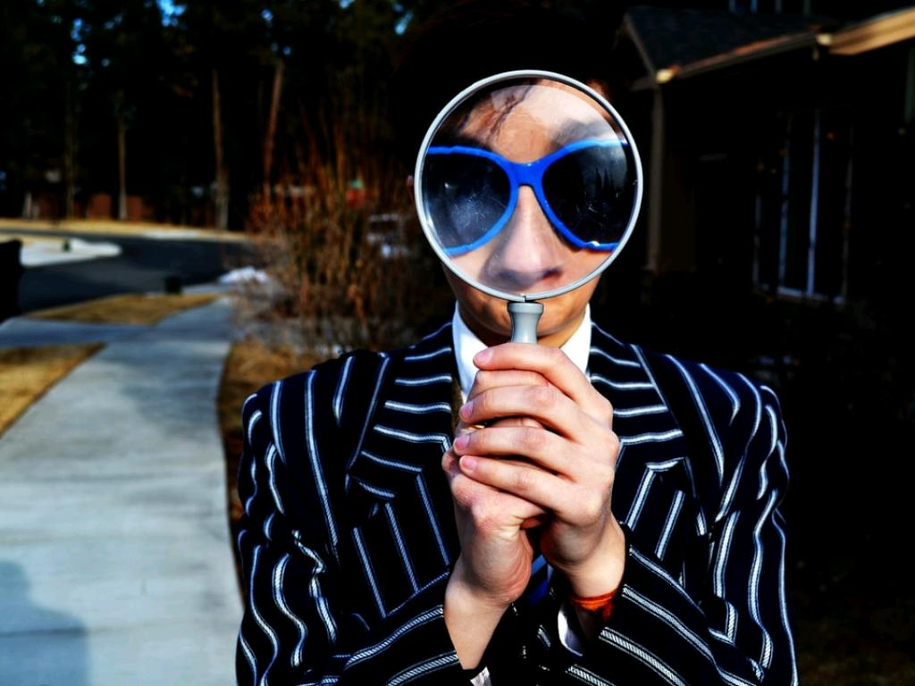
WITH SECRETS THAT MOST DON'T SEE
cc: Marten Newhall - https://unsplash.com/@laughayette?utm_source=haikudeck&utm_medium=referral&utm_campaign=api-credit
Notes:
Well when its funny I laugh... It like in a speech...the first thing you need is clarity on your message What is the process that makes someone laugh?

Slide 5
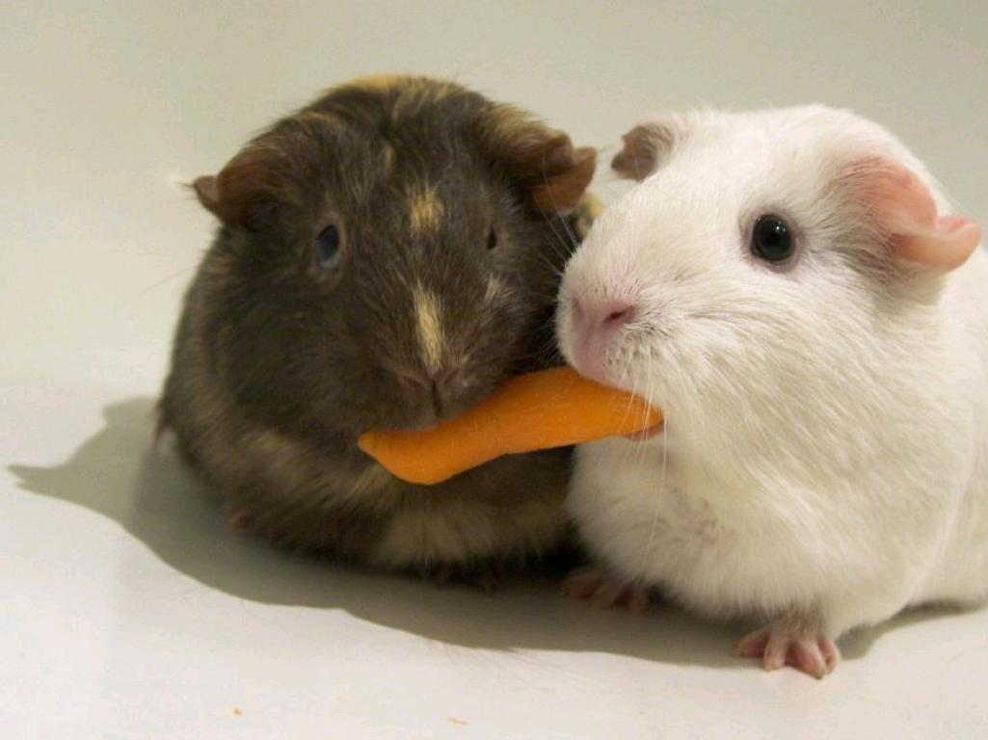
EVEN FEWER SHARE
cc: ryancr - https://www.flickr.com/photos/33128961@N00
Notes:
Well when its funny I laugh... It like in a speech...the first thing you need is clarity on your message What is the process that makes someone laugh?

Slide 6
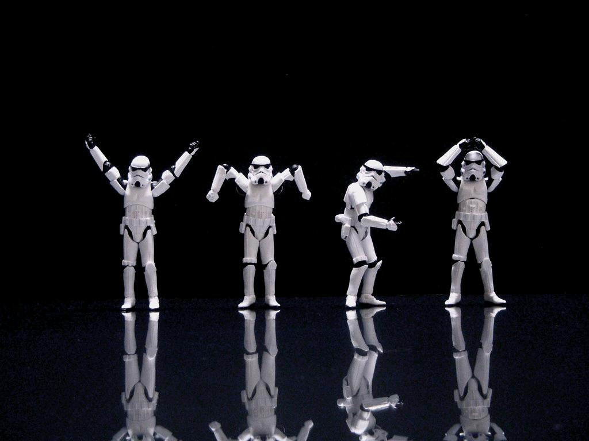
WHY USE HUMOR?
cc: JD Hancock - https://www.flickr.com/photos/83346641@N00
Notes:
Well when its funny I laugh... It like in a speech...the first thing you need is clarity on your message What is the process that makes someone laugh?

Slide 7
HERE'S WHY
Speak for an hour - 3% retention
use visual aids UP 5 -10%
Tell a story, people remember 50%
If the Story is Funny, it goes up to almost 70%
cc: mag3737 - https://www.flickr.com/photos/50318388@N00
Notes:
It's an unfair advantage to use humor in a contest speech Most Toastmaster's are thinking about their words, and lead with Madame TM, Fellow toastmasters

Slide 8
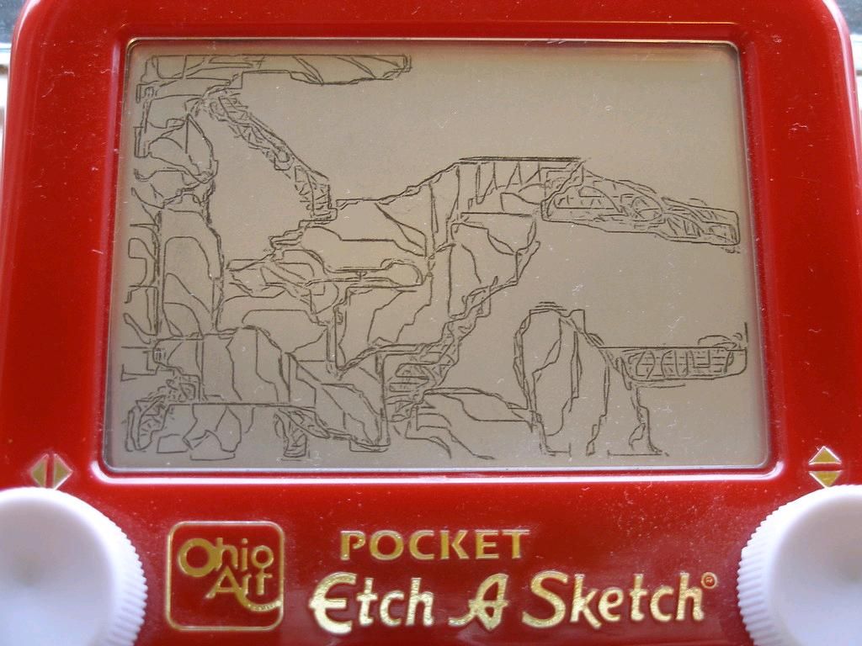
HUMOR IS EDUCATIONALLY EFFECTIVE
In Leadership
In education
In presentations
In Sales
In gaining trust
In Asking forgiveness from your Spouse....(ish)
cc: atduskgreg - https://www.flickr.com/photos/62234213@N00
Notes:
Well when its funny I laugh... It like in a speech...the first thing you need is clarity on your message What is the process that makes someone laugh?

Slide 9
ALSO
Laughing at work raises productivity 31%
Happy salespeople sell 37% more
84% of people believe a funnier person does a better job than their serious co-worker
91% of CEO's look for 2 main qualities ...Work Ethic and Sense of Humor
Remember this........
cc: Pearse O'Halloran - https://unsplash.com/@pearseoh?utm_source=haikudeck&utm_medium=referral&utm_campaign=api-credit
Notes:
Well when its funny I laugh... It like in a speech...the first thing you need is clarity on your message What is the process that makes someone laugh?

Slide 10
A FUNNY PERSON
GETS MORE CHANCES IN LIFE
cc: Austin Chan - https://unsplash.com/@austinchan?utm_source=haikudeck&utm_medium=referral&utm_campaign=api-credit
Notes:
Well when its funny I laugh... It like in a speech...the first thing you need is clarity on your message What is the process that makes someone laugh?

Slide 11
THE HEIGHT OF LAUGHTER
CREATES THE HEIGHT OF LEARNING
cc: Joshua Earle - https://unsplash.com/@joshuaearle?utm_source=haikudeck&utm_medium=referral&utm_campaign=api-credit
Notes:
Well when its funny I laugh... It like in a speech...the first thing you need is clarity on your message What is the process that makes someone laugh?

Slide 12
HUMOR SHAKES YOUR BRAIN'S ETCH A SKETCH
cc: atduskgreg - https://www.flickr.com/photos/62234213@N00
Notes:
Well when its funny I laugh... It like in a speech...the first thing you need is clarity on your message What is the process that makes someone laugh?

Slide 13
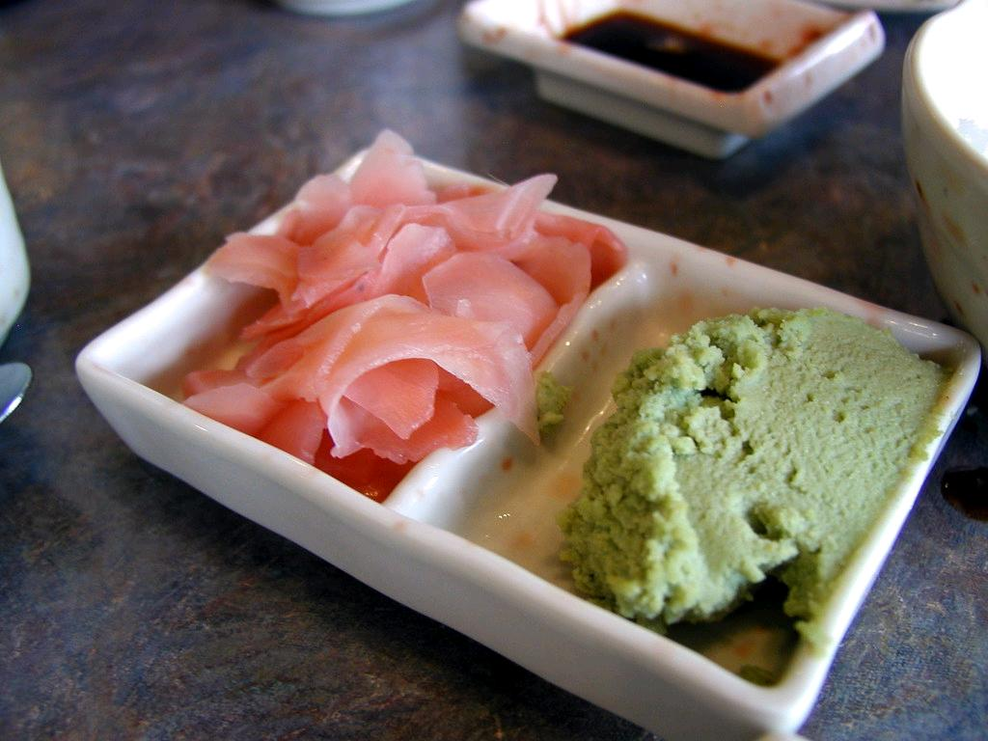
IT'S PALLET CLEANSER
IT IS IMPOSSIBLE TO BE ANGRY, SAD, FEARFUL
cc: fortinbras - https://www.flickr.com/photos/82568321@N00
Notes:
Well when its funny I laugh... It like in a speech...the first thing you need is clarity on your message What is the process that makes someone laugh?

Slide 14
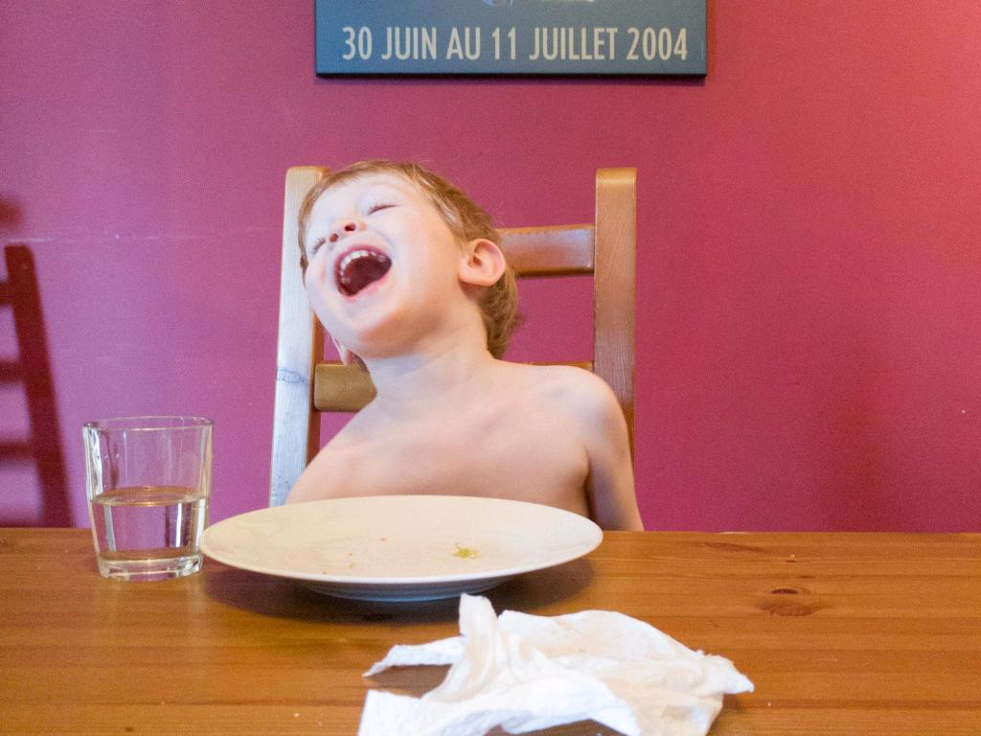
WHEN YOU LAUGH
cc: tompagenet - https://www.flickr.com/photos/73422480@N00
Notes:
you cannot hate you cannot fear

Slide 15
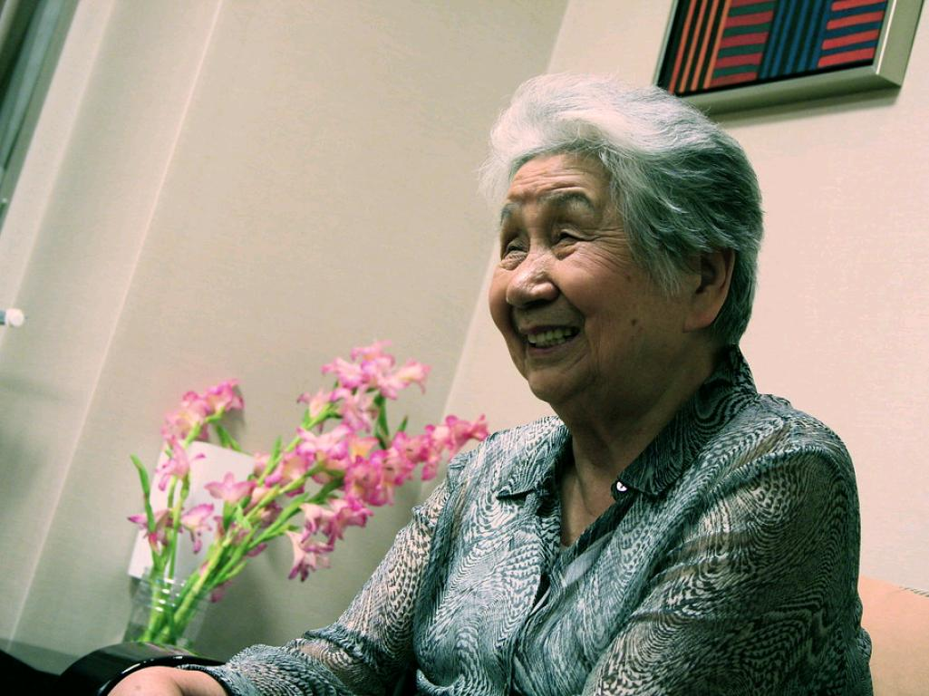
WHEN YOU CREATE LAUGHTER
cc: shindz - https://www.flickr.com/photos/90922774@N00
Notes:
you create instant rapport likability and trust...and I can prove it

Slide 16
WE HAVE ALL MET
cc: Nguyen Dang Hoang Nhu - https://unsplash.com/@nguyendhn?utm_source=haikudeck&utm_medium=referral&utm_campaign=api-credit
Notes:
Well when its funny I laugh... It like in a speech...the first thing you need is clarity on your message What is the process that makes someone laugh?

Slide 17
MAGICAL
cc: Karen Roe - https://www.flickr.com/photos/28752865@N08
Notes:
Well when its funny I laugh... It like in a speech...the first thing you need is clarity on your message What is the process that makes someone laugh?

Slide 18
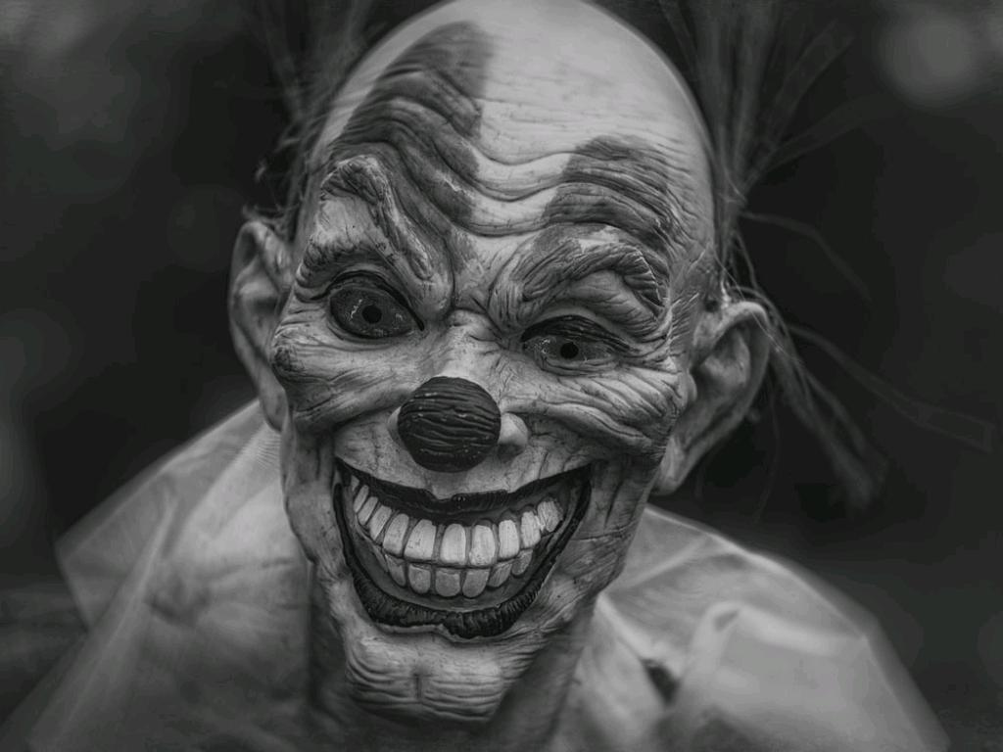
CREEPY
cc: Robert Zunikoff - https://unsplash.com/@rzunikoff?utm_source=haikudeck&utm_medium=referral&utm_campaign=api-credit
Notes:
Well when its funny I laugh... It like in a speech...the first thing you need is clarity on your message What is the process that makes someone laugh?

Slide 19
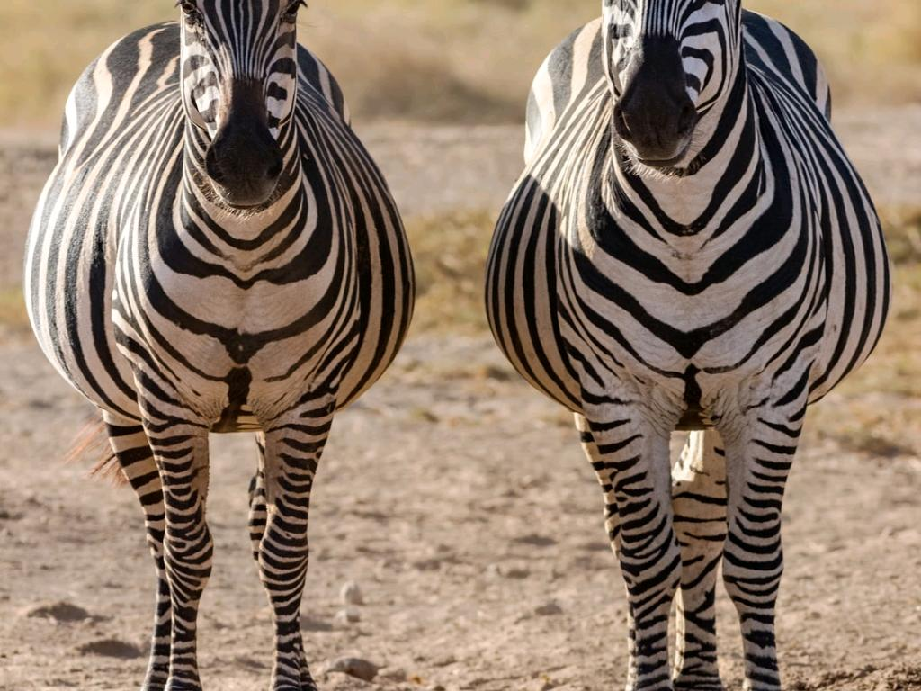
WHAT'S THE DIFFERENCE?
cc: Neil and Zulma Scott - https://unsplash.com/@valenciascott?utm_source=haikudeck&utm_medium=referral&utm_campaign=api-credit
Notes:
Well when its funny I laugh... It like in a speech...the first thing you need is clarity on your message What is the process that makes someone laugh?

Slide 20
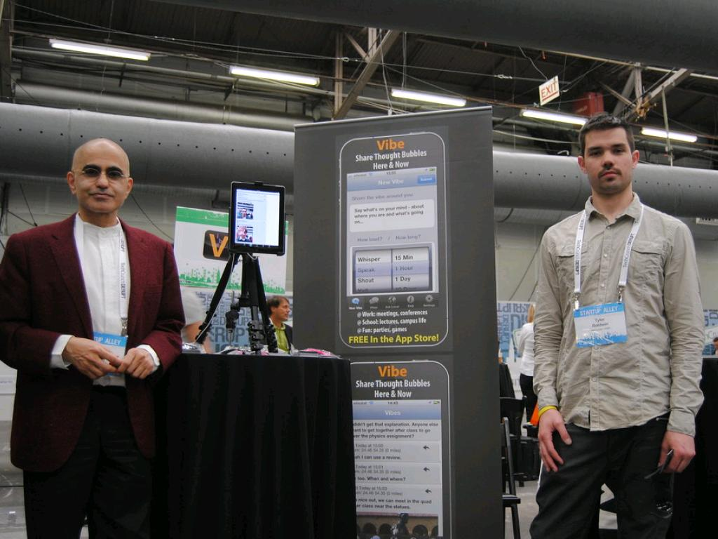
THE VIBE
cc: TechCrunch - https://www.flickr.com/photos/52522100@N07
Notes:
Well when its funny I laugh... It like in a speech...the first thing you need is clarity on your message What is the process that makes someone laugh?

Slide 21
cc: delete08 - https://www.flickr.com/photos/33360697@N05
Notes:
Well when its funny I laugh... It like in a speech...the first thing you need is clarity on your message What is the process that makes someone laugh?

Slide 22
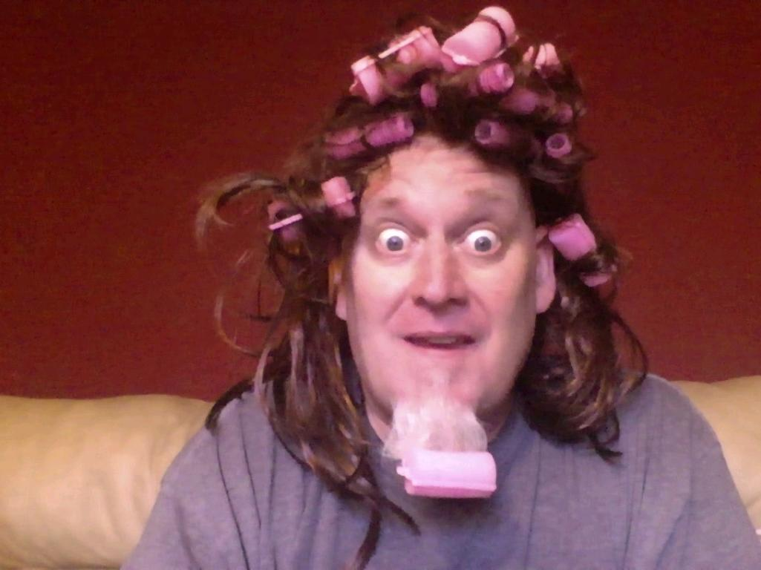
Notes:
Well when its funny I laugh... It like in a speech...the first thing you need is clarity on your message What is the process that makes someone laugh?

Slide 23
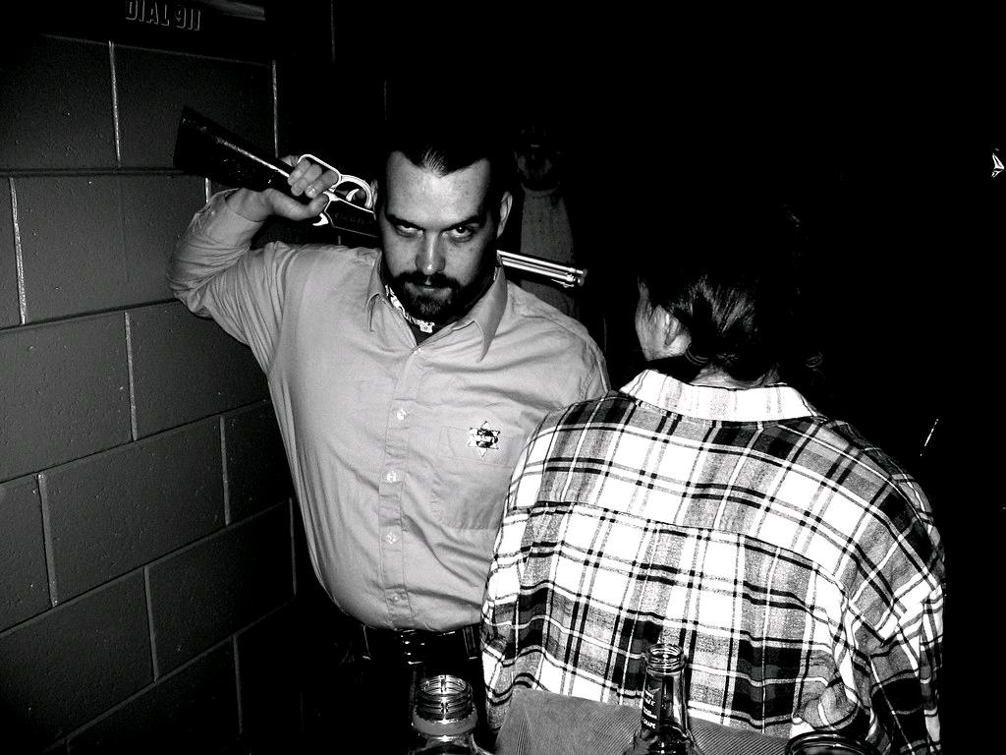
CREEPY
cc: Dance Party Duo - https://www.flickr.com/photos/58013815@N00
Notes:
Well when its funny I laugh... It like in a speech...the first thing you need is clarity on your message What is the process that makes someone laugh?

Slide 24
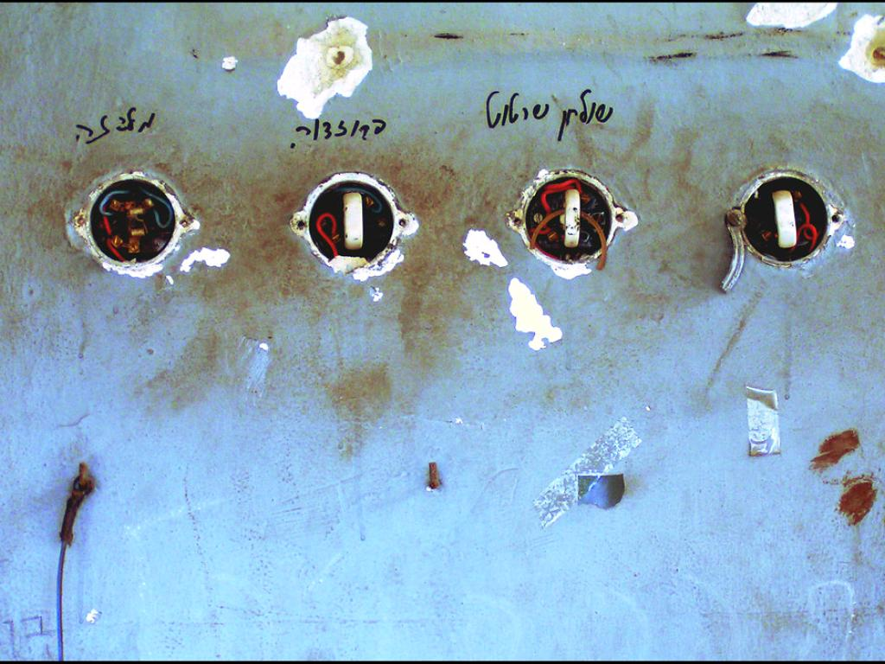
4 SWITCHES
cc: Tal Bright - https://www.flickr.com/photos/48553010@N00
Notes:
Well when its funny I laugh... It like in a speech...the first thing you need is clarity on your message What is the process that makes someone laugh?

Slide 25
cc: gwilmore - https://www.flickr.com/photos/86013963@N00
Notes:
Well when its funny I laugh... It like in a speech...the first thing you need is clarity on your message What is the process that makes someone laugh?

Slide 26
CONTEST NINJA TIPS
Create a title, that creates laughter
Forget about laughs, focus on the message
The Laughs will unleash themselves if..
You reach out for help
Humor does not exist in vacuum (unless your vacuum breaks down while your spouse is using it)
Get coached
Biggest point follows biggest laugh
cc: atduskgreg - https://www.flickr.com/photos/62234213@N00
Notes:
If the Laughter does not apply to the message of the speech it is a time waster. It actually distracts your audience from connecting with your story

Slide 27
Here's The Problem
cc: Sebastian Herrmann - https://unsplash.com/@officestock?utm_source=haikudeck&utm_medium=referral&utm_campaign=api-credit

Slide 28
What is Funny?
cc: Matthew Henry - https://unsplash.com/@matthewhenry?utm_source=haikudeck&utm_medium=referral&utm_campaign=api-credit

Slide 29
Is it a gift?
cc: Jess Bailey - https://unsplash.com/@jessbaileydesigns?utm_source=haikudeck&utm_medium=referral&utm_campaign=api-credit

Slide 30
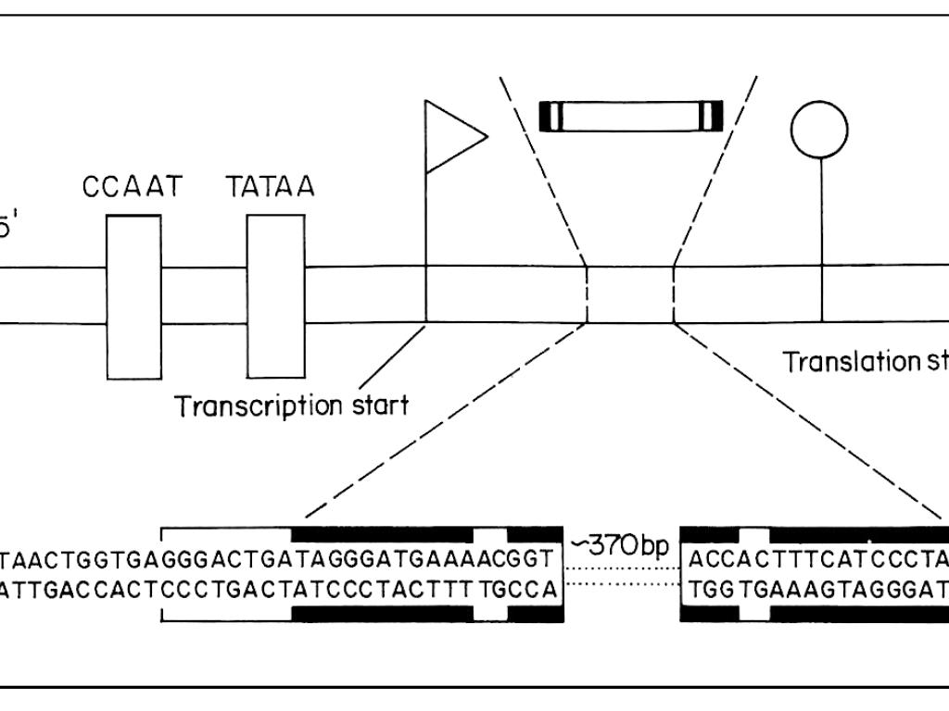
It is a definable process that very few understand
cc: IRRI Images - https://www.flickr.com/photos/86712369@N00

Slide 31
The Clarity with which you define something's structure is proportional to the ease in creating it
cc: OSPAN ALI - https://unsplash.com/@ospanali?utm_source=haikudeck&utm_medium=referral&utm_campaign=api-credit
Notes:
Go to Cara's speech

Slide 32
INPHONE.CO/LEANINFACTOR

Slide 35
WHAT IS FUNNY?
WHAT IS IT THAT YOU FIND FUN AND ENJOYABLE?
cc: Veronique Debord - https://www.flickr.com/photos/41497284@N00

Slide 36
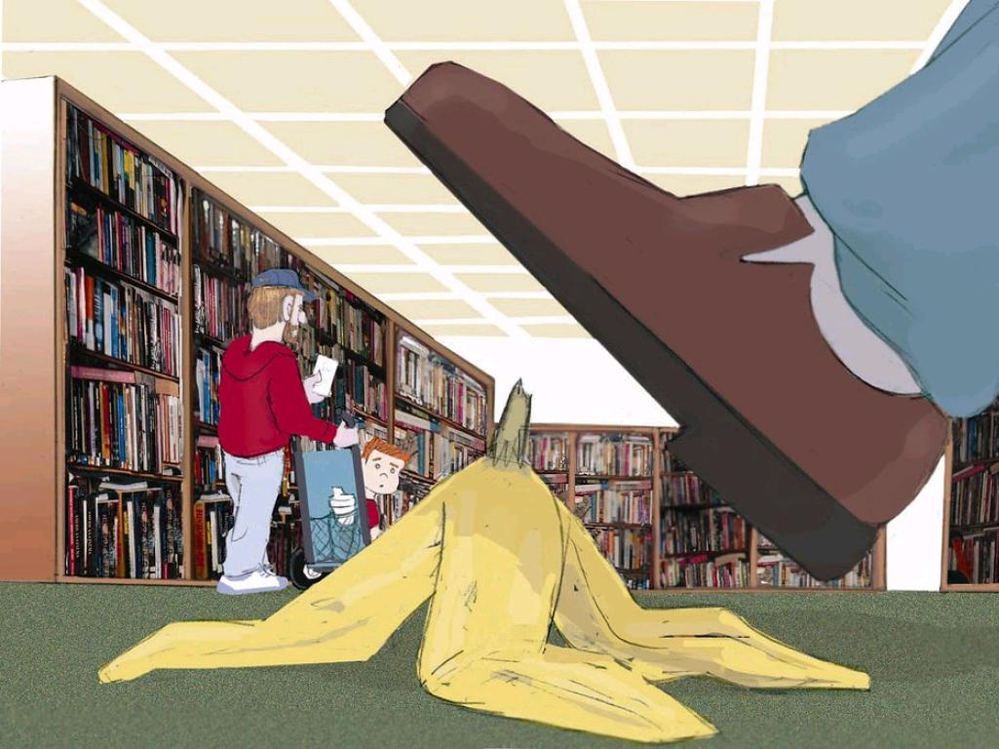
HURL HUMOR DEFINITION
A BENIGN VIOLATION OF A NORM , THAT SURPRISES YOU
cc: cali.org - https://www.flickr.com/photos/63316539@N03
Notes:
How low can you get away with? It's ok to talk about scars...as a matter of fact we show them off...but nobody likes to share their open wounds

Slide 37
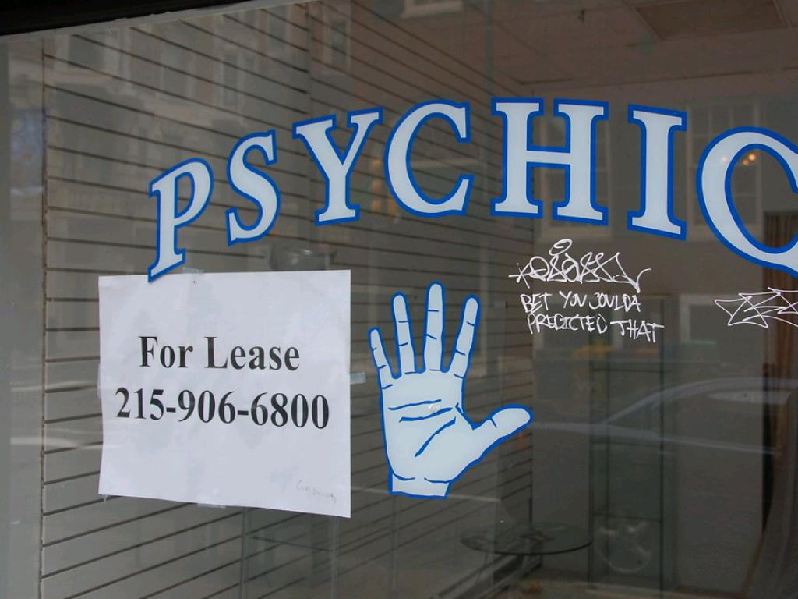
COMEDY PREYS ON ...
cc: kjarrett - https://www.flickr.com/photos/29304822@N00

Slide 38
THE PREDICTABILITY OF HUMAN BEINGS
cc: kjarrett - https://www.flickr.com/photos/29304822@N00

Slide 39
PEOPLE'S CONSISTANT FOCUS ON THE LOGIC OF INTENDED IDEAS, WHILE the funny FOCUS ON THE LOGIC OF THE WORDS
cc: kjarrett - https://www.flickr.com/photos/29304822@N00

Slide 40
GO FROM BLAND TO GRAND
Descriptions
Tonality
Expressions and emotions
Surprise
Dialogue
cc: Veronique Debord - https://www.flickr.com/photos/41497284@N00

Slide 41
5 DESCRIPTORS - TSSSSS
Taste
Sights
Sounds
Smells
Sensations

Slide 42
DESCRIBE FROM BLAND TO GRAND
I was a Senior
I got dressed up
went to a bar
What someone is Wearing
A house that stands out on the block
A themed restaurant
DONT TRY TO BE FUNNY...JUST PAINT A VIVID PICTURE
cc: pedrosimoes7 - https://www.flickr.com/photos/46944516@N00
Notes:
It was a beautiful day at the beach.... VS 74 california degrees, not a leaf rustling.... surfers, bikinis people watching surfer and bikini's .... California christmas

Slide 43
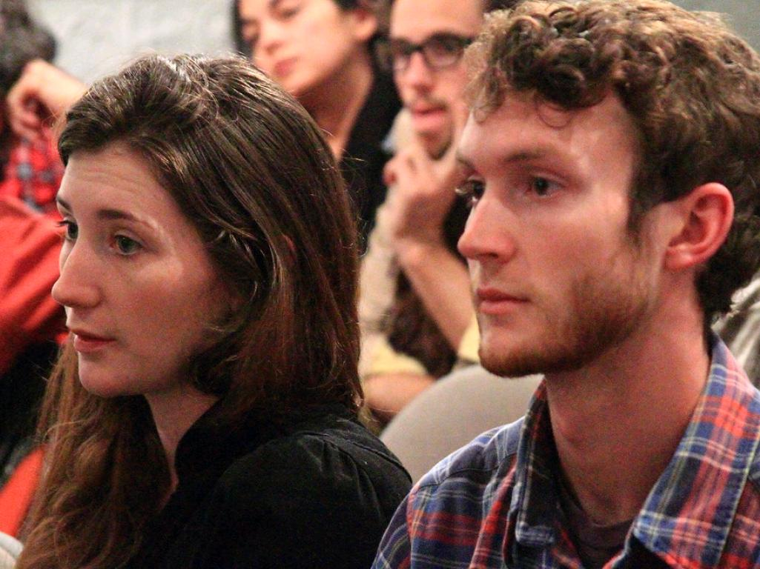
PHYSICALITY AND EMOTION
Show dont tell
Congruency (face & words)
cc: uniondocs - https://www.flickr.com/photos/8207752@N03
Notes:
I told my mom I was going to the store. we constantly fought over her cooking and my girlfriend I said I didn't like her cooking...she had the same thoughts on my girlfriend Mom I'm going down to the store and pick up some good food, do you want something...."while you pick up that good food dont forget to dump that bad girlfriend Mehrabi's test.

Slide 44
WE USE AWE
Actions
Words
Expressions and Emotions

Slide 45
JOKE STRUCTURE
Set Up
Punch

Slide 46
JOKE STRUCTURE
Set Up
(Creating Audience Perception)
Using a 2 way option
Crushing the Audience Perception
Punch
Notes:
A joke is just like an effective first line in a story.... it paints the picture of where YOU want the audience to go. 2 way option is also called a Phonetic Ambiguity (think Geico commercials) This is the most common way to create laughter between 2 people on the planet The punch is Actions Words, Expressions or Emotions that paint a completely different picture DESTROYING the first picture

Slide 47
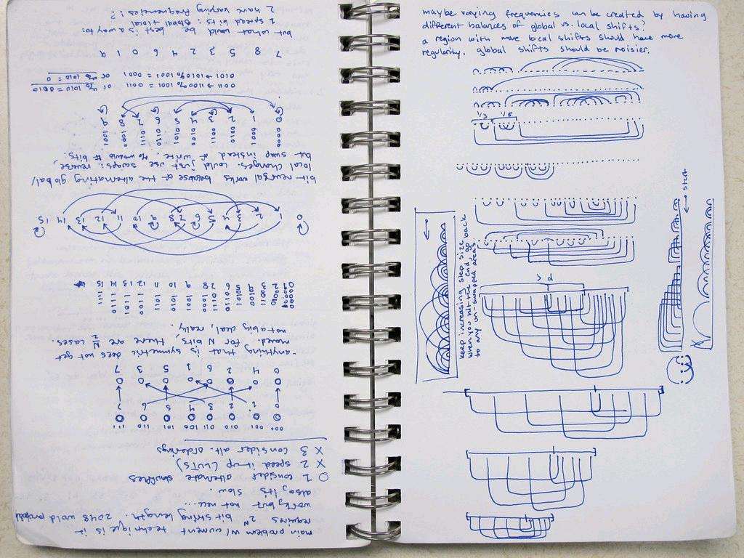
The Humor Algorithm
cc: Kyle McDonald - https://www.flickr.com/photos/28622838@N00

Slide 48
P.O.W. T.O.P.
Play On Words - 2 way Option (Geico Ads)
Turn of Phrase- pavlov's dog
The simple truth
Reforming

Slide 49
COMMON CLICHES CREATING UNCOMMON ANSWERS
It is what it is
You know what they say
without further ado
Thinking outside the box
Been there done that
cc: pedrosimoes7 - https://www.flickr.com/photos/46944516@N00
Notes:
Think Exageration, Flip, Opposites,

Slide 50
DIALOGUE
Show dont tell
Let other people in your story get the laughs
What would it sound like in a conversation
reminders and advice
allows you to avoid preachyness
cc: hernanpba - https://www.flickr.com/photos/67430875@N03
Notes:
I told my mom I was going to the store. we constantly fought over her cooking and my girlfriend I said I didn't like her cooking...she had the same thoughts on my girlfriend Mom I'm going down to the store and pick up some good food, do you want something...."while you pick up that good food dont forget to dump that bad girlfriend

Slide 51
SURPRISE
Flip
opposite
Exaggerate
Unreal answer
cc: keyaanrizwee - https://www.flickr.com/photos/30716824@N02

Slide 52
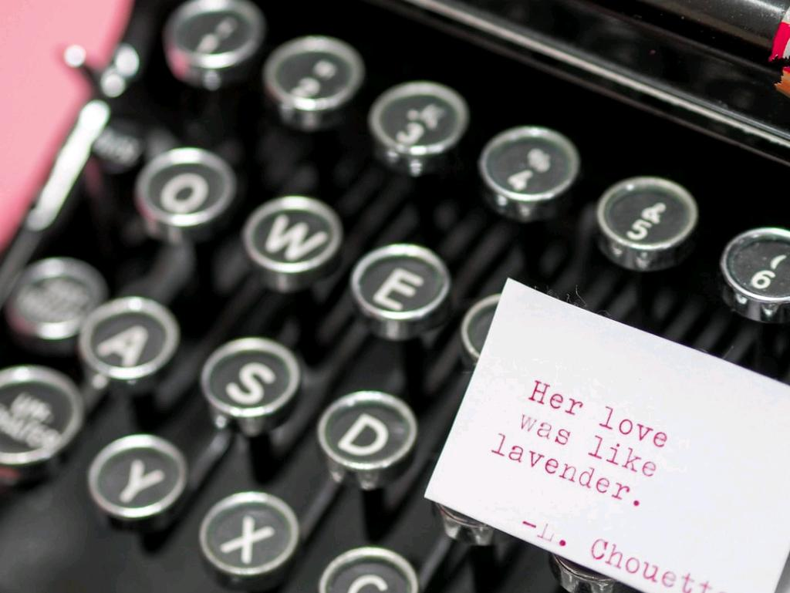
Creating a Picture
cc: Laura Chouette - https://unsplash.com/@laurachouette?utm_source=haikudeck&utm_medium=referral&utm_campaign=api-credit

Slide 53
2 WAY OPTIONS
Words with 2 meanings
Different spellings, sounding the same
remember the logic of the words is what we are shooting for, not the logic of the idea
Geico commercials
Phonetic ambiguities

Slide 54
REFORMING
That's Ray-markable
Put the Fun back in dysfuntion

Slide 55
THE TAKE OFF
Oldest form of wordplay
"if at first you don't succeed ...You're fired"

Slide 56
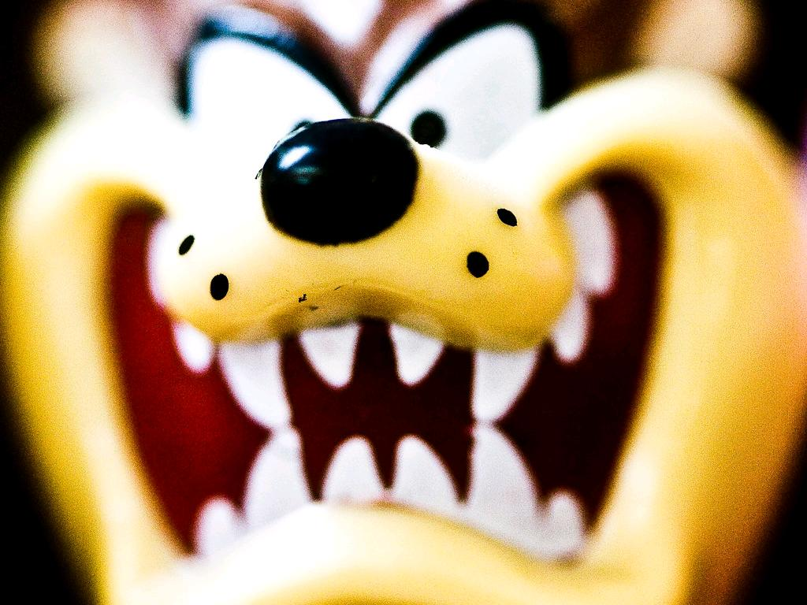
YOU CREATE THE PUNCHLINE (BO5)
I'm on a Whiskey Diet
I've been seeing someone
My sister took out her husband on Valentines Day
It's very difficult to date a chess champion
The best thing about the pandemic is
cc: Thomas Hawk - https://www.flickr.com/photos/51035555243@N01

Slide 57
Q&A
cc: WordCamp United States - https://www.flickr.com/photos/137179446@N08

Slide 58
RESOURCES
TinyURL.com/RayandJeff.com
Calendly.com/humor/15min
Laser Coaching for Toastmasters

Slide 59
CALENDLY.COM/HUMOR/15MIN
ANY QUESTIONS? LET'S TALK!!

