Slide 1
Game Officials Website
www.gameofficials.net

Slide 2
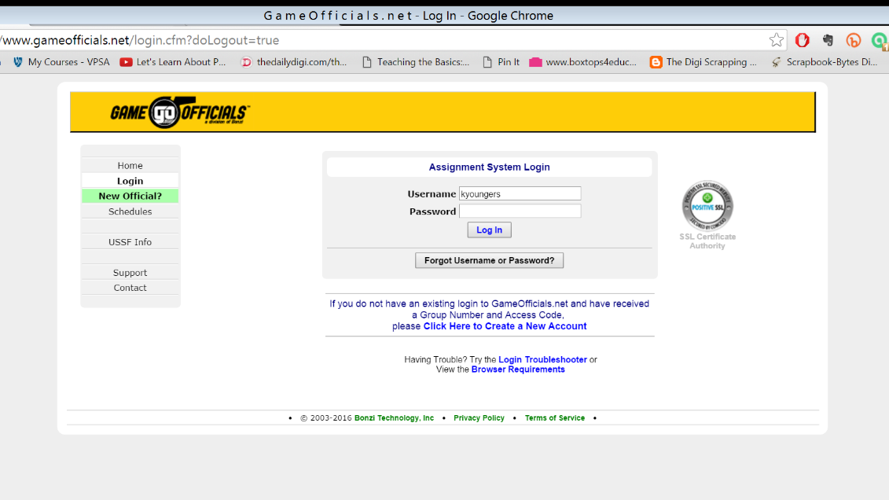
You used this system to register for your training.
Use “Forgot Username or Password?” if you need it!

Slide 3
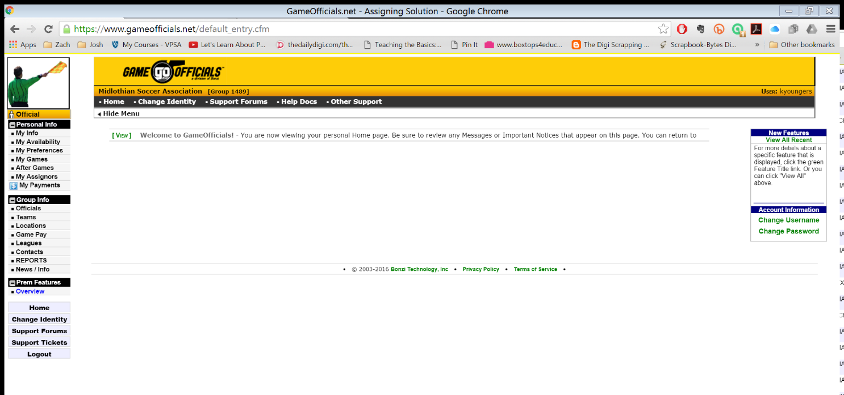
Main Login Screen

Slide 4
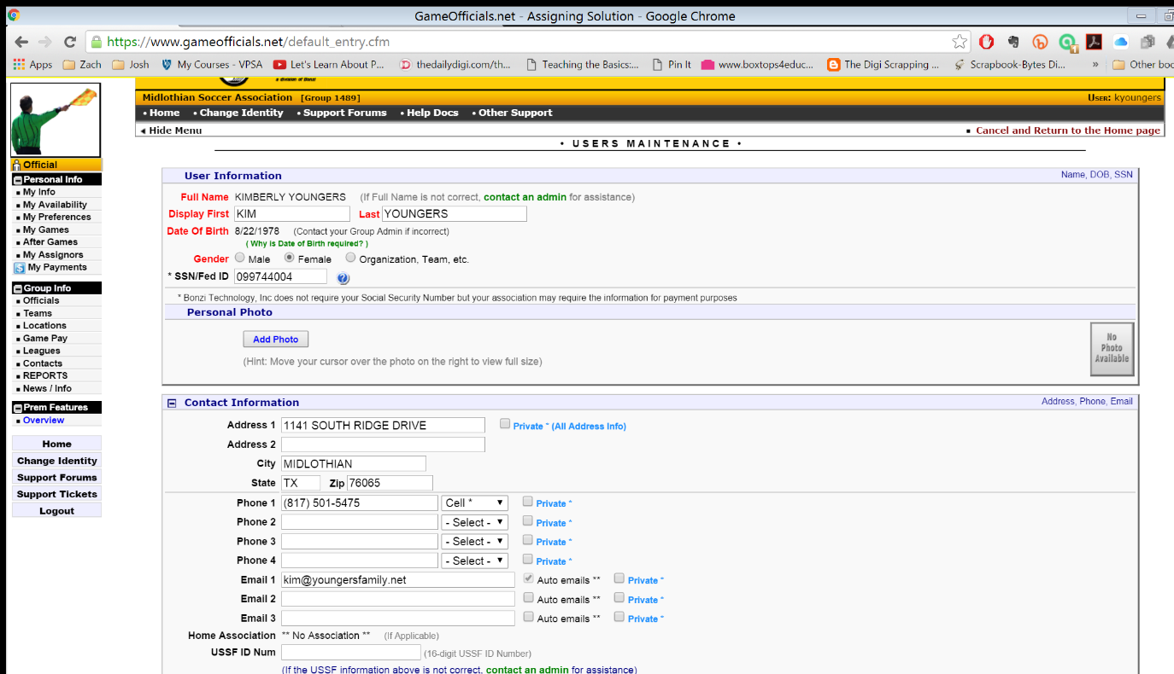
My Info Tab
Update User Information
Date of Birth
SSN – REQUIRED for payment
Contact Information
  Put in the order you want us to use them
  Adding more then 1 email address is fine – referee email and parent email. Both will receive emails.

Slide 5
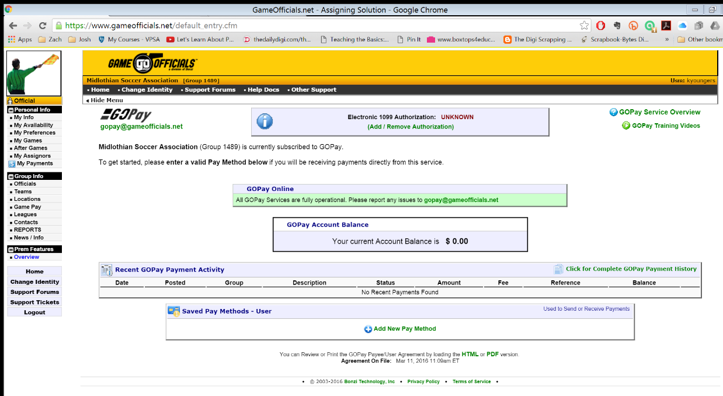
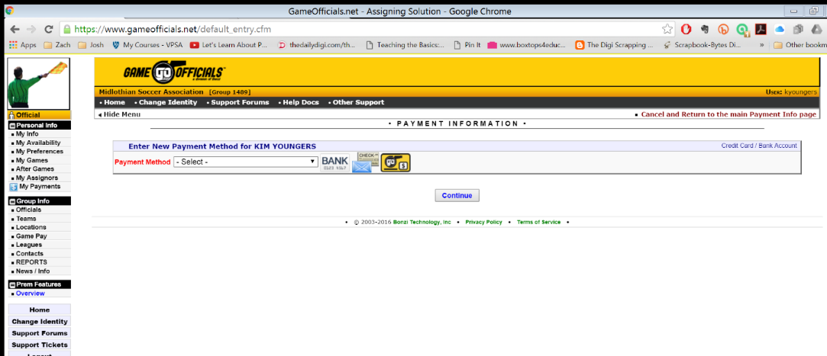
My Payments Tab
Select Add New Pay Method
Choices are:
  Direct Deposit into Checking or Savings Account
  Checks by Mail
Work with your parents to make that choice and get it setup!
Expect payments to be issued by Tuesday-ish each week. Faster is our goal.
NOTE: If you select “Checks by Mail” the checks DO NOT come from us. They are sent from GameOfficials. There is a $6.00 fee per check issued and they only mail them on Thursdays. Direct Deposit is the best option.

Slide 6
W9 form
We must have a W-9 form on file before a referee can be paid.
The form is available on the “Messages” section of Game Officials.

Slide 7
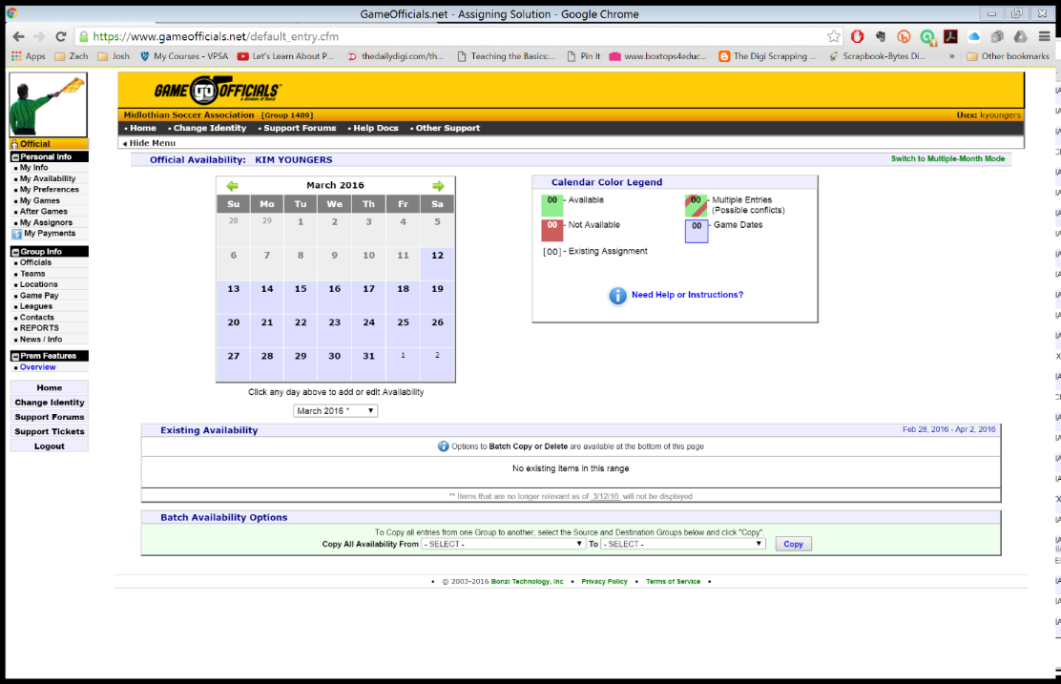
My Availability Tab
Everyone is set to UNAVAILABLE as default
YOU must go into here and tell us when you are available each week.
MUST be done by Monday morning to be on the initial list of assignments. Set a reminder on your phone to do it each Friday for the following week.
Check in with your parents on your schedule before you enter it. Please remember that if you set yourself as available, we are depending on you.

Slide 8
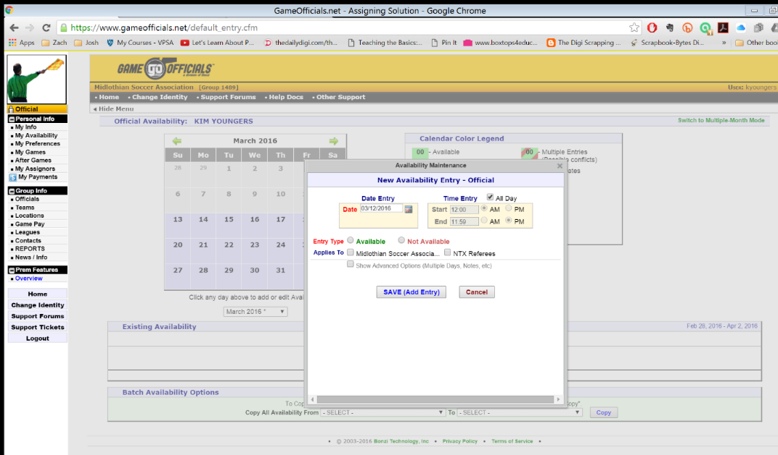
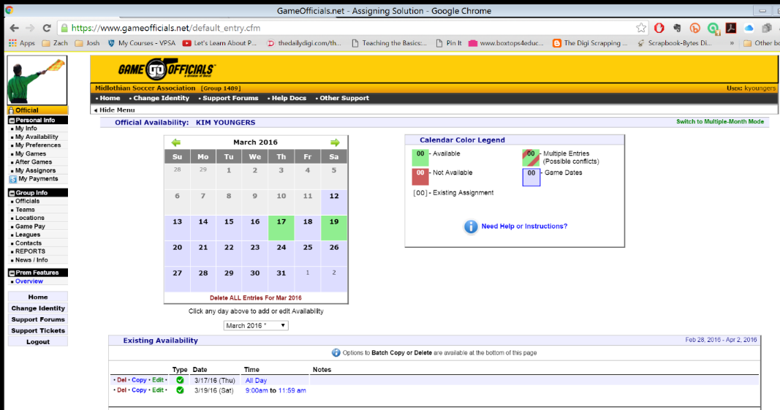
My Availability Tab
Click on the calendar date and this window pops up.
You will see a list of your availability.

Slide 9
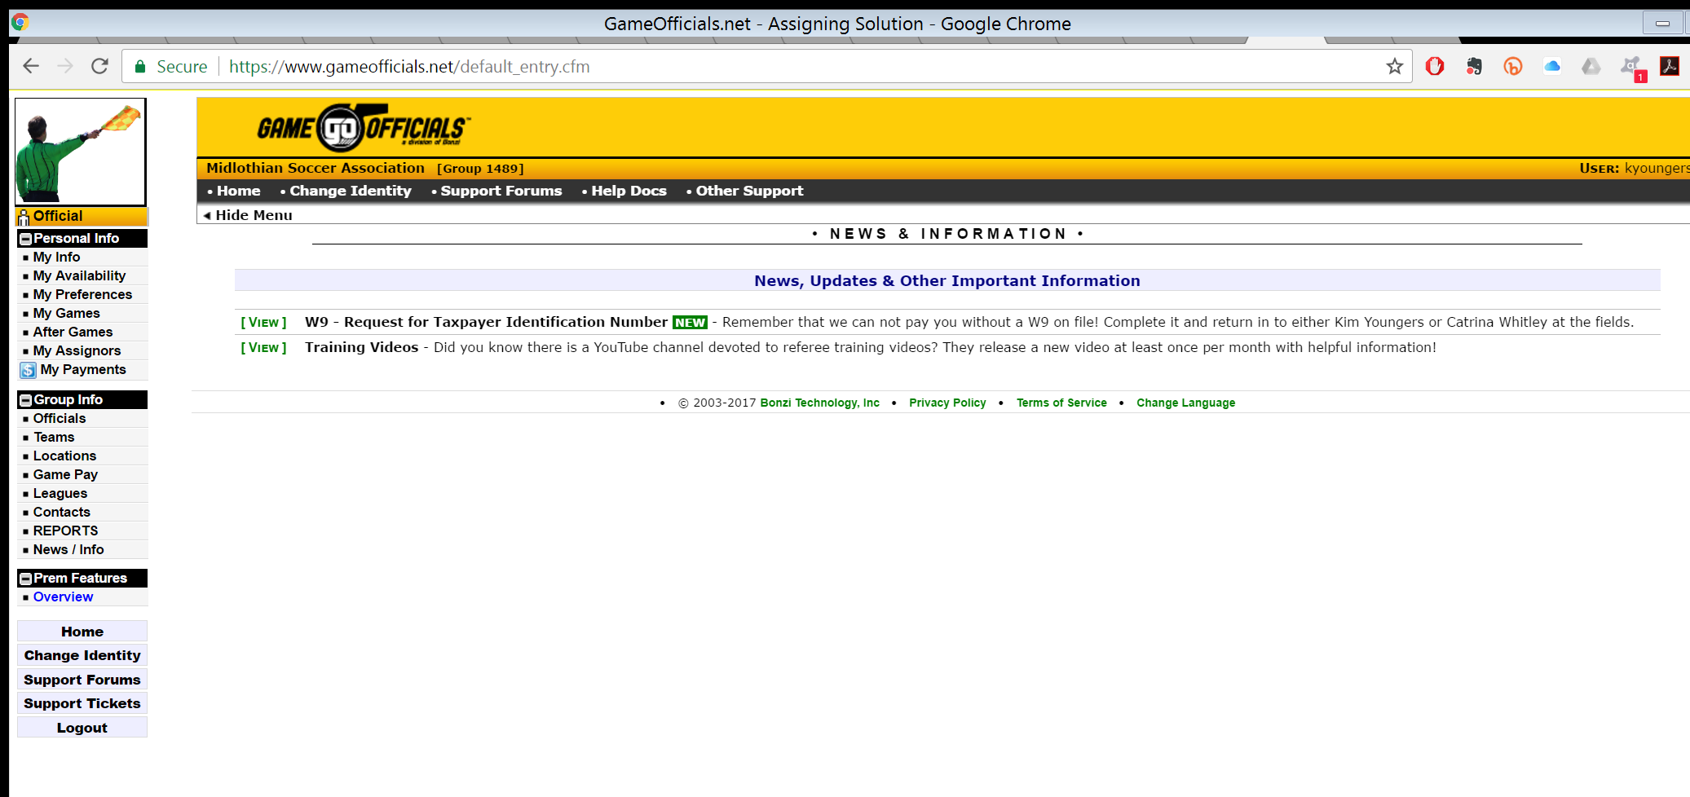
News/Messages
Check the News/Info portion of Game Officials regularly.

