Slide 1
Does the Assessor Raise or Lower Taxes?
No! While you may often see the job title of “Tax Assessor”, there is no such position defined by New York State law – and assessors don’t levy taxes. The elected officials who create and vote on budgets are responsible for tax rates and levies.
Tracy Carman
Communications Director, NYS Assessors Association

Slide 2
NYS STAR Information
By: Thurston Assessors

Slide 3
NYS STAR Information
The School Tax Relief (STAR) program offers property tax relief to eligible New York State homeowners on School District taxes.
There are two forms of STAR. Basic STAR and Enhanced STAR. Each with egilibility requirements.
Basic STAR
Enhanced STAR
Over 65

Slide 4
NYS STAR Information
If you are eligible and enrolled in the STAR program, you’ll receive your benefit each year in one of two ways:
STAR exemption. A reduction on your school tax bill. If you’ve been receiving the STAR exemption since 2016, you can continue to receive it for the same primary residence. As long as you remain eligible, you’ll see a reduction on your school tax bill for the amount of your STAR exemption. Note: The STAR exemption is no longer available to new homeowners.
STAR credit. The Tax Department will issue your STAR benefit via check or direct deposit. You can use your STAR benefit to help pay your school taxes.

Slide 5
NYS STAR Information – Eligibility
Basic STAR
The property must be the primary residence of an owner.
Must be owned by the eligible applicant.
Life use, Trust and Life Estates are eligible.
Corporations, partnerships, and LLCs are not eligible unless it is a farm dwelling.
Land contracts where the purchaser is in possession of home, the purchaser is considered the owner and therefore meets the owner/residency requirements.
Married couples can receive only one STAR benefit regardless of how many properties they own, unless the are legally separated.
Owners cannot have more than one STAR.
Parents own and reside at one property, and they are an owner of a property with a child where the child resides. We are directed by the state to remove the exception from a property.
Income of $250,000 or less for the exemption and $500,000 for the credit.
The income limit applies to the combined incomes of only the owners and owners’ spouse who reside at the property.
Based on the first $30,000 of the full value of a home.

Slide 6
NYS STAR Information – Eligibility
Enhanced STAR
The property must be the primary residence of at least one age-eligible owner.
Must be owned by the eligible applicant.
Life use, Trust and Life Estates are eligible.
Corporations, partnerships, and LLCs are not eligible unless it is a farm dwelling.
Land contracts where the purchaser is in possession of home, the purchases is considered the owner and therefore meets the owner/residency requirements.
65 or older.
In the current tax exemption year. For example, for 2025 tax roll year if you are 65 anytime in 2025 then you meet the age requirement even if after March 1st.
All owners must be at 65 as of December 31, except where jointly owned by a married couple or only siblings, in which cases only one owner needs to be 65.
Income of $107,300 or less for 2025.
The income limit applies to the combined incomes of all owners (residents and non-residents) and any owner’s spouse who resides at the property.

Slide 7
NYS STAR Information – Eligibility
Enhanced STAR continued
Based on the first $84,000 of the full value of a home for the 2024-2025 school year.
Married couple can receive only one STAR benefit regardless of how many properties they own, unless the are legally separated.
A surviving spouse can retain an existing Enhanced STAR benefit that had been granted to an age-eligible spouse if the surviving spouse is at least 62 years of age by December 31 in the year that their age-eligible spouse passed away. Otherwise, the surviving spouse may apply for Enhanced STAR in the year in which they turn 65. Until then, they may receive the Basic STAR benefit as long as they are otherwise eligible.

Slide 8
NYS STAR Information – Eligibility
Enhanced STAR continued
To upgrade your Basic STAR exemption to the Enhanced STAR exemption, you must submit the following to your assessor:
RP-425-E, Application for Enhanced STAR Exemption, and
RP-425-IVP, Supplement to Form RP-425-E (include the Social Security numbers of all owners of the property and any of their spouses who reside at the property).
Eligible owners should apply to their assessor’s office by March 1.

Slide 9
NYS STAR Information – Eligibility
Special eligibility rules
Nursing home residents
If you own your home, you're eligible for Basic or Enhanced STAR, as long as no one other than the co-owner or spouse resides there.
Trusts
If you're a trust beneficiary who conveyed your home to trustees but continues to live in the home, you get the STAR benefit. For example, a senior creates a trust and conveys her home to her children as trustees. If she remains in the home as the beneficiary of the trust, she is considered the homeowner and gets the STAR benefit.
Life estates
Under a life estate, one party has a life tenancy (ownership for the rest of his or her life) and another party—the remainderman—will become the owner after the life tenant dies. While the deed may appear to convey ownership to the remainderman, the remainderman will not take title until the death of the life tenant. Therefore, for exemption purposes, the life tenant is deemed to own the property, and STAR eligibility is based on the life tenant's qualifications.

Slide 10
NYS STAR Information - Definitions
Primary Residence
There is no one single factor that determines whether a property is your primary residence, but factors such as voting, vehicle registrations, and length of time spent each year on the property may be relevant.
The assessor may ask you to provide proof of residency with the application. In addition, the assessor may occasionally request proof of residence after the exemption has been granted to verify that the property remains your primary residence.

Slide 11
NYS STAR Information - Definitions
Income
Income eligibility for the 2025 STAR credit is based on federal or state income tax return information from the 2023 tax year.
Income for STAR purposes means federal adjusted gross income minus the taxable amount of total distributions from IRAs (Individual retirement accounts and individual retirement annuities).
Income from selling property is included.

Slide 12
NYS STAR Information - Definitions
Income
To determine your income eligibility, use the table below to identify line references on your federal or state income tax returns:
How to calculate your income for STAR
Form number | Title of income tax form | Income for STAR purposes
 |  | 2022 income tax form | 2023 income tax form
Federal Form 1040 | U.S. Individual Income Tax Return | Adjusted gross income (line 11) minus taxable portion of IRA distributions (line 4b) | Adjusted gross income (line 11) minus taxable portion of IRA distributions (line 4b)
NYS Form IT-201 | Resident Income Tax Return | Federal adjusted gross income (line 19) minus taxable portion of IRA distributions (line 9) | Federal adjusted gross income (line 19) minus taxable portion of IRA distributions (line 9)

Slide 13
NYS STAR Information - Definitions
Income - continued
Income is verified by NYS for both the STAR exemption and STAR credit.
If you file income taxes, then no further action is required by you. NYS will review.
If you do not file income taxes, then you will receive a form RP-5300-WS from NYS to fill in your income and send back to the address on the form. Please review the income year when filling out the form. Also return timely.
Definition of Income can change with any new laws.

Slide 14
NYS STAR Information – Savings amount compare
Compare STAR credit and exemption savings amounts
The amount of the STAR credit can differ from the STAR exemption savings because, by law, the STAR credit can increase by as much as 2% each year, but the value of the STAR exemption savings cannot increase.
Your individual STAR credit or STAR exemption saving may be less than the amount shown on the next slide. This may be due to a few reasons.
Your individual STAR credit or STAR exemption savings cannot exceed the amount of the school taxes you pay.
To ensure that STAR credits are issues timely, the government request expected tax rates from the school districts. If the actual tax rate is greater that the expected rate, the amount shown may be greater that the STAR credit you received. The additional amount will be added to your 2023 STAR credit check.
Using date provided by Steuben/NYS county in the next slide if may benefit to switch to the STAR credit.

Slide 15
NYS STAR Information – Benefit difference between exemption and credit
Municipality | School district | Tax class | Enhanced STAR credit | Enhanced STAR exemption savings | Difference between Enhanced STAR credit and exemption savings* | Basic STAR credit | Basic STAR exemption savings | Difference between Basic STAR credit and exemption savings
Town of Thurston | Addison |  | $1,213.00 | $1,160.00 | $53.00 | $446.83 | $446.83 | $0.00
Town of Thurston | Bath |  | $1,093.00 | $990.00 | $103.00 | $462.48 | $448.00 | $14.48
Town of Thurston | Campbell-Savona |  | $1,220.00 | $1,146.00 | $74.00 | $473.50 | $473.50 | $0.00

Slide 16
NYS STAR Information – Switching to STAR credit
Switching to STAR credit
If you want to receive the STAR credit instead of the exemption, it may be to your advantage. However, once you switch to the STAR credit, you cannot switch back to the exemption.
To receive the STAR credit, phone 518-457-2036
To receive the STAR credit, access the Homeowner Benefit Portal in your Individual Online Services account:
Log in to (or create) your Individual Online Services account.
Select the ≡ Services menu in the upper-left corner of your Account Summary.
Select Real property tax, then choose Homeowner Benefit Portal from the expanded menu.
Select Actions and choose Switch to credit from the drop-down menu.
This must be done by December 31^{st.}

Slide 17
NYS STAR Information – STAR Credit
STAR credit – Further details
How to report your property tax credit details. You do not need to do anything on your New York State income tax return, unless you itemize your deductions. If you itemize your deductions, reduce your itemized deduction for real estate taxes paid by the total amount of any STAR credit received during the tax year, keep your check stub for your tax records.

Slide 18
NYS STAR Information – STAR Credit New Homeower
STAR credit – New homeowner
Apply by:
Phoning 518-457-2036
Using the Home owners portal (get more info here)
To view whether you are receiving the STAR credit or the STAR exemption, access the Homeowner Benefit Portal by logging into your Tax Department Individual Online Services account.
Once you have an Individual account:
Log in and select the ≡ Services menu in the upper-left corner of your Account Summary.
Choose Real property tax, then Homeowner Benefit Portal from the expanded menu.
View your benefit type in the Benefit type column.
If you do not have an Individual Online Services account, create one.

Slide 19
NYS STAR Information – STAR Credit New Homeowner
STAR credit – New homeowner
You will become eligible for the STAR credit in the first year that you own the home and it is your primary residence as of the date that school taxes are due.
Example 1: If the school taxes in your community are due by September 30, and you purchase the home on September 15, you will become eligible for STAR that year, as long as you Register for the STAR credit and meet the eligibility criteria.
Exception: If the prior owner had been receiving a STAR exemption on the home, and the sale occurred after the local taxable status date (generally March 1), his or her STAR exemption will be carried over to your first school tax bill, and you will begin receiving the STAR credit the following year.
Example 2: If the school taxes in your community are due by September 30, and you purchase the home on October 15 (after school taxes are due), you will become eligible for the STAR credit the following year, as long as you register and meet the eligibility criteria.

Slide 20
NYS STAR Information - Misc
Can I qualify for both School low income and Basic STAR
Yes, however the income limit can be and is different than other taxing authorities.
For example, it is a much lower income limit than for County taxes.

Slide 21
NYS STAR Information - Misc
Changes in ownership, residency, or mailing address
I registered for the STAR credit in a previous year. Since then, I bought and moved to a new home. Do I need to register again?
Yes. If you change residences, you must re-register for the STAR credit for your new property in order to receive the benefit on your new home. See Register for the STAR credit.
I have not moved, or sold my property, but would like to change my mailing address. Should I update my STAR registration?
Yes. Log in to your Individual Online Services account to view your existing registration.
After you log in, select the ≡ Services menu in the upper-left corner of your screen. You’ll find the link for Homeowner Benefit Portal in the Real property tax menu.
To update a registration, select Actions and choose Edit Registration from the drop-down menu.

Slide 22
NYS STAR Information - Misc
Changes in ownership, residency, or mailing address
I have continuously owned my home and have been receiving the STAR exemption, but a co-owner has been added or removed due to marriage, divorce, or the death of a spouse. Do I have to switch to the STAR credit?
No. If you received the STAR exemption in 2015 and you continue to own the home, you’re eligible to continue receiving the exemption.

Slide 23
NYS STAR Information - Misc
Respond to letter
We may send you a letter requesting additional information or notifying you of a change to your STAR benefit or to the STAR program.
If you received a STAR letter, select it from the list below for more information. (You can find the number of your letter in its lower-left corner.)

Slide 24
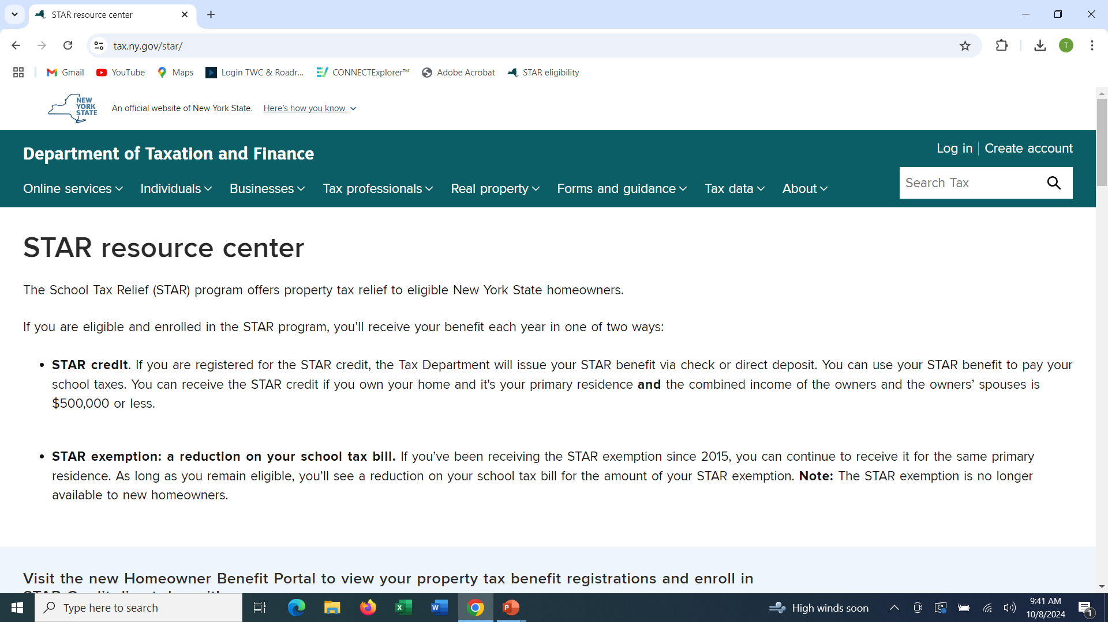
NYS STAR Information
The New York State website contains a great deal of information available to you. www.tax.ny.gov/star

Slide 25
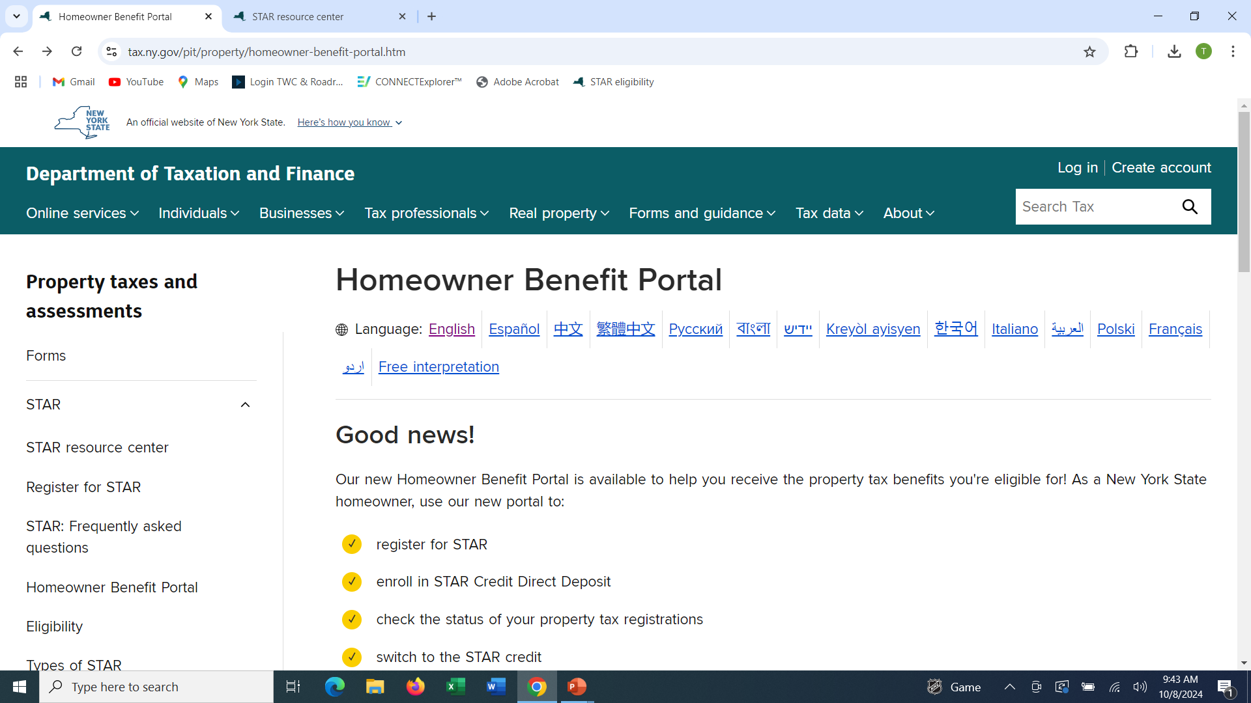
NYS STAR Information
The New York State website contains a great deal of information available to you.

Slide 26
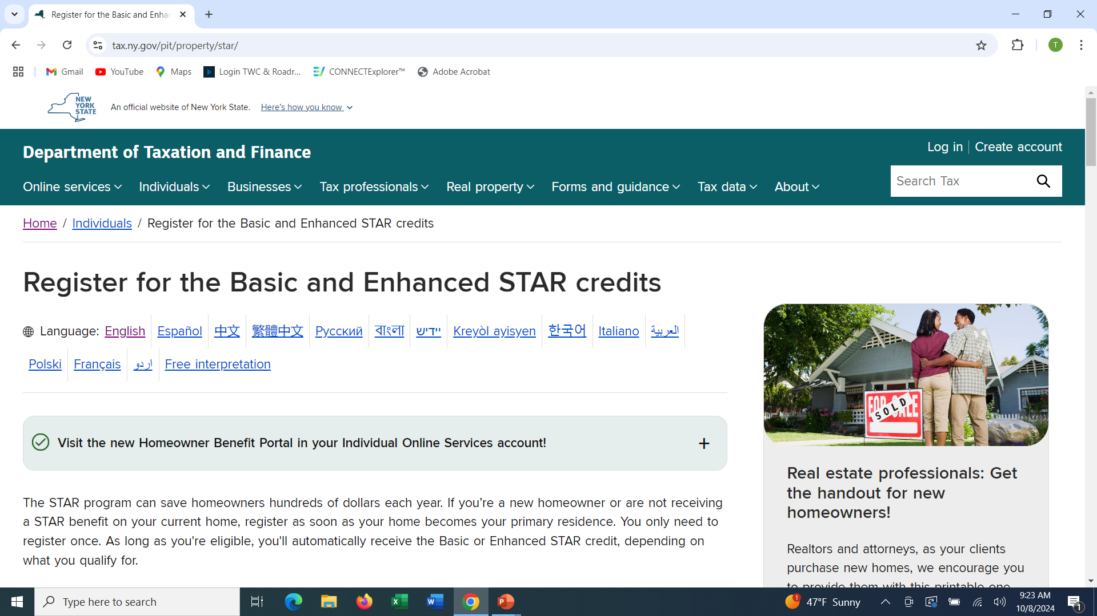
NYS STAR Information

Slide 27
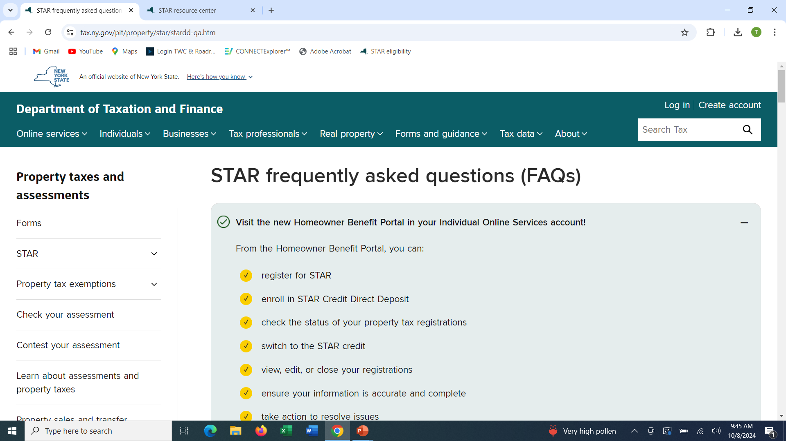
NYS STAR Information

Slide 28
NYS STAR Information - Misc
Assessors
Thursday evenings starting second week of September thru April, 7pm until 8:30pm at Thurston Town Hall 607-527-4494 or call an assessor to make an appointment.
Email thurston.assessor@gmail.com
Gordon Foster 607-383-4377
Diana Dixon 607-527-8313
Gerald J. Gebhard 607-259-7622

