Slide 1
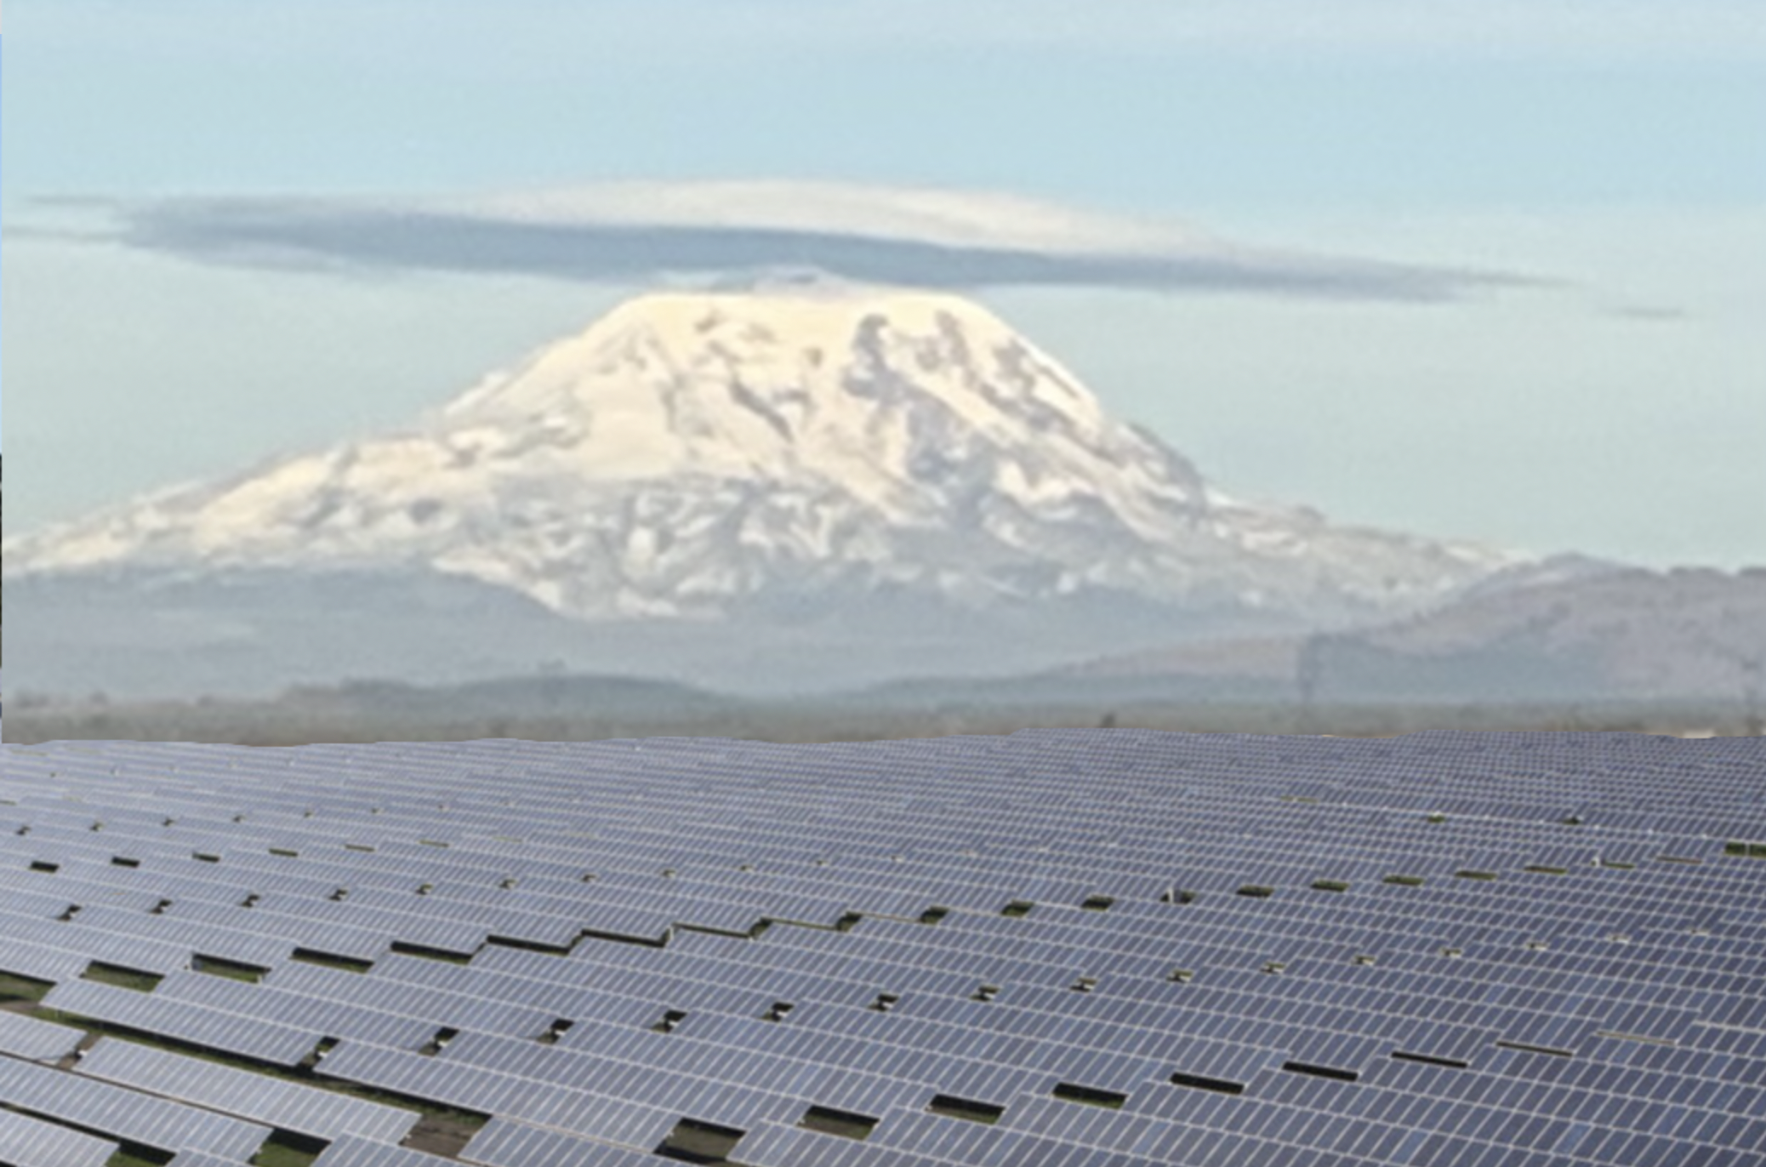
Klickitat County Industrial Scale Solar Projects
CEASE Citizens Educated About Solar Energy cease2020.org

Slide 2
Options for permitting Industrial Scale Solar Projects in Klickitat County
1. Energy Overlay Zone (if inside the EOZ)
2. Energy Facility Siting Evaluation Council aka EFSEC (anywhere)
3. Comprehensive Plan through a Conditional Use Permit (outside the EOZ)

Slide 3
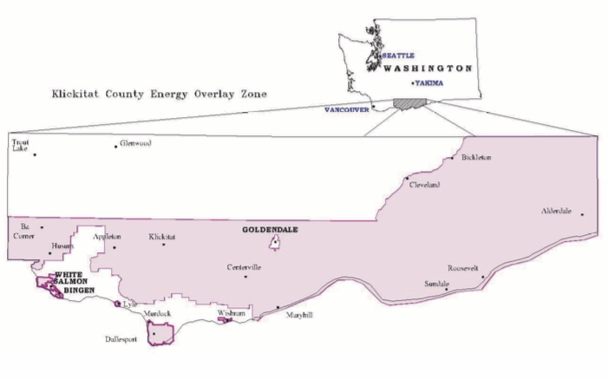
History Energy Overlay Zone EOZ
Energy Overlay Zone EOZ: Established in 2005 for Wind projects the EOZ covers 2/3 of the county. Renewable Energy Projects such as Wind and Industrial Solar are permitted out right.

Slide 4
Concerns
Lack of ordinances and governances
Lack of data
Lack of transparency
Expense to a resident to appeal is $4,000
Loss of property value
Many residents are outside the EOZ
Solar Projects like the ones proposed are unprecedented.
EFSEC takes control from local government. Lack of local ordinances to consider.

Slide 5
Energy Overlay Zone Outdated
None of the references or studies that were done for the Environmental Impact Statements referenced Industrial Scale Solar Projects
A lot of growth has happened in 16 years.

Slide 6
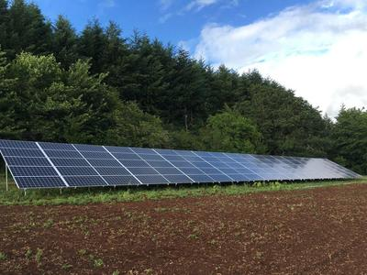
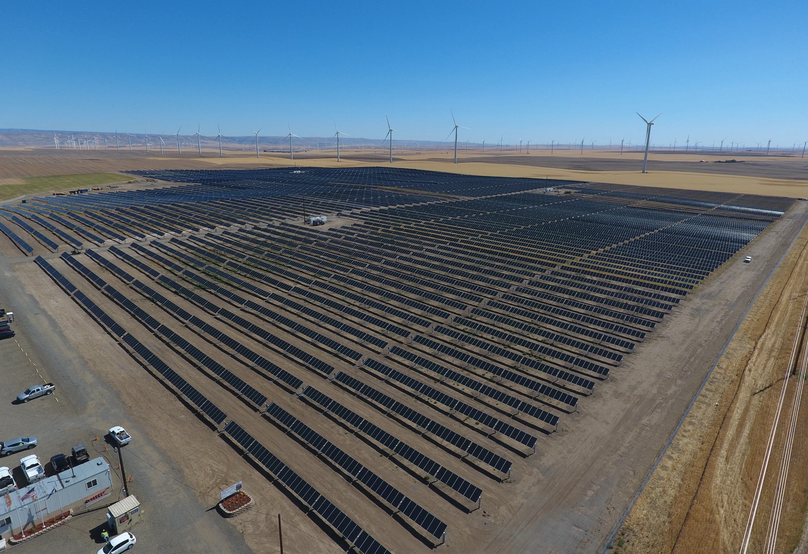
40 KW system
150 MW system
NOTE: Kilowatt = 1,000 Watts MagaWatt=1,000 Kilowatts.

Slide 7
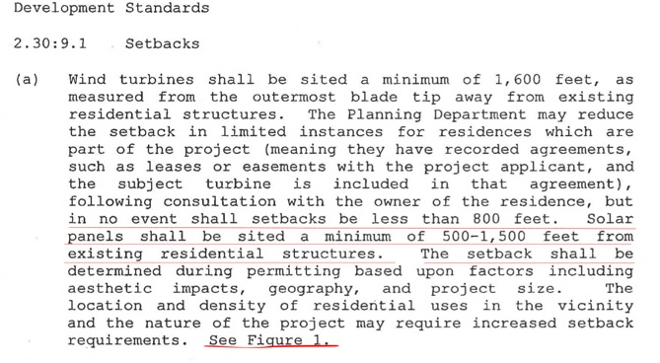
Current Siting Ordinances for Industrial Solar Projects

Slide 9
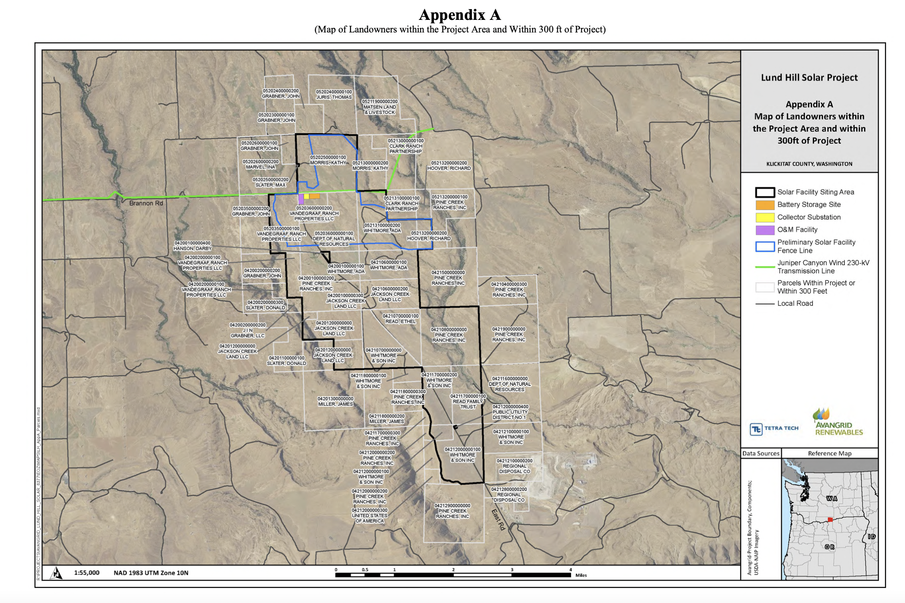
Washington’s Largest Utility Scale Solar Project
Lund Hill in Bickleton surrounds a resident in a 5,000 acre project

Slide 10
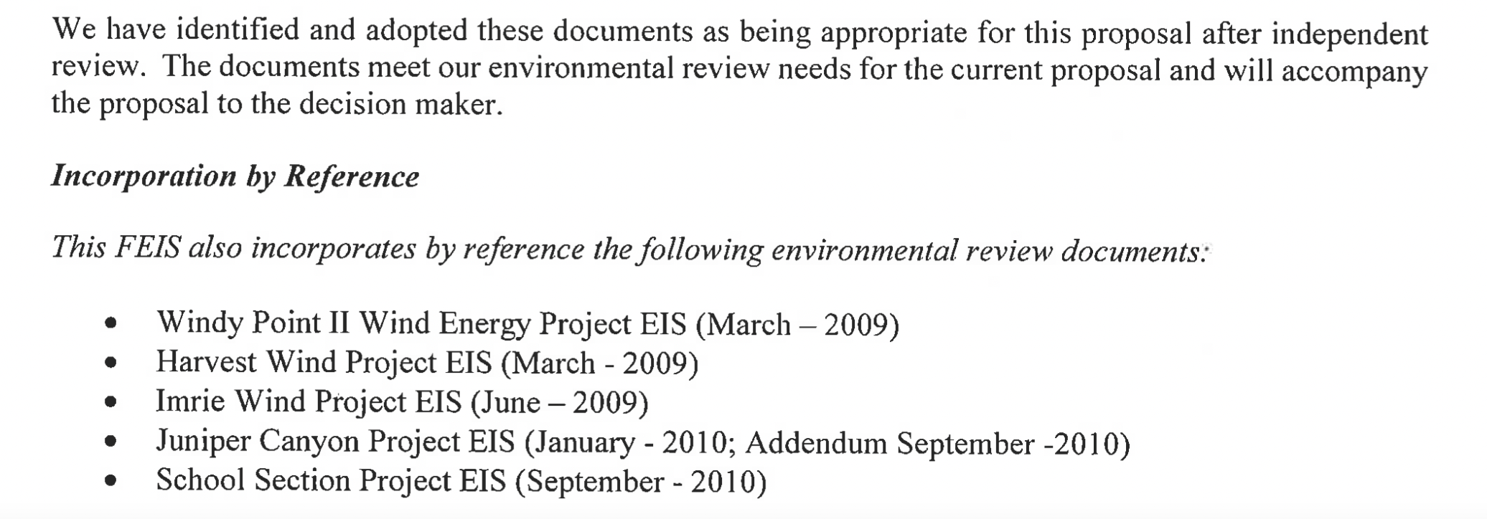
References for Lund Hill Solar Project based on all wind projects

Slide 12
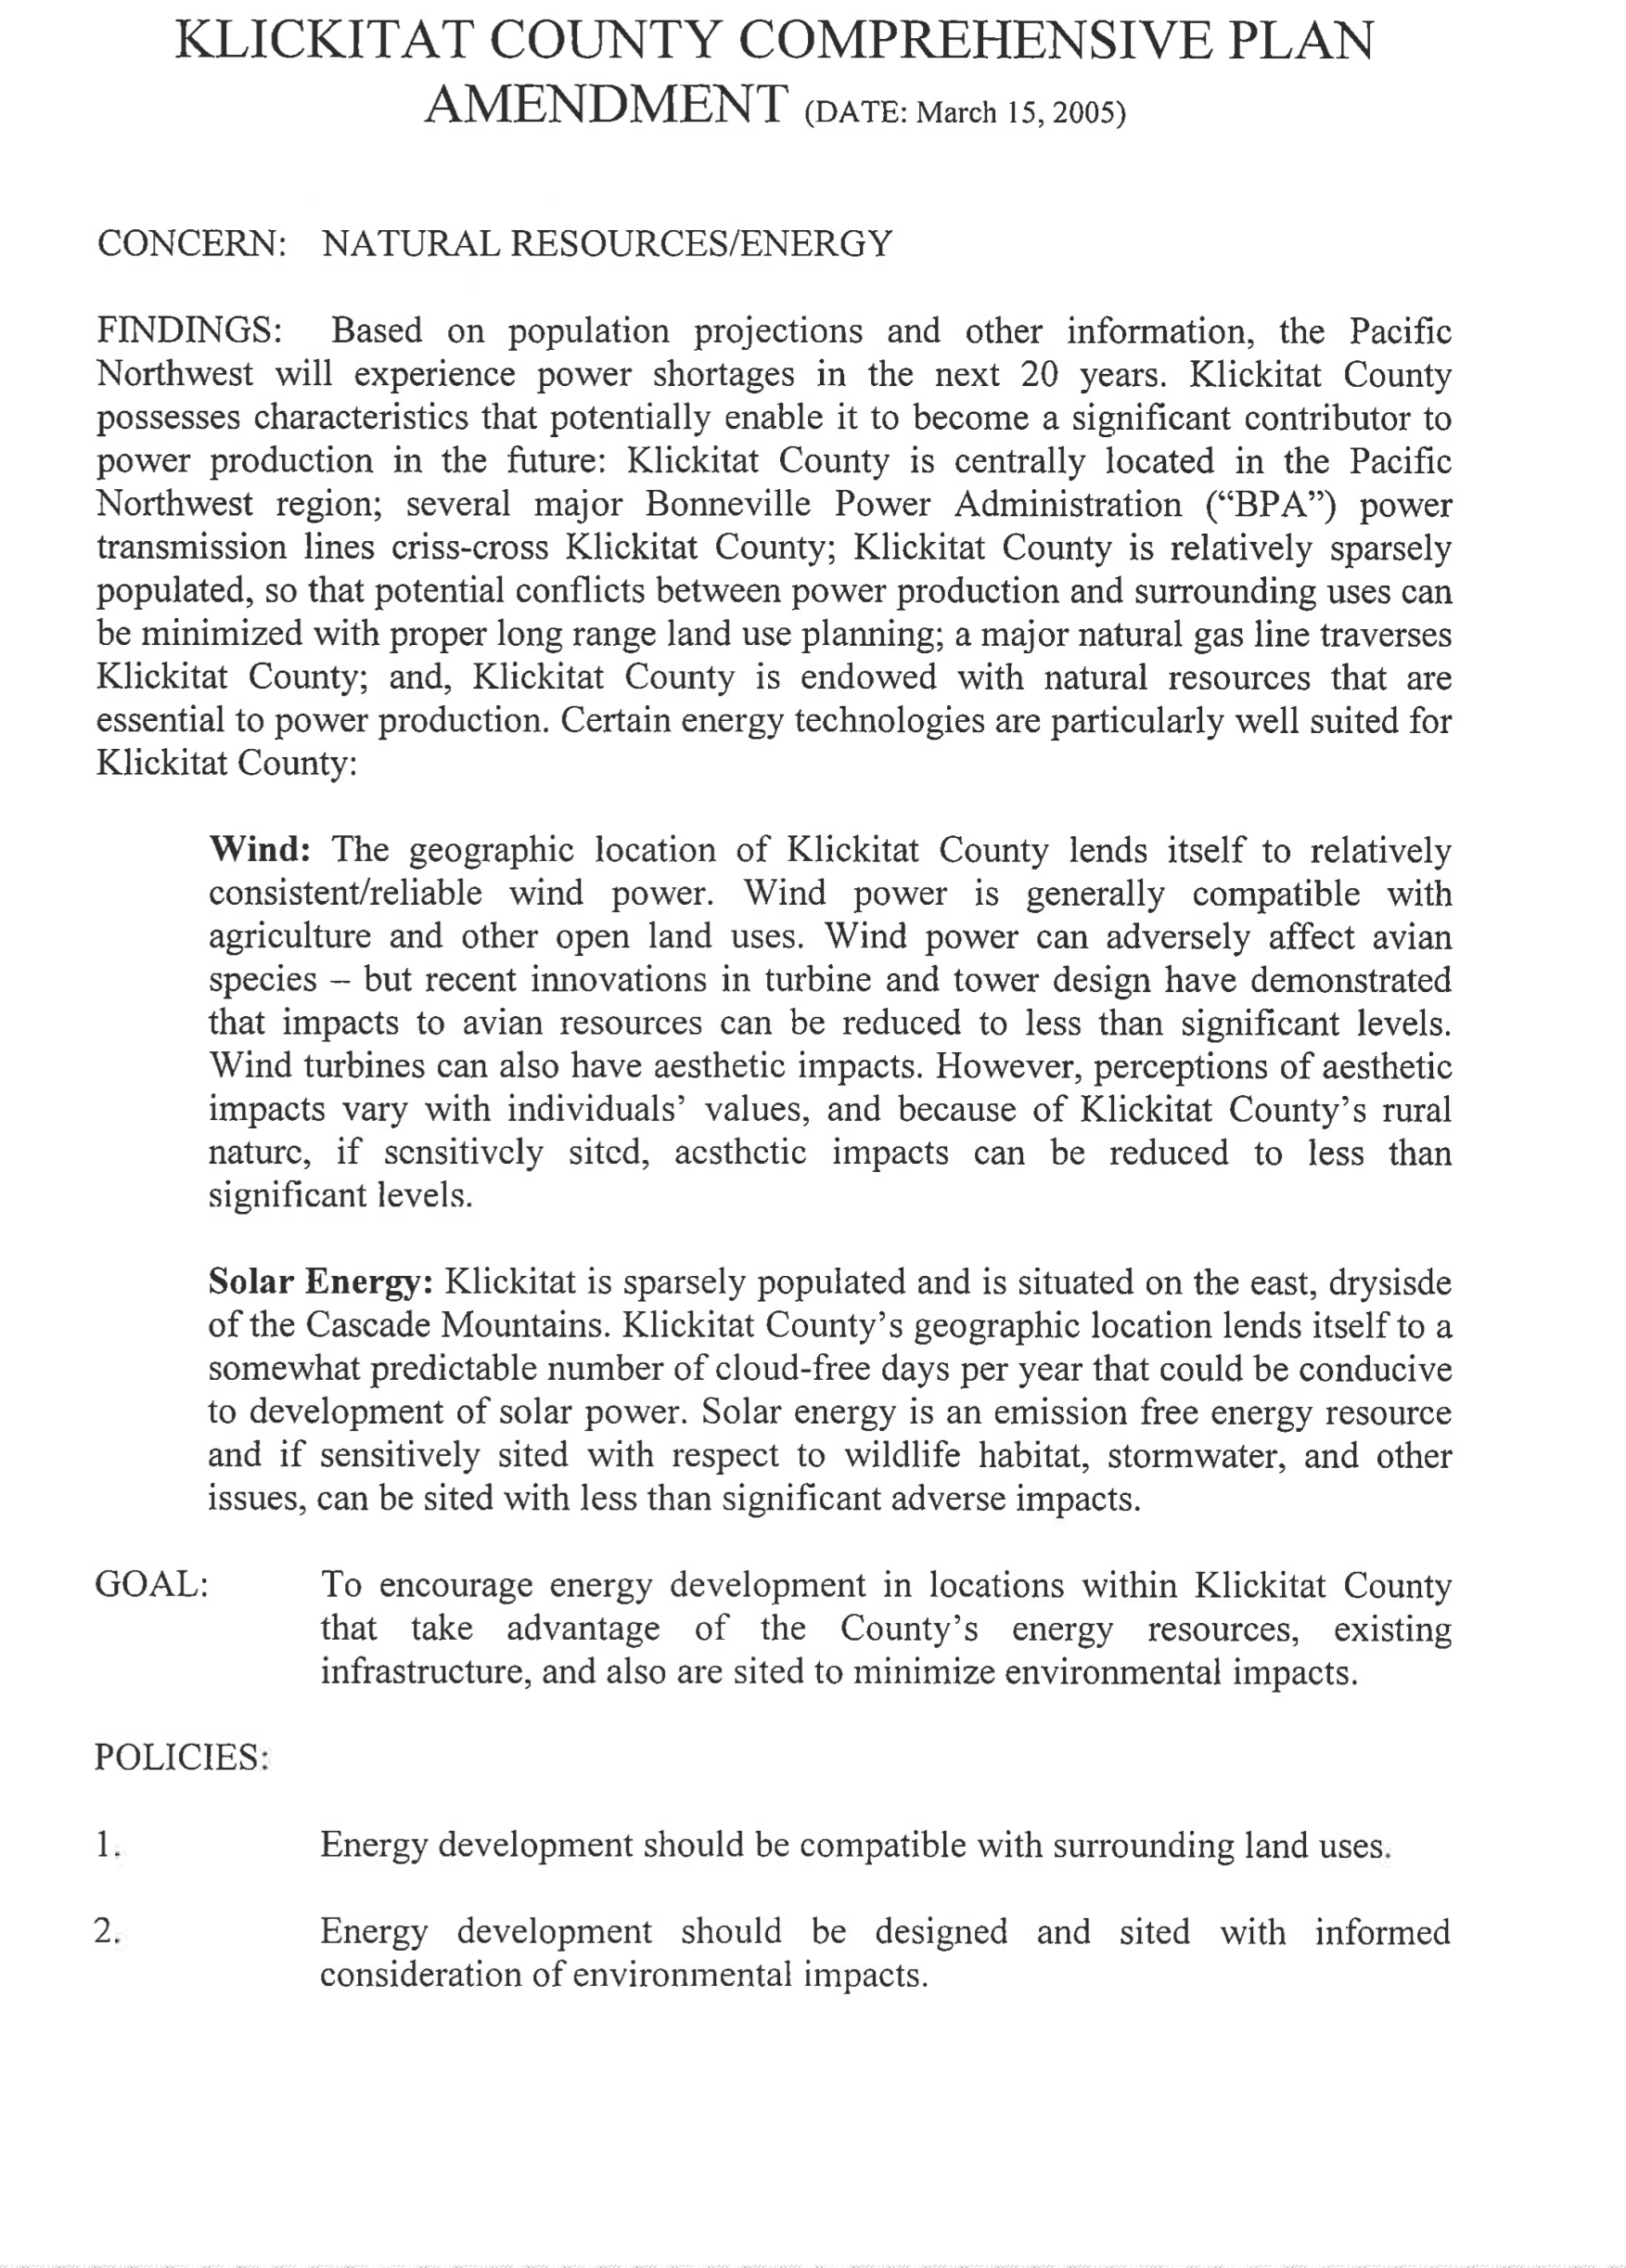

Slide 14
In depth review of the Comprehensive Plan
“Klickitat is sparsely populated and situated on the east dryside of the cascade mountains…”
“Solar Energy is an emission free energy resource and if sensitively sited with respect to wildlife habitat, stormwater and other issues, can be sited with less than significant adverse impacts.”
“The energy overlay shall include siting standards as a means of addressing characteristics and issues of each site”
Projects outside the EOZ shall be subjected to a Conditional Use Permit

Slide 15
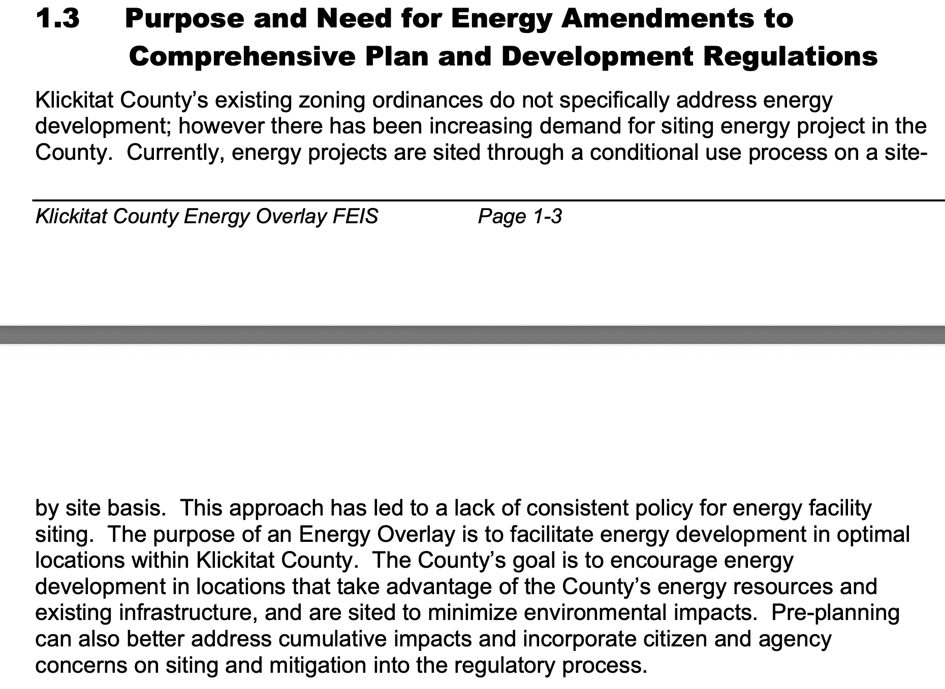

Slide 16
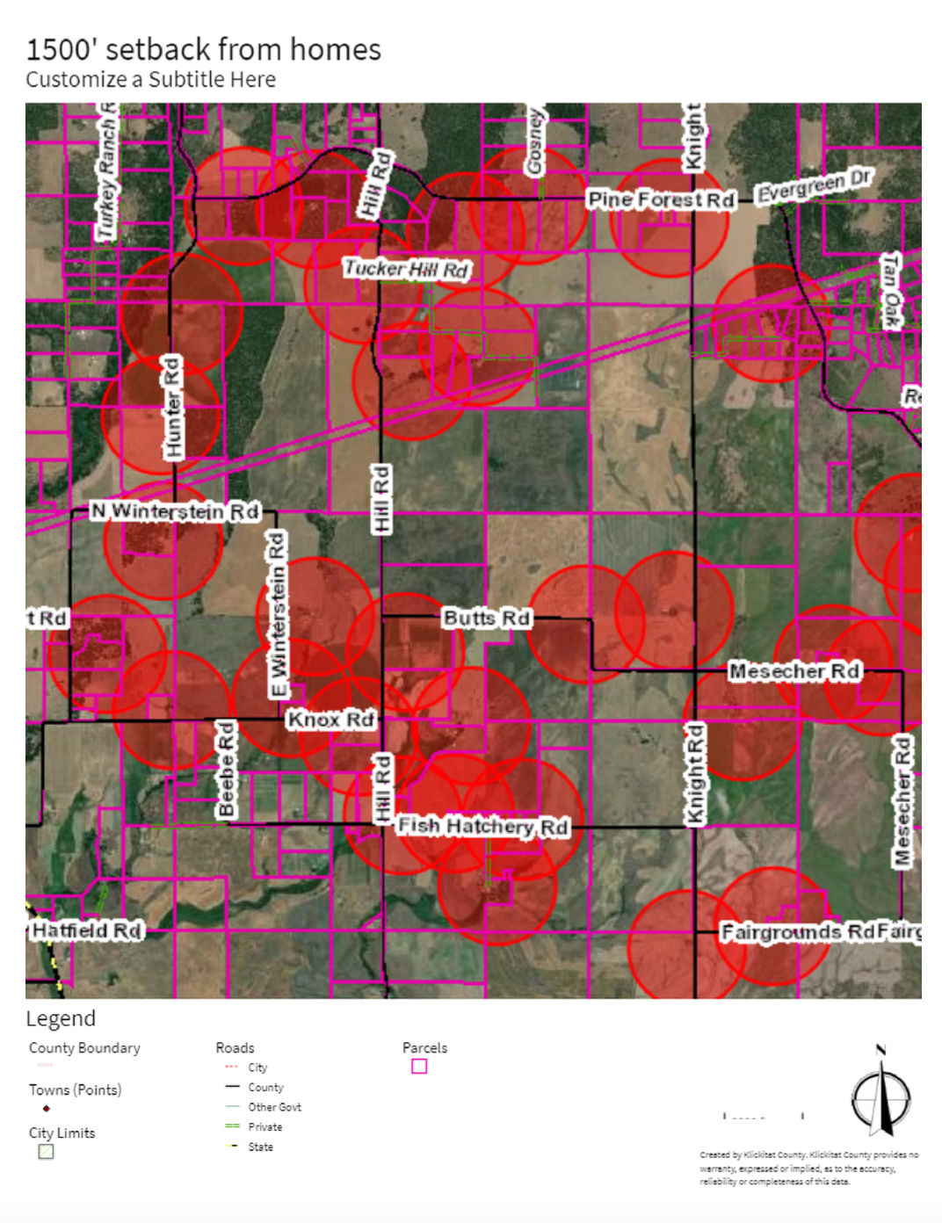
Not “Sparsely Populated”

Slide 17
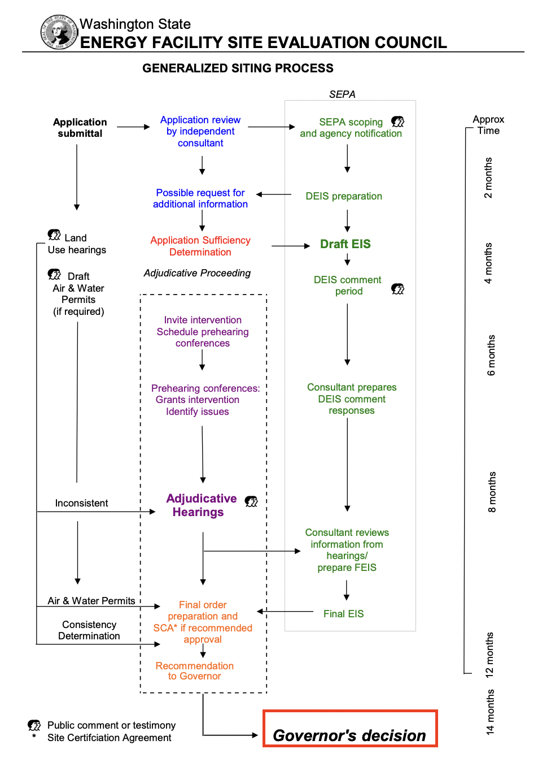
Without local ordinances siting councils like EFSEC will use our County’s existing industrial solar ordinances. It will be easy to comply when there is nothing to comply with. This is why it is essential to establish ordinances now.

Slide 18
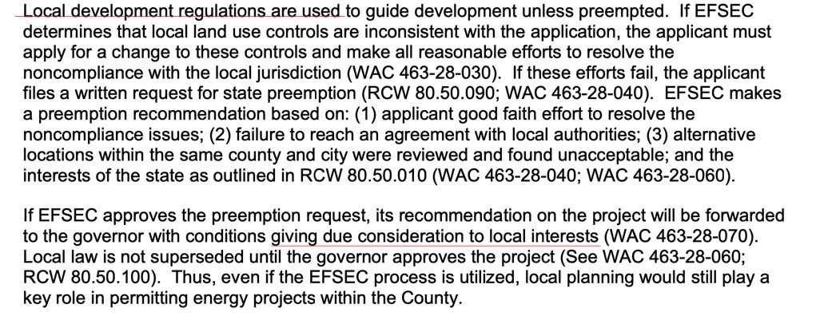

Slide 19
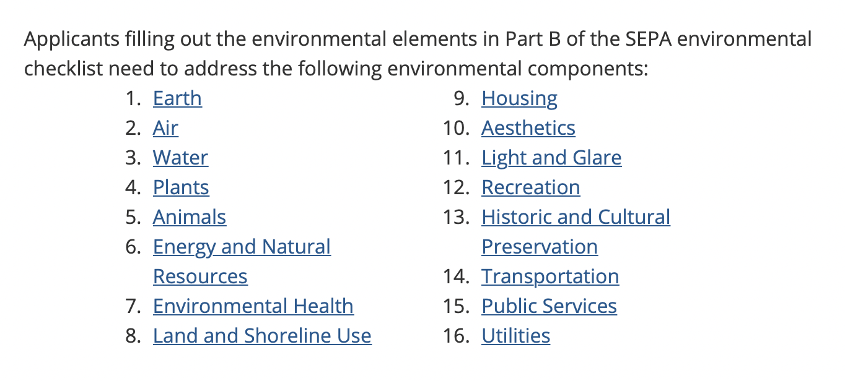
SEPA Componets

Slide 20
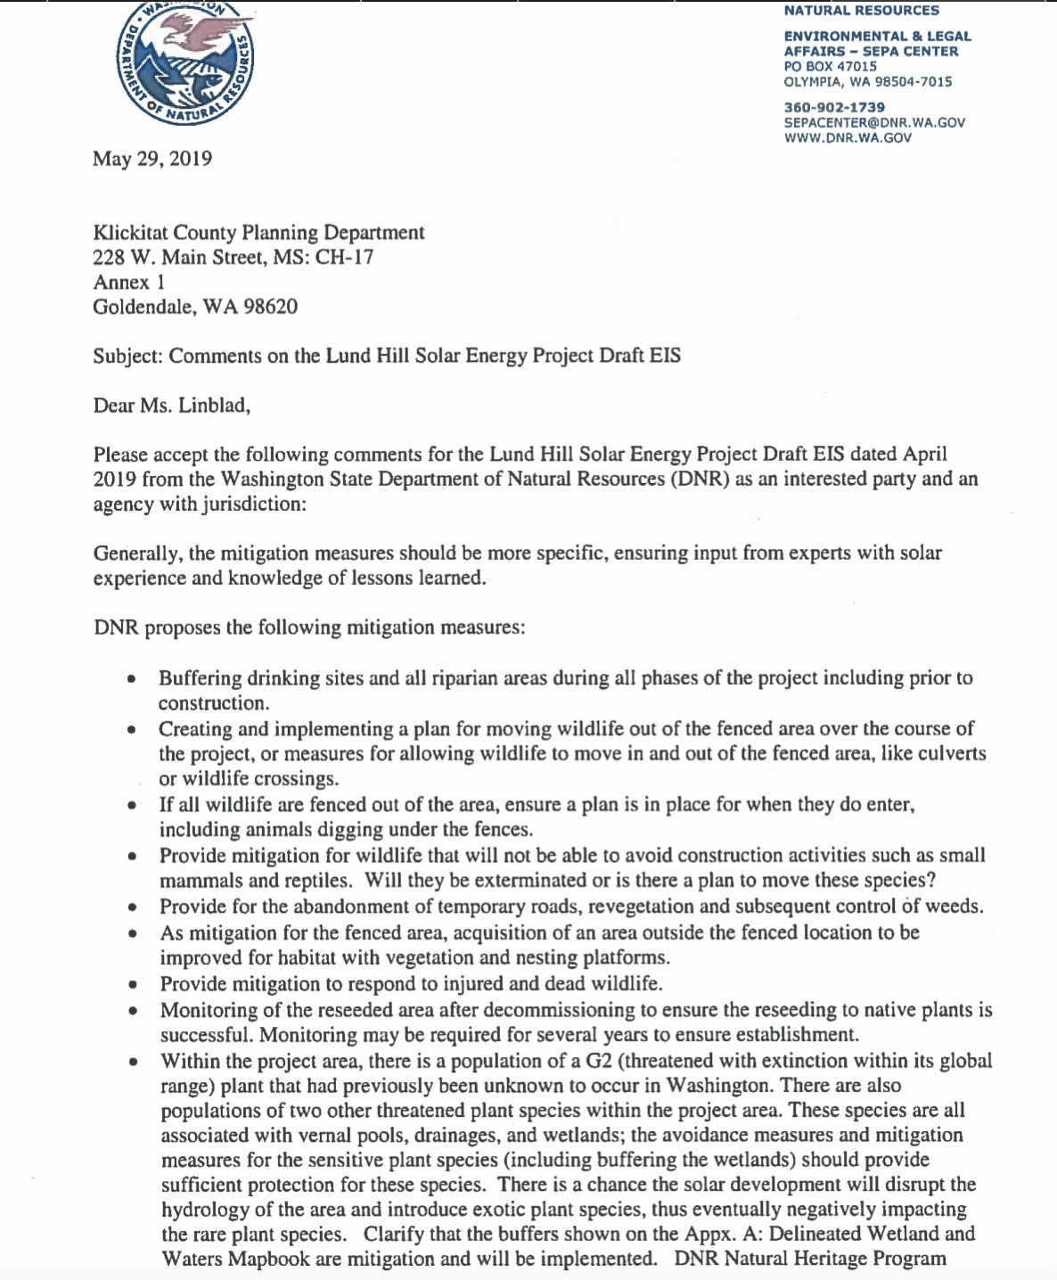
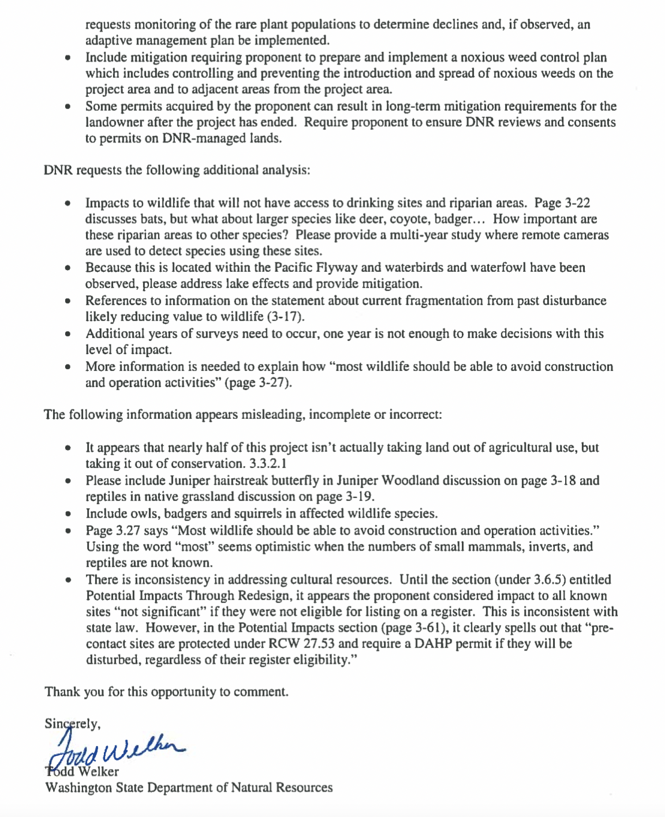

Slide 21
Mitigation Results

Slide 22
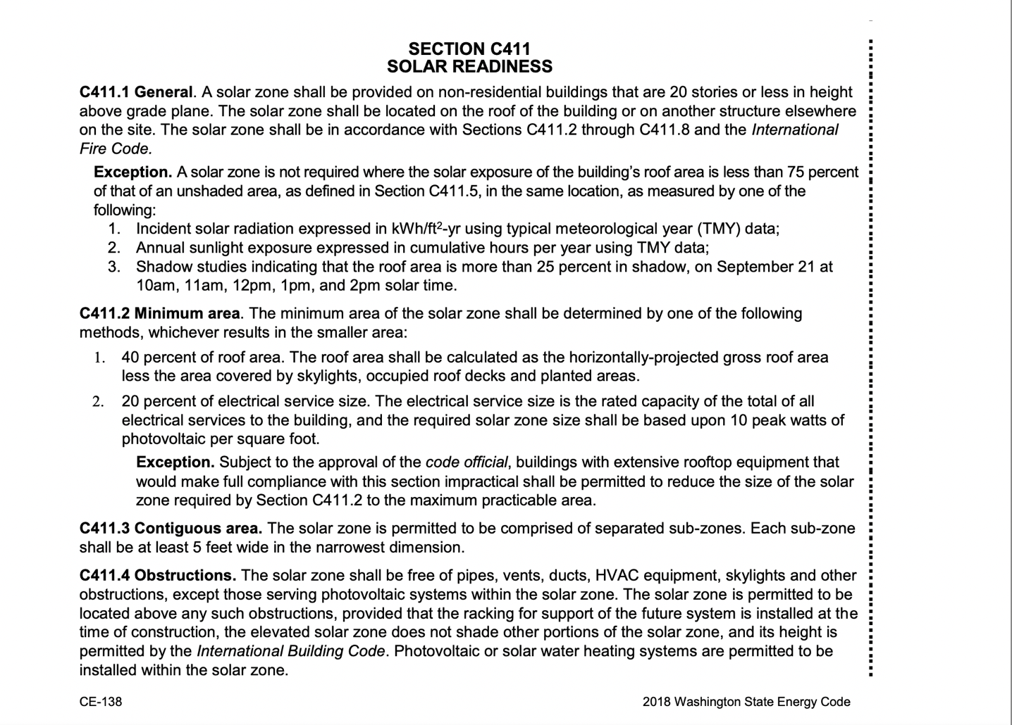
Assumption:
Surely there’s State codes and laws that corporations have to abide by.
Truth:
If you were to look up “solar” in our State’s building codes you will not find anything regarding industrial scale solar projects.
More needs to be done on all levels of Government. Local, State, and Federal all lack proper data and experts to approve these projects.

Slide 23
Conditional Use Permit
CUP

Slide 24
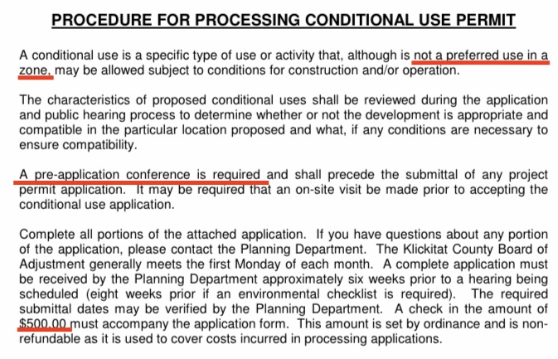

Slide 25
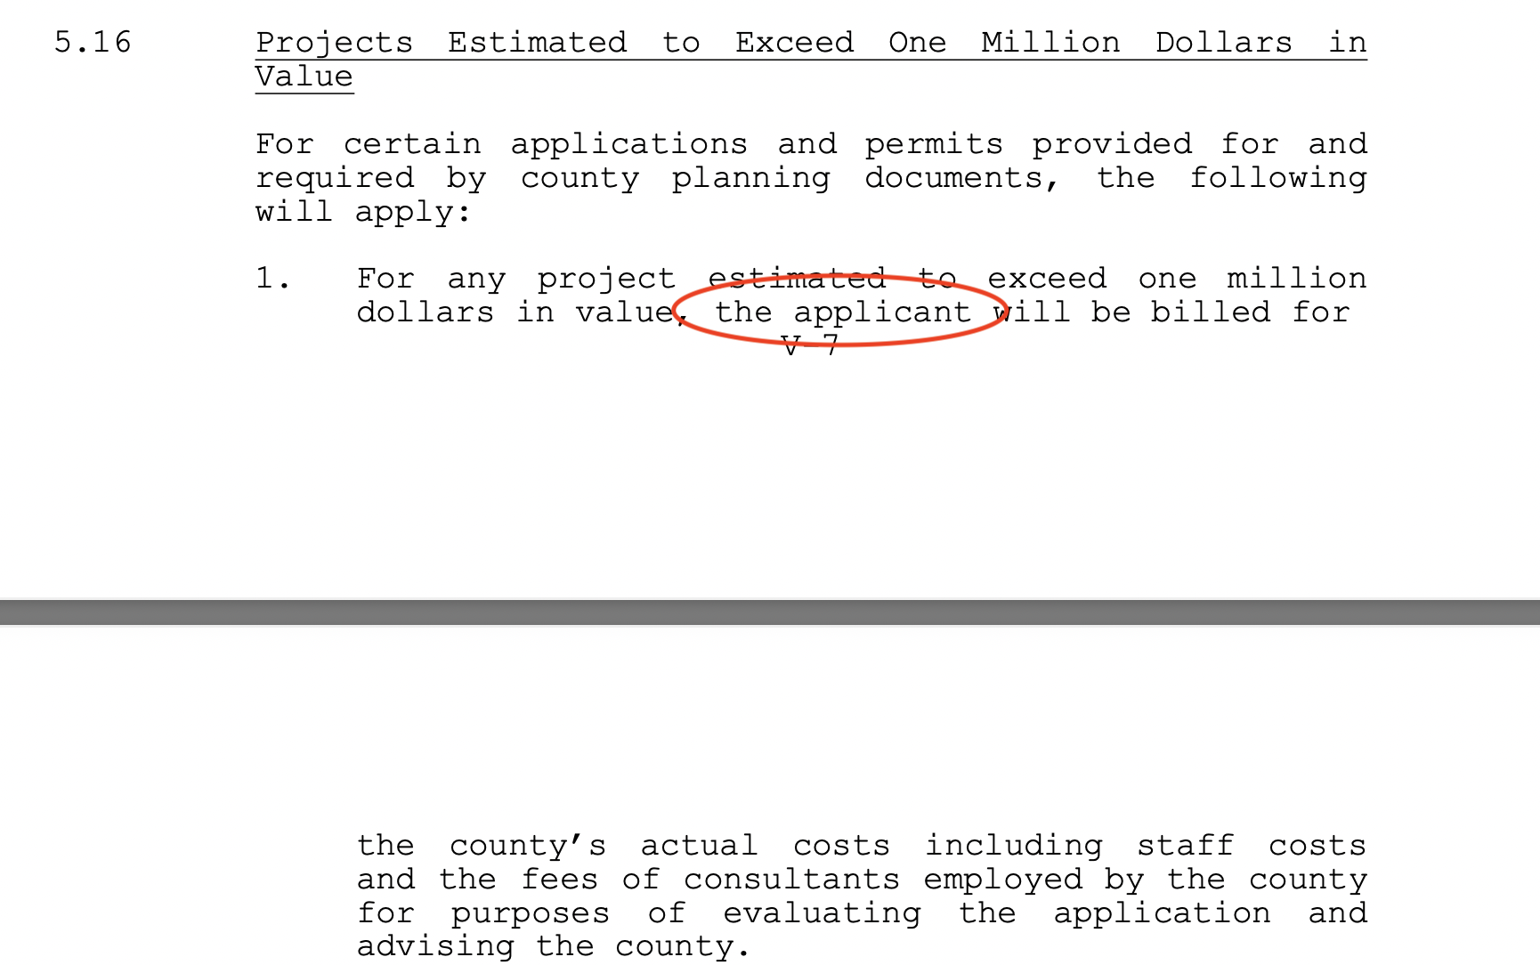
If the applicant is billed to cover county’s costs, then why does it cost $4,000 for the resident to file an appeal?

Slide 26
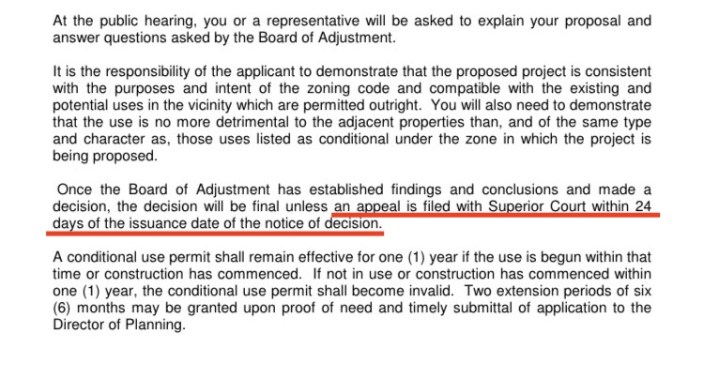

Slide 27
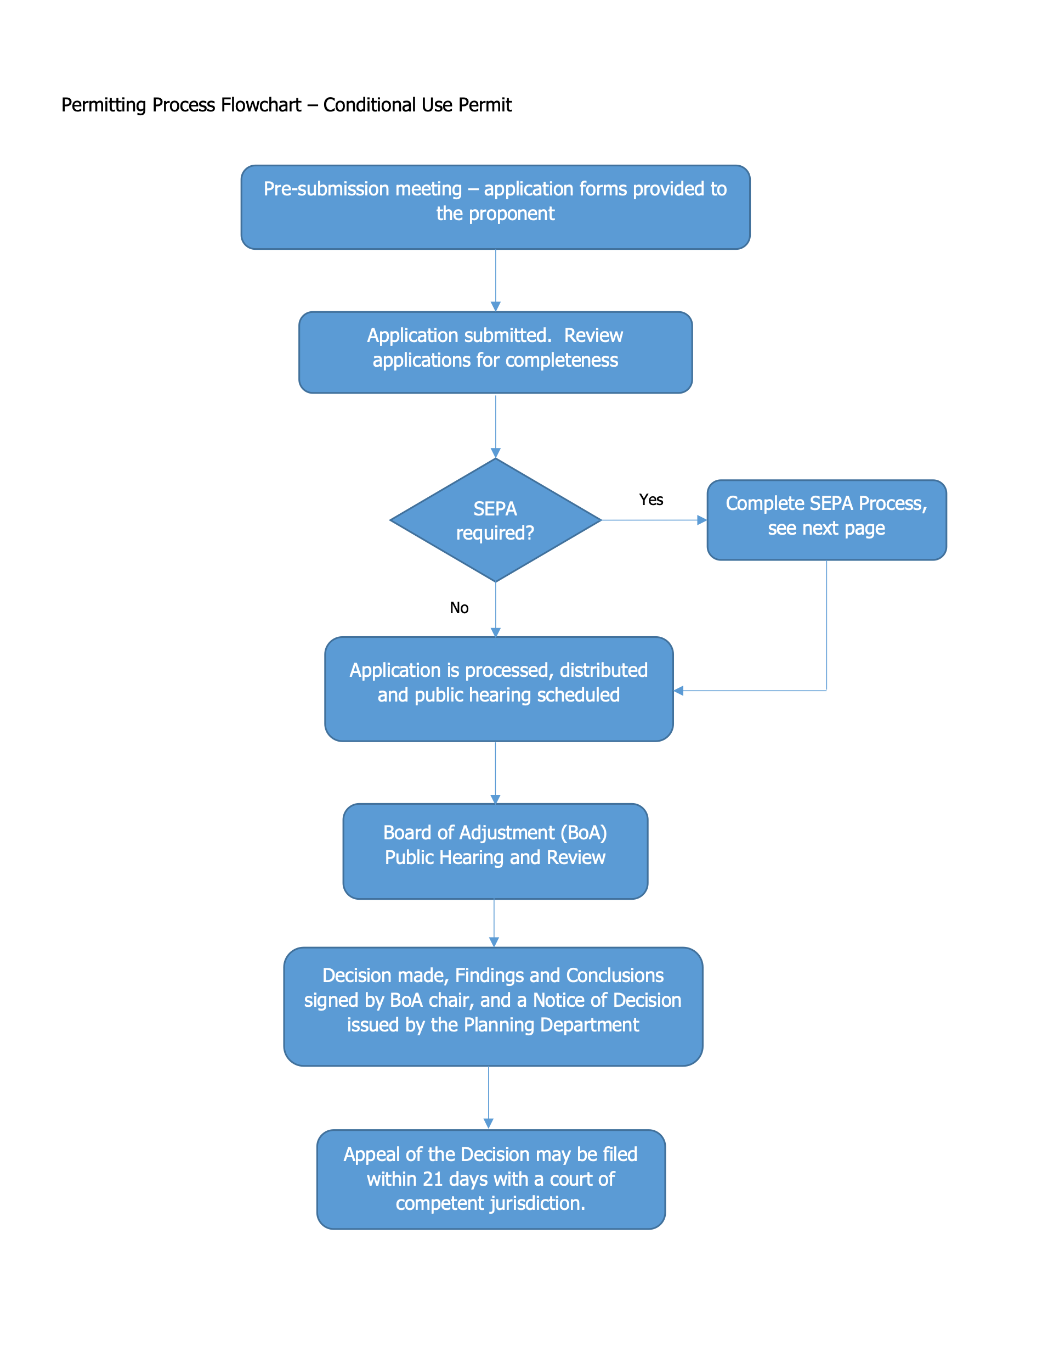

Slide 28
