Slide 1
Presentation to the
East Garrison Community Services District Advisory Committee
LAFCO of Monterey County
LOCAL AGENCY FORMATION COMMISSION
Jonathan Brinkmann, Principal Analyst
September 10, 2025

Slide 2
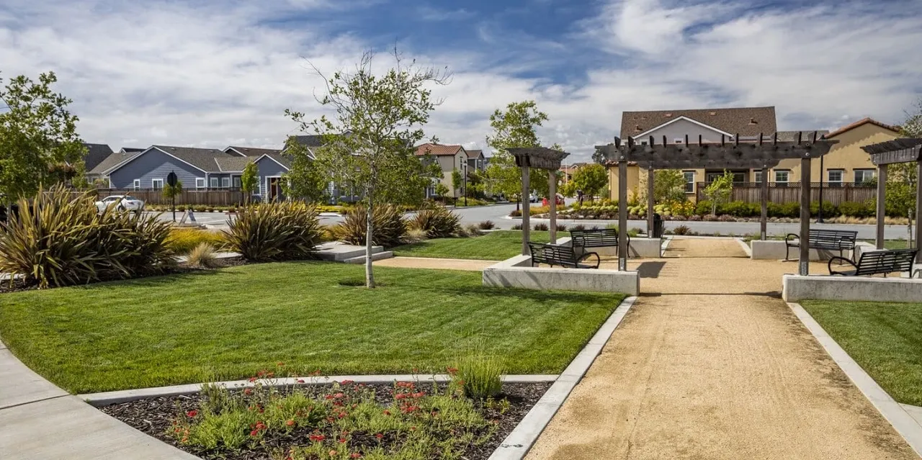
Overview
LAFCO’s Role & Responsibilities
2025 LAFCO Study for East Garrison CSD
Study Recommendations
Local Agency Formation Commission of Monterey County

Slide 3
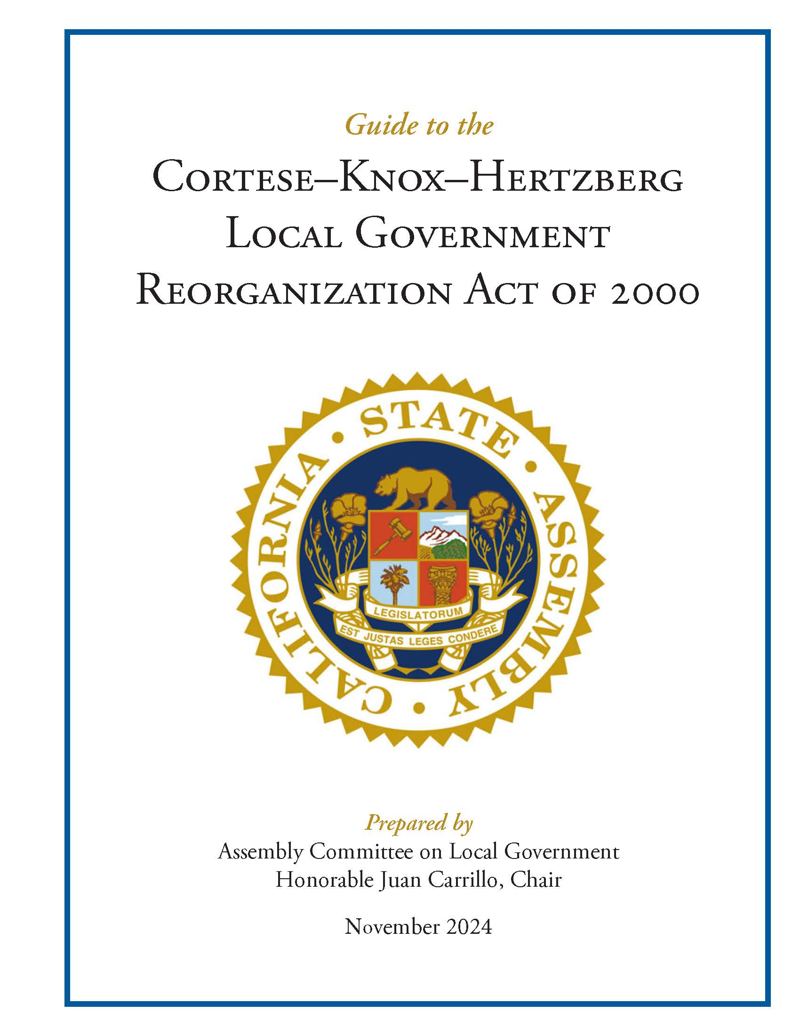
Introduction
LAFCO of Monterey County…
An independent regulatory authority of the State of California, created in 1963
General powers and authority to regulate boundaries of cities and special districts
Local Agency Formation Commission of Monterey County

Slide 4
LAFCO’s Role
LAFCO’s mission is to promote sustainable growth and good governance in Monterey County by:
        Encouraging the orderly formation, growth and development of local government agencies
        Discouraging urban sprawl
        Preserving open space and prime agricultural lands
        Encouraging efficient delivery of government services
Local Agency Formation Commission of Monterey County

Slide 5
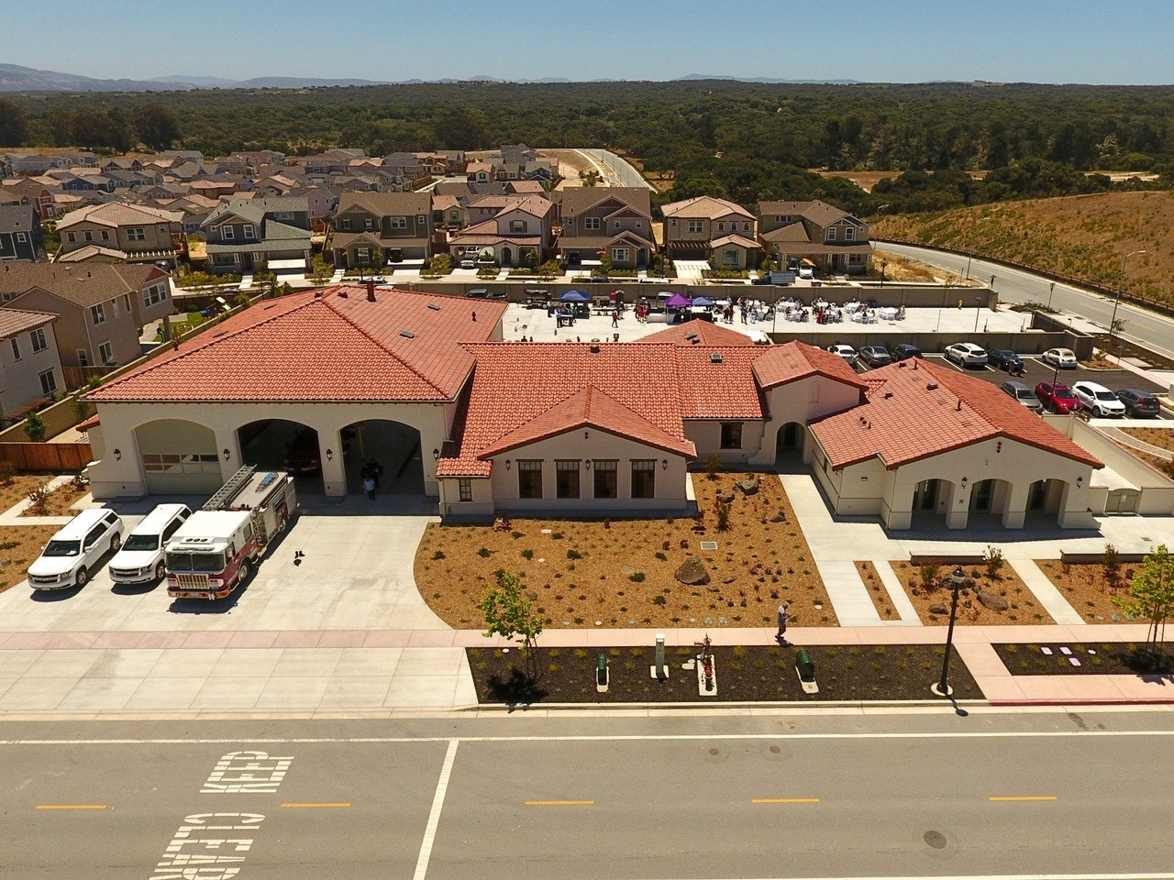
LAFCO Commissioners and Staff
Commissioners, a unique mix:
      County Supervisors (3)
      City Councilmembers (3)
      Special District Board Members (3)
      Public Members (2)
  All 11 members are required to represent the interests of the entire public.
Professional Staff (3 FTE staff plus contract staff)
Local Agency Formation Commission of Monterey County

Slide 6
LAFCO’s Oversight Responsibilities
Under LAFCO Purview
12 Cities
42 Independent Special Districts
  Airport, Cemeteries, Community Service Districts, Fire, Harbor, Health Care, Mosquito Abatement, Memorial, Recreation & Park, Resource Conservation, Solid Waste, Water
48 Dependent Special Districts
  County Service Areas, Water, Transit, Sanitation
Not Under LAFCO Purview
Joint Power Authorities
Community Facilities Districts
Mello-Roos Districts
School or College Districts
County Boundaries
Bridge & Highway Districts
Improvement Districts
Zones of Benefit
Air Pollution/Quality Districts
Local Agency Formation Commission of Monterey County

Slide 7
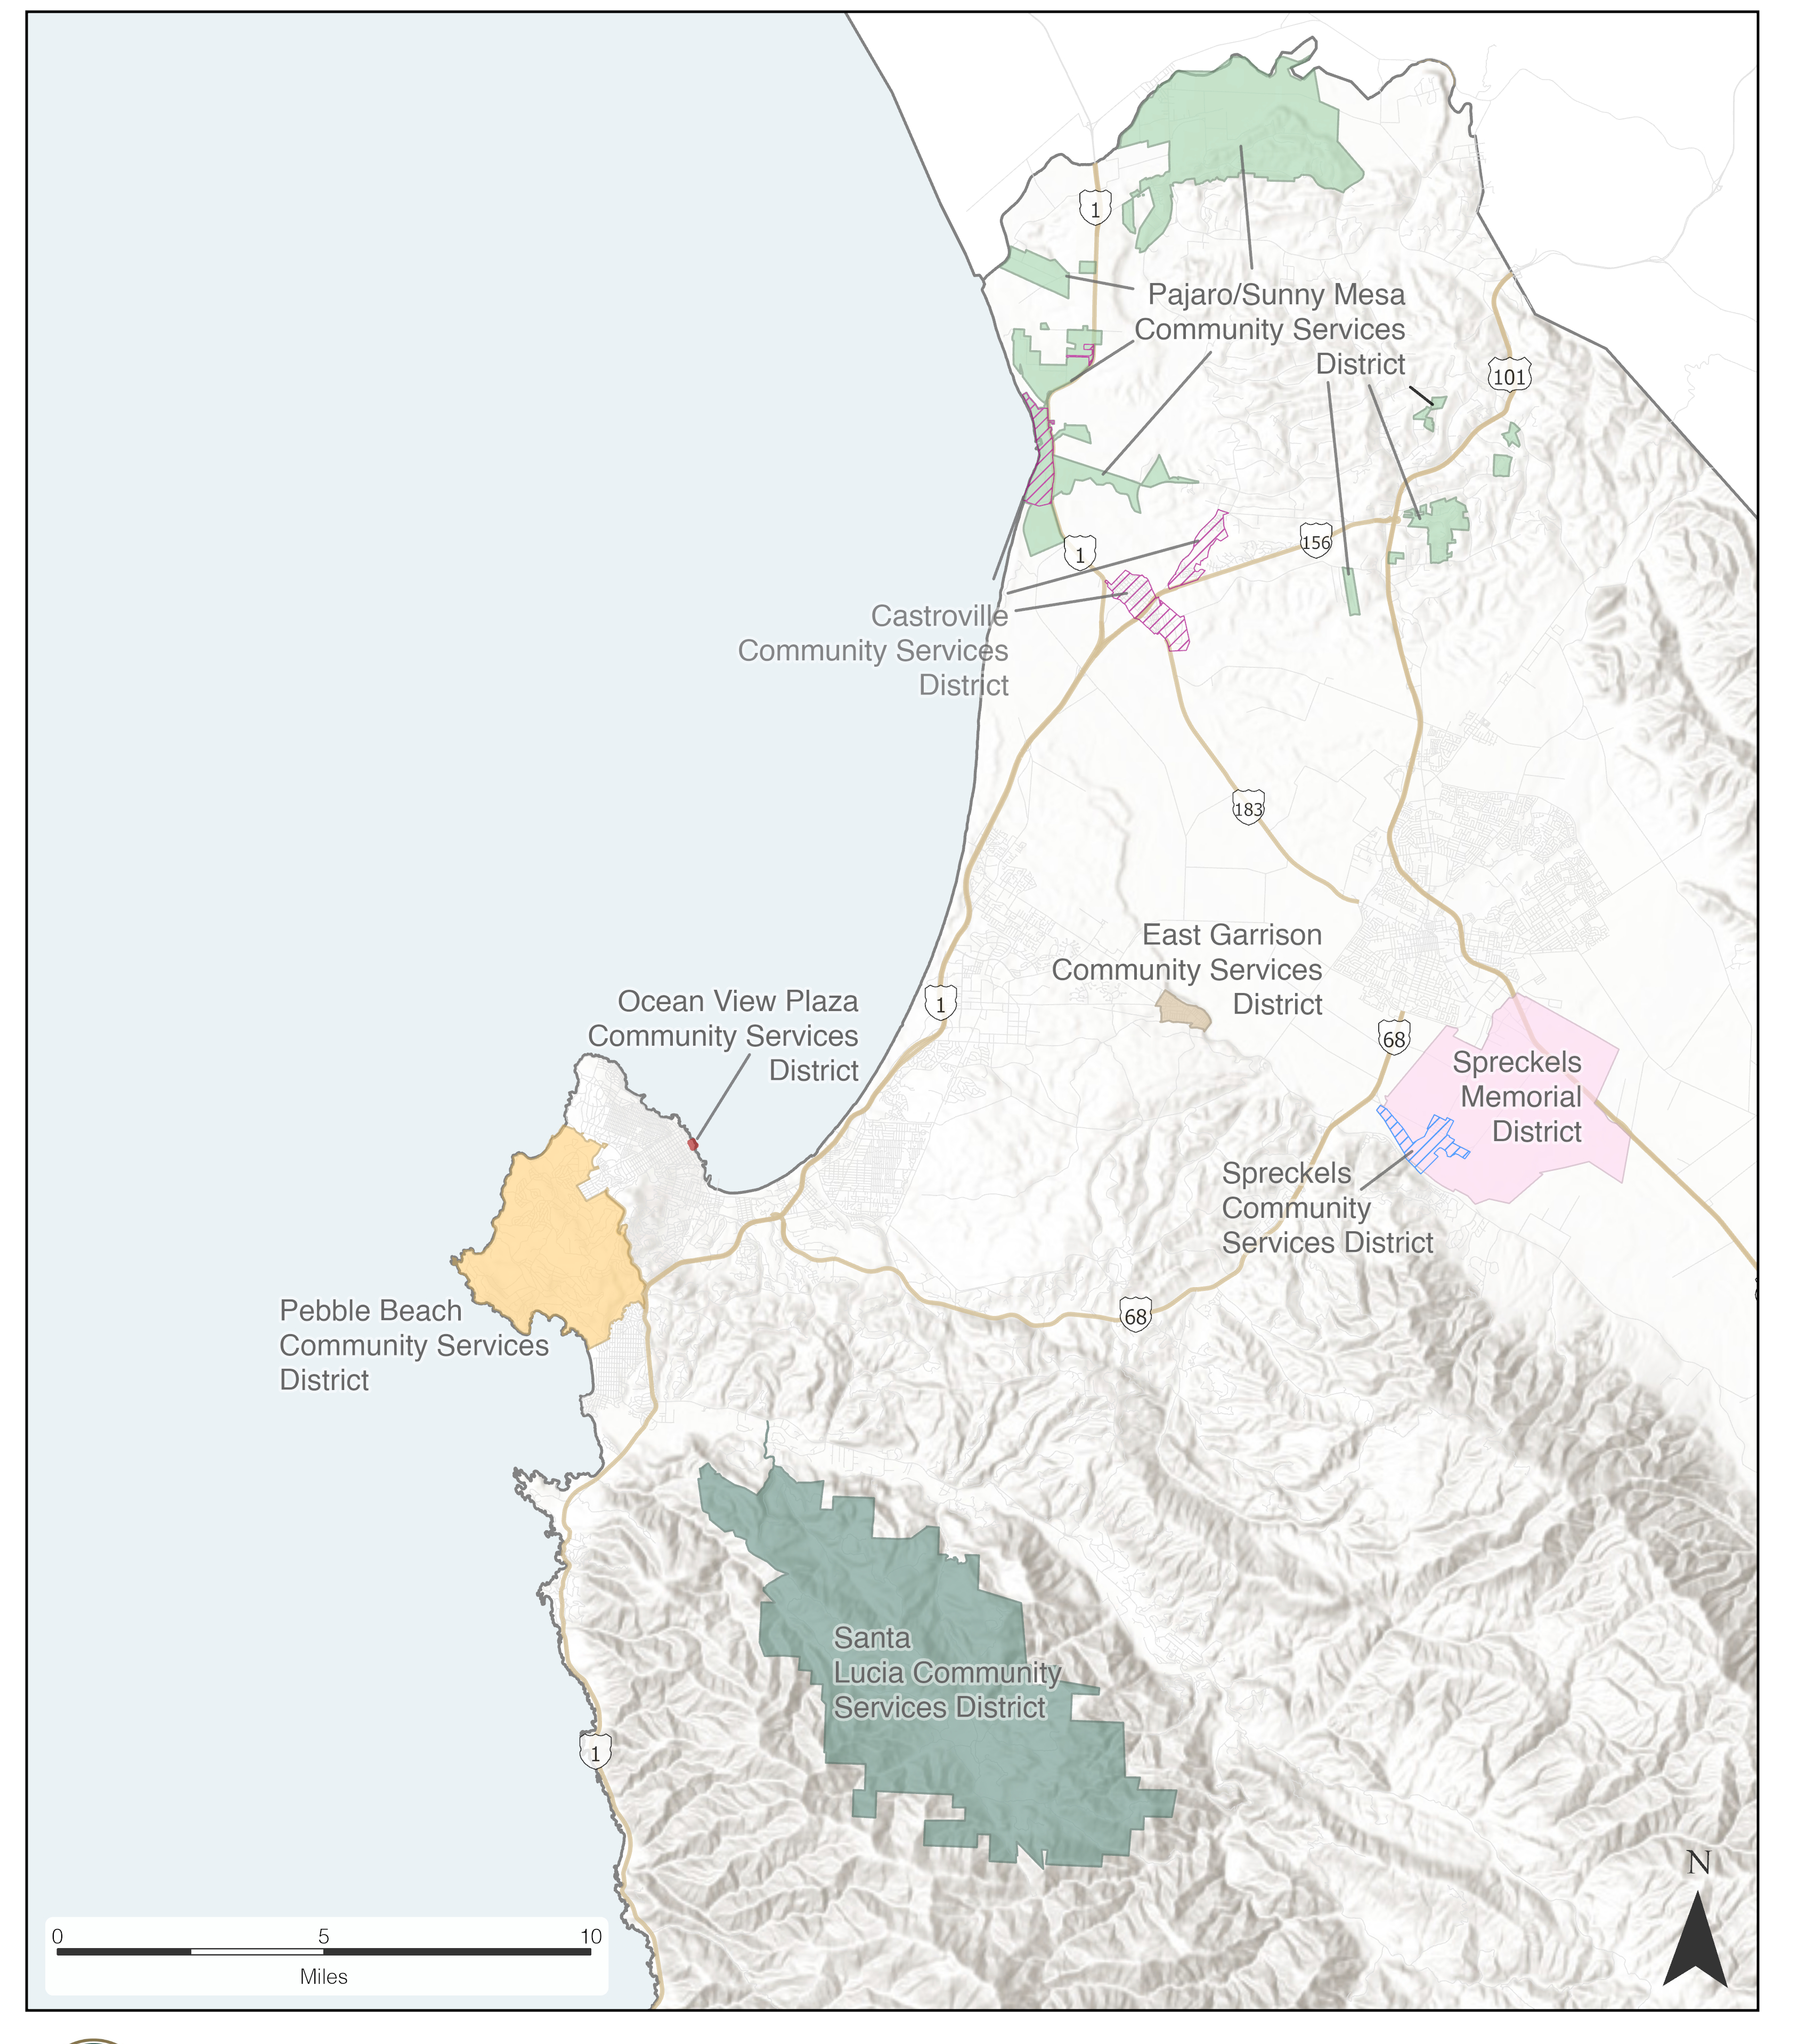
2025 LAFCO Study for East Garrison CSD
Reviewed Services, Governance, Finances, Boundaries, and Spheres of Influence for East Garrison CSD and other CSDs
Dependent District Status
Local Agency Formation Commission of Monterey County

Slide 8
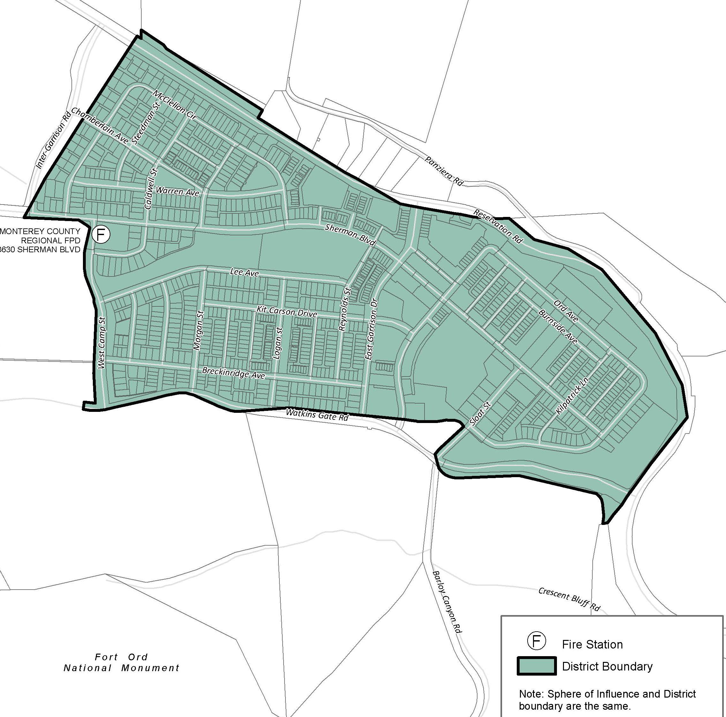
LAFCO Study Recommendations
Affirm currently adopted Sphere of Influence for East Garrison CSD
Continue to coordinate with and assist the County of Monterey in achieving East Garrison CSD becoming an independent special district.
Local Agency Formation Commission of Monterey County

Slide 9
Questions
LAFCO staff are available to help answer your questions.

