Slide 1
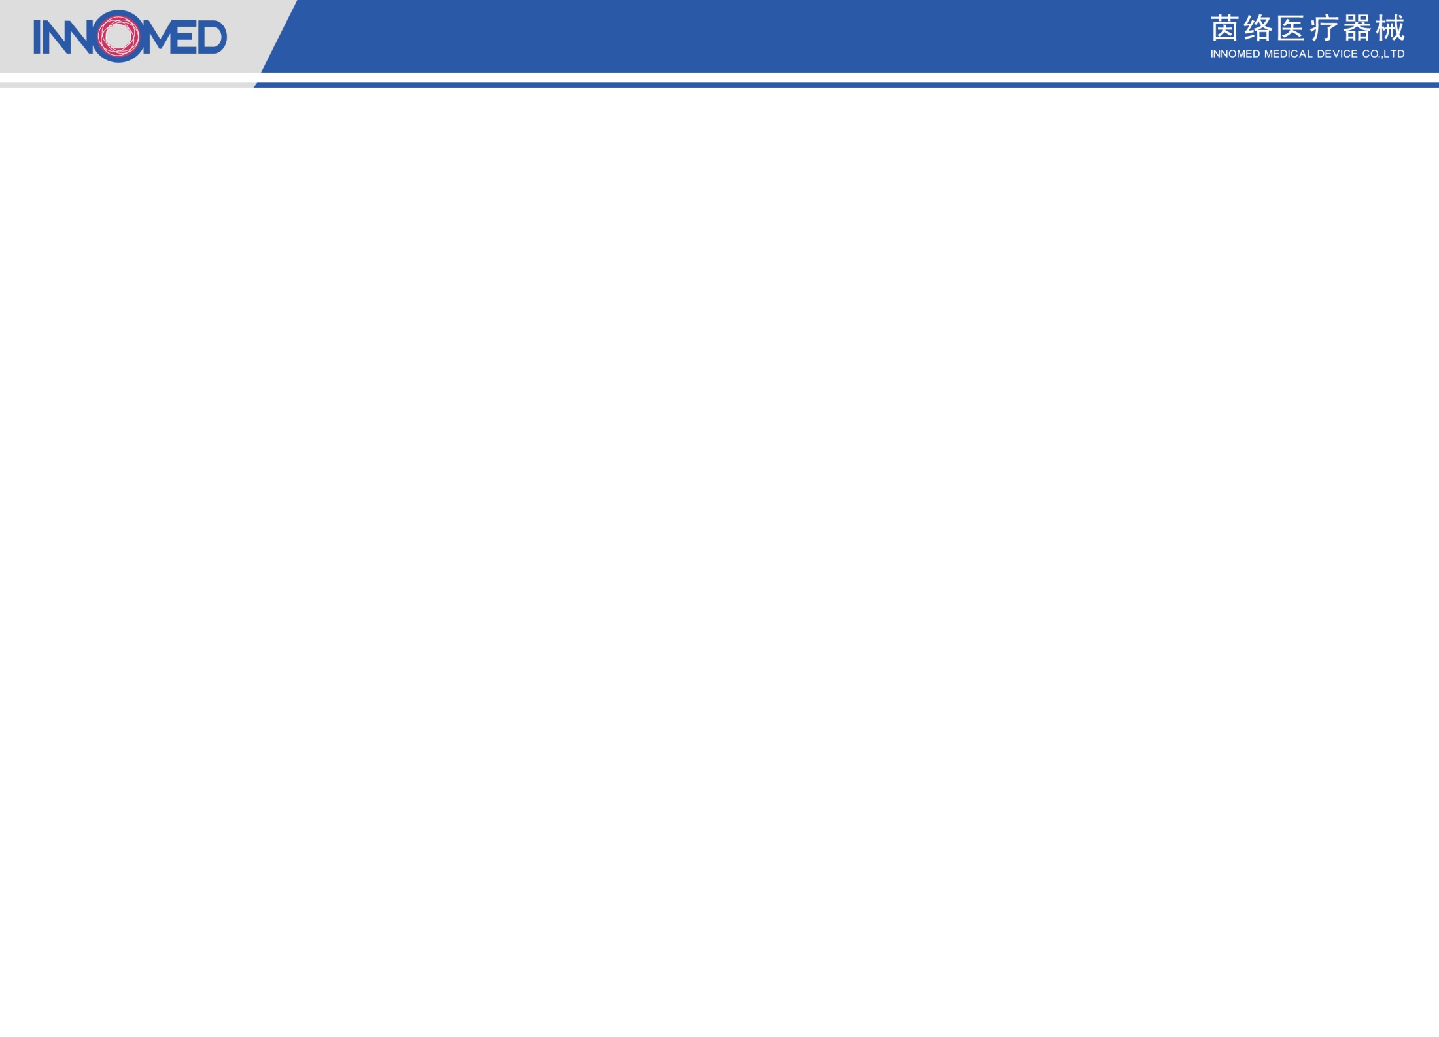
Guidewire Trial Sample Description
Qinghai Provincial People’s Hospital
Specifications | Lot Number | Tip Force | Remark
IW-14-190-MDS | 07SY23042301 | 0.8 gf | Improved one to one torque
 | 07SY23042302 | 0.6 gf
 | 0722051801 | 0.8 gf
 | 0723032101 | 1.5 gf
Total six surgeries were recorded and found one vessel was tortuous, seven vessels were narrowed, and one vessel was occluded. The usage of Inno-Pathwire is listed below:

Slide 2
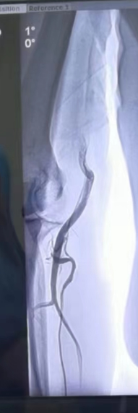
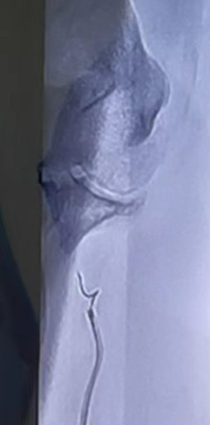
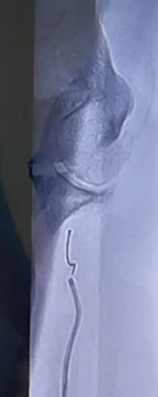
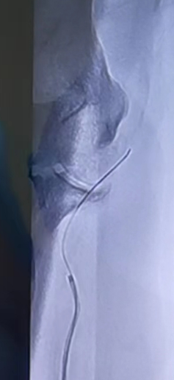
Surgery One:
Surgeon: Head of Cardiovascular Group
Guidewire：Inno-Pathwire（0.6 gf）
Patient’s Lesion: Radial Artery Tortuosity
When the patient used the angiographic guidewire and catheter during the surgery, the radial artery was tortuous and could not pass through. Afterwards, the Inno-Pathwire was used for guidance and successfully reached the ascending aorta.
0.6 gf
Wrong path
Target path
Successfully passed tortuous vessel

Slide 3
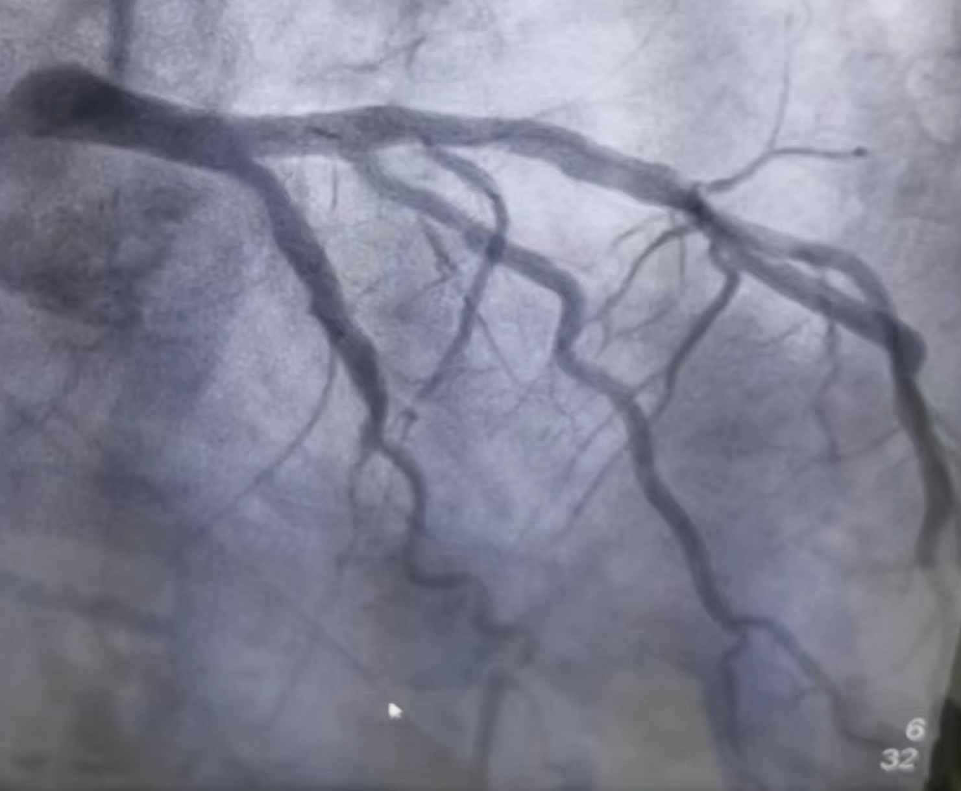
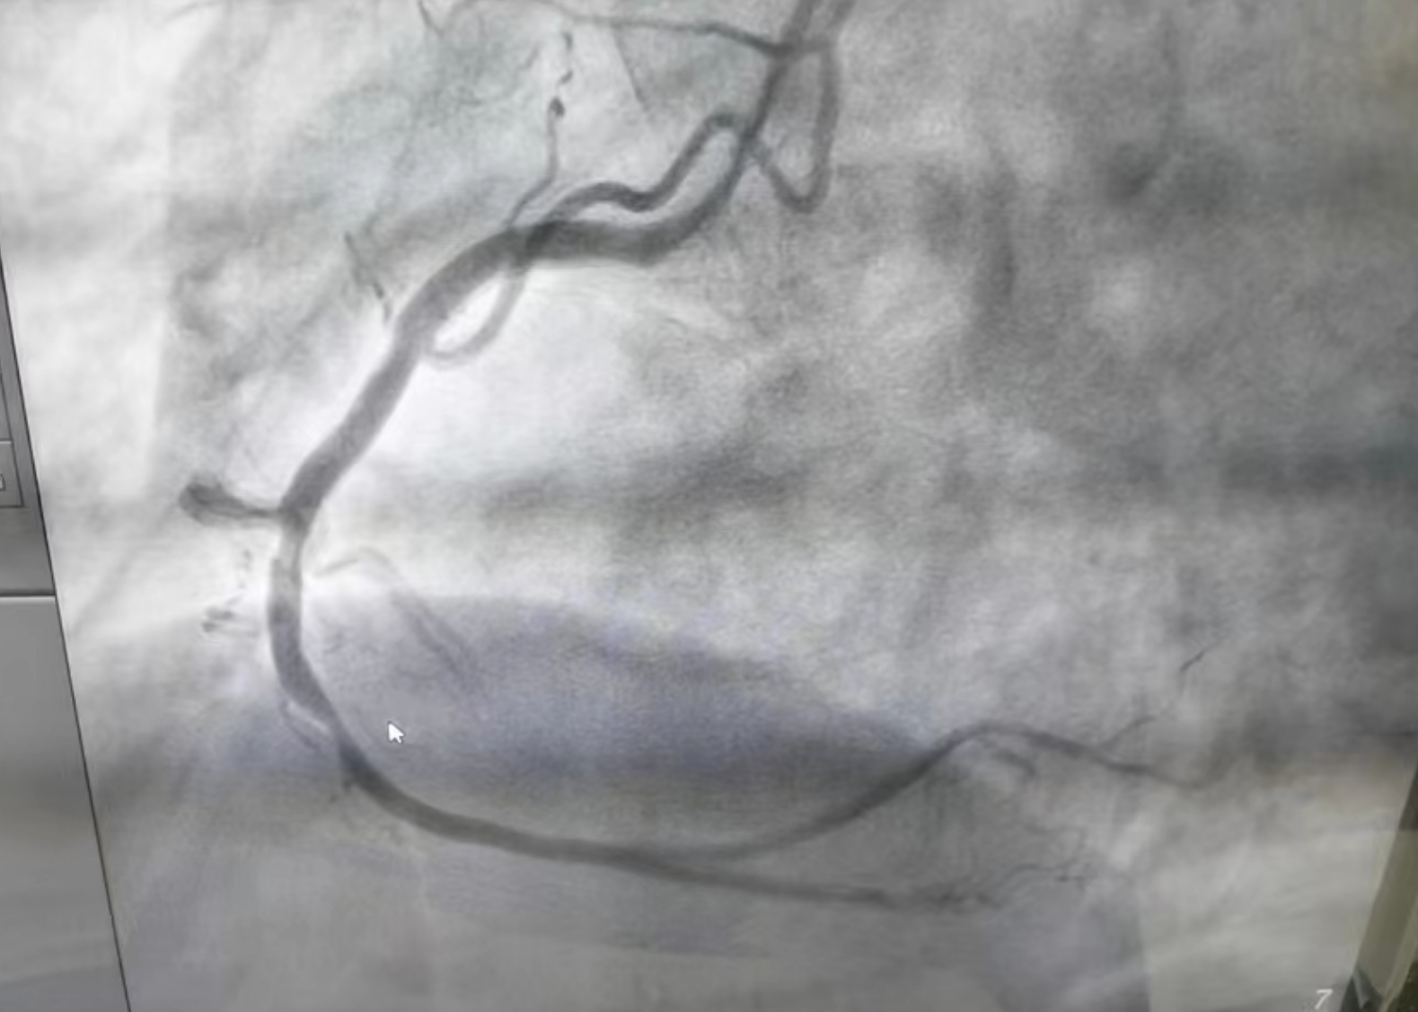
Surgery Two
Surgeon: Chief Cardiovascular Doctor
Guidewire: Inno-Pathwire - 0.6 gf (n=1) and 1.5 gf (n=2）
Patient lesions:
Stenosis of the left anterior descending branch.
Stenosis of the right coronary artery.

Slide 4
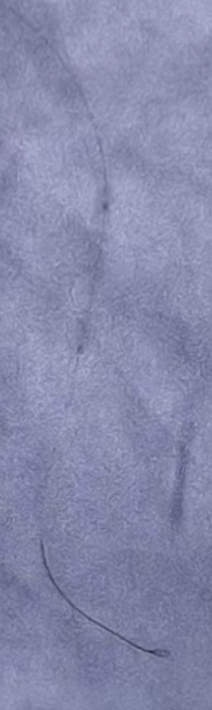
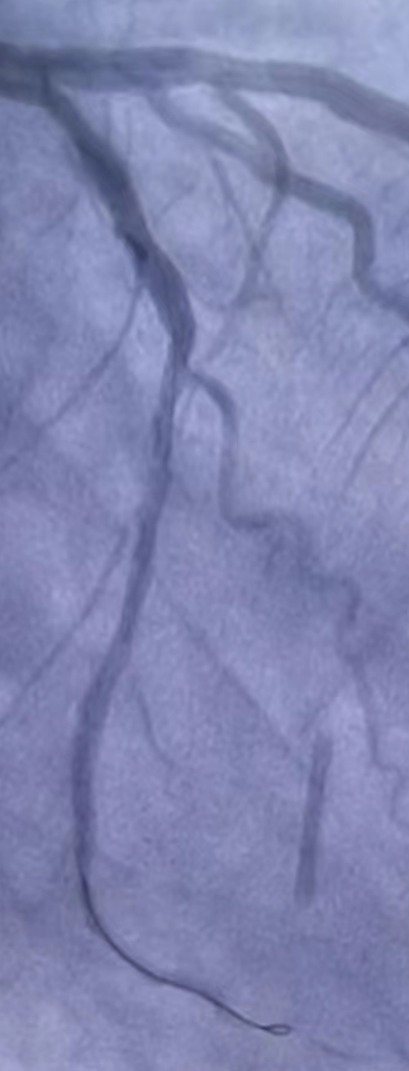
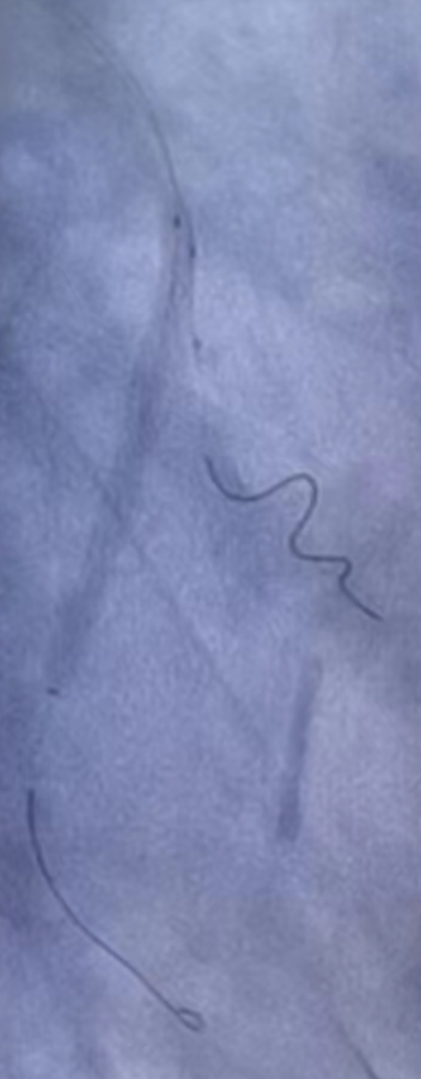
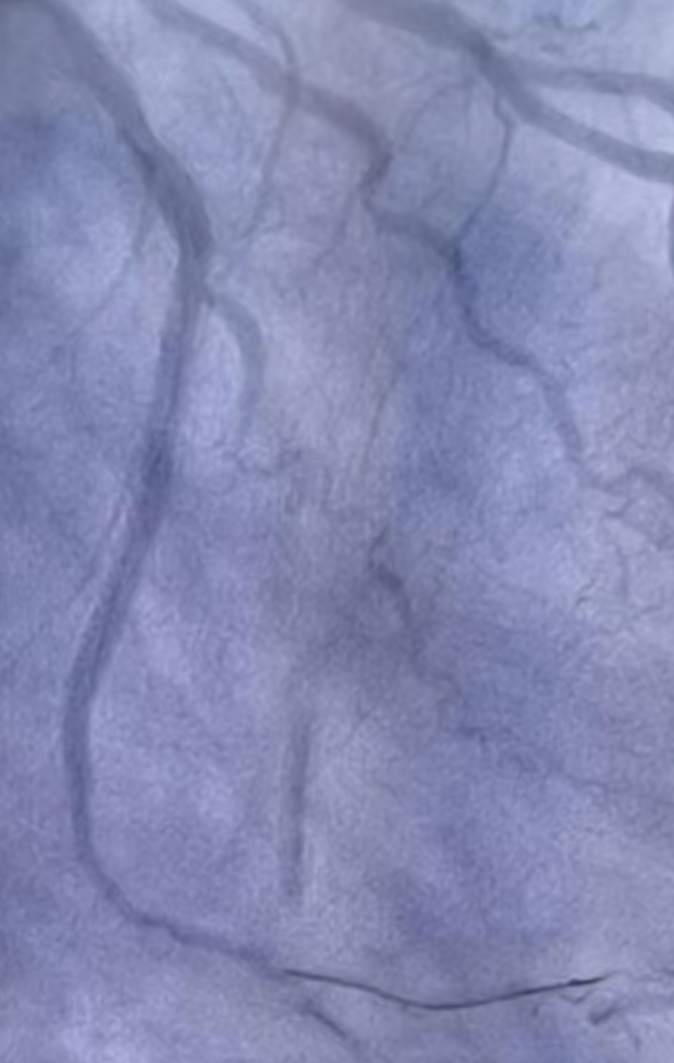
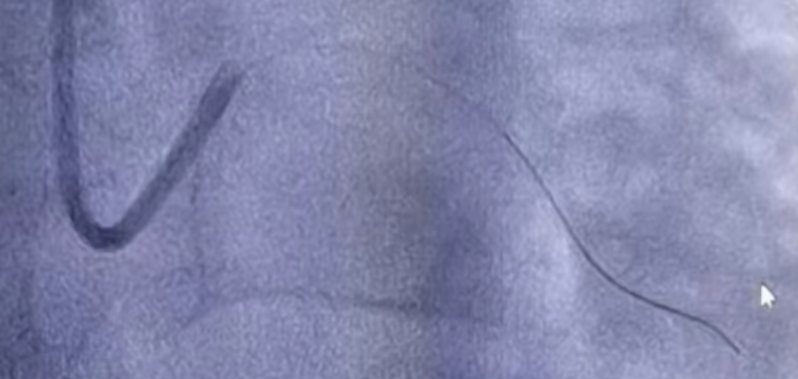
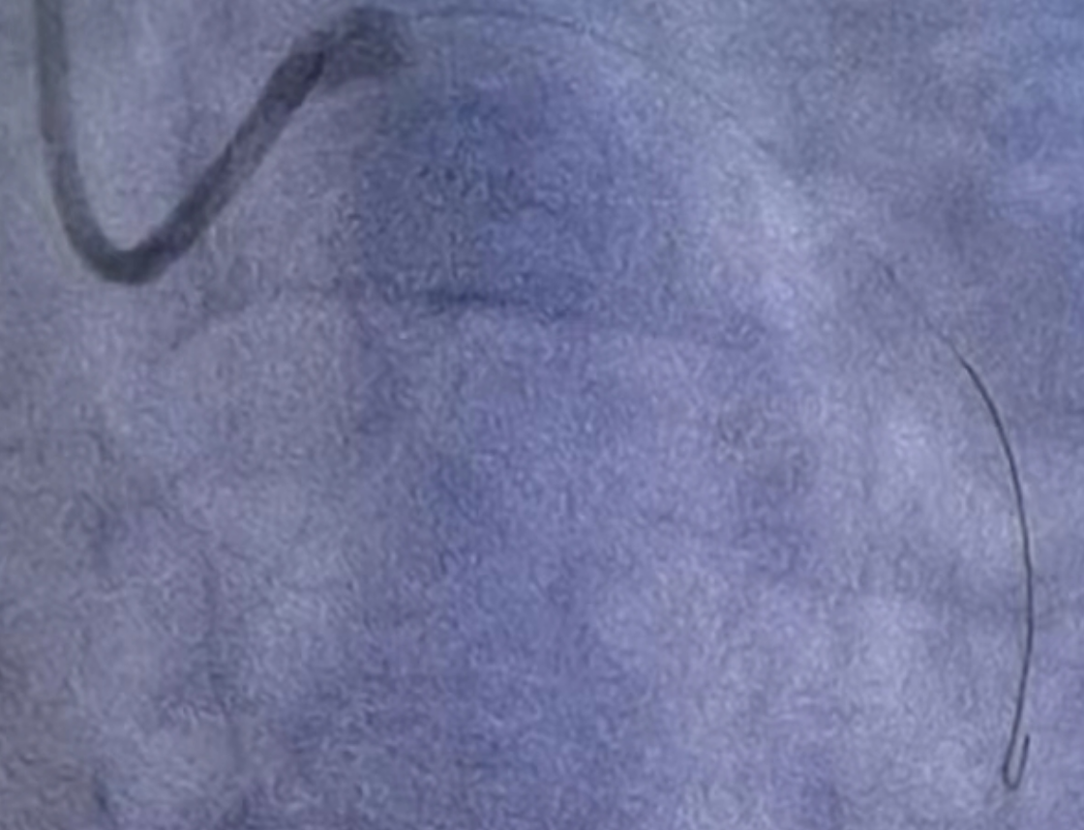
1
a. Stenosis of the left anterior descending branch.
3
Blood vessels used for collateral protection (tortuous)
4
Left coronary angiography, diagnosis of left anterior descending branch stenosis
1.5 gf
2
1.5 gf
0.6 gf
0.6 gf
After successfully reaching the target blood vessel, the stent was released, and the surgery was completed.
0.6 gf
1.5 gf
After the guidewire passes through the lesion, the balloon catheter is dilated. It was judged that a stent needs to be implanted. A guidewire is required for side branch protection.
Guidewire forms a loop at the stenosis

Slide 5
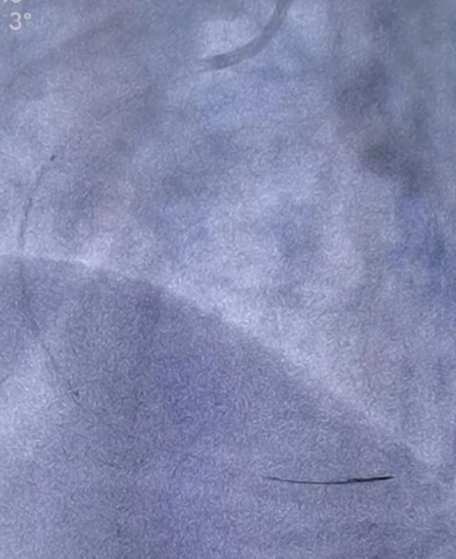
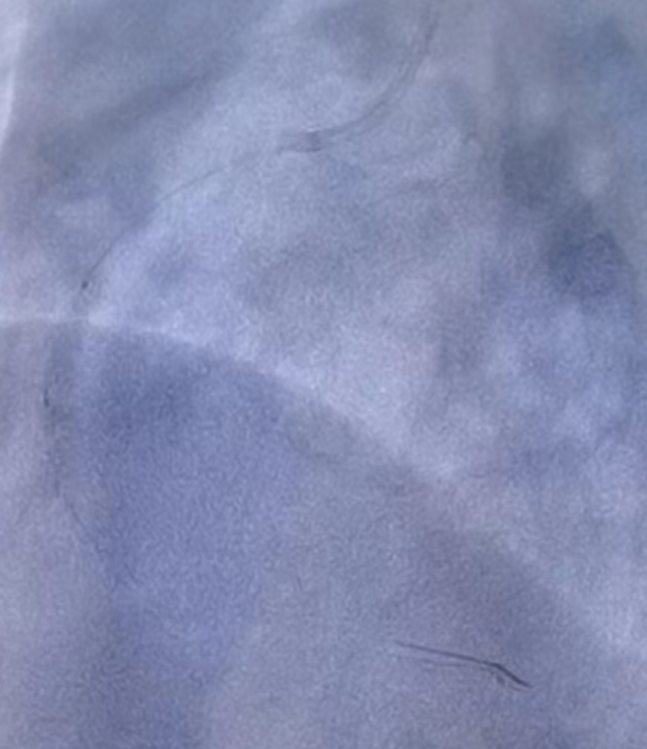
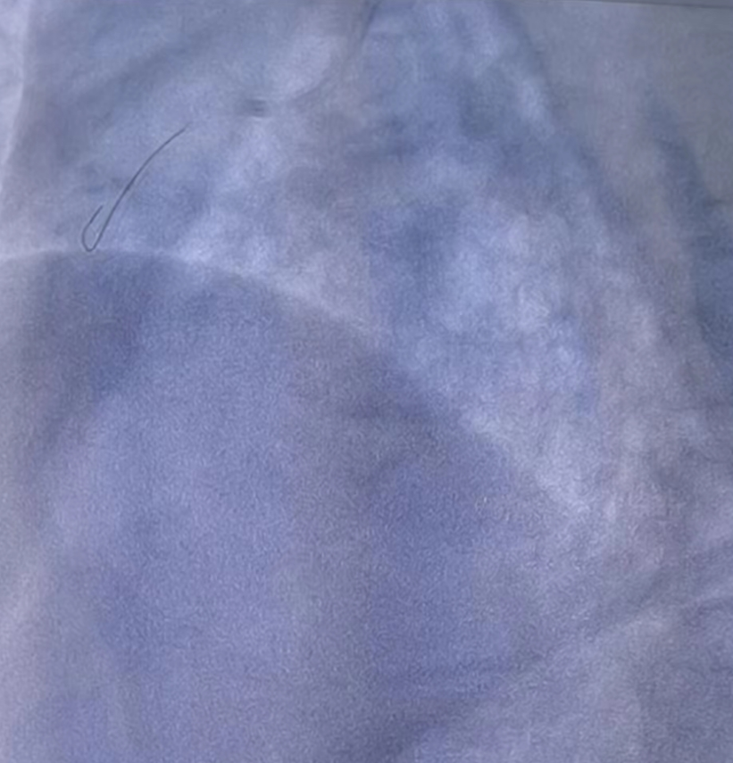
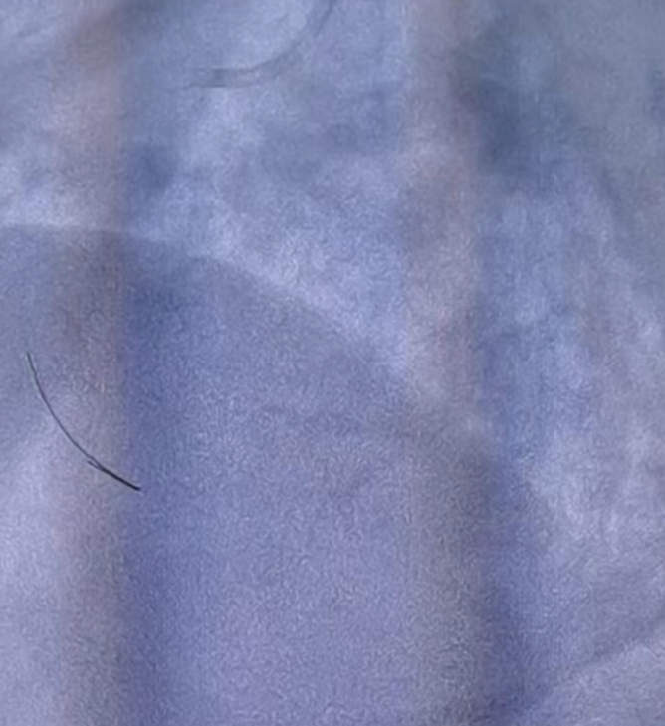
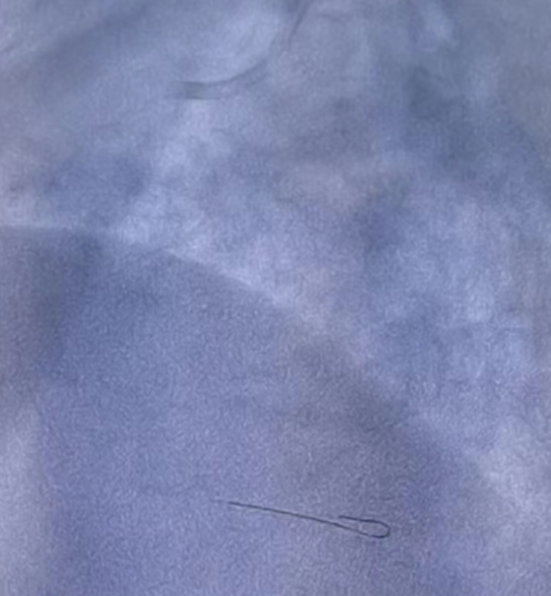
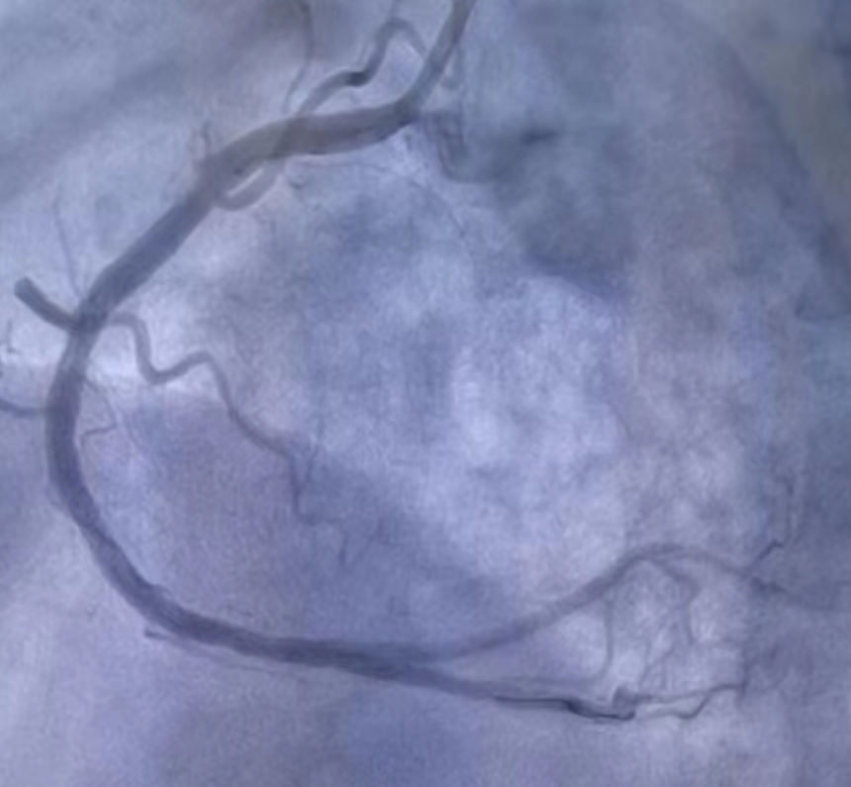
b. Stenosis of the right coronary artery.
2
Right coronary artery with two plaque stenosis
1
Guidewire loops through lesion
Guidewire delivery stent, post-expansion balloon successfully completed the surgery.
3
1.5 gf

Slide 6
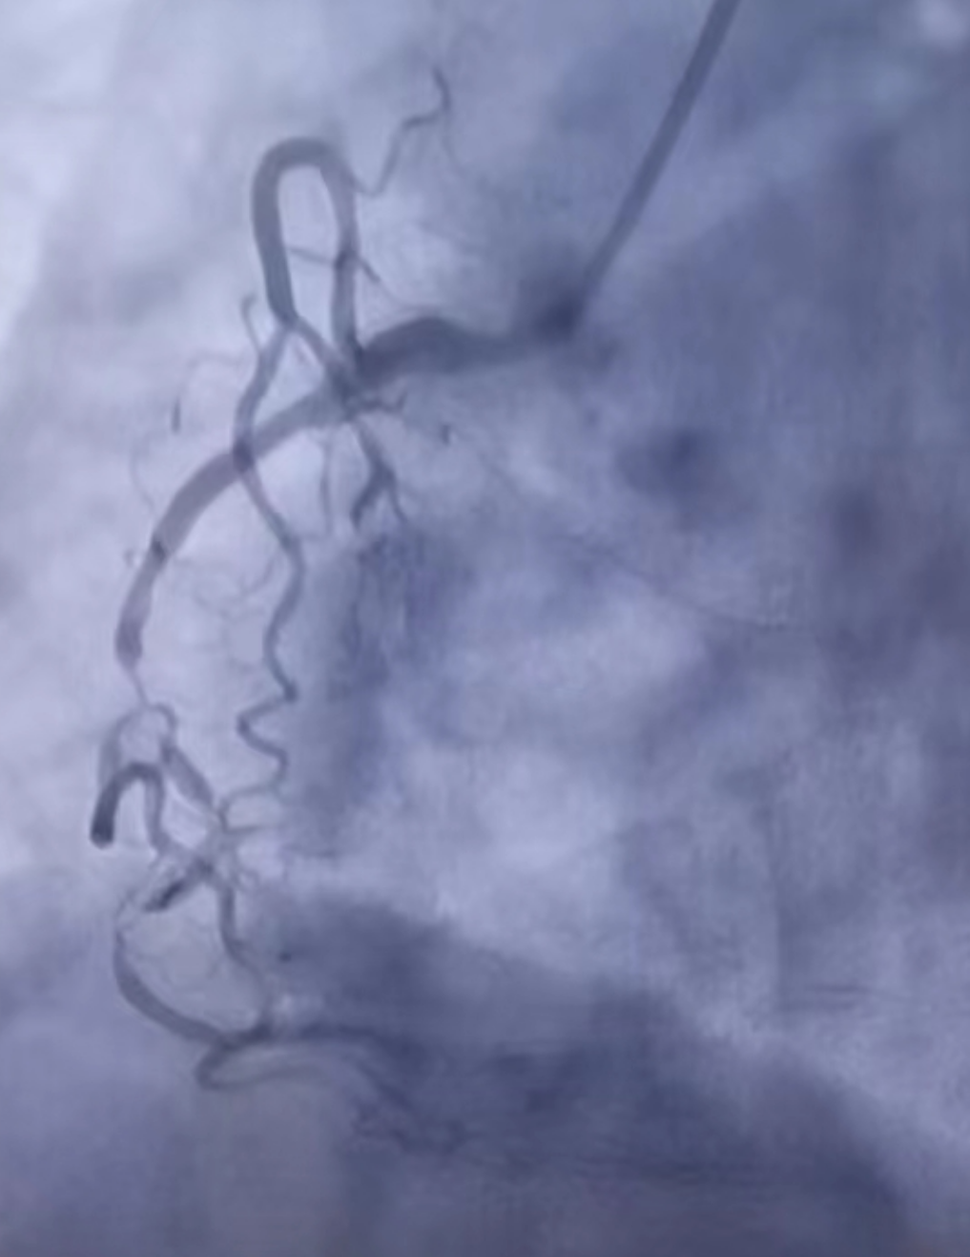
Surgery Three
Surgeon: Chief Cardiovascular Doctor
Guidewires：Inno-Pathwire with 0.8 gf (n=2),
Fielder-XT
Patient lesion: stenosis of the right coronary artery and its branches.

Slide 7
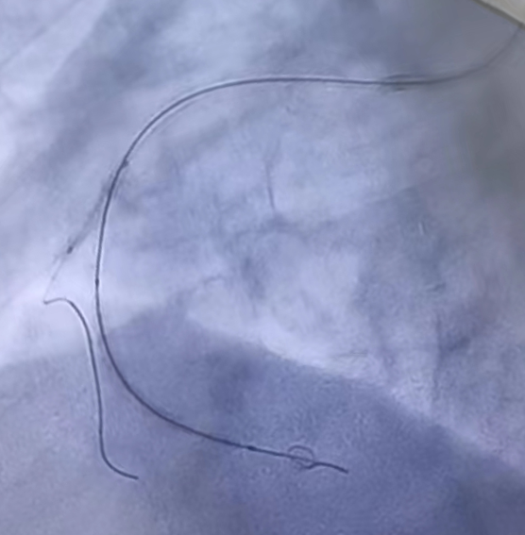
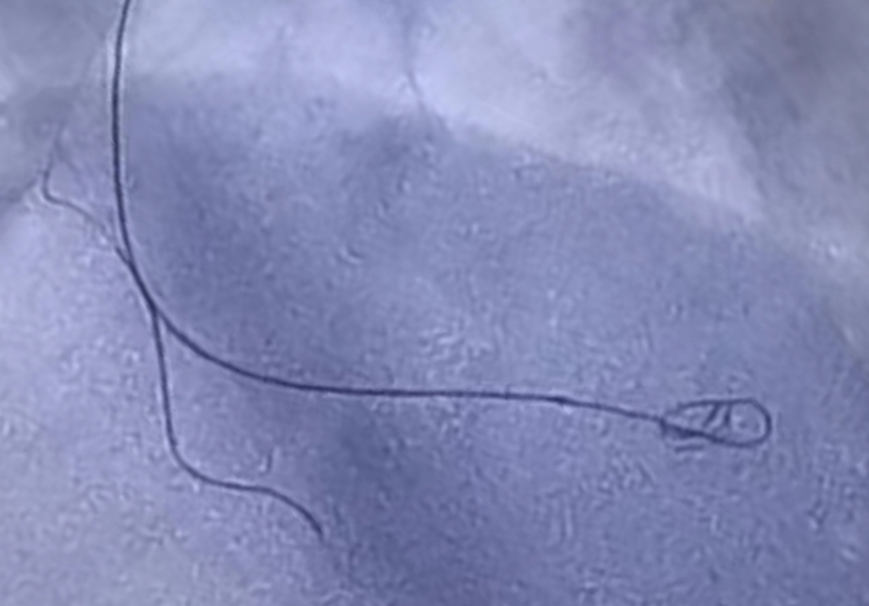
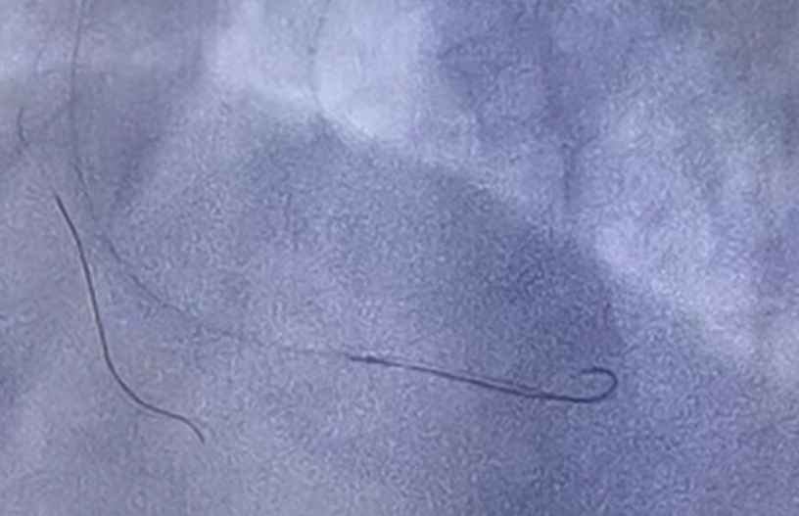
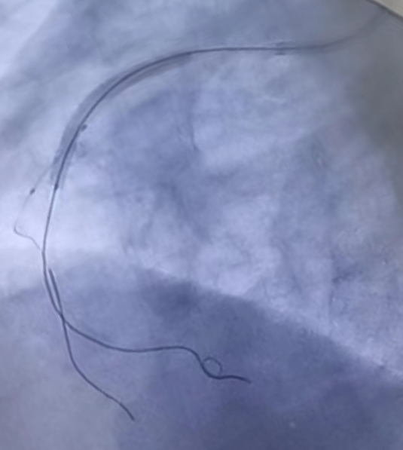
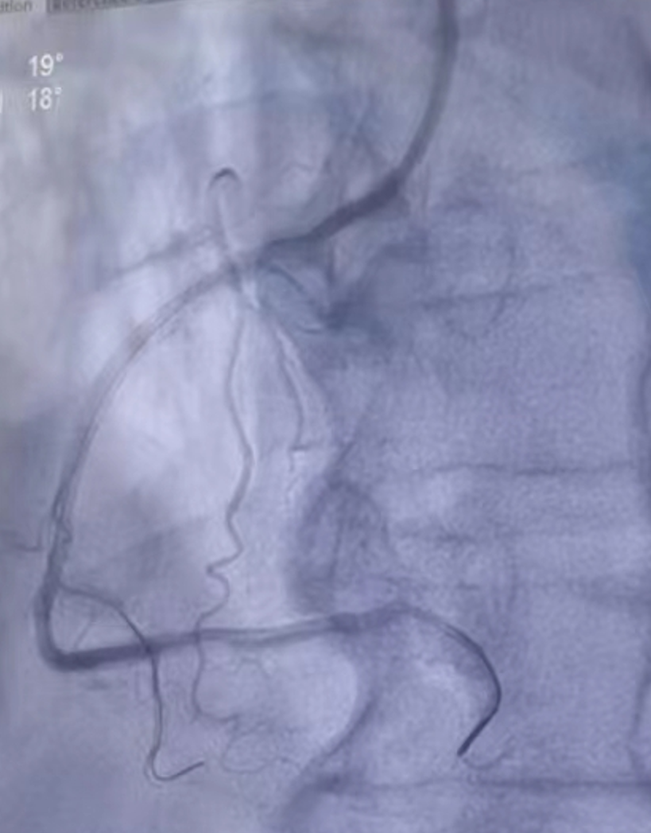
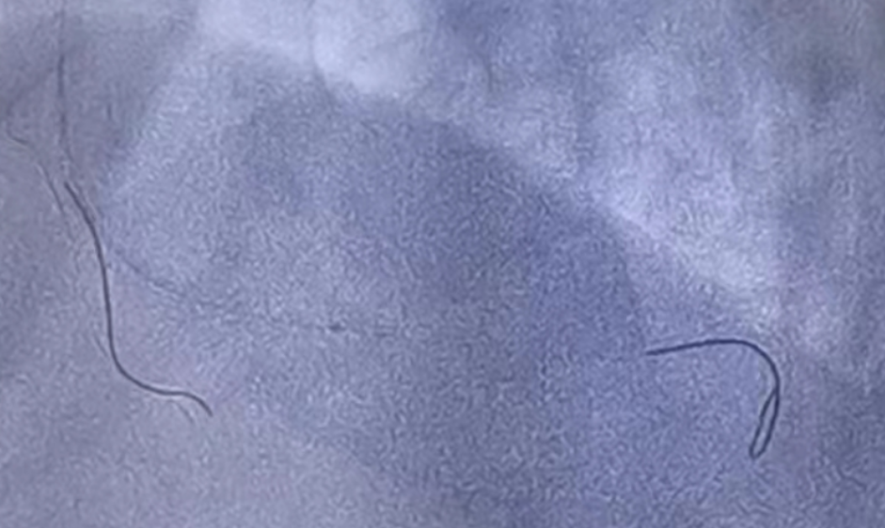
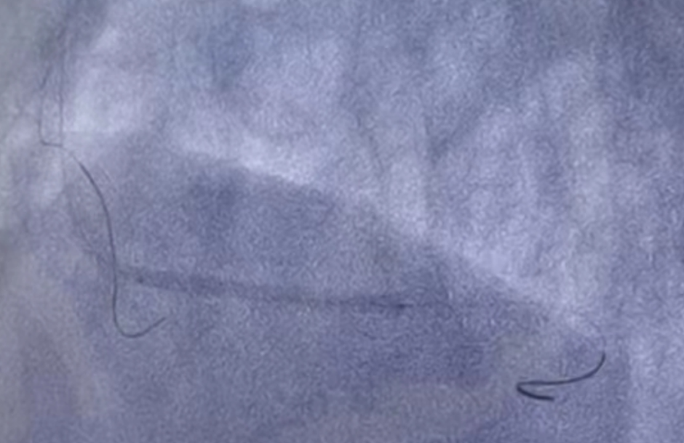
Stenosis of the right coronary artery and its branches
1
3
2
Field-XT guidewire is looped at the end of the vessel, which may damage the vessel.
Pre-expanded balloon
Fielder-XT
Pathwire (0.8 gf)
Fielder-XT
For safety, replace it by a pathwire (0.8 gf)
Pathwire (0.8 gf)
Pathwire(0.8g)
Pre-expanded balloon
Pathwire (0.8 gf)
Pathwire forms a small-sized loop, which is safe and easy to operate.
Pathwire ( 0.8 gf)
Fielder-XT
Pathwire (0.8 gf)
Pathwirev(0.8 gf)
Pathwire can guide and support the stent delivery.
Pre-expansion by using Fielder-XT and Pathwire.
Pathwire ( 0.8 gf)
Pathwire (0.8 gf)
The surgery is successfully completed.

Slide 8
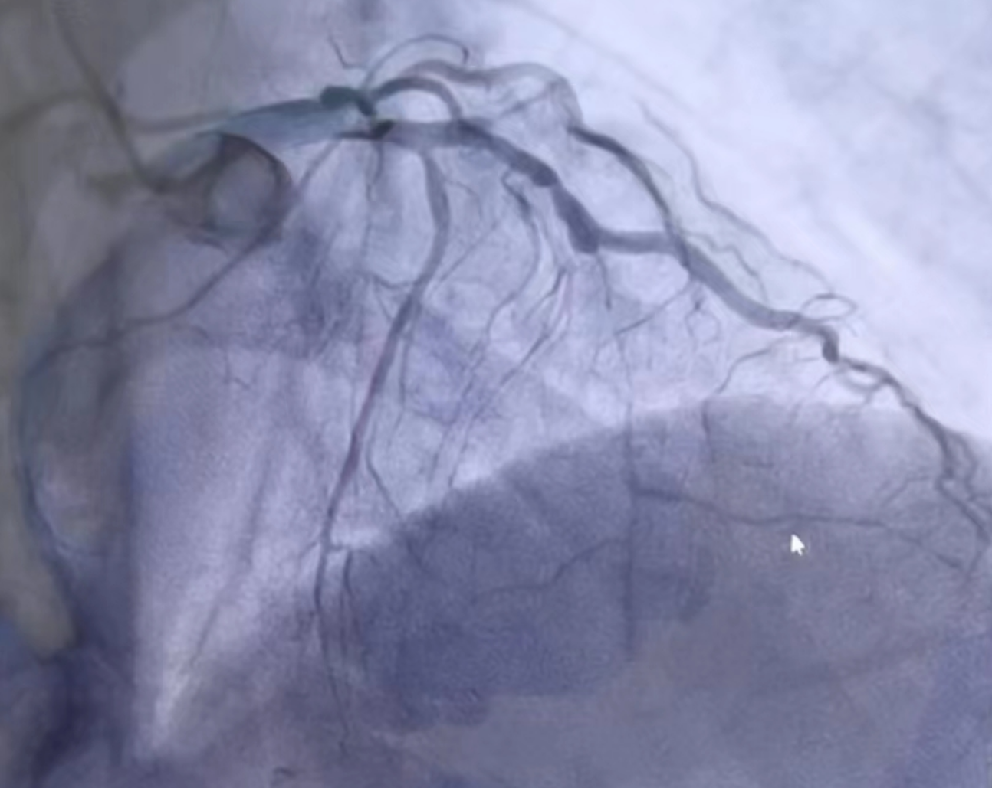
Diagonal branch
stenosis.
Surgery Four
Surgeon: Chief Cardiovascular Doctor
Guidewire: Inno-Pathwire - 0.8 gf n=2), Fielder-XT
Patient’s lesion:
Anterior descending artery stenosis.
Diagonal branch stenosis.
Anterior descending artery stenosis.
c.心房支狭窄

Slide 9
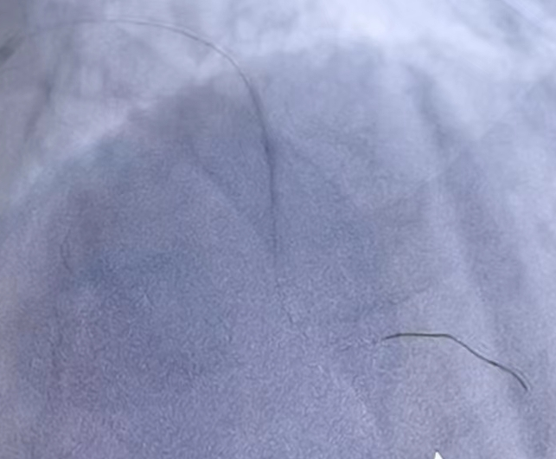
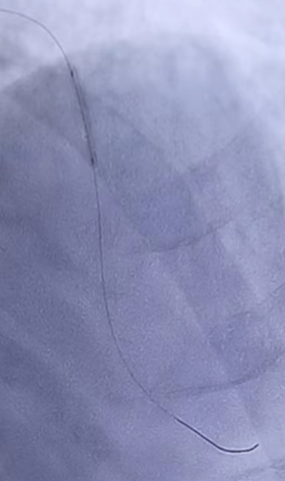
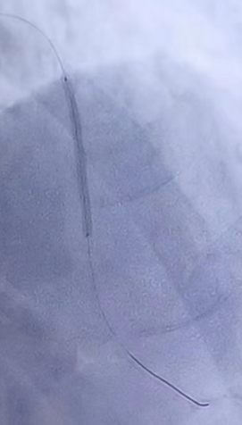
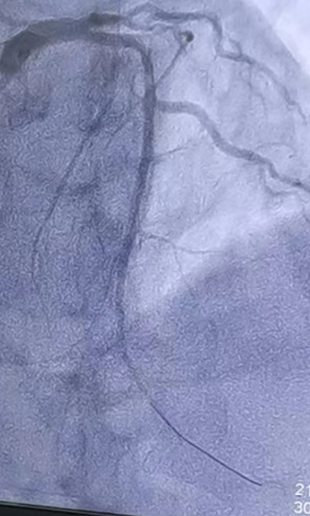
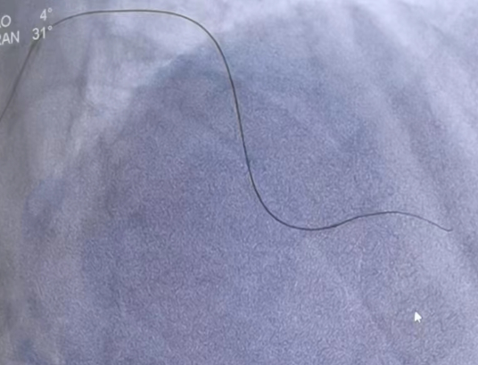
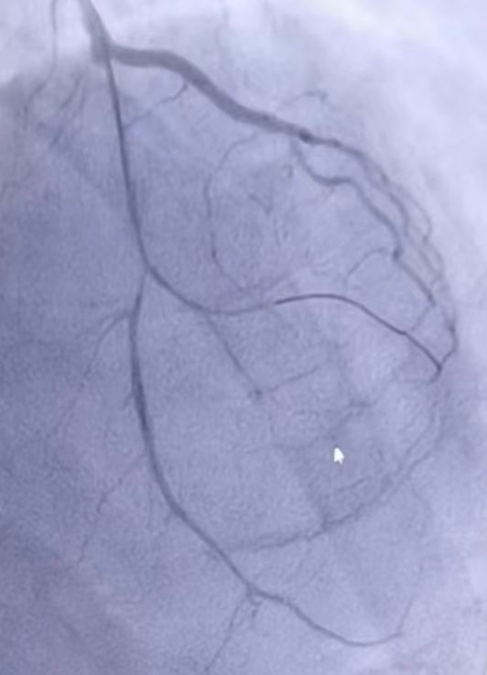
Anterior descending artery stenosis.
1
2
Balloon in narrow section
3
Pre-expanded balloon
stent
Anterior descending artery stenosis
Pathwire( 0.8 gf)
Pathwire guides the pre-expanded balloon and stent to the lesion to complete the treatment.
Microcatheter tip
Use the Fielder-XT guidewire to open the stenosis of the anterior descending artery and guide the microcatheter into the anterior descending branch.
Fix the microcatheter, replace the Pathwire (0.8 gf), and use the balloon to pre-expand and then perform angiography.

Slide 10
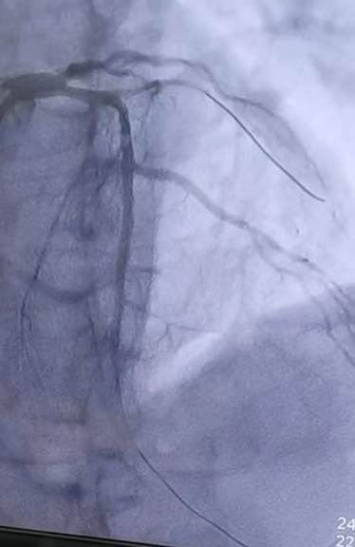
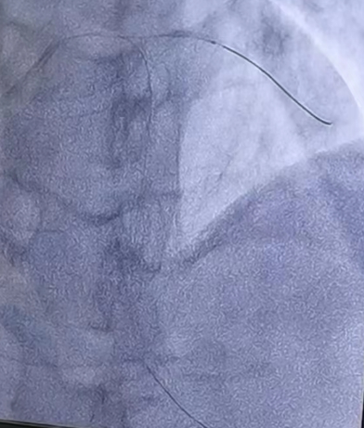
b. Diagonal branch stenosis.
1
3
2
balloon
Pathwire (0.8 gf)
Pathwire (0.8 gf)
Pathwire support balloon for expansion.
Successfully completed the treatment.

Slide 11
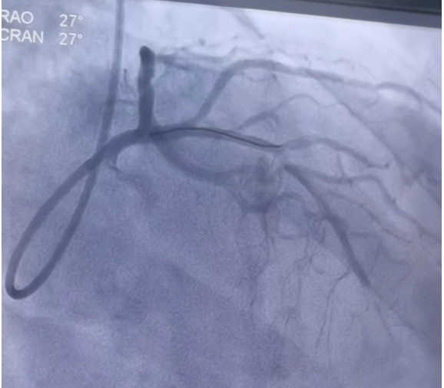
Surgery Five
Surgeon: Leader of cardiovascular surgery doctor, Chief cardiovascular doctor.
Guidewire：Inno-Pathwire - 1.5 gf (n=2)
Patient’s lesion: restenosis at the junction of previously implanted stents in the anterior descending artery.
Use pathwire to make a circular loop, which is difficult to enter the stent. Later, use the same pathwire, make a small angle elbow on the tip, push it while rotating and enter the stent and the occlusion smoothly.
Anterior descending artery stenosis
Previously implanted stent

Slide 12
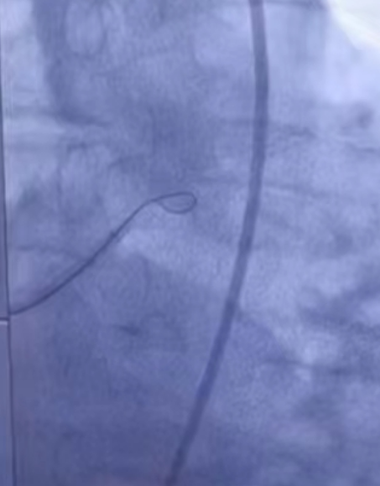
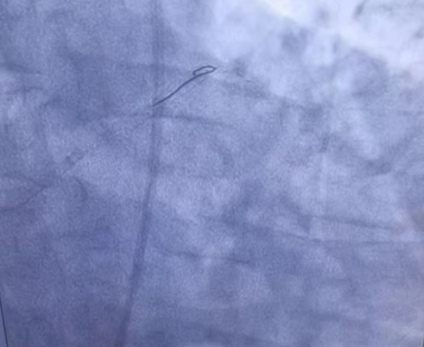
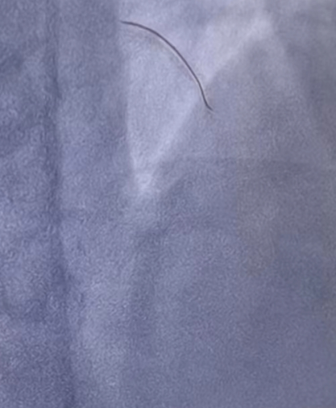
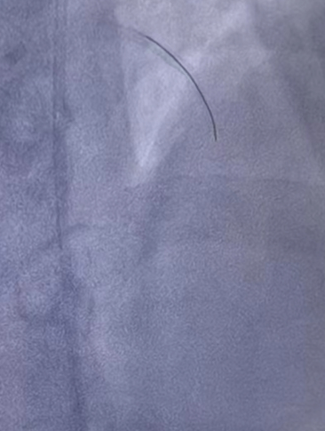
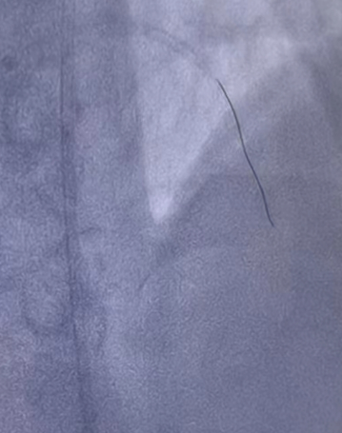
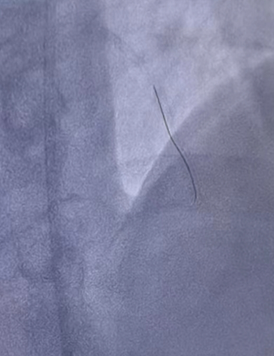
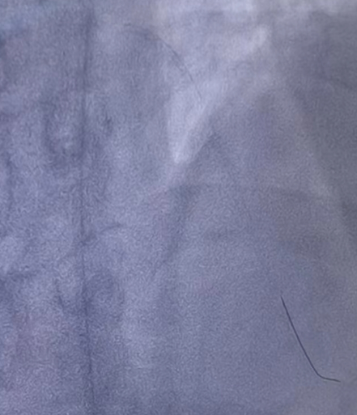
1
2
First, used the UB3 guidewire to form a loop to implement, but the guidewire was too stiff, and the size of the loop was too large to enter the stent.
Later, tried pathwire to make a circular push, after passing through the first stent, the occlusion segment could not be passed.
Pathwire( 1.5 gf)
3
Pathwire (1.5 gf)
Finally, used the same pathwire to make a small angle elbow on the tip, pushed it while rotating, passed the stent and the occlusion smoothly, and successfully completed the treatment.

Slide 13
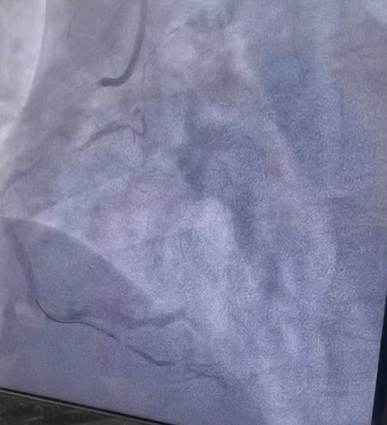
Surgery Six
Surgeon: Chief Cardiovascular Doctor
Guidewire: Inno-Pathwire (0.8 gf)
Patient’s lesion: posterior descending artery occlusion.
The Inno-Pathwire combined with the UB3 guidewire opened the occlusion lesions of the posterior descending artery.
Posterior descending artery occlusion.

Slide 14
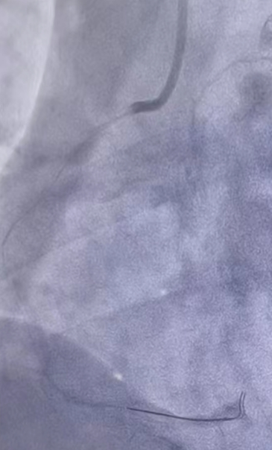
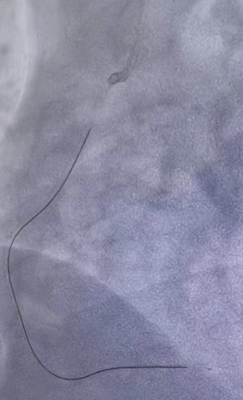
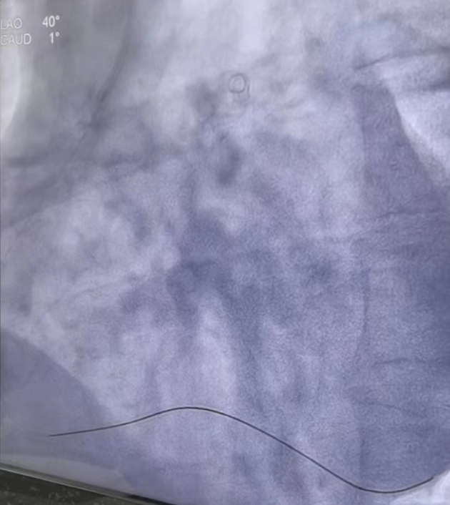
1
2
3
Microcatheter tip
Microcatheter tip
Microcatheter tip
UB3
UB3
Pathwire (0.8 gf)
The Inno-Pathwire guides the microcatheter to the occlusion.
The UB3 guidewire follows the microcatheter to the occlusion.
After the UB3 guidewire reaches the occlusion with the microcatheter, push the microcatheter through the lesion.

Slide 15
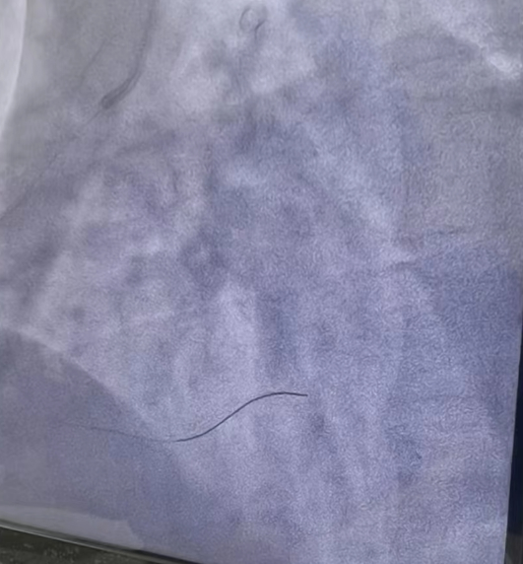
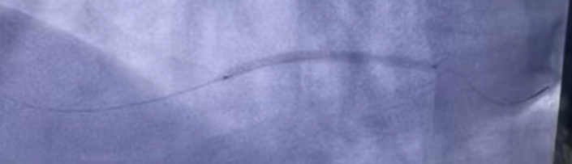

4
5
stent
Pathwire (0.8 gf)
With the guidewire in place, the microcatheter is withdrawn. The stent is delivered along the guidewire, and the occlusion is expanded.
6
Microcatheter tip
Pathwire(0.8g)
The surgery was successfully completed.
The Inno-Pathwire goes through the lesion along with the microcatheter.

Slide 16
Description of the trial samples by Qinghai Provincial People’s Hospital
Total six surgeries were recorded and found one vessel was tortuous, seven vessels were narrowed, and one vessel was occluded. The usage of Inno-Pathwire is listed below:
After the surgeries, the doctor’s evaluation: low tip force, less damage to blood vessels when guiding the devices, good tracking performance and can pass through tortuous blood vessels smoothly. The performance of torqueability was not mentioned, it indicates the torqueability is within the normal acceptable range (need to use a torquer to control the torqueability).
Specification | 0.6 gf | 0.8 gf | 1.5 gf
Quantity | 2pcs | 5pcs | 3pcs

