Slide 1
Company value through the lens of an investment banker/buyer
Anja Bernier, CBA, CVA - Managing Director
Efficient Evolutions LLC

Slide 2
Agenda
Buyer Types
Key Value Drivers
Offering Memorandum
LOI
Due Diligence

Slide 3
Buyer types
Strategic Buyers
  Typically don’t buy companies with less than 750,000 EBITDA
  What exactly are they after?
    Revenue?
    Diversification?
    IP
    Synergies?
Private Equity/Family Offices
  Typically don’t buy companies with less than $1 million EBITDA
  Involvement/Management of company
Individual Buyers
  Can rarely afford to buy the kind of company they are pursuing

Slide 4
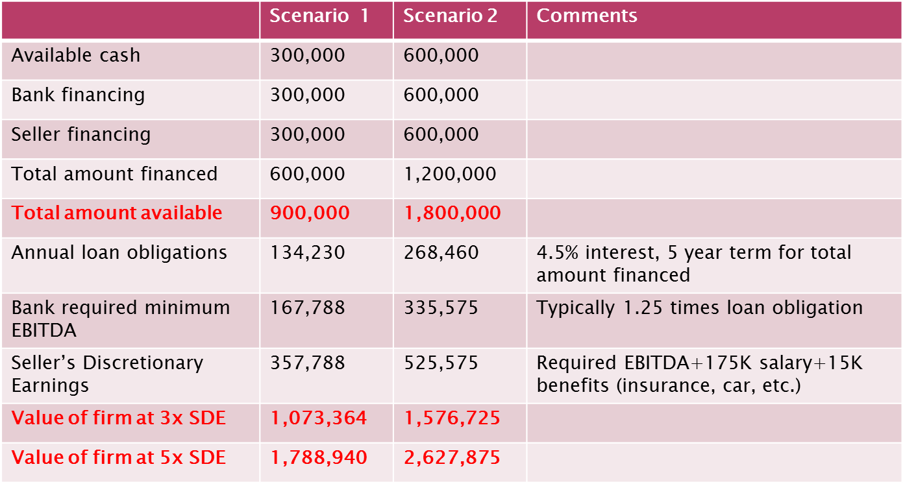
Individual Buyer - Scenarios

Slide 5
Beauty is in the eye of the beholder
Every acquirer has different views and priorities
  What is a deal breaker for one, can be insignificant to another
It can make sense to have several versions of an Offering Memorandum
Talking to just one potential acquirer essentially guarantees a lower sale price
  Why pay more, if you know you have no competition?!

Slide 6
Key Value Drivers
Customer Diversification
Recurring Revenue Streams
Being a big fish in a small pond
Know-how is spread across people
Positive profit (margin) trend
Getting organized/literally cleaning house

Slide 7
Customer Diversification
No customer should account for > 10% of revenues
Top 3 customers combined should be <20% of revenues
Tie large customers to company
  Incentives
  Barriers
Diversify across industries and geographies

Slide 8
Customer Diversification - Examples
Printing company: free plates for multi-year contracts
Inventory Management System
Airline Industry and 9/11
The Great Recession

Slide 9
Recurring Revenue Streams
Multi-Year Contracts
Auto-Renewals
Sunk money subscriptions/consumables
Service contracts
Check for Assignment Clauses!

Slide 10
Recurring Revenue Streams - Examples
Multi-Year Contracts: Comcast
Auto-Renewals: Most online subscriptions (www.dividends.com)
Sunk money subscriptions/consumables: Gillette & razors, HP & ink, security monitoring, cloud storage
Service contracts: optical instruments

Slide 11
Being a big fish in a small pond
Be a known and substantial entity within a defined market
  Strategic acquirers go after known experts first
  Better to be #1 in a small market segment than #10 in a large one (ozone measuring company)
  Have defined expertise and diversify/broaden customer and revenue base across industries
Proprietary know-how and connections (Mueller: patents & Pepsi)

Slide 12
Spread Know-How
Key asset of the company should NOT be the business owner
  Litmus test: will the company skip a significant beat if the owner would get hit by a bus tomorrow?
  Buyers are concerned about cooperation of seller during transition period
Know-how, vendor and customer relationships need to be spread across multiple people (the more the better)
  Golden Handcuffs

Slide 13
Positive Profit Margin Trend
No matter the reason, a negative profit margin trend will result in a lower sale price
$6 million revenues with $1.2 million profit (20%) is more attractive than $7.5 million revenues with $900K profit (12%)
Reduce discretionary earnings 2-3 years before sale
Profit focused sale incentives programs

Slide 14
Getting Organized/Literally Cleaning House
Nobody wants to buy a mess
Organize/clean-up financials and filing systems
Remove offensive posters/screen savers etc.
DOL postings
Dismiss “problematic” employees
Clean-up / settle law suits

Slide 15
Company Value is all about deal terms
There is NOTHING hypothetical about the buyer and seller
Its an emotional process for both sides, and a lot of decisions are thus not based on logic or facts
Many buyers offer what they can afford
Many sellers ask what they need
Almost all small companies sell in asset based transactions
  All liabilities, and all current assets are typically excluded
Most deals involve financing
= Essentially no company ever sells at Fair Market Value

Slide 16
Offering Memorandum
At least 10-15 pages
Strategic Buyers: facts & figures focus
Individual Buyers: storytelling
Disclose “Issues”
Leaving information out will provide buyer with ammunition to renegotiate terms during due diligence

Slide 17
LOI
Be as detailed as possible
  Financing Structure
  How much at closing?
  Seller financing?
    Terms?
  Earnout?
    Benchmarks
  Transition period

Slide 18
Due Diligence
Makes or breaks the deal
The more information the buyer had before signing the LOI, the less reasons he has to renegotiate
Disclose what you are being asked for but don’t provide additional information
Time is the enemy of every deal
Anticipate potential questions and concerns
Prepare key employees
  Golden Handcuffs

Slide 19
Questions?
Anja Bernier CBA, CVA
Office: 781 806 0880
Email: abernier@efficientevolutions.com

