Slide 1


Daily Prayer for 1st April 2026
St Christopher’s Cathedral and Awali Church, Bahrain
The Diocese of Cyprus and the Gulf

Slide 2
Daily Prayer for 1st April 2026
St Christopher’s Cathedral, Bahrain
“Let all who are Thirsty”
The Diocese of Cyprus and the Gulf

Slide 3
Welcome
Opening Acclamation:
O Lord, open our lips
And our mouth shall proclaim your praise. Amen.
Rejoice in the Lord always: again I say rejoice.
Be known to everyone: for your consideration of others,
The Lord is near: do not be anxious.
But in everything make your requests known to God: in prayer and petition with thanksgiving.
Then the peace of God, which passes all understanding: will keep your hearts and minds through Jesus Christ our Lord.
Glory to the Father, and to the Son, and to the Holy Spirit;
as it was in the beginning is now and shall be forever. Amen.

Slide 4
Opening Prayer
That this evening may be holy, good, and peaceful; let us pray with one heart and mind.
silence is kept
As our evening prayer rises before you, O God,
so may your mercy come down upon us
to cleanse our hearts
and set us free to sing your praise
now and forever.
Amen.

Slide 5
The Psalm – Psalm 6
O Lord, do not rebuke me in your anger
or discipline me in your wrath.
Be gracious to me, O Lord, for I am languishing;
O Lord, heal me, for my bones are shaking with terror.
My soul also is struck with terror,
while you, O Lord—how long?
Turn, O Lord, save my life;
deliver me for the sake of your steadfast love.
For in death there is no remembrance of you;
in Sheol who can give you praise?
I am weary with my moaning;
every night I flood my bed with tears; I drench my couch with my weeping.
My eyes waste away because of grief;
they grow weak because of all my foes.
Depart from me, all you workers of evil,
for the Lord has heard the sound of my weeping.
The Lord has heard my supplication;
the Lord accepts my prayer.
All my enemies shall be ashamed and struck with terror;
they shall turn back and in a moment be put to shame.
Glory to the Father and to the Son and to the Holy Spirit;
as it was in the beginning is now and shall be for ever. Amen.

Slide 6
Magnificat
My soul proclaims the greatness of the Lord, my spirit rejoices in God my Saviour;
he has looked with favour on his lowly servant.
From this day all generations will call me blessed;
the Almighty has done great things for me and holy is his name.
He has mercy on those who fear him,
from generation to generation.
He has shown strength with his arm
and has scattered the proud in their conceit,
Casting down the mighty from their thrones
and lifting up the lowly.
He has filled the hungry with good things
and sent the rich away empty.
He has come to the aid of his servant Israel,
to remember his promise of mercy,
The promise made to our ancestors,
to Abraham and his children for ever.
Glory to the Father and to the Son and to the Holy Spirit;
as it was in the beginning is now and shall be for ever. Amen.

Slide 7
Scripture – Lamentations 1
Zion stretches out her hands, but there is no one to comfort her; the Lord has commanded against Jacob that his neighbors should become his foes; Jerusalem has become a filthy thing among them. The Lord is in the right, for I have rebelled against his word; but hear, all you peoples, and behold my suffering; my young women and young men have gone into captivity. I called to my lovers, but they deceived me; my priests and elders perished in the city while seeking food to revive their lives. Look, O Lord, at how distressed I am; my stomach churns; my heart is wrung within me because I have been very rebellious. In the street the sword bereaves; in the house it is like death. They heard how I was groaning, with no one to comfort me. All my enemies heard of my trouble; they are glad that you have done it. Bring on the day that you have announced, and let them be as I am. Let all their evildoing come before you, and deal with them as you have dealt with me because of all my transgressions; for my groans are many, and my heart is faint.
This is the word of the Lord.
Thanks be to God.

Slide 8
Scripture – 2 Corinthians 1
We do not want you to be ignorant, brothers and sisters, of the affliction we experienced in Asia, for we were so utterly, unbearably crushed that we despaired of life itself. Indeed, we felt that we had received the sentence of death so that we would rely not on ourselves but on God, who raises the dead. He who rescued us from so deadly a peril will continue to rescue us; on him we have set our hope that he will rescue us again, as you also join in helping us by your prayers, so that many may give thanks on our behalf for the blessing granted us through the prayers of many. Indeed, this is our boast, the testimony of our conscience: we have behaved in the world with holiness and godly sincerity, not by earthly wisdom but by the grace of God—and all the more toward you. For we write you nothing other than what you can read and also understand; I hope you will understand until the end— as you have already understood us in part—that on the day of the Lord Jesus we are your boast even as you are our boast. Since I was sure of this, I wanted to come to you first, so that you might have a double favor; I wanted to visit you on my way to Macedonia and to come back to you from Macedonia and have you send me on to Judea. Was I vacillating when I wanted to do this? Do I make my plans according to ordinary human standards, ready to say “Yes, yes” and “No, no” at the same time? As surely as God is faithful, our word to you is not “Yes and No.” For the Son of God, Jesus Christ, whom we proclaimed among you, Silvanus and Timothy and I, was not “Yes and No,” but in him it has always been “Yes.”

Slide 9
Scripture – 2 Corinthians 1
For in him every one of God’s promises is a “Yes.” For this reason it is through him that we say the “Amen,” to the glory of God. But it is God who establishes us with you in Christ and has anointed us, who has put his seal on us and given us his Spirit in our hearts as a down payment.
This is the word of the Lord.
Thanks be to God.

Slide 10

Homily
Mark
Notes:
Prayers of the People

Slide 11
Nunc Dimitis
Now, Lord, you let your servant go in peace
your word has been fulfilled.
My own eyes have seen the salvation
which you have prepared in the sight of every people;
A light to reveal you to the nations
and the glory of your people Israel.
Glory to the Father and to the Son and to the Holy Spirit;
as it was in the beginning is now and shall be for ever. Amen.

Slide 12
Prayers
Lord, have mercy upon us
Christ, have mercy upon us
Lord, have mercy upon us
Show us your mercy, O Lord:
and grant us your salvation.
O Lord, be gracious to our lands:
and mercifully hear us when we call upon you.
Let your priests be clothed with righteousness:
and let your servants shout for joy.
O Lord, make your ways known upon the earth:
let all nations acknowledge your saving power.
Make our hearts clean, O God:
and renew a right spirit within us. Amen.

Slide 13
Prayers
Eternal God, from whom all holy desires, all good counsels, and all just works proceed:
give your servants that peace which the world cannot give
that our hearts may be set to obey your commandments
and that, free from the fear of our enemies,
we may pass our time in rest and quietness;
through the merits of Jesus Christ our Saviour. Amen.
Lighten our darkness, Lord we pray
And in your great mercy,
defend us from all perils and dangers of this night,
For the sake of your Son, our Saviour, Jesus Christ, Amen.

Slide 14
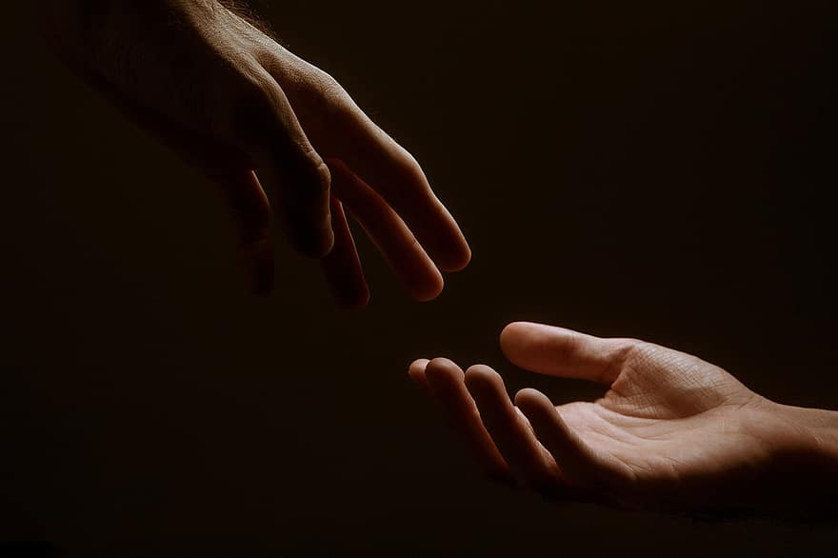
Prayer
Prayers
Let us pray for:
The world in which we live
The people who lead us
The people who need our prayers
The sick and the dying
Our families and loved ones
Lord, in your mercy
Hear our prayer.
Notes:
Prayers of the People

Slide 15
Blessing
Lord’s Prayer:
Our Father,
who art in heaven,
hallowed be thy name;
thy kingdom come;
thy will be done;
on earth as it is in heaven.
Give us this day our daily bread.
And forgive us our trespasses,
as we forgive those who trespass against us.
And lead us not into temptation;
but deliver us from evil.
For thine is the kingdom, the power, and the glory,
for ever and ever. Amen.
The Grace:
The grace of our Lord Jesus Christ, and the love of God, and the fellowship of the Holy Spirit, be with us all for ever more. Amen.

Slide 16
Daily Prayer for 1st April 2026
St Christopher’s Cathedral and Awali Church, Bahrain
“Abide with me”
The Diocese of Cyprus and the Gulf

Slide 17
Daily Prayer for 1st April 2026
St Christopher’s Cathedral and Awali Church, Bahrain
The Diocese of Cyprus and the Gulf

