Slide 1

Holy Communion 27th March 2026 St Christopher’s Cathedral and Awali Church, Bahrain
The Diocese of Cyprus and the Gulf

Slide 2
Ride on Ride on in Majesty
The Diocese of Cyprus and the Gulf

Slide 3
Welcome
Opening Acclamation: Grace, mercy and peace from God our Father
and the Lord Jesus Christ be with you. And also with you.
Dear brothers and sisters in Christ, during Lent we have been preparing by works of love and self-sacrifice for the celebration of our Lord’s death and resurrection. Today we come together to begin this solemn celebration in union with the Church throughout the world. Christ enters his own city to complete his work as our Saviour, to suffer, to die, and to rise again. Let us go with him in faith and love, so that, united with him in his sufferings, we may share his risen life.

Slide 4
Welcome
Almighty God,
to whom all hearts are open,
all desires known,
and from whom no secrets are hidden:
cleanse the thoughts of our hearts
by the inspiration of your Holy Spirit,
that we may perfectly love you,
and worthily magnify your holy name;
through Christ our Lord.
Amen.

Slide 5
Prayer
Confession: God shows his love for us
in that, while we were still sinners, Christ died for us.
Let us then show our love for him
by confessing our sins in penitence and faith.
Most merciful God, we confess that we have sinned against you in thought, word and deed, by what we have done and by what we have left undone. We have not loved you with our whole heart. We have not loved our neighbours as ourselves. In your mercy forgive what we have been, help us to amend what we are, and direct what we shall be; through Jesus Christ our Lord. Amen.

Slide 6
Prayer
Absolution: Almighty God have mercy upon you,
forgive you all your sins
through our Lord Jesus Christ,
strengthen you in all goodness,
and by the power of the Holy Spirit
Keep you in eternal life.
Amen.

Slide 7
Prayer
Collect for Palm Sunday: True and humble king,
hailed by the crowd as Messiah:
grant us the faith to know you and love you,
that we may be found beside you
on the way of the cross,
which is the path of glory;
through Jesus Christ your Son our Lord,
who is alive and reigns with you,
in the unity of the Holy Spirit,
one God, now and for ever.
Amen.

Slide 8
Nicene Creed
We believe in one God,
the Father, the Almighty,
maker of heaven and earth,
of all that is,
seen and unseen.
We believe in one Lord, Jesus Christ,
the only Son of God,
eternally begotten of the Father,
God from God, Light from Light,
true God from true God,
begotten, not made,
of one Being with the Father;
through him all things were made.
For us and for our salvation he came down from heaven,
was incarnate from the Holy Spirit and the Virgin Mary
and was made man.

Slide 9
Nicene Creed
For our sake he was crucified under Pontius Pilate;
he suffered death and was buried.
On the third day he rose again
in accordance with the Scriptures;
he ascended into heaven
and is seated at the right hand of the Father.
He will come again in glory to judge the living and the dead,
and his kingdom will have no end.
We believe in the Holy Spirit,
the Lord, the giver of life,
who proceeds from the Father and the Son,
who with the Father and the Son is worshipped and glorified,
who has spoken through the prophets.
We believe in one holy catholic and apostolic Church.
We acknowledge one baptism for the forgiveness of sins.
We look for the resurrection of the dead,
and the life of the world to come.
Amen.

Slide 10
Scripture – Psalm 118
O give thanks to the LORD, for he is good; his steadfast love endures forever!
Let Israel say, "His steadfast love endures forever."
Open to me the gates of righteousness,
that I may enter through them and give thanks to the LORD.
This is the gate of the LORD; the righteous shall enter through it.
I thank you that you have answered me and have become my salvation.
The stone that the builders rejected has become the chief cornerstone.
This is the Lord's doing; it is marvelous in our eyes.
This is the day that the LORD has made; let us rejoice and be glad in it.
Save us, we beseech you, O LORD! O LORD, we beseech you, give us success!
Blessed is the one who comes in the name of the LORD.
We bless you from the house of the LORD.
The LORD is God, and he has given us light.
Bind the festal procession with branches, up to the horns of the altar.
You are my God, and I will give thanks to you; you are my God; I will extol you.
O give thanks to the LORD, for he is good, for his steadfast love endures forever
This is the word of the Lord
Thanks be to God

Slide 11
Majesty
The Diocese of Cyprus and the Gulf

Slide 12
Gospel Acclamation
Praise to you, O Christ, King of eternal glory.
Christ humbled himself and became obedient unto death,
even death on a cross.
Therefore God has highly exalted him
and given him the name that is above every name.
Praise to you, O Christ, King of eternal glory.

Slide 13
Gospel
Hear the Gospel of our Lord Jesus Christ according to Matthew.
Glory to you, O Lord.
When they had come near Jerusalem and had reached Bethphage, at the Mount of Olives, Jesus sent two disciples, saying to them, "Go into the village ahead of you, and immediately you will find a donkey tied and a colt with her; untie them and bring them to me. If anyone says anything to you, just say this, 'The Lord needs them.' And he will send them immediately." This took place to fulfil what had been spoken through the prophet; "Tell the daughter of Zion, Look, your king is coming to you, humble and mounted on a donkey, and on a colt, the foal of a donkey." The disciples went and did as Jesus had directed them; they brought the donkey and the colt and put their cloaks on them, and he sat on them. A very large crowd spread their cloaks on the road, and others cut branches from the trees and spread them on the road. The crowds that went ahead of him and that followed were shouting, "Hosanna to the Son of David! Blessed is the one who comes in the name of the Lord! Hosanna in the highest heaven!" When he entered Jerusalem, the whole city was in turmoil, asking, "Who is this?" The crowds were saying, "This is the prophet Jesus from Nazareth in Galilee."
This is the Gospel of the Lord.
Praise to you, O Christ.

Slide 14

Sermon
Martin
Notes:
Prayers of the People

Slide 15
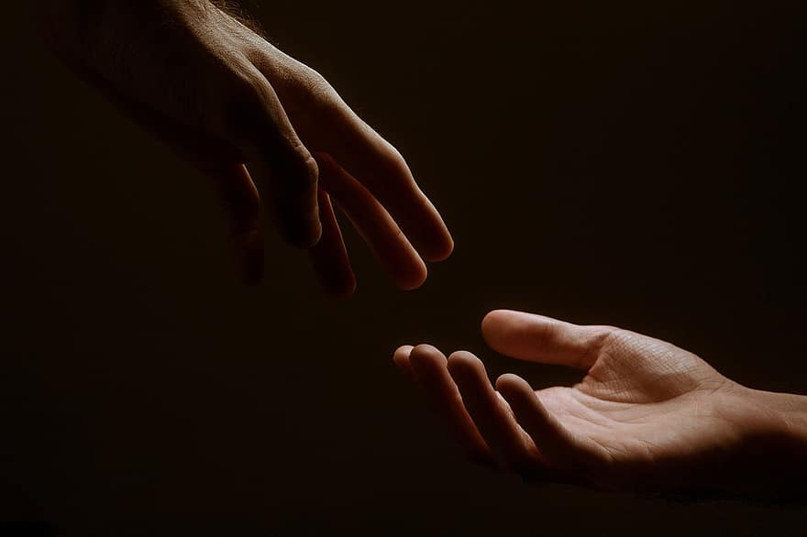
Prayer
Prayers
Let us pray for:
The world in which we live
The people who lead us
The people who need our prayers
The sick and the dying
Our families and loved ones
Lord, in your mercy
Hear our prayer.
Notes:
Prayers of the People

Slide 16
Peace
Jesus Christ is our Peace, he has reconciled us to God in one body by the Cross.
We meet in his name and share his Peace.
The peace of the Lord be always with you - “Shalom”
And also with you - “Shalom”

Slide 17
My Song is Love Unknown
The Diocese of Cyprus and the Gulf

Slide 18
Eucharist
Jesus, true vine and bread of life,
ever giving yourself that the world might live,
let us share your death and passion:
make us perfect in your love.
Amen.
The Lord is here
His Spirit is with us.
Lift up your hearts.
We lift them to the Lord.
Let us give thanks to the Lord our God.
It is right to give thanks and praise.

Slide 19
Eucharist
It is indeed right and just,
our duty and our salvation,
always and everywhere to give you thanks,
holy Father, almighty and eternal God,
through Jesus Christ our Lord.
For as the time of his passion
and resurrection draws near
the whole world is called
to acknowledge his hidden majesty.
The power of the life-giving cross
reveals the judgement that has come upon the world
and the triumph of Christ crucified.
He is the victim who dies no more,
the Lamb once slain, who lives for ever,
our advocate in heaven to plead our cause,
exalting us there to join with angels and archangels,
for ever praising you and saying:
Holy, Holy, Holy Lord
God of Power and Might.
Heaven and Earth
are full of your Glory
Hosannah in the highest.
Blessed is the one
who comes in the name of the Lord.
Hosannah in the highest.

Slide 20
Eucharist
Father, as we bring this bread and wine,
and remember his death and resurrection,
send your Holy Spirit,
that we who share these gifts
may be fed by Christ’s body and his blood.
Pour your Spirit on us
that we may love one another,
work for the healing of the earth,
and share the good news of Jesus,
as we wait for his coming in glory.
For honour and praise belong to you, Father,
with Jesus your Son, and the Holy Spirit:
one God, for ever and ever.
Amen
Father, on the night before he died,
Jesus shared a meal with his friends.
He took the bread, and thanked you.
He broke it, and gave it to them, saying:
Take and eat; this is my body, given for you.
Do this to remember me.
After the meal, Jesus took the cup of wine.
He thanked you, and gave it to them, saying:
Drink this, all of you.
This is my blood,
the new promise of God’s unfailing love.
Do this to remember me.
Great is the mystery of faith:
Christ has died.
Christ is risen.
Christ will come again.

Slide 21
Eucharist
Our Father,
who art in heaven,
hallowed be thy name;
thy kingdom come;
thy will be done;
on earth as it is in heaven.
Give us this day our daily bread.
And forgive us our trespasses,
as we forgive those who trespass against us.
And lead us not into temptation;
but deliver us from evil.
For thine is the kingdom,
the power, and the glory,
for ever and ever.
Amen.
Every time we eat this bread
and drink this cup,
we proclaim the Lord’s death
until he comes.
Jesus, Lamb of God, have mercy on us.
Jesus, bearer of our sins, have mercy on us.
Jesus, redeemer of the world,
grant us your peace.
Draw near with faith.
Receive the body of our Lord Jesus Christ
which he gave for you,
and his blood which he shed for you.
Eat and drink
in remembrance that he died for you,
and feed on him in your hearts
by faith with thanksgiving.

Slide 22
All Glory Laud and Honour
The Diocese of Cyprus and the Gulf

Slide 23
Prayer
Prayer: Lord Jesus Christ,
you humbled yourself in taking the form of a servant,
and in obedience died on the cross for our salvation:
give us the mind to follow you
and to proclaim you as Lord and King,
to the glory of God the Father.
Faithful God,
may we who share this banquet
glory in the cross of our Lord Jesus Christ,
our salvation, life and hope,
who reigns as Lord now and for ever. Amen.

Slide 24
Blessing
Blessing: May the Father,
who so loved the world that he gave his only Son,
bring you by faith to his eternal life.
Amen.
May Christ,
who accepted the cup of sacrifice
in obedience to the Father’s will,
keep you steadfast as you walk with him the way of his cross.
Amen.
May the Spirit,
who strengthens us to suffer with Christ
that we may share his glory,
set your minds on life and peace.
Amen.
And the blessing of God almighty,
the Father, the Son, and the Holy Spirit,
be among you and remain with you
And all whom you love,
this day and forevermore,
Amen.
Go in peace to Love and Serve the Lord.
In the name of Christ, Amen.

Slide 25
Holy Communion 27th March 2026 St Christopher’s Cathedral and Awali Church, Bahrain
The Diocese of Cyprus and the Gulf

