Slide 1
Welcome to our Service at
The Annex, Riyadh
Holy Communion – 2.00pm Good Friday 3 April, 2026

Slide 2
Welcome
Opening Acclamation: Grace, mercy and peace from God our Father and the Lord Jesus Christ be with you. And also with you.
We give thanks for this penitential journey to the cross.
Lord bless us and save us.
Amen
Almighty God,
to whom all hearts are open,
all desires known,
and from whom no secrets are hidden:
cleanse the thoughts of our hearts
by the inspiration of your Holy Spirit,
that we may perfectly love you,
and worthily magnify your holy name;
through Christ our Lord.
Amen.

Slide 3
There is a Green Hill Far Away
1 There is a green hill far away,
outside a city wall,
where the dear Lord was crucified,
who died to save us all.
2 We may not know, we cannot tell
what pains He had to bear,
but we believe it was for us
He hung and suffered there.
3 He died that we might be forgiv'n,
He died to make us good,
that we might go at last to heav'n,
saved by His precious blood.
4 There was no other good enough
to pay the price of sin;
He only could unlock the gate
of heav'n, and let us in.
5 O dearly, dearly has He loved,
and we must love Him too,
and trust in His redeeming blood,
and try His works to do.

Slide 4
Collect
Almighty Father,
look with mercy on this your family
for which our Lord Jesus Christ was content to be betrayed
and given up into the hands of sinners
and to suffer death upon the cross;
who is alive and glorified with you and the Holy Spirit,
one God, now and for ever.
Amen

Slide 5
The Passion
The Passion of our Lord Jesus Christ according to John.
Jesus went out with his disciples across the Kidron valley to a place where there was a garden, which he and his disciples entered. Now Judas, who betrayed him, also knew the place, because Jesus often met there with his disciples. So Judas brought a detachment of soldiers together with police from the chief priests and the Pharisees, and they came there with lanterns and torches and weapons. Then Jesus, knowing all that was to happen to him, came forward and asked them, ‘For whom are you looking?’ They answered, ‘Jesus of Nazareth.’ Jesus replied, ‘I am he.’ Judas, who betrayed him, was standing with them. When Jesus said to them, ‘I am he’, they stepped back and fell to the ground. Again he asked them, ‘For whom are you looking?’ And they said, ‘Jesus of Nazareth.’ Jesus answered, ‘I told you that I am he. So if you are looking for me, let these men go.’ This was to fulfil the word that he had spoken, ‘I did not lose a single one of those whom you gave me.’ Then Simon Peter, who had a sword, drew it, struck the high priest’s slave, and cut off his right ear. The slave’s name was Malchus. Jesus said to Peter, ‘Put your sword back into its sheath. Am I not to drink the cup that the Father has given me?’

Slide 6
The Passion
So the soldiers, their officer, and the Jewish police arrested Jesus and bound him. First they took him to Annas, who was the father-in-law of Caiaphas, the high priest that year. Caiaphas was the one who had advised the Jews that it was better to have one person die for the people. Simon Peter and another disciple followed Jesus. Since that disciple was known to the high priest, he went with Jesus into the courtyard of the high priest, but Peter was standing outside at the gate. So the other disciple, who was known to the high priest, went out, spoke to the woman who guarded the gate, and brought Peter in. The woman said to Peter, ‘You are not also one of this man’s disciples, are you?’ He said, ‘I am not.’ Now the slaves and the police had made a charcoal fire because it was cold, and they were standing round it and warming themselves. Peter also was standing with them and warming himself. Then the high priest questioned Jesus about his disciples and about his teaching. Jesus answered, ‘I have spoken openly to the world; I have always taught in synagogues and in the temple, where all the Jews come together. I have said nothing in secret. Why do you ask me? Ask those who heard what I said to them; they know what I said.’ When he had said this, one of the police standing nearby struck Jesus on the face, saying, ‘Is that how you answer the high priest?’ Jesus answered, ‘If I have spoken wrongly, testify to the wrong. But if I have spoken rightly, why do you strike me?’ Then Annas sent him bound to Caiaphas the high priest.

Slide 7
The Passion
Now Simon Peter was standing and warming himself. They asked him, ‘You are not also one of his disciples, are you?’ He denied it and said, ‘I am not.’ One of the slaves of the high priest, a relative of the man whose ear Peter had cut off, asked, ‘Did I not see you in the garden with him?’ Again Peter denied it, and at that moment the cock crowed. Then they took Jesus from Caiaphas to Pilate’s headquarters. It was early in the morning. They themselves did not enter the headquarters, so as to avoid ritual defilement and to be able to eat the Passover. So Pilate went out to them and said, ‘What accusation do you bring against this man?’ They answered, ‘If this man were not a criminal, we would not have handed him over to you.’ Pilate said to them, ‘Take him yourselves and judge him according to your law.’ The Jews replied, ‘We are not permitted to put anyone to death.’ (This was to fulfil what Jesus had said when he indicated the kind of death he was to die.) Then Pilate entered the headquarters again, summoned Jesus, and asked him, ‘Are you the King of the Jews?’ Jesus answered, ‘Do you ask this on your own, or did others tell you about me?’ Pilate replied, ‘I am not a Jew, am I? Your own nation and the chief priests have handed you over to me. What have you done?’ Jesus answered, ‘My kingdom is not from this world. If my kingdom were from this world, my followers would be fighting to keep me from being handed over to the Jews. But as it is, my kingdom is not from here.’ Pilate asked him, ‘So you are a king?’

Slide 8
The Passion
Jesus answered, ‘You say that I am a king. For this I was born, and for this I came into the world, to testify to the truth. Everyone who belongs to the truth listens to my voice.’ Pilate asked him, ‘What is truth?’ After he had said this, he went out to the Jews again and told them, ‘I find no case against him. But you have a custom that I release someone for you at the Passover. Do you want me to release for you the King of the Jews?’ They shouted in reply, ‘Not this man, but Barabbas!’ Now Barabbas was a bandit. Then Pilate took Jesus and had him flogged. And the soldiers wove a crown of thorns and put it on his head, and they dressed him in a purple robe. They kept coming up to him, saying, ‘Hail, King of the Jews!’ and striking him on the face. Pilate went out again and said to them, ‘Look, I am bringing him out to you to let you know that I find no case against him.’ So Jesus came out, wearing the crown of thorns and the purple robe. Pilate said to them, ‘Here is the man!’ When the chief priests and the police saw him, they shouted, ‘Crucify him! Crucify him!’ Pilate said to them, ‘Take him yourselves and crucify him; I find no case against him.’ The Jews answered him, ‘We have a law, and according to that law he ought to die because he has claimed to be the Son of God.’ Now when Pilate heard this, he was more afraid than ever. He entered his headquarters again and asked Jesus, ‘Where are you from?’ But Jesus gave him no answer.

Slide 9
The Passion
Pilate therefore said to him, ‘Do you refuse to speak to me? Do you not know that I have power to release you, and power to crucify you?’ Jesus answered him, ‘You would have no power over me unless it had been given you from above; therefore the one who handed me over to you is guilty of a greater sin.’ From then on Pilate tried to release him, but the Jews cried out, ‘If you release this man, you are no friend of the emperor. Everyone who claims to be a king sets himself against the emperor.’ When Pilate heard these words, he brought Jesus outside and sat on the judge’s bench at a place called The Stone Pavement, or in Hebrew Gabbatha. Now it was the day of Preparation for the Passover; and it was about noon. He said to the Jews, ‘Here is your King!’ They cried out, ‘Away with him! Away with him! Crucify him!’ Pilate asked them, ‘Shall I crucify your King?’ The chief priests answered, ‘We have no king but the emperor.’ Then he handed him over to them to be crucified. So they took Jesus; and carrying the cross by himself, he went out to what is called The Place of the Skull, which in Hebrew is called Golgotha. There they crucified him, and with him two others, one on either side, with Jesus between them. Pilate also had an inscription written and put on the cross. It read, ‘Jesus of Nazareth, the King of the Jews.’ Many of the Jews read this inscription, because the place where Jesus was crucified was near the city; and it was written in Hebrew, in Latin, and in Greek.

Slide 10
The Passion
Then the chief priests of the Jews said to Pilate, ‘Do not write, “The King of the Jews”, but, “This man said, I am King of the Jews.” ’ Pilate answered, ‘What I have written I have written.’ When the soldiers had crucified Jesus, they took his clothes and divided them into four parts, one for each soldier. They also took his tunic; now the tunic was seamless, woven in one piece from the top. So they said to one another, ‘Let us not tear it, but cast lots for it to see who will get it.’ This was to fulfil what the scripture says, ‘They divided my clothes among themselves, and for my clothing they cast lots.’ And that is what the soldiers did. Meanwhile, standing near the cross of Jesus were his mother, and his mother’s sister, Mary the wife of Clopas, and Mary Magdalene. When Jesus saw his mother and the disciple whom he loved standing beside her, he said to his mother, ‘Woman, here is your son.’ Then he said to the disciple, ‘Here is your mother.’ And from that hour the disciple took her into his own home. After this, when Jesus knew that all was now finished, he said (in order to fulfil the scripture), ‘I am thirsty.’ A jar full of sour wine was standing there. So they put a sponge full of the wine on a branch of hyssop and held it to his mouth. When Jesus had received the wine, he said, ‘It is finished.’ Then he bowed his head and gave up his spirit.

Slide 11
The Passion
Since it was the day of Preparation, the Jews did not want the bodies left on the cross during the sabbath, especially because that sabbath was a day of great solemnity. So they asked Pilate to have the legs of the crucified men broken and the bodies removed. Then the soldiers came and broke the legs of the first and of the other who had been crucified with him. But when they came to Jesus and saw that he was already dead, they did not break his legs. Instead, one of the soldiers pierced his side with a spear, and at once blood and water came out. (He who saw this has testified so that you also may believe. His testimony is true, and he knows that he tells the truth.) These things occurred so that the scripture might be fulfilled, ‘None of his bones shall be broken.’ And again another passage of scripture says, ‘They will look on the one whom they have pierced.’
This is the Passion of the Lord.

Slide 12
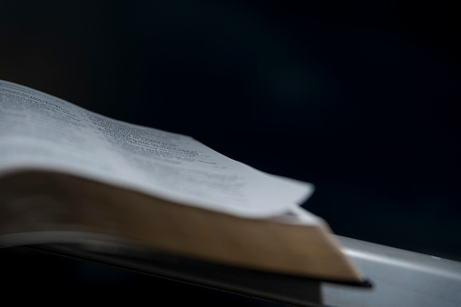
Sermon
+Sean
Notes:
Prayers of the People

Slide 13
The Proclamation of the Cross
The cross of Christ.
The cross on which the Saviour of the world was hung.
This is the wood of the cross, on which hung the Saviour of the world.
Come, let us worship.
Is it nothing to you, all you who pass by?
Look and see if there is any sorrow like my sorrow
which was brought upon me,
which the Lord inflicted on the day of his fierce anger.
Holy God
holy and strong,
holy and immortal,
have mercy upon us.

Slide 14
The Proclamation of the Cross
O my people, O my Church,
what have I done to you,
or in what have I offended you?
Testify against me.
I led you forth from the land of Egypt,
and delivered you by the waters of baptism,
but you have prepared a cross for your Saviour.
Holy God holy and strong,
holy and immortal,
have mercy upon us.
I led you through the desert forty years,
and fed you with manna.
I brought you through tribulation and penitence,
and gave you my body, the bread of heaven,
but you prepared a cross for your Saviour.

Slide 15
The Proclamation of the Cross
Holy God holy and strong,
holy and immortal,
have mercy upon us.
What more could I have done for you
that I have not done?
I planted you, my chosen and fairest vineyard,
I made you the branches of my vine;
but when I was thirsty, you gave me vinegar to drink,
and pierced with a spear the side of your Saviour.
Holy God holy and strong,
holy and immortal,
have mercy upon us.
I went before you in a pillar of cloud,
and you have led me to the judgement hall of Pilate.
I scourged your enemies and brought you
to a land of freedom,
but you have scourged, mocked and beaten me.
I gave you the water of salvation from the rock,
but you have given me gall and left me to thirst.

Slide 16
The Proclamation of the Cross
Holy God holy and strong,
holy and immortal,
have mercy upon us.
I gave you a royal sceptre,
and bestowed the keys of the kingdom,
but you have given me a crown of thorns.
I raised you on high with great power,
but you have hanged me on the cross.
Holy God holy and strong,
holy and immortal,
have mercy upon us.
My peace I gave, which the world cannot give,
and washed your feet as a sign of my love,
but you draw the sword to strike in my name,
and seek high places in my kingdom.
I offered you my body and blood,
but you scatter and deny and abandon me.

Slide 17
The Proclamation of the Cross
Holy God holy and strong,
holy and immortal,
have mercy upon us.
I sent the Spirit of truth to guide you,
and you close your hearts to the Counsellor.
I pray that all may be one in the Father and me,
but you continue to quarrel and divide.
I call you to go and bring forth fruit,
but you cast lots for my clothing.
Holy God holy and strong,
holy and immortal,
have mercy upon us.
I came to you as the least of your brothers and sisters;
I was hungry and you gave me no food,
I was thirsty and you gave me no drink,
I was a stranger and you did not welcome me,
naked and you did not clothe me,
sick and in prison and you did not visit me.

Slide 18
The Acclamation of the Cross
We adore you, O Christ, and we bless you,
because by your holy cross you have redeemed the world.
This is the wood of the cross,
on which hung the Saviour of the world.
Come, let us worship.
O Saviour of the world,
who by your cross and precious blood have redeemed us,
save us and help us, we humbly pray.

Slide 19
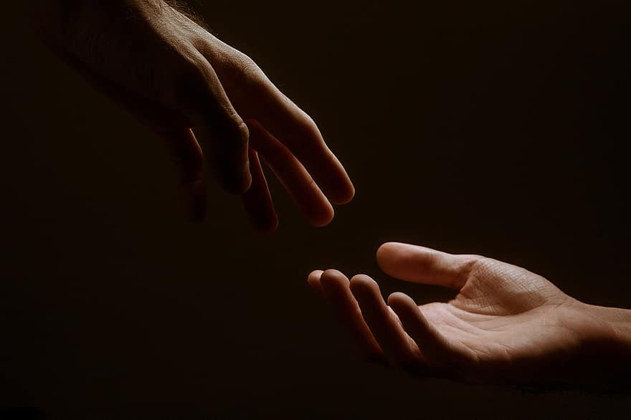
Prayers
Prayers
Let us pray for:
The world in which we live
The people who lead us
The people who need our prayers
The sick and the dying
Our families and loved ones
Lord, in your mercy
Hear our prayer.
Notes:
Prayers of the People

Slide 20
Peace
Jesus Christ is our Peace, he has reconciled us to God in one body by the Cross.
We meet in his name and share his Peace.
The peace of the Lord be always with you - “Shalom”
And also with you - “Shalom”

Slide 21
My God is Love Unknown
1 My song is love unknown–
my Savior’s love to me;
love to the loveless shown,
that they might lovely be.
Oh, who am I, that for my sake
my Lord should take frail flesh and die?
2 He came from His blest throne
salvation to bestow;
but men made strange, and none
the longed for Christ would know.
But oh, my Friend, my Friend indeed,
who at my need His life did spend!
3 Sometimes they strew His way,
and His sweet praises sing;
resounding all the day
hosannas to their King.
Then “Crucify!” is all their breath,
and for His death they thirst and cry.
4 Why, what hath my Lord done?
What makes this rage and spite?
He made the lame to run;
He gave the blind their sight.
Sweet injuries! Yet they at these
themselves displease,
and 'gainst Him rise.
5 They rise, and needs will have
my dear Lord made away.
A murderer they save;
the Prince of Life they slay.
Yet cheerful He to suff'ring goes,
that He His foes from thence might free.
6 In life, no house, no home
my Lord on earth might have;
in death, no friendly tomb
but what a stranger gave.
What may I say? Heav'n was His home;
but mine the tomb wherein He lay.
7 Here might I stay and sing–
no story so divine!
Never was love, dear King,
never was grief like Thine.
This is my Friend, in whose sweet praise
I all my days could gladly spend.

Slide 22
Eucharist
The Lord is here
His Spirit is with us.
Lift up your hearts.
We lift them to the Lord.
Let us give thanks to the Lord our God.
It is right to give thanks and praise.
It is indeed right to give you thanks,
God our Creator,
loving and faithful,
holy and strong.
You made us
and the whole universe,
and filled your world with life.
You sent your Son to live among us,
Jesus our Saviour, Mary’s child.
He suffered on the cross;
he died to save us from our sins;
he rose in glory from the dead.
You send your Spirit
to bring new life to the world,
and clothe us with power from on high.
And so we join angels and archangels
And all the company of heaven
to celebrate and praise your holy name saying:
Holy, Holy, Holy Lord
God of Power and Might.
Heaven and Earth are full of your Glory
Hosannah in the highest.
Blessed is the one who comes in the name of the Lord
Hosannah in the highest.

Slide 23
Eucharist
Father, as we bring this bread and wine,
and remember his death and resurrection,
send your Holy Spirit,
that we who share these gifts
may be fed by Christ’s body and his blood.
Pour your Spirit on us
that we may love one another,
work for the healing of the earth,
and share the good news of Jesus,
as we wait for his coming in glory.
For honour and praise belong to you, Father,
with Jesus your Son, and the Holy Spirit:
one God, for ever and ever.
Amen
Father, on the night before he died,
Jesus shared a meal with his friends.
He took the bread, and thanked you.
He broke it, and gave it to them, saying:
Take and eat; this is my body, given for you.
Do this to remember me.
After the meal, Jesus took the cup of wine.
He thanked you, and gave it to them, saying:
Drink this, all of you.
This is my blood,
the new promise of God’s unfailing love.
Do this to remember me.
Great is the mystery of faith:
Christ has died.
Christ is risen.
Christ will come again.

Slide 24
Eucharist
Our Father,
who art in heaven,
hallowed be thy name;
thy kingdom come;
thy will be done;
on earth as it is in heaven.
Give us this day our daily bread.
And forgive us our trespasses,
as we forgive those who trespass against us.
And lead us not into temptation;
but deliver us from evil.
For thine is the kingdom,
the power, and the glory,
for ever and ever. Amen.
Draw near with faith
Eat and drink of the body and blood
Of our Lord Jesus Christ
And feed upon him in your hearts by Faith with thanksgiving

Slide 25
Conclusion
O Lord Jesus Christ,
Son of the living God,
set your passion, cross and death
between your judgement and our souls,
now and in the hour of our death.
Grant mercy and grace to the living,
rest to the departed,
to your Church peace and concord
and to us sinners forgiveness,
and everlasting life and glory;
for, with the Father and the Holy Spirit,
you are alive and reign,
God, now and for ever.
Amen

