Slide 1

Daily Prayer for 8th April 2026
St Christopher’s Cathedral and Awali Church, Bahrain
The Diocese of Cyprus and the Gulf

Slide 2
Daily Prayer for 8th April 2026
St Christopher’s Cathedral, Bahrain
“Inspired by Love and Anger”
The Diocese of Cyprus and the Gulf

Slide 3
Welcome
Opening Acclamation:
Grace, mercy and peace from God our Father and the Lord Jesus Christ be with you.
And also with you.
Jesus Christ is risen; Alleluia!
He is risen indeed; Alleluia!
Amen
We have come together in the name of Christ
to offer our praise and thanksgiving,
to hear and receive God’s holy word,
to pray for the needs of the world,
and to seek the forgiveness of our sins,
that by the power of the Holy Spirit
we may give ourselves to the service of God.
Amen.

Slide 4
Prayer
Confession:
Most merciful God, we confess that we have sinned against you in thought, word and deed, by what we have done and by what we have left undone. We have not loved you with our whole heart. We have not loved our neighbours as ourselves. In your mercy forgive what we have been, help us to amend what we are, and direct what we shall be; through Jesus Christ our Lord. Amen.
Almighty God have mercy upon you,
forgive you all your sins
through our Lord Jesus Christ,
strengthen you in all goodness,
and by the power of the Holy Spirit
Keep you in eternal life. Amen.

Slide 5
Prayer
Collect for St Julie Billiart on 8th April
Heavenly Father, as we remember
St. Julie Billiart, joyful daughter of God
and a tireless teacher of the faith,
help us to embrace the challenges of life with courage,
kindness, and trust in God's goodness.
May we find creative ways
to serve others and teach the truth with love;
through Jesus Christ your Son our Lord,
who is alive and reigns with you,
in the unity of the Holy Spirit,
one God, now and for ever.
Amen.

Slide 6
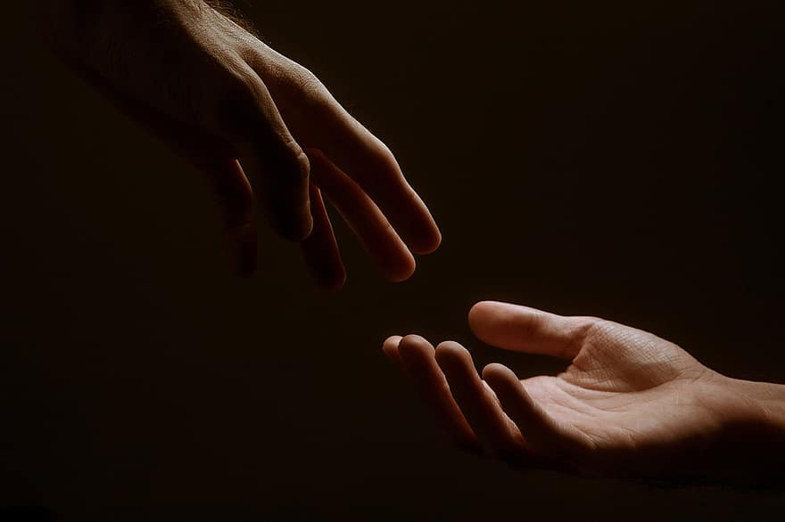
Prayer
Prayers
Let us pray for:
The world in which we live
The people who lead us
The people who need our prayers
The sick and the dying
Our families and loved ones
Lord, in your mercy
Hear our prayer.
Notes:
Prayers of the People

Slide 7
Nunc Dimitis
Now, Lord, you let your servant go in peace
your word has been fulfilled.
My own eyes have seen the salvation
which you have prepared in the sight of every people;
A light to reveal you to the nations
and the glory of your people Israel.
Glory to the Father and to the Son and to the Holy Spirit;
as it was in the beginning is now and shall be for ever. Amen.

Slide 8
Scripture
Psalm 105:
He spread out a cloud for a covering
and a fire to light up the night.
They asked and he brought them quails;
he satisfied them with the bread of heaven.
He opened the rock, and the waters gushed out
and ran in the dry places like a river.
For he remembered his holy word
and Abraham, his servant.
So he brought forth his people with joy,
his chosen ones with singing.
He gave them the lands of the nations
and they took possession of the fruit of their toil,
That they might keep his statutes
and faithfully observe his laws. Alleluia.
Glory to the Father and to the Son and to the Holy Spirit;
as it was in the beginning is now and shall be for ever. Amen.

Slide 9
Scripture
Matthew 28:
Now the eleven disciples went to Galilee, to the mountain to which Jesus had directed them. When they saw him, they worshipped him; but some doubted. And Jesus came and said to them, ‘All authority in heaven and on earth has been given to me. Go therefore and make disciples of all nations, baptizing them in the name of the Father and of the Son and of the Holy Spirit, and teaching them to obey everything that I have commanded you. And remember, I am with you always, to the end of the age.’
This is the word of the Lord.
Thanks be to God.

Slide 10
Collects
As our evening prayer rises before you, O God,
so may your mercy come down upon us
to cleanse our hearts
and set us free to sing your praise
now and for ever. Amen.
Lighten our darkness, Lord we pray
And in your great mercy,
defend us from all perils and dangers of this night,
For the sake of your Son, our Saviour, Jesus Christ, Amen.

Slide 11
Blessing
Lord’s Prayer:
Our Father, who art in heaven, hallowed be thy name; thy kingdom come; thy will be done; on earth as it is in heaven. Give us this day our daily bread. And forgive us our trespasses, as we forgive those who trespass against us. And lead us not into temptation; but deliver us from evil. For thine is the kingdom, the power, and the glory, for ever and ever. Amen.
Blessing:
May the God of peace sanctify you wholly;
and may your spirit and soul and body be kept sound and blameless
at the coming of our Lord Jesus Christ;
and the blessing of God Almighty, the Father, the Son and the Holy Spirit
Rest upon you and keep you and all whom you love, safe and well, for evermore, Amen.
Closing Prayer:
Heavenly Father, as we are in Christ, may we also abide in your love and stay faithful to our calling in You, in the unity of the Holy Spirit. Amen.

Slide 12
Daily Prayer for 8th April 2026
St Christopher’s Cathedral, Bahrain
"Go and make Disciples"
The Diocese of Cyprus and the Gulf

Slide 13
Daily Prayer for 8th April 2026
St Christopher’s Cathedral and Awali Church, Bahrain
The Diocese of Cyprus and the Gulf

