Slide 1

Daily Prayer for 18th March 2026
St Christopher’s Cathedral and Awali Church, Bahrain
The Diocese of Cyprus and the Gulf

Slide 2
Daily Prayer for 18th March 2026
St Christopher’s Cathedral, Bahrain
“The Potter’s Hand”
The Diocese of Cyprus and the Gulf

Slide 3
Welcome
Opening Acclamation:
Grace, mercy and peace from God our Father and the Lord Jesus Christ be with you.
And also with you.
We give thanks for this penitential journey to the cross.
Lord bless us and save us.
Amen
Blessed are you, Lord God of our salvation,
to you be glory and praise for ever.
In the darkness of our sin you have shone in our hearts
to give the light of the knowledge of the glory of God
in the face of Jesus Christ.
Open our eyes to acknowledge your presence,
that freed from the misery of sin and shame
we may grow into your likeness from glory to glory.
Blessed be God, Father, Son and Holy Spirit.
Amen.

Slide 4
Prayer
Confession:
Most merciful God, we confess that we have sinned against you in thought, word and deed, by what we have done and by what we have left undone. We have not loved you with our whole heart. We have not loved our neighbours as ourselves. In your mercy forgive what we have been, help us to amend what we are, and direct what we shall be; through Jesus Christ our Lord. Amen.
Almighty God have mercy upon you,
forgive you all your sins
through our Lord Jesus Christ,
strengthen you in all goodness,
and by the power of the Holy Spirit
Keep you in eternal life. Amen.

Slide 5
Prayer
Collect for Lent:
Almighty and everlasting God,
you hate nothing that you have made
and forgive the sins of all those who are penitent:
create and make in us new and contrite hearts
that we, worthily lamenting our sins
and acknowledging our wretchedness,
may receive from you, the God of all mercy,
perfect remission and forgiveness;
through Jesus Christ your Son our Lord,
who is alive and reigns with you,
in the unity of the Holy Spirit,
one God, now and for ever.
Amen.

Slide 6
Prayer
Collect for St Cyril on 18th March
Strengthen, O God,
your Church in the sacraments of your grace,
that we, in union with the teaching and prayers
of your servant Cyril of Jerusalem,
may enter more fully into your Paschal mystery;
through Jesus Christ our Lord,
who lives and reigns with you and the Holy Spirit,
one God, now and for ever.
Amen.

Slide 7
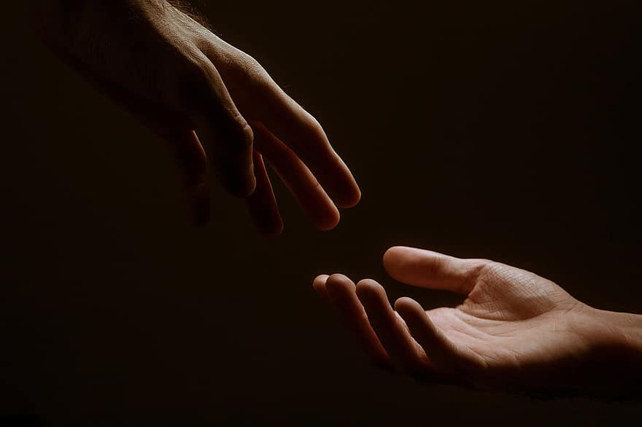
Prayer
Prayers
Let us pray for:
The world in which we live
The people who lead us
The people who need our prayers
The sick and the dying
Our families and loved ones
Lord, in your mercy
Hear our prayer.
Notes:
Prayers of the People

Slide 8
Benedictus
Blessed be the Lord the God of Israel,
who has come to his people and set them free.
He has raised up for us a mighty Saviour,
born of the house of his servant David.
Through his holy prophets God promised of old
to save us from our enemies, from the hands of all that hate us,
To show mercy to our ancestors,
and to remember his holy covenant.
This was the oath God swore to our father Abraham:
to set us free from the hands of our enemies,
Free to worship him without fear,
holy and righteous in his sight all the days of our life.
And you, child, shall be called the prophet of the Most High,
for you will go before the Lord to prepare his way,
To give his people knowledge of salvation
by the forgiveness of all their sins.
In the tender compassion of our God
the dawn from on high shall break upon us,
To shine on those who dwell in darkness and the shadow of death,
and to guide our feet into the way of peace.
Glory to the Father and to the Son and to the Holy Spirit;
as it was in the beginning is now and shall be for ever. Amen.

Slide 9
Scripture
Psalm 91:
There shall no evil happen to you,
neither shall any plague come near your tent.
For he shall give his angels charge over you,
to keep you in all your ways.
They shall bear you in their hands,
lest you dash your foot against a stone.
You shall tread upon the lion and adder;
the young lion and the serpent you shall trample underfoot.
Because they have set their love upon me, therefore will I deliver them;
I will lift them up, because they know my name.
They will call upon me and I will answer them;
I am with them in trouble, I will deliver them and bring them to honour.
With long life will I satisfy them
and show them my salvation.
Glory to the Father and to the Son and to the Holy Spirit;
as it was in the beginning is now and shall be for ever. Amen.

Slide 10
Scripture
Jeremiah 18:
The word that came to Jeremiah from the Lord: “Come, go down to the potter’s house, and there I will let you hear my words.” So I went down to the potter’s house, and there he was working at his wheel. The vessel he was making of clay was spoiled in the potter’s hand, and he reworked it into another vessel, as seemed good to him. Then the word of the Lord came to me: Can I not do with you, O house of Israel, just as this potter has done? says the Lord. Just like the clay in the potter’s hand, so are you in my hand, O house of Israel. At one moment I may declare concerning a nation or a kingdom that I will pluck up and break down and destroy it, but if that nation, concerning which I have spoken, turns from its evil, I will change my mind about the disaster that I intended to bring on it. And at another moment I may declare concerning a nation or a kingdom that I will build and plant it, but if it does evil in my sight, not listening to my voice, then I will change my mind about the good that I had intended to do to it. Now, therefore, say to the people of Judah and the inhabitants of Jerusalem: Thus says the Lord: Look, I am a potter shaping evil against you and devising a plan against you. Turn now, all of you, from your evil way, and amend your ways and your doings.
This is the word of the Lord.
Thanks be to God.

Slide 11
Collects
As our evening prayer rises before you, O God,
so may your mercy come down upon us
to cleanse our hearts
and set us free to sing your praise
now and for ever. Amen.
Lighten our darkness, Lord we pray
And in your great mercy,
defend us from all perils and dangers of this night,
For the sake of your Son, our Saviour, Jesus Christ, Amen.

Slide 12
Blessing
Lord’s Prayer:
Our Father, who art in heaven, hallowed be thy name; thy kingdom come; thy will be done; on earth as it is in heaven. Give us this day our daily bread. And forgive us our trespasses, as we forgive those who trespass against us. And lead us not into temptation; but deliver us from evil. For thine is the kingdom, the power, and the glory, for ever and ever. Amen.
Blessing:
May the God of peace sanctify you wholly;
and may your spirit and soul and body be kept sound and blameless
at the coming of our Lord Jesus Christ;
and the blessing of God Almighty, the Father, the Son and the Holy Spirit
Rest upon you and keep you and all whom you love, safe and well, for evermore, Amen.
Closing Prayer:
God our Redeemer, hear the prayer of our heart and the cries of our mouth. Transform us as the potter shapes the clay into vessels fit for your service; through our Lord, Jesus Christ. Amen

Slide 13
Daily Prayer for 18th March 2026
St Christopher’s Cathedral, Bahrain
"Spirit of the Living God"
The Diocese of Cyprus and the Gulf

Slide 14
Daily Prayer for 18th March 2026
St Christopher’s Cathedral and Awali Church, Bahrain
The Diocese of Cyprus and the Gulf

