Slide 1


Daily Prayer for 17th March 2026 St Christopher’s Cathedral and Awali Church, Bahrain
The Diocese of Cyprus and the Gulf

Slide 2
Daily Prayer for 17th March 2026 St Christopher’s Cathedral, Bahrain
“Hope for the Worlds Despair”
The Diocese of Cyprus and the Gulf

Slide 3
Welcome
Opening Acclamation: Grace, mercy and peace from God our Father and the Lord Jesus Christ be with you. And also with you.
O Lord, open our lips
And our mouth shall proclaim your praise.
Amen
Rejoice in the Lord always: again I say rejoice.
Be known to everyone: for your consideration of others,
The Lord is near: do not be anxious.
But in everything make your requests known to God: in prayer and petition with thanksgiving.
Then the peace of God, which passes all understanding: will keep your hearts and minds through Jesus Christ our Lord.
Glory to the Father, and to the Son, and to the Holy Spirit;
as it was in the beginning is now and shall be forever. Amen.

Slide 4
Opening Prayer
That this evening may be holy, good, and peaceful; let us pray with one heart and mind.
silence is kept
As our evening prayer rises before you, O God,
so may your mercy come down upon us
to cleanse our hearts
and set us free to sing your praise
now and forever.
Amen.

Slide 5
Prayer
Confession: Most merciful God, we confess that we have sinned against you in thought, word and deed, by what we have done and by what we have left undone. We have not loved you with our whole heart. We have not loved our neighbours as ourselves. In your mercy forgive what we have been, help us to amend what we are, and direct what we shall be; through Jesus Christ our Lord. Amen.
Almighty God have mercy upon you,
forgive you all your sins
through our Lord Jesus Christ,
strengthen you in all goodness,
and by the power of the Holy Spirit
Keep you in eternal life. Amen.

Slide 6
Prayer
Collect for Lent: Almighty and everlasting God,
you hate nothing that you have made
and forgive the sins of all those who are penitent:
create and make in us new and contrite hearts
that we, worthily lamenting our sins
and acknowledging our wretchedness,
may receive from you, the God of all mercy,
perfect remission and forgiveness;
through Jesus Christ your Son our Lord,
who is alive and reigns with you,
in the unity of the Holy Spirit,
one God, now and for ever.
Amen.

Slide 7
Prayer
Collect for St Patrick on 17th March Christ be with you, Christ within you
Christ before you,
Christ beside you, Christ to win you,
Christ to comfort and restore you,
Christ beneath you, Christ above you,
Christ in quiet, Christ in danger,
Christ in hearts of all that love you,
Christ in mouth of friend and stranger
Amen.

Slide 8
Scripture
Psalm 34: Come, bless the Lord, all you servants of the Lord,
you that by night stand in the house of the Lord.
Lift up your hands towards the sanctuary
and bless the Lord.
The Lord who made heaven and earth
give you blessing out of Zion.
Glory to the Father and to the Son and to the Holy Spirit;
as it was in the beginning is now and shall be for ever. Amen.

Slide 9
Magnificat
My soul proclaims the greatness of the Lord, my spirit rejoices in God my Saviour;
he has looked with favour on his lowly servant.
From this day all generations will call me blessed;
the Almighty has done great things for me and holy is his name.
He has mercy on those who fear him,
from generation to generation.
He has shown strength with his arm
and has scattered the proud in their conceit,
Casting down the mighty from their thrones
and lifting up the lowly.
He has filled the hungry with good things
and sent the rich away empty.
He has come to the aid of his servant Israel,
to remember his promise of mercy,
The promise made to our ancestors,
to Abraham and his children for ever.
Glory to the Father and to the Son and to the Holy Spirit;
as it was in the beginning is now and shall be for ever. Amen.

Slide 10
Scripture
Mark 4: On that day, when evening had come, he said to them, “Let us go across to the other side.” And leaving the crowd behind, they took him with them in the boat, just as he was. Other boats were with him. A great windstorm arose, and the waves beat into the boat, so that the boat was already being swamped. But he was in the stern, asleep on the cushion, and they woke him up and said to him, “Teacher, do you not care that we are perishing?” And waking up, he rebuked the wind and said to the sea, “Be silent! Be still!” Then the wind ceased, and there was a dead calm. He said to them, “Why are you afraid? Have you still no faith?” And they were filled with great fear and said to one another, “Who then is this, that even the wind and the sea obey him?”
This is the word of the Lord.
Thanks be to God.

Slide 11

Homily
Paul
Notes:
Prayers of the People

Slide 12
Nunc Dimitis
Now, Lord, you let your servant go in peace
your word has been fulfilled.
My own eyes have seen the salvation
which you have prepared in the sight of every people;
A light to reveal you to the nations
and the glory of your people Israel.
Glory to the Father and to the Son and to the Holy Spirit;
as it was in the beginning is now and shall be for ever. Amen.

Slide 13
Prayers
Lord, have mercy upon us
Christ, have mercy upon us
Lord, have mercy upon us
Show us your mercy, O Lord:
and grant us your salvation.
O Lord, be gracious to our lands:
and mercifully hear us when we call upon you.
Let your priests be clothed with righteousness:
and let your servants shout for joy.
O Lord, make your ways known upon the earth:
let all nations acknowledge your saving power.
Make our hearts clean, O God:
and renew a right spirit within us. Amen.

Slide 14
Prayers
Eternal God, from whom all holy desires, all good counsels, and all just works proceed:
give your servants that peace which the world cannot give
that our hearts may be set to obey your commandments
and that, free from the fear of our enemies,
we may pass our time in rest and quietness;
through the merits of Jesus Christ our Saviour. Amen.
Lighten our darkness, Lord we pray
And in your great mercy,
defend us from all perils and dangers of this night,
For the sake of your Son, our Saviour, Jesus Christ, Amen.

Slide 15
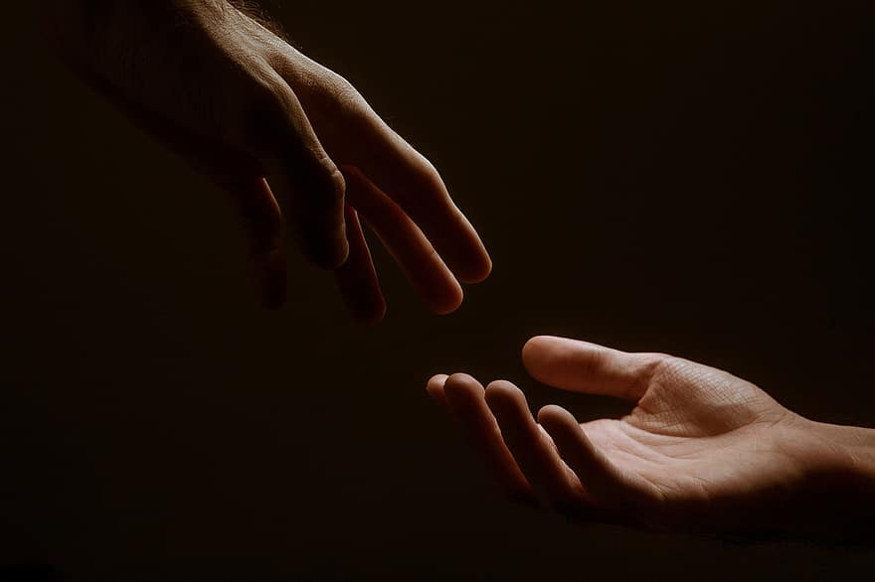
Prayer
Prayers
Let us pray for:
The world in which we live
The people who lead us
The people who need our prayers
The sick and the dying
Our families and loved ones
Lord, in your mercy
Hear our prayer.
Notes:
Prayers of the People

Slide 16
Blessing
Lord’s Prayer: Our Father, who art in heaven, hallowed be thy name; thy kingdom come; thy will be done; on earth as it is in heaven. Give us this day our daily bread. And forgive us our trespasses, as we forgive those who trespass against us. And lead us not into temptation; but deliver us from evil. For thine is the kingdom, the power, and the glory, for ever and ever. Amen. Blessing: May the God of peace sanctify you wholly;
and may your spirit and soul and body be kept sound and blameless
at the coming of our Lord Jesus Christ;
and the blessing of God Almighty, the Father, the Son and the Holy Spirit
Rest upon you and keep you and all whom you love, safe and well, for evermore, Amen.
The Grace:
The grace of our Lord Jesus Christ, and the love of God, and the fellowship of the Holy Spirit, be with us all for ever more. Amen.

Slide 17
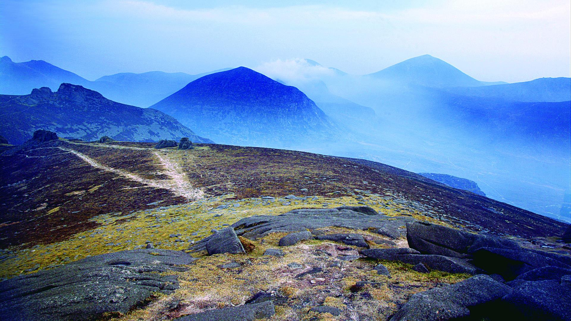

Be Thou my vision, O Lord of my heart;
Nought be all else to me save that thou art
Thou my best thought, in the day or the night,
Waking or sleeping, thy presence my light.
Be thou my wisdom, be thou my true Word;
I ever with thee and thou with me, Lord;
Thou my great Father, and I thy true son;
Thou in me dwelling, and I with thee one.
Be thou my breast-plate, my sword for the fight,
Be thou my armour, and be thou my might.
Thou my soul’s shelter, and thou my high tower:
Raise thou me heavenward, O Power of my power.
Riches I heed not, nor man’s empty praise,
Thou mine inheritance, now and always:
Thou and thou only, the first in my heart,
High King of heaven, my treasure thou art.
Be Thou My Vision – The Prayer of St Patrick

Slide 18
Daily Prayer for 17th March 2026 St Christopher’s Cathedral and Awali Church, Bahrain
The Diocese of Cyprus and the Gulf

