Slide 1

Daily Prayer for 28th March 2026
St Christopher’s Cathedral and Awali Church, Bahrain
The Diocese of Cyprus and the Gulf

Slide 2
Daily Prayer for 28th March 2026
St Christopher’s Cathedral, Bahrain
“As the Deer Pants for the Water”
The Diocese of Cyprus and the Gulf

Slide 3
Welcome
Opening Acclamation:
Grace, mercy and peace from God our Father and the Lord Jesus Christ be with you.
And also with you.
We give thanks for this penitential journey to the cross.
Lord bless us and save us.
Amen
We have come together in the name of Christ
to offer our praise and thanksgiving,
to hear and receive God’s holy word,
to pray for the needs of the world,
and to seek the forgiveness of our sins,
that by the power of the Holy Spirit
we may give ourselves to the service of God.
Amen.

Slide 4
Prayer
Confession:
Most merciful God, we confess that we have sinned against you in thought, word and deed, by what we have done and by what we have left undone. We have not loved you with our whole heart. We have not loved our neighbours as ourselves. In your mercy forgive what we have been, help us to amend what we are, and direct what we shall be; through Jesus Christ our Lord. Amen.
Almighty God have mercy upon you,
forgive you all your sins
through our Lord Jesus Christ,
strengthen you in all goodness,
and by the power of the Holy Spirit
Keep you in eternal life. Amen.

Slide 5
Prayer
Collect for Lent:
Almighty and everlasting God,
you hate nothing that you have made
and forgive the sins of all those who are penitent:
create and make in us new and contrite hearts
that we, worthily lamenting our sins
and acknowledging our wretchedness,
may receive from you, the God of all mercy,
perfect remission and forgiveness;
through Jesus Christ your Son our Lord,
who is alive and reigns with you,
in the unity of the Holy Spirit,
one God, now and for ever.
Amen.

Slide 6
Prayer
Collect for St Hesychius on 28th March
Truly blessed is he who cleaves,
with his thought, to the Prayer of Jesus,
constantly calling to Him in his heart,
just as air cleaves to our bodies,
or the flame to the candle.
Heavenly Father, may we cleave to the example of St Hesychius
And make the cries of our hearts our constant prayer;
Through our Lord Jesus Christ, Your Son,
who lives and reigns with You
in the unity of the Holy Spirit,
one God, forever and ever.
Amen.

Slide 7
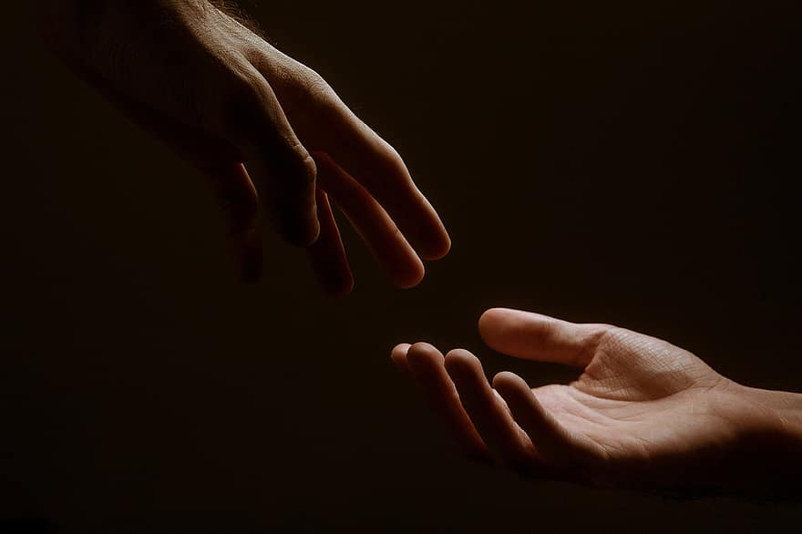
Prayer
Prayers
Let us pray for:
The world in which we live
The people who lead us
The people who need our prayers
The sick and the dying
Our families and loved ones
Lord, in your mercy
Hear our prayer.
Notes:
Prayers of the People

Slide 8
Song of Christ the Servant
Christ committed no sin, no guile was found on his lips.
Christ suffered for you, leaving you an example,
that you should follow in his steps.
He committed no sin, no guile was found on his lips,
when he was reviled, he did not revile in turn.
When he suffered, he did not threaten,
but he trusted himself to God who judges justly.
Christ himself bore our sins in his body on the tree,
that we might die to sin and live to righteousness.
By his wounds, you have been healed, for you were straying like sheep,
but have now returned to the shepherd and guardian of your souls.
Glory to the Father and to the Son and to the Holy Spirit;
as it was in the beginning is now and shall be for ever. Amen.
Christ committed no sin, no guile was found on his lips.

Slide 9
Scripture
Psalm 128:
Blessed are all those who fear the Lord,
and walk in his ways.
You shall eat the fruit of the toil of your hands;
it shall go well with you, and happy shall you be.
Your wife within your house shall be like a fruitful vine;
your children round your table, like fresh olive branches.
Thus shall the one be blest
who fears the Lord.
The Lord from out of Zion bless you,
that you may see Jerusalem in prosperity all the days of your life.
May you see your children’s children,
and may there be peace upon Israel.
Glory to the Father and to the Son and to the Holy Spirit;
as it was in the beginning is now and shall be for ever. Amen.

Slide 10
Scripture
Jeremiah 25:
The word that came to Jeremiah concerning all the people of Judah, in the fourth year of King Jehoiakim son of Josiah of Judah (that was the first year of King Nebuchadrezzar of Babylon), which the prophet Jeremiah spoke to all the people of Judah and all the inhabitants of Jerusalem: For twenty-three years, from the thirteenth year of King Josiah son of Amon of Judah to this day, the word of the Lord has come to me, and I have spoken persistently to you, but you have not listened. And though the Lord persistently sent you all his servants the prophets, you have neither listened nor inclined your ears to hear when they said, ‘Turn now, everyone of you, from your evil way and wicked doings, and you will remain upon the land that the Lord has given to you and your ancestors from of old and for ever; do not go after other gods to serve and worship them, and do not provoke me to anger with the work of your hands. Then I will do you no harm.’ Yet you did not listen to me, says the Lord, and so you have provoked me to anger with the work of your hands to your own harm. Therefore thus says the Lord of hosts: Because you have not obeyed my words, I am going to send for all the tribes of the north, says the Lord, even for King Nebuchadrezzar of Babylon, my servant, and I will bring them against this land and its inhabitants, and against all these nations around; and the work of their hands.
This is the word of the Lord.
Thanks be to God.

Slide 11
Collects
As our evening prayer rises before you, O God,
so may your mercy come down upon us
to cleanse our hearts
and set us free to sing your praise
now and for ever. Amen.
Lighten our darkness, Lord we pray
And in your great mercy,
defend us from all perils and dangers of this night,
For the sake of your Son, our Saviour, Jesus Christ, Amen.

Slide 12
Blessing
Lord’s Prayer:
Our Father, who art in heaven, hallowed be thy name; thy kingdom come; thy will be done; on earth as it is in heaven. Give us this day our daily bread. And forgive us our trespasses, as we forgive those who trespass against us. And lead us not into temptation; but deliver us from evil. For thine is the kingdom, the power, and the glory, for ever and ever. Amen.
Blessing:
May the God of peace sanctify you wholly;
and may your spirit and soul and body be kept sound and blameless
at the coming of our Lord Jesus Christ;
and the blessing of God Almighty, the Father, the Son and the Holy Spirit
Rest upon you and keep you and all whom you love, safe and well, for evermore, Amen.
Closing Prayer:
Blessed Son of David, King of Kings and Lord of Lords, may we greet you in our hearts as we celebrate your entry into Zion, the heavenly city; through our Lord, Jesus Christ, in the unity of the Holy Spirit. Amen.

Slide 13
Daily Prayer for 28th March 2026
St Christopher’s Cathedral, Bahrain
"In Christ’s Peace and Love"
The Diocese of Cyprus and the Gulf

Slide 14
Daily Prayer for 28th March 2026
St Christopher’s Cathedral and Awali Church, Bahrain
The Diocese of Cyprus and the Gulf

