Slide 1

Daily Prayer for 23rd March 2026
St Christopher’s Cathedral and Awali Church, Bahrain
The Diocese of Cyprus and the Gulf

Slide 2
Daily Prayer for 23rd March 2026
St Christopher’s Cathedral, Bahrain
“As the Deer Pants for the Water”
The Diocese of Cyprus and the Gulf

Slide 3
Welcome
Opening Acclamation:
Grace, mercy and peace from God our Father and the Lord Jesus Christ be with you.
And also with you.
We give thanks for this penitential journey to the cross.
Lord bless us and save us.
Amen
We have come together in the name of Christ
to offer our praise and thanksgiving,
to hear and receive God’s holy word,
to pray for the needs of the world,
and to seek the forgiveness of our sins,
that by the power of the Holy Spirit
we may give ourselves to the service of God.
Amen.

Slide 4
Prayer
Confession:
Most merciful God, we confess that we have sinned against you in thought, word and deed, by what we have done and by what we have left undone. We have not loved you with our whole heart. We have not loved our neighbours as ourselves. In your mercy forgive what we have been, help us to amend what we are, and direct what we shall be; through Jesus Christ our Lord. Amen.
Almighty God have mercy upon you,
forgive you all your sins
through our Lord Jesus Christ,
strengthen you in all goodness,
and by the power of the Holy Spirit
Keep you in eternal life. Amen.

Slide 5
Prayer
Collect for Lent:
Almighty and everlasting God,
you hate nothing that you have made
and forgive the sins of all those who are penitent:
create and make in us new and contrite hearts
that we, worthily lamenting our sins
and acknowledging our wretchedness,
may receive from you, the God of all mercy,
perfect remission and forgiveness;
through Jesus Christ your Son our Lord,
who is alive and reigns with you,
in the unity of the Holy Spirit,
one God, now and for ever.
Amen.

Slide 6
Prayer
Collect for St Turibius on 23rd March
O God, who gave increase to Your Church
through the apostolic labors and zeal for truth
of the Bishop Saint Turibius,
grant that the people consecrated to You
may always receive new growth
in faith and holiness.
Through our Lord Jesus Christ, Your Son,
who lives and reigns with You
in the unity of the Holy Spirit,
one God, forever and ever.
Amen.

Slide 7
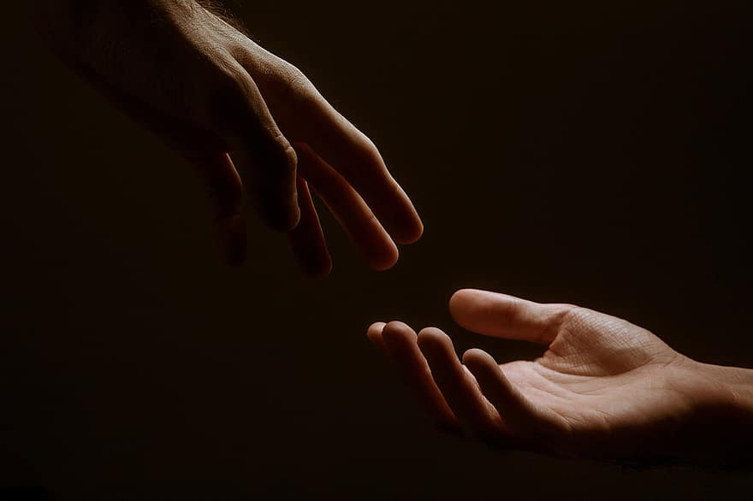
Prayer
Prayers
Let us pray for:
The world in which we live
The people who lead us
The people who need our prayers
The sick and the dying
Our families and loved ones
Lord, in your mercy
Hear our prayer.
Notes:
Prayers of the People

Slide 8
Song of Christ the Servant
Christ committed no sin, no guile was found on his lips.
Christ suffered for you, leaving you an example,
that you should follow in his steps.
He committed no sin, no guile was found on his lips,
when he was reviled, he did not revile in turn.
When he suffered, he did not threaten,
but he trusted himself to God who judges justly.
Christ himself bore our sins in his body on the tree,
that we might die to sin and live to righteousness.
By his wounds, you have been healed, for you were straying like sheep,
but have now returned to the shepherd and guardian of your souls.
Glory to the Father and to the Son and to the Holy Spirit;
as it was in the beginning is now and shall be for ever. Amen.
Christ committed no sin, no guile was found on his lips.

Slide 9
Scripture
Psalm 26:
Give judgement for me, O Lord, for I have walked with integrity;
I have trusted in the Lord and have not faltered.
Test me, O Lord, and try me;
examine my heart and my mind.
For your love is before my eyes;
I have walked in your truth.
I have not joined the company of the false,
nor consorted with the deceitful.
I hate the gathering of evildoers
and I will not sit down with the wicked.
I will wash my hands in innocence, O Lord,
that I may go about your altar,
To make heard the voice of thanksgiving
and tell of all your wonderful deeds.
Glory to the Father and to the Son and to the Holy Spirit;
as it was in the beginning is now and shall be for ever. Amen.

Slide 10
Scripture
1 Corinthians 11:
For I received from the Lord what I also handed on to you, that the Lord Jesus on the night when he was betrayed took a loaf of bread, and when he had given thanks, he broke it and said, ‘This is my body that is for you. Do this in remembrance of me.’ In the same way he took the cup also, after supper, saying, ‘This cup is the new covenant in my blood. Do this, as often as you drink it, in remembrance of me.’ For as often as you eat this bread and drink the cup, you proclaim the Lord's death until he comes.
This is the word of the Lord.
Thanks be to God.

Slide 11
Collects
As our evening prayer rises before you, O God,
so may your mercy come down upon us
to cleanse our hearts
and set us free to sing your praise
now and for ever. Amen.
Lighten our darkness, Lord we pray
And in your great mercy,
defend us from all perils and dangers of this night,
For the sake of your Son, our Saviour, Jesus Christ, Amen.

Slide 12
Blessing
Lord’s Prayer:
Our Father, who art in heaven, hallowed be thy name; thy kingdom come; thy will be done; on earth as it is in heaven. Give us this day our daily bread. And forgive us our trespasses, as we forgive those who trespass against us. And lead us not into temptation; but deliver us from evil. For thine is the kingdom, the power, and the glory, for ever and ever. Amen.
Blessing:
May the God of peace sanctify you wholly;
and may your spirit and soul and body be kept sound and blameless
at the coming of our Lord Jesus Christ;
and the blessing of God Almighty, the Father, the Son and the Holy Spirit
Rest upon you and keep you and all whom you love, safe and well, for evermore, Amen.
Closing Prayer:
God is Love and if we abide in Love, Love abides in us. Father, guide us in all humility to bow down in reverence at the name of our Lord, Jesus Christ, in the unity of the Holy Spirit. Amen.

Slide 13
Daily Prayer for 23rd March 2026
St Christopher’s Cathedral, Bahrain
"In Christ’s Peace and Love"
The Diocese of Cyprus and the Gulf

Slide 14
Daily Prayer for 21st March 2026
St Christopher’s Cathedral and Awali Church, Bahrain
The Diocese of Cyprus and the Gulf

