Slide 1

Daily Prayer for 7th March 2026
St Christopher’s Cathedral, Bahrain
The Diocese of Cyprus and the Gulf

Slide 2
Daily Prayer for 7th March 2026
St Christopher’s Cathedral, Bahrain
"Lead us Heavenly Father, Lead us"
The Diocese of Cyprus and the Gulf

Slide 3
Welcome
Opening Acclamation:
Grace, mercy and peace from God our Father and the Lord Jesus Christ be with you.
And also with you.
We give thanks for this penitential journey to the cross.
Lord bless us and save us.
Amen
Blessed are you, Lord God of our salvation,
to you be glory and praise for ever.
In the darkness of our sin you have shone in our hearts
to give the light of the knowledge of the glory of God
in the face of Jesus Christ.
Open our eyes to acknowledge your presence,
that freed from the misery of sin and shame
we may grow into your likeness from glory to glory.
Blessed be God, Father, Son and Holy Spirit.
Amen.

Slide 4
Prayer
Confession:
Most merciful God, we confess that we have sinned against you in thought, word and deed, by what we have done and by what we have left undone. We have not loved you with our whole heart. We have not loved our neighbours as ourselves. In your mercy forgive what we have been, help us to amend what we are, and direct what we shall be; through Jesus Christ our Lord. Amen.
Almighty God have mercy upon you,
forgive you all your sins
through our Lord Jesus Christ,
strengthen you in all goodness,
and by the power of the Holy Spirit
Keep you in eternal life. Amen.

Slide 5
Prayer
Collect for Lent:
Almighty and everlasting God,
you hate nothing that you have made
and forgive the sins of all those who are penitent:
create and make in us new and contrite hearts
that we, worthily lamenting our sins
and acknowledging our wretchedness,
may receive from you, the God of all mercy,
perfect remission and forgiveness;
through Jesus Christ your Son our Lord,
who is alive and reigns with you,
in the unity of the Holy Spirit,
one God, now and for ever.
Amen.

Slide 6
Prayer
Collect for Seafarers
Loving God, you give us everything.
Hear us as we pray for seafarers
who endure hardship, danger and discomfort
to bring us the goods we use each day.
Keep them safe in the palm of your hand
and bring them through sunshine and storm
to their homes and loved ones.
Through Jesus Christ who stilled the storm
and called seafarers to follow him.
Amen.

Slide 7
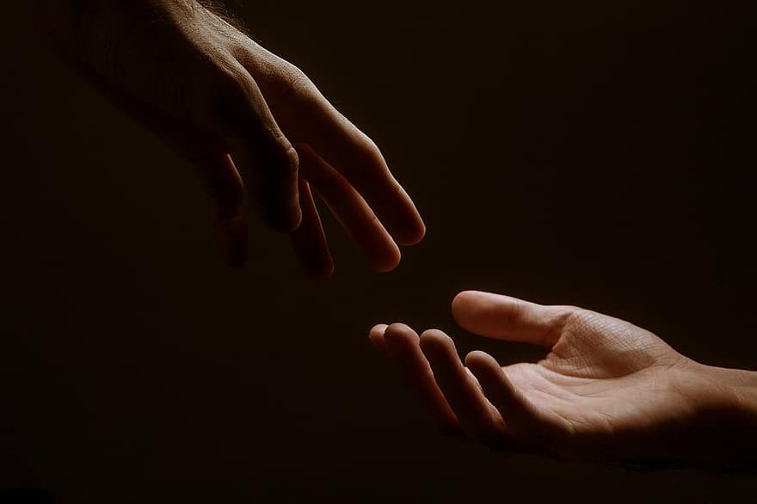
Prayer
Prayers
Let us pray for:
The world in which we live
The people who lead us
The people who need our prayers
The sick and the dying
Our families and loved ones
Lord, in your mercy
Hear our prayer.
Notes:
Prayers of the People

Slide 8
Nunc Dimitis
Now, Lord, you let your servant go in peace
your word has been fulfilled.
My own eyes have seen the salvation
which you have prepared in the sight of every people;
A light to reveal you to the nations
and the glory of your people Israel.
Glory to the Father and to the Son and to the Holy Spirit;
as it was in the beginning is now and shall be for ever. Amen.

Slide 9
Scripture
Psalm 107:
Some went down to the sea in ships,
doing business on the mighty waters;
they saw the deeds of the Lord,
his wondrous works in the deep.
For he commanded and raised the stormy wind,
which lifted up the waves of the sea.
They mounted up to heaven; they went down to the depths;
their courage melted away in their calamity;
they reeled and staggered like drunkards
and were at their wits’ end.
Then they cried to the Lord in their trouble,
and he brought them out from their distress;
he made the storm be still,
and the waves of the sea were hushed.
Glory to the Father and to the Son and to the Holy Spirit;
as it was in the beginning is now and shall be for ever. Amen.

Slide 10
Scripture
Mark 4:35-41:
On that day, when evening had come, he said to them, “Let us go across to the other side.” And leaving the crowd behind, they took him with them in the boat, just as he was. Other boats were with him. A great windstorm arose, and the waves beat into the boat, so that the boat was already being swamped. But he was in the stern, asleep on the cushion, and they woke him up and said to him, “Teacher, do you not care that we are perishing?” And waking up, he rebuked the wind and said to the sea, “Be silent! Be still!” Then the wind ceased, and there was a dead calm. He said to them, “Why are you afraid? Have you still no faith?” And they were filled with great fear and said to one another, “Who then is this, that even the wind and the sea obey him?”
This is the word of the Lord.
Thanks be to God.

Slide 11
Collects
As our evening prayer rises before you, O God,
so may your mercy come down upon us
to cleanse our hearts
and set us free to sing your praise
now and for ever. Amen.
Lighten our darkness, Lord we pray
And in your great mercy,
defend us from all perils and dangers of this night,
For the sake of your Son, our Saviour, Jesus Christ, Amen.

Slide 12
Blessing
Lord’s Prayer:
Our Father, who art in heaven, hallowed be thy name; thy kingdom come; thy will be done; on earth as it is in heaven. Give us this day our daily bread. And forgive us our trespasses, as we forgive those who trespass against us. And lead us not into temptation; but deliver us from evil. For thine is the kingdom, the power, and the glory, for ever and ever. Amen.
Blessing:
May the God of peace sanctify you wholly;
and may your spirit and soul and body be kept sound and blameless
at the coming of our Lord Jesus Christ;
and the blessing of God Almighty, the Father, the Son and the Holy Spirit
Rest upon you and keep you and all whom you love, safe and well, for evermore, Amen.
Closing Prayer:
God our Redeemer show us compassion and love. Protect us from the storm, defend us from our enemies and calm the waves of anxiety that sweep our hearts. Amen.

Slide 13
Daily Prayer for 7th March 2026
St Christopher’s Cathedral, Bahrain
"It is well with my Soul"
The Diocese of Cyprus and the Gulf

Slide 14
Daily Prayer for 5th March 2026
St Christopher’s Cathedral, Bahrain
The Diocese of Cyprus and the Gulf

