Slide 1
Daily Prayer for 30th March 2026
St Christopher’s Cathedral and Awali Church, Bahrain

Slide 2
Daily Prayer for 30th March 2026
St Christopher’s Cathedral, Bahrain
“God of Mercy and Compassion”

Slide 3
Welcome
Opening Acclamation:
Grace, mercy and peace from God our Father and the Lord Jesus Christ be with you.
And also with you.
We give thanks for this penitential journey to the cross.
Lord bless us and save us.
Amen
Blessed are you, Lord God of our salvation,
to you be glory and praise for ever.
In the darkness of our sin you have shone in our hearts
to give the light of the knowledge of the glory of God
in the face of Jesus Christ.
Open our eyes to acknowledge your presence,
that freed from the misery of sin and shame
we may grow into your likeness from glory to glory.
Blessed be God, Father, Son and Holy Spirit.
Amen.

Slide 4
Prayer
Confession:
Most merciful God, we confess that we have sinned against you in thought, word and deed, by what we have done and by what we have left undone. We have not loved you with our whole heart. We have not loved our neighbours as ourselves. In your mercy forgive what we have been, help us to amend what we are, and direct what we shall be; through Jesus Christ our Lord. Amen.
Almighty God have mercy upon you,
forgive you all your sins
through our Lord Jesus Christ,
strengthen you in all goodness,
and by the power of the Holy Spirit
Keep you in eternal life. Amen.

Slide 5
Prayer
Collect for Lent:
Almighty and everlasting God,
you hate nothing that you have made
and forgive the sins of all those who are penitent:
create and make in us new and contrite hearts
that we, worthily lamenting our sins
and acknowledging our wretchedness,
may receive from you, the God of all mercy,
perfect remission and forgiveness;
through Jesus Christ your Son our Lord,
who is alive and reigns with you,
in the unity of the Holy Spirit,
one God, now and for ever.
Amen.

Slide 6
Prayer
Collect for Holy Week on 30th March
Almighty and everlasting God,
who in your tender love towards the human race
sent your Son our Saviour Jesus Christ
to take upon him our flesh
and to suffer death upon the cross:
grant that we may follow the example of his patience and humility,
and also be made partakers of his resurrection;
through Jesus Christ your Son our Lord,
who is alive and reigns with you,
in the unity of the Holy Spirit,
one God, now and for ever.
Amen.

Slide 7
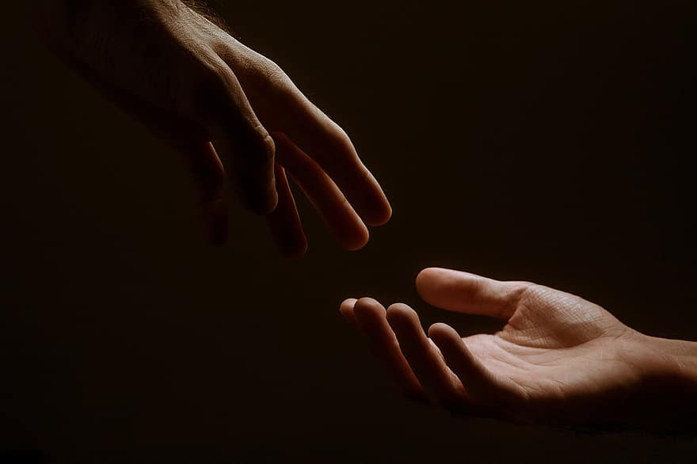
Prayer
Prayers
Let us pray for:
The world in which we live
The people who lead us
The people who need our prayers
The sick and the dying
Our families and loved ones
Lord, in your mercy
Hear our prayer.
Notes:
Prayers of the People

Slide 8
Magnificat
My soul proclaims the greatness of the Lord, my spirit rejoices in God my Saviour;
he has looked with favour on his lowly servant.
From this day all generations will call me blessed;
the Almighty has done great things for me and holy is his name.
He has mercy on those who fear him,
from generation to generation.
He has shown strength with his arm
and has scattered the proud in their conceit,
Casting down the mighty from their thrones
and lifting up the lowly.
He has filled the hungry with good things
and sent the rich away empty.
He has come to the aid of his servant Israel,
to remember his promise of mercy,
The promise made to our ancestors,
to Abraham and his children for ever.
Glory to the Father and to the Son and to the Holy Spirit;
as it was in the beginning is now and shall be for ever. Amen.

Slide 9
Scripture
Psalm 25:
To you, O Lord, I lift up my soul; O my God, in you I trust;
let me not be put to shame; let not my enemies triumph over me.
Let none who look to you be put to shame,
but let the treacherous be shamed and frustrated.
Make me to know your ways, O Lord,
and teach me your paths.
Lead me in your truth and teach me,
for you are the God of my salvation; for you have I hoped all the day long.
Remember, Lord, your compassion and love,
for they are from everlasting.
Remember not the sins of my youth or my transgressions,
but think on me in your goodness, O Lord, according to your steadfast love.
Gracious and upright is the Lord;
therefore shall he teach sinners in the way.
Glory to the Father and to the Son and to the Holy Spirit;
as it was in the beginning is now and shall be for ever. Amen.

Slide 10
Scripture
Colossians 1:
He is the head of the body, the church; he is the beginning, the firstborn from the dead, so that he might come to have first place in everything. For in him all the fullness of God was pleased to dwell, and through him God was pleased to reconcile to himself all things, whether on earth or in heaven, by making peace through the blood of his cross. And you who were once estranged and hostile in mind, doing evil deeds, he has now reconciled in his fleshly body through death, so as to present you holy and blameless and irreproachable before him—provided that you continue securely established and steadfast in the faith, without shifting from the hope promised by the gospel that you heard, which has been proclaimed to every creature under heaven. I, Paul, became a servant of this gospel.
This is the word of the Lord.
Thanks be to God.

Slide 11
Collects
As our evening prayer rises before you, O God,
so may your mercy come down upon us
to cleanse our hearts
and set us free to sing your praise
now and for ever. Amen.
Lighten our darkness, Lord we pray
And in your great mercy,
defend us from all perils and dangers of this night,
For the sake of your Son, our Saviour, Jesus Christ, Amen.

Slide 12
Blessing
Lord’s Prayer:
Our Father, who art in heaven, hallowed be thy name; thy kingdom come; thy will be done; on earth as it is in heaven. Give us this day our daily bread. And forgive us our trespasses, as we forgive those who trespass against us. And lead us not into temptation; but deliver us from evil. For thine is the kingdom, the power, and the glory, for ever and ever. Amen.
Blessing:
May the God of peace sanctify you wholly;
and may your spirit and soul and body be kept sound and blameless
at the coming of our Lord Jesus Christ;
and the blessing of God Almighty, the Father, the Son and the Holy Spirit
Rest upon you and keep you and all whom you love, safe and well, for evermore, Amen.
Closing Prayer:
God our Hope, hear the prayer of our heart and the cries of our mouth. Show us the meaning of hope amidst darkness and desolation that we may see the light of Christ. Amen

Slide 13
Daily Prayer for 30th March 2026
St Christopher’s Cathedral, Bahrain
"Were I to cross"

Slide 14
Daily Prayer for 30th March 2026
St Christopher’s Cathedral and Awali Church, Bahrain

