Slide 1

Daily Prayer for 4th April 2026
St Christopher’s Cathedral and Awali Church, Bahrain
The Diocese of Cyprus and the Gulf

Slide 2
Daily Prayer for 4th April 2026
St Christopher’s Cathedral, Bahrain
“Wait for the Lord”
The Diocese of Cyprus and the Gulf

Slide 3
Welcome
Opening Acclamation:
Grace, mercy and peace from God our Father and the Lord Jesus Christ be with you.
And also with you.
We give thanks for this penitential journey to the cross.
Lord bless us and save us.
Amen
We have come together in the name of Christ
to offer our praise and thanksgiving,
to hear and receive God’s holy word,
to pray for the needs of the world,
and to seek the forgiveness of our sins,
that by the power of the Holy Spirit
we may give ourselves to the service of God.
Amen.

Slide 4
Prayer
Confession:
Most merciful God, we confess that we have sinned against you in thought, word and deed, by what we have done and by what we have left undone. We have not loved you with our whole heart. We have not loved our neighbours as ourselves. In your mercy forgive what we have been, help us to amend what we are, and direct what we shall be; through Jesus Christ our Lord. Amen.
Almighty God have mercy upon you,
forgive you all your sins
through our Lord Jesus Christ,
strengthen you in all goodness,
and by the power of the Holy Spirit
Keep you in eternal life. Amen.

Slide 5
Prayer
Collect for Lent:
Almighty and everlasting God,
you hate nothing that you have made
and forgive the sins of all those who are penitent:
create and make in us new and contrite hearts
that we, worthily lamenting our sins
and acknowledging our wretchedness,
may receive from you, the God of all mercy,
perfect remission and forgiveness;
through Jesus Christ your Son our Lord,
who is alive and reigns with you,
in the unity of the Holy Spirit,
one God, now and for ever.
Amen.

Slide 6
Prayer
Collect for Easter Saturday on 4th April
Grant, Lord,
that we who are baptized into the death
of your Son our Saviour Jesus Christ
may continually put to death our evil desires
and be buried with him;
and that through the grave and gate of death
we may pass to our joyful resurrection;
through his merits,
who died and was buried and rose again for us,
your Son Jesus Christ our Lord.
Amen.

Slide 7
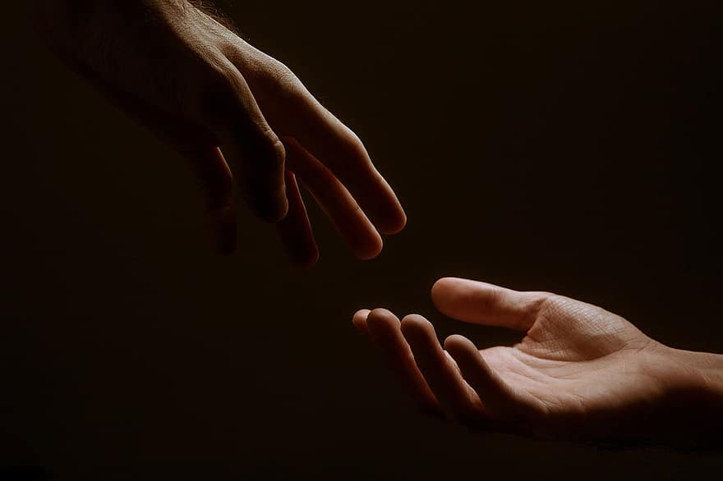
Prayer
Prayers
Let us pray for:
The world in which we live
The people who lead us
The people who need our prayers
The sick and the dying
Our families and loved ones
Lord, in your mercy
Hear our prayer.
Notes:
Prayers of the People

Slide 8
Nunc Dimitis
Now, Lord, you let your servant go in peace
your word has been fulfilled.
My own eyes have seen the salvation
which you have prepared in the sight of every people;
A light to reveal you to the nations
and the glory of your people Israel.
Glory to the Father and to the Son and to the Holy Spirit;
as it was in the beginning is now and shall be for ever. Amen.

Slide 9
Scripture
Psalm 116:
I love the Lord, for he has heard the voice of my supplication;
because he inclined his ear to me on the day I called to him.
The snares of death encompassed me; the pains of hell took hold of me;
by grief and sorrow was I held.
Then I called upon the name of the Lord:
‘O Lord, I beg you, deliver my soul.’
Gracious is the Lord and righteous;
our God is full of compassion.
The Lord watches over the simple;
I was brought very low and he saved me.
Turn again to your rest, O my soul,
for the Lord has been gracious to you.
Glory to the Father and to the Son and to the Holy Spirit;
as it was in the beginning is now and shall be for ever. Amen.

Slide 10
Scripture
1 John 5:
Who is it that conquers the world but the one who believes that Jesus is the Son of God?
This is the one who came by water and blood, Jesus Christ, not with the water only but with the water and the blood. And the Spirit is the one that testifies, for the Spirit is the truth. There are three that testify: the Spirit and the water and the blood, and these three agree. If we receive human testimony, the testimony of God is greater; for this is the testimony of God that he has testified to his Son. Those who believe in the Son of God have the testimony in their hearts. Those who do not believe in God have made him a liar by not believing in the testimony that God has given concerning his Son. And this is the testimony: God gave us eternal life, and this life is in his Son. Whoever has the Son has life; whoever does not have the Son of God does not have life.
This is the word of the Lord.
Thanks be to God.

Slide 11
Collects
As our evening prayer rises before you, O God,
so may your mercy come down upon us
to cleanse our hearts
and set us free to sing your praise
now and for ever. Amen.
Lighten our darkness, Lord we pray
And in your great mercy,
defend us from all perils and dangers of this night,
For the sake of your Son, our Saviour, Jesus Christ, Amen.

Slide 12
Blessing
Lord’s Prayer:
Our Father, who art in heaven, hallowed be thy name; thy kingdom come; thy will be done; on earth as it is in heaven. Give us this day our daily bread. And forgive us our trespasses, as we forgive those who trespass against us. And lead us not into temptation; but deliver us from evil. For thine is the kingdom, the power, and the glory, for ever and ever. Amen.
Blessing:
May the God of peace sanctify you wholly;
and may your spirit and soul and body be kept sound and blameless
at the coming of our Lord Jesus Christ;
and the blessing of God Almighty, the Father, the Son and the Holy Spirit
Rest upon you and keep you and all whom you love, safe and well, for evermore, Amen.
Closing Prayer:
Heavenly Father, we wait on the Lord that your glorious mercies may be bestowed upon we who do not deserve. Send your spirit to comfort our journey as we seek the light of Christ, in the unity of the Holy Spirit. Amen.

Slide 13
Daily Prayer for 2nd April 2026
St Christopher’s Cathedral, Bahrain
"In our Darkness"
The Diocese of Cyprus and the Gulf

Slide 14
Daily Prayer for 2nd April 2026
St Christopher’s Cathedral and Awali Church, Bahrain
The Diocese of Cyprus and the Gulf

