Slide 1

Daily Prayer for 15th March 2026 St Christopher’s Cathedral and Awali Church, Bahrain
For Our Mothers on Mothering Sunday
The Diocese of Cyprus and the Gulf

Slide 2
Daily Prayer for 15th March 2026 St Christopher’s Cathedral, Bahrain
Forever My Home
The Diocese of Cyprus and the Gulf

Slide 3
Welcome
Opening Acclamation: Grace, mercy and peace from God our Father and the Lord Jesus Christ be with you. And also with you.
We give thanks for this penitential journey to the cross.
Lord bless us and save us.
Amen
Blessed are you, Lord God of our salvation,
to you be glory and praise for ever.
In the darkness of our sin you have shone in our hearts
to give the light of the knowledge of the glory of God
in the face of Jesus Christ.
Open our eyes to acknowledge your presence,
that freed from the misery of sin and shame
we may grow into your likeness from glory to glory.
Blessed be God, Father, Son and Holy Spirit.
Amen.

Slide 4
Prayer
Confession: Most merciful God, we confess that we have sinned against you in thought, word and deed, by what we have done and by what we have left undone. We have not loved you with our whole heart. We have not loved our neighbours as ourselves. In your mercy forgive what we have been, help us to amend what we are, and direct what we shall be; through Jesus Christ our Lord. Amen.
Almighty God have mercy upon you,
forgive you all your sins
through our Lord Jesus Christ,
strengthen you in all goodness,
and by the power of the Holy Spirit
Keep you in eternal life. Amen.

Slide 5
Prayer
Collect for Lent: Almighty and everlasting God,
you hate nothing that you have made
and forgive the sins of all those who are penitent:
create and make in us new and contrite hearts
that we, worthily lamenting our sins
and acknowledging our wretchedness,
may receive from you, the God of all mercy,
perfect remission and forgiveness;
through Jesus Christ your Son our Lord,
who is alive and reigns with you,
in the unity of the Holy Spirit,
one God, now and for ever.
Amen.

Slide 6
Prayer
Collect for St Louise on 15th March O Gracious God, Saint Louise devoted her life to helping Saint Vincent de Paul
serve the needs of the poor. She often taught:
"Be diligent in serving the poor. Love the poor, honor them, as you would honor Christ Himself."
Teach me how to think generously.
Give me a heart that desires to care for the poor
as if I were serving Jesus directly,
and help me to see Jesus in each person that begs on the street corner or church door.
Through Jesus Christ your Son our Lord,
who is alive and reigns with you,
in the unity of the Holy Spirit,
one God, now and for ever.
Amen.

Slide 7
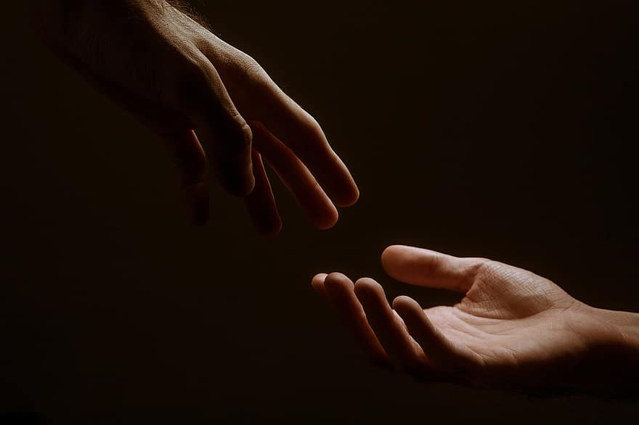
Prayer
Prayers
Let us pray for:
The world in which we live
The people who lead us
The people who need our prayers
The sick and the dying
Our families and loved ones
Lord, in your mercy
Hear our prayer.
Notes:
Prayers of the People

Slide 8
Nunc Dimitis
Now, Lord, you let your servant go in peace
your word has been fulfilled.
My own eyes have seen the salvation
which you have prepared in the sight of every people;
A light to reveal you to the nations
and the glory of your people Israel.
Glory to the Father and to the Son and to the Holy Spirit;
as it was in the beginning is now and shall be for ever. Amen.

Slide 9
Scripture
Psalm 91: In you, O Lord, have I taken refuge; let me never be put to shame;
deliver me in your righteousness.
Incline your ear to me;
make haste to deliver me.
Be my strong rock, a fortress to save me, for you are my rock and my stronghold;
guide me, and lead me for your name’s sake.
Take me out of the net that they have laid secretly for me,
for you are my strength.
Into your hands I commend my spirit,
for you have redeemed me, O Lord God of truth.
I hate those who cling to worthless idols;
I put my trust in the Lord.
I will be glad and rejoice in your mercy,
for you have seen my affliction and known my soul in adversity.
You have not shut me up in the hand of the enemy;
you have set my feet in an open place.
Glory to the Father and to the Son and to the Holy Spirit;
as it was in the beginning is now and shall be for ever. Amen.

Slide 10
Scripture
James 5: Be patient, therefore, beloved, until the coming of the Lord. The farmer waits for the precious crop from the earth, being patient with it until it receives the early and the late rains. You also must be patient. Strengthen your hearts, for the coming of the Lord is near. Beloved, do not grumble against one another, so that you may not be judged. See, the Judge is standing at the doors! As an example of suffering and patience, beloved, take the prophets who spoke in the name of the Lord. Indeed we call blessed those who showed endurance. You have heard of the endurance of Job, and you have seen the purpose of the Lord, how the Lord is compassionate and merciful.
This is the word of the Lord.
Thanks be to God.

Slide 11
Collects
As our evening prayer rises before you, O God,
so may your mercy come down upon us
to cleanse our hearts
and set us free to sing your praise
now and for ever. Amen.
Lighten our darkness, Lord we pray
And in your great mercy,
defend us from all perils and dangers of this night,
For the sake of your Son, our Saviour, Jesus Christ, Amen.

Slide 12
Blessing
Lord’s Prayer: Our Father, who art in heaven, hallowed be thy name; thy kingdom come; thy will be done; on earth as it is in heaven. Give us this day our daily bread. And forgive us our trespasses, as we forgive those who trespass against us. And lead us not into temptation; but deliver us from evil. For thine is the kingdom, the power, and the glory, for ever and ever. Amen. Blessing: May the God of peace sanctify you wholly;
and may your spirit and soul and body be kept sound and blameless
at the coming of our Lord Jesus Christ;
and the blessing of God Almighty, the Father, the Son and the Holy Spirit
Rest upon you and keep you and all whom you love, safe and well, for evermore, Amen.
Closing Prayer:
God our Redeemer shall wipe away our tears. All that Jesus has done for your children will not go unrewarded. There is hope for the future and salvation for the lost. Amen.

Slide 13
Daily Prayer for 15th March 2026 St Christopher’s Cathedral, Bahrain "Father of Light"
The Diocese of Cyprus and the Gulf

Slide 14
Daily Prayer for 15th March 2026 St Christopher’s Cathedral and Awali Church, Bahrain
The Diocese of Cyprus and the Gulf

