Slide 1

Daily Prayer for 14th March 2026 St Christopher’s Cathedral and Awali Church, Bahrain
The Diocese of Cyprus and the Gulf

Slide 2
Daily Prayer for 14th March 2026 St Christopher’s Cathedral and Awali Church, Bahrain
"Christ be our Light"
The Diocese of Cyprus and the Gulf

Slide 3
Welcome
Opening Acclamation: Grace, mercy and peace from God our Father and the Lord Jesus Christ be with you. And also with you.
We give thanks for this penitential journey to the cross.
Lord bless us and save us.
Amen
Almighty God,
to whom all hearts are open,
all desires known,
and from whom no secrets are hidden:
cleanse the thoughts of our hearts
by the inspiration of your Holy Spirit,
that we may perfectly love you,
and worthily magnify your holy name;
through Christ our Lord.
Amen.

Slide 4
Prayer
Confession: Most merciful God, we confess that we have sinned against you in thought, word and deed, by what we have done and by what we have left undone. We have not loved you with our whole heart. We have not loved our neighbours as ourselves. In your mercy forgive what we have been, help us to amend what we are, and direct what we shall be; through Jesus Christ our Lord. Amen.
Almighty God have mercy upon you,
forgive you all your sins
through our Lord Jesus Christ,
strengthen you in all goodness,
and by the power of the Holy Spirit
Keep you in eternal life. Amen.

Slide 5
Prayer
Collect for Lent: Almighty and everlasting God,
you hate nothing that you have made
and forgive the sins of all those who are penitent:
create and make in us new and contrite hearts
that we, worthily lamenting our sins
and acknowledging our wretchedness,
may receive from you, the God of all mercy,
perfect remission and forgiveness;
through Jesus Christ your Son our Lord,
who is alive and reigns with you,
in the unity of the Holy Spirit,
one God, now and for ever.
Amen.

Slide 6
Prayer
Collect for the Saint Matilda on 14th March 2026 O God, by whose grace the blessed Matilda,
enkindled with the fire of thy love,
became a burning and shining light in thy Church:
Grant that we may be inflamed
with the same spirit of discipline and love
and ever walk before thee as children of light.
Through our Lord Jesus Christ, Your Son,
who lives and reigns with You
in the unity of the Holy Spirit,
one God for ever and ever.
Amen.

Slide 7
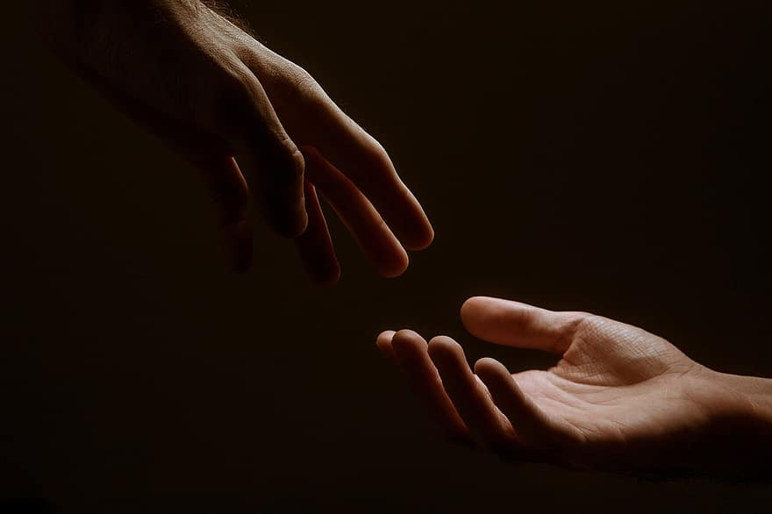
Prayer
Prayers
Let us pray for:
The world in which we live
The people who lead us
The people who need our prayers
The sick and the dying
Our families and loved ones
Lord, in your mercy
Hear our prayer.
Notes:
Prayers of the People

Slide 8
Magnificat
My soul proclaims the greatness of the Lord, my spirit rejoices in God my Saviour;
he has looked with favour on his lowly servant.
From this day all generations will call me blessed;
the Almighty has done great things for me and holy is his name.
He has mercy on those who fear him,
from generation to generation.
He has shown strength with his arm
and has scattered the proud in their conceit,
Casting down the mighty from their thrones
and lifting up the lowly.
He has filled the hungry with good things
and sent the rich away empty.
He has come to the aid of his servant Israel,
to remember his promise of mercy,
The promise made to our ancestors,
to Abraham and his children for ever.
Glory to the Father and to the Son and to the Holy Spirit;
as it was in the beginning is now and shall be for ever. Amen.

Slide 9
Scripture
Psalm 116: I will walk before the Lord
in the land of the living.
I believed that I should perish for I was sorely troubled;
and I said in my alarm, ‘Everyone is a liar.’
How shall I repay the Lord
for all the benefits he has given to me?
I will lift up the cup of salvation
and call upon the name of the Lord.
I will fulfil my vows to the Lord
in the presence of all his people.
Precious in the sight of the Lord
is the death of his faithful servants.
O Lord, I am your servant, your servant, the child of your handmaid;
you have freed me from my bonds.
I will offer to you a sacrifice of thanksgiving
and call upon the name of the Lord.
I will fulfil my vows to the Lord
in the presence of all his people,
In the courts of the house of the Lord,
in the midst of you, O Jerusalem.
This is he word of the Lord
Thanks be to God

Slide 10
Scripture
John 9:1-4 As he walked along, he saw a man blind from birth. His disciples asked him, ‘Rabbi, who sinned, this man or his parents, that he was born blind?’ Jesus answered, ‘Neither this man nor his parents sinned; he was born blind so that God’s works might be revealed in him. We must work the works of him who sent me while it is day; night is coming when no one can work. As long as I am in the world, I am the light of the world.’
This is the word of the Lord.
Thanks be to God.

Slide 11
Collects
As our evening prayer rises before you, O God,
so may your mercy come down upon us
to cleanse our hearts
and set us free to sing your praise
now and for ever. Amen.
Lighten our darkness, Lord we pray
And in your great mercy,
defend us from all perils and dangers of this night,
For the sake of your Son, our Saviour, Jesus Christ, Amen.

Slide 12
Blessing
Lord’s Prayer: Our Father, who art in heaven, hallowed be thy name; thy kingdom come; thy will be done; on earth as it is in heaven. Give us this day our daily bread. And forgive us our trespasses, as we forgive those who trespass against us. And lead us not into temptation; but deliver us from evil. For thine is the kingdom, the power, and the glory, for ever and ever. Amen. Blessing: May the God of peace sanctify you wholly;
and may your spirit and soul and body be kept sound and blameless
at the coming of our Lord Jesus Christ;
and the blessing of God Almighty, the Father, the Son and the Holy Spirit
Rest upon you and keep you and all whom you love, safe and well, for evermore, Amen.
Closing Prayer:
God our Redeemer show us compassion and love. Lead us, guide us, fill us with your Spirit. Show us the way from darkness to light that we may be the light of the world. Amen.

Slide 13
Daily Prayer for 14th March 2026 St Christopher’s Cathedral and Awali Church, Bahrain "Father of Light"
The Diocese of Cyprus and the Gulf

Slide 14
Daily Prayer for 14th March 2026 St Christopher’s Cathedral and Awali Church, Bahrain
The Diocese of Cyprus and the Gulf

