Slide 1

Holy Communion
4th April 2026
St Christopher’s Cathedral and Awali Church, Bahrain
The Diocese of Cyprus and the Gulf

Slide 2
My Song if Love Unknown
The Diocese of Cyprus and the Gulf

Slide 3
Welcome
Opening Acclamation:
Grace, mercy and peace from God our Father and the Lord Jesus Christ be with you.
And also with you.
We give thanks for this penitential journey to the cross.
Lord bless us and save us.
Amen
Almighty God,
to whom all hearts are open,
all desires known,
and from whom no secrets are hidden:
cleanse the thoughts of our hearts
by the inspiration of your Holy Spirit,
that we may perfectly love you,
and worthily magnify your holy name;
through Christ our Lord.
Amen.

Slide 4
Prayer
Confession:
Let us confess our sins to Almighty God:
Most merciful God, we confess that we have sinned against you in thought, word and deed, by what we have done and by what we have left undone. We have not loved you with our whole heart. We have not loved our neighbours as ourselves. In your mercy forgive what we have been, help us to amend what we are, and direct what we shall be; through Jesus Christ our Lord. Amen.
Almighty God have mercy upon you,
forgive you all your sins
through our Lord Jesus Christ,
strengthen you in all goodness,
and by the power of the Holy Spirit
Keep you in eternal life. Amen.

Slide 5
Prayer
Collect for the Holy Week:
Most merciful God,
who by the death and resurrection of your Son Jesus Christ
delivered and saved the world:
grant that by faith in him who suffered on the cross
we may triumph in the power of his victory;
through Jesus Christ your Son our Lord,
who is alive and reigns with you,
in the unity of the Holy Spirit,
one God, now and for ever.
Amen.

Slide 6
Apostles Creed
I believe in God, the Father almighty,
creator of heaven and earth.
I believe in Jesus Christ, his only Son, our Lord,
who was conceived by the Holy Spirit,
born of the Virgin Mary,
suffered under Pontius Pilate,
was crucified, died, and was buried;
he descended to the dead.
On the third day he rose again;
he ascended into heaven,
he is seated at the right hand of the Father,
and he will come to judge the living and the dead.
I believe in the Holy Spirit,
the holy catholic Church,
the communion of saints,
the forgiveness of sins,
the resurrection of the body,
and the life everlasting.
Amen.

Slide 7
Scripture
Psalm 31:
In you, O LORD, I seek refuge;
do not let me ever be put to shame; in your righteousness deliver me;
Incline your ear to me; rescue me speedily.
Be a rock of refuge for me, a strong fortress to save me.
You are indeed my rock and my fortress;
for your name's sake lead me and guide me;
take me out of the net that is hidden for me,
for you are my refuge.
My times are in your hand;
deliver me from the hand of my enemies and persecutors.
Let your face shine upon your servant;
save me in your steadfast love.
This is he word of the Lord
Thanks be to God

Slide 8
Scripture
Job 14:1-14
"A mortal, born of woman, few of days and full of trouble, comes up like a flower and withers, flees like a shadow and does not last. Do you fix your eyes on such a one? Do you bring me into judgment with you? Who can bring a clean thing out of an unclean? No one can. Since their days are determined, and the number of their months is known to you, and you have appointed the bounds that they cannot pass, look away from them and desist, that they may enjoy, like laborers, their days. "For there is hope for a tree, if it is cut down, that it will sprout again and that its shoots will not cease. Though its root grows old in the earth and its stump dies in the ground, yet at the scent of water it will bud and put forth branches like a young plant. But mortals die and are laid low; humans expire, and where are they? As waters fail from a lake and a river wastes away and dries up, so mortals lie down and do not rise again; until the heavens are no more, they will not awake or be roused out of their sleep. Oh that you would hide me in Sheol, that you would conceal me until your wrath is past, that you would appoint me a set time and remember me! If mortals die, will they live again? All the days of my service I would wait until my release should come.
This is the word of the Lord.
Thanks be to God.

Slide 9
Scripture
1 Peter 4:1-8
Since, therefore, Christ suffered in the flesh, arm yourselves also with the same intention (for whoever has suffered in the flesh has finished with sin), so as to live for the rest of your earthly life no longer by human desires but by the will of God. You have already spent enough time in doing what the gentiles like to do, living in debauchery, passions, drunkenness, revels, carousing, and lawless idolatry. They are surprised that you no longer join them in the same excesses of dissipation, and so they blaspheme. But they will have to give an accounting to him who stands ready to judge the living and the dead. For this is the reason the gospel was proclaimed even to the dead, so that, though they had been judged in the flesh as everyone is judged, they might live in the spirit as God does. The end of all things is near; therefore be serious and discipline yourselves for the sake of your prayers. Above all, maintain constant love for one another, for love covers a multitude of sins.
This is the word of the Lord.
Thanks be to God.

Slide 10
As the Deer
The Diocese of Cyprus and the Gulf

Slide 11
Scripture
Hear the Gospel of our Lord Jesus Christ according to John.
Glory to you, O Lord.
After these things, Joseph of Arimathea, who was a disciple of Jesus, though a secret one because of his fear of the Jews, asked Pilate to let him take away the body of Jesus. Pilate gave him permission, so he came and removed his body. Nicodemus, who had at first come to Jesus by night, also came, bringing a mixture of myrrh and aloes, weighing about a hundred pounds. They took the body of Jesus and wrapped it with the spices in linen cloths, according to the burial custom of the Jews. Now there was a garden in the place where he was crucified, and in the garden there was a new tomb in which no one had ever been laid. And so, because it was the Jewish day of Preparation and the tomb was nearby, they laid Jesus there.
This is the Gospel of Christ
Praise to you, Lord Jesus.

Slide 12

Sermon
Martin
Notes:
Prayers of the People

Slide 13
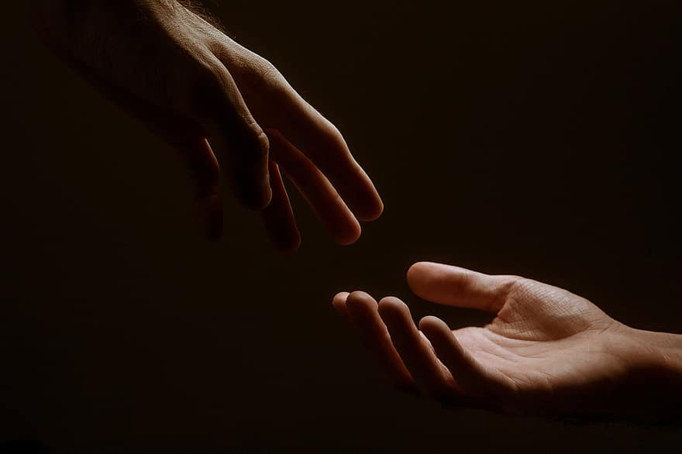
Prayer
Prayers
Let us pray for:
The world in which we live
The people who lead us
The people who need our prayers
The sick and the dying
Our families and loved ones
Lord, in your mercy
Hear our prayer.
Notes:
Prayers of the People

Slide 14
Peace
Jesus Christ is our Peace, he has reconciled us to God in one body by the Cross.
We meet in his name and share his Peace.
The peace of the Lord be always with you - “Shalom”
And also with you - “Shalom”

Slide 15
I am the Bread of Life
The Diocese of Cyprus and the Gulf

Slide 16
Eucharist
The Lord is here
His Spirit is with us.
Lift up your hearts.
We lift them to the Lord.
Let us give thanks to the Lord our God.
It is right to give thanks and praise.
It is indeed right to give you thanks,
God our Creator,
loving and faithful,
holy and strong.
You made us
and the whole universe,
and filled your world with life.
You sent your Son to live among us,
Jesus our Saviour, Mary’s child.
He suffered on the cross;
he died to save us from our sins;
he rose in glory from the dead.
You send your Spirit
to bring new life to the world,
and clothe us with power from on high.
And so we join angels and archangels
And all the company of heaven
to celebrate and praise your holy name saying:
Holy, Holy, Holy Lord
God of Power and Might.
Heaven and Earth are full of your Glory
Hosannah in the highest.
Blessed is the one who comes in the name of the Lord.

Slide 17
Eucharist
Father, as we bring this bread and wine,
and remember his death and resurrection,
send your Holy Spirit,
that we who share these gifts
may be fed by Christ’s body and his blood.
Pour your Spirit on us
that we may love one another,
work for the healing of the earth,
and share the good news of Jesus,
as we wait for his coming in glory.
For honour and praise belong to you, Father,
with Jesus your Son, and the Holy Spirit:
one God, for ever and ever.
Amen
Father, on the night before he died,
Jesus shared a meal with his friends.
He took the bread, and thanked you.
He broke it, and gave it to them, saying:
Take and eat; this is my body, given for you.
Do this to remember me.
After the meal, Jesus took the cup of wine.
He thanked you, and gave it to them, saying:
Drink this, all of you.
This is my blood,
the new promise of God’s unfailing love.
Do this to remember me.
Great is the mystery of faith:
Christ has died.
Christ is risen.
Christ will come again.

Slide 18
Eucharist
Our Father,
who art in heaven,
hallowed be thy name;
thy kingdom come;
thy will be done;
on earth as it is in heaven.
Give us this day our daily bread.
And forgive us our trespasses,
as we forgive those who trespass against us.
And lead us not into temptation;
but deliver us from evil.
For thine is the kingdom,
the power, and the glory,
for ever and ever. Amen.
Draw near with faith
Eat and drink of the body and blood
Of our Lord Jesus Christ
And feed upon him by Faith with thanksgiving

Slide 19
Great is Thy Faithfulness
The Diocese of Cyprus and the Gulf

Slide 20
Prayer
Prayer:
Lord and heavenly Father,
we offer you through your dear Son Jesus Christ
this our sacrifice of praise and thanksgiving.
Grant that by his merits and death,
and through faith in his blood,
we and all your Church may receive forgiveness of our sins
and all other benefits of his passion.
And here we offer and present to you,
O Lord, ourselves, our souls and our bodies,
to be a reasonable, holy and living sacrifice;
fill us all who share in this holy communion
with your grace and heavenly blessing. Amen.

Slide 21
Blessing
Blessing:
May the God of peace sanctify you wholly;
that your spirit and soul and body be kept sound and blameless
at the coming of our Lord Jesus Christ;
and the blessing of God Almighty, the Father, the Son and the Holy Spirit
Rest upon you and keep you and all whom you love, safe and well, for evermore, Amen.
Closing Prayer:
God our Redeemer show us compassion and love. Lead us, guide us, fill us with your Spirit. Show us the way from darkness to light that we may be the light of the world; so go in the light of Jesus.
In the name of Christ, Amen.

Slide 22
Holy Communion
4th April March 2026
St Christopher’s Cathedral and Awali Church, Bahrain
The Diocese of Cyprus and the Gulf

