Slide 1

Daily Prayer for 11th April 2026 St Christopher’s Cathedral and Awali Church, Bahrain
The Diocese of Cyprus and the Gulf

Slide 2
Daily Prayer for 11th April 2026 St Christopher’s Cathedral and Awali Church, Bahrain
“Thomas Merton Prayer”
The Diocese of Cyprus and the Gulf

Slide 3
Welcome
Opening Acclamation: Grace, mercy and peace from God our Father and the Lord Jesus Christ be with you. And also with you.
Our Lord, Jesus Christ is risen; Alleluia.
He is risen indeed; Alleluia!
Amen
Blessed are you, Lord God of our salvation,
to you be glory and praise for ever.
In the darkness of our sin you have shone in our hearts
to give the light of the knowledge of the glory of God
in the face of Jesus Christ.
Open our eyes to acknowledge your presence,
that freed from the misery of sin and shame
we may grow into your likeness from glory to glory.
Blessed be God, Father, Son and Holy Spirit.
Amen.

Slide 4
Prayer
Confession: Most merciful God, we confess that we have sinned against you in thought, word and deed, by what we have done and by what we have left undone. We have not loved you with our whole heart. We have not loved our neighbours as ourselves. In your mercy forgive what we have been, help us to amend what we are, and direct what we shall be; through Jesus Christ our Lord. Amen.
Almighty God have mercy upon you,
forgive you all your sins
through our Lord Jesus Christ,
strengthen you in all goodness,
and by the power of the Holy Spirit
Keep you in eternal life. Amen.

Slide 5
Prayer
Collect for 7th April Lord of all life and power,
who through the mighty resurrection of your Son
overcame the old order of sin and death
to make all things new in him:
grant that we, being dead to sin
and alive to you in Jesus Christ,
may reign with him in glory;
to whom with you and the Holy Spirit
be praise and honour, glory and might,
now and in all eternity.
Amen.

Slide 6
Prayer
Collect for St John Baptist de la Salle on 7th April O God, who chose Saint John Baptist de la Salle
to educate young Christians,
raise up, we pray,
teachers in your Church
ready to devote themselves
wholeheartedly to the human
and Christian formation of the young.
Through our Lord Jesus Christ, your Son,
who lives and reigns with you
in the unity of the Holy Spirit,
one God, now and forever.
Amen.

Slide 7
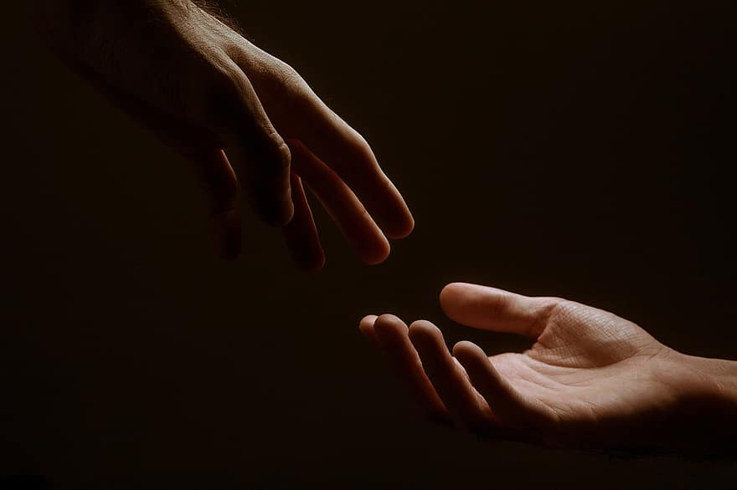
Prayer
Prayers
Let us pray for:
The world in which we live
The people who lead us
The people who need our prayers
The sick and the dying
Our families and loved ones
Lord, in your mercy
Hear our prayer.
Notes:
Prayers of the People

Slide 8
Benedictus
Blessed be the Lord the God of Israel,
who has come to his people and set them free.
He has raised up for us a mighty Saviour,
born of the house of his servant David.
Through his holy prophets God promised of old
to save us from our enemies, from the hands of all that hate us,
To show mercy to our ancestors,
and to remember his holy covenant.
This was the oath God swore to our father Abraham:
to set us free from the hands of our enemies,
Free to worship him without fear,
holy and righteous in his sight all the days of our life.
And you, child, shall be called the prophet of the Most High,
for you will go before the Lord to prepare his way,
To give his people knowledge of salvation
by the forgiveness of all their sins.
In the tender compassion of our God
the dawn from on high shall break upon us,
To shine on those who dwell in darkness and the shadow of death,
and to guide our feet into the way of peace.
Glory to the Father and to the Son and to the Holy Spirit;
as it was in the beginning is now and shall be for ever. Amen.

Slide 9
Scripture
Psalm 145: The Lord is loving to everyone
and his mercy is over all his creatures.
All your works praise you, O Lord,
and your faithful servants bless you.
They tell of the glory of your kingdom
and speak of your mighty power,
To make known to all peoples your mighty acts
and the glorious splendour of your kingdom.
Your kingdom is an everlasting kingdom;
your dominion endures throughout all ages.
The Lord is sure in all his words
and faithful in all his deeds.
The Lord upholds all those who fall
and lifts up all those who are bowed down.
The eyes of all wait upon you, O Lord,
and you give them their food in due season.
Glory to the Father and to the Son and to the Holy Spirit;
as it was in the beginning is now and shall be for ever. Amen.

Slide 10
Scripture
Song of Soloman 8: Set me as a seal upon your heart,
as a seal upon your arm;
for love is strong as death,
passion fierce as the grave.
Its flashes are flashes of fire,
a raging flame.
Many waters cannot quench love,
neither can floods drown it.
If one offered for love
all the wealth of one’s house,
it would be utterly scorned.
This is the word of the Lord.
Thanks be to God.

Slide 11
Collects
As our evening prayer rises before you, O God,
so may your mercy come down upon us
to cleanse our hearts
and set us free to sing your praise
now and for ever. Amen.
Lighten our darkness, Lord we pray
And in your great mercy,
defend us from all perils and dangers of this night,
For the sake of your Son, our Saviour, Jesus Christ, Amen.

Slide 12
Blessing
Lord’s Prayer: Our Father, who art in heaven, hallowed be thy name; thy kingdom come; thy will be done; on earth as it is in heaven. Give us this day our daily bread. And forgive us our trespasses, as we forgive those who trespass against us. And lead us not into temptation; but deliver us from evil. For thine is the kingdom, the power, and the glory, for ever and ever. Amen. Blessing: May the God of peace sanctify you wholly;
and may your spirit and soul and body be kept sound and blameless
at the coming of our Lord Jesus Christ;
and the blessing of God Almighty, the Father, the Son and the Holy Spirit
Rest upon you and keep you and all whom you love, safe and well, for evermore, Amen.
Closing Prayer:
God our Salvation, hear the prayer of our heart and the cries of our mouth. Lreveal your love among us in the way of Christ, our King and guide our footsteps to follow you and no other; in the unity of the Holy Spirit Amen.

Slide 13
Daily Prayer for 11th April 2026 St Christopher’s Cathedral and Awali Church, Bahrain
“Open the Eyes of My Heart”
The Diocese of Cyprus and the Gulf

Slide 14
Daily Prayer for 11th April 2026 St Christopher’s Cathedral and Awali Church, Bahrain
The Diocese of Cyprus and the Gulf

