Slide 1

Daily Prayer for 12th April 2026 St Christopher’s Cathedral and Awali Church, Bahrain
The Diocese of Cyprus and the Gulf

Slide 2
Daily Prayer for 12th April 2026 St Christopher’s Cathedral and Awali Church, Bahrain
“We Hymn Thee”
The Diocese of Cyprus and the Gulf

Slide 3
Welcome
Opening Acclamation: Grace, mercy and peace from God our Father and the Lord Jesus Christ be with you. And also with you.
Our Lord Jesus Christ is Risen, Alleluia
He is Risen indeed! Alleluia!
We have come together in the name of Christ
to offer our praise and thanksgiving,
to hear and receive God’s holy word,
to pray for the needs of the world,
and to seek the forgiveness of our sins,
that by the power of the Holy Spirit
we may give ourselves to the service of God.
Amen.

Slide 4
Prayer
Confession: Most merciful God, we confess that we have sinned against you in thought, word and deed, by what we have done and by what we have left undone. We have not loved you with our whole heart. We have not loved our neighbours as ourselves. In your mercy forgive what we have been, help us to amend what we are, and direct what we shall be; through Jesus Christ our Lord. Amen.
Almighty God have mercy upon you,
forgive you all your sins
through our Lord Jesus Christ,
strengthen you in all goodness,
and by the power of the Holy Spirit
Keep you in eternal life. Amen.

Slide 5
Prayer
Collect for St Teresa of the Andes on 12th April: God of mercy, joy of the saints,
you set the youthful heart of Saint Teresa
ablaze with the fire of love for Christ and for his Church;
and even in suffering you made her a cheerful witness to charity;
fill us with the delights of your Spirit,
so that we may proclaim by word and deed
the joyful message of your love to the world;
through Jesus Christ, our Lord,
In the unity of the Holy Spirit,
oine God, now and forever,
Amen.

Slide 6
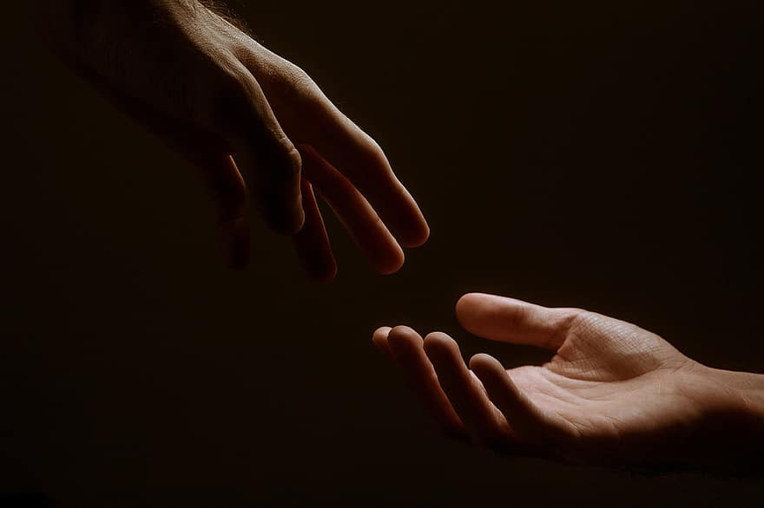
Prayer
Prayers
Let us pray for:
The world in which we live
The people who lead us
The people who need our prayers
The sick and the dying
Our families and loved ones
Lord, in your mercy
Hear our prayer.
Notes:
Prayers of the People

Slide 7
Song of Christ the Servant
Christ committed no sin, no guile was found on his lips.
Christ suffered for you, leaving you an example,
that you should follow in his steps.
He committed no sin, no guile was found on his lips,
when he was reviled, he did not revile in turn.
When he suffered, he did not threaten,
but he trusted himself to God who judges justly.
Christ himself bore our sins in his body on the tree,
that we might die to sin and live to righteousness.
By his wounds, you have been healed, for you were straying like sheep,
but have now returned to the shepherd and guardian of your souls.
Glory to the Father and to the Son and to the Holy Spirit;
as it was in the beginning is now and shall be for ever. Amen.
Christ committed no sin, no guile was found on his lips.

Slide 8
Scripture
Psalm 30: I will exalt you, O Lord, because you have raised me up
and have not let my foes triumph over me.
O Lord my God, I cried out to you
and you have healed me.
You brought me up, O Lord, from the dead;
you restored me to life from among those that go down to the Pit.
Sing to the Lord, you servants of his;
give thanks to his holy name.
For his wrath endures but the twinkling of an eye,
his favour for a lifetime.
Heaviness may endure for a night,
but joy comes in the morning.
Glory to the Father and to the Son and to the Holy Spirit;
as it was in the beginning is now and shall be for ever. Amen.

Slide 9
Scripture
Daniel 6: Then the king gave the command, and Daniel was brought and thrown into the den of lions. The king said to Daniel, ‘May your God, whom you faithfully serve, deliver you!’ A stone was brought and laid on the mouth of the den, and the king sealed it with his own signet and with the signet of his lords, so that nothing might be changed concerning Daniel. Then the king went to his palace and spent the night fasting; no food was brought to him, and sleep fled from him.
Then, at break of day, the king got up and hurried to the den of lions. When he came near the den where Daniel was, he cried out anxiously to Daniel, ‘O Daniel, servant of the living God, has your God whom you faithfully serve been able to deliver you from the lions?’ Daniel then said to the king, ‘O king, live for ever! My God sent his angel and shut the lions’ mouths so that they would not hurt me, because I was found blameless before him; and also before you, O king, I have done no wrong.’ Then the king was exceedingly glad and commanded that Daniel be taken up out of the den. So Daniel was taken up out of the den, and no kind of harm was found on him, because he had trusted in his God.
This is the word of the Lord.
Thanks be to God.

Slide 10
Collects
As our evening prayer rises before you, O God,
so may your mercy come down upon us
to cleanse our hearts
and set us free to sing your praise
now and for ever. Amen.
Lighten our darkness, Lord we pray
And in your great mercy,
defend us from all perils and dangers of this night,
For the sake of your Son, our Saviour, Jesus Christ, Amen.

Slide 11
Blessing
Lord’s Prayer: Our Father, who art in heaven, hallowed be thy name; thy kingdom come; thy will be done; on earth as it is in heaven. Give us this day our daily bread. And forgive us our trespasses, as we forgive those who trespass against us. And lead us not into temptation; but deliver us from evil. For thine is the kingdom, the power, and the glory, for ever and ever. Amen. Blessing: May the God of peace sanctify you wholly;
and may your spirit and soul and body be kept sound and blameless
at the coming of our Lord Jesus Christ;
and the blessing of God Almighty, the Father, the Son and the Holy Spirit
Rest upon you and keep you and all whom you love, safe and well, for evermore, Amen.
Closing Prayer:
Blessed Jesus, King of Kings and Lord of Lords, may we follow you in the example of our lives as we celebrate your gift of new life; in the unity of the Holy Spirit. Amen.

Slide 12
Daily Prayer for 12th April 2026 St Christopher’s Cathedral and Awali Church, Bahrain
“Faith Like Daniel”
The Diocese of Cyprus and the Gulf

Slide 13
Daily Prayer for 12th April 2026 St Christopher’s Cathedral and Awali Church, Bahrain
The Diocese of Cyprus and the Gulf

