Slide 1

Daily Prayer for 16th April 2026 St Christopher’s Cathedral and Awali Church, Bahrain
The Diocese of Cyprus and the Gulf

Slide 2
Daily Prayer for 16th April 2026 St Christopher’s Cathedral and Awali Church, Bahrain
“Oh Come, Oh Come, Emmanuel”
The Diocese of Cyprus and the Gulf

Slide 3
Welcome
Opening Acclamation: Grace, mercy and peace from God our Father and the Lord Jesus Christ be with you. And also with you.
Our Lord, Jesus Christ is risen; Alleluia.
He is risen indeed; Alleluia!
Amen
Blessed are you, Lord God of our salvation,
to you be glory and praise for ever.
In the darkness of our sin you have shone in our hearts
to give the light of the knowledge of the glory of God
in the face of Jesus Christ.
Open our eyes to acknowledge your presence,
that freed from the misery of sin and shame
we may grow into your likeness from glory to glory.
Blessed be God, Father, Son and Holy Spirit.
Amen.

Slide 4
Prayer
Confession: Most merciful God, we confess that we have sinned against you in thought, word and deed, by what we have done and by what we have left undone. We have not loved you with our whole heart. We have not loved our neighbours as ourselves. In your mercy forgive what we have been, help us to amend what we are, and direct what we shall be; through Jesus Christ our Lord. Amen.
Almighty God have mercy upon you,
forgive you all your sins
through our Lord Jesus Christ,
strengthen you in all goodness,
and by the power of the Holy Spirit
Keep you in eternal life. Amen.

Slide 5
Prayer
Collect of St Bernadette on 16th April Let the crucifix be not only in my eyes and on my breast,
but in my heart, O Jesus!
Release all my affections and draw them upwards.
Let my crucified heart sink forever into Thine
and bury itself in the mysterious wound
made by the entry of the lance;
Through Jesus Christ, our Lord,
who is alive and reigns with you, our Father,
In unity with the Holy Spirit,
now and in all eternity.
Amen.

Slide 6
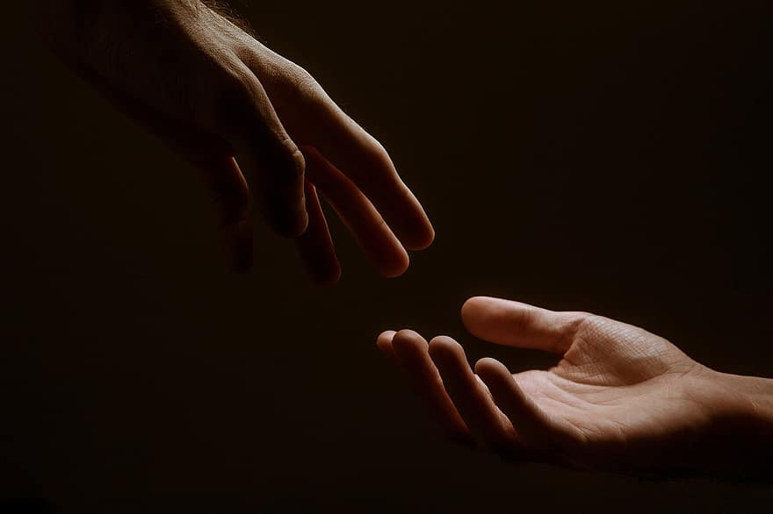
Prayer
Prayers
Let us pray for:
The world in which we live
The people who lead us
The people who need our prayers
The sick and the dying
Our families and loved ones
Lord, in your mercy
Hear our prayer.
Notes:
Prayers of the People

Slide 7
Benedictus
Blessed be the Lord the God of Israel,
who has come to his people and set them free.
He has raised up for us a mighty Saviour,
born of the house of his servant David.
Through his holy prophets God promised of old
to save us from our enemies, from the hands of all that hate us,
To show mercy to our ancestors,
and to remember his holy covenant.
This was the oath God swore to our father Abraham:
to set us free from the hands of our enemies,
Free to worship him without fear,
holy and righteous in his sight all the days of our life.
And you, child, shall be called the prophet of the Most High,
for you will go before the Lord to prepare his way,
To give his people knowledge of salvation
by the forgiveness of all their sins.
In the tender compassion of our God
the dawn from on high shall break upon us,
To shine on those who dwell in darkness and the shadow of death,
and to guide our feet into the way of peace.
Glory to the Father and to the Son and to the Holy Spirit;
as it was in the beginning is now and shall be for ever. Amen.

Slide 8
Scripture
Psalm 34: I will bless the Lord at all times;
his praise shall ever be in my mouth.
My soul shall glory in the Lord;
let the humble hear and be glad.
O magnify the Lord with me;
let us exalt his name together.
I sought the Lord and he answered me
and delivered me from all my fears.
Look upon him and be radiant
and your faces shall not be ashamed.
This poor soul cried, and the Lord heard me
and saved me from all my troubles.
The angel of the Lord encamps around those who fear him
and delivers them.
O taste and see that the Lord is gracious;
blessed is the one who trusts in him.
Glory to the Father and to the Son and to the Holy Spirit;
as it was in the beginning is now and shall be for ever. Amen.

Slide 9
Scripture
Deuteronomy 4: See, just as the Lord my God has charged me, I now teach you statutes and ordinances for you to observe in the land that you are about to enter and occupy. You must observe them diligently, for this will show your wisdom and discernment to the peoples, who, when they hear all these statutes, will say, ‘Surely this great nation is a wise and discerning people!’ For what other great nation has a god so near to it as the Lord our God is whenever we call to him? And what other great nation has statutes and ordinances as just as this entire law that I am setting before you today? But take care and watch yourselves closely, so as neither to forget the things that your eyes have seen nor to let them slip from your mind all the days of your life; make them known to your children and your children’s children—how you once stood before the Lord your God at Horeb… Then the Lord spoke to you out of the fire. You heard the sound of words but saw no form; there was only a voice. He declared to you his covenant, which he charged you to observe, that is, the ten commandments; and he wrote them on two stone tablets. And the Lord charged me at that time to teach you statutes and ordinances for you to observe in the land that you are about to cross into and occupy.
This is the word of the Lord.
Thanks be to God.

Slide 10
Collects
As our evening prayer rises before you, O God,
so may your mercy come down upon us
to cleanse our hearts
and set us free to sing your praise
now and for ever. Amen.
Lighten our darkness, Lord we pray
And in your great mercy,
defend us from all perils and dangers of this night,
For the sake of your Son, our Saviour, Jesus Christ, Amen.

Slide 11
Blessing
Lord’s Prayer: Our Father, who art in heaven, hallowed be thy name; thy kingdom come; thy will be done; on earth as it is in heaven. Give us this day our daily bread. And forgive us our trespasses, as we forgive those who trespass against us. And lead us not into temptation; but deliver us from evil. For thine is the kingdom, the power, and the glory, for ever and ever. Amen. Blessing: May the God of peace sanctify you wholly;
and may your spirit and soul and body be kept sound and blameless
at the coming of our Lord Jesus Christ;
and the blessing of God Almighty, the Father, the Son and the Holy Spirit
Rest upon you and keep you and all whom you love, safe and well, for evermore, Amen.
Closing Prayer:
God our Salvation, hear the prayer of our heart and the cries of our mouth. You revealed your love among your people Israel, and call us all to be grafted into the vine of life in Christ. Amen.

Slide 12
Daily Prayer for 16th April 2026 St Christopher’s Cathedral and Awali Church, Bahrain
“You are the Vine”
The Diocese of Cyprus and the Gulf

Slide 13
Daily Prayer for 16th April 2026 St Christopher’s Cathedral and Awali Church, Bahrain
The Diocese of Cyprus and the Gulf

