Slide 1

Daily Prayer for 5th April 2026 St Christopher’s Cathedral and Awali Church, Bahrain with St Christopher’s School
The Diocese of Cyprus and the Gulf

Slide 2
Daily Prayer for 5th April 2026 St Christopher’s Cathedral and Awali Church, Bahrain with St Christopher’s School
He is not Here
The Diocese of Cyprus and the Gulf

Slide 3
Welcome
Opening Acclamation: Grace, mercy and peace from God our Father and the Lord Jesus Christ be with you. And also with you.
Today the Lord Jesus is Risen, Alleluia
He is Risen indeed! Alleluia!
We have come together in the name of Christ
to offer our praise and thanksgiving,
to hear and receive God’s holy word,
to pray for the needs of the world,
and to seek the forgiveness of our sins,
that by the power of the Holy Spirit
we may give ourselves to the service of God.
Amen.

Slide 4
Prayer
Confession: Most merciful God, we confess that we have sinned against you in thought, word and deed, by what we have done and by what we have left undone. We have not loved you with our whole heart. We have not loved our neighbours as ourselves. In your mercy forgive what we have been, help us to amend what we are, and direct what we shall be; through Jesus Christ our Lord. Amen.
Almighty God have mercy upon you,
forgive you all your sins
through our Lord Jesus Christ,
strengthen you in all goodness,
and by the power of the Holy Spirit
Keep you in eternal life. Amen.

Slide 5
Prayer
Collect for Easter Day: Lord of all life and power,
who through the mighty resurrection of your Son
overcame the old order of sin and death
to make all things new in him:
grant that we, being dead to sin
and alive to you in Jesus Christ,
may reign with him in glory;
to whom with you and the Holy Spirit
be praise and honour, glory and might,
now and in all eternity.
Amen.

Slide 6
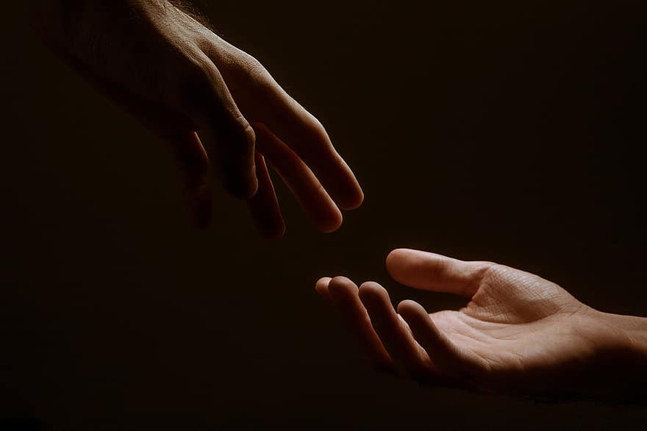
Prayer
Prayers
Let us pray for:
The world in which we live
The people who lead us
The people who need our prayers
The sick and the dying
Our families and loved ones
Lord, in your mercy
Hear our prayer.
Notes:
Prayers of the People

Slide 7
Song of Christ the Servant
Christ committed no sin, no guile was found on his lips.
Christ suffered for you, leaving you an example,
that you should follow in his steps.
He committed no sin, no guile was found on his lips,
when he was reviled, he did not revile in turn.
When he suffered, he did not threaten,
but he trusted himself to God who judges justly.
Christ himself bore our sins in his body on the tree,
that we might die to sin and live to righteousness.
By his wounds, you have been healed, for you were straying like sheep,
but have now returned to the shepherd and guardian of your souls.
Glory to the Father and to the Son and to the Holy Spirit;
as it was in the beginning is now and shall be for ever. Amen.
Christ committed no sin, no guile was found on his lips.

Slide 8
Scripture
Psalm 105: O give thanks to the Lord and call upon his name;
make known his deeds among the peoples.
Sing to him, sing praises,
and tell of all his marvellous works.
Rejoice in the praise of his holy name;
let the hearts of them rejoice who seek the Lord.
Seek the Lord and his strength;
seek his face continually.
Remember the marvels he has done,
his wonders and the judgements of his mouth,
O seed of Abraham his servant,
O children of Jacob his chosen.
He is the Lord our God;
his judgements are in all the earth.
Glory to the Father and to the Son and to the Holy Spirit;
as it was in the beginning is now and shall be for ever. Amen.

Slide 9
Scripture
Revelation 1: Then I turned to see whose voice it was that spoke to me, and on turning I saw seven golden lampstands, and in the midst of the lampstands I saw one like the Son of Man, clothed with a long robe and with a golden sash across his chest. His head and his hair were white as white wool, white as snow; his eyes were like a flame of fire, his feet were like burnished bronze, refined as in a furnace, and his voice was like the sound of many waters. In his right hand he held seven stars, and from his mouth came a sharp, two-edged sword, and his face was like the sun shining with full force. When I saw him, I fell at his feet as though dead. But he placed his right hand on me, saying, ‘Do not be afraid; I am the first and the last, and the living one. I was dead, and see, I am alive for ever and ever; and I have the keys of Death and of Hades.
This is the word of the Lord.
Thanks be to God.

Slide 10
Collects
As our evening prayer rises before you, O God,
so may your mercy come down upon us
to cleanse our hearts
and set us free to sing your praise
now and for ever. Amen.
Lighten our darkness, Lord we pray
And in your great mercy,
defend us from all perils and dangers of this night,
For the sake of your Son, our Saviour, Jesus Christ, Amen.

Slide 11
Blessing
Lord’s Prayer: Our Father, who art in heaven, hallowed be thy name; thy kingdom come; thy will be done; on earth as it is in heaven. Give us this day our daily bread. And forgive us our trespasses, as we forgive those who trespass against us. And lead us not into temptation; but deliver us from evil. For thine is the kingdom, the power, and the glory, for ever and ever. Amen. Blessing: May the God of peace sanctify you wholly;
and may your spirit and soul and body be kept sound and blameless
at the coming of our Lord Jesus Christ;
and the blessing of God Almighty, the Father, the Son and the Holy Spirit
Rest upon you and keep you and all whom you love, safe and well, for evermore, Amen.
Closing Prayer:
Blessed Jesus, King of Kings and Lord of Lords, may we greet you in our hearts as we celebrate your rising to new life; in the unity of the Holy Spirit. Amen.

Slide 12
Daily Prayer for 5th April 2026 St Christopher’s Cathedral and Awali Church, Bahrain with St Christopher’s School
“Shine Jesus Shine”
The Diocese of Cyprus and the Gulf

Slide 13
Daily Prayer for 5th April 2026 St Christopher’s Cathedral and Awali Church, Bahrain with St Christopher’s School
The Diocese of Cyprus and the Gulf

